Slide 1

Kinect
-Zheng Wei

Slide 2
Kinect
1.What is Kinect
2.Where to use
3.How to use
4.The skill of Programming by Kinect
5.The e.g.
6.Future work

Slide 3
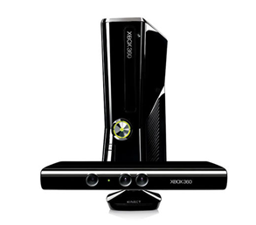
What is kinect
Kinect is a motion sensing input device that was created by Microsoft
Kinect features
Some of the different features of the Kinect include facial recognition, a motion sensor, skeletal tracking, and voice recognition.

Slide 4
What is kinect
Voice Recognition
Facial Recognition
Skeletal Tracking
Depth Tracking

Slide 5
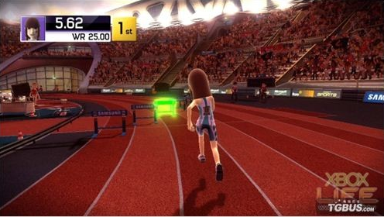
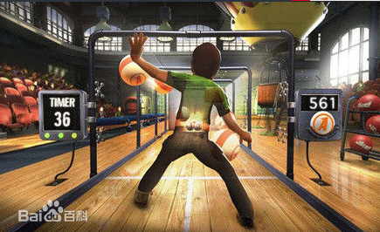
Where to use
Joyride
Kinect Sports
Kinect Adventures
Dance Central

Slide 6
How to use
Starting to Playing with Kinect
Starting to play Kinect is easy. If the system has been set up properly as mentioned above, it is a simple matter of standing in front of the motion sensor and waving.
Requirements
Space Requirements , software , hardware

Slide 7
How to use
Navigating
The player will have to wave his or her hand, so the system can recognize the them
Get Recognized by Kinect
Kinect ID is what Kinect uses to recognize an individual player
Voice Activation
The microphone icon indicates that the player can use speech recognition

Slide 8
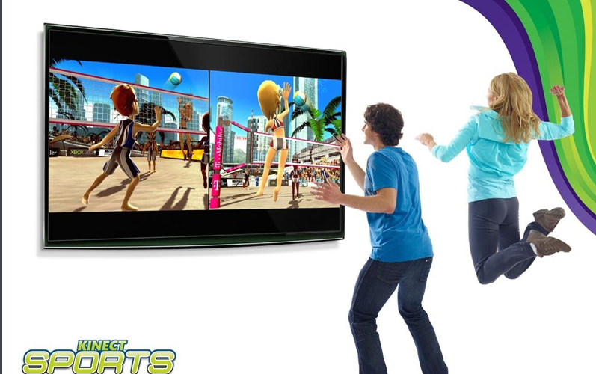
How to use
Kinect Guide Gesture
The player needs to raise his or her left hand and move it up or down to access the guide.

Slide 9
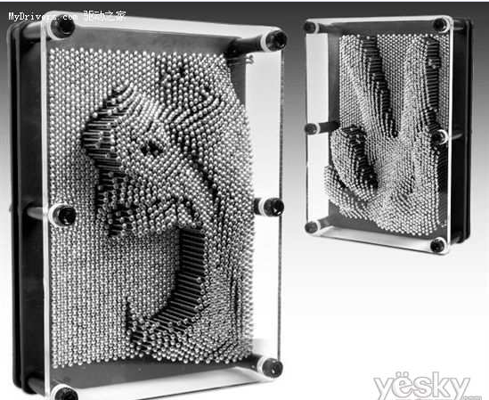
The principle of Kinect
Depth Frame Data
CMOS , The depth of each pixel

Slide 10
How to use
Skeleton Frame Data
to look for in the image is of a moving object may be the human body
each pixel of the image transferred into machine learning system

Slide 11
How to use
Color Frame Data
image data in pixel
every pixel have 4 element: first blue , second green, third red, fourth stay with…
The difference in The conventional

Slide 12
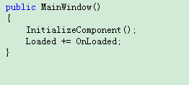
Programming
Program by Kinect efficiently
e.g.

Slide 13
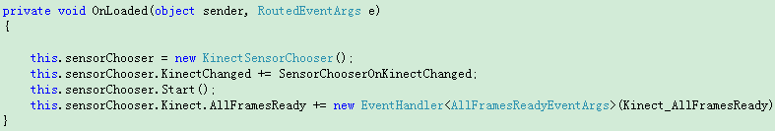
Programming
OnLoad function

Slide 14
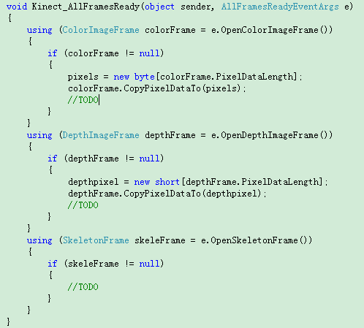
Programming
AllFrameReady Function

Slide 15
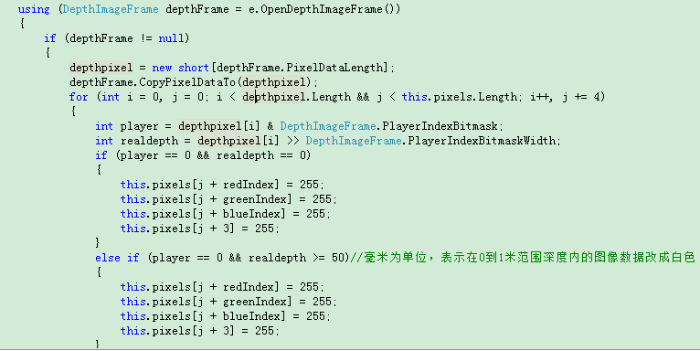
Programming
Depth Data & Color Data

Slide 16

Programming
事件触发

Slide 17
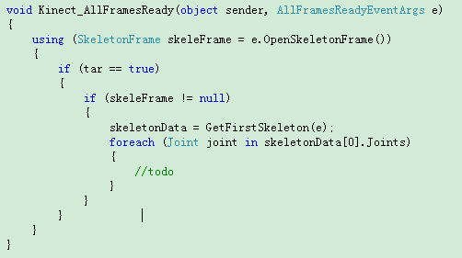
Programming
触发处理

Slide 18

Programming

Slide 19
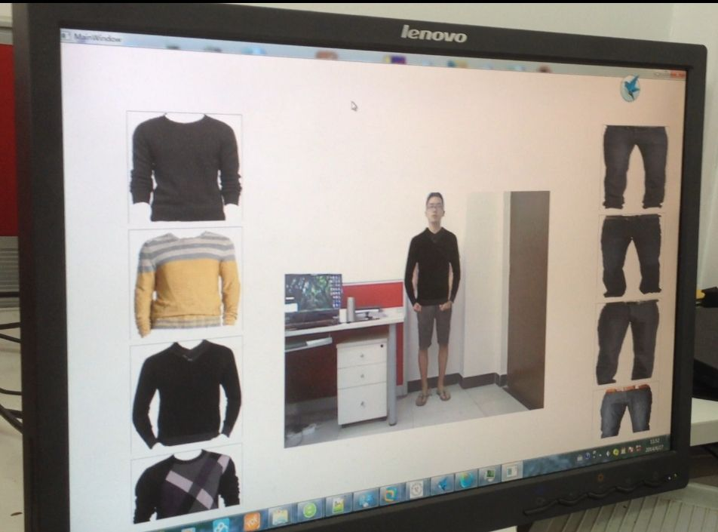
Interface
e.g.

Slide 20
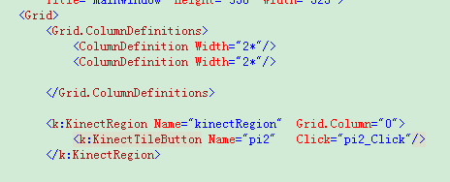
Programming
Interface

Slide 21
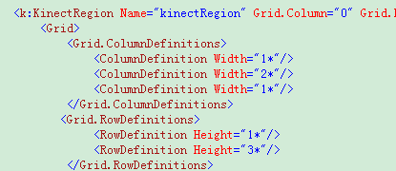
Interface

Slide 22
Future work
Effective programming
Specification

Slide 23
Thank you

