Slide 1

Advanced Software Engineering
PROJECT

Slide 2
1. MapReduce Join (2人)
Focused on performance analysis on different implementation of join processors in MapReduce.
  Homogenization: add additional information about the source of the data in the map phase, then do the JOIN in the reduce phase.
  Map-Reduce-Merge: a new primitive called merge is added to process the join separately.
  Other implementation: the map-reduce execution plan for joins generated by Hive.
进行性能分析与比较（生成至少10张以上图表）

Slide 3
2. 大型社交网络的结构分析(3-4人)
学习分类、聚类算法
使用Google+和Twitter社交圈数据
http://snap.stanford.edu/data/egonets-Gplus.html
http://snap.stanford.edu/data/egonets-Twitter.html
在M/R或Spark上搭建分布式计算系统
通过Mahout/Mllib等开源工具进行数据分析、发现两种社交网络的“特性”
进行性能分析与比较（生成至少10张以上图表）
Bonus：比较M/R和Spark的性能
Never use off-the-self softwares!!!

Slide 4
3. 分布式排序学习系统的搭建(3-4人)
学习Pointwise, Pairewise, Listwise三大类算法
使用Microsoft Learning-to-Rank Datasets
http://research.microsoft.com/en-us/projects/mslr/
在M/R、Storm、Spark其中一种架构上搭建分布式计算系统
至少实现上述三大类算法中的三种算法
进行性能分析与比较（生成至少10张以上图表）
Bonus：比较M/R和Spark的性能

Slide 5
Mechanism
Working in group: 2, OR, 3-4 students, clear roles
Email me (ase_bit@yahoo.com) by this Friday (Dec 19)
  Team leader, Team members
  Topic
Deadline: 16 Jan 2015!
Deliverable: project report in Chinese
  Introduction (motivation, WHY?)
  Your proposal (HOW?)
  Performance Evaluation
  Conclusion
Presentation

Slide 6
Suggested Arrangement
Week-1: Define your roles and start literature research
Week-2 and 3: Propose solutions
Week-4 and 5: Implementation and obtain results
Finally, spend a few days writing your report

Slide 7
希望大家关注的问题
这不仅仅是个工程项目
通过以此来训练研究性思维
别人做过些什么？有什么问题？
在哪里改进？性能如何？
性能：
  自身性能：正确率，吞吐率，并发率，时延
  比较性能：其他算法，其他系统
多用开源框架
打分充分考虑团队整体贡献和每个队员的贡献

Slide 8
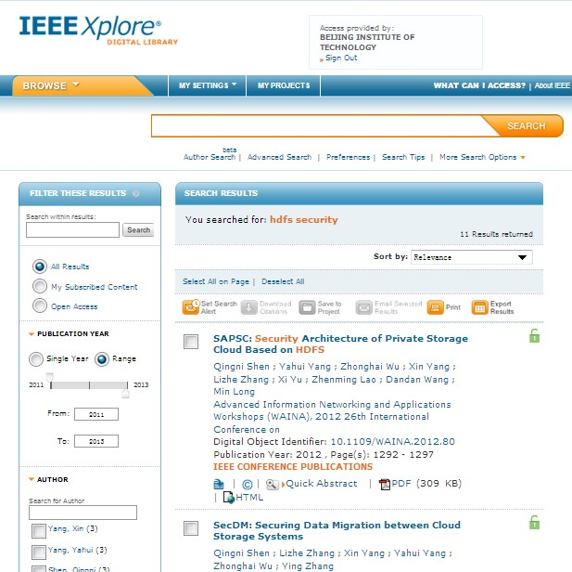
IEEE Xplore: http://ieeexplore.ieee.org/

Slide 9
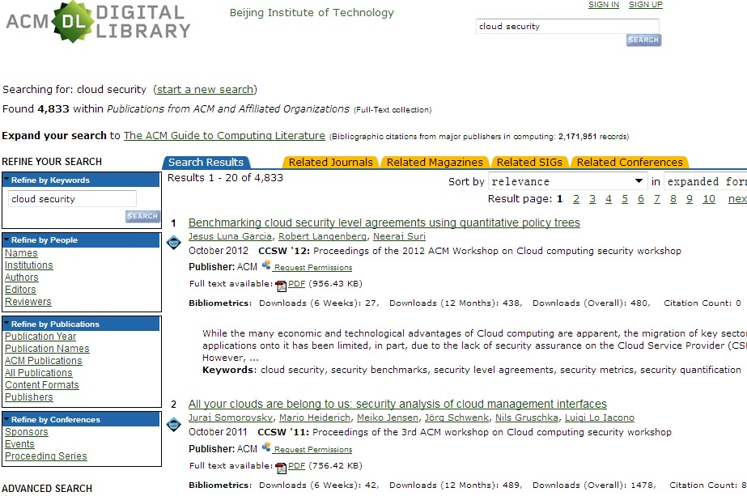
http://dl.acm.org

Slide 10
Advanced Software Engineering
Social Network Analysis

Slide 11
Key Players
How to identify key/central nodes in network

Slide 12
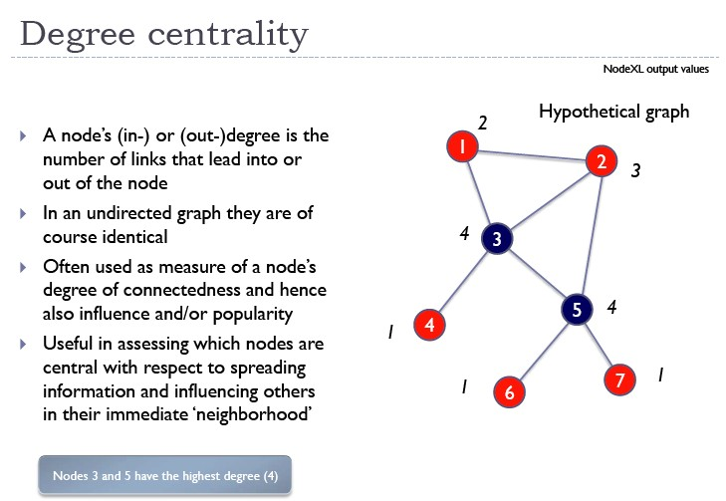

Slide 13
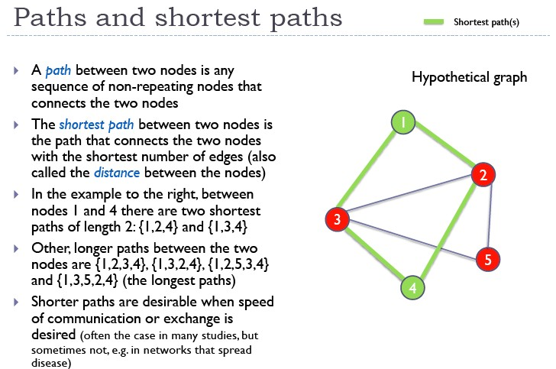

Slide 14
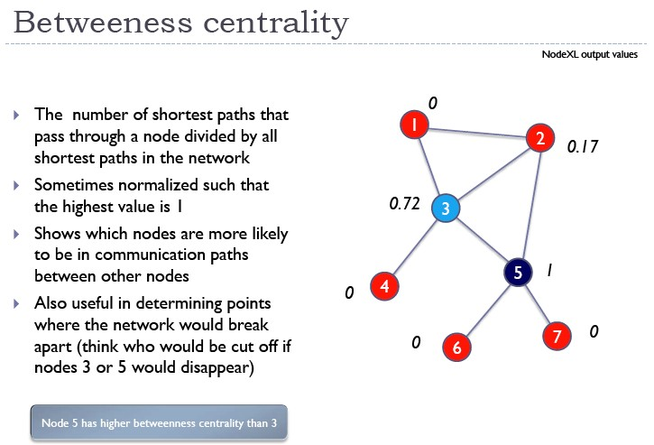

Slide 15
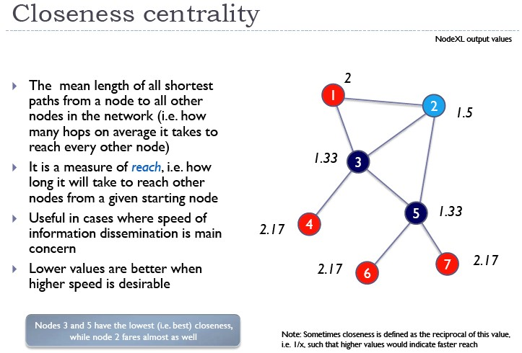

Slide 16
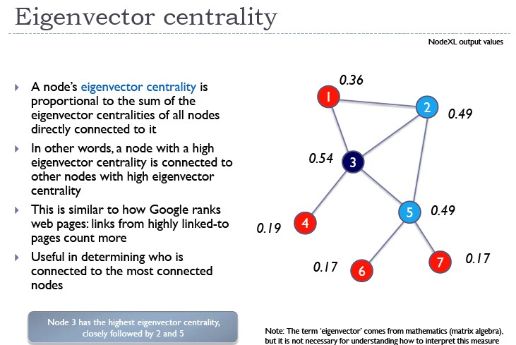

Slide 17
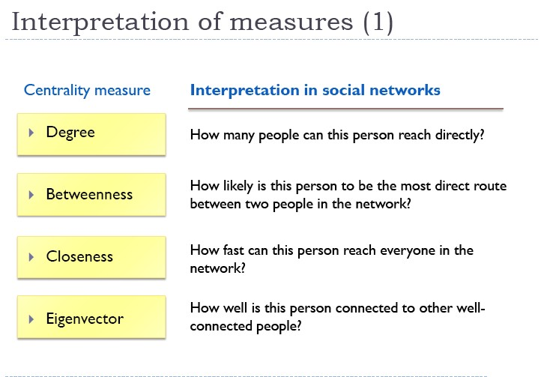

Slide 18
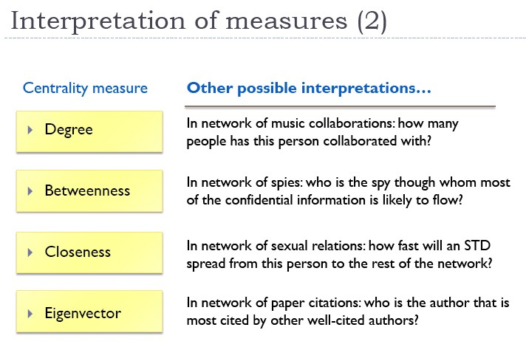

Slide 19
Cohesion
How to characterize a network’s structure

Slide 20
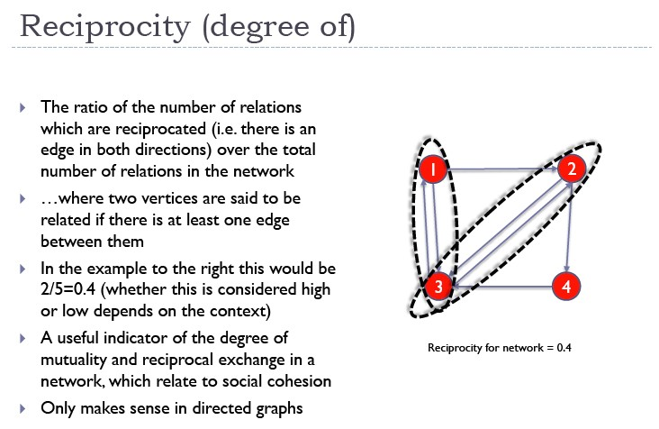

Slide 21
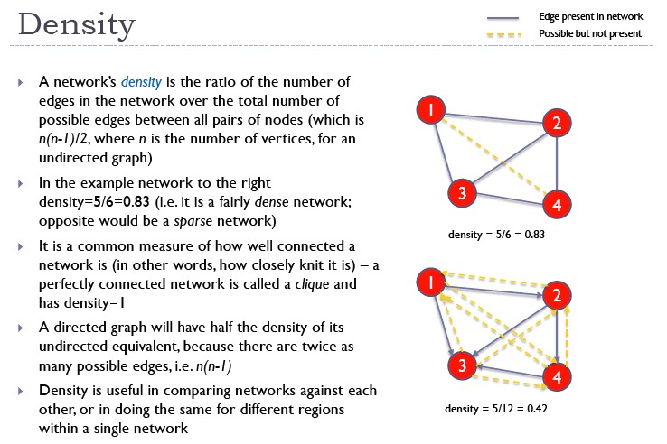

Slide 22
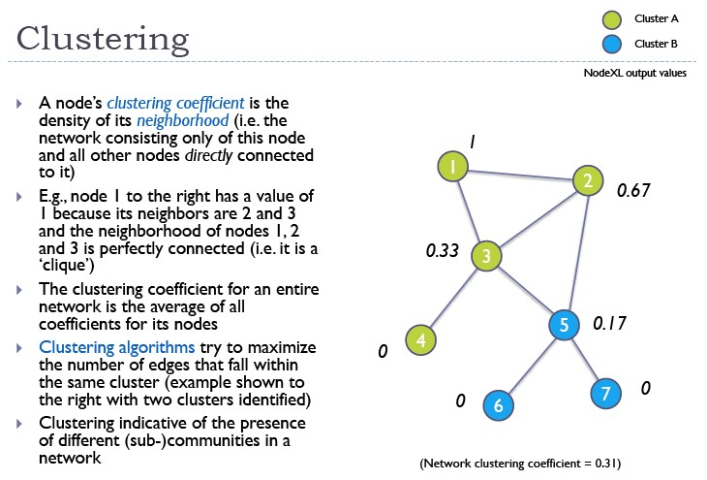

Slide 23
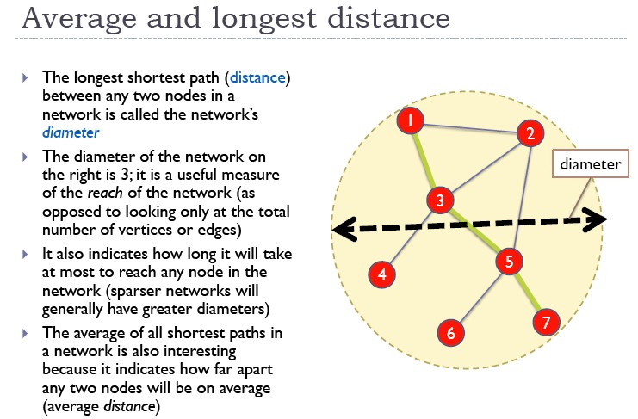

Slide 24
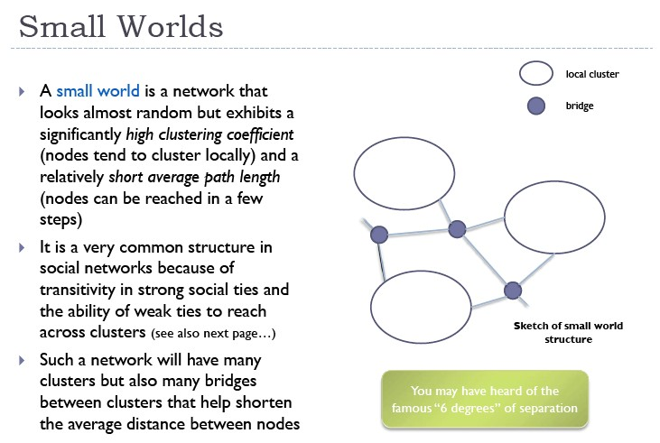

Slide 25
Example
Facebook: 5.8million users (2009), avr 5.73 degrees, max 12 degrees
Twitter:
  5.2 billion relationships, avr 4.67 degrees
  50% users only 4 step away
  Almost everyone <5 steps
  For any 1,500 random users, 3.435 steps
Erdos Number: Collaborative distance through paper co-authoring

Slide 26
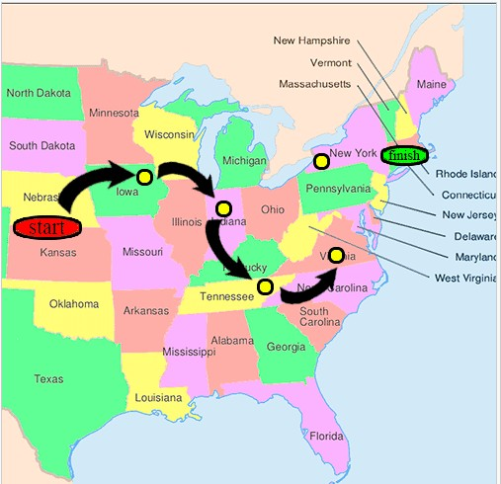
Experiment: Forwarding Letters in US

Slide 27
Example: Social Evolution data set by MIT Media Lab
80 undergraduates with smart devices, moving around the campus.
collects the phone usages and student locations from October 2008 to June 2009.
phone usage:
  3.15 million records of Bluetooth scans
  3.63 million scans of WLAN access-points
  61,100 call records
  47,700 logged SMS events.
students provide offline, self-report answers related to their health habits, diet and exercise, weight changes, and political opinions during the presidential election campaign.

Slide 28
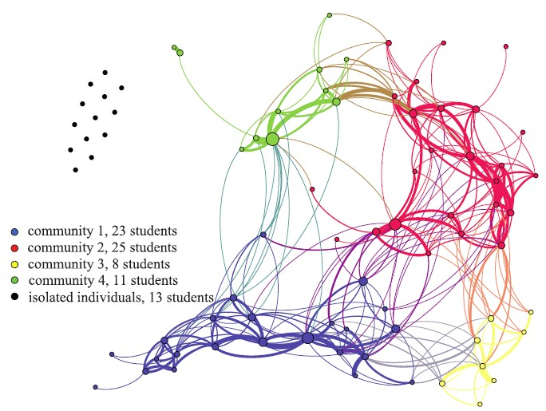
Contact graph, only links of greater than 2,000 contacts between two students are shown. Bigger nodes indicate higher betweenness centrality value for the corresponding participants. Thicker edges indicate higher contact frequency between the connected nodes.

Slide 29
