Slide 1

Choose location for restaurant in New York City
Chi Zhang

Slide 2
Background
New York City
8,400,000 population
302.6 square miles
5 Boroughs

Slide 3
Problem
Someone is looking to open a restaurant, there are many things to consider
Segmentation of the Borough
Population density
Average income
Accessibility and Visibility
Environment
Neighbors with business
etc
Here we mainly focus on the Neighbors and Environment

Slide 4
Methodology
All neighborhoods in New York City
Labelled by marks of different colors
depend on Borough
From Foursquare API
Here we focus on Queens, marked by
black marks

Slide 5
Clustering Neighborhoods
Use k-means method to cluster the neighborhoods in Queen
Labelled with different marks
Visualize the resulting clusters

Slide 6
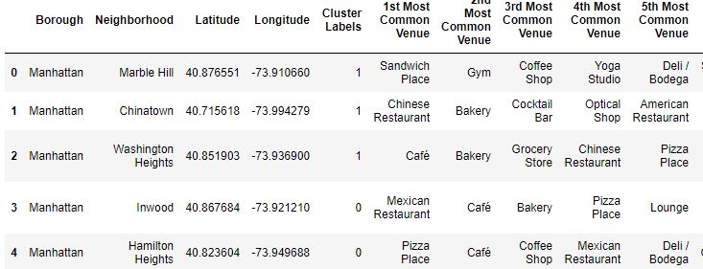
Dataframe with most common venue
A new dataframe is created,
includes the cluster as well as the top venues for each neighborhood.

Slide 7
Conclusion
All neighborhoods in Queens are explored and analyzed, we create a dataframe to collect information of 2969 neighborhoods which split into 320 unique categories. We then analyze each neighborhood, group by neighborhoods and take the mean of the frequency of occurrence of each category. k-means clustering method is used to cluster the neighborhood into 5 clusters.
We also visualize the resulting and examine clusters, and determine the discriminating venue categories that distinguished each cluster.
In order to chose the proper place for restaurant, we should check the table from the project for location information and the top most common venue.

Slide 8
Thanks
Chi Zhang

