Slide 1
Project presentation on Maharashtra TOURISM
bakhteyar khan
Amruta dharne
sagar bhuvad
Animesh ghosh

Slide 2
Presentation flow
Introduction
Technology
Advantages
snapshots

Slide 3
introduction
The aim of this project was to make a user friendly website “Maharashtra tourism” which will provide the users a glimpse of all the famous places to visit in Maharashtra and some detailed description about them. The users will also be able to PLAN A TRIP as per their convenience.
OUR WEBSITE ALSO SHOWCASE SOME NEW PLACES TO MUST VISIT IN MAHARASHTRA FOR THE PEOPLE LIVING IN DIFFERENT STATES. WE HAVE SOME NICE PACKAGES FOR PEOPLE TO STAY NEARBY AT AFFORDABLE PRICES.

Slide 4
technology
FRONT END :IN this project we are using html5, css, bootstrap and JSP Pages
BUSINESS LOGIC :java, servlet, jsp, jstl . we have also used session and cookies
BACKEND :Mysql for database
Testing : Junit is used.

Slide 5
Advantages
It is very responsive.
EasY TO USE AND EXPLORE
HAVE AFFORDABLE PRICES FOR HOTELS
GOOD TRIP PLANNER

Slide 6
Project SNAPSHOTS

Slide 7
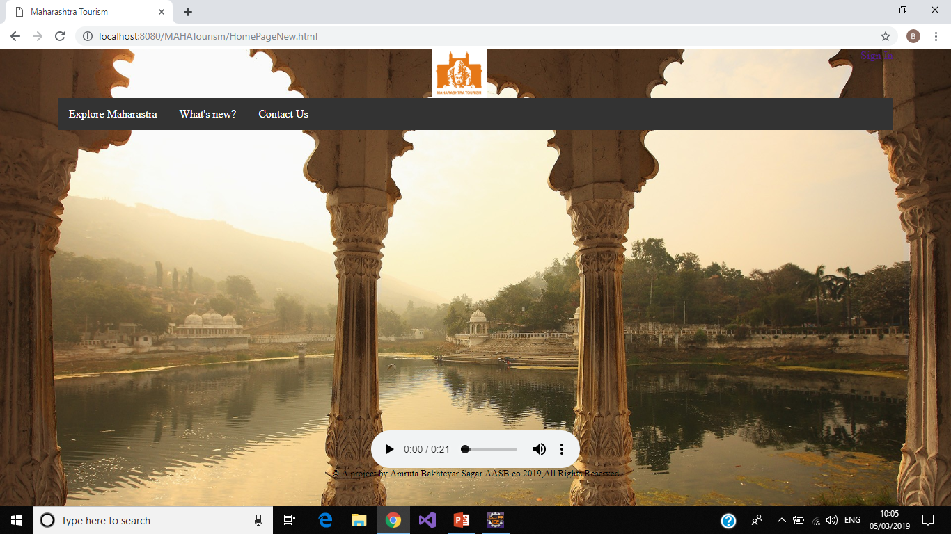

Slide 8
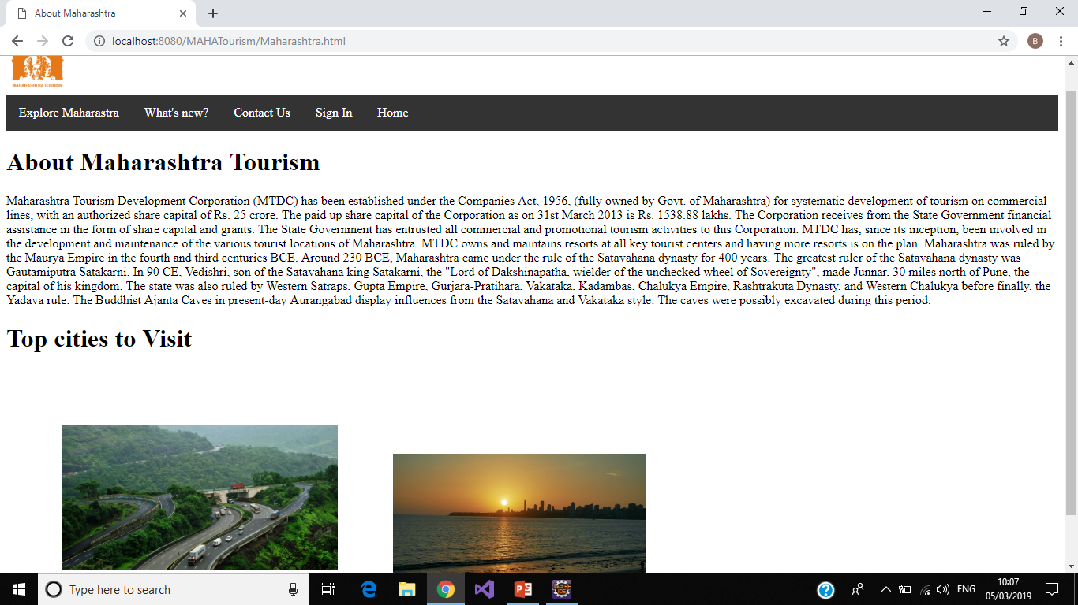

Slide 9
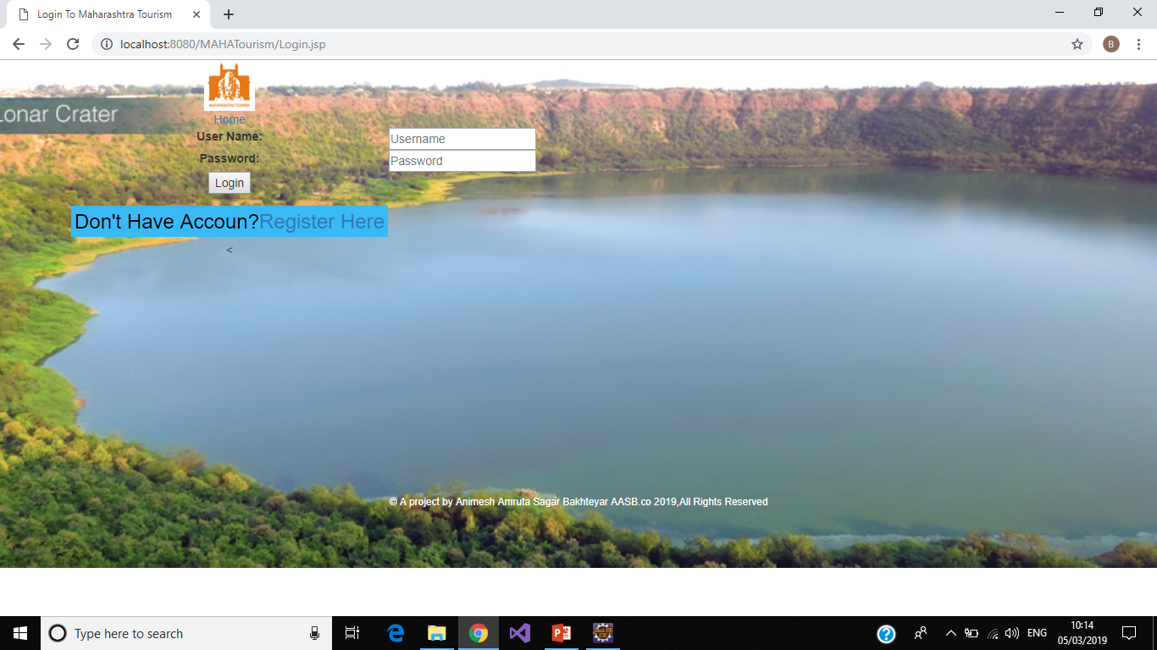

Slide 10
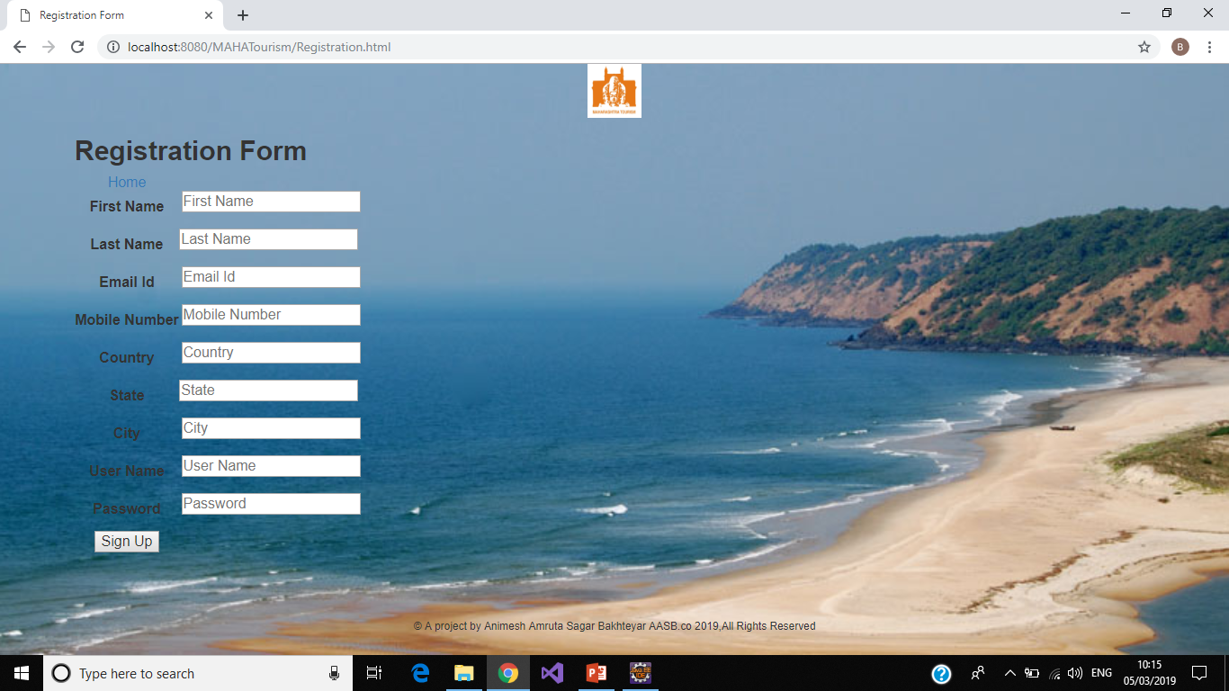

Slide 11


