Slide 1
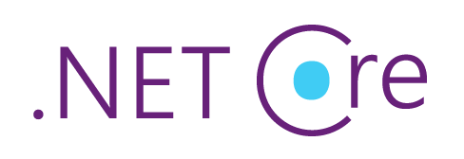
OAuth Demystified

Slide 2


.Net Devs Nuget

Slide 3

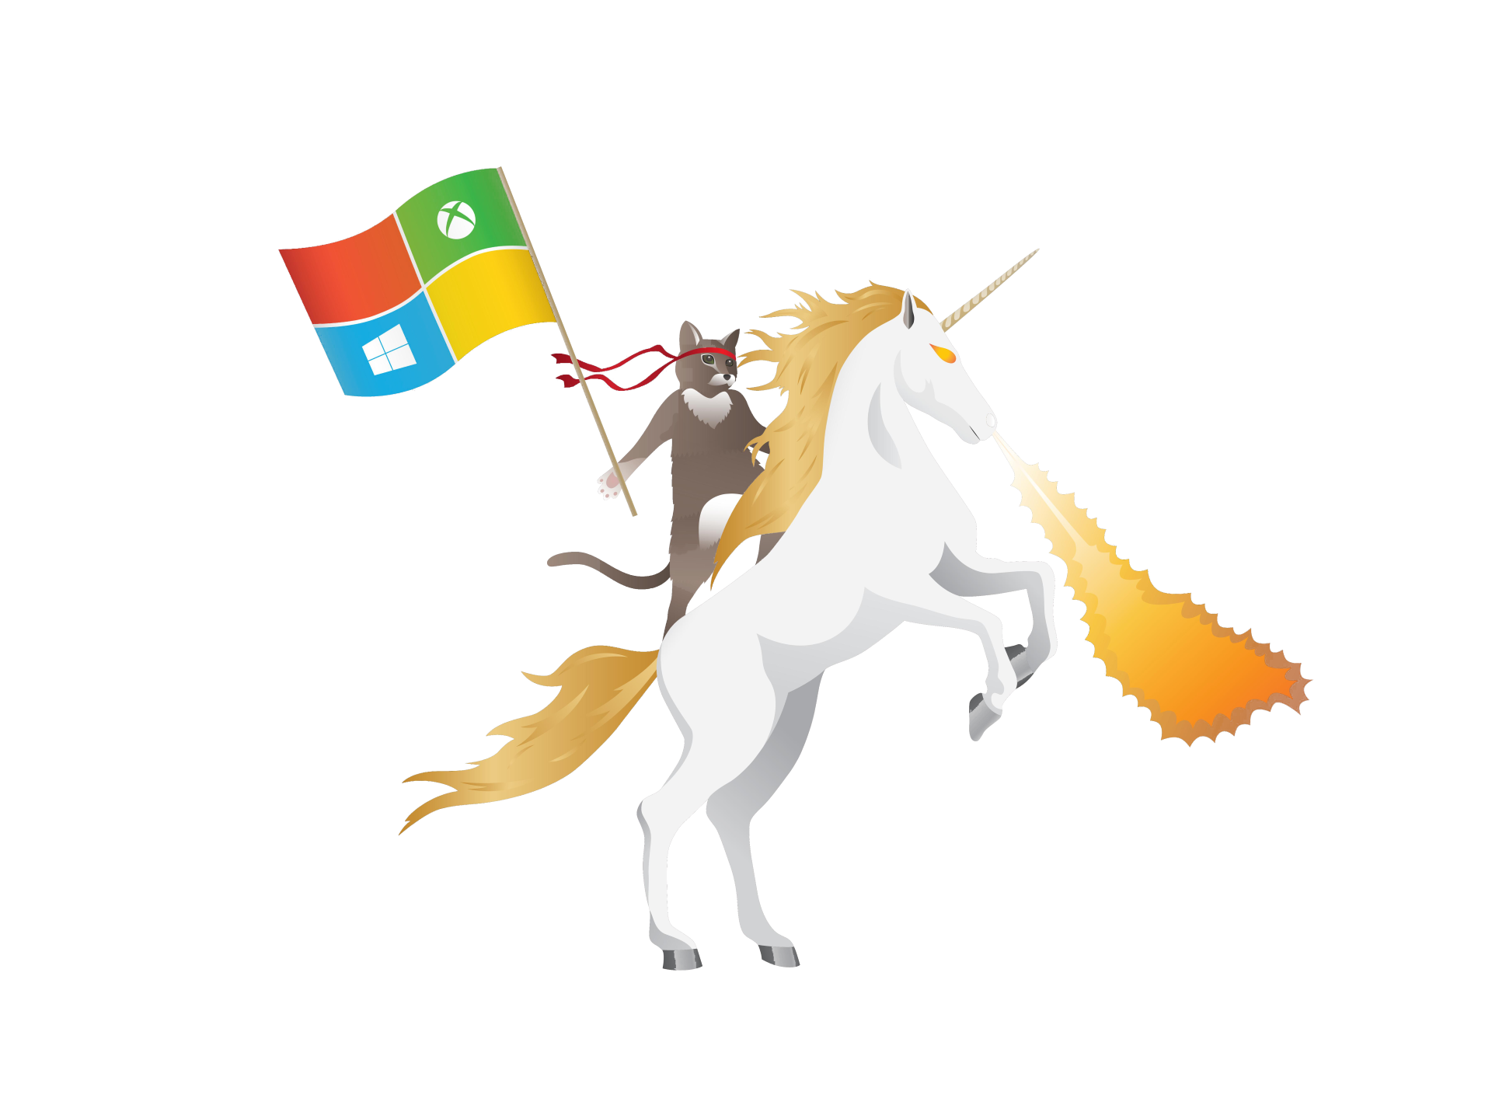
OAuth
OAuth (Open Authorization) is an open standard for token-based authentication and authorization on the Internet.
Various flows for various purposes:
Authorization code grant
Implicit grant
Client credential grant

Slide 4
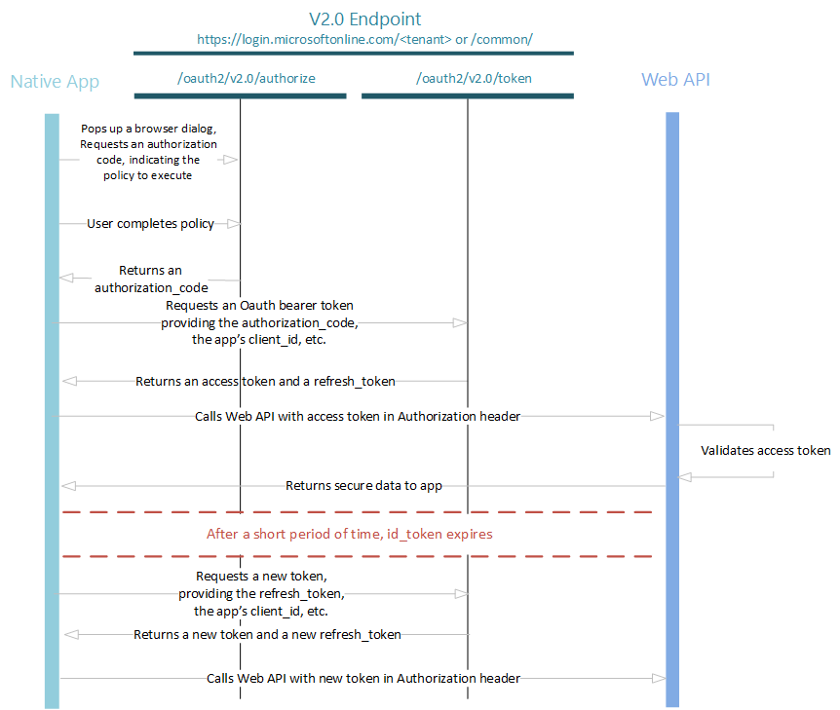
The authorization code grant type is used to obtain both access tokens and refresh tokens and is optimized for confidential clients. Since this is a redirection-based flow, the client must be capable of interacting with the resource owner's user-agent (typically a web browser) and capable of receiving incoming requests (via redirection) from the authorization server.
Authorization code grant

Slide 5
GET https://login.microsoftonline.com/<tenant>/oauth2/authorize ?client_id=<identifier (guid) of the app registered in AzureAD>
&response_type=code
&redirect_uri=<encoded URL where AzureAD will send response>
&response_mode=form_post //can be also query, fragment
Authorization code grant

Slide 6
POST /<tenant>/oauth2/token HTTP/1.1 Host: https://login.microsoftonline.com Content-Type: application/x-www-form-urlencoded client_id=<identifier (guid) of the app registered in AzureAD>
&scope=<requested scope>
&code=<code received from previous request>
&redirect_uri=<same URL as in initial call>
&grant_type=authorization_code
&client_secret=<client secret generated during app registration>
Authorization code grant

Slide 7
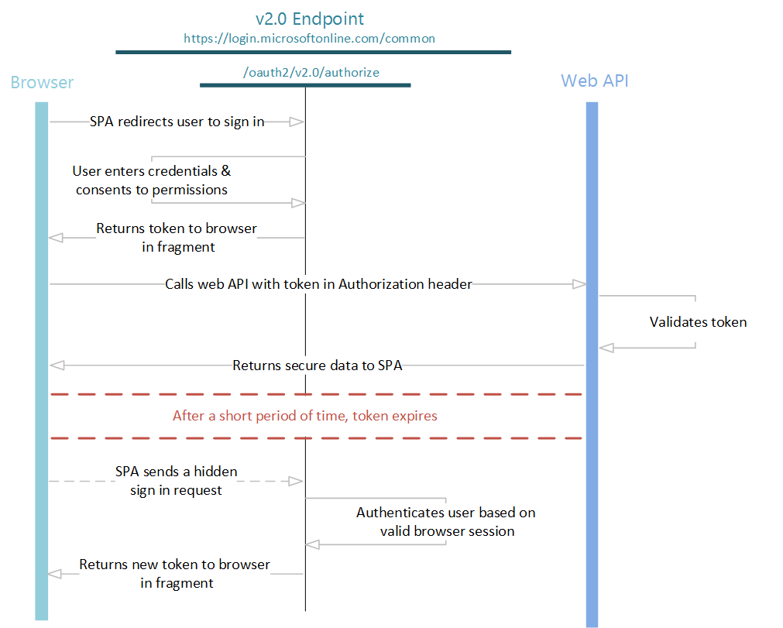
The implicit grant type is used to obtain access tokens (it does not support the issuance of refresh tokens) and is optimized for public clients known to operate a particular redirection URI. These clients are typically implemented in a browser using a scripting language such as JavaScript.
Since this is a redirection-based flow, the client must be capable of interacting with the resource owner's user-agent (typically a web browser) and capable of receiving incoming requests (via redirection) from the authorization server.
Implicit code grant

Slide 8
GET https://login.microsoftonline.com/<tenant>/oauth2/authorize
?client_id=<identifier (guid) of the app registered in AzureAD>
&response_type=id_token token
&redirect_uri=<encoded URL where AzureAD will send response>
&scope=<requested scope>
&resource=<required resource>
&response_mode=fragment //can be also query, form_post
&state=12345
&nonce=678910
Implicit code grant

Slide 9
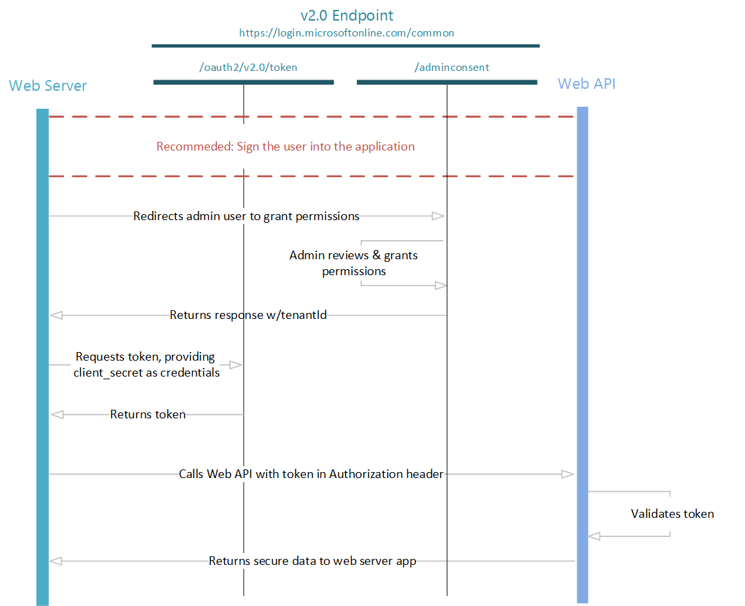
The client can request an access token using only its client credentials (or other supported means of authentication) when the client is requesting access to the protected resources under its control, or those of another resource owner that have been previously arranged with the authorization server
Client credentials grant

Slide 10
POST /<tenant>/oauth2/token HTTP/1.1 Host: https://login.microsoftonline.com Content-Type: application/x-www-form-urlencoded client_id=<identifier (guid) of the app registered in AzureAD>
&scope=<requested scope>
&redirect_uri=<same URL as in initial call>
&grant_type=client_credentials
&client_secret=<client secret generated during app registration>
Client credentials grant

Slide 11
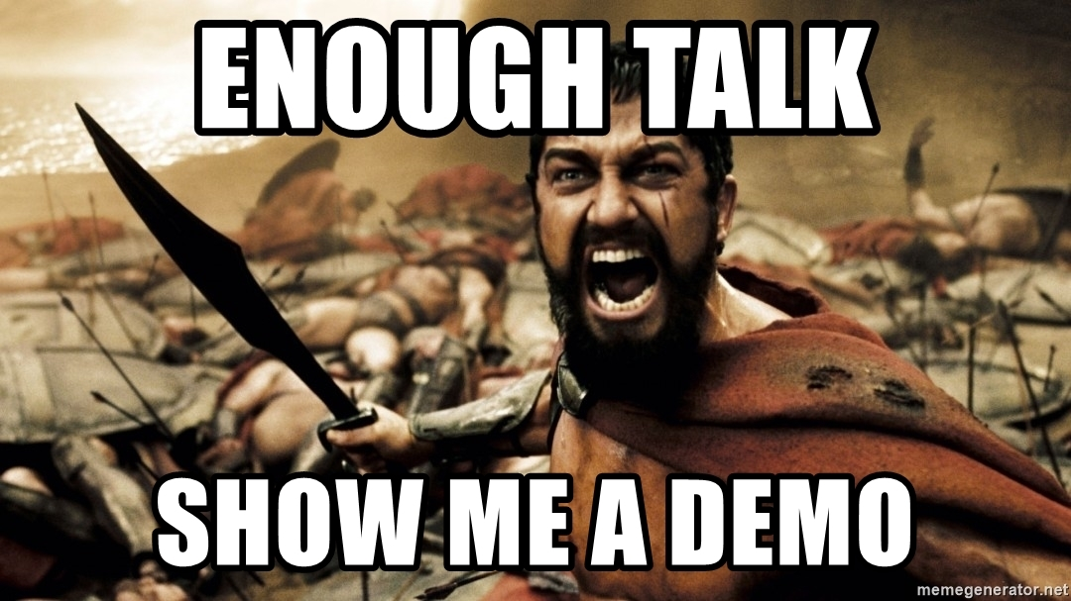
.Net Devs Demo

Slide 12
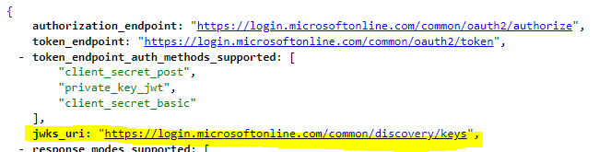
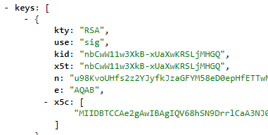
Asynchronous cryptography used
Tokens are signed by the OAuth Server by private key
OAuth Server exposes endpoint with configuration (.well-known/openid-configuration.)
Token Verification

Slide 13
Asynchronous cryptography used
Tokens are signed by the OAuth Server by private key
OAuth Server exposes endpoint with configuration (.well-known/openid-configuration.)
Token Verification

Slide 14
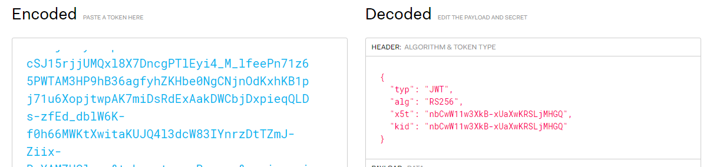
Token includes required verification info in header
Additional claims to validate:
audience claim => to ensure that the token was intended to be given to your app
issuer claim => to verify that the token was issued to your app by the v2.0 endpoint
not before and expiration time claims => to verify that the token has not expired
Token Verification

Slide 15

After all sildes .Net Devs still Nuget

Slide 16
Q & A

Slide 17
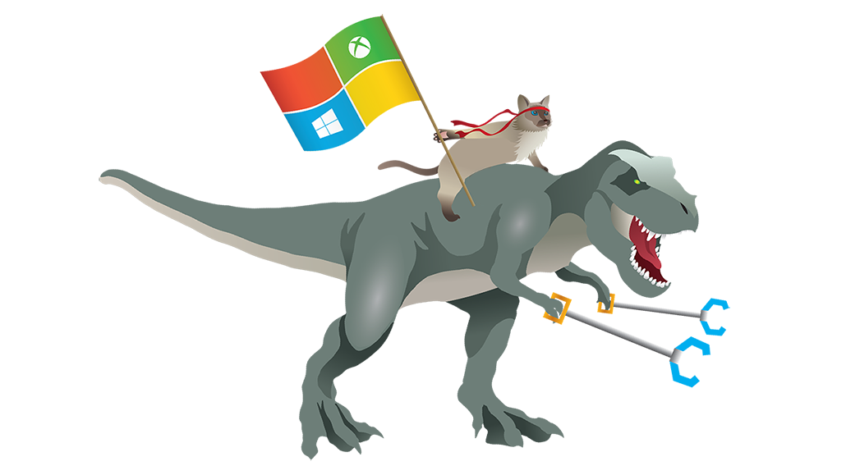

OAuth Demystified
#MSTechTalks

