Slide 1


CDC Germany 2026
30 Sept - 01 Oct 2026 · Congress Park Hanau
SESSION
Building External MCP Servers with Azure Functions
Onur Okutucu
Microsoft MVP (Azure & AI Foundry) · MCT · CTO, Collabix AI
Thursday · 10:15-11:00
cdc-germany.de

Slide 2
CDC Germany 2026
30 Sept - 01 Oct 2026 · Congress Park Hanau
THE PROBLEM
Your agent is exactly as useful as the tools it can reach.
LLMs read. MCP lets them do. Azure Functions makes the doing cheap, secure and boring to operate.

Slide 3
The next 45 minutes
01
02
03
04
Fundamentals
MCP in five minutes, why Functions, two ways to host, the 401 handshake.
Four demos, live
Self-hosted, MCP Apps, Entra on-behalf-of, API Center + Foundry.
Running it for real
Cold starts, slow tools, keys vs Entra, versioning, war stories.
Take it home
The cheat sheet and a repo you can azd up tonight.
CDC Germany 2026

Slide 4
CDC Germany 2026
30 Sept - 01 Oct 2026 · Congress Park Hanau
PART 1 · FUNDAMENTALS
The fundamentals, fast.
Just enough to make every demo obvious: MCP in one picture, why Functions, two ways to host, the 401 handshake. Twelve minutes, no protocol trivia.

Slide 5
MCP in one picture
WHAT IS MCP?
The Model Context Protocol: an open standard that lets any AI app discover tools, call them and read data. Think USB-C for agents: build a server once, plug it into every MCP app.
Nov 2024 open-sourced by Anthropic
2025 OpenAI, Google, Microsoft adopt it
Dec 2025 donated to the Linux Foundation
HOST
The app you talk to
Runs the model, owns the chat and asks for your consent.
FOR EXAMPLE
· VS Code
· Microsoft 365 Copilot
· Claude Desktop, ChatGPT
· Foundry agents, your app
CLIENT
The connector
Lives inside the host, one per server. Speaks JSON-RPC over stdio or HTTP.
FOR EXAMPLE
· GitHub Copilot (in VS Code)
· Foundry's MCP tool
· The MCP SDK in your app
SERVER
Your code, today
Tools (verbs) · Resources (nouns) · Prompts · MCP Apps (UI)
FOR EXAMPLE
· Today: 4 Azure Function apps
· GitHub, Azure, Playwright
· A Python file on a laptop
One protocol, any model, any client. Write the server once; every agent in the company can use it.
CDC Germany 2026

Slide 6
Local is a demo. External is a product.
 | Local MCP server | External (remote) MCP server
Transport | stdio: a process on your laptop | Streamable HTTP: an endpoint in the cloud
Who can use it | You | Your team, your company, your customers
Secrets live in | Environment variables and hope | Managed identity, Key Vault, Entra tokens
Caller identity | Whoever is at the keyboard | A real user or app, verified per request
Scaling & ops | Restart it when it dies | Scales on demand; logs, alerts, versions
CDC Germany 2026

Slide 7
Why Azure Functions for MCP
Scale to zero, scale to many
Flex Consumption bills per execution. A server nobody calls costs nothing; one everybody calls just grows.
A tool is a function
Triggers and bindings you already know. Blob, Cosmos DB, Service Bus, SQL: one decorator away from any tool.
Auth is built in
Entra ID login per the MCP auth spec, no middleware to write. Keys for dev, OAuth for anything shared.
Enterprise plumbing included
VNET integration, API Management in front, App Insights behind. Your platform team already approved all of it.
CDC Germany 2026

Slide 8
Two ways to host an MCP server on Functions
The MCP extension (today's pick)
Self-hosted SDK server (preview)
Tool, resource and prompt triggers
.NET, Java, Python, TypeScript, JavaScript
MCP Apps: tools that return interactive UI
Functions speaks the protocol for you
Built-in auth, system keys, host.json config
One MCP endpoint per function app: /runtime/webhooks/mcp
Bring an existing FastMCP / SDK server as-is
No code changes: runs as a custom handler
Stateless, Streamable HTTP servers
Python, TypeScript, .NET, Java samples
Same Flex plan, same built-in auth
Best when the server already exists
CDC Germany 2026

Slide 9
The extension's building blocks
mcp_tool()
mcp_resource_trigger()
mcp_prompt_trigger()
ui:// + tool metadata
Tool = verb
The agent calls it with arguments. Typed parameters become the JSON schema; the docstring is the description.
Resource = noun
Data the agent reads by URI: runbooks, configs, a Definition of Done, airports nearby.
Prompt = template
Reusable instructions served by the server (/standup, /plane_spotter) as slash commands in the client.
MCP Apps = UI
A tool returns an interactive panel instead of a wall of JSON. Renders in VS Code, Claude, M365 Copilot.
CDC Germany 2026

Slide 10
A tool is just a function
# Python · Azure Functions MCP extension (azure-functions ≥ 2.0)
@app.mcp_tool(metadata=RADAR_UI)
@app.mcp_tool_property(arg_name="radius_nm",
description="Search radius in NM (default 25)")
def flights_overhead(radius_nm: int = 25) -> CallToolResult:
"""What is flying over us right now? Live ADS-B positions."""
aircraft = fetch_adsb(HOME_LAT, HOME_LON, radius_nm)
return CallToolResult(
content=[TextContent(text=summary(aircraft))],
structured_content={"aircraft": aircraft})
Decorator = manifest
Name and description are what the model reads. Write them for the model.
Parameters = schema
Typed Python args become the tool's JSON schema. No JSON strings.
Return = result
Text, structured JSON, images, links, or a UI. Zero protocol code.
CDC Germany 2026

Slide 11
Security: the 401 handshake, step by step
CLIENT
Calls the MCP endpoint with no token
FUNCTIONS
401 + link to Protected Resource Metadata
ENTRA ID
User signs in, consents, gets an access token
TOOL RUNS
Token validated; the caller's identity is in your code
Built-in auth
App Service authentication does the OAuth dance per the MCP spec, all in Bicep. You configure, you don't code.
On-behalf-of
Exchange the user's token for Graph, ARM, Azure DevOps. The tool acts as the user, with the user's rights.
Belt and braces
API Management as the gateway for policies and rate limits; VNET integration so the app is never public.
CDC Germany 2026

Slide 12
CDC Germany 2026
30 Sept - 01 Oct 2026 · Congress Park Hanau
PART 2 · FOUR DEMOS
Four servers, four superpowers.
For each one: what it does, which tools it has, which kind of MCP server, which Functions feature. Then we run it live.

Slide 13
The demo map: one story, four acts
# | Server | Kind of MCP server | Superpower | Functions feature
1 | concierge | Self-hosted MCP SDK server (Python) | Lift and shift: the same file on my laptop and in the cloud | Custom handler, function key
2a | skywatch | Functions MCP extension | Tools with a face: a live radar inside the chat | Tool, resource and prompt triggers; MCP App
2b | domainforge | Functions MCP extension | Buttons that do things: Reserve writes to storage | MCP App + Blob output binding
3 | adopilot | MCP extension + built-in auth | It knows who you are and acts as you | Entra auth, managed identity, on-behalf-of
4 | all of them | API Center + Foundry | Find it, reuse it, with a human approving writes | Registry API, project connections
CDC Germany 2026

Slide 14
Demo 1 · concierge: one file, two homes
Self-hosted MCP server
MCP Python SDK
stdio → Streamable HTTP
Function key
WHAT IT DOES
Your conference buddy. Answers 'where, when, what's on' from the live CDC agenda (public API, with a snapshot fallback).
INSIDE THE SERVER
find_session · whats_on search, and what's on right now
breaks · plan_my_day lunch, coffee, a personal plan
speaker_info · session_status who, and where it runs
coffee_check · buzzword_bingo just for fun
UNDER THE HOOD
Plain MCPServer + @mcp.tool(): 9 tools, zero Azure code
host.json: configurationProfile mcp-custom-handler
Endpoint /mcp, stateless HTTP, scales to zero
WHY YOU'D WANT THIS
You already have an MCP server? Move it to Azure without changing a line: add a host.json, deploy, share a URL.
TRY IT "Where is Onur's session, and when is lunch?" Local first, then the same question to Azure.
CDC Germany 2026

Slide 15
Demo 2a · skywatch: a radar in the chat
MCP extension
MCP App (ui://)
Resource
Prompt
Function key
WHAT IT DOES
Live aircraft over Hanau (ADS-B), with airline and route, drawn as an interactive radar that refreshes itself inside the chat.
INSIDE THE SERVER
flights_overhead the radar widget (MCP App)
radar_image PNG for clients without MCP Apps
find_flight one flight by callsign
airports://nearby resource: nearby airports
/plane_spotter prompt
UNDER THE HOOD
Tool metadata points at ui://skywatch/radar.html
A resource trigger serves the widget; it polls every 15 s
adsb.lol with OpenSky fallback · routes from adsbdb
WHY YOU'D WANT THIS
Agents answer with walls of JSON. With MCP Apps a tool returns real UI: tables, maps, charts, in VS Code, M365 Copilot and more.
TRY IT "What's flying over us right now?" Then: "Where are the three nearest planes going?"
CDC Germany 2026

Slide 16
Demo 2b · domainforge: buttons that do things
MCP extension
MCP App
Blob output binding
Prompt
Deterministic
WHAT IT DOES
Invents pun domain names for a business and a city, checks them live, and shows a picker. Reserve books one.
INSIDE THE SERVER
brainstorm_domains obvious names first, then puns
check_domains availability picker (MCP App)
reserve_domain writes a JSON ticket to Blob
/name_my_business the prompt that runs it all
UNDER THE HOOD
RDAP lookup, DNS-over-HTTPS fallback for .de
Widget → callServerTool('reserve_domain')
func.Out[str] + Blob binding, managed identity
WHY YOU'D WANT THIS
The UI isn't just a display: a click calls your server back. And Functions bindings write to Blob, Cosmos DB or Service Bus in one line.
TRY IT /name_my_business → pizza, Hanau → click Reserve → check the reservations container.
CDC Germany 2026

Slide 17
Demo 3 · adopilot: it knows who you are
MCP extension
Built-in Entra auth
On-behalf-of
Resource + prompt
No secrets
WHAT IT DOES
Your Azure DevOps sidekick: sprint board, bugs, pipelines, and filing a bug, all as the signed-in user.
INSIDE THE SERVER
whoami Microsoft Graph /me, as you
sprint_board · open_bugs Azure DevOps, as you
pipeline_health recent pipeline runs
create_bug confirms first, stamped with you
/standup prompt
ado://team/definition-of-done resource
UNDER THE HOOD
authsettingsV2 + protected resource metadata, all Bicep
Federated credential from a managed identity, no secret
WHY YOU'D WANT THIS
Shared tools need identity. 401, sign in, and the tool acts with your permissions, audited, with no PAT or client secret anywhere.
TRY IT "Who am I signed in as?" Then paste a complaint: "Turn that into a P2 bug and assign it to me."
CDC Germany 2026

Slide 18
Demo 4 · find it, reuse it
Azure API Center
MCP registry
Entra only
Foundry Agent Service
Human approval
WHAT IT DOES
A private catalog of all four servers, and a Foundry agent that uses skywatch and domainforge with no new code.
INSIDE THE SERVER
API Center 4 servers registered as kind 'mcp' in Bicep
registry API v0.1 Entra sign-in, Data Reader role
Foundry agent MCP tools via project connections
require_approval reads free, reserve_domain waits
UNDER THE HOOD
Same servers, a third client, zero client code
Optional: APIM in front for keys, quotas, rate limits
WHY YOU'D WANT THIS
Fifty teams, fifty MCP servers: people need to find them, trust them and reuse them from any agent platform.
TRY IT "What's flying over Hanau? Name a pizza place after the nearest airline and reserve it." Approve.
CDC Germany 2026

Slide 19
What's running: one azd up
AGENTS
Any MCP client
VS Code Copilot
M365 Copilot
Foundry agent
Your own app
adopilot · Entra
whoami · sprint_board · open_bugs · create_bug · pipeline_health · /standup
BACKENDS
APIs & storage
Graph · Azure DevOps
adsb.lol · adsbdb
RDAP + DNS
Blob Storage · App Insights
skywatch · MCP App
flights_overhead (radar) · radar_image · find_flight · airports://nearby · /plane_spotter
HTTP + key or Entra token
Managed identity · OBO
domainforge · MCP App
brainstorm_domains · check_domains (picker) · reserve_domain (Blob) · /name_my_business
+ concierge (self-hosted) · API Center · Foundry · 1 Bicep · 1 azd up
CDC Germany 2026

Slide 20
CDC Germany 2026
30 Sept - 01 Oct 2026 · Congress Park Hanau
PART 3 · TAKE IT HOME
Running it for real.
Cold starts, slow tools, keys vs Entra, versioning, the lessons we paid for, and the code.

Slide 21
Running it for real
Concern | What to do about it
Cold starts | Flex Consumption always-ready instances for servers people actually use; let the rest scale to zero.
Slow tools | Keep a tool under a few seconds. Longer work starts a Durable orchestration and returns a status the agent can poll.
Observability | Every tool call is a function invocation in App Insights: who called what, with which arguments, how long.
Keys vs OAuth | Keys for local dev and smoke tests only. Shared servers: Entra + on-behalf-of. No PAT, no client secret, ideally behind APIM.
Versioning | Tool names and descriptions are your API contract. Add tools freely; rename or change semantics only with a new server.
CDC Germany 2026

Slide 22
MCP on Functions in 2026: the cheat sheet
Feature | In the demo | One sentence
Typed Python decorators | every @app.mcp_tool() | The parameter is the schema, the docstring is the prompt.
Structured content | sprint_board, flights_overhead | Typed objects for UIs and code; text for humans. Same call.
API Center + Foundry | registry, Foundry agent | How others find your tools and reuse them from another agent platform.
Resource + prompt triggers | definition-of-done, /standup | The team's playbook, versioned with the server.
MCP Apps (official extension) | radar, domain picker | Tool returns UI. VS Code, M365 Copilot and other MCP Apps hosts. No client code.
Bindings next to tools | reserve_domain → Blob | Swap Blob for Cosmos, SQL or Service Bus in one line.
Built-in auth + on-behalf-of | adopilot (all Bicep) | The 401 is the server asking who you are; then it acts as you.
Self-hosted SDK servers | concierge (Demo 1) | Lift-and-shift an existing FastMCP server. Same platform.
CDC Germany 2026

Slide 23
Field notes from building these for real
Tool descriptions are prompts
Real bug from this demo: "e.g. 'Active'" in a parameter description made the agent filter a Scrum board to nothing. Fixed in the description.
Five sharp tools beat forty vague ones
Every tool costs context and confuses selection. Wrap intent, not every REST endpoint you own.
Return structure, not prose
Compact JSON with stable keys. The agent will narrate it; you don't have to.
Auth on day one: test it with the real client
Start with Entra; it's Bicep, not a refactor. VS Code sends an RFC 8707 resource: register the server URL on the app.
CDC Germany 2026

Slide 24
Three things to take back to the datacenter
1
An MCP server on Azure Functions is one decorator on a function you were going to write anyway.
2
External means identity: the 401 handshake and Entra make the agent act as a real person with real permissions.
3
Start small: three tools, one resource, one prompt, azd up, then register it in API Center so others find it.
CDC Germany 2026

Slide 25
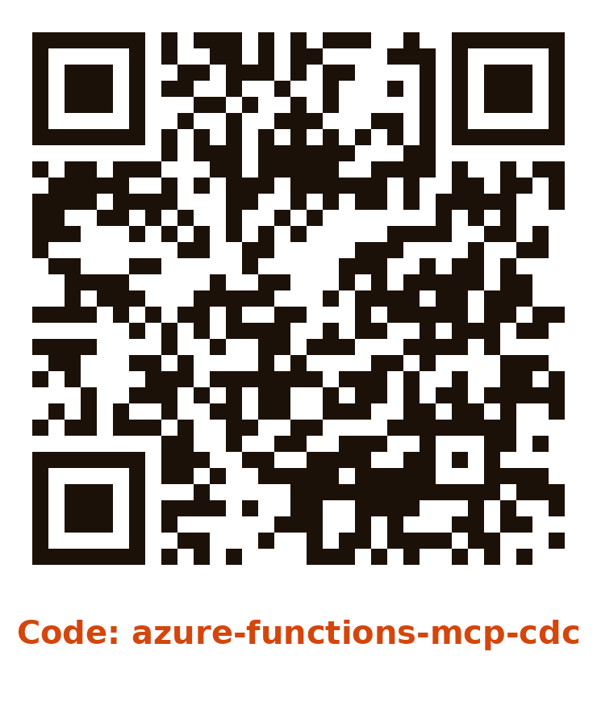
Steal these links
Remote MCP on Functions: landing page
aka.ms/remote-mcp
azd templates for .NET, Python, TypeScript, Java; APIM and self-hosted variants
The extension itself
github.com/Azure/azure-functions-mcp-extension
Source, host.json options, release notes
Tutorial: host an MCP server on Functions
learn.microsoft.com/azure/azure-functions/functions-mcp-tutorial
MCP Apps: the official extension
blog.modelcontextprotocol.io/posts/2026-01-26-mcp-apps
Spec, SDK and client support
Today's demo kit
github.com/bakionur/azure-functions-mcp-cdc
Four servers, Bicep, scripts. Clone it and azd up
Scan for the code: four MCP servers on Azure Functions, one azd up.
CDC Germany 2026

Slide 26
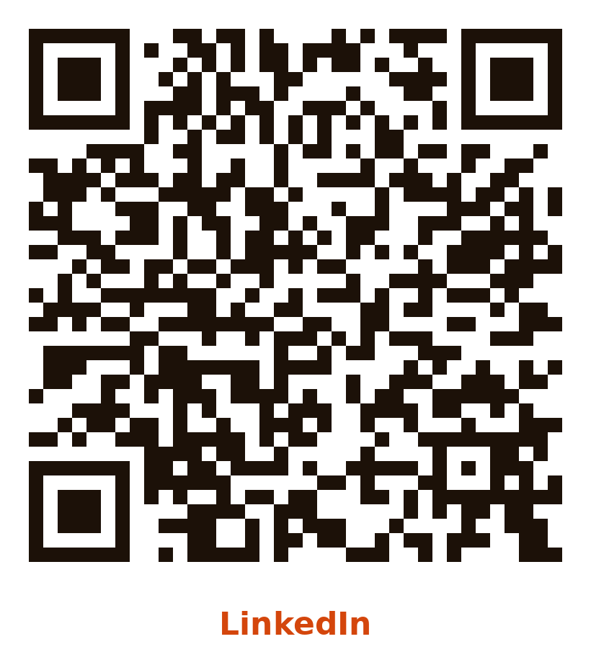
CDC Germany 2026
30 Sept - 01 Oct 2026 · Congress Park Hanau
THANK YOU
Danke, Hanau! Questions?
Onur Okutucu
Microsoft MVP (Azure & AI Foundry) · MCT · CTO, Collabix AI
LinkedIn: linkedin.com/in/bakionur
Code: github.com/bakionur/azure-functions-mcp-cdc
cdc-germany.de

Slide 27










CDC Germany 2026
30 Sept - 01 Oct 2026 · Congress Park Hanau
THANK YOU
A big thank you to our sponsors!
P L A T I N U M
G O L D
cdc-germany.de · 30 September - 01 October 2026 · Congress Park Hanau

