Slide 1

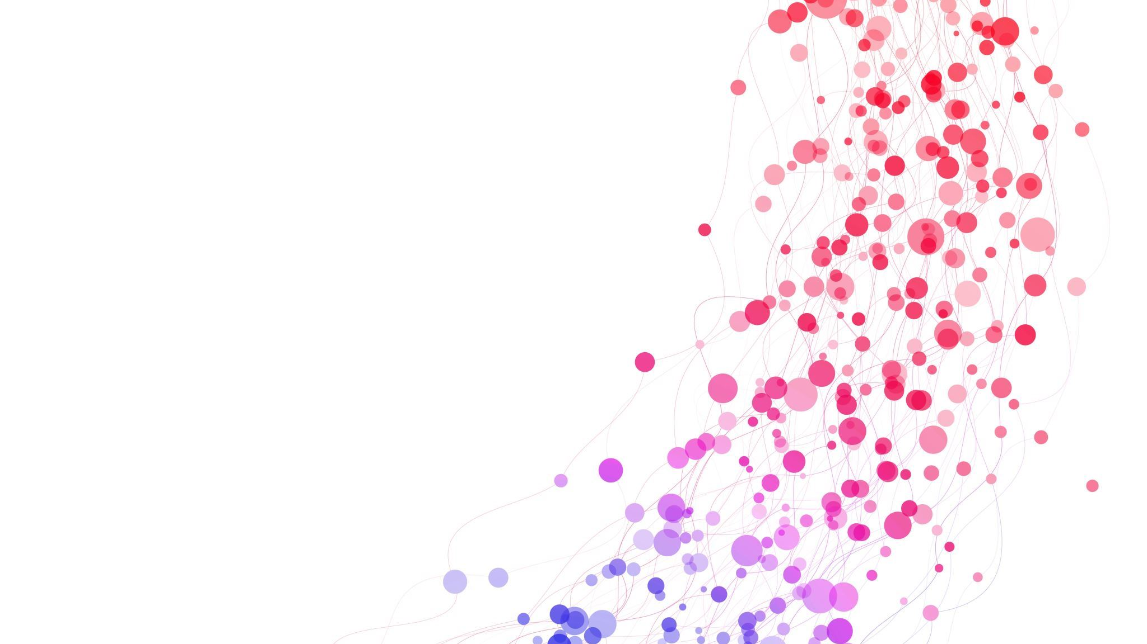
Admit Transfer Discharge System (ATDS)
Bakkesh S Subedhar

Slide 2
iQGatewayTM
Overview
HealthSure hospital needs to automate the patient admission, discharge & transfer process (Room Transfer) which is currently depending on huge manual interventions.
Based on their customer feedbacks , they want to build a web application which eases these process.
The complete system should be automated including the insurance clearance which is raised by the patient. This module will support only cash less based services provided by the insurance agencies.
MENTORLABSTM

Slide 3
iQGatewayTM
Architecture
USER
PRESENTATION LAYER
BUSINESS LAYER
SERVICE LAYER
DATA ACCESS LAYER
DATA LAYER
MENTORLABSTM

Slide 4
iQGatewayTM
Functional Modules
Patient
Able to view the availability of Rooms.
Book for a specific room / Request for Transfer the rooms.
Get the status of request.
Notifications on Discharge.
Follow procedure of cashless services.
HOSPITAL ADMIN
Access all the patient request.
Approve or cancel the room request.
Should be able to view the available room details.
Generate discharge details.
Communicate with Insurance Admin.
INSURANCE ADMIN
Maintains all discharge details.
Verifies the clearance of insurance claim for cashless services.
MENTORLABSTM

Slide 5
iQGatewayTM
Activity Diagram
Admit Transfer Discharge System
Chech for availability and book ward/Transfer Ward
Patient
Get Status of requests
Notification on discharge
Administer over all patient request
Hospital Admin
View availability of wards
Generate and Maintain Discharge Details
Insurance Admin
Verifies the clearance of insurance claims
MENTORLABSTM

Slide 6
iQGatewayTM
Responsibilities
Project Planning and Design:​
Defined the scope and objectives of the project based on the
problem statement.​
Conducted a comprehensive analysis of the manual ward admission,
transfer and discharge processes.​
Designed the system architecture, considering factors like scalability,
security, and usability.​
Created wireframes and UI/UX designs to outline the visual elements and
user interactions.​
MENTORLABSTM

Slide 7
iQGatewayTM
Software Development:
Implemented the front-end interface using React.js to ensure an intuitive
and responsive user experience.
Developed the back-end logic using Spring Boot, handling user
authentication, data storage, and manipulation.
Designed and managed the database schema using MongoDB, ensuring
efficient data storage and retrieval.
Implemented API endpoints for various functionalities, such as issuing
health cards and managing branches.
MENTORLABSTM

Slide 8
iQGatewayTM
Design Technologies and Methods Used
Programming Language : Java 1.8 (8) - as it the most stable version.
Frameworks : Spring boot, React JS.
Development Environment: Microsoft Visual Studio Code v1.81.1.
Spring Tool Suite v3.8.3 .
Design : Object Oriented Design Methodology.
Microservice Architecture.
Diagrams and models : Enterprise Architect v16.1 (Professional).
Visual Paradigm CE 17.0.
Database tools: MongoDB Compass 1.39.0.
MENTORLABSTM

Slide 9
iQGatewayTM
Documentations and References
Software Requirements Specification (SRS.doc)
The High-Level Design (HLD) and Low-Level Design (LLD) documents have been developed based on the Software Requirements Specification (SRS) document. The SRS document comprehensively details the functional and non-functional requirements of the Admit Transfer Discharge System.
Low Level Design (LLD.doc )
The Low-Level Design (LLD) document provides an in-depth description of the implementation details for each module of the Admit Transfer Discharge System. It outlines the data structures, algorithms, and interfaces that will be used to realize the system's functionality.
MENTORLABSTM

Slide 10
iQGatewayTM
High Level Design (HLD.doc)
The High-Level Design (HLD) document presents an architectural overview of the Admit Transfer Discharge System. It outlines the main components, their interactions, and the overall system structure. The HLD serves as a blueprint for the subsequent development phase.
JAVA Documentation
Java documentation refers to the detailed information and explanations provided for Java programming elements, such as classes, methods, interfaces, and packages. It serves as a reference guide for developers, offering insights into how different components of the Java programming language and its standard libraries work. Properly documented code is crucial for maintainability, collaboration, and understanding the purpose and usage of code snippets and libraries.
MENTORLABSTM

Slide 11
iQGatewayTM
Verification & Validation Criteria's
Unit testing specification and report :
Test cases were written and verified for all the various data access classes before implementation into the service layer.
Integration testing results.
Before each layer was integrated with the entire module, it was tested for smooth integration.
Results of functional testing:
After the overall development of the project, a few functional test cases were developed and the project was tested.
MENTORLABSTM

Slide 12
iQGatewayTM
Project Outcomes
Gained insights into using technologies such as React.js, Spring Boot, and MongoDB.
Acquired hands-on experience in full-stack development, integrating front-end and back-end components seamlessly, and development tools like Eclipse neon3, MongoDB Compass , Spring Tool Suit(STS), Microsoft VS Code, Visual Paradigm and Enterprise Architect.
Enhanced problem-solving skills through identifying and resolving technical challenges.
MENTORLABSTM

Slide 13
iQGatewayTM
Q&A?
MENTORLABSTM

Slide 14
THANK YOU

