Slide 1
Accelerating SQL Database Operations on a GPU with CUDA
Peter Bakkum & Kevin Skadron
The University of Virginia
GPGPU-3 Presentation
March 14, 2010

Slide 2
Overview
Implementation of certain SQL SELECT queries to run on an NVIDIA GPU with CUDA
Built on top of the SQLite database
Average query speedup of 35X
Two goals:
Accelerate existing database operations
Give programmers easier access to GPU hardware

Slide 3
Outline
SQL Review
SQLite
Implementation
Scope
Limitations
Testing, Results
Multicore
Hardware Limitations
Future Work
Conclusions

Slide 4
SQL Review
Widely-used database query language
Declarative, thus easy to parallelize
Data mining operations have been accelerated on GPUs
SELECT name FROM students
WHERE gpa > 3 AND age < 25

Slide 5
SQLite
Most widely installed SQL database
Simple design
Easy to understand code
Code placed in the public domain
Performance comparable to other open-source databases

Slide 6
SQLite Architecture
Runs as part of the client process
SQL queries are parsed and transformed to a program in an intermediate language of opcodes
Process resembles compilation, output resembles assembly
Intermediate language program, or query plan, executed by the SQLite virtual machine

Slide 7
Implementation
A re-implementation of the virtual machine as a CUDA kernel
Uses SQLite query processor
Many query plans execute opcodes over all rows in a table, inherently parallelizable
Data selected from SQLite and transferred to GPU in initialization step
Queries execute in a kernel launch
Results transferred from the GPU

Slide 8
Implementation
Each thread assigned a table row
Threads execute opcodes
Thread divergence occurs as threads jump to different opcodes based on the data
Reductions must be performed to coordinate output of results and aggregations of values

Slide 9
Example Opcode Program
1: Integer 3 1 0
2: Integer 25 2 0
…
6: Column 0 1 3
7: Lt 1 12 3
8: Column 0 2 3
9: Gt 2 12 3
10: Column 0 0 5
11: ResultRow 5 1 0
12: Next 0 6 0
1: Integer 3 1 0
2: Integer 25 2 0
…
6: Column 0 1 3
7: Lt 1 12 3
8: Column 0 2 3
9: Gt 2 12 3
10: Column 0 0 5
11: ResultRow 5 1 0
12: Next 0 6 0
Alice | 3.5 | 23
Bob | 2.5 | 26

Slide 10
GPU Limitations
GPU memory size
4 GB on Tesla C1060 GPUs
Data must be transferred to GPU
Results must be transferred back
CUDA makes certain optimizations more difficult

Slide 11
Scope
Subset of possible SELECT queries
Numerical data types
32, 64 bit ints, 32, 64 bit IEEE 754 floats
Mid-size data sets
Applications that run multiple queries over the same data
Ignore the data transfer time to the GPU

Slide 12
Testing
13 queries benchmarked on CPU and GPU
Random data set of 5 million rows, varying distribution, data type
Running times include the query execution time and the results transfer time
Tesla C1060 GPU, CUDA 2.2
4 GB memory, 240 streaming multiprocessors, 102 GB/s bandwidth
Intel Xeon X5550 with Linux 2.6.24
CPU code compiled and optimized with the Intel C Compiler 11.1

Slide 13
Running Time Comparison

Slide 14
Speedup Comparison

Slide 15
Results
The average query took 2.27 seconds for CPU execution, .063 seconds for GPU execution
36X speedup
Speedup varied by query, range of 20-70X
The size of the result set significantly affected relative query speed
Synchronization among threads
Time to transfer results back from the GPU

Slide 16
Multicore
SQLite does not take advantage of multiple cores, the results shown are for a single core
The maximum possible speedup is n times on an n-core machine, less because of overhead
The GPU is faster because of the number of SMs, memory throughput, and very efficient thread synchronization

Slide 17
Hardware Limitations
No support for indirect jumps
Dynamically accessed arrays are stored in local (global memory latency) memory
Certain 32 and 64 bit math operations are emulated on current hardware
These limitations are expected to be removed in Fermi, the next generation of NVIDIA hardware

Slide 18
Future Work
This is preliminary work, there are a number of topics available for future research:
More complete implementation of SQL, including JOINs, INSERTs, indices etc.
Multi-GPU, Distributed GPU implementation
Direct comparison to multi-core
Direct comparison to other databases
GPU-targeted SQL query processor

Slide 19
Conclusions
SQL is a good programming paradigm for accessing GPU hardware
Many database operations can be significantly accelerated on GPUs
Next-generation GPU hardware will likely improve these results
This is an open area for future research

Slide 20
Questions

Slide 21
SQL Queries Tested
SELECT id, uniformi, normali5 FROM test WHERE uniformi > 60 AND normali5 < 0
SELECT id, uniformf, normalf5 FROM test WHERE uniformf > 60 AND normalf5 < 0
SELECT id, uniformi, normali5 FROM test WHERE uniformi > -60 AND normali5 < 5
SELECT id, uniformf, normalf5 FROM test WHERE uni-formf > -60 AND normalf5 < 5
SELECT id, normali5, normali20 FROM test WHERE (normali20 + 40) > (uniformi - 10)
SELECT id, normalf5, normalf20 FROM test WHERE (normalf20 + 40) > (uniformf - 10)
SELECT id, normali5, normali20 FROM test WHERE normali5 * normali20 BETWEEN -5 AND 5
SELECT id, normalf5, normalf20 FROM test WHERE normalf5 * normalf20 BETWEEN -5 AND 5
SELECT id, uniformi, normali5, normali20 FROM test WHERE NOT uniformi OR NOT normali5 OR NOT normali20
SELECT id, uniformf, normalf5, normalf20 FROM test WHERE NOT uniformf OR NOT normalf5 OR NOT normalf20
SELECT SUM(normalf20) FROM test
SELECT AVG(uniformi) FROM test WHERE uniformi > 0
SELECT MAX(normali5), MIN(normali5) FROM test

Slide 22
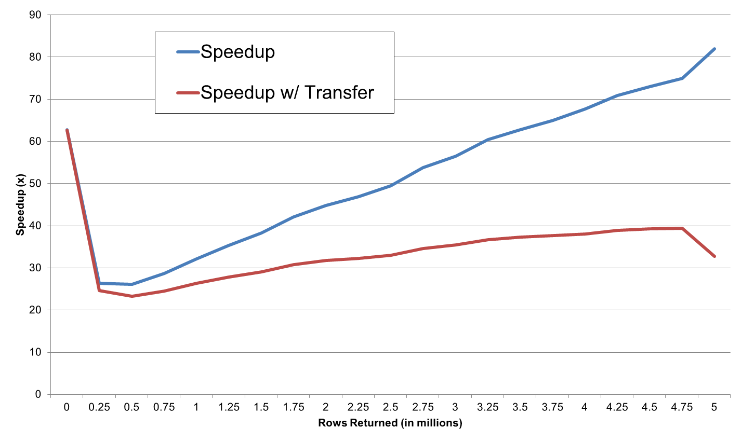
Rows Returned vs. Speedup

