Slide 1

MIS 376 KNOWLEDGE MAPPING AND DATA VISULATION TERM PROJECT
Development of E-commerce during pandemic

Slide 2

WHAT IS E-COMMERCE?
Electronic commerce, or e-commerce for short , is the concept of electronic commerce that emerged with the increase in the use of the Internet after 1995.
Electronic commerce consists of three stages: advertising and market research, order and payment, and delivery
Among the factors that make e-commerce so popular are; e-commerce provides a direct relationship between the company and its target audience, provides the information they want to marketers, is fast and low-cost, and all these are done electronically

Slide 3

E-Commerce in TURKEY
E-commerce contributes to the growth of especially retail, technology and tourism sectors in Turkey
Mobile internet and mobile applications play a leading role in the development of e-commerce.
The biggest share in the Turkish e-commerce market belongs to the top 10 shopping sites. The traffic, repetition rate and basket performance of these large e-commerce sites are increasing every year compared to small e-commerce sites.

Slide 4
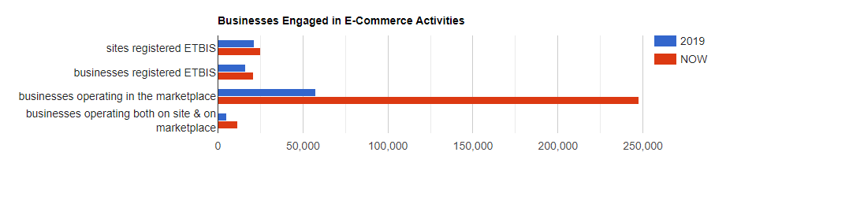
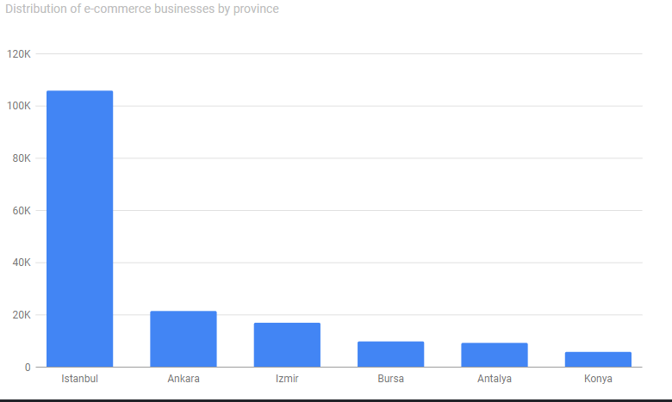

Slide 5
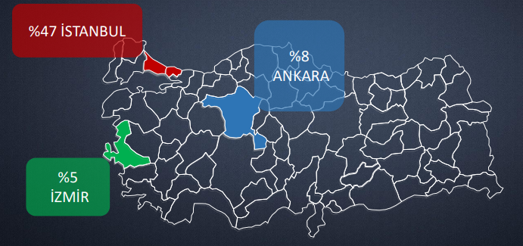

Slide 6
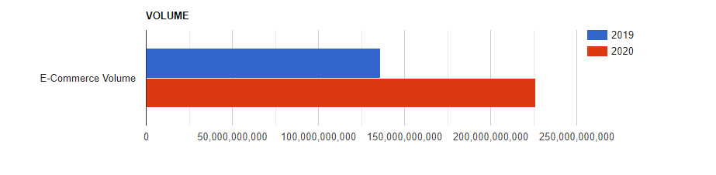
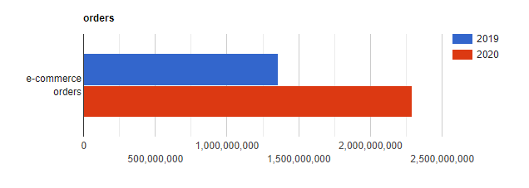

Slide 7
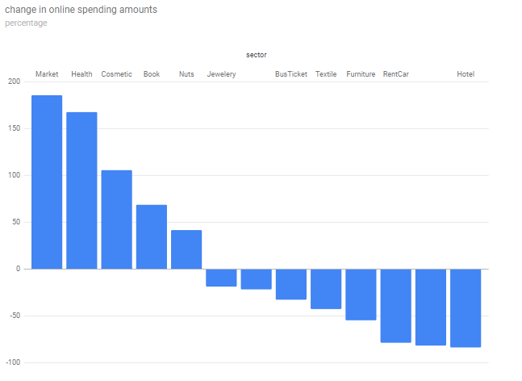

Slide 8
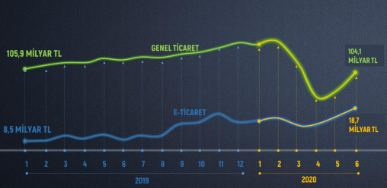

Slide 9

THANK’S FOR LISTENING

