Slide 1
RFID Enabled Remote Door Lock System
TANUMON ROY
B.Tech (3/4) – B
174259
Submitted to:
Prof. K. Ravi Kishore

Slide 2
Components of Project
RC522 RFID (Sensor)
ESP8266 (WiFi Module)
AWS IoT Core (Cloud Platform)
Amazon SNS (Notification Service)
Blynk App (Application Layer)

Slide 3
RFID
RFID is an acronym for “radio-frequency identification” and refers to a technology whereby digital data encoded in RFID tags or smart labels (defined below) are captured by a reader via radio waves.
RFID tag consists of an integrated circuit and an antenna. The tag is also composed of a protective material that holds the pieces together and shields them from various environmental conditions.

Slide 4
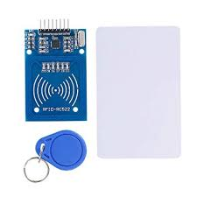
RFID Sensor and Tags

Slide 5
ESP8266 - Introduction
It is a WiFi Module produced by manufacturer Espressif Systems in Shanghai, China.
It is a self contained SOC with integrated TCP/IP protocol stack
It can give any microcontroller access to the WiFi network

Slide 6
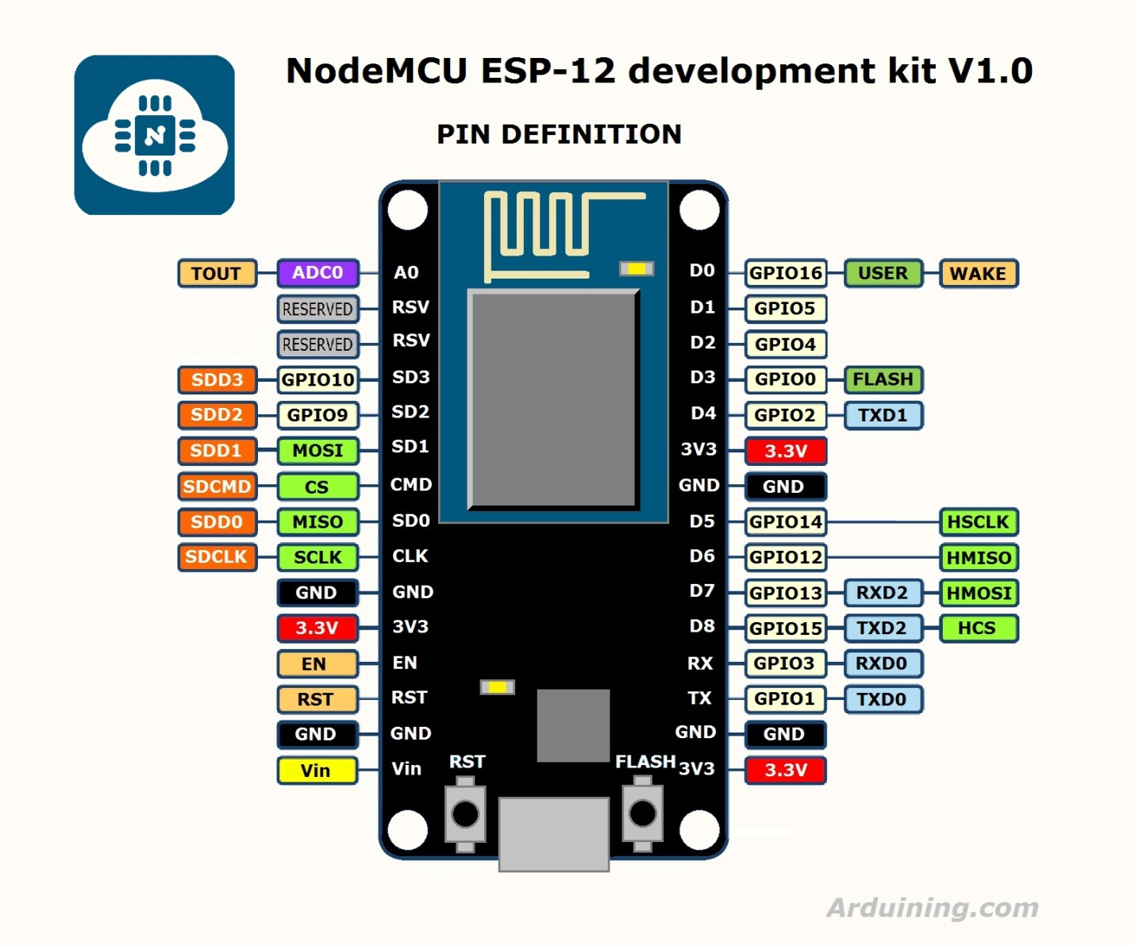
ESP8266 - Pin Diagram

Slide 7
AWS IoT Core
AWS IoT Core is a managed cloud service that lets connected devices easily and securely interact with cloud applications and other devices.
AWS IoT Core can support billions of devices and trillions of messages, and can process and route those messages to AWS endpoints and to other devices reliably and securely.
With AWS IoT Core, applications can keep track of and communicate with all other related devices, all the time, even when they aren’t connected.

Slide 8
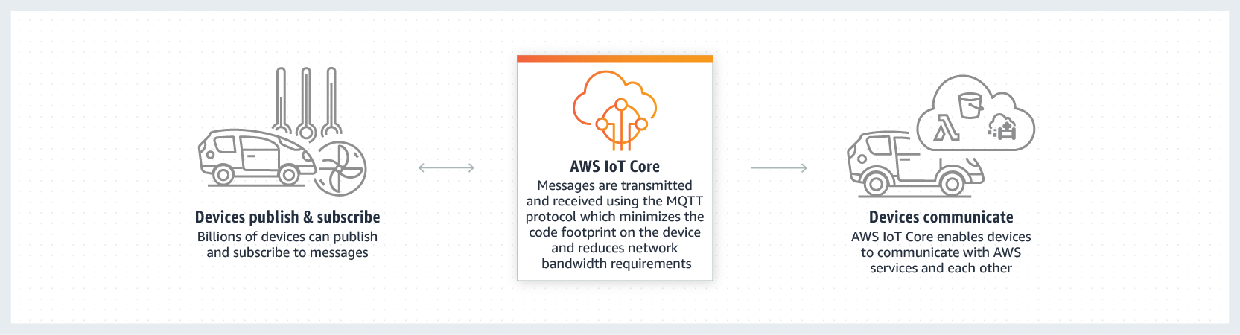
AWS IoT Core

Slide 9
Amazon SNS
Amazon Simple Notification Service (SNS) is a highly available, durable, secure, fully managed pub/sub messaging service that enables you to decouple microservices, distributed systems, and serverless applications. Amazon SNS provides topics for high-throughput, push-based, many-to-many messaging.

Slide 10
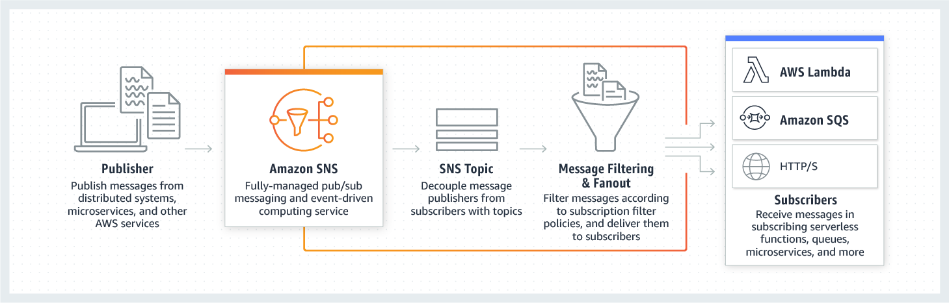
Amazon SNS

Slide 11
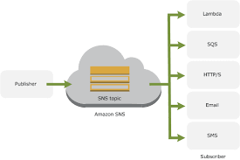
Amazon SNS

Slide 12
Blynk App
Blynk is a Platform with IOS and Android apps to control Arduino, Raspberry Pi, ESP8266 and the likes over the Internet. It’s a digital dashboard where you can build a graphic interface for your project by simply dragging and dropping widgets.

Slide 13
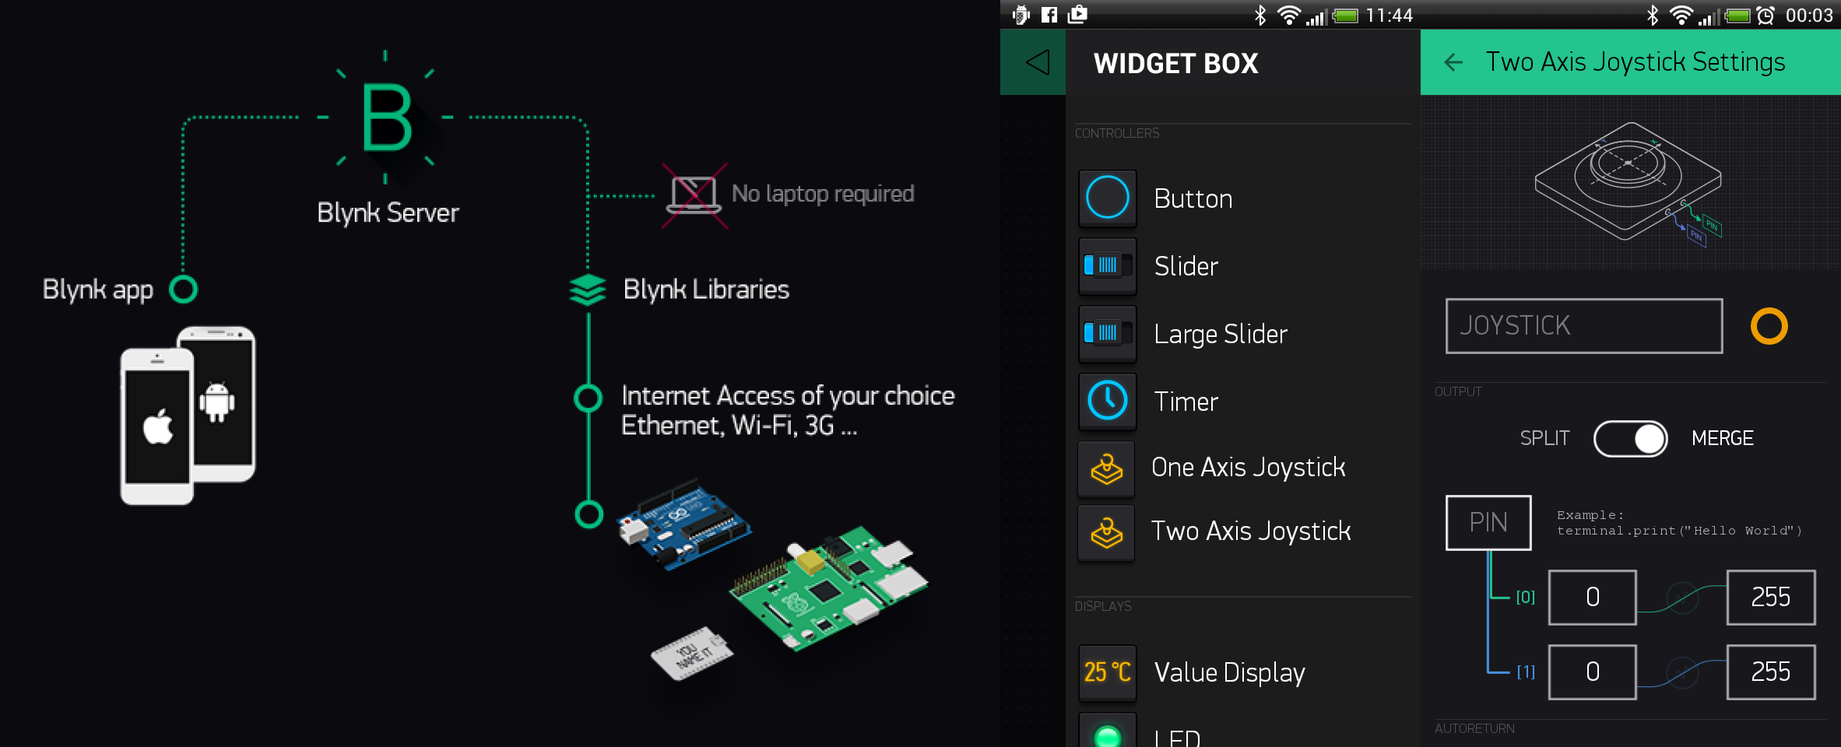
Blynk App

Slide 14
Design Flow
SENSOR
RFID Sensor
Used to read UID of RFID tags
WiFi MODULE
ESP8266 WiFi Module
Controls different I/O aspects of the system
CLOUD PLATFORM
AWS IoT Core
Stores the data(RFID Tag UID) published to it and acts on it
Sending UID of RFID Tags to Cloud Platform
Receiving user input and opening the door

Slide 15
Design Flow
NOTIFICATION
Amazon SNS
Notifies the user through email when anyone comes to the door and shows their RFID tag
EXECUTION
Blynk App
Controls the opening and closing of door remotely by the user

Slide 16
Applications
This system can be used as a part of Home Automation as well as Security.
On the application level, the user gets an email notification whenever someone comes in front of the door with their RFID tag. The email contains the details like the tag UID and the tag-holder.
The user then just have to open Blynk App in his/her smartphone and decide whether to open or close the door.
This activity can be executed remotely from anywhere around the globe.

Slide 17
THANK YOU

