Slide 1

Air Vista Database
Holistic Aviation Data Manager
Submitted To:
Ms. Amninder Kaur
Project By:
Bakshish Kaur (Roll No. RD2533A05)

Slide 2





Problem and Solution
The Challenge
The AirVista Solution
Aviation data is inherently complex, fragmented, and voluminous. Managing airports, airlines, fleets, and passenger manifests separately leads to:
A centralized Relational Database Management System designed to streamline aviation operations.
Centralized: Unified schema for all entities.
Inconsistent data across departments.
Automated: Triggers for real-time validation.
Delays in status updates.
Secure: Robust integrity constraints.
Difficulty in generating holistic reports.

Slide 3
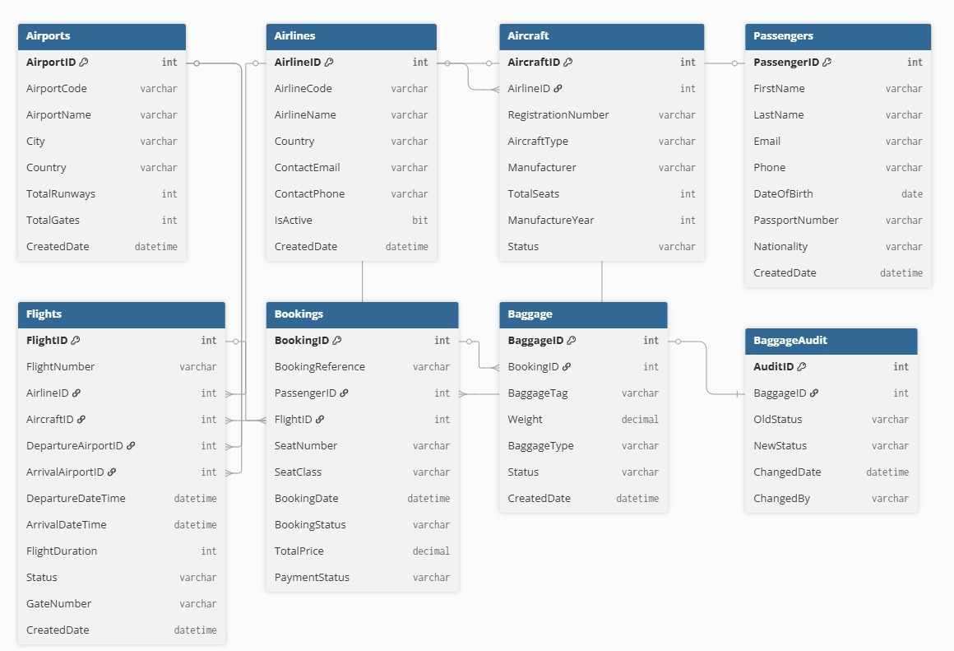
Relationships among Tables (Schema)

Slide 4
Table: Airports
The foundation of the network, defining physical locations.
Column Name | Data Type | Constraints / Description
PK AirportID | INT | Identity(1,1), Primary Key
AirportCode | VARCHAR(10) | Unique, Not Null (e.g., 'JFK')
AirportName | VARCHAR(100) | Not Null
City | VARCHAR(50) | Not Null
Country | VARCHAR(50) | Not Null
TotalRunways | INT | Default 0
TotalGates | INT | Default 0
CreatedDate | DATETIME | Default GetDate()

Slide 5

Table: Airlines
Stores operator information and contact details.
Column Name | Data Type | Constraints / Description
PK AirlineID | INT | Identity(1,1), Primary Key
AirlineCode | VARCHAR(10) | Unique, Not Null (e.g., 'BA')
AirlineName | VARCHAR(100) | Not Null
Country | VARCHAR(50) | HQ Country
ContactEmail | VARCHAR(100) | Corporate Contact
ContactPhone | VARCHAR(20) | Support Number
IsActive | BIT | Default 1 (True)
CreatedDate | DATETIME | Default GetDate()

Slide 6

Table: Aircraft
Physical assets linked to specific Airlines.
Column Name | Data Type | Constraints / Description
PK AircraftID | INT | Identity(1,1)
FK AirlineID | INT | Refs Airlines(AirlineID)
RegistrationNumber | VARCHAR(20) | Unique, Not Null
AircraftType | VARCHAR(50) | e.g., 'Boeing 787'
Manufacturer | VARCHAR(50) | e.g., 'Boeing'
TotalSeats | INT | Capacity limit
Status | VARCHAR(20) | Check('Active', 'Maintenance', 'Grounded')

Slide 7

Table: Passengers
Personal Identification Information (PII) for customers.
Column Name | Data Type | Constraints / Description
PK PassengerID | INT | Identity(1,1)
FirstName | VARCHAR(50) | Not Null
LastName | VARCHAR(50) | Not Null
Email | VARCHAR(100) | Indexed for search
Phone | VARCHAR(20) | Contact Info
DateOfBirth | DATE | Age verification
PassportNumber | VARCHAR(20) | Unique Constraint
Nationality | VARCHAR(50) | -

Slide 8

Table: Flights
The central operational table connecting Aircraft, Airlines, and Airports.
Column Name | Data Type | Constraints / Description
PK FlightID | INT | Identity(1,1)
FlightNumber | VARCHAR(20) | Indexed
FK AirlineID | INT | Refs Airlines
FK AircraftID | INT | Refs Aircraft
FK DepartureAirportID | INT | Refs Airports
FK ArrivalAirportID | INT | Refs Airports
Status | VARCHAR(20) | 'Scheduled', 'Departed', etc.

Slide 9

Table: Flights (Timing Columns)
Continuation of the Flights table schema focusing on timing.
Column Name | Data Type | Constraints / Description
DepartureDateTime | DATETIME | Not Null, Indexed
ArrivalDateTime | DATETIME | Not Null
FlightDuration | INT | Minutes (Calculated via Trigger)
GateNumber | VARCHAR(10) | Boarding Gate
CreatedDate | DATETIME | Default GetDate()

Slide 10

Table: Bookings
Links Passengers to Flights. Represents revenue generation.
Column Name | Data Type | Constraints / Description
PK BookingID | INT | Identity(1,1)
BookingReference | VARCHAR(20) | Unique PNR
FK PassengerID | INT | Refs Passengers
FK FlightID | INT | Refs Flights
SeatClass | VARCHAR(20) | 'Economy', 'Business', 'First'
TotalPrice | DECIMAL(10,2) | Cost of ticket
BookingStatus | VARCHAR(20) | 'Confirmed', 'Cancelled'

Slide 11

Table: Baggage & BaggageAudit
Baggage Table
BaggageAudit Table
PK BaggageID
FK BookingID
BaggageTag (Unique)
Weight (Decimal)
BaggageType (Checked/Carry)
Status (Loaded/Lost/etc.)
Tracks status changes.
PK AuditID
BaggageID
OldStatus
NewStatus
ChangedDate
ChangedBy

Slide 12

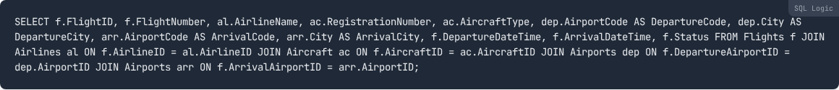
View: vw_FlightSchedule
Purpose: Consolidates flight data for display boards.

Slide 13

View: vw_BookingDetails
Purpose: Comprehensive manifest for ground staff including passenger PII.
Usage: Check-in counters use this to verify identity and seat assignment.

Slide 14

View: vw_RevenueByAirline
Purpose: Financial aggregation for management dashboards.

Slide 15



Procedures: Transactional
sp_BookFlight
sp_UpdateFlightStatus
Inputs: PassengerID, FlightID, Seat, Class, Price
Inputs: FlightID, NewStatus
Logic: Generates a unique BookingReference (BK + Date + Random) and inserts a new record with status 'Confirmed' and Payment 'Pending'.
Logic: Updates the status column after validating the input against allowed values.
Output: Returns the generated BookingReference.

Slide 16




Procedures: Analytical
sp_GetFlightStatus
sp_GenerateRevenueReport
Inputs: FlightNumber, Date
Inputs: StartDate, EndDate
Complexity: High. It joins Flight, Airline, and Aircraft tables. Crucially, it calculates AvailableSeats dynamically:
Logic: Filters flights by date range. Pivots revenue data to show breakdown by Seat Class (Economy, Business, First) per airline.

Slide 17



User Defined Functions
fn_CalculateOccupancyRate
fn_GetPassengerBookingCount
Type: Scalar Function (Returns Decimal)
Type: Scalar Function (Returns Int)
Input: FlightID
Input: PassengerID
Logic:
Logic:
Used in reports to highlight under-performing flights.
Used to determine frequent flyer status.

Slide 18

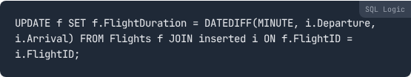
Triggers: Automation
trg_UpdateFlightDuration (AFTER INSERT, UPDATE)
Automatically maintains data consistency for flight times.
Scenario: If a flight is delayed and the ArrivalDateTime changes, this trigger automatically recalculates the duration column, ensuring reports are never stale.

Slide 19

Triggers: Data Integrity
trg_PreventOverbooking (INSTEAD OF INSERT)
Acts as a gatekeeper for the Bookings table.
Mechanism: This is an INSTEAD OF trigger. It intercepts the INSERT command, checks the capacity of the specific aircraft assigned to the flight, and only proceeds if seats are available.

Slide 20

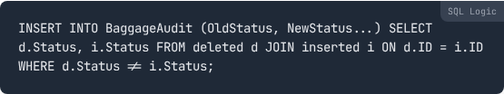
Triggers: Auditing
trg_LogBaggageStatusChange (AFTER UPDATE)
Maintains a historical paper trail for baggage handling.
Target: Baggage Table
Logic: Compares Deleted.Status (Old) vs Inserted.Status (New).
Action: If distinct, inserts a record into BaggageAudit.

Slide 21



Database Cursors
Used for row-by-row operations where set-based logic is insufficient.
cursor_PendingPayments
Context: Batch processing job.
Operation: Selects all Bookings with PaymentStatus = 'Pending' for a specific flight. Iterates through them one by one to simulate verification and updates them to 'Completed'.
cursor_ActiveFlights
Context: Display System.
Operation: Iterates through flights marked as 'Scheduled' to print details to the console/log. Useful for generating linear feed data.

Slide 22

Performance Indexes
Five Non-Clustered Indexes created to optimize specific query patterns.
Index Name | Target Column | Optimization Goal
IX_Flights_DepartureDateTime | Flights(DepartureDateTime) | Speeds up "Upcoming Flights" and schedule range queries.
IX_Flights_FlightNumber | Flights(FlightNumber) | Optimizes search by Flight Code (e.g., 'AI101').
IX_Bookings_PassengerID | Bookings(PassengerID) | Fast retrieval of "My Bookings" for a passenger.
IX_Bookings_FlightID | Bookings(FlightID) | Essential for calculating occupancy/seat counts quickly.
IX_Passengers_Email | Passengers(Email) | Accelerates login and user lookup by email address.

Slide 23
Thankyou!
The Air Vista database successfully implements a normalized schema, enforced integrity via triggers, robust reporting via views/procedures, and optimized performance using strategic indexing.

