Slide 1

SKILL 2026 · Studierendenkonferenz Informatik · INFORMATIK 2026, Dresden
Is Grokking a Loss of Normal Hyperbolicity of the Interpolation Manifold?
Suvinava Basak
Technische Universität Braunschweig, Data Science
Accepted paper · GI-Edition Lecture Notes in Informatics (LNI)
Notes:
Good morning, everyone. My name is Suvinava Basak. I am a master's student in Data Science at TU Braunschweig.
The paper I am presenting asks one question. When a network groks — when it suddenly generalizes, long after it has already memorized its training set — is that sudden jump a bifurcation? More precisely: is it a loss of normal hyperbolicity of the interpolation manifold? Let me give you the answer right away, so you know where we are going. In our experiment: no. The result is negative, and that negative result is the contribution. In the next twenty minutes I want to show you the question, the instrument we built to answer it, and what the instrument actually shows.

Slide 2
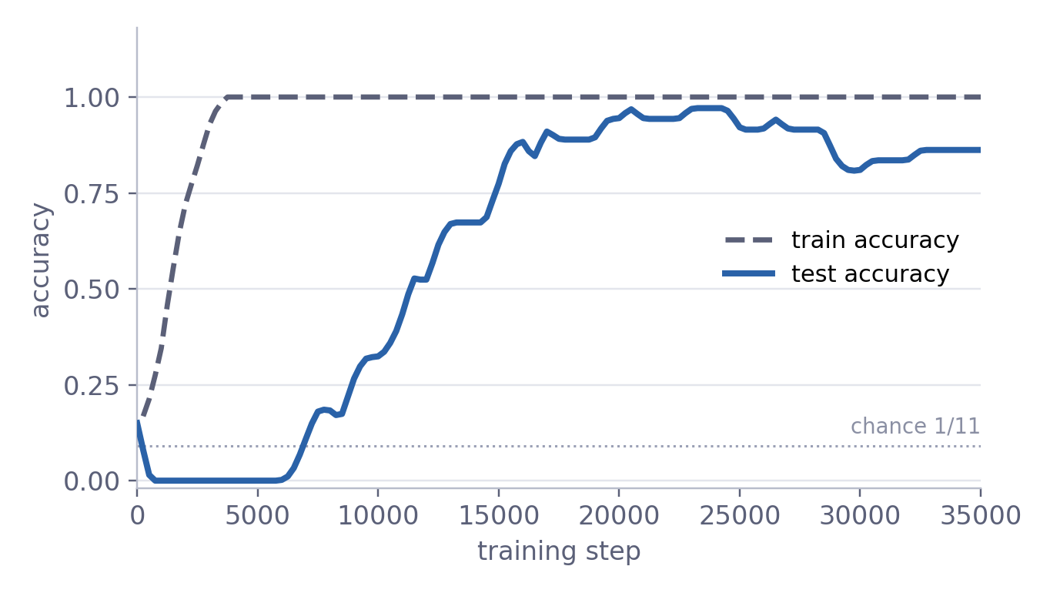
What is grokking? An example from our run
Overview
1 Memorization
2 Plateau
3 Transition
Grokking
A network first fits its training set perfectly while test accuracy stays at or below chance — and generalizes only much later [Power et al. 2022].
Click a phase to step through it.
Two-layer ReLU network learning (a + b) mod 11 from 70 % of all pairs; setup details later. Curves traced from Fig. 1 of the paper (seed 0).
Notes:
First, the phenomenon itself.
Grokking was described by Power and co-authors in 2022. A network reaches perfect training accuracy while its test accuracy stays at or below chance — and then, much later in training, with nothing else changing, it generalizes.
What you see here is exactly that, from the run in our paper. A small two-layer ReLU network learns addition modulo eleven from seventy percent of all pairs. The dashed line is training accuracy, the blue line is test accuracy, and the dotted line is the chance level, one in eleven.
Let me show you this running, rather than as a finished picture.
Watch the dashed line first. Training accuracy shoots up and reaches one within about three thousand steps. At that moment the network has fit every training pair it has ever seen. If you were only monitoring the training loss, you would think you were finished.
Now watch the blue line. It does not follow. It drops to zero and stays at zero, below chance, for thousands of steps.
And here, with no change in the training signal at all, test accuracy starts to climb, and it keeps climbing to about ninety-five percent. That delay is grokking. The training loss is silent through the whole thing. So if we want to understand what changes at that moment, we have to look somewhere other than the loss — we have to look at the geometry of the parameter space.

Slide 3
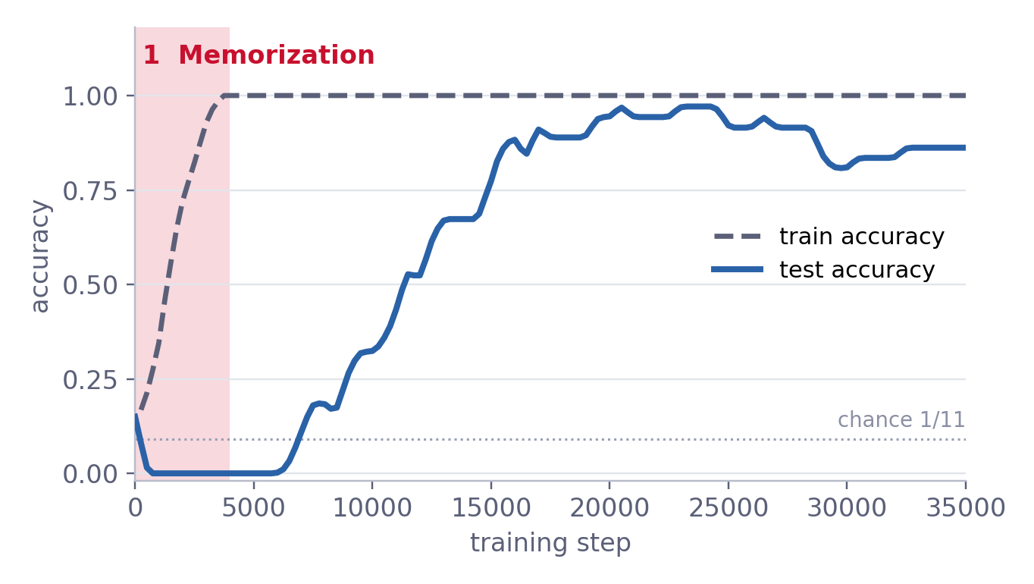
What is grokking? An example from our run
Overview
1 Memorization
2 Plateau
3 Transition
1 Memorization
Training accuracy climbs from chance to 1.0 within about 4,000 steps: the network fits every training pair.
Test accuracy falls to 0.0 — it is learning the training set, not the rule.
Two-layer ReLU network learning (a + b) mod 11 from 70 % of all pairs; setup details later. Curves traced from Fig. 1 of the paper (seed 0).
Notes:
Let me name the three phases, because I will refer to them for the rest of the talk.
Phase one, memorization. Training accuracy climbs from chance to one very fast. The network interpolates the training data. Test accuracy falls to zero: nothing it has learned transfers to unseen pairs.

Slide 4
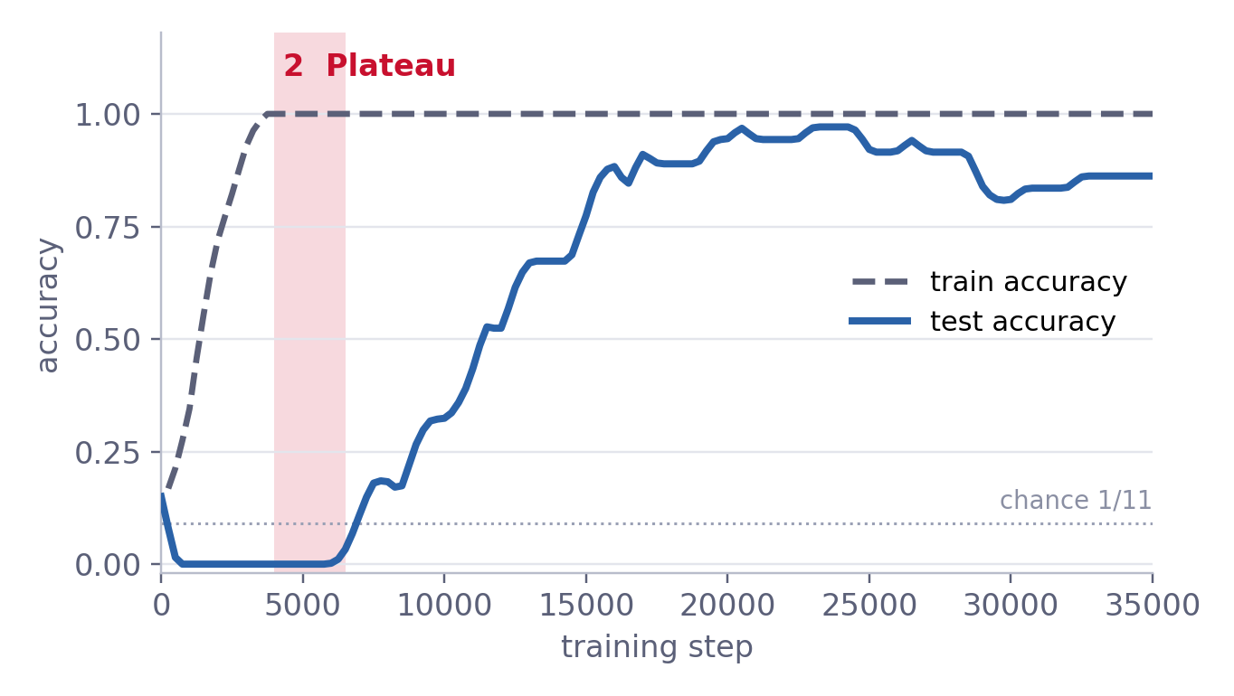
What is grokking? An example from our run
Overview
1 Memorization
2 Plateau
3 Transition
2 Plateau
Training accuracy 1.0, test accuracy 0.0 — below the 1/11 ≈ 0.09 chance level.
The memorizing solution actively mispredicts unseen pairs. In the accuracy curves, nothing seems to happen for a while (≈ steps 4,000–6,000).
Two-layer ReLU network learning (a + b) mod 11 from 70 % of all pairs; setup details later. Curves traced from Fig. 1 of the paper (seed 0).
Notes:
Phase two, the plateau. Training accuracy is one, test accuracy is zero.
I want to emphasise: zero, not chance. The memorizing solution actively mispredicts unseen pairs — it is worse than guessing. And in the accuracy curves, for a few thousand steps, nothing appears to happen at all.

Slide 5
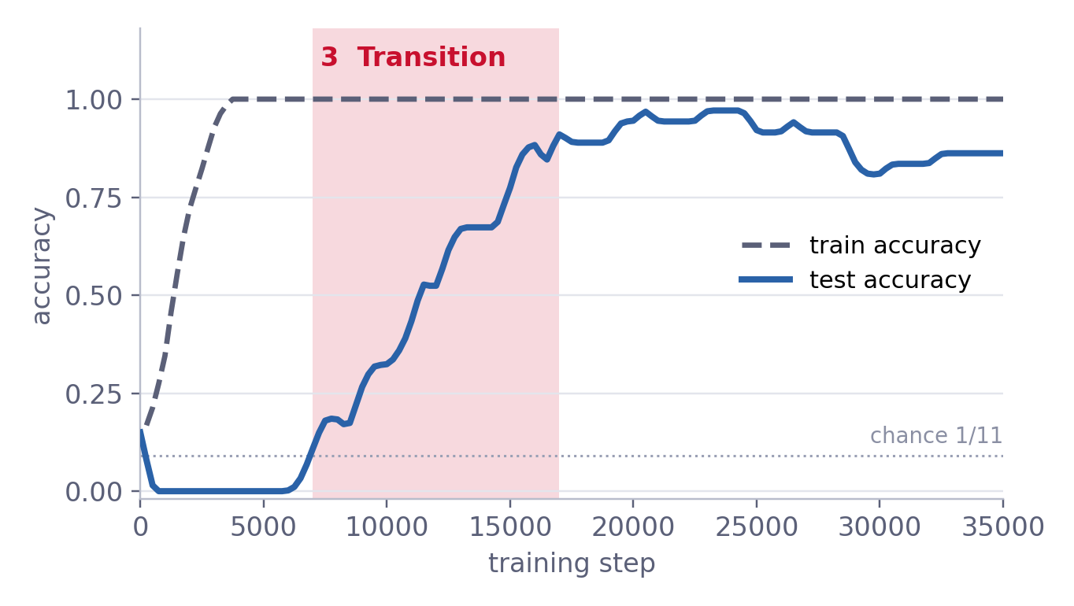
What is grokking? An example from our run
Overview
1 Memorization
2 Plateau
3 Transition
3 Transition
Test accuracy rises over roughly steps 7,000–17,000 to ≈ 0.95, then settles near 0.86 — with training accuracy unchanged.
This talk: what happens geometrically in this window?
Two-layer ReLU network learning (a + b) mod 11 from 70 % of all pairs; setup details later. Curves traced from Fig. 1 of the paper (seed 0).
Notes:
Phase three, the transition. Test accuracy starts to climb up. So the question for this talk is: what happens geometrically in the parameter space during this window?

Slide 6
Current account: interpolation first, then slow norm drift
dθ/dt = − ∇L(θ) − λθ
Muşat 2025
Norm minimization on the zero-loss manifold, in the limit of infinitesimal learning rate and weight decay.
Fast: −∇L pulls the parameters onto the zero-loss (interpolation) manifold.
Slow: −λθ (small weight decay) drifts along that manifold toward lower norm.
Boursier, Pesme & Dragomir 2025
Same endpoint via a Riemannian norm flow on the manifold of interpolating solutions.
Lyu et al. 2024
Homogeneous nets, large init, small weight decay: provable sharp transition from a kernel predictor to a min-norm / max-margin KKT point.
Gradient-flow limit with decoupled weight decay λ.
Notes:
There is a productive recent answer to that, and it is the starting point of our paper.
The idea is to treat the long phase after memorization as constrained optimization. Once the network interpolates, gradient descent with a small weight decay effectively minimizes the parameter norm, subject to staying on the zero-loss manifold.
You can see it in the equation. The dynamics have two terms. Minus the gradient of the loss is the fast term: it pulls the parameters onto the set of interpolating solutions. Minus lambda theta — the weight decay — is the slow term: it drifts the parameters along that set, toward lower norm.
Three papers give us this picture. Muşat, last year, derives the norm minimization on the zero-loss manifold, in the limit of infinitesimal learning rate and weight decay. Boursier, Pesme and Dragomir reach the same endpoint through a Riemannian norm flow on the manifold of interpolating solutions. And Lyu and co-authors prove, for homogeneous networks with large initialization and small weight decay, a sharp transition from a kernel predictor to a minimum-norm, maximum-margin solution.
They differ in the details, but they share one structure: something fast onto a set, something slow along it.

Slide 7
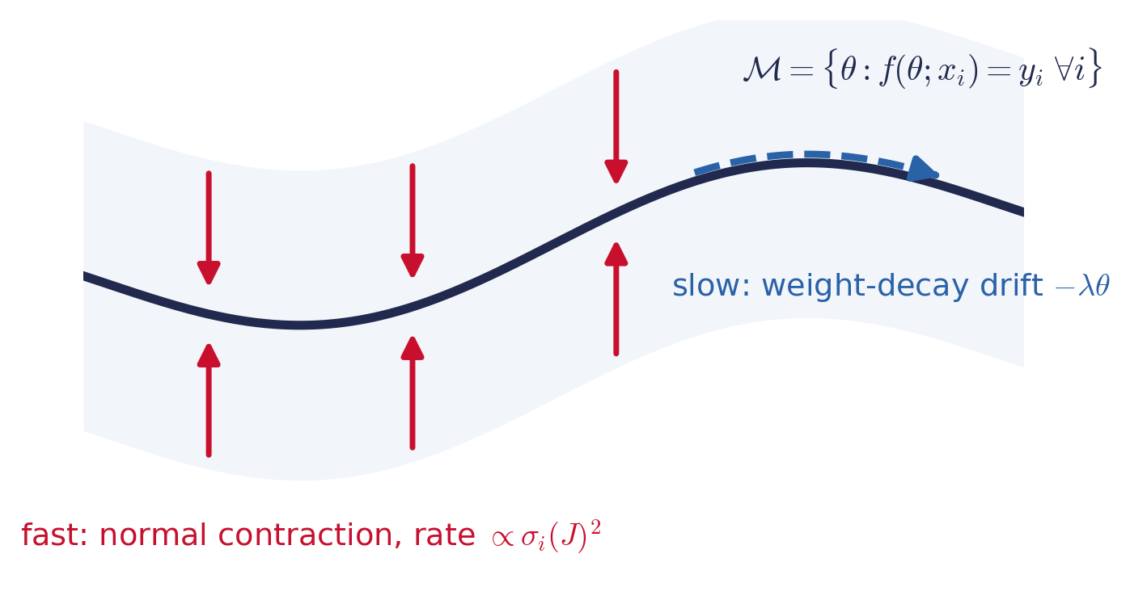
Seen as dynamics: a fast–slow system with a slow manifold
The interpolation manifold ℳ plays the role of a slow manifold.
Normal hyperbolicity: normal contraction rates stay bounded away from 0 along the slow drift.
Fenichel theory [Fenichel 1979; Kuehn 2015]: then the slow manifold persists and the reduced flow is well defined.
Gap: the grokking accounts share this structure but do not invoke this mathematics — nor ask what happens when normal hyperbolicity is lost.
Schematic, not data.
Notes:
And that structure has a name in dynamical systems. It is a singularly perturbed system — a fast–slow system. The interpolation manifold plays the role of the slow manifold.
The picture is this. The red arrows are the fast direction: the flow contracts onto the manifold, and I will show you in a moment that the rate of that contraction is set by the singular values of a certain Jacobian.
The blue arrow is the slow direction: the weight-decay drift along the manifold.
For this decomposition to be valid, you need one condition: normal hyperbolicity. That means the normal contraction rates stay bounded away from zero along the drift. If that holds, Fenichel's theory guarantees that the slow manifold persists under perturbation and that the reduced flow — the norm flow of those three papers — is well defined.
Here is the gap we noticed. All of these accounts have exactly this structure, but none of them invokes this mathematics. And in particular, none of them asks what happens if normal hyperbolicity is lost. Because in fast–slow systems, that is precisely when you get sudden jumps.

Slide 8
Research question
Is the sharp generalization transition in grokking a loss of normal hyperbolicity of the interpolation manifold — or does the manifold stay uniformly attracting while generalization happens by smooth drift?
What we set out to do
1
Formalize
2
Measure
3
Test
Cast post-memorization training as a fast–slow system with the interpolation manifold as slow manifold, and state two competing hypotheses.
Derive one scalar, optimizer-agnostic diagnostic that would detect a loss of normal hyperbolicity.
Track it through a real grokking run against test accuracy — across 5 seeds and the low end of the spectrum.
Notes:
So this is our question.
Is the sharp generalization transition in grokking a loss of normal hyperbolicity of the interpolation manifold? Or does the manifold stay uniformly attracting, while generalization happens by smooth drift?
To answer it, we had three things to do.
First, formalize: state the post-memorization phase as a fast–slow system, and turn the question into two competing hypotheses.
Second, measure: derive one scalar quantity that would detect a loss of normal hyperbolicity — and, importantly, one that does not depend on which optimizer we use.
Third, test: track that quantity through a real grokking run, read it against test accuracy, and check it across seeds and across several directions, not just one.

Slide 9
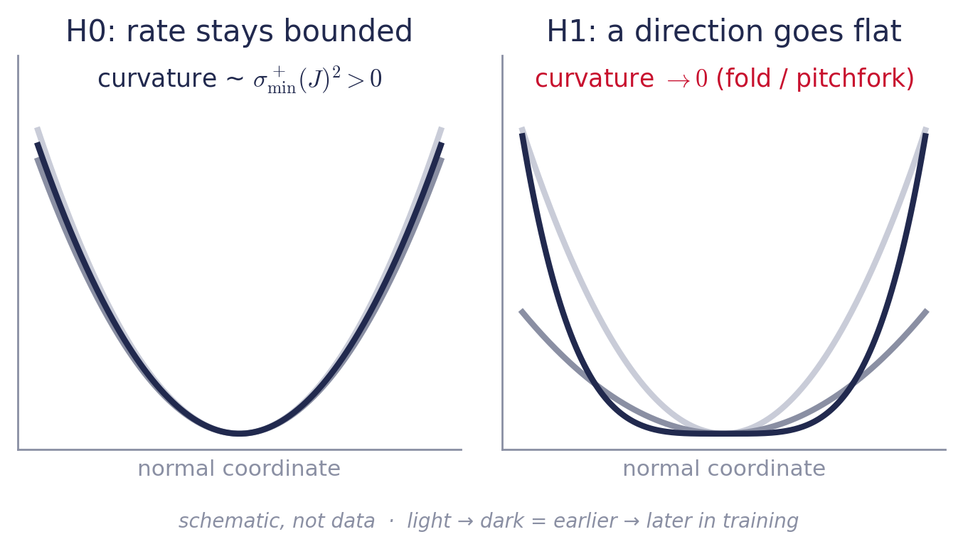
Two hypotheses for the sharp transition
H1 — bifurcation
A normal restoring direction softens toward 0; the timescale separation breaks and the trajectory jumps (fold / pitchfork). Modular addition's symmetry makes a pitchfork a natural candidate.
Prediction: σ⁺_{min}(J) dips toward 0 at the transition
H0 — smooth contraction
The manifold stays uniformly normally hyperbolic; the transition is a feature of the slow drift through a region where test behaviour changes quickly.
Prediction: σ⁺_{min}(J) stays bounded away from 0
Notes:
Here are the two hypotheses.
H1 is the bifurcation picture. At the transition, one normal restoring direction softens toward zero. The separation between the fast and the slow timescale breaks down, and the trajectory jumps — a fold, or a pitchfork. And a pitchfork is a natural guess here, because modular addition has a symmetry group, and symmetry breaking is what pitchforks do. If H1 were true, it would connect the dynamical picture to the mechanistic-interpretability picture of grokking rather nicely.
H0 is the smooth-contraction picture. The manifold stays uniformly normally hyperbolic. Nothing degenerates. The transition looks sharp simply because the slow drift passes through a region where the test behaviour changes quickly. This is the picture implied by the three papers on the previous slide.
The sketches on the right are schematic — they are not data. They show the curvature in a normal direction. On the left, under H0, the well stays steep throughout training. On the right, under H1, it flattens out.
And that gives us two different predictions for one measurable number, which is the next slide.

Slide 10
The diagnostic: a single scalar along the trajectory
Squared loss L(θ) = (1/n) Σᵢ ‖f(θ; xᵢ) − yᵢ‖²
Residuals r(θ) = (f(θ; xᵢ) − yᵢ)ᵢ ∈ ℝ^{nc}
Residual Jacobian J(θ) = ∂r/∂θ ∈ ℝ^{nc×D}, Gauss–Newton G = J⊤J
On ℳ: row(J) = normal space, ker J = tangent space
slowest normal restoring rate
κ(θ) = σ⁺_{min}(J(θ))²
σ⁺_{min}(J) = smallest nonzero singular value of J. With nc < D, J generically has full row rank, so all nc singular values are positive.
Why squared loss? It makes the interpolation manifold an exact object with a well-defined tangent and normal structure.
Notes:
We train with the squared loss, and that is a deliberate choice. With the squared loss, the interpolation manifold is an exact object: it is the set of parameters where every residual is exactly zero. So it has a well-defined tangent space and a well-defined normal space, which is what the whole argument needs.
Collect the residuals into one vector r, and take its Jacobian with respect to the parameters — that is J. The Gauss–Newton matrix is J transpose J.
Now, at a point on the manifold there is a clean geometric split. The row space of J is the normal space: these are the directions in which the residuals, and therefore the loss, change to first order. The kernel of J is the tangent space: the directions along which the model stays interpolating.
The nonzero eigenvalues of the Gauss–Newton matrix are the squared singular values of J. So the slowest normal restoring rate — the weakest direction, the one that would go flat first — is the square of the smallest nonzero singular value of J. That is our diagnostic.
One technical remark: our network is over-parameterized, with more parameters than residuals, so J generically has full row rank, and all of its singular values are positive. There is nothing degenerate to begin with.

Slide 11
Why σ⁺_{min}(J) measures normal contraction
1 At an interpolating point
2 Linearized fast flow
3 Normal hyperbolicity
r(θ★) = 0 ⇒
∇²L = (2/n)(J⊤J + Σₖ rₖ∇²rₖ)
= (2/n) J⊤J
dδθ/dt ≈ −(2/n) J⊤J δθ
Tangential parts (ker J) are not restored; normal parts contract at rates (2/n) σᵢ(J)²
⇔ the slowest rate stays bounded away from 0 along the drift.
Loss of normal hyperbolicity ⇔ σ⁺_{min}(J) → 0
Read σ⁺_{min}(J(θ(t))) against test accuracy: dip toward 0 → H1 bounded away from 0 → H0
Depends only on the model and data at θ → well defined under any optimizer, not only gradient flow.
Notes:
Let me justify that in three steps, because it is the core of the paper.
Step one. Take a point where the residuals are exactly zero. The Hessian of the squared loss has two terms: the Gauss–Newton term, and a second term that is a sum of residuals times second derivatives. At an interpolating point the residuals vanish, so the second term vanishes with them. The Hessian there is exactly two over n times J transpose J.
Step two. Linearize the fast flow around that point. A perturbation splits into a tangential part and a normal part. The tangential part lies in the kernel of J, so it is not restored at all — those are the slow directions, the ones the weight decay moves along. The normal part contracts, and it contracts at rates given by the squared singular values of J.
Step three. Normal hyperbolicity is exactly the statement that the slowest of these rates stays bounded away from zero along the drift.
So a loss of normal hyperbolicity — the prerequisite for the fold or pitchfork in H1 — is exactly the smallest nonzero singular value going to zero. That turns the whole question into one curve. Plot that number along training, read it against test accuracy: a dip toward zero supports H1, a value bounded away from zero supports H0.
And note the last line: this quantity depends only on the model and the data at the current parameters. It is well defined for any trajectory, whichever optimizer produced it. That matters for the next slide.

Slide 12






Experimental setup
Task
Model
Loss & init
Modular addition mod p = 11; one-hot (a, b) in, one-hot (a + b) mod p out; random 70 / 30 train/test split.
Two-layer ReLU network, width 96, no second-layer bias.
Squared loss, full batch; large init (Kaiming × 3.5) for a clear memorization plateau [Liu et al. 2023].
Optimizer
Measurement
Robustness
AdamW, lr 3 × 10⁻³, decoupled weight decay 2.0, 35,000 steps.
Snapshot θ every 500 steps; SVD of J in float32 in a separate pass.
5 initialization seeds; the 6 smallest singular values tracked.
Notes:
The setup is deliberately small and clean.
The task is modular addition with p equal to eleven, one-hot inputs, one-hot targets, and a random seventy–thirty split. The model is the two-layer ReLU network you already saw, width ninety-six. We use the squared loss, full-batch training, and a large initialization — Kaiming times three and a half — which, following Liu, Michaud and Tegmark, gives a clear memorization plateau.
We optimize with AdamW, learning rate three times ten to the minus three, decoupled weight decay two, for thirty-five thousand steps. AdamW is a practical choice: it reached the transition within our compute budget. The fast–slow theory is stated for gradient descent, and I will come back to that in the limitations.
We snapshot the parameters every five hundred steps and compute the singular value decomposition in a separate pass, so the measurement does not slow down training. And we repeat everything over five initialization seeds, tracking the six smallest singular values, not only the smallest.

Slide 13
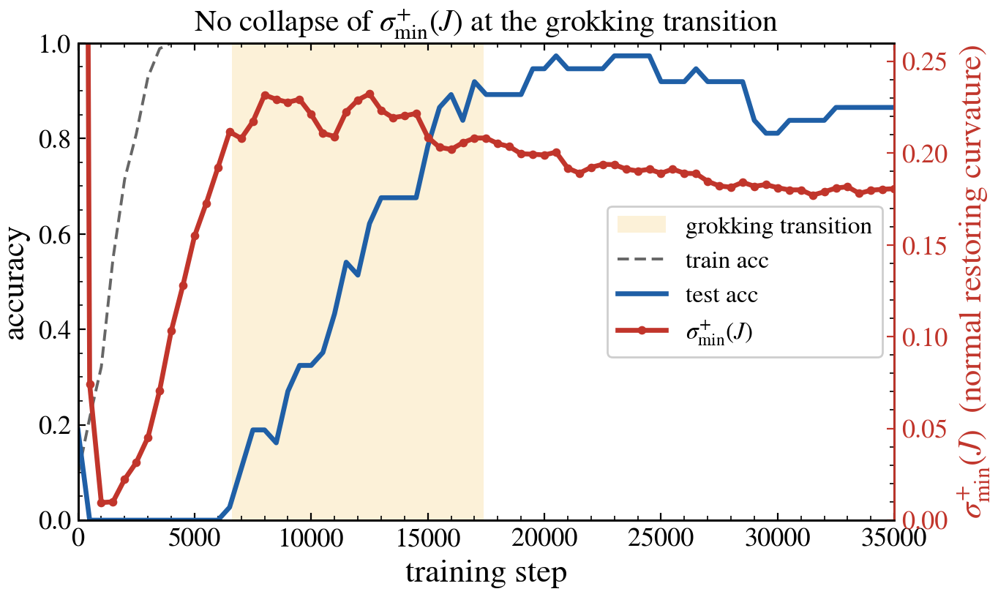
Result: σ⁺_{min}(J) does not collapse at the transition
Same run as the grokking example, now with σ⁺_{min}(J) in red.
σ⁺_{min}(J) near 0 only before memorization: global min ≈ 1 × 10⁻² at step 1,000.
During the transition it is at its largest values — the restoring rate peaks rather than collapsing.
Fig. 1 of the paper · single seed · shaded band = generalization transition
Notes:
This is the main result. It is the same run you saw at the beginning — the same blue and dashed curves — with our diagnostic added in red, on the right-hand axis. The shaded band marks the generalization transition.
If H1 were right, the red curve would dip toward zero inside that band.
It does not. It does the opposite.
The red curve is near zero in exactly one place: before memorization. Its global minimum, is at step one thousand — at that point training accuracy is still well below one and the network has not yet differentiated its outputs. There is no
manifold there yet.
Then it rises, monotonically, as the manifold forms. And across the entire transition it sits at its largest values. The normal restoring rate peaks while the model generalizes, instead of collapsing.
So the diagnostic does not behave the way H1 predicts. Whatever makes this transition sudden, it is not a normal direction going flat.

Slide 14
By phase: highest restoring rate during generalization
Transition window
min 0.202, median 0.220 — the highest of all phases.
Only near-zero regime
Pre-memorization (min 0.0096) — unrelated to grokking.
Instrument check
That reading shows the diagnostic can register a genuinely near-degenerate Jacobian when one occurs.
Notes:
There is one more thing I want you to take from this table, and it is about the instrument rather than the result. The pre-memorization reading shows that the diagnostic does go nearly to zero when the Jacobian is genuinely close to degenerate. So it is sensitive enough to see such a thing. The absence of a dip during the transition is therefore informative — it is not a blind spot of the measurement.

Slide 15
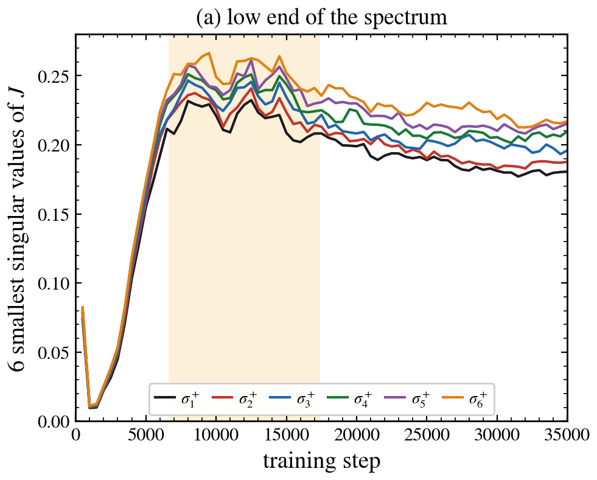
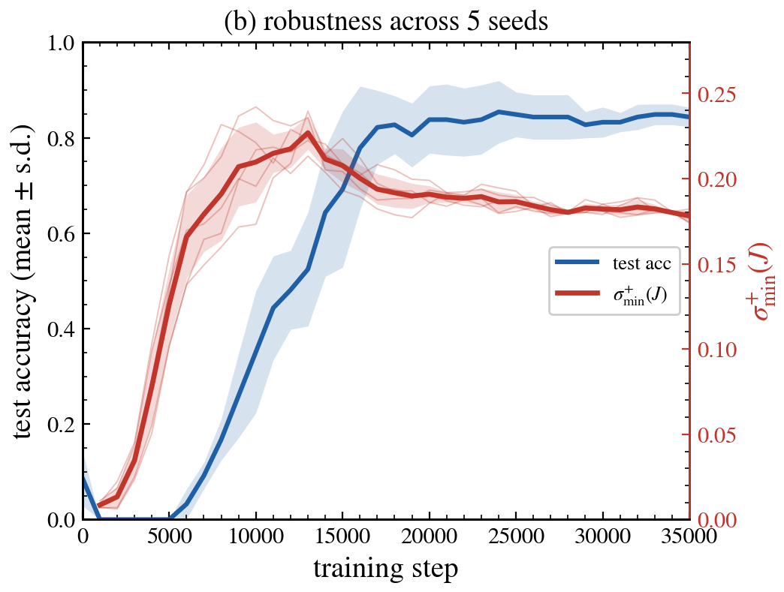
Two checks: not one singular value, not one seed
(a) Low end of the spectrum
(b) Five seeds
The six smallest singular values form a tight cluster bounded away from 0 — no low-dimensional subspace collapses.
Transitions at different steps (test acc > 0.5 between ≈ 10k and 16k), yet in every seed σ⁺_{min}(J) stays in 0.18–0.23 in its transition window.
Notes:
Two objections come up immediately, and we tried to address both.
The first objection: you are looking at one number. Maybe one direction collapses and the minimum is dominated by something else. So on the left we plot the six smallest singular values. They form a tight cluster, they move together, and all of them stay bounded away from zero across the transition. The only dip, again, is before memorization. So no low-dimensional subspace at the bottom of the spectrum collapses either.
The second objection: maybe this is one lucky seed. On the right, five seeds. The transitions happen at different steps — test accuracy first passes one half somewhere between ten thousand and sixteen thousand steps, depending on the seed. But in every single seed, during its own transition window, the diagnostic stays between zero point one eight and zero point two three. The seed-averaged curve shows no dip, and neither does any individual one.

Slide 16
Side observation: no visible ℓ₂-norm contraction (AdamW)
Interpretation
Consistent with AdamW's implicit bias being governed by an ℓ∞-type rather than ℓ₂ geometry [Xie & Li 2024; Gronich & Vardi 2026]. We treat it as a caveat about the optimizer, not a claim about the manifold.
≈ 10
parameter norm through the transition — it does not decrease, and drifts slightly upward
What we deliberately do not report
The timescale ratio σ⁺_{min}(J)² / λ. In the gradient-flow theory λ is the drift rate; AdamW's decoupled weight decay does not play that role (Adam rescales the effective step per coordinate), so the raw ratio would misstate the separation.
Notes:
One honest side observation before the limitations.
In this run, the parameter norm does not decrease through the transition. It stays around ten and even drifts slightly upward. So generalization here is not accompanied by a visible L2-norm contraction, even though the theory I quoted at the beginning is a norm-minimization theory.
We read that as a statement about the optimizer, not about the manifold: AdamW's implicit bias is known to be governed by an L-infinity-type geometry rather than an L2 one.
For the same reason, we deliberately do not report the timescale ratio — the diagnostic squared, divided by lambda. In the gradient-flow theory, lambda is the drift rate. Under AdamW it is not, because Adam rescales the effective step per coordinate. The raw ratio would simply misstate the separation of timescales, so it belongs in a gradient-flow study, not in this one.

Slide 17



What this does not establish
Optimizer
AdamW, while the fast–slow theory is stated for gradient descent / flow. The sharpest regimes (GD, large init, small weight decay) are untested.
Sharpness
The observed transition is moderately gradual rather than maximally sharp.
Global measure
A loss of normal hyperbolicity confined to a narrow, test-relevant subspace (e.g. symmetry-aligned directions) could hide from the low end of the spectrum.
Discrete trajectory
We measure snapshots of a discrete trajectory, not the gradient-flow limit in which the manifold is exactly defined.
Framing: constraining, not refuting — in this regime, grokking is not accompanied by a global collapse of the manifold's normal restoring rate.
Notes:
I want to be explicit about what we have not shown.
First, the optimizer. We used AdamW, while the theory is stated for gradient descent or gradient flow. The sharpest grokking regimes — gradient descent, large initialization, small weight decay — are untested here.
Second, sharpness. Our transition takes about ten thousand steps. It is moderately gradual, not maximally sharp.
Third, and this is the one I find most interesting: our diagnostic is still a global measure. A loss of normal hyperbolicity confined to a narrow, test-relevant subspace — for instance the symmetry-aligned directions of modular addition — could in principle happen while the low end of the spectrum stays exactly where we see it.
Fourth, we measure snapshots of a discrete trajectory, not the gradient-flow limit in which the manifold is exactly defined.
So the honest framing is the line at the bottom: this result constrains, it does not refute. In this regime, grokking is not accompanied by a global collapse of the manifold's normal restoring rate.

Slide 18
Conclusion and next steps
Next experiments
Diagnostic: σ⁺_{min}(J) turns the bifurcation question into a single measurable curve.
Finding: the manifold stays normally hyperbolic through the transition — across 5 seeds and the 6 smallest singular values.
Reading: evidence favours H0 (smooth contraction) over H1 (bifurcation) in this regime.
1
Same diagnostic under gradient descent in a sharp-transition regime.
2
Subspace-resolved curvature: project onto directions that best separate train from test, or onto symmetry-aligned subspaces.
3
If no dip appears: characterize which geometric quantity does move monotonically — under AdamW possibly an ℓ∞- or sparsity-based measure.
Notes:
To summarise.
We took a question that was phrased in geometric language — is grokking a bifurcation of the interpolation manifold? — and turned it into a single measurable curve: the smallest nonzero singular value of the residual Jacobian, which for the squared loss is the slowest normal restoring rate.
On a network that grok, the answer appears to be no. The manifold stays normally hyperbolic straight through the transition, robustly across five seeds and across the six smallest singular values. The evidence favours the smooth-contraction picture over the bifurcation picture, in this regime.
And the limitations name the next experiments.
One: the same diagnostic under gradient descent, in a sharp-transition regime.
Two: a subspace-resolved version — project the Jacobian onto the directions that best separate training from test points, or onto symmetry-aligned subspaces, and look there.
Three: if no dip ever appears, then find the geometric quantity that does move monotonically through the transition. Under AdamW, that may well be an L-infinity or a sparsity-based measure rather than the L2 norm.
What I would like you to take away is the instrument: one number, cheap to compute, optimizer-independent, that turns a qualitative dynamical-systems question into something you can plot.

Slide 19


Thank you — questions?
Suvinava Basak · Technische Universität Braunschweig
github.com/baksho/grokking-normal-hyperbolicity
suvinava.basak@tu-braunschweig.de
Notes:
Open the discussion. In slideshow mode each question below is a link to its backup slide; every backup slide has a 'back' link to this slide.

Slide 20
References
Boursier, E.; Pesme, S.; Dragomir, R.-A.: A Theoretical Framework for Grokking: Interpolation followed by Riemannian Norm Minimisation. NeurIPS 2025. arXiv:2505.20172.
Fenichel, N.: Geometric Singular Perturbation Theory for Ordinary Differential Equations. J. Differential Equations 31(1), 53–98, 1979.
Gronich, E.; Vardi, G.: The Implicit Bias of Adam and Muon on Smooth Homogeneous Neural Networks. 2026. arXiv:2602.16340.
Kuehn, C.: Multiple Time Scale Dynamics. Springer, 2015.
Liu, Z.; Michaud, E. J.; Tegmark, M.: Omnigrok: Grokking Beyond Algorithmic Data. ICLR 2023. arXiv:2210.01117.
Lyu, K. et al.: Dichotomy of Early and Late Phase Implicit Biases Can Provably Induce Grokking. ICLR 2024. arXiv:2311.18817.
Musat, T.: The Geometry of Grokking: Norm Minimization on the Zero-Loss Manifold. arXiv:2511.01938, 2025.
Power, A. et al.: Grokking: Generalization Beyond Overfitting on Small Algorithmic Datasets. MATH-AI Workshop, 2022. arXiv:2201.02177.
Soudry, D. et al.: The Implicit Bias of Gradient Descent on Separable Data. JMLR 19(70), 1–57, 2018.
Truong, K. X. et al.: The Norm-Separation Delay Law of Grokking: A First-Principles Theory of Delayed Generalization. 2026. arXiv:2603.13331.
Xie, S.; Li, Z.: Implicit Bias of AdamW: ℓ∞-Norm Constrained Optimization. ICML 2024. arXiv:2404.04454.
Notes:
Backup / reference slide — do not present. Full list in the paper.

Slide 21
Backup Slides
Backup — click a question to jump to it
Q1 Why AdamW, when the fast–slow theory is stated for gradient descent?
Q2 Grokking is usually studied with cross-entropy. Why squared loss?
Q3 Could a loss of normal hyperbolicity hide in a subspace you did not look at?
Q4 ReLU makes J piecewise constant and you sample every 500 steps. Could you miss a short dip?
Q5 The derivation assumes r = 0. Is the network actually on the manifold?
Q6 If the manifold stays normally hyperbolic, what makes the transition sharp?
Q7 Does this hold beyond a tiny setting (p = 11, two-layer MLP)?
Notes:
Open the discussion. In slideshow mode each question below is a link to its backup slide; every backup slide has a 'back' link to this slide.

Slide 22
BACKUP · Q1
← back to questions
Why AdamW, when the fast–slow theory is stated for gradient descent?
Short answer
Optimizer-agnostic: σ⁺_{min}(J) depends only on the model and data at θ, so it is well defined for any trajectory.
What does change: the interpretation of the slow drift. Under AdamW, λ is not the drift rate — which is why we do not report σ⁺_{min}(J)²/λ.
Open: the sharpest regimes (GD, large init, small weight decay) are untested — our first next experiment.
Practicality: AdamW reached the transition within our compute budget. The diagnostic itself does not depend on the optimizer.
Notes:
Backup for Q&A. Short answer first, then details only if asked to go deeper.

Slide 23
BACKUP · Q2
← back to questions
Grokking is usually studied with cross-entropy. Why squared loss?
Short answer
With squared loss, r = 0 on M, so the Hessian there is exactly the Gauss–Newton matrix — the whole derivation rests on this.
With cross-entropy on separable data the loss has no finite minimizer (shown for linear models by Soudry et al. 2018): it only approaches 0 as the logits grow, so there is no exact zero-loss set to be normally hyperbolic.
Lyu et al. 2024 obtain their grokking transition for both classification and regression, so squared loss is not an exotic setting.
Squared loss makes the interpolation manifold an exact object: M = {θ : f(θ; xᵢ) = yᵢ for all i}, with a well-defined tangent and normal structure.
Notes:
Backup for Q&A. Short answer first, then details only if asked to go deeper.

Slide 24
BACKUP · Q3
← back to questions
Could a loss of normal hyperbolicity hide in a subspace you did not look at?
Short answer
We already go beyond one number: the six smallest singular values stay clustered and bounded away from 0.
But they are still a global measure: a softening confined to a narrow, test-relevant subspace (e.g. symmetry-aligned directions of modular addition) could leave the low end of the spectrum untouched.
Needed: a subspace-resolved curvature — J projected onto the directions that most separate train from test points, or onto symmetry-aligned subspaces.
Yes, in principle. This is the main limitation we state, and the most important follow-up.
Notes:
Backup for Q&A. Short answer first, then details only if asked to go deeper.

Slide 25
BACKUP · Q4
← back to questions
ReLU makes J piecewise constant and you sample every 500 steps. Could you miss a short dip?
Short answer
J changes when activation patterns switch; in practice the σ⁺_{min}(J) trajectory is smooth at snapshot resolution.
The transition spans ≈ 7,000–17,000 steps, i.e. about 20 snapshots, and shows no downward trend at all — the values are at their maximum.
My expectation (not tested): approaching a fold, the normal rate would soften progressively rather than in one isolated step — which would be visible as a trend.
A dip shorter than the snapshot spacing could in principle fall between snapshots; denser sampling around the transition is a cheap check.
Notes:
Backup for Q&A. Short answer first, then details only if asked to go deeper.

Slide 26
BACKUP · Q5
← back to questions
The derivation assumes r = 0. Is the network actually on the manifold?
Short answer
The neglected term (2/n) Σₖ rₖ ∇²rₖ is weighted by the residuals, so it is small when the training residuals are small.
The paper does not report the residual magnitude.
This is part of the fourth limitation: a discrete trajectory, not the gradient-flow limit in which M is exactly defined.
Not exactly: with weight decay and a discrete optimizer the iterate sits near M, not on it. The identity ∇²L = (2/n)JᵀJ is exact only at r = 0.
Notes:
Backup for Q&A. Short answer first, then details only if asked to go deeper.

Slide 27
BACKUP · Q6
← back to questions
If the manifold stays normally hyperbolic, what makes the transition sharp?
Short answer
This matches the smooth-contraction picture [Boursier et al. 2025; Lyu et al. 2024; Muşat 2025].
Related: Truong et al. 2026 frame the grokking delay as norm contraction across a geometric gap (cited for context; not reproduced by us).
Caveat for our run: the ℓ₂ norm does not shrink under AdamW, so identifying the quantity that does move monotonically is open — possibly ℓ∞- or sparsity-based.
H0: the geometry stays regular; the sharpness comes from the slow drift passing through a region where test behaviour changes quickly.
Notes:
Backup for Q&A. Short answer first, then details only if asked to go deeper.

Slide 28
BACKUP · Q7
← back to questions
Does this hold beyond a tiny setting (p = 11, two-layer MLP)?
Short answer
Here n = 84 training pairs, c = 11 classes, so J is 924 × 3,264 (nc < D, full row rank generically) — a full SVD is cheap.
For larger models a full SVD becomes expensive; only the smallest singular values are needed, so iterative methods would be the natural route (not something we have implemented).
Natural next settings: larger p, deeper networks, transformers — together with GD and a sharper transition.
We do not know — the claim is deliberately scoped to this setting.
Notes:
Backup for Q&A. Short answer first, then details only if asked to go deeper.

