Slide 1

Predicting Giving
GBUS 8496 · GROUP 11
Malorie Black · Reid Jacobson · Thadeus Knospe · Rodolfo Perez-Cortes Manrique · Bakul Badwal
Notes:
Suggested speaker: Malorie
- Hi, we're Group 11. Our question: when a nonprofit gets a new donor, who will give again, and who might need a nudge to come back?
- Disclosure: I founded GoGood Technologies, a donor engagement platform. Nonprofits like our stakeholder are GoGood's customers. That's why we picked this problem, so weigh what we say accordingly.
Contributors: whole team. Malorie proposed the topic; the team chose it by vote.

Slide 2


Why this matters to us
GoGood × Darden School Foundation
Alumni agents reach out
Each outreach logged
Did they give again?
Notes:
Suggested speaker: Malorie
- Through GoGood, I'm working with the Darden School Foundation. Alumni volunteers (class agents) reach out to classmates, each outreach gets logged, and we track whether it's followed by a gift.
- The goal is to learn whether outreach actually increases the chance someone gives again. Our class project can't answer that on its own: nobody in our data was randomly contacted. That's exactly why the Darden work matters, and we'll come back to it at the end.
- Why you should care: as Darden alumni, you'll be asked to give. Many of you will sit on boards or lead organizations that ask others for money. You'll be on both sides of this problem.
[Malorie: adjust the Darden details to what you're comfortable sharing publicly.]

Slide 3


Why this matters to us
Soon, this is could be you
GoGood × Darden School Foundation
You'll be asked to give
You'll ask others to give
Alumni agents reach out
Each outreach logged
Did they give again?
You'll decide who to contact
Notes:
Suggested speaker: Malorie
- Through GoGood, I'm working with the Darden School Foundation. Alumni volunteers (class agents) reach out to classmates, each outreach gets logged, and we track whether it's followed by a gift.
- The goal is to learn whether outreach actually increases the chance someone gives again. Our class project can't answer that on its own: nobody in our data was randomly contacted. That's exactly why the Darden work matters, and we'll come back to it at the end.
- Why you should care: as Darden alumni, you'll be asked to give. Many of you will sit on boards or lead organizations that ask others for money. You'll be on both sides of this problem.
[Malorie: adjust the Darden details to what you're comfortable sharing publicly.]

Slide 4
The pool is shrinking
Share of U.S. households making a charitable gift.
Indiana University Lilly Family School of Philanthropy, Philanthropy Panel Study.
Notes:
Household participation fell from 66.2% in 2000 to 49.6% in 2018 to 46.9% in 2020. Fewer Americans give at all, and those who do give a smaller share of their income: individual giving is 1.7% of disposable personal income, against a peak of 2.4% in 2000 and 2005. For a small nonprofit, acquiring a new donor gets harder every year.

Slide 5
The pool is shrinking
And the donors they win do not come back
Share of U.S. households making a charitable gift.
Indiana University Lilly Family School of Philanthropy, Philanthropy Panel Study.
Notes:
Household participation fell from 66.2% in 2000 to 49.6% in 2018 to 46.9% in 2020. Fewer Americans give at all, and those who do give a smaller share of their income: individual giving is 1.7% of disposable personal income, against a peak of 2.4% in 2000 and 2005. For a small nonprofit, acquiring a new donor gets harder every year.

Slide 6
Total dollars are slightly growing.
Total U.S. charitable giving, billions of 2025 dollars
Giving USA 2026. Constant 2025 dollars, computed from Giving USA reported inflation-adjusted annual changes.
Notes:
Total giving hit $617.2 billion in 2025, the first year above $600 billion and a record in current dollars. Adjusted for inflation it is the second-highest year on record, still short of the 2021 peak. Giving fell 10.5% in real terms in 2022 and another 2.1% in 2023. Where growth has come from: foundations now supply 19% of all giving, up from 7% in 1986-1990, while individuals have fallen from 80% to 64%. A nonprofit with no major-gift officer cannot reach any of that top-end growth.

Slide 7
Who this matters for
212,000
public charities run on less than $500,000 a year.
National Center for Charitable Statistics, The Nonprofit Sector in Brief 2019 (reporting public charities, 2016).
Notes:
Two-thirds of reporting public charities, about 212,000 organizations, operate on under $500,000 a year, and together they account for less than 2% of sector spending. The largest 5.4% of charities account for 88% of it. So the money is concentrated at the top and the organizations are concentrated at the bottom. Our stakeholder sits in that bottom two-thirds: no analyst, no major-gift officer, and the retention problem hits her hardest.

Slide 8
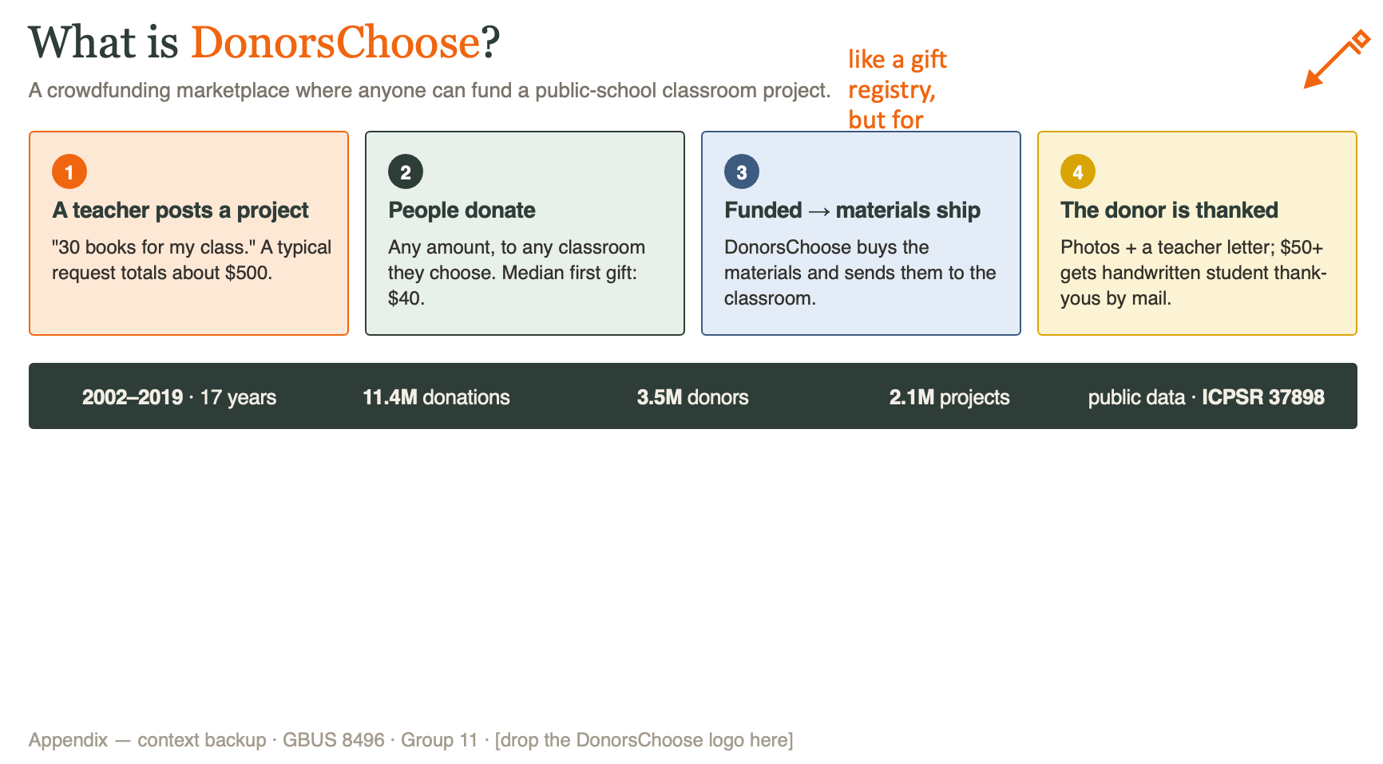
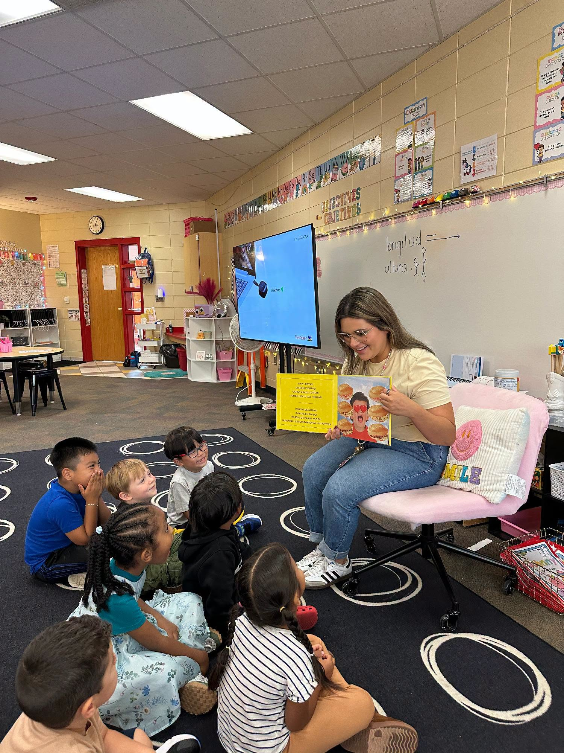
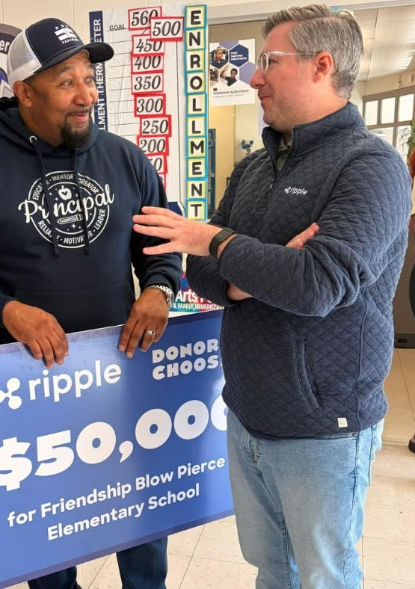

Notes:
Rodolfo

Slide 9





The data: DonorsChoose
Teachers post classroom requests. Anyone can fund them.
11.4M
3.5M
2.1M
17 yrs
donations
donors
classroom projects
2002–2019
Every row used. No sampling.
Source: ICPSR study 37898 (free, public)
Notes:
Suggested speaker: Rodolfo
- DonorsChoose is a site where teachers post classroom project requests and anyone can fund them.
- Public data from ICPSR (study 37898). Anyone can download it with a free account.
- Two files: Donations (11.4M rows) and Projects (2.1M rows). We used every row, no sampling. It all ran on a laptop.
- What we know about each first gift: amount, month, whether it was matched, paid with a gift card, or teacher-referred. Plus project details: school state, subject, grade, cost, and school poverty level.
- What we don't have: exact dates (month only), donor demographics, and the project essay text (hidden by ICPSR).
Contributors: Bakul (data pipeline), Reid (joining the project details).

Slide 10
100 new donors. Who comes back?
TODAY
Nonprofit outreach rep picks the biggest first gifts.
OUR QUESTION
Can data predict who gives again?
gives again within a year
Notes:
Suggested speaker: Rodolf
- Meet our stakeholder: a development lead at a nonprofit with about a $500K budget and no data staff.
- Of every 100 new individual donors, only about 13 give again within a year (12.6% in our 2017–18 test years).
- Today, the outreach rep decides who gets personal attention by gift size.
- Our first question: can data predict who gives again better than gift size?
- Next slide: why predicting who gives isn't the whole answer.
Contributors: Malorie (stakeholder framing).

Slide 11
The questions
Can we predict who is most likely to give again?
Can we predict who is most likely to give the most over time?
Is there anything we can do to improve these metrics?
Notes:
Suggested speaker: Rodolf
- Meet our stakeholder: a development lead at a nonprofit with about a $500K budget and no data staff.
- Of every 100 new individual donors, only about 13 give again within a year (12.6% in our 2017–18 test years).
- Today, the outreach rep decides who gets personal attention by gift size.
- Our first question: can data predict who gives again better than gift size?
- Next slide: why predicting who gives isn't the whole answer.
Contributors: Malorie (stakeholder framing).

Slide 12





What we did
1 · Check
2 · Label
3 · Split
4 · Baseline
5 · Model
6 · Rank
Can we follow one donor over time?
Gave again within 12 months?
Learn from the past, test on the future
Rule to beat: biggest gift first
Chance of return × likely amount
Sort by predicted repeat value
3.28M first-time donors labeled
15.8% gave again within a year
Notes:
Suggested speaker: Bakul
1. Check (Bakul): confirmed the same donor ID shows up across gifts. 25% of donors gave to more than one project, so we can actually track a second gift.
2. Label (Bakul): for each donor, find their first gift month, then check: did they give again in the next 12 months? Extra gifts in the same month count as part of the first gift. Refunds removed. Donors whose 12 months weren't over by the end of 2019 were dropped, not counted as "no." Result: 3.28M first-time donors, 15.8% gave again.
3. Split (Bakul): learn from older donors, test on newer ones. Next slide.
4. Baseline (Bakul): the rule to beat is "biggest first gift first." For first-time donors, everyone has the same recency and frequency, so the classic RFM rule collapses to gift size. It's also what she does today. We also built a simple logistic regression as a floor ($119 per call).
5. Model (Rodolfo, using Reid's project features): gradient boosting, which combines many small decision trees. Two parts: the chance a donor gives again, and how much if they do. Multiply them to get expected dollars per donor.
6. Rank (Malorie and Bakul): sort donors by expected repeat dollars. The team also built a cost comparison (expected value vs. the cost of outreach), but the cost per contact is still a placeholder, and that math assumes outreach causes the gift, which we can't show yet.

Slide 13
What the model looked at
19 inputs, all known the day of the first gift. No names, no demographics.
About the gift
About the project
Gift amount
School state
Classrooms funded that month
Subject
Matched by a partner
Grade level
Paid with a gift card
Project cost
Referred by a teacher
Students reached
Month and year of the gift
School poverty level
How long it had been posted
Notes:
Suggested speaker: Bakul
- Everything the model sees is something the development lead would know the day the first gift arrives. That rule is what keeps it honest.
- About the gift: amount, how many classrooms they funded in that first month, whether it was matched by a corporate partner, paid with a gift card, or referred by a teacher, and the month and year.
- About the project they funded: school state, subject, grade, cost, students reached, school poverty level, and how long the project had been posted.
- 19 inputs in total. The slide groups a few of them (for example, there are two cost fields and two subject fields).
- Deliberately left out: the thank-you packet flag (no record of when it was sent), teacher ID (the model would just memorize specific teachers), anything that happened after the gift, and essay text (hidden in the public data).
Contributors: Rodolfo (model inputs), Reid (project details join), Bakul (donation-side inputs).

Slide 14
Two decision tree models
Gift + project inputs
MODEL 1
MODEL 2
Chance of giving again
Total giving if they return
Donor | First-month giving | Return probability | Amount if returning | Probability × amount
A | $200 | 10% | $150 | $15
B | $50 | 40% | $75 | $30
C | $100 | 25% | $200 | $50
Baseline picks A
Probability ranking picks B
Dollar ranking picks C
Notes:
Thadeus
We use these gift and project inputs in two models, each predicting something different.
The first predicts the chance of giving again within the next 12 months. The second estimates total giving during that period, if the donor returns.
To illustrate how this helps us prioritize donors for outreach, let’s look at three fictional donors.
The table shows their first-month giving, alongside example predictions from the two models: their return probability and giving amount if they return.
This gives us three ways to rank them.
The baseline needs no model: simply select whoever gave the most in the first month. Here, that’s A.
Alternatively, we can select whoever is most likely to return. In this case, that’s B.
Finally, we can consider both the chance of returning and the amount they might give. Multiplying the two gives us a dollar-ranking score. Here, C comes first.
Different objectives produce different lists. How do those lists perform on actual donors?

Slide 15
Comparing the selected donors of each ranking
Who gives again?
How much giving?
Share of selected donors who returned
Subsequent dollars per selected donor
+$3.45
per selected donor versus gift size; a 3.0% gain
Notes:
Thadeus
To see how these ranking methods perform, we applied them on our test data of about 800 thousand donors,
Then we looked at the top 10% of each ranking and compared them by: share of donors that return and the subsequent giving per donor
On the left, probability ranking finds the most returners: about 24 out of every 100 selected donors, compared with 20 for the gift-size baseline.
But finding more returners does not necessarily mean finding more dollars. On the right, dollar ranking identifies the most giving: about $120 per selected donor, versus $116 for the baseline.
That is a $3.45 improvement, or 3%. A modest gain over a strong simple rule.

Slide 16
Gift behavior carries the strongest signal
GIVING BEHAVIOR
PROJECT CONTEXT
Longer bar = greater loss of ranking accuracy (ROC-AUC) when shuffled
Notes:
Thadeus
Going back to our inputs, lets look at which information mattered most when predicting whether a donor would give again.
The two most important inputs are how much they gave in the first month and how many gifts they made.
Information about the projects they supported also helps, but plays a smaller role.
This helps explain why gift size alone was already a strong baseline.

Slide 17
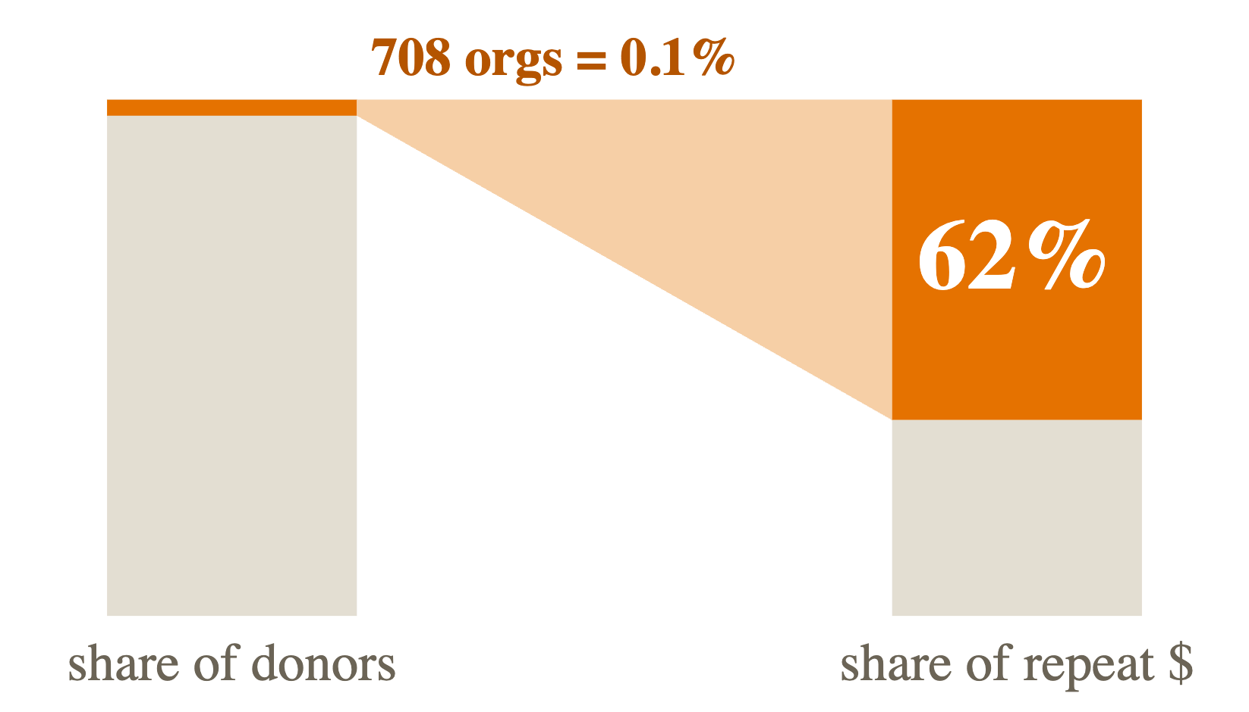
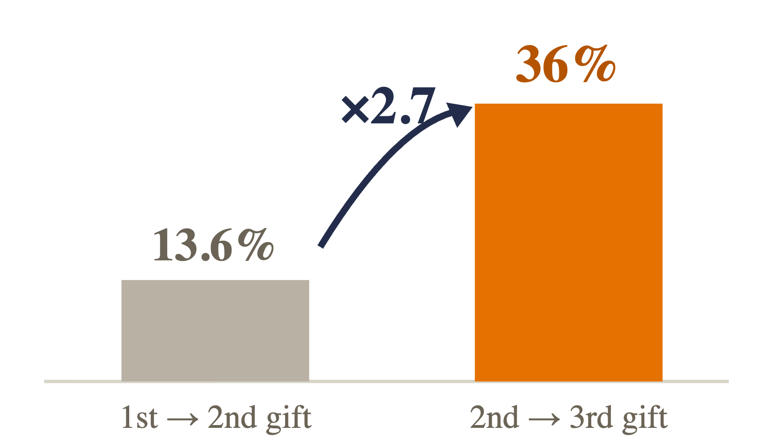
What the data taught us
THE TRAP
THE DOOR
Corporate matching, not people. We score individuals only.
Loyalty compounds. The second gift is the door.

Slide 18
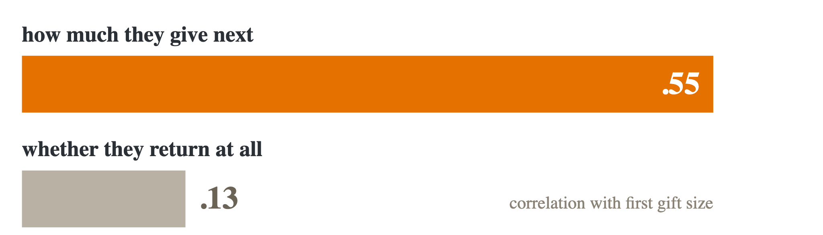
What the data taught us
THE SPLIT
Gift size tells you how much someone gives next — almost nothing about whether they come back.
Two questions, two models.

Slide 19

What changed, and why
HYPOTHESIS
ACTUAL
"Gift size finds 80% of dollars!"
It was corporate matching. Individuals only.
Thank-you packet as a key feature
Not able to predict if it influences second gift
Specific donation targets drive increased donation
Individual donors not as much a trend
Notes:
Suggested speaker: Reid
- The 80% "win": our first result looked amazing until we saw it was corporate matching programs. We kept both numbers and scored individuals only. One line in the config, reversible.
- Thank-you packet: the codebook doesn't say when it was mailed. If it was mailed after the second gift, it would leak the answer. Professor Albert pre-approved dropping it.
- Data size: our proposal asked about sampling because of file size. Reading the data in 1M-row chunks let us use every row on a laptop.
- Amount: the decision step first assumed every returner gives $50 (DonorsChoose's typical gift). That quietly turned "rank by expected dollars" back into "rank by probability." We switched to the model's own predicted amount per donor.
- Also: project essays are hidden in the public data, so text features were never an option.
Contributors: Bakul (integration), Rodolfo (amount model), Malorie (topic).

Slide 20




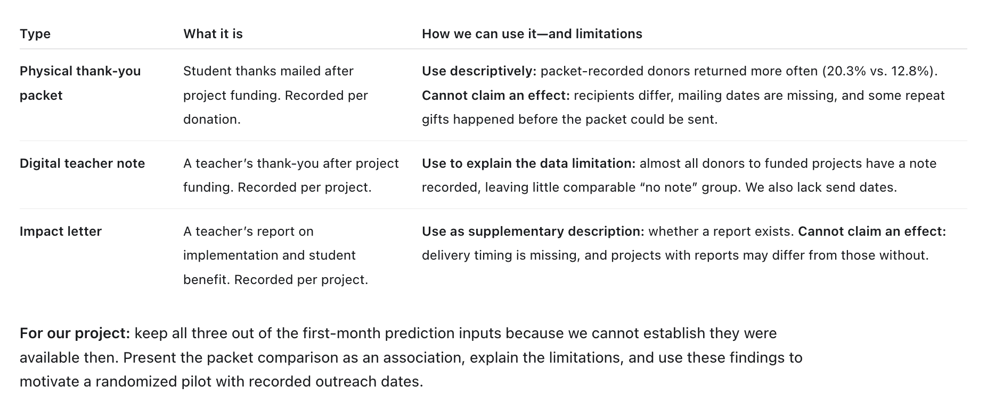
What we don't know yet
Does outreach cause the gift?
Who was already followed up with?
Nobody was randomly contacted, so we can't find the persuadables.
Calls and emails aren't recorded. Some repeat gifts may be from follow-up we can't see.
Thadeus: Summary of thank you analysis
Does the thank-you packet work?
Does this carry over to one nonprofit?
Citizen donors with a packet recorded returned at 20.3%, versus 12.8% without one.
We count a gift to any classroom, not to the same organization.
Notes:
Suggested speaker: Reid
- 1. Does outreach cause the gift? Nobody in the data was randomly contacted, so we can't measure what outreach adds. Why it matters: without that, a nonprofit could spend its scarce staff time on donors who'd give anyway.
- 2. Who was already followed up with? Phone calls, personal emails, and DonorsChoose's own marketing emails aren't in the data. Why it matters: some "gave again" may be because of follow-up we can't see. So our model predicts giving under business as usual, not giving "on their own."
- 3. Does the thank-you packet work? It's the one follow-up recorded in our data, but the codebook doesn't say when it was sent, so we left it out of the model. Why it matters: it's the cheapest outreach there is. Next step: check whether packets went to donors above a gift-size cutoff. If so, comparing donors just above and just below that line is a near-experiment.
- 4. Does this carry over? Our label counts a second gift to any classroom on DonorsChoose. A real nonprofit cares about a second gift to them. Next step: rerun with "same teacher or same school" as the label.
- Also worth saying: our ranking is modest (AUC 0.60, where 0.5 is a coin flip), and a small number of big donors hold most of the repeat dollars, so averages can swing.

Slide 21





Next: the Darden pilot
1 · Score
2 · Split at random
3 · Reach out
4 · Compare
Model predicts who's likely to give
Within each score group
Class agents contact one group first starting with those who have given before
The gap is what outreach adds
WHAT WE'D TEST
Personal outreach vs. none
Personal thank-you vs. standard
Impact update vs. none
Notes:
Suggested speaker: Malorie
- The way to find persuadables is a randomized test.
- 1. Score donors with the model, so we know who's likely to give anyway.
- 2. Within each score group (high, medium, low), randomly split donors into two groups.
- 3. Class agents reach out to one group first; the other gets business as usual. Randomizing timing (early vs. later outreach) means no one is left out.
- 4. Compare giving between the two groups. The difference is what outreach actually adds, and we see it separately for each score group. That tells us where the persuadables are.
- What we'd test maps to the psychology from the start: personal outreach (connection), a personal thank-you (gratitude and reciprocity), and an impact update (seeing what your gift did).
- Before the pilot, we can already test the thank-you packet in the DonorsChoose data.
- This builds on the outreach logging GoGood is doing with the Darden School Foundation.
[Malorie: adjust the pilot details to what's planned and shareable.]

Slide 22
What GoGood should do
1
Predict who's likely to give again.
Its top 10% held 58% of next year's repeat dollars
2
Don't spend outreach on sure things.
Likely givers may come back anyway. Save personal time.
3
Run the Darden pilot to find the persuadables.
Random outreach, measured within each score group
github.com/bakulbadwal/gbus8496-project
Notes:
Suggested speaker: Malorie
- I'm the client here, so here's what I'm taking back to GoGood.
- 1. Use the model to predict who's likely to give again. Its top 10% held 58% of next year's repeat dollars. It runs monthly on a laptop in about 10 minutes, with no API costs. No model? Biggest gift first gets 56%.
- 2. Predicting giving is not the same as knowing who to reach. Likely givers may come back anyway, so personal outreach time may be better spent elsewhere. We don't yet know where.
- 3. Run the Darden pilot to find the persuadables: randomized outreach, measured within score groups.
- Limit: DonorsChoose donors give through a marketplace; small-nonprofit donors have a relationship with one organization.
- Close: every number reproduces with one command from our repo. Thank you!
Contributors: Malorie (recommendation), whole team.

Slide 23





How we double-checked
13 label tests
No peeking
Test opened once
Tiny fake dataset with known answers
Only what's known on day one
Locked until the model was final
Bootstrap
Calibrated
One command
The +$3.80 gap is not luck
Top 10%: predicted 27%, actual 24%
Re-runs everything from raw data
Notes:
Suggested speaker: Thadeus
- 13 label tests: we built a tiny fake dataset of 9 donors where we know the right answer, and tested every labeling rule against it.
- No peeking: every feature had to be something she'd know the day the first gift arrives. We dropped the thank-you packet flag because the codebook doesn't say when it was mailed. We also left out teacher ID so the model couldn't just memorize specific teachers. Honest limit: this was careful judgment field by field, not an automated leakage test.
- Test opened once: the 2017–18 data was scored a single time, after the model was final.
- Bootstrap: +$3.80 per donor, plus or minus $0.51. About 7 standard errors.
- Calibrated: when the model says a group has a 27% chance, about 24% actually come back (top 10% of the list). Overall error is under 1 percentage point. This matters because the call decision uses the model's probabilities directly.
- One command: python evals/run_all.py rebuilds every number from the raw files.
- Also: when Reid's project join was turned into a script, the numbers were re-run and matched his notebook exactly.
Contributors: Bakul (tests, calibration code, run_all), Rodolfo (bootstrap), Reid (join cross-check).

Slide 24
What the data taught us
Organizations vs Individuals
Who gives ≠ Who gives most
62% of repeat dollars came from just 708 organizations
Ranking by who returns finds more people, but fewer dollars
Selection Effects Compound
How much ≠ who
36% of 2nd time donors give a 3rd time vs 13.6% from first to 2nd (2.7 times as likely)
Gift size predicts the next amount, barely whether they return
Notes:
Suggested speaker: Reid
- 62% / 708 organizations: corporate matching programs. The biggest made 66,348 donations in one year. Our first result said "gift size finds 80% of the dollars." It was just finding these organizations, which she already knows. So we scored individual donors only (86% of donors).
- $107 vs $120: if you rank by chance of returning, 24% of your list comes back (vs 22%), but they give less. More donors or more dollars? That's the client's call.
- 14% vs 0%: the model reaches small donors the gift-size rule never picks. These are the people she can't spot by hand. Their hit rate is a bit lower (22% vs 26% for $100+ donors).
- How much vs who: gift size has a weak link to whether someone returns (correlation about 0.13) but a strong link to how much they give if they do (about 0.55). Also: gift-card donors were less likely to return, and repeat rates fell over the years.
Contributors: Reid (feature exploration), Bakul (donor-type profile).

Slide 25

What building it taught us
Beat the simple rule first
Biggest gift first was hard to beat
EVERY NUMBER, ONE COMMAND
Split by time
python evals/run_all.py
Random splits flatter the model
Lock the test
About 10 minutes on a laptop. No API costs.
One look, at the very end
AI wrote code, tests checked it
Every AI session logged and verified
Notes:
Suggested speaker: Thadeus
- Beat the simple rule first: we built the baselines and the scoring before the model. Biggest gift first turned out to be a tough bar.
- Split by time: donor behavior drifts, so a random split would have made us look better than we are.
- Lock the test: scored once. On the 2016 practice test the edge was only +$1.77, and we treated it as marginal instead of celebrating early.
- AI wrote code, tests checked it: most code was written with Claude Code. Every session is logged in AI-USE-NOTE.md with how it was verified. Real bugs showed up when we moved from fake data to real data: a missing-value format crashed the model, and the first model was undertrained. Both were caught and fixed (Rodolfo).
- Every number reproduces with one command, about 10 minutes on a laptop, no API costs.
Contributors: whole team; Bakul (run_all pipeline), Rodolfo (bug fixes).

Slide 26
We tested on the future
2003
2016
2018
Learn
Tune
Test
Patterns from older donors
Practice test
815K donors, opened once
A random split would let the model peek at the future.
Notes:
Suggested speaker: Thadeus
- We never split the data at random. A random split lets the model learn from the future, and donor behavior changes over time (repeat rates fell in later years).
- Learn: first gifts from 2003 to 2015. Tune: 2016 was our practice test, used for every tuning decision. After tuning, the final model was retrained on everything through 2016.
- Test: 2017 and 2018 first-time donors, about 815,000 individual donors. Locked away and scored exactly once, at the end.
- Why stop at 2018: the data ends in 2019, and a donor needs a full 12 months to show whether they come back.
Contributors: Bakul (split rules), Rodolfo (practice-test loop).

Slide 27
Thadeus: I think we should mention why we even need to pick people? -> added the first bullet vs the previous slide
100 new donors. Who should be contacted?
LIMITED TIME FOR OUTREACH
10 available outreach slots
TODAY
Nonprofit outreach rep picks the biggest first gifts.
OUR QUESTION
Can data predict who gives again?
gives again within a year
Notes:
Suggested speaker: Rodolf
- Meet our stakeholder: a development lead at a nonprofit with about a $500K budget and no data staff.
- Of every 100 new individual donors, only about 13 give again within a year (12.6% in our 2017–18 test years).
- Today, the outreach rep decides who gets personal attention by gift size.
- Our first question: can data predict who gives again better than gift size?
- Next slide: why predicting who gives isn't the whole answer.
Contributors: Malorie (stakeholder framing).

Slide 28
Thadeus: Alternative to previous slide to not preempt following slides & mention focus on citizen donor only
What we did
1 · Select
2 · Label
3 · Train
4 · Tune
5 · Refit
6 · Test
Citizen donors only
Giving in the next 12 months
2003–2015
1,766,703 donors
2016
390,081 donors
2003–2016
2,156,784 donors
2017–2018
814,971 donors
2.97M eligible citizen donors
12 months of full follow-up

Slide 29
Thadeus: Idea to illustrate following one donor; maybe appendix
One donor, multiple donations
Illustrative donor A first appears in January 2016
Donation date | Gift | How we use it
Jan 10, 2016 | $30 | First-month input
Jan 24, 2016 | $20 | First-month input
Mar 12, 2016 | $40 | Next 12 months
Dec 2, 2016 | $60 | Next 12 months
Feb 3, 2017 | $80 | Outside outcome window
INPUTS
$30 + $20 = $50
Gift count: 2
OUTCOMES
Gave again: Yes
Future giving: $100

Slide 30
Make sure headline model and numbers align
Who did the model add?
Biggest-gift list
Our model's list
22%
of these small donors gave again (average donor: 13%)
PLACEHOLDER
What do they have in common?
0 of 100 gave under $50
14 of 100 gave under $50
Guess: gave to several classrooms at once, didn't use a gift card, certain states or subjects.
first gift under $50
Notes:
Suggested speaker: Reid or Rodolfo
- Half of all new donors (52%) gave under $50. The biggest-gift rule never picks any of them: its top 10% are all $50 and up.
- 14% of our model's list gave under $50. These are the people a development lead would never pick by hand.
- Are they real returners? 22% of them gave again, compared with about 13% for the average new donor. Their hit rate is a bit lower than the model's $100+ picks (26%), but they're real. Whether outreach would change anything for them is still unknown.
- PLACEHOLDER: what they have in common is not yet measured. To run: profile donors on the model's list but not on the gift-size list, and compare classrooms funded, gift card use, state, subject, and grade.
Sources: evals/results/12_calibration_model.txt (14.4% of list under $50; 22.1% return rate on that slice; 26.2% for $100+). The 0% for the gift-size rule follows from 47.6% of donors giving $50 or more, so its top 10% contains no one under $50.
Contributors: Rodolfo (model), Bakul (error analysis by gift size).

Slide 31
Add probability only model
A small, real edge
58%
of next year's repeat dollars, from 10% of donors
+$3.80
per donor vs. biggest gift first
Real, but small.
Notes:
Suggested speaker: Thadeus
- Each bar: the average dollars given again over the next 12 months by the donors on each list (top 10%). These are real past donations from our locked 2017–18 test set. Nobody was contacted as part of our study.
- Random pick: $19. Everyone (the average donor): $21.
- Biggest gift first: $116. Our model: $120.
- Our model's top 10% accounts for 58% of all repeat dollars. Biggest gift first gets 56%.
- Is +$3.80 real? We re-sampled the same donors many times and compared both lists each time (a paired bootstrap). The gap is about 7 standard errors, so it's not luck.
- Honest read: real, but small. Gift size already carries most of the signal.
- Important: this measures how well we predict giving, not the value of reaching out. Many of these donors are likely sure things who'd give anyway (see the four kinds of donors).
Contributors: Rodolfo (model and bootstrap), Bakul (scoring code).

Slide 32
Thadeus: Add thank you data
What we don't know yet
Does outreach cause the gift?
Who was already followed up with?
Nobody was randomly contacted, so we can't find the persuadables.
Calls and emails aren't recorded. Some repeat gifts may be from follow-up we can't see.
Does the thank-you packet work?
Does this carry over to one nonprofit?
The one follow-up in our data, undated relative to the gifts
We count a gift to any classroom, not to the same organization.
Notes:
Suggested speaker: Reid
- 1. Does outreach cause the gift? Nobody in the data was randomly contacted, so we can't measure what outreach adds. Why it matters: without that, a nonprofit could spend its scarce staff time on donors who'd give anyway.
- 2. Who was already followed up with? Phone calls, personal emails, and DonorsChoose's own marketing emails aren't in the data. Why it matters: some "gave again" may be because of follow-up we can't see. So our model predicts giving under business as usual, not giving "on their own."
- 3. Does the thank-you packet work? It's the one follow-up recorded in our data, but the codebook doesn't say when it was sent, so we left it out of the model. Why it matters: it's the cheapest outreach there is. Next step: check whether packets went to donors above a gift-size cutoff. If so, comparing donors just above and just below that line is a near-experiment.
- 4. Does this carry over? Our label counts a second gift to any classroom on DonorsChoose. A real nonprofit cares about a second gift to them. Next step: rerun with "same teacher or same school" as the label.
- Also worth saying: our ranking is modest (AUC 0.60, where 0.5 is a coin flip), and a small number of big donors hold most of the repeat dollars, so averages can swing.

Slide 33



Which features mattered
PLACEHOLDER · BEST GUESS
1
Gift amount
Bigger gift, more likely
2
Paid with a gift card
Less likely to return
3
Year of first gift
Newer donors, less likely
4
Classrooms funded that month
More classrooms, more likely
5
State × subject × grade
Depends on the mix
Guess from the simpler model's weights and Reid's exploration. Replace with measured importance from the final model.
Notes:
PLACEHOLDER SLIDE: replace with real feature importance from the final model before presenting.
To run: permutation importance (or SHAP) on the final gradient boosting model, on the 2017–18 test set.
Suggested speaker: Thadeus
Current best guess and where it comes from:
- The simpler logistic model's standardized weights, which are the only measured signals in the repo so far: gift amount +0.235, paid with gift card -0.213, year of first gift -0.210, classrooms funded in the first month +0.199. All four are similar in size.
- Supporting evidence for classrooms funded: ranking by that alone found slightly more returners than gift size (20.4% vs 19.7% of the list came back).
- Gift cards: someone else paid, so the donor may feel less personally invested.
- Year: repeat rates fell over time.
- Combinations: Reid found gift size works differently depending on state, subject, and grade. Tree models can learn those combinations; the simple rule can't.
Contributors: Reid (interaction exploration), Bakul (simple model).

