Slide 1
GBUS 8496 · MACHINE LEARNING AND AI FOR BUSINESS · GROUP 11
Malorie · 1 / 10
Predicting the
Second Gift
Which first-time donors will give again, and which ones a small nonprofit should spend staff time on.
Malorie Black · Reid Jacobson · Thadeus Knospe · Rodolfo Perez-Cortes Manrique · Bakul Badwal
DISCLOSURE, SAID FIRST
One of us founded GoGood Technologies, a donor-engagement platform whose customers are the stakeholder in this talk. That is why we chose the problem. Weigh what we say accordingly.
Notes:
30 seconds. Title, five names, then the disclosure out loud — Albert asked for it explicitly. Saying it first makes it a strength: we picked a problem one of us has watched people have.

Slide 2
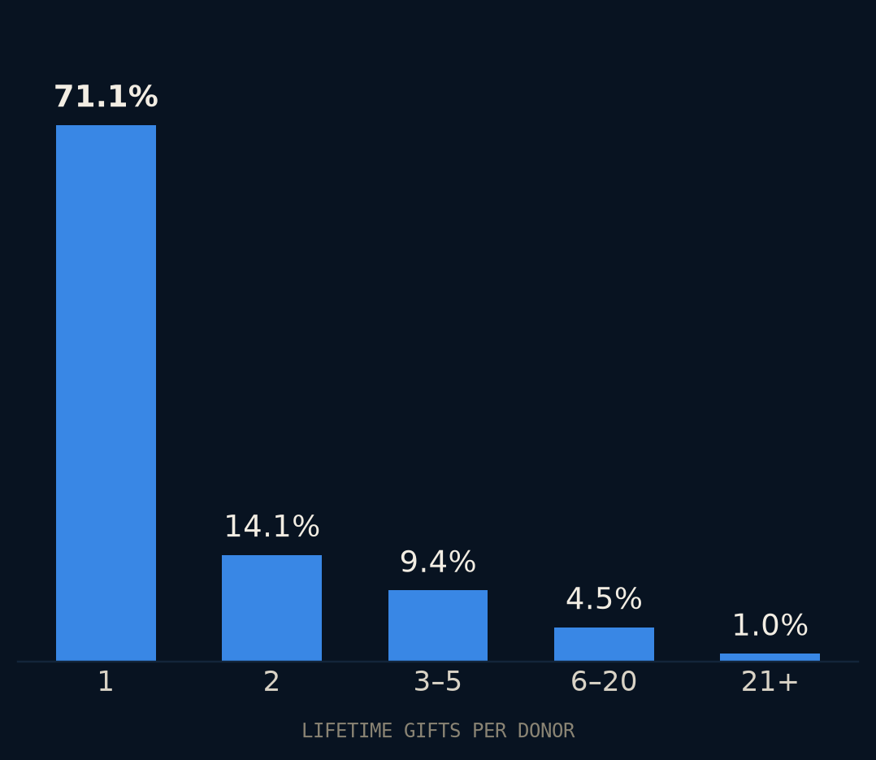
THE PROBLEM
Malorie · 2 / 10
71%
of DonorsChoose donors gave once and never again.
3.5 million donors, seventeen years. The second gift is where retention is won or lost, and small organizations have the least capacity to work it.
OUR STAKEHOLDER
A development lead at a ~$500K nonprofit, no data staff. Each month she can personally follow up with a fraction of last month's new donors. She builds that list by hand, from recency and gift size.
Notes:
60 seconds. Land the number and the person, then stop. Chart data: evals/results/01_check_donor_id.txt.

Slide 3
DATA AND LABEL
Bakul · 3 / 10
Four decisions turn eleven million rows into one label. Each could have gone the other way.
11.4M
1
Same-month repeats don't count
2
Twelve whole months
DONATIONS
One checkout can fund several classrooms. Two gifts in month one are one event, not a return. She cannot steward back someone who never left.
M+1 to M+12. Dates are month-level, so no finer definition exists and none is claimed.
3.28M
LABELLED DONORS
15.8%
3
Unclosed windows: dropped, not zeroed
4
Refunds are not gifts
REPEAT WITHIN 12 MO
A 2019 donor has not had a year to come back. Labelling them 0 teaches the model that recent donors never return.
The codebook lists a minimum amount of −$15. A reversal cannot open a cohort or count as a return. 151 rows, excluded.
ICPSR 37898, 2002–2019. Train through 2016, hold out 2017–18: a random split would let the model see the future.
Notes:
55 seconds. One line per decision. The point is not the decisions themselves but that each is stated and reversible — the notebook reports the positive rate both ways for the same-month rule.

Slide 4
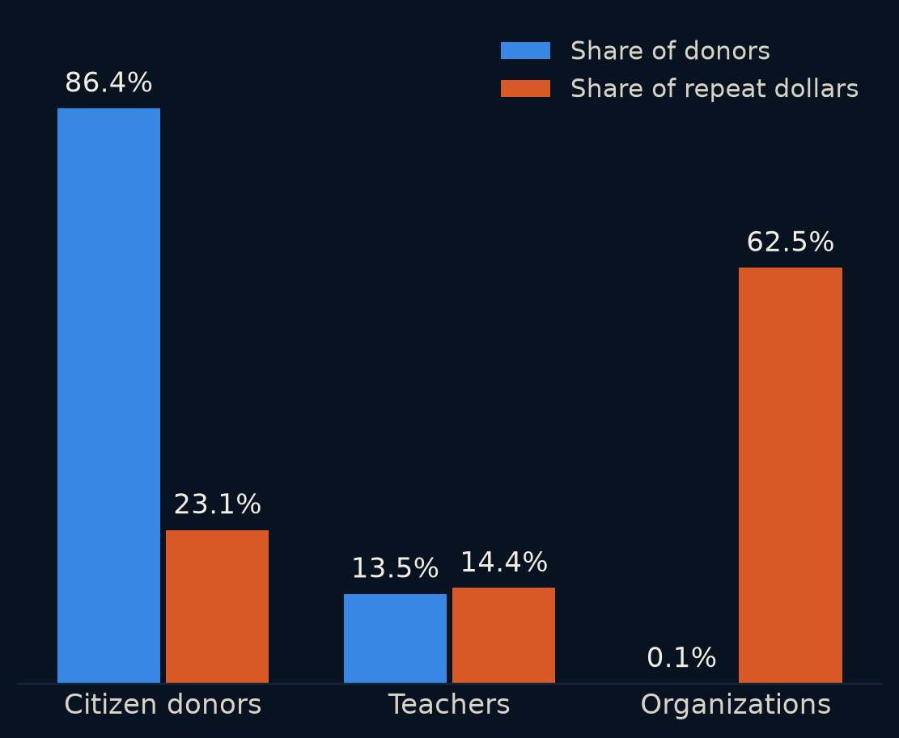
THE FINDING
Bakul · 4 / 10
708 organizations hold 62% of every repeat dollar.
Our first result found 80% of all repeat dollars at 10% capacity with the dumbest possible rule: rank by gift size. It looked like a triumph.
It was measuring corporate matching programs. The largest made 66,348 donations in its twelve-month window. Any ranker wins the pooled contest by finding them — and she already knows who they are.
THE DECISION
Score citizen donors only — 86% of people, the ones she actually calls. One line in config, reversible, both numbers kept.
Notes:
60 seconds. Tell it as it happened. This is the slide the 'genuine insight' vote is won on. Chart data: evals/results/03_profile_cohorts.txt, holdout cohorts.

Slide 5
FEATURES
Reid · 5 / 10
What predicts a return
Gift size finds dollars; [feature] finds people. Here is what moved and what did not.
DROP HERE
Feature importance or lift table — one chart
Structure to keep: one chart of importance or lift, one sentence per feature that mattered, one on what did not. Text is masked by ICPSR — no embeddings. Tie back to slide 4.
Notes:
55 seconds. Owner fills in. Serves the 'genuine insight' question.

Slide 6
THE HEADLINE
Rodolfo · 6 / 10
At her capacity, dollars identified per contact
Citizen donors · top 10% of each month's new donors · 2017–18 holdout · value identified, never “caused”
RANKING | PRECISION | RECALL | VALUE FOUND | $ / CONTACT
Our model — probability × amount score | 22.3% | 17.7% | 58.1% | $120
First gift size — the honest baseline | 19.7% | 15.7% | 56.4% | $116
First-month gift count | 20.4% | 16.2% | 41.4% | $85
Random | 12.7% | 10.1% | 9.1% | $19
Contact everyone | 12.6% | 100% | 100% | $21
30 paired donor bootstrap samples: +$3.51 ± 0.51 per contact over gift size (±1 standard error). The 3.0% gain is modest; gift size already carries most of the dollar signal. The baseline is fair: on a first-gift cohort, RFM collapses to gift size, and it is what she does by hand.
Notes:
60 seconds. Headline metric is dollars per contact, not AUC — Albert said the ranking at capacity is the decision. Every row is real: baselines in evals/results/04_score_citizen.txt, model in evals/results/10_model_holdout.txt (model frozen Sep 22; parser correction rerun Sep 27). Gradient-boosted classifier + log-amount regressor on donation-file and projects-join features. If asked: ranking by probability alone finds more returners (24.3% precision) but fewer dollars ($108).

Slide 7
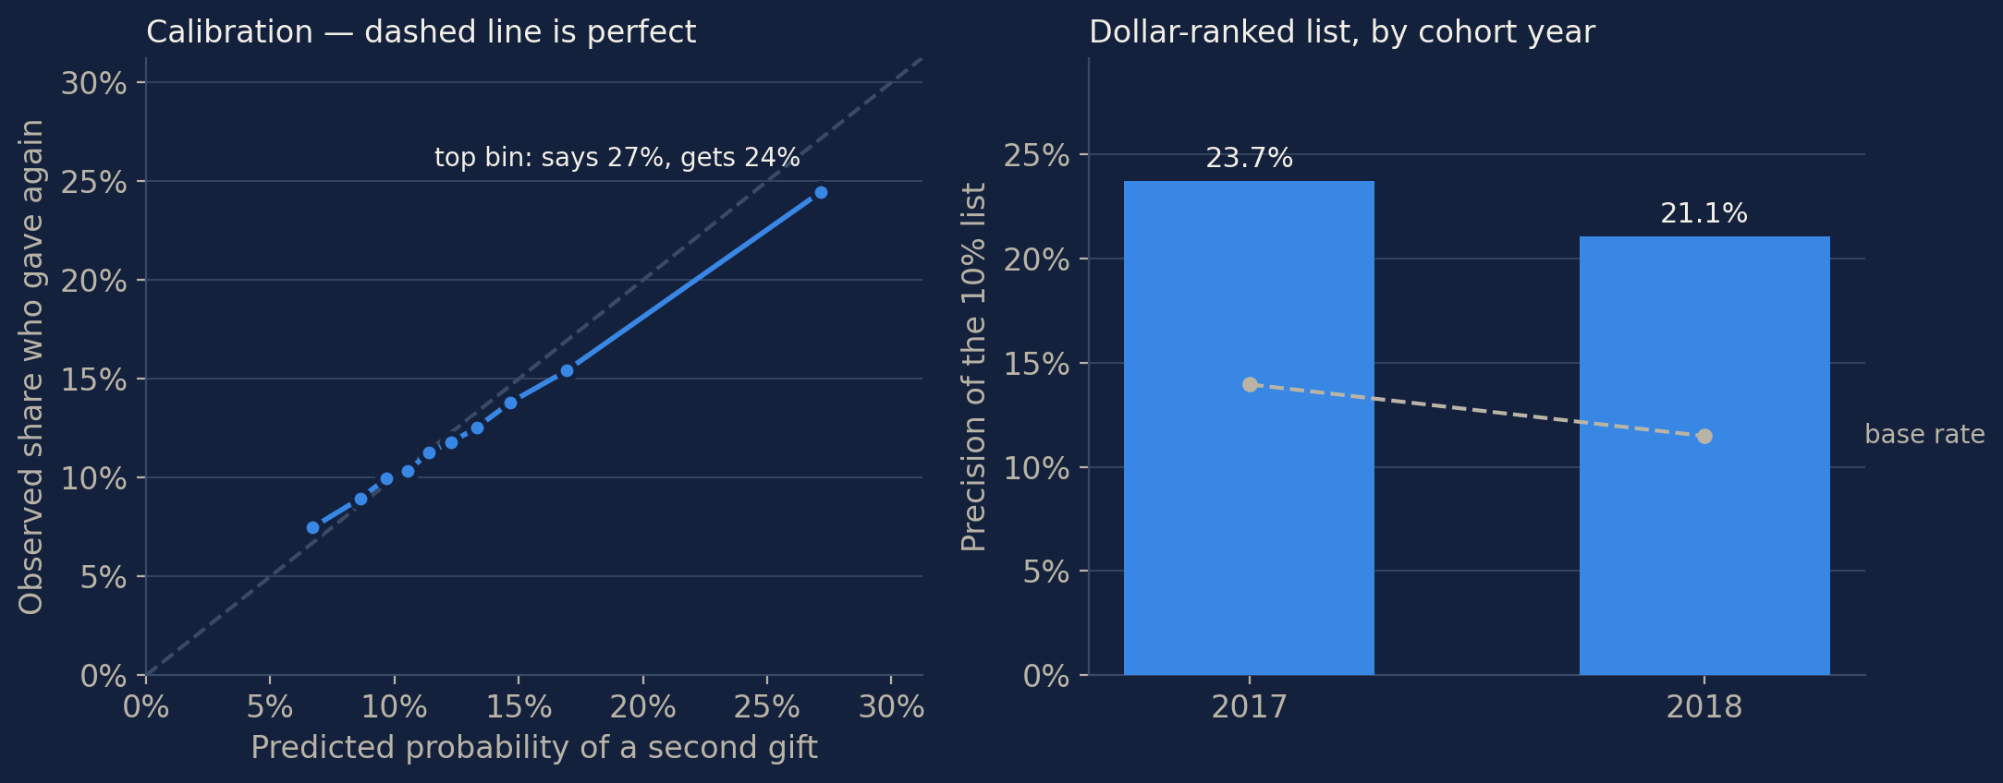
EVALUATION
Thadeus · 7 / 10
The gain holds, but the dollar list favors large gifts
Under-$50 donors: 52.4% of the holdout, only 0.51% of the dollar-ranked list (14.1% if ranked by probability).
Notes:
60 seconds. We rebuilt the evaluation from the raw files and reproduced the headline. The left chart asks whether predicted return chances match reality. In the highest probability tenth, the model says 27.2 percent return and 24.5 percent do. The right chart follows the same dollar-ranked list as the headline: 23.7 percent return in 2017 and 21.1 percent in 2018, while the overall rate also falls. Dollars per selected donor fall from 139 to 103, but the model beats gift size in both years. Its limitation is coverage: donors giving under 50 dollars are half the population but just 0.51 percent of this list. The 14.1 percent figure belongs to the probability-only list, which finds more returners but fewer dollars. Source: evals/results/12_calibration_model.txt; notebook 04. First gift means total first-month giving. These are observations about frozen predictions, not new tuning.

Slide 8
THE DECISION
Malorie · 8 / 10
What she does on Monday
3,013
$25
$7.72M
No API
SELECTED · DEC 2018
PER CALL · PLACEHOLDER
VALUE LESS ASSUMED COST
EXTERNAL MODEL CALLS
The model's list contains $9.76M of subsequent giving. Subtracting $2.04M of hypothetical contact costs leaves $7.72M, versus $7.44M for gift-size ranking. Neither balance measures outreach profit: we do not know how much extra giving a call causes.
COST AT PRODUCTION SCALE
Scoring runs locally without API fees. Staff outreach, setup and maintenance still cost money. Replace the $25 contact-cost assumption with evidence from practice.
Notes:
60 seconds. The 282 thousand dollar difference is giving identified in two historical lists of equal size, not incremental revenue caused by calls. The 25 dollar contact cost is a placeholder; Malorie supplies the real cost. The model was trained on log amounts, so its score is not a calibrated mean-dollar forecast. EV greater than cost is only illustrative. Source: evals/results/11_decision_model.txt. Compute uses no external model API; staff, setup and maintenance costs are not zero.

Slide 9
LIMITS
Thadeus · 9 / 10
What we did not find, and what we are not claiming
1
2
3
Outreach impact is unknown
Thank-you packet: dropped
Transfer is untested
The records show who gave again, not what a call changed. Dollars identified minus assumed contact cost is not measured profit.
The codebook gives no timing. The flag may record something that happened after the second gift. Albert pre-approved dropping it.
We tested 2017–18 DonorsChoose cohorts. Performance for today’s donors or another nonprofit has not been established.
Next: validate locally, measure real contact costs, and test randomized outreach before scaling.
Notes:
50 seconds. Three limits matter for the recommendation. First, we can identify future giving, but we cannot say a call created it. Donors might have given anyway. The reported value less contact cost is therefore not a profit estimate. Second, we excluded the thank-you-packet flag because its timing is unknown; it might contain information recorded after the outcome. Third, we tested historical DonorsChoose donors, not today's donors at Malorie's customers. Transfer needs a local test. Before scaling, measure real staff costs and randomly assign outreach in a pilot so we can estimate additional giving caused by contact. The log-amount score also needs mean-dollar calibration before treating it as an absolute cost threshold. Sources: docs/ALBERT-FEEDBACK.md; src/model.py; src/decision.py; evals/results/12_calibration_model.txt.

Slide 10
RECOMMENDATION
Malorie · 10 / 10
Pilot the model-ranked list against gift-size ranking. The historical top 10% contained 58% of subsequent giving; test whether outreach adds donations before scaling.
github.com/bakulbadwal/gbus8496-project · every number reproduces with python evals/run_all.py
Notes:
20 seconds. One sentence, then stop. 58% = value identified at 10% capacity, evals/results/10_model_holdout.txt.

