Slide 1
GBUS 8496 · MACHINE LEARNING AND AI FOR BUSINESS · GROUP 11
Malorie · 1 / 10
Predicting the
Second Gift
Which first-time donors will give again, and which ones a small nonprofit should spend staff time on.
Malorie Black · Reid Jacobson · Thadeus Knospe · Rodolfo Perez-Cortes Manrique · Bakul Badwal
DISCLOSURE, SAID FIRST
One of us founded GoGood Technologies, a donor-engagement platform whose customers are the stakeholder in this talk. That is why we chose the problem. Weigh what we say accordingly.
Notes:
30 seconds. Title, five names, then the disclosure out loud — Albert asked for it explicitly. Saying it first makes it a strength: we picked a problem one of us has watched people have.

Slide 2
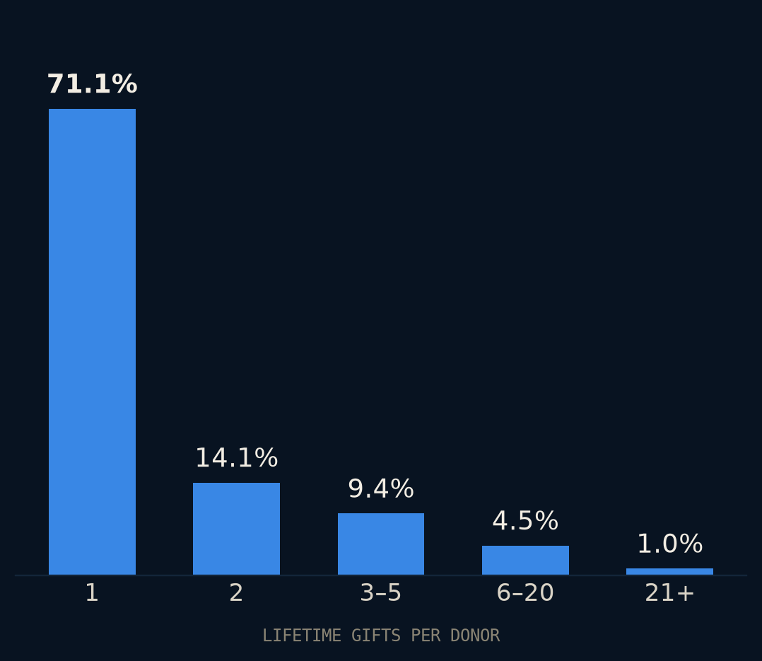
THE PROBLEM
Malorie · 2 / 10
71%
of DonorsChoose donors gave once and never again.
3.5 million donors, seventeen years. The second gift is where retention is won or lost, and small organizations have the least capacity to work it.
OUR STAKEHOLDER
A development lead at a ~$500K nonprofit, no data staff. Each month she can personally follow up with a fraction of last month's new donors. She builds that list by hand, from recency and gift size.
Notes:
60 seconds. Land the number and the person, then stop. Chart data: evals/results/01_check_donor_id.txt.

Slide 3
DATA AND LABEL
Bakul · 3 / 10
Four decisions turn eleven million rows into one label. Each could have gone the other way.
11.4M
1
Same-month repeats don't count
2
Twelve whole months
DONATIONS
One checkout can fund several classrooms. Two gifts in month one are one event, not a return. She cannot steward back someone who never left.
M+1 to M+12. Dates are month-level, so no finer definition exists and none is claimed.
3.28M
LABELLED DONORS
15.8%
3
Unclosed windows: dropped, not zeroed
4
Refunds are not gifts
REPEAT WITHIN 12 MO
A 2019 donor has not had a year to come back. Labelling them 0 teaches the model that recent donors never return.
The codebook lists a minimum amount of −$15. A reversal cannot open a cohort or count as a return. 151 rows, excluded.
ICPSR 37898, 2002–2019. Train through 2016, hold out 2017–18: a random split would let the model see the future.
Notes:
55 seconds. One line per decision. The point is not the decisions themselves but that each is stated and reversible — the notebook reports the positive rate both ways for the same-month rule.

Slide 4
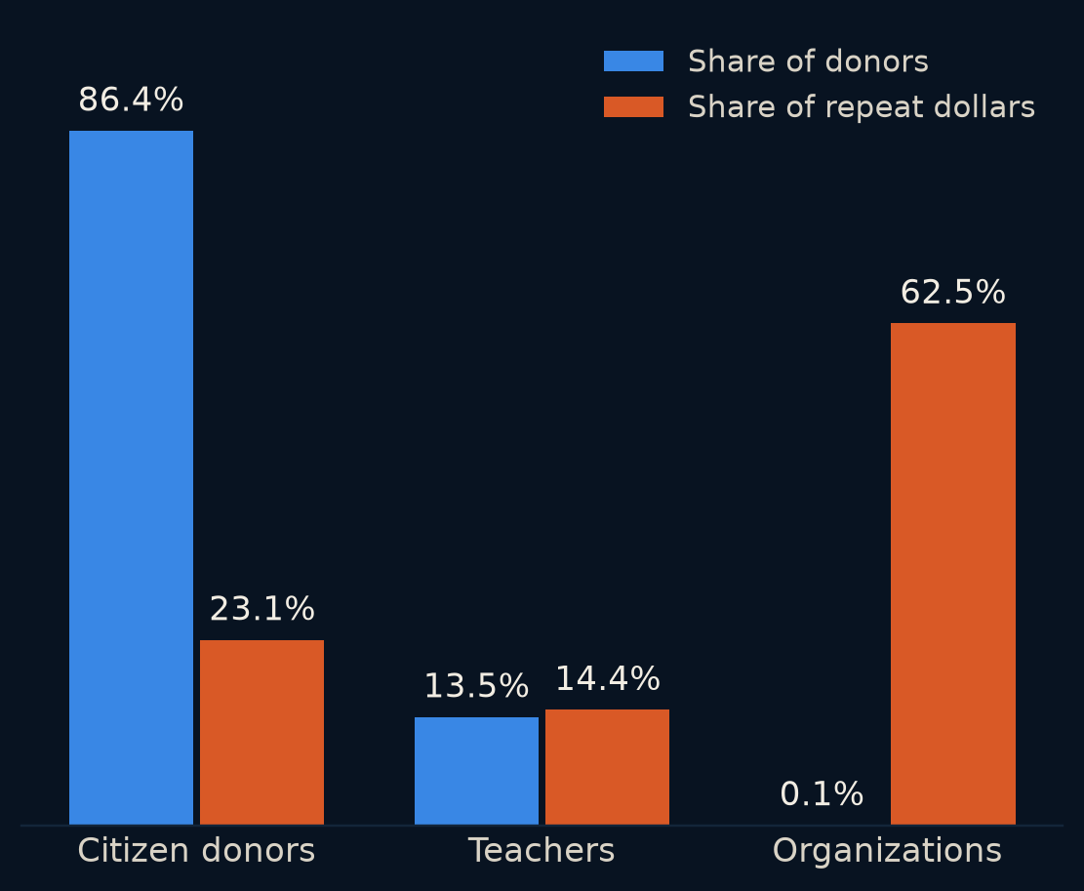
THE FINDING
Bakul · 4 / 10
708 organizations hold 62% of every repeat dollar.
Our first result found 80% of all repeat dollars at 10% capacity with the dumbest possible rule: rank by gift size. It looked like a triumph.
It was measuring corporate matching programs. The largest made 66,348 donations in its twelve-month window. Any ranker wins the pooled contest by finding them — and she already knows who they are.
THE DECISION
Score citizen donors only — 86% of people, the ones she actually calls. One line in config, reversible, both numbers kept.
Notes:
60 seconds. Tell it as it happened. This is the slide the 'genuine insight' vote is won on. Chart data: evals/results/03_profile_cohorts.txt, holdout cohorts.

Slide 5
FEATURES
Reid · 5 / 10
What predicts a return
Gift size finds dollars; [feature] finds people. Here is what moved and what did not.
DROP HERE
Feature importance or lift table — one chart
Structure to keep: one chart of importance or lift, one sentence per feature that mattered, one on what did not. Text is masked by ICPSR — no embeddings. Tie back to slide 4.
Notes:
55 seconds. Owner fills in. Serves the 'genuine insight' question.

Slide 6
THE HEADLINE
Rodolfo · 6 / 10
At her capacity, dollars identified per contact
Citizen donors · top 10% of each month's new donors · 2017–18 holdout · value identified, never “caused”
RANKING | PRECISION | RECALL | VALUE FOUND | $ / CONTACT
Our model | [ ] | [ ] | [ ] | $[ ]
First gift size — the honest baseline | 19.7% | 15.7% | 56.4% | $116
First-month gift count | 20.4% | 16.2% | 41.4% | $85
Random | 12.7% | 10.1% | 9.1% | $19
Contact everyone | 12.6% | 100% | 100% | $21
The baseline is fair: on a first-gift cohort, RFM collapses to gift size, and gift size is what she does by hand. If the model does not beat $116, say so and go to slide 9.
Notes:
60 seconds. Headline metric is dollars per contact, not AUC — Albert said the ranking at capacity is the decision. Baseline rows are real (evals/results/04_score_citizen.txt); the model row is the owner's.

Slide 7
EVALUATION
Thadeus · 7 / 10
How we know it works — and where it does not
It is calibrated here, it is not calibrated there, and it is weakest on exactly the donors she cares about most.
DROP HERE
Calibration curve
DROP HERE
Error by cohort year / gift band
Calibration curve on the holdout. Error analysis by cohort year — does 2018 behave like 2015? — and by first-gift size band, where most of her donors live.
Notes:
60 seconds. Answers Albert's 'how do you know it works' directly. The honest sentence about where it is weakest is the one the room respects.

Slide 8
THE DECISION
Malorie · 8 / 10
What she does on Monday
[N] hrs
[N] calls
$[ ]
$0
MONTHLY CAPACITY
AT [ ] MIN EACH
PER CONTACT
TO RUN, MONTHLY
Given her hours, work this list and expect roughly $[Y] in subsequent giving that the old list would have missed. Amount model: cohort median to start (Albert: fine). This answers 'what would it cost at scale' in one line.
DROP HERE
The recommendation sentence a development lead repeats to her board
Notes:
60 seconds. Cost per contact from real practice — a number GoGood can defend. Production cost is effectively zero and should be said as such.

Slide 9
LIMITS
Thadeus · 9 / 10
What we did not find, and what we are not claiming
1
2
3
No causal claim
Thank-you packet: dropped
Transfer is a hypothesis
Nobody was randomly assigned to be contacted. We rank by predicted future value and say “identified”, never “caused”.
The codebook gives no timing. The flag may record something that happened after the second gift. Albert pre-approved dropping it.
DonorsChoose donors are marketplace donors; small-nonprofit donors are relational. Behavioural features likely transfer; platform-specific ones likely do not.
Notes:
50 seconds. Three things, plainly. Serves the insight question and the honesty Albert grades under 'technical contribution'.

Slide 10
RECOMMENDATION
Malorie · 10 / 10
Rank this month's first-time donors by [model / gift size], call the top [N], and expect to reach [X] percent of next year's repeat giving with [Y] hours.
One sentence. Then stop.
github.com/bakulbadwal/gbus8496-project · every number reproduces with python evals/run_all.py
Notes:
20 seconds. The exact words come from slides 6 and 8.

