Slide 1
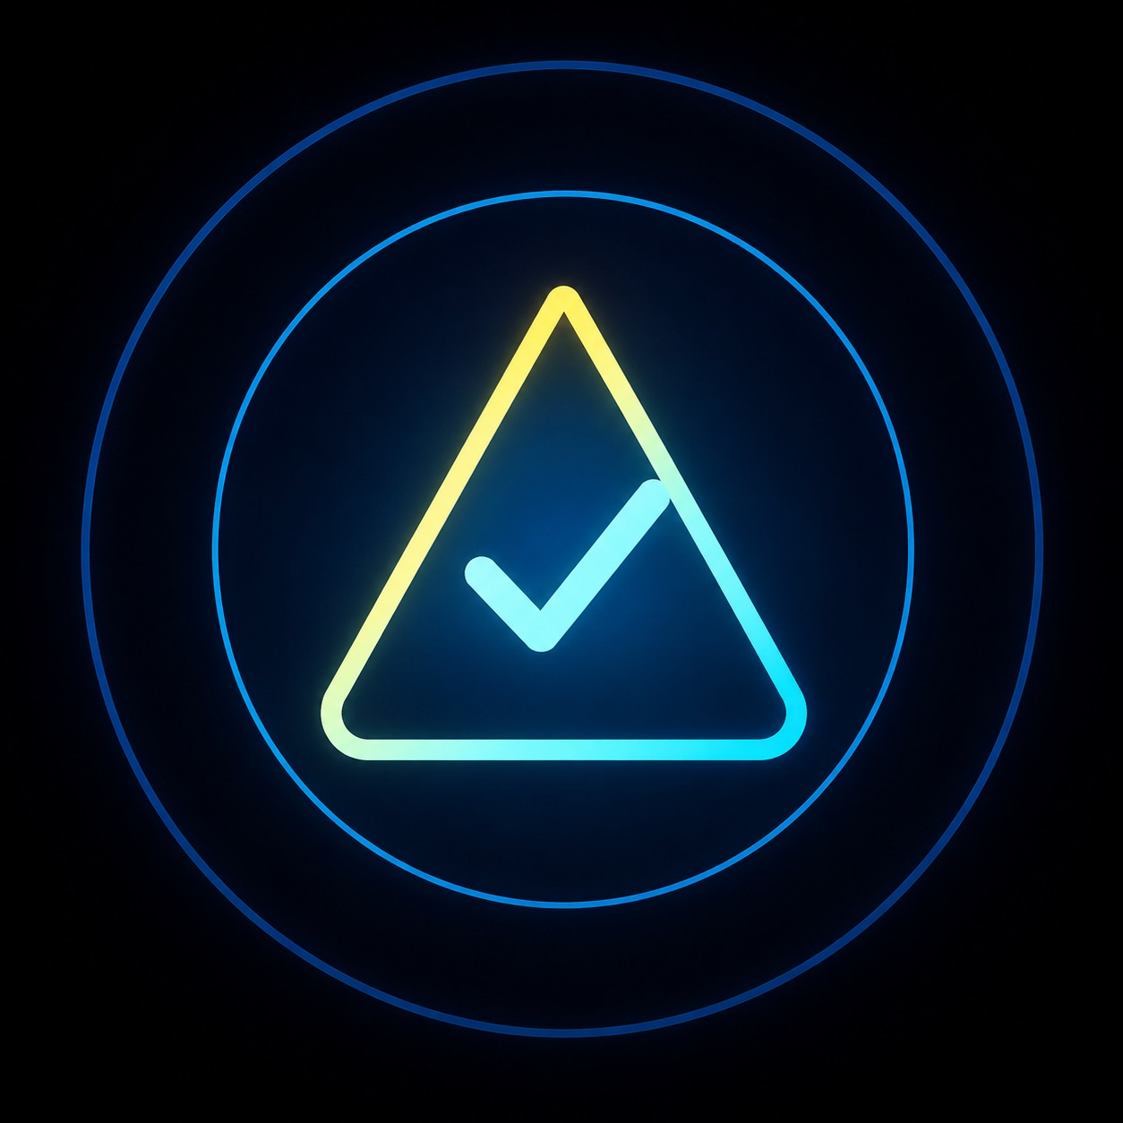
TUMAR.AI
The trust layer
before the click.
A multilingual cybersecurity assistant—built to help people everywhere make safer digital decisions in seconds.
Live MVP · Kazakh · Русский · English
Mission: make trustworthy AI accessible to everyone.
tumar-ai.streamlit.app
TUMAR.AI
01

Slide 2
WHY THIS MARKET
Cybercrime moved into the conversation layer.
23:41
The user has seconds.
“Unusual login from Almaty.
Confirm your identity now.”
Antivirus protects the device.
Tumar.AI protects the decision.
recognisable sender · fear · one tap
Beachhead: people in Kazakhstan receiving suspicious messages in Kazakh, Russian, or English.
Verify any public fraud statistic before presenting.
TUMAR.AI
02

Slide 3
BEACHHEAD CUSTOMER
Start with the people and institutions already carrying the pain.
PRIMARY USER
Everyday smartphone user
Needs an answer before clicking or replying
DISTRIBUTION PARTNER
Bank or telecom operator
Already owns the trust relationship and support cost
EXPANSION BUYER
Government, university, enterprise
Needs multilingual protection at volume
Kazakhstan first → Central Asia next
TUMAR.AI
03

Slide 4

PRACTICAL MVP TODAY
Streamlit makes the product real, shareable, and testable now.
1
2
3
User input
Trust report
Next action
Paste a message, link, or email
Score + evidence + explanation
One safe decision
Streamlit Community Cloud gives the MVP a public URL, GitHub-based updates, and managed secrets; the next step is reliability and measurement.
TUMAR.AI
04

Slide 5


LIVE PROOF
The product explains the risk—and tells the user what to do next.
Messages · Links · Screenshots · Passwords · Breaches
TUMAR.AI
05

Slide 6
GROUNDED INTELLIGENCE
AI explains. Security sources verify.
INPUT
SIGNALS
SOURCES
OUTPUT
Message
URL
Screenshot
Heuristics
Intent
Language
XposedOrNot
Password k-anonymity
Trust score
Evidence
Action
Why XposedOrNot?
It gives Tumar.AI a real breach-exposure signal instead of asking a language model to guess whether an email has appeared in known leaks.
TUMAR.AI
06

Slide 7
SCALE PLAN
Streamlit is the front door. PostgreSQL becomes the memory layer.
TODAY
NEXT
SCALE
Streamlit MVP
REST API
PostgreSQL
Fast feedback
Public demo
Session-scoped reports
Auth
Rate limits
Observability
Users + consent
Reports + events
Redacted corpus metadata
PostgreSQL is not for storing raw passwords or indiscriminate message dumps. It is for controlled, auditable product data and consented, redacted learning signals.
TUMAR.AI
07

Slide 8
BUSINESS MODEL
Free distribution now. Paid prevention where the cost is visible.
FREE
PILOT
API
Web app + Telegram bot
Bank / telecom
Institutional licence
Acquire users and learn the threat patterns
Measure prevented scams and support burden
Charge by protected customers or volume
First pilot metrics: correct intervention rate · false positives · repeat usage · support-call reduction
TUMAR.AI
08

Slide 9
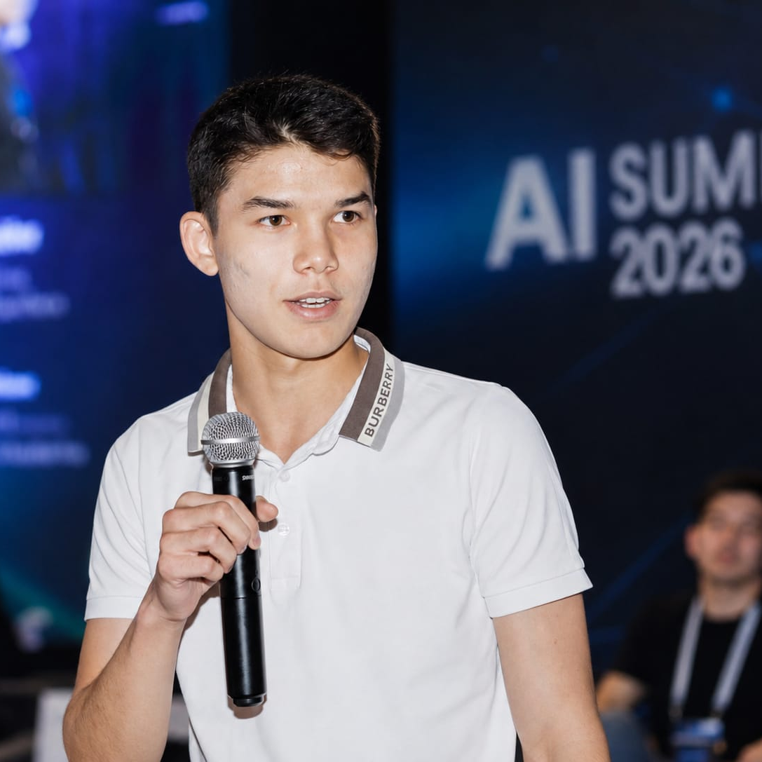
MISSION + FOUNDER
A local trust problem with regional ambition.
“Trust is only useful when it is simple enough to act on in seconds.”
FOUNDER FOCUS
Building Tumar.AI end to end: product, detection pipeline, and a multilingual trust layer for everyday users.
BAKYTZHAN ZHYLSAIYN
Founder & CEO · AI Summit 2026
Mission: help people everywhere make safer digital decisions through trustworthy AI.
TUMAR.AI
09
Notes:
[Sources]
- Founder portrait provided by Bakytzhan Zhylsaiyn: C:/Users/User/Downloads/WhatsApp Image 2026-08-06 at 14.18.53.jpeg

Slide 10
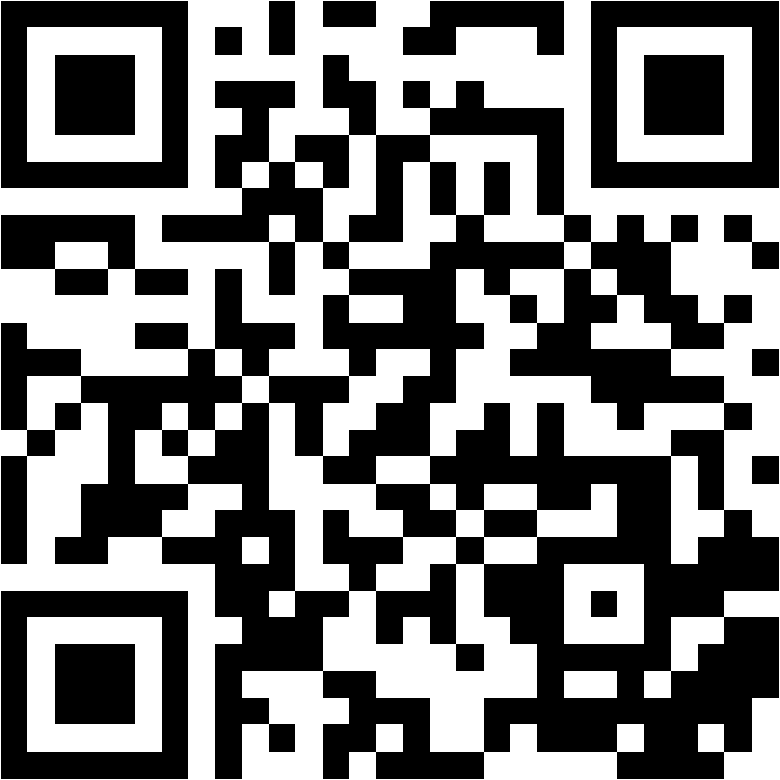
TUMAR.AI
Every phone should
carry a digital amulet.
The ask: a pilot partner, real-world scam patterns, and measured feedback.
SCAN TO WATCH THE LAUNCH FILM
tumar-ai.streamlit.app/launch-film
Launch film + product animation · Scan on any phone to watch the story, then try the live MVP.
TUMAR.AI / ASK
10
Notes:
[Sources]
- Launch Film and Product Animation provided by Bakytzhan Zhylsaiyn.
- QR destination: https://tumar-ai.streamlit.app/launch-film

