Slide 1
TUMAR.AI
Your digital amulet
against online scams.
Tumar.AI
Likely scam
14 / 100 trust
Do not open the link.
Call your bank directly.
A multilingual cybersecurity assistant for the moment before you click, reply, or share.
Kazakh · Русский · English
Recommended action
tumar-ai.streamlit.app
TUMAR.AI
01

Slide 2
THE PROBLEM
Scams win in the moment of doubt.
The message looks ordinary. The decision is not.
₸25B
+25%
23:41
“Unusual login from Almaty.
Confirm your identity now.”
lost to online fraud in Kazakhstan in six months
year-over-year growth in online fraud cases
recognisable sender · fear · one-tap link
Sources: Kazakhstan Ministry of Internal Affairs / Prosecutor General’s Office, H1 2025. Verify figures before public use.
TUMAR.AI
02

Slide 3
WHY CURRENT TOOLS MISS IT
Most defenses protect systems. Scams target judgment.
Antivirus
Spam filters
Awareness training
Files and downloads
Email inboxes
General knowledge
The scam arrives as conversation.
The message comes through Telegram or WhatsApp.
The lesson arrives weeks before the decision.
No one is standing next to the person at 23:41.
TUMAR.AI
03

Slide 4
THE SOLUTION
An assistant that checks anything suspicious before you act.
Messages. Links. Screenshots. Passwords. Email addresses.
1
2
3
4
Paste or forward
Trust Engine
One verdict
Next action
The content as it arrives
Signals + model reasoning
Score + explanation
Plain-language guidance
Same report language across every module
TUMAR.AI
04

Slide 5
LIVE DEMO
Tumar.AI / Quick Check
Paste anything suspicious.
Get a verdict and a reason.
Paste anything suspicious.
Bank alert: unusual login...
Confirm your identity now
Check it
Kazakh · Русский · English
The live demo should show one message, one suspicious link, and one breach check. Stop after the recommendation—the point is trust, not feature inventory.
TUMAR.AI / DEMO
05

Slide 6
PRODUCT SURFACE
Three ways in, because that is how scams arrive.
MESSAGE
LINK
SCREENSHOT
Paste the SMS or forwarded chat.
Check the address before opening it.
Upload what people actually share.
Intent, urgency, impersonation
Look-alikes, shorteners, risky signals
Text extraction, then analysis
Every verdict comes with the reason behind it.
TUMAR.AI
06

Slide 7
WHY TUMAR.AI IS DIFFERENT
Protection people can trust because it explains itself.
Capability
Antivirus
Bank alerts
Tumar.AI
Works in the moment of doubt
—
—
●
Kazakh language
partial
—
●
Explains the verdict
—
partial
●
Real breach lookup
—
—
●
Privacy-first session handling
—
—
●
Never promise “safe forever.” Give the next safe action.
TUMAR.AI
07

Slide 8
DISTRIBUTION BEFORE MONETISATION
The consumer product is the wedge. Institutions pay for prevention.
NOW
NEXT
THEN
Free web app
+ Telegram bot
Bank / telco
pilot
API licence
for institutions
Build trust and usage where scams arrive.
Measure scams prevented and support calls avoided.
Volume-based protection for the region.
Kazakhstan first → Central Asia next
TUMAR.AI
08

Slide 9
FROM MVP TO INFRASTRUCTURE
The next milestone is measured prevention—not more features.
1
2
3
4
NOW
NEXT
THEN
BEYOND
MVP shipped
Pilot
Before the tap
Central Asia
Web app, REST API, three languages
One bank or telco; measure prevented scams
Real-time link defence inside the flow
Same languages, same playbooks
Ask: pilot partner, feedback, and access to real-world scam data
TUMAR.AI
09

Slide 10
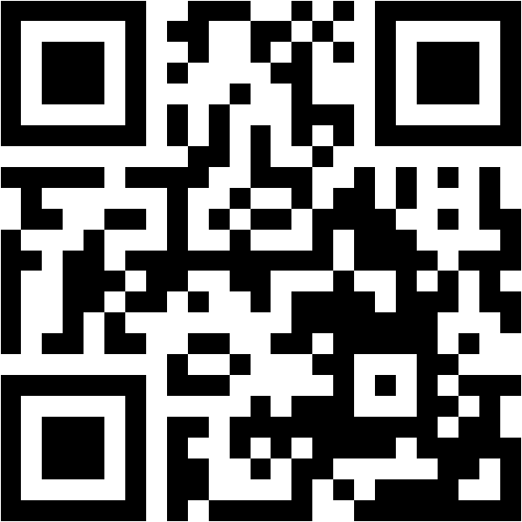
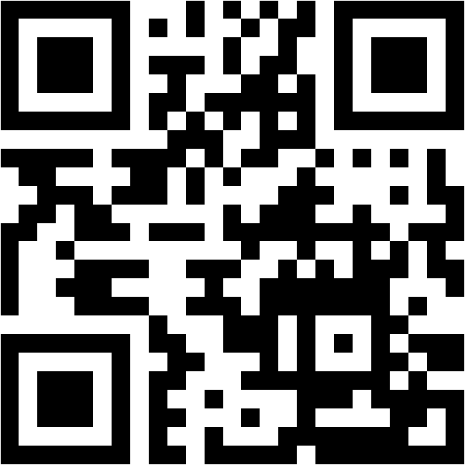
TUMAR.AI
Every phone should
carry a digital amulet.
Scan to try the live MVP.
WEB APP
TELEGRAM BOT
tumar-ai.streamlit.app
Kazakh · Русский · English
@tumar_ai_bot
TUMAR.AI / TRY IT
10

Slide 11
APPENDIX
The Trust Engine keeps every module speaking the same language.
INPUTS
SIGNALS
REASONING
OUTPUT
Telegram
Web app
REST API
Heuristics
Breach lookups
Language cues
Configurable AI
structured evidence
Trust score
explanation
next action
One report schema means the web app, bot, and future clients do not need separate security logic.
APPENDIX / TUMAR.AI
11

Slide 12
APPENDIX
Privacy is a product constraint, not a footer claim.
Passwords
Only a five-character hash prefix is sent to HIBP; the password never reaches the AI layer.
Reports
Results live in the browser session and are not written to disk.
Email checks
The address is sent to XposedOrNot for the actual breach lookup.
Contributions
Only optional, consented, redacted samples can enter the corpus.
APPENDIX / TUMAR.AI
12

Slide 13
APPENDIX
The product is honest about what it knows—and what it does not.
CURRENTLY MEASURED
OPTIONAL / CONFIGURABLE
Gemini + deterministic signals
XposedOrNot breach lookup
HIBP k-anonymity password lookup
DeepSeek as an alternate text provider
Vision provider for screenshot analysis
Future real-time link defence
This distinction protects trust with users, judges, and future partners.
APPENDIX / TUMAR.AI
13

