Slide 1
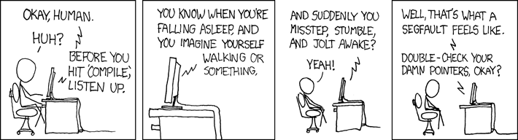
C++
CS2150: Program and Data Representation
University of Virginia Computer Science
Spring 2012 Aaron Bloomfield

Slide 2
Intro to C++

Slide 3
Why C++ and not Java?
It’s good to learn a second language
C++ is widely used
Can be more efficient
More control
C++ will let us “get under the hood” more
Data and program representation in memory
Memory allocation
Notes:
Support object-oriented programming
Upward-compatible with C
legal C programs should be legal C++ programs… not always true
C constructs such as using pointers for arrays still exist within C++
Be as fast as C programs
(so, if you don’t use a feature, shouldn’t have to pay the runtime cost)
no runtime bounds checking
no dynamic dispatch
no garbage collection
Language is continually changing
things were successively added at different times
templates, exception, namespaces
But, what this means is that: compilers are behind the official specification

Slide 4
A brief history lesson
C was created in 1972 by Dennis Ritchie
Intended to be terse, quick to write, and efficient
C++ was created in 1985 by Bjarne Stroustrup
Added classes while being backwards compatible
Has pretty terrible syntax!

Slide 5
Hello World – Java vs. C++
// Java
public class HelloWorld
{
public static void main(String [] args)
{
System.out.println("Hello World!");
}
}
// C++
#include <iostream>
using namespace std;
int main()
{
cout << “Hello World!” << endl;
return 0;
}

Slide 6
Differences
main()
Preprocessor
#include
using namespace std;
Output

Slide 7
main()
Not a part of any class
called a function
Must be global
Must have a return type of int
By convention, main returns 0

Slide 8
Preprocessor
Examples
#include <iostream> // System file
#include “ListNode.h” // user-defined file
What this does
Compiler inserts the contents of the file in the place where the #include statement appears

Slide 9
C++ Compilation Process Overview
Preprocess source file
handle #includes and any other # statements
Compile resulting file
Link the resulting files from Step 2 (more on this later…)

Slide 10
using Directive
Similar to Java’s import
Allows the programmer to not have to type the full class name
// C++
#include <iostream>
using namespace std;
int main()
{
cout << “Hello World!”
<< endl;
return 0;
}
// C++
#include <iostream>
int main()
{
std::cout <<
“Hello World!”
<< std::endl;
return 0;
}

Slide 11
I/O
Basic I/O
// use iostream library
#include <iostream>
using namespace std;
int main()
{
int x;
cout << “Enter a value for x: “;
cin >> x;
return 0;
}

Slide 12
C++ Primitive Types
int
Can be 16, 32, 64 bits depending on the platform
float
double
char
C++ generally uses 8 bit ASCII encoding (more on this later)
bool

Slide 13
C++ Operators and Expressions
if statement
in C++ condition can be either int or bool
if ( x = 0 )
This will NOT cause a compiler error in C++
if ( i )
This is valid

Slide 14
Operators and Expressions
loops, same as Java
while, for, do while, break, continue

Slide 15
Functions

Slide 16
Functions
Methods not member of a class
#include <iostream>
using namespace std;
ret_type func_name(int a, int b, …)
{
<function body>
}
int main()
{… z = func_name(x,y, …)… return 0;}

Slide 17
Declaring mutually recursive functions
bool even (int x);
bool odd (int x) {
if ( x == 0 )
return false;
else
return even (x-1);
}
bool even (int x) {
if ( x == 0 )
return true;
else
return odd (x-1);
}

Slide 18
Function Prototypes
C++ compiler process files top to bottom
order of appearance matters… without a function prototype
General form of a prototype
ret_type func_name(int a, int b, …);

Slide 19
Example
#include <iostream>
using namespace std;
int max(int a, int b); // prototype
int main(){
int x=37; int y=52;
cout << max(x,y) << endl;
return 0;
}
// actual function implementation
int max(int a, int b)
{
return (a>b) ? a : b;
}

Slide 20
Classes

Slide 21
Java – IntCell.java
public class IntCell
{
public IntCell() // default constructor
{ this(0); }
// one parameter constructor
public IntCell(int initialValue)
{ storedValue = initialValue; }
// accessor member function
public int getValue()
{ return storedValue; }
// mutator member function
public void setValue(int val)
{ storedValue = val; }
(continued on next slide)

Slide 22
Java – IntCell.java
// private data member
private int storedValue;
// main()
public static void main(String [] args)
{
IntCell m1 = new IntCell();
IntCell m2 = new IntCell(37);
System.out.println(m1.getValue() + “ ” +
m2.getValue());
}
}

Slide 23
How Would You Translate This Java Source into C++?
Need 3 files
Header file that contains class definition
IntCell.h
C++ file that contains class implementation
IntCell.cpp
C++ file that contains a main()
TestIntCell.cpp
Separation of interface
and implementation

Slide 24
C++ IntCell – TestIntCell.cpp
#include <iostream>
#include "IntCell.h"
using namespace std;
int main( )
{
IntCell m1; // calls the default constructor
IntCell m2( 37 );
//IntCell m2 = 37; // does not work
cout << m1.getValue( ) << " " << m2.getValue( )
<< endl;
m1 = m2;
m2.setValue( 40 );
cout << m1.getValue( ) << " " << m2.getValue( )
<< endl;
return 0;
}

Slide 25
C++ IntCell – IntCell.h
#ifndef INTCELL_H
#define INTCELL_H
class IntCell
{
public:
explicit IntCell( int initialValue = 0 );
int getValue( ) const;
void setValue( int val );
private:
int storedValue;
int max(int m);
};
#endif
No visibility modifier
semi-colon ends
class declaration

Slide 26
End of lecture on Fri, Jan 20
We also went over the last 3 slides of 01-intro
And we’ll have to review the last 5 or so slides in more detail next time

Slide 27
C++ IntCell – IntCell.cpp
#include "IntCell.h"
IntCell::IntCell( int initialValue ) : storedValue( initialValue )
{
}
int IntCell::getValue( ) const
{
return storedValue;
}
void IntCell::setValue( int val )
{
storedValue = val;
}
int IntCell::max(int m){
return 1;
}
explicit not present

Slide 28
C++ IntCell – IntCell.h (again)
#ifndef INTCELL_H
#define INTCELL_H
class IntCell
{
public:
explicit IntCell( int initialValue = 0 );
int getValue( ) const;
void setValue( int val );
private:
int storedValue;
int max(int m);
};
#endif

Slide 29
C++ IntCell – TestIntCell.cpp
#include <iostream>
#include "IntCell.h"
using namespace std;
int main( )
{
IntCell m1; // calls the default constructor
IntCell m2( 37 );
//IntCell m2 = 37; // does not work
cout << m1.getValue( ) << " " << m2.getValue( )
<< endl;
m1 = m2;
m2.setValue( 40 );
cout << m1.getValue( ) << " " << m2.getValue( )
<< endl;
return 0;
}

Slide 30
Separate Compilation
Java source
C++ source files
Java Compiler
Preprocessor
preprocessed files
Java bytecode
( .class file)
Compiler
object files
Linker
JVM
executable file
Machine language
Machine language
Notes:
machine code for each .cpp file
Links all the .o files and libraries to generate an executable

Slide 31
In-Class Example (Files on Collab)
Converting Java to C++
Rational.java
to
Rational.h
Rational.cpp
TestRational.cpp

Slide 32
The General Conversion Process
Create .h file with class definition
Member function signatures, no implementations
Create .cpp file containing member function implementations
Create .cpp file containing main()

Slide 33
Reminders
int main()
Input/Output
#include <iostream>
using namespace std;
cout << varName << “ “ << endl;
Class syntax
public and private sections
semi-colon at the end of class declaration
ClassName::

Slide 34
I’ll Explain Later, But For Now…
Printing
instead of ‘+’ use << to concatenate items to print
Remove this and new from conversion

Slide 35
Rational.h
#ifndef RATIONAL_H
#define RATIONAL_H
class Rational {
public:
Rational(); // default constructor
~Rational(); // destructor
Rational(int numerator, int denominator);
void print() ;
Rational times(Rational b);
Rational plus(Rational b);
Rational reciprocal();
Rational divides(Rational b);
private:
int num; // the numerator
int den; // the denominator
int gcd(int m, int n);
};
#endif

Slide 36
Rational.cpp
#include "Rational.h"
#include <iostream>
using namespace std;
// default constructor: initialize to 0/1
Rational::Rational() : num(0), den(1) { }
void Rational::print()
{
if (den == 1)
{ cout << num << "" << endl; }
else
{ cout << num << "/" << den << endl; }
}

Slide 37
Rational.cpp
Rational Rational::times(Rational b)
{
return Rational(num * b.num, den * b.den);
}

Slide 38
Rational.cpp
Rational::Rational(int numerator, int denominator)
{
if (denominator == 0)
{
cout << "Denominator is zero" << endl;
}
int g = gcd(numerator, denominator);
num = numerator / g;
den = denominator / g;
}

Slide 39
TestRational.cpp
#include "Rational.h"
int main()
{
Rational x, y, z;
// 1/2 + 1/3 = 5/6
x = Rational(1, 2);
y = Rational(1, 3);
z = x.plus(y);
z.print();
// … other code very much like above
}

Slide 40
.h vs. .cpp?
C++ naming convention
.h // header files
function prototypes
class definitions
macro definitions
.cpp // implementation files
Definitions may only appear in 1 place
compiler errors: “multiply defined XYZ”

Slide 41
Pre-processor

Slide 42
Preprocessing
#include
Direct copy of file specified to location specified
In general, only #include .h files.
#ifndef
“if not defined”
other preprocessor directives: #ifdef, #if
#define
Defines a macro (direct text replacement)
#define TRUE 0
if(TRUE == 0) {…}
#define _MY_OBJECT_H
#endif
specifies the end of any #if

Slide 43
#define
Can define a constant
#define PI 3.14159
…
area = PI * r * r;
Can just define an identifier
#define FOO
#ifdef FOO // is true!
#ifndef FOO // is false!

Slide 44
What problems arise?
odd.h:
#include “even.h”
bool odd (int x);
even.h:
#include “odd.h”
bool even (int x);

Slide 45
Preventing #include loops
odd.h:
#ifndef ODD_H
#define ODD_H
#include “even.h”
bool odd (int x);
#endif
even.h:
#ifndef EVEN_H
#define EVEN_H
#include “odd.h”
bool even (int x);
#endif

Slide 46
Pointers

Slide 47
Pointer Variables
Stores a memory address of another object
Can be a primitive type or a class type

Slide 48
Examples of Pointers
int * x;
char *y;
Rational * rPointer;
// pointer to int
// pointer to char
// pointer to Rational

Slide 49
What Types are These?
float * num1
double num2
Rational fraction1
Square * square1
int num3

Slide 50
C++ Syntax: *
Asterisk *
In a definition
defines pointer type
int *x
In an expression
“dereferences”
evaluates object to which the pointer points
*x = 2

Slide 51
C++ Syntax: &
Ampersand &
In a definition
defines a reference type (more on this later)
In an expression
“address of”
x = &y

Slide 52
End of lecture on Mon, Jan 23
We started on slide 20 today

Slide 53
Pointer Variables
x
Address
int x = 1;
int y = 5;
int * x_pointer = &x;
cout << *x_pointer;
1000
1004
1008
1012
1016
1
5
y
1000
type “pointer to int”
x_pointer

Slide 54
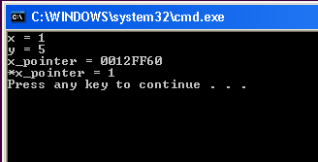
x_pointer = &x
address
* “dereferences x_pointer”

Slide 55
Dereferencing and Assigning
Address
12FF60
12FF54
12FF …
12FF …
12FF …
2
x
1
*x_pointer = 2;
y
5
Dereference x_pointer
12FF60
x_pointer

Slide 56
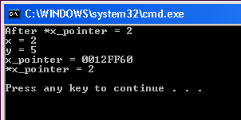
*x_pointer = 2

Slide 57
x_pointer = &y
Address
12FF60
12FF54
12FF …
12FF …
12FF …
2
x
x_pointer = &y;
y
5
“address of”
12FF60
12FF54
x_pointer

Slide 58
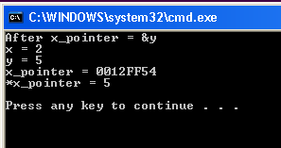
x_pointer = &y

Slide 59
*x_pointer = 3
Address
12FF60
12FF54
12FF …
12FF …
12FF …
2
x
*x_pointer = 3;
y
5
3
“dereference”
x_pointer
12FF54
x_pointer

Slide 60
Binky’s Pointer Fun
cslibrary.stanford.edu

Slide 61
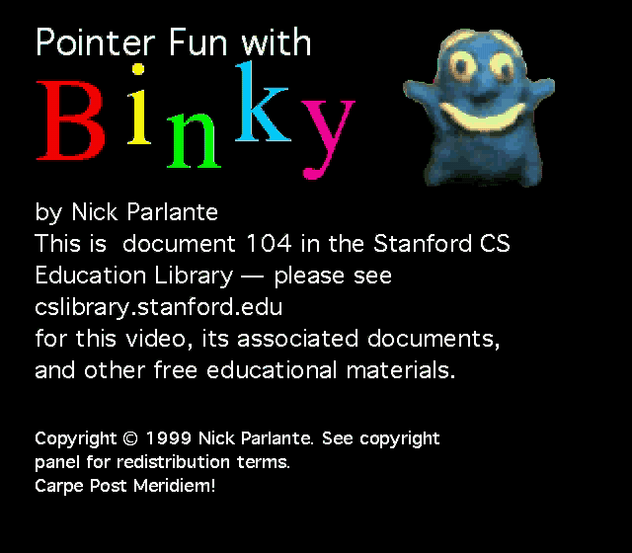
Binky’s Pointer Fun
http://www.youtube.com/watch?v=UvoHwFvAvQE

Slide 62
What Types are These?
char * x;
int **y;
Rational *rNumber1;
Square **blah;

Slide 63
Pointer Pitfalls: Uninitialized Pointers
Cause runtime errors
int n = 30;
int * p;
*p = n; //ERROR!!!
p does not have a valid memory address!
A common initializer value used by programmers is NULL
int *p=NULL; // better code, then add code to check for NULL value

Slide 64
Uses for Pointers

Slide 65
swap()
void swap(int * x, int * y)
{
int temp = *x;
*x = *y;
*y = temp;
}

Slide 66
Calling swap()
int main()
{
int a=0;
int b=3;
cout << "Before swap(): a: " << a << "b: "
<< b << endl;
swap(&b,&a);
cout << "After swap(): a: " << a << "b: "
<< b << endl;
return 0;
}

Slide 67
Dynamic Memory Allocation
new and delete

Slide 68
Static Memory Allocation
Amount of space (memory) already known
// declare array of 10 elements
int someArray[10];
// declare a pointer to int
int *value1_address = someArray[3];

Slide 69
Dynamic Memory Allocation
Don’t know how much memory is needed in advance
Need to create the space on the fly
new
returns a pointer to newly created “thing”

Slide 70
Dynamic Arrays
int main()
{
int n;
// read in a value from the user
cout << "Please enter an integer value: " ;
cin >> n;
// use the user's input to create an array of int using new
int * ages = new int [n];

Slide 71
// use a loop to prompt the user to initialize the array
for (int i=0; i < n; i++)
{
cout << "Enter a value for ages[ " << i << " ]: ";
cin >> ages[i];
}
// print out the contents of the array
for(int i=0; i<n; i++)
{
cout << "ages[ " << i << " ]: " << ages[i];
}
// finished with the array
//clean up the memory used by calling delete
delete [] ages;
return 0;
}

Slide 72
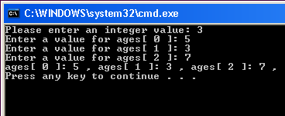
Output

Slide 73
C++ Syntax: new
General form
SomeTypePtr = new SomeType;
Examples
int * intPointer = new int;
Rational * rPointer = new Rational;
int * intPointer2 = new int(0);
Rational * rPointer2 = new Rational(1,2);

Slide 74
Memory Management
Java is garbage collected
Allocated memory is automatically reclaimed, programmer does not need to think about it
C++ does not have garbage collection
Programmer must reclaim that memory, otherwise that memory can’t be used

Slide 75
C++ Syntax -- delete
delete
delete rPointer
delete intPointer
delete []
delete [] ages

Slide 76
delete
#include <string>
using namespace std;
int main()
{
string * pointerToString = new string(“hi”);
// some code that uses pointerToString here
delete pointerToString;
return 0;
}

Slide 77
Remember this…
Anything allocated with new MUST be deallocated with delete

Slide 78
Accessing parts of an object
For a regular (i.e., non-pointer) object, use a period:
Rational r;
r.num = 4;
For a pointer, dereference it first (as *r is the object, and r is the pointer):
Rational *r = new Rational();
(*r).num = 4;
A shorthand for the last line is below (the arrow means ‘follow the pointer’):
r->num = 4;
References (which we haven’t seen yet) work like regular objects

Slide 79
End of lecture on Wed, Jan 25
We started on slide 50 today

Slide 80
C++ and memory allocation
Assume int *x has been declared
And int y is from user input
Consider these separate C++ lines of code:
x = new int[10]; // 40 bytes
x = new int; // 4 bytes
x = new int[y]; // y*4 bytes
When they are deleted, how does C++ know how much memory to free up?

Slide 81
C++ and memory allocation
#include <iostream>
using namespace std;
class Foo {
int x, y;
};
int main() {
cout << "sizeof(int): " << sizeof(int) << endl;
cout << "sizeof(Foo): " << sizeof(Foo) << endl;
Foo *foo = new Foo();
Foo *bar = new Foo();
cout << "1st Foo: " << foo << endl;
cout << "2nd Foo: " << bar << endl;
int diff = ((int)bar)-((int)foo);
cout << "Difference: " << diff << endl;
delete foo;
delete bar;
return 0;
}
sizeof(int): 4
sizeof(Foo): 8
1st Foo: 0x6a0670
2nd Foo: 0x6a0680
Difference: 16

Slide 82
Associativity of *
Consider:
char* x, y;
We can all agree that x is a character pointer (32 bits)
But what type is y?
It’s a regular char (8 bits)
The * is right associative, meaning that the spacing should be:
char *x, y;
This won’t be consistent in this course…

Slide 83
Doubly linked lists
A very brief overview

Slide 84
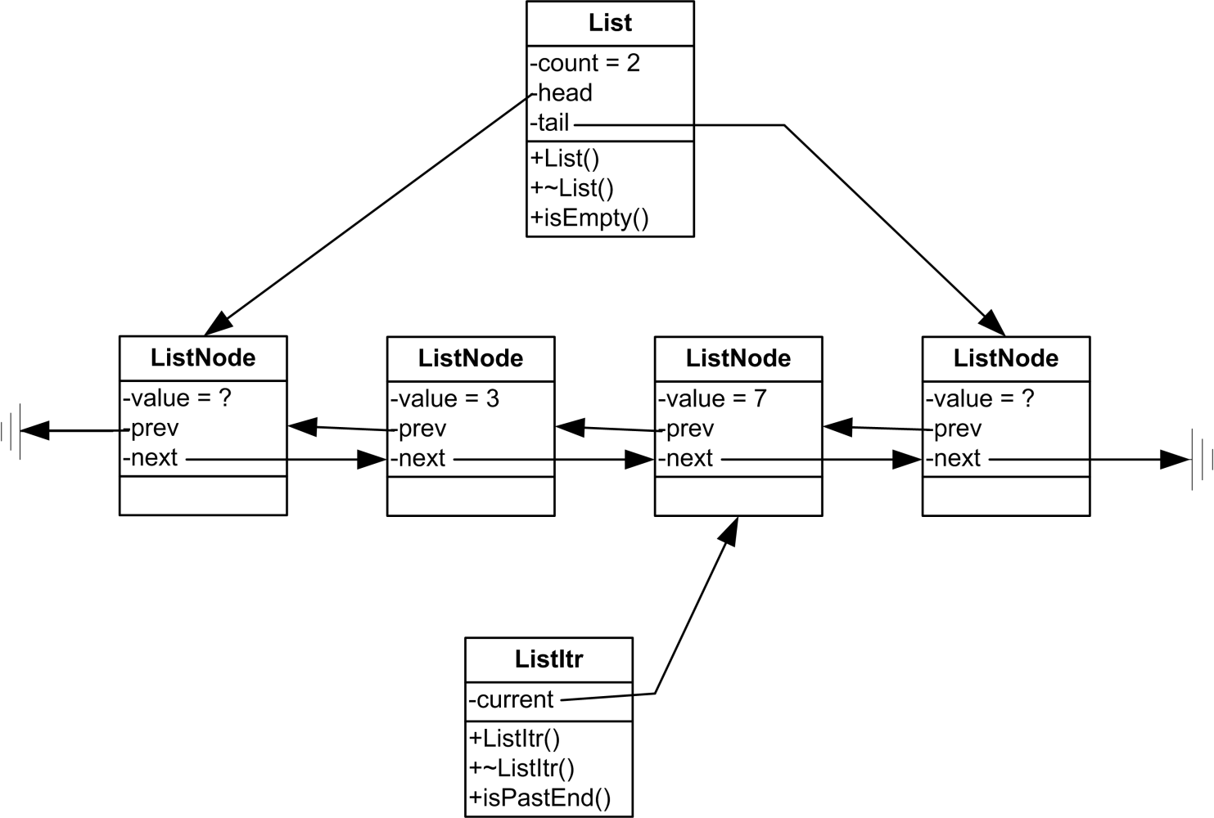
From lab 2

Slide 85
friend
Sometimes other classes need access to private data members of another class
class ListNode
{
public:
// …
private:
ListNode *next, *previous;
friend class List;
};
Why not just write accessor functions?

Slide 86
Common mistakes
Consider a class Foo with an uninitialized ListNode* field list that needs to be initialized in the constructor.
What is wrong with the following two methods?
They both compile just fine
Foo() {
ListNode* list = new ListNode();
}
Foo() {
ListNode temp();
list = &temp;
}

Slide 87
References

Slide 88
References
Declaring a reference
List sampleList = List();
List & theList = sampleList;
Reference to a List object
What is a reference?
Like a pointer, it holds an address, BUT…
Its address cannot change (its address is constant)
It MUST be initialized upon declaration (cannot be initialized to NULL… normally…)
Has implicit dereferencing
int *x = NULL;
int &y = *x;

Slide 89
swap() with Pointers
void swap(int * x, int * y)
{
int temp = *x;
*x = *y;
*y = temp;
}
Programmer must specify dereferencing explicitly

Slide 90
swap with References
void swap(int & x, int & y)
{
int temp = x;
x = y;
y = temp;
}
Dereferencing is implied with each use
All Java non-primitive types are references

Slide 91
End of lecture on Fri, Jan 27

Slide 92
Calling swap() with references
int main()
{
int a=0;
int b=3;
cout << "Before swap(): a: " << a << "b: " << b << endl;
swap(b,a);
cout << "After swap(): a: " << a << "b: "
<< b << endl;
return 0;
}

Slide 93
Accessing Members of An Object
class Square
{
public:
// constructors, etc. would be here
private:
int sideLength;
};

Slide 94
Accessing Members through a Pointer
// other code omitted for space reasons
int main()
{
Square *squarePtr = new Square(1);
int length = squarePtr->sideLength;
return 0;
}
Equivalent to saying (*squarePtr).sideLength

Slide 95
Accessing Members through a Reference
// other code omitted for space reasons
int main()
{
Square square = Square(1);
Square & squareRef = square;
int length = squareRef.sideLength;
return 0;
}
Uses a period

Slide 96
Accessing Pointers within Objects
class example1
{
…
public:
int *a;
};
…
example1 *c = new example1;
int x = 0;
(*c).a = &x
c->a = &x;
Assign address of x
dereference c, then access a

Slide 97
Pointer/Reference Cheat Sheet
Location | * | &
Definition | “pointer to” | “reference to”
Statement | “dereference” | “address of”
o1->method() is the same as (*o1).method()

Slide 98
Parameter Passing

Slide 99
Call By Value
Actual argument is copied into formal parameter
int max(int a, int b);
void swap (int * x, int *y);
bool compare(Rational left, Rational right);
Can also pass pointers by value

Slide 100
Call By Reference
Pass references as parameters
void swap (int &x, int &y);
Use when formal parameter should be able to change the value of the actual argument

Slide 101
Call By Constant Reference
Parameters are constant (won’t change) and are passed by reference
bool compare(const Rational & left, const Rational & right);
Use when there is a class type that cannot be changed by formal parameter

Slide 102
Other parameter passing types
Call by copy-restore
Call by name
Call by need
Call by macro expansion

Slide 103
Return Passing
Return by value
return a copy (possibly a copy of the pointer)
Return by reference
return a reference
Return by constant reference

Slide 104
Review

Slide 105
Review
Dynamic Memory Allocation
new
Allocates a new memory location for use
Example:
Square * ptrToAnotherSquare = new Square(5);
Triangle *ptrToTriangle = new Triangle();
Circle *ptrToCircle = new Circle;
delete
Reclaims memory allocated with new
Example:
delete ptrToAnotherSquare;
Reclaims the memory location that was allocated, NOT the pointer.
The pointer may be reassigned

Slide 106
Review
Call by value
actual argument is copied into formal parameter
Example: int max(int x, int y);
Call by reference
Passes references
Example:
void swap(int & a, int & b){/* body */}
int main()
{
int x = 1;
int y = 2;
swap(x, y); // passed by reference
return 0;
}
Use when parameters won’t need to change
Function needs to be able to change actual argument

Slide 107
Review
Call by constant reference
Passes references where function may not change the actual arguments
Example:
bool greaterThan(const Rational & a, const Rational & b);
int main()
{
Rational x(1,2);
Rational y(3,4);
bool result = greaterThan(x,y);
return 0;
}
Use for large objects where no changes will occur.
Saves copy time and space.

Slide 108
“The Big Three”
Destructors,
Copy Constructors,
operator=

Slide 109
C++ Provides These By Default
Destructor
Copy Constructor
operator=
There are some problems with these…

Slide 110
Destructors
Called whenever an object
goes out of scope, or
delete is called
Frees up any resources allocated during the use of an object
Example (only prototype shown):
~IntCell();

Slide 111
Copy Constructor
Special constructor that creates a new object, initialized to a copy of the same type of object
Called in the following situations:
declaration with initalization
IntCell copy = original;
IntCell copy(original);
if object is passed by value
if object is returned by value

Slide 112
operator=
aka copy assignment operator
Intended to copy the state of original into copy
Called when = is applied to two objects AFTER both have previously been constructed
IntCell original; // constructor called
IntCell copy;
copy = original; // operator= called

Slide 113
End of lecture on Mon, Jan 30

Slide 114
Sample (advanced) code

Slide 115
test.h
class test {
static int idcount;
const int id;
int value;
public:
test();
test(int v);
test(const test& x);
~test();
test& operator=(const test& other);
friend ostream& operator<<(ostream& out, const test& f);
};

Slide 116
test.cpp 1/2
int test::idcount = 0;
test::test() : id (idcount++), value(0) {
cout << "calling test(); object created is " << *this
<< "; address is " << this << endl;
}
test::test(int v) : id (idcount++), value(v) {
cout << "calling test(" << v << "); object created is " << *this
<< "; address is " << this << endl;
}
test::test(const test& x) : id(x.id), value(x.value) {
cout << "calling test(&test) on " << *this << "; address is " << this << endl;
}

Slide 117
test.cpp 2/2
test::~test() {
cout << "calling ~test() on " << *this << endl;
}
test& test::operator=(const test& other) {
cout << "calling operator=(" << other << ")" << endl;
test *tmp = new test(other);
return *tmp;
}
ostream& operator<<(ostream& out, const test& f) {
out << "test[id=" << f.id << ",v=" << f.value << "]";
}

Slide 118
The one subroutine…
test bar(test param) {
return test(10);
}

Slide 119
main() code and output, 1/6
test a();
cout << "attempted to create a: " << a << endl;
cout << "----------------------------------------" << endl;
test aa;
cout << "created aa: " << aa << endl;
attempted to create a: 1
----------------------------------------
calling test(); object created is test[id=0,v=0]; address is 0xff852a50
created aa: test[id=0,v=0]

Slide 120
main() code and output, 2/6
cout << "----------------------------------------" << endl;
test b(1);
cout << "created b: " << b << endl;
----------------------------------------
calling test(1); object created is test[id=1,v=1]; address is 0xff852a48
created b: test[id=1,v=1]

Slide 121
main() code and output, 3/6
cout << "----------------------------------------" << endl;
test *c = new test(2);
cout << "created *c: " << *c << " at " << c << endl;
test *d = new test;
cout << "created *d: " << *d << " at " << d << endl;
----------------------------------------
calling test(2); object created is test[id=2,v=2]; address is 0xa009008
created *c: test[id=2,v=2] at 0xa009008
calling test(); object created is test[id=3,v=0]; address is 0xa009018
created *d: test[id=3,v=0] at 0xa009018

Slide 122
main() code and output, 4/6
cout << "----------------------------------------" << endl;
cout << "about to invoke subroutine..." << endl;
test e = bar(*c);
cout << "finished invoking subroutine..." << endl;
----------------------------------------
about to invoke subroutine...
calling test(&test) on test[id=2,v=2]; address is 0xff852a38
calling test(10); object created is test[id=4,v=10]; address is 0xff852a40
calling ~test() on test[id=2,v=2]
finished invoking subroutine...

Slide 123
main() code and output, 5/6
cout << "----------------------------------------" << endl;
test f = b;
cout << "----------------------------------------" << endl;
cout << "about to delete a test object..." << endl;
delete c;
// ----------------------------------------
// calling test(&test) on test[id=1,v=1]; address is 0xff852a30
----------------------------------------
about to delete a test object...
calling ~test() on test[id=2,v=2]

Slide 124
main() code and output, 6/6
cout << "----------------------------------------" << endl;
cout << "assignment..." << endl;
aa = b;
cout << "----------------------------------------" << endl;
cout << "about to leave main..." << endl;
----------------------------------------
assignment...
calling operator=(test[id=1,v=1])
calling test(&test) on test[id=1,v=1]; address is 0xa009008
----------------------------------------
about to leave main...
calling ~test() on test[id=1,v=1]
calling ~test() on test[id=4,v=10]
calling ~test() on test[id=1,v=1]
calling ~test() on test[id=0,v=0]

Slide 125
End of lecture on Wed, Feb 1
We also went over the first 11 slides of 03-lists

