Slide 1
CS2150: Program and Data Representation
University of Virginia Computer Science
Spring 2012 Aaron Bloomfield
Yet More …C++
and
Lists… Linked Lists

Slide 2
CS2150 Roadmap
Data Representation
Program Representation
Real World Problems
Objects
High-level language
“Hello”
Java
code
[‘H’,’i’,\0]
Arrays
Low-level language
0x42381a,
3.14,
‘x’
Addresses,
Numbers,
Characters
C++ code
JVML
Virtual Machine language
x86
Assembly
01001010
Bits
Real World Physics

Slide 3
Standard Template Library
vector

Slide 4
Standard Template Library (STL)
C++ package that implements standard data structures
vector
Replacement for C++ built-in array
Arrays:
Can’t be copied with =
Doesn’t have notion of capacity
No index validity checking
string
Replacement for C built-in string (array of characters)
C strings (char array or char*)
== doesn’t compare correctly

Slide 5
Vector
Growable (can change size)
#include <vector>
Object & operator[](int idx)
Object & at(int idx)
int capacity() const
void reserve(int newCapacity)
int size() const
void clear()
bool empty()
void push_back()
void pop_back()
const Object & back() const
const Object & front() const

Slide 6
Iterators
iterator
Nested type that represents position
STL provides
iterator begin()
iterator end()
iterator methods
itr++, ++itr // advances itr
*itr //returns ref to obj at itr loc.
itr1==itr2 // true if same location
itr1!=itr2 //true if different location

Slide 7
Iterators (cont’d)
Vector operations that require iterators
iterator insert(iterator pos, const Object &x)
iterator erase(iterator pos)
iterator erase(iterator start, iterator end)

Slide 8
Further reading
Operator overloading
C++ for Java Programmers (CJP), Chapter 5
Templates
CJP, Chapter 7
Weiss, Ch. 1.6
vector
Weiss, Chapter 1.4.4, Chapter 3.3
Reference Links for Lab 2

Slide 9
C++ Templates
Function and class templates
C++ for Java Programmers, Chapter 7

Slide 10
Templates
Java
Uses inheritance to write type-independent code
Or generics
C++
Uses templates
function templates
class templates

Slide 11
End of lecture on Wed, Feb 1
Also went over the last 13 slides of 02-cpp

Slide 12
Function Templates (Ch. 7)
Not an actual function
A pattern for a function. Expanded by compiler as needed
// Return the maximum item in array a.
// Comparable objects must provide operator<
template <typename Comparable>
const Comparable & findMax( const vector<Comparable> & a )
{ int maxIndex = 0;
for( int i = 1; i < a.size( ); i++ )
if( a[ maxIndex ] < a[ i ] )
maxIndex = i;
return a[ maxIndex ];
}

Slide 13
Example
#include <iostream>
#include “IntCell.h”
#include <vector>
using namespace std;
int main()
{
vector<int> v1(37);
vector<double> v2(40);
vector<string> v3(80);
vector<IntCell> v4(75);
// intervening code omitted for space reasons…
cout << findMax(v1) << endl; // ok: Comparable = int
cout << findMax(v2) << endl; // ok: Comparable = double
cout << findMax(v3) << endl; // ok: Comparable = string
cout << findMax(v4) << endl; // Illegal: no operator<
}

Slide 14
findMax() Expanded
const int & findMax(const vector<int> &a) {…/* body of function template */ …}
const double & findMax(const vector<double> &a) {…/* body */…}
const string & findMax(const vector<string> &a) {… /* body */ …}
const IntCell & findMax(const vector<IntCell> &a) {… /* body */ …}

Slide 15
Class Templates
Similar to function template, but for classes
Not actual classes
Pattern for a class

Slide 16
ObjectCell Template Class
#ifndef OBJECTCELL_H
#define OBJECTCELL_H
template <typename Object>
class ObjectCell
{
public:
explicit ObjectCell(const Object & initValue = Object())
: storedValue(initValue) {}
const Object & getValue() const {return storedValue;}
void setValue(const Object & val) {storedValue = val;}
private:
Object storedValue;
};
#endif

Slide 17
Using ObjectCell class template
int main()
{
ObjectCell<int> m1;
ObjectCell<double> m2(3.14);
m1.setValue(37);
m2.setValue(m2.getValue() *2);
…
}

Slide 18
Templates Miscellaneous
Templates can have more than one parameter
template <typename Keytype, typename ValueType>
class Map{/* … */};
Map<string,Date> birthdays;

Slide 19
Templates Misc. (cont’d)
Non-type parameters
template <typename Object, int size>
class Buffer{};
nontype parameter must be compile-time constant
Buffer<string,1024> buf1;

Slide 20
Templates Misc. (cont’d)
Default template parameters
template <typename Object=char, int size=4096>
class Buffer{};
nontype parameter must be compile-time constant
Buffer<> buf1; // Buffer<char,4096>
Buffer<int> buf2; // Buffer<int,4096>
Member templates
See CFJ 7.5.4

Slide 21
Abstract Data Types: Lists
Linked Lists

Slide 22
Abstract Data Types (ADT)
Set of objects with a set of operations that can be performed on the object
Definition of a type
A C++ class is a way to implement an ADT
Hides implementation details from the programs that use them
Why?
Huh?

Slide 23
Lists ADT
A₀, A₁, A₂, A₃,…
size N
empty list – list of size 0
A₀ is the first element
A_{i} follows A_{i-1}
position of element A_{i} is I
Extended the language by adding a new type

Slide 24
List ADT Operations
printList
print the list
makeEmpty
make the list empty
find
find the position of an item in the list
insert
insert an item to the list
remove
remove an item from the list
findKth
find the element at position K
next
return the position of the successor
previous
return the position of the predecessor
Why these operations?
What if we need more?

Slide 25
Example
34, 12, 52, 16, 12
A₀, A₁, A₂, A₃, A₄
find(52)
returns 2 //position of 52
insert(x,2)
34, 12, x, 52, 16, 12
remove(52)
find(1)
Why not 3?

Slide 26
Implementations of Lists: Arrays
pos
0 1 2 … n-2 n-1
A₀
A₁
A₂
…
A_{n-2}
A_{n-1}
Fixed capacity
printList – linear time
findKth – constant time
insert and delete - varies
Important performance statistics

Slide 27
List Implementation: Linked List
A₀
A₁
A₂
A₃
Nodes
element
link (pointer!) to node containing successor
printList, find, findKth – linear time
remove – change one pointer
insert
get a new node (new)
adjust 2 pointers

Slide 28
Linked List insert()
Special cases
inserting to the front
inserting at the end
removing last node

Slide 29
List Iterators
Why are they needed?
position is needed for some list operations
find()
insert()
remove()
ListItr
maintains notion of position by maintaining a pointer to a particular ListNode

Slide 30
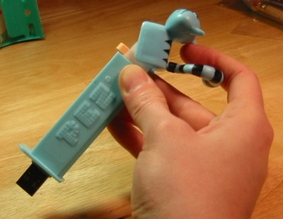
Stacks
LIFO

Slide 31
Stacks
List with restrictions
Insert and delete can only be performed at the top of the list
LIFO
Attributes
top of stack
Fundamental operations (constant time)
Push
Put on the top
Pop
Delete from the top
on empty stack causes exception
Top
Examine top of the stack
on empty stack causes exception

Slide 32
Stack Applications
Undo operation in programs
Operator precedence
Symbol balancing
Parenthesis matching
Postfix calculators
Activation records
List of active procedures and associated information

Slide 33
Stack Applications: Symbol Balancing
Read characters to end of file
If opening symbol
Push onto stack
If closing symbol
If stack empty
error!
Else Pop stack
If popped symbol is not corresponding opening symbol
error!
If at EOF and stack not empty
error!

Slide 34
Stack Applications: Symbol Balancing
{ ( [ ] ) }
{ [ ( } ) ]

Slide 35
Stack Applications: Postfix Calculator
If number
Push number onto stack
If operator
Apply operator to 2 numbers popped from stack, then place result on stack

Slide 36
Stack Applications: Postfix Calculator
6 5 2 3 + 8 * + 3 + *

Slide 37
Stack Applications: Activation Records
Memory
0x0
Program
Heap
0xffffffff
Stack

Slide 38
Stack Applications: Activation Record
Memory
0x0
Program
Stack Pointer
…
Fib(n-2)
Fib(n-1)
main
0xffffffff
Stack

Slide 39
End of lecture on Fri, Feb 3

Slide 40
Implementations: Linked List
Singly linked list
Push – insert at front of list
Pop – remove element at front of list
Top – examine element at front of list

Slide 41
Stack: Linked List Implementation
#include “ListNode.h”
class Stack {
public:
Stack(); // constructor
~Stack(); // destructor
bool isEmpty() const; // checks for empty
void push(int value); // push value onto stack
void pop(); // pop top of stack
int top(); // returns topOfStack
private:
ListNode * topOfStack; // or perhaps StackNode…
};
assumes stack of int stored in
ListNode

Slide 42
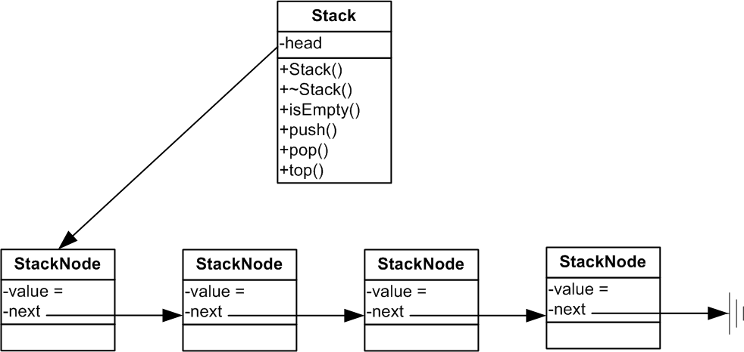
Stack: Linked List Implementation
Stack()
~Stack()
void push (int)
bool isEmpty()
void pop()
int top()

Slide 43
Implementations: Array
Array
Avoids links, most operations are very fast constant time
Stack consists of
theArray // the stack
topOfStack // current index of the top
Push
Increment topOfStack
Set theArray[topOfStack] to value
Pop
Set return value = theArray[topOfStack]
Decrement topOfStack

Slide 44
Stack: Vector Implementation
#include <vector>
using namespace std;
class Stack {
public:
Stack(); // constructor
~Stack(); // destructor
bool isEmpty() const; // checks for empty
void push(int value); // push value onto stack
void pop(); // pop top of stack
int top();
private:
vector<int> theStack;
};

Slide 45
Stack: Vector Implementation
//isEmpty() return true if stack is size 0
bool Stack::isEmpty() const {
return (theStack.size()==0);
}
// push implementation
void Stack::push(int value){
theStack.push_back(value);
}

Slide 46
How Would You Implement pop() and top()?
void Stack::pop(){
}
int Stack::top(){
}

Slide 47
Stacks
List with restrictions
Insert and delete can only be performed at the top of the list
LIFO
Attributes
top of stack
Fundamental operations (constant time)
Push
Pop
Top
Implementations
Linked List
Array
Vector (variable size “array”)

Slide 48
Queues

Slide 49
Queues
Also list: Operations
Enqueue - Insert at one end (back)
Dequeue - Delete at other end (front)
FIFO
Linked list and array implementations are constant time for all operations

Slide 50
Implementations
Arrays
theArray
front position/index
back position/index
current size
Linked List

Slide 51
Array Implementation
Operations
enqueue
increment current size
increment back
set theArray[back] = element
dequeue
set return value to theArray[front]
decrement current size
increment front

Slide 52
Linked List Implementation
class Queue{
public:
Queue(); // constructor
~Queue(); // destructor
// enqueue item to back of list
void enqueue(ListNode *node);
// remove item from front of list
ListNode * dequeue();
// other supporting methods…
private:
// pointers to front and back of list
ListNode * front, *back;
};

Slide 53
Linked List Implementation
enqueue
dequeue

Slide 54
Queue Applications
Print queues
Lines in general
File serving
Call queues

Slide 55
C++ string manipulation and conversion

Slide 56
C++ string
C++ <string> library
provides string class and member functions
size()
length()
at()
operator[]
operator+=
c_str()
substr()

Slide 57
Code Demo – cStringTest.cpp
at(int pos)
access character within string at index position, pos
someString.at(3);
operator[]
access character within string using array-style notation
someString[3];
c_str()
converts C++ string to C-style string
used to convert c++ string to C-style which is char *
substr()
returns substring of a string given some parameters
See source code

Slide 58
Entering Control-D for input
… will return an empty string (length 0)
Like Java, to compare strings, you need to compare the characters that they point to
.equals() in Java
But in the STL string class, the == operator is overloaded to do this!
So you can compare STL strings with ==
But not standard C strings (i.e. char*)

Slide 59
from_string()
template <typename theType>
// returns false if conversion fails
bool from_string(theType & t,
const string & s,
ios_base& (*theFuncPtr)(ios_base &))
{
// input string stream to parse
istringstream inputStringStream(s);
// call the appropriate function for the type
return !(inputStringStream >> theFuncPtr >> t).fail();
}

Slide 60
End of lecture on Mon, Feb 6
Also went over the first 9 slides of 04-numbers

