Slide 1
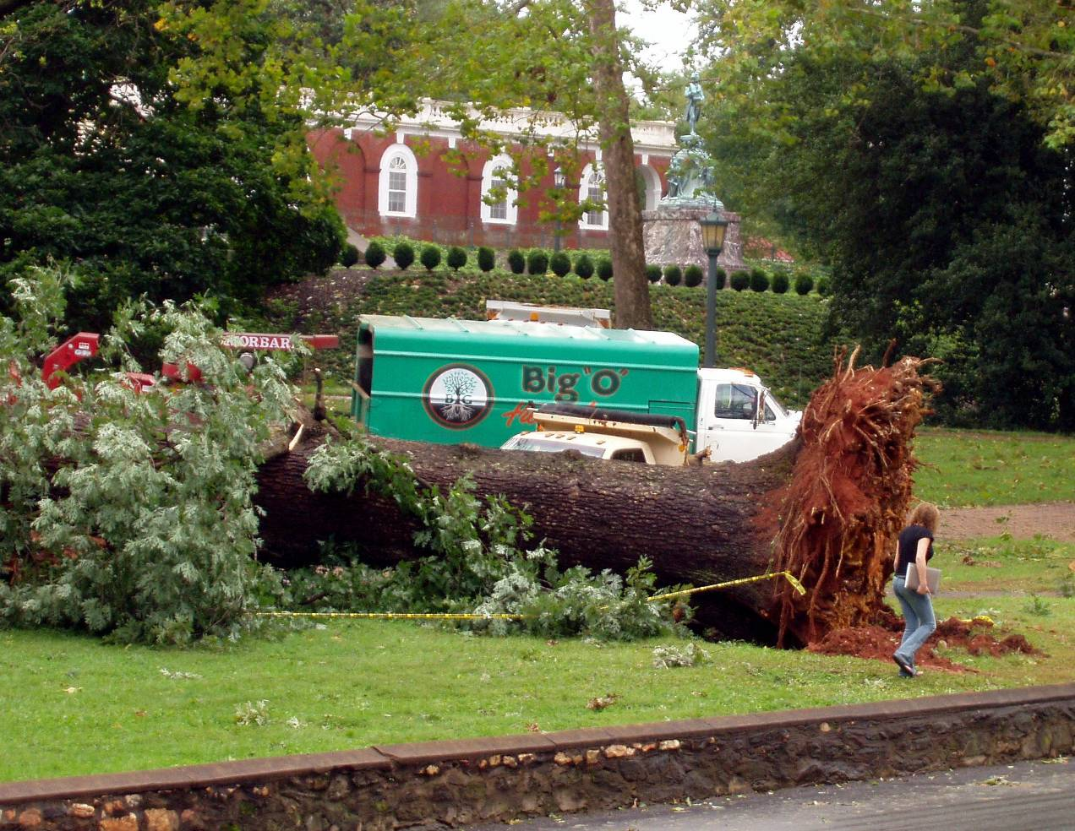
CS2150: Program and Data Representation
University of Virginia Computer Science
Spring 2012 Aaron Bloomfield
Primitive Arrays
and
Order of Growth

Slide 2
Topics
Primitive Arrays in C/C++
C++ implementation
Orders of Growth
Why?
What? O, Ω, Θ, o, ω
How?

Slide 3
Primitive arrays in C/C++

Slide 4
Primitive Arrays in C++
Declaring (two ways):
Specify name, type, and size
int someInts[3];
Specify name, type, and initialization list
int someInts[ ] = {4, 37, 18};
Creates 3 ints
someInts[0], someInts[1], someInts[2]

Slide 5
Things to Note about Arrays in C++
No index checking!
Compiler and runtime system will not catch accesses out of array index bounds
Out of bounds access will cause unpredictable behavior
When passed as an argument to a function
Function does not know the size of the array
Need to pass another argument containing the size
Cannot be copied with =
Must be copied element by element

Slide 6
C++ Implementation of Arrays
Array names are pointers to beginning of array
int someInts[3];
size is only used by compiler to set aside memory for the array
someInts is set to &someInts[0]
Also called the base address
Local constant – Cannot be changed
Note that the previous declaration is almost the same as int* someInts = new int[3];

Slide 7
int someInts[3];
Address
&someInts[0]
1000
someInts[0]
&someInts[1]
1004
someInts[1]
someInts[2]
&someInts[2]
1008
…
local constant
someInts=1000
Assumes ints are
4 bytes

Slide 8
Where is someInt[i] located in memory?
Remember
someInts is a pointer to address of someInts[0] (&someInt[0])
Array elements are laid out sequentially in contiguous memory addresses
&someInts[i] = {addr of someInts} + (sizeof(int) * i)

Slide 9
Operations on Arrays
someInts=someOtherArray; // illegal
Array base addresses are considered constant (cannot be reassigned)
This is one example of when pointers and arrays are NOT the same
Is someInts==someOtherArray allowed?
Yes, but will only evaluate to true if someInts and someOtherArray point at the same memory location

Slide 10
Function Calls and Arrays
someFunc(int arrayOfInts[]){ … }
…
int main()
{
int someInts[3];
someFunc(someInts);//no brackets
}
someInts is a memory address
size of someInts[] unknown
Is this pass by reference?
Pass by value?

Slide 11
Multidimensional Arrays
int m[2][3]; //2 rows, 3 columns
int m[][] =
{{1,2,3},{4,5,6}};
// initialize row 0: 1,2,3
// initialize row 1: 4,5,6

Slide 12
C++ Implementation
Single row layout
0
1
2
row major
0
m
1
1000
1000
m[0][0]
m[0][1]
m[0][2]
m[1][0]
m[1][1]
m[1][2]

Slide 13
Command-line parameters
You can define the main() method as:
int main()
int main (int argc, char **argv)
Or: int main (int argc, char* argv[])
The second gives us two parameters:
The number of command line parameters
Note that the program executable is 1
An array of C-style strings (char*) containing those parameters

Slide 14
Orders of growth

Slide 15
Orders of Growth
Algorithm Analysis
Orders of growth classes
Running Time Calculations

Slide 16
Classifying functions by their Asymptotic Growth Rates
Asymptotic growth rate, asymptotic order, or order of functions
Comparing and classifying functions that ignores constant factors and small inputs.
The sets big oh O(g), big theta Θ(g), big omega Ω(g)
Ω(g): functions that grow at least as fast as g
g
Θ(g): functions that grow at the same rate as g
O(g): functions that grow no faster than g

Slide 17
Why do we care?
Some data structures are faster than others
Each data structure has some operations that are fast, and some that are slow
We need a way to compare them
This allows us to
Better choose the data structures that we will use
Better design additional data structures

Slide 18
Input sizes
Your algorithm does not matter if you have 10 elements
A shuffle sort will work just fine
Consider big input sizes:
UVa’s e-mail has ~100,000 e-mail addresses
Mapquest (for driving routes) has ~20 million intersections
Google’s index is 24 billion items

Slide 19
Even for small input sizes…
This is from the first lecture set
All times are in ms (1/1000th of a second)
Data structure | Total time | Insert time | Search time | Delete time
Vector | 17,311 | 30 | 12,620 | 4,661
ArrayList | 17,281 | 28 | 12,609 | 4,644
LinkedList | 24,255 | 54 | 17,934 | 6,267
HashSet | 122 | 103 | 9 | 10
TreeSet | 119 | 93 | 14 | 12
Vector, sorted | 294 | 36 | 19 | 239

Slide 20
The Sets O(g), Θ(g), Ω(g)
Let g and f be a functions from the nonnegative integers into the positive real numbers
For some real constant c > 0 and some nonnegative integer constant N₀
O(g) is the set of functions f, such that
f(N) ≤ c g(N) for all N ≥ n₀
Ω(g) is the set of functions f, such that
f(N) ≥ c g(N) for all N ≥ n₀
Θ(g) = O(g) ∩ Ω(g)
Θ(g) is the asymptotic order of g or the order of g
f ∈Θ(g) read as “f is asymptotic order g” or “f is order g”

Slide 21
End of lecture on Wed, Feb 15

Slide 22
Asymptotic Bounds
The Sets big oh O(g), big theta Θ(g), big omega Ω(g) – remember these meanings:
O(g): functions that grow no faster than g, or asymptotic upper bound
Ω(g): functions that grow at least as fast as g, or asymptotic lower bound
Θ(g): functions that grow at the same rate as g, or asymptotic tight bound

Slide 23
O Examples
f (n) ∈ O (g (n)) means: there are positive constants c and n₀ such that f(n) ≤ cg(n) for all values n ≥ n₀.
x ∈ O (x²)?
Yes, c = 1, n₀=2 works fine.
10x ∈ O (x)?
Yes, c = 11, n₀=2 works fine.
x² ∈ O (x)?
No, no matter what c and n₀
we pick, cx² > x for big enough x

Slide 24
Given f ∈ O (h) and g ∉ O (h) which of these are true
For all positive integers m, f (m) < g (m).
For some positive integer m, f (m) < g (m).
For some positive integer m₀, and all positive integers m > m₀, f (m) < g (m).
a and b
b and c
a and c

Slide 25
1 is false: Prove by Counter-Example
f (n) ∈ O (h (n)) and g (n) ∉ O (h (n))
For all positive integers m, f (m) < g (m).
Pick h (n) = n², f (n) = 5n², g(n)= n³.
For m = 2, f (m) = 20 > 8 = g(m).
Therefore, a is false.
f (n) ∈ O (g (n)) means there are positive constants c and n₀ such that f(n) ≤ cg(n) for all values n ≥ n₀.

Slide 26
2 is true: Intuition
If f ∈ O (h) and g ∉ O (h) then, for some positive integer m, f (m) < g (m).
g must grow faster than h, otherwise g would be in O(h).
f must grow no faster than h, since f ∈ O (h)
So, if g grows faster than h, but f grows as slow or slower than h, eventually, g(n) > f (n) so for some m, f (m) < g (m).

Slide 27
Given f ∈ O (h) and g ∉ O (h) which of these are true
For all positive integers m, f (m) < g (m).
For some positive integer m, f (m) < g (m).
For some positive integer m₀, and all positive integers m > m₀, f (m) < g (m).
a and b
b and c
a and c

Slide 28
Lower Bound: Ω (Omega)
f(n) is Ω (g (n)) means:
There are positive constants c and n₀ such that
f (n) ≥ cg(n)
for all n ≥ n₀
Difference from O: this was ≤

Slide 29
Where is
Ω(n²)?
O(n³)
f(n) = 12n² + n
O(n²)
f(n) = n^{2.5}
Ω(n²)
Faster Growing
f(n) = n^{3.1} – n²

Slide 30
Theta (“Order of”)
Intuition: the set Θ(f ) is the set of functions that grow as fast as f
Definition: f (n) ∈ Θ (g (n)) if and only if both:
1. f (n) ∈ O (g (n))
and 2. f (n) ∈ Ω (g (n))
Note: we do not have to pick the same c and n₀ values for 1 and 2
When we say, “f is order g” that means f (n) ∈ Θ (g (n))

Slide 31
Tight Bound Theta (Θ)
O(n³)
f(n) = 12n² + n
O(n²)
f(n) = n^{2.5}
Ω(n²)
Θ(n²)
Faster Growing
f(n) = n^{3.1} – n²

Slide 32
Little-oh
Let g(x) ∈ o(f(x))
Any function that is o(f) is also O(f)
So both act as an upper bound
But a O(f) bound can also be Ω(f) and thus Θ(f)
Meaning the bound can be tight
Little-oh means the bound can not be tight
Thus, it’s O(f) but not Ω(f)
Or, that g(x) will ALWAYS be lower than f(x)
For some constants c and n₀
Rarely used in computer science…

Slide 33
Little-omega
Analogous to little-oh
It’s a lower bound that cannot be a tight lower bound
If something is ω(f), then it’s Ω(f), but not O(f) (or o(f) or Θ(f))
Rarely used in computer science…

Slide 34
Another Way to Define Order Classes
Comparing f(n) and g(n) as n approaches infinity,
If
< ∞, including the case in which the limit is 0 then f ∈O(g)
> 0, including the case in which the limit is ∞ then f ∈ Ω(g)
= c and 0 < c < ∞ then f ∈ Θ(g)
= 0 then f ∈ o(g) //read as “little oh of g”
= ∞ then f ∈ ω(g) //read as “little omega of g”

Slide 35
A note about notation
Technically, f(x) = O(h(x)) implies an equality
This is really an abuse of notation, but we can deal with it
It should be f(x) ∈ O(h(x))

Slide 36
Some Properties of O(g), Θ(g), Ω(g)
Transitive: If f ∈O(g) and g ∈O(h), then f ∈O(h)
O is transitive. Also Ω, Θ, o, ω are transitive.
Reflexive: f ∈ Θ(f)
As is big-Oh and big-omega
Symmetric: If f ∈ Θ(g), then g ∈ Θ(f)
Big-Oh is not symmetric! (neither is Ω, o, or ω)
Θ defines an equivalence relation on the functions.
Each set Θ(f) is an equivalence class (complexity class).
f ∈O(g) ⇔ g ∈ Ω(f)
O(f + g) = O(max(f, g))
similar equations hold for Ω and Θ

Slide 37
Classification of functions
Θ(1) denotes the set of functions bounded by a constant (for large n)
f ∈ Θ(n), f is linear
f ∈ Θ(n log n), f is log-linear
f ∈ Θ(n²), f is quadratic
f ∈ Θ(n³), f is cubic
f ∈ Θ(2^{n}), f is exponential
n^{k} ∈ o(c^{n}) for any k > 0 and any c > 1
powers of n grow more slowly than any exponential function c^{n}

Slide 38
A note about logs
The difference between log₁₀x and log₂x is always a constant
Specifically, about 3.322
Since we don’t care about constants in these analyses, we’ll ignore the log base
Most things in CS are log base 2 anyway…

Slide 39
Typical Growth Rates
Function | Name
c | Constant
log N | Logarithmic
log² N | Log-squared
N | Linear
N log N | Log-linear
N² | Quadratic
N³ | Cubic
2^{N} | Exponential

Slide 40
Does Order Class Matter?
No, not for small inputs
Yes, for many real problems
Notes:
Start here on 9/6/05

Slide 41
Practical Complexity

Slide 42
Practical Complexity

Slide 43
Practical Complexity

Slide 44
Practical Complexity

Slide 45
Practical Complexity

Slide 46
General Rules for Running Time Calculations (Big-Oh)
For loops
At most the running time of the statements inside the for loop
Nested loops
Analyze from inside to out.
Runtime of the statement * product of the sizes of the loops
Consecutive statements
Additive
if/else
Time for the test + longer of the runtimes

Slide 47
End of lecture on Fri, Feb 17
We aren’t going over the remaining slides in this lecture set

Slide 48
Another Example: Fibonacci Numbers
Recursive mathematical definition
Fibonacci numbers: F(0) = F(1) = 1 F(n) = F(n-1) + F(n-2) for n > 1
Note base case
How to implement? Can you name two different ways?
Loop. Complexity: O(n)
Recursively. Complexity: exponential!

Slide 49
Implement Fibonacci numbers
It’s beautiful code, no? long fib(int n) { assert(n >= 0); if ( n <= 1 )
return 1; return fib(n-1) + fib(n-2); }
Is there a problem here? (Yes, inefficient.)
Run and time it.
Trace it out
Show what recursive calls are made for smaller inputs

Slide 51
Analysis of Recursive fib(n)
long fib(int n) { assert(n >= 0); if ( n <= 1 )
return 1;
return fib(n-1) +
fib(n-2); }
Time for each recursive call:
T(Base case)
+
T( fib(n-1) )
+
T( fib(n-2) )
// O(1)
Repeated substitution

Slide 52
Analysis of fib(n)
T(n) | T(n-1) + T(n-2) + c
T(n-1) | T(n-2) + T(n-3) + c
T(n-2) | T(n-3) + T(n-4) + c
T(n-3) | T(n-4) + T(n-5) + c
T(n-4) | T(n-5) + T(n-6) + c
...

Slide 53
Fib 5
Fib 4
Fib 3
+c
Fib 3
Fib 2
+c
Fib 2
Fib 1
+c
Fib 1
Fib 0
+c
Fib 2
Fib 1
+c
Fib 1
Fib 0
+c
Fib 1
Fib 0
+c

Slide 54
Recursion: Good or Evil?
It depends…
Sometimes recursion is an efficient design strategy, sometimes not
Important! we can define recursively and implement non-recursively
Note that many recursive algorithms can be re-written non-recursively
Use an explicit stack
Remove tail-recursion (compilers often do this for you)
For Fibonacci, the answer is: Bad Idea!

Slide 55
Fibonnaci, non-recursive
long fib(int n) {
int previous = 1; // initialize fib 0 = 1
int result = 1; // initialize to fib 1 = 1
if(n == 0 || n==1)
return result;
for(int i = 2; i <= n; i++) { // calculate for n ≥ 2
int sum = result + previous;
previous = result; // save previous result
result = sum; // save current result
}
return result;
}

Slide 56
Binary Search
int binarySearch(const vector<char> & theVec, char value) {
int low = 0, high = theVec.size()-1;
while (low <= high) {
int mid = (low+high)/2;
if(theVec.at(mid) < value) // need to search right half
low = mid + 1;
else if(theVec.at(mid) > value) // need to search left half
high = mid – 1;
else
return mid; // found it!
}
return NOT_FOUND;
}

