Slide 1
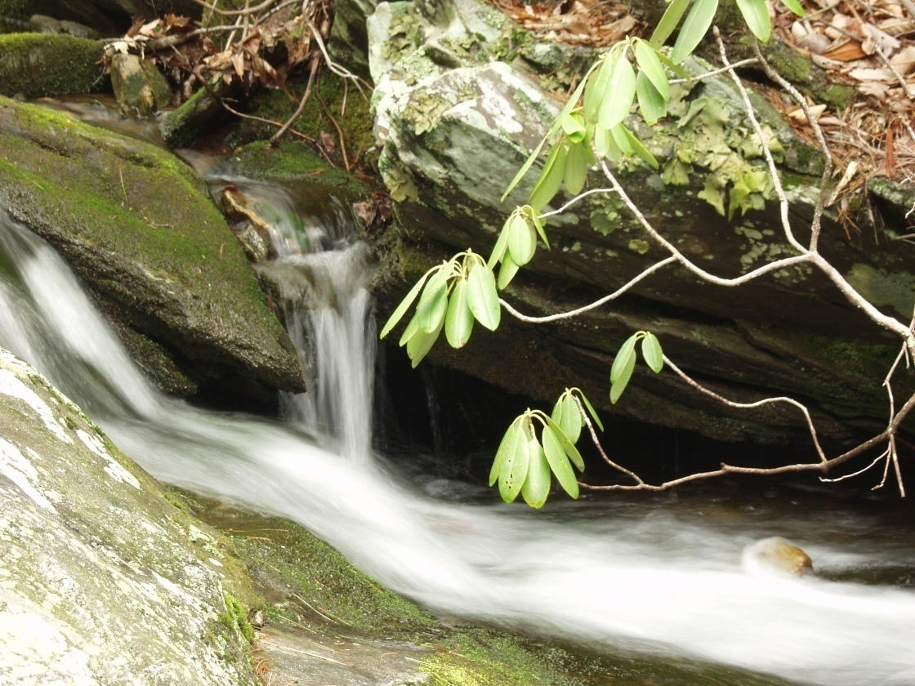
CS2150: Program and Data Representation
University of Virginia Computer Science
Spring 2012 Aaron Bloomfield
Trees

Slide 2
Trees: Main Points
Definitions and terminology
Five types of trees:
Binary trees
Binary search trees
AVL trees
Splay trees
Red-black trees
Tree traversals
pre-order
post-order
in-order

Slide 3
Data Structures
If we have a good list implementation, do we need any other data structures?
For computing: no
We can compute everything with just lists (actually even less). The underlying machine memory can be thought of as a list.
For thinking: yes
Lists are a very limited way of thinking about problems.

Slide 4
List Limitations
L
Info:
1
Info:
2
Info:
3
Next:
Next:
Next:
Node
Node
Node
In a list, every element has direct relationships with only two things: predecessor and successor
Access time: Θ(n)
Goal: Θ(log n)

Slide 5
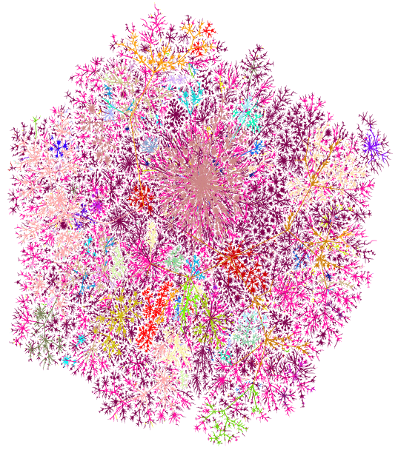
Complex Relationships
Bill Cheswick’s
Map of the Internet
http://research.lumeta.com/ches/map/gallery/

Slide 6
Tree Terminology

Slide 7
List → Tree
List: each element has relationships with up to 2 other elements:
Binary Tree: each element has relationships with up to 3 other elements:
Predecessor
Element
Successor
Parent
Tree is a special case of List
Element
Left Child
Right Child

Slide 8
Tree Terms
Root: a node with no parent
There can only be one root
Leaf: a node with no children
Sibling: same parent
Height of a Node: length of the longest path from that node to a leaf
Height of a Tree: maximum depth of a node in that tree = height of the root
Depth of a Node: length of the path from the Root to that node

Slide 9
Tree Terms
Root
Note that CS trees
are usually drawn
upside down!
French
Height = 3
Depth = 4
Romanian
Spanish
Italian
Norwegian
Czech
Leaf
German
Anglo-Saxon
Height = 0
English
Sibling

Slide 10
More Tree Terms
Path: sequence of nodes n₁, n₂, …, n_{k} such that n_{i} is parent of n_{i+1} for 1≤ i ≤k
Length: number of edges in the path
Internal path length: sum of the depths of all nodes

Slide 11
Other Examples of Trees
=
Files/folders on a computer
Compilers: parse tree
a = (b+c) * d;
Genealogy trees
Becomes complicated with some complex family relationships
Lab 5 – expression trees
a
*
+
d
b
c

Slide 12
First child/next sibling
home
class TreeNode
{
private:
string element;
TreeNode *firstChild;
TreeNode *nextSibling;
public:
// …
}
aaron
cs2150
cs2110
Mail
school
pers
lab1
lab2
proj1
coll.h
coll.cpp
proj.h

Slide 13
Tree Traversals
TreeNode::printTree(TreeNode tnode)
{
tnode.print();
for each child c of tnode
c.printTree();
}
int TreeNode::numNodes(TreeNode tnode)
{
if(tnode==NULL)
return 0;
else
{
sum=0;
for each child c of tnode
sum += numNodes(c);
return 1 + sum;
}
}
pre-order
node first,
then children
post-order
children first,
then node

Slide 14
Tree Preorder Traversal
A
B
C
D
E
F
G
H
I
J
K
L
M

Slide 15
Traversals of trees
/
*
*
+
-
5
6
1
2
3
4
Pre: / * + 1 2 – 3 4 * 5 6
In: (1+2) * (3-4) / (5*6)
Post: 1 2 + 3 4 - * 5 6 * /

Slide 16
In-order Traversal
void BST::print(BNode *curNode) {
if(curNode != NULL) {
print(curNode->left);
cout << curNode->element;
print(curNode->right);
}
}
in-order
left node first,
then self
then right node

Slide 17
Types of Trees

Slide 18
Binary Trees
All nodes have at most 2 children
class BinaryNode
{
public:
// …
private:
int element;
BinaryNode *left;
BinaryNode *right;
};
1
2
3
4
5
1
6
2
3
7
4
5
6
7

Slide 19
Binary Search Trees (BST)
Each node has a key value that can be compared
Binary search tree property
every node in left subtree has key whose value is < root’s key value, AND
every node in right subtree has key whose value is > root’s key value

Slide 20
Example
5
4
8
1
7
11
3

Slide 21
Counter-Example
8
5
11
2
6
10
18
4
20
15
21

Slide 22
The difference:
Both binary trees and binary search trees have 0-2 children per node
But a binary search tree is sorted

Slide 23
Binary Search Tree Operations

Slide 24
find
Basic idea:
Compare value to be found to key of the root of the tree
if they are equal, then done
if not equal, recurse depending on which half of tree the value should be in if it is in tree.

Slide 25
BST find
BNode * BST::find(const int x, BNode *curNode) {
// handle case where a NULL pointer could be passed
// curNode->right or curNode->left might be NULL
if(curNode == NULL)
return NULL;
else if(x < curNode->element)
return find(x, curNode->left); // search left
else if(x > curNode->element)
return find(x, curNode->right); //search right
else
return curNode; // matched
}

Slide 26
BST insert
Do a find, when we reach a NULL pointer, create a new node there.
void BST::insert(const int x, BNode * & curNode) {
if(curNode==NULL)
curNode = new BNode(x,NULL,NULL);
else if(x < curNode->element)
insert(x, curNode->left);
else if(x > curNode->element)
insert(x, curNode->right);
else
; // duplicate… do nothing
}

Slide 27
End of lecture on Mon, Feb 20

Slide 28
BST findMax, findMin
To find the maximum element in BST:
5
4
8
1
7
11
3

Slide 29
BST remove
Disrupts tree structure
Code in Weiss fig. 4.26
Basic idea:
find node to be removed.
“fix” tree so that binary search tree property still holds true
Cases:
Node has no children
Node has one child
Node has two children

Slide 30
No Children
5
4
8
1
7
11
3

Slide 31
One Child
Adjust pointer of parent to point at child, reclaim memory
5
4
8
1
7
11
3

Slide 32
Two Children
5
4
8
1
7
11
3

Slide 33
Two Children
Replace node with successor. Then remove successor from tree.
7
4
8
1
7
11
3

Slide 34
BST Heights

Slide 35
BST Height
n-node BST: Worst case depth
n-1
Claim:
Max number nodes in a
binary tree of height h is
2^{h+1} -1
1
2
3
4
5
6
7

Slide 36
Proof by Induction on h
For h=0, tree has one node, which is 2⁰⁺¹-1 = 1
Assume the claim is true for any tree of height h.
Any tree of height h+1 has at most 2 subtrees of height h. Each subtree has 2^{h+1} -1 nodes; add one more for the root
Thus, our new tree of height h+1 has:
2(2^{h+1} -1)+1 = 2^{h+2} -1 nodes
If we put h+1 into our inductive hypothesis (instead of h), we get the same value
Thus, it is proven

Slide 37
Relationship between h and n
Given n nodes and height h, then by the claim,
n ≤ 2^{h+1} -1
Simplify:
n+1 ≤ 2^{h+1}
log₂(n+1) ≤ log₂(2^{h+1})
log₂(n+1) ≤ h + 1
so, h ≥ log(n+1) -1
Average depth of
nodes in a tree
Assumes: random insertion;
each item equally likely
to be looked up

Slide 38
Perfect Binary Tree
How many leaves?
2^{h}
How many nodes?
h
2^{h+1}-1
All leaves have the same depth
# Nodes = 1 + 2 + 2² + ... + 2^{h}

Slide 39
Expression Trees
Prelab 5

Slide 40
Expression Trees
+
Infix
(a + ((b+c) *d))
Postfix
a b c + d * +
Prefix
+ a * + b c d
a
*
+
d
b
c

Slide 41
Building Expression Trees
Textbook, Chapter 4.2.2
Uses a stack
In-class example

Slide 42
AVL Trees

Slide 43
Animation Tools
http://www.qmatica.com/DataStructures/Trees/BST.html
That domain seems to be currently having problems; a mirror is at http://webdiis.unizar.es/asignaturas/EDA/AVLTree/avltree.html
We’ll be using this website throughout this slide set

Slide 44
End of lecture on Wed, Feb 22

Slide 45
AVL Trees
Motivation:
Guarantee Θ(log n) running time on find, insert, and remove
Idea:
Keep tree balanced after each operation
Solution: AVL trees
Named after the inventors, Adelson-Velskii and Landis

Slide 46
AVL Tree Property
For every node in the tree, the height of the left and right sub-trees differs at most by 1.

Slide 47
AVL Tree
5
4
9
1
7
11
8

Slide 48
AVL balance factor
Each node of a BST holds:
The data
Left subtree node
Right subtree node
Maybe a parent node
An AVL tree also holds a balance factor
The height of the right subtree minus the height of the left subtree
Can be computed on the fly, as well..
“Balanced” trees
0 means balanced
1 means the right subtree is one longer than the left subtree
-1 means the left is 1 more than the right
“Unbalanced” trees
A balance factor of -2 or 2
We’ll fix the tree
Will we ever hit -3 or 3?

Slide 49
AVL Tree, with balance factors
5
1
By definition, a BST is a valid AVL tree if the balance factor for EVERY node is -1, 0, or 1
-1
4
9
-1
1
1
7
11
0
0
8
0

Slide 50
Not an AVL Tree
5
-2
Not balanced!
Height diff>1
0
4
-3
8
1
0
7
11
0
2
3
-1
2
0

Slide 51
AVL Tree Operations

Slide 52
AVL Trees: find, insert
find: same as BST find
insert: same as BST insert, except might need to “fix” the AVL tree after the insert (rotations)
Runtime analysis:
Θ(d), where d is the depth of the node being found/inserted
What is the maximum height of an n-node AVL tree?

Slide 53
AVL tree operations
Perform the operation (insert, delete)
Move back up to the root, updating the balance factors
Why only those nodes?
Because those are the only ones who have had their subtrees altered
Do tree rotations where the balance factors are 2 or -2

Slide 54
How many times to “fix” the tree?
Any single insert will only modify the balance factor by one
So we fix the lowest off-balance nodes
Then everything above it is then balanced
This means that we will have to only look at the bottom two unbalanced nodes

Slide 55
AVL insert
Let x be the deepest node where imbalance occurs
Four cases where the insert happened:
In the Left subtree of left child of x
In the Right subtree of left child of x
In the Left subtree of the right child of x
In the Right subtree of the right child of x
Cases 1 & 4: Single rotation
Cases 2 & 3: Double rotation

Slide 56
AVL single right rotation
-2
15
-1
-2
5
20
0
-1
3
9
17
21
-1
2
4
0
1

Slide 57
AVL single right rotation

Slide 58
AVL single right rotation

Slide 59
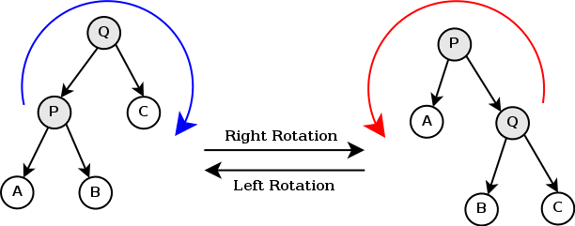
There are also left rotations
Note that the trees shown are not necessarily AVL trees, but the rotations are correct

Slide 60
Cases 2 & 3 – Attempt Single Rotation

Slide 61
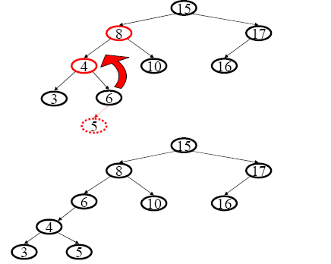
Double Rotation, Step 1

Slide 62
Double Rotation, Step 2

Slide 63
Double Rotation, both steps

Slide 64
Double Rotation, General

Slide 65
Ack! Terminology
What everybody else calls a ‘single right rotation’, the book calls ‘rotateWithLeftChild()’
Single left rotation is ‘rotateWithRightChild()’
Some people will state a ‘double left rotation’
But is that a left-right? Or a right-left?
We’ll call them ‘double left-right’ and ‘double right-left’

Slide 66
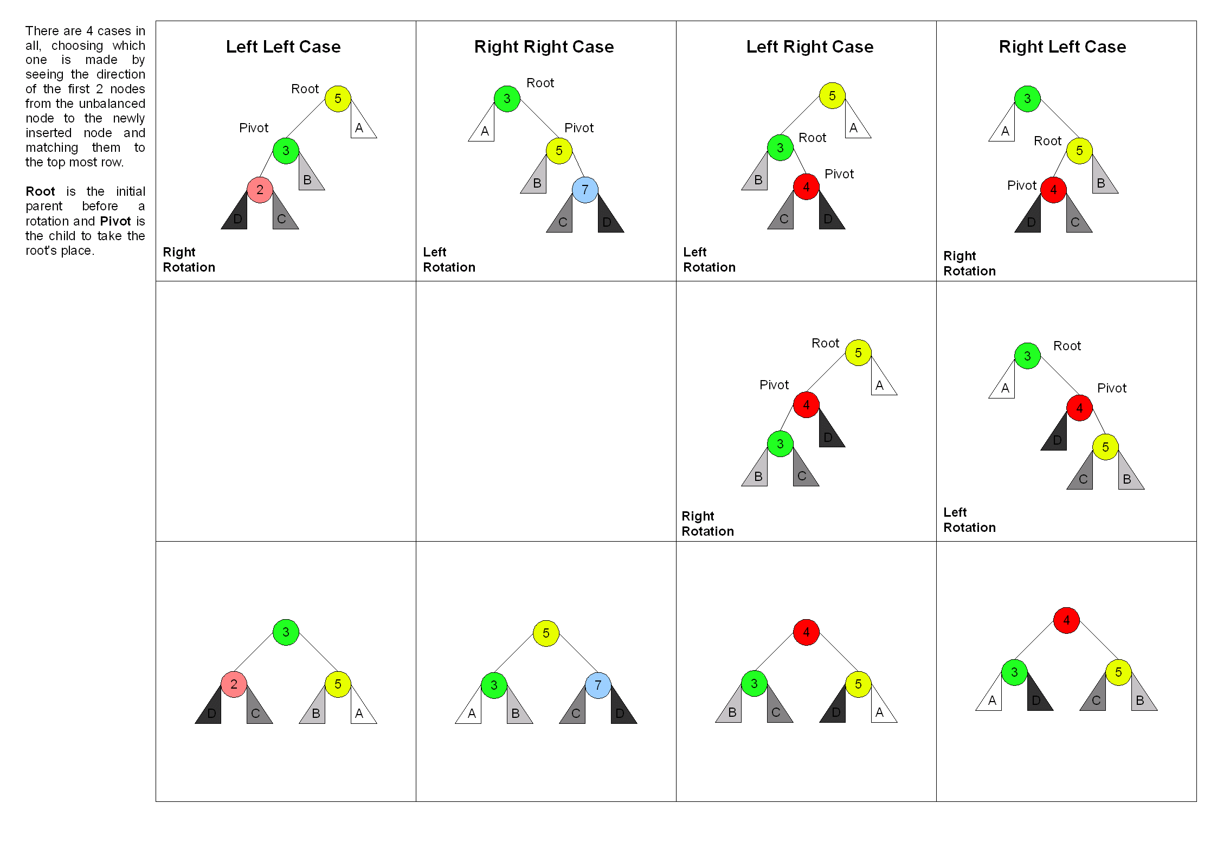

Slide 67
End of lecture on Fri, Feb 24

Slide 68
AVL Tree: Runtime Analysis
Find
Θ(log n) time. Height of tree is always Θ(log n)
Insert
Θ(log n) time. find() takes Θ(log n), then may have to visit every node on path back to root to perform up to 2 single rotations
Remove
Θ(log n). Left as an exercise
Print
Θ(n). No matter the data structures, it still will take n steps to print n elements

Slide 69
Red-black Trees

Slide 70
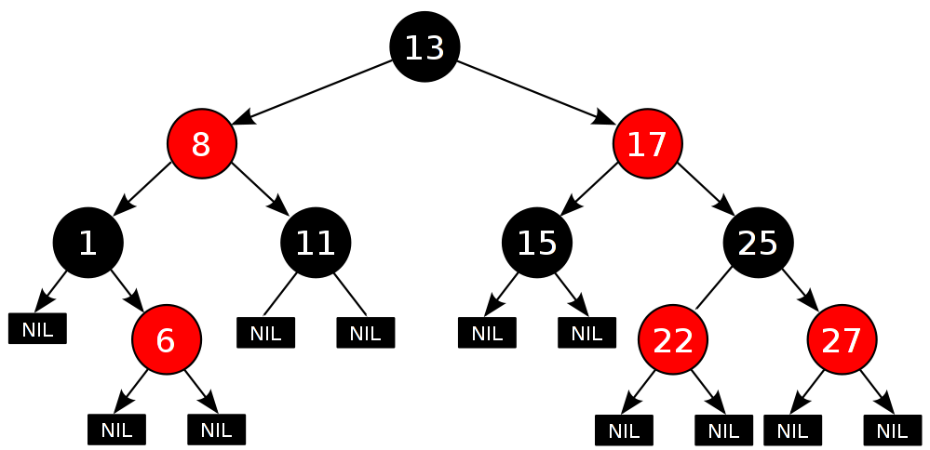
Red-black trees
Each node has a color attribute, which is either (wait for it…) red or black

Slide 71
Red-black tree properties
All of these properties must hold for a red-black tree
A node is either red or black.
The root is black.
All leaves are black. (The leaves are the null children)
Both children of every red node are black.
Therefore, a black node is the only possible parent for a red node.
Every simple path from a node to any descendant leaf contains the same number of black nodes.
Counting or not counting the null black nodes, it doesn't make a difference as long as you are consistent

Slide 72
Insert
Insert the node as for a normal BST
And color it red
5 possible cases
The new node is the root node
The new node’s parent is black
Both the parent and uncle (aunt?) are red
Parent is red, uncle is black, new node is right child of parent
Parent is red, uncle is black, new node is left child of parent

Slide 73
Case 1: new node is root
Case 1 is that the new node is the root node
Thus, it must be painted black, as per rule 2
This adds a black node to every path in the tree, so property 5 still holds

Slide 74
Case 2: new node’s parent is black
Case 2 is when the new node’s parent is a black node
Property 4 (children of a red node are black) is not invalidated
Property 5 (all paths from a given node to it’s leaf nodes have the same number of black nodes) is not threatened
The new node’s children are black, but that’s the same number of black nodes as the node it replaced

Slide 75
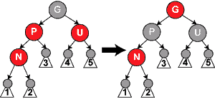
Case 3: parent and uncle are red
We change grandparent to red
And parent and uncle to black
Property 5 still holds
However, the grandparent may threaten property 2 or 4
So recursively do this on the grandparent
This occurs prior to any rotations

Slide 76
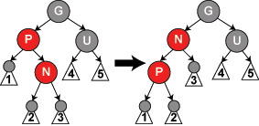
Case 4: P is red, U black, N is right child of P
Perform a left rotation on P and N
Property 4 is still violated
Now treat it as case 5 (where P is a left-child of N)

Slide 77
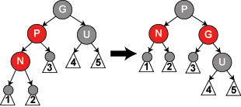
Case 5: P is red, U black, N is left child of P
Perform a right rotation on P and G
This will satisfy properties 4 and 5

Slide 78
Removal
Do a normal BST remove
Find next highest/lowest value, put it’s value in the node to be deleted, remove that highest/lowest node
Note that that node won’t have 2 children!
We replace the node to be deleted with it’s left child
This child is N, it’s sibling is S, it’s parent is P
A total of 6 cases!
N is the new root
S is red
P, S, and S’s children are black
S and S’s children are black, but P is red
S is black, S’s left child is red, S’s right child is black, and N is the left child of it’s parent
S is black, S’s right child is red, and N is the left child of parent P
We won’t see them in detail, though…

Slide 79
Why a red-black versus AVL?
AVL trees are more rigidly balanced than red-black trees
Thus, more rotations are required during the operations in the worst case
Time-critical applications will see a performance boost
Functional programming languages used red-black trees for associative arrays (hashes)
The tree can be a persistent data structure
A data structure that retains a “memory” of it’s mutations

Slide 80
Splay Trees

Slide 81
Splay Trees
A self-balancing tree that keeps “recently” used nodes close to the top
This improves performance!
Great for caches
Not good for uniform access
Easier to implement than red-black or AVL trees

Slide 82
Main operation: splaying
Anytime you find / insert / delete a node, you splay the tree around that node
Perform tree rotations to make that node the new root node
See demo at http://www.qmatica.com/DataStructures/Trees/BST.html
That domain seems to be currently having problems; a mirror is at http://webdiis.unizar.es/asignaturas/EDA/AVLTree/avltree.html

Slide 83
Time complexity
How long does a splay take?
Θ(h), where h is the height of the tree
A splay tree can look like a linked list
Which means that the running time can be Θ(n) for a given operation!
That’s not good…
A splay tree is O(log n) amortized time

Slide 84
Amortized analysis
An AVL tree will take Θ(log n) time for each and every operation in a series of operations
Guaranteed
A splay tree will take an average of Θ(log n) time for the same set of operations
Some individual ones will take more time
But the total cumulative time to insert a set of elements will be the same for both types of trees

Slide 85
Splay tree conclusions
Pros
Easy to implement
Θ(log n) amortized time
Good for caches where locality matters
Cons
Not guaranteed Θ(log n) time for a single operation
Bad access time for uniform accesses

Slide 86
More amortized analysis
Consider a vector insert
Worst case is that you have to double the size of the array (from n to 2n), and copy the elements over, which takes n steps
But this doesn’t happen all that often!

Slide 87
Vector amortized running time
Consider a vector of initial capacity of 100 elements, in which we insert about 1,600 elements
So n = 1600
First “doubling” is from 100->200, costing 100 copies
Second is 200->400, costing 200 copies
Third is 400->800, costing 400 copies
Fourth is 800->1600, costing 800 copies
Assume we have not (yet) doubled from 1600->3200
For 1,600 elements, we have 100+200+400+800 = 1500 copies

Slide 88
Vector amortized running time
If we insert 3200 elements, we need 3100 copies
6400 requires 6300 copies
n elements requires about n-100 copies
Which means that the number of copies is proportional to n
So a vector’s insert is:
Θ(n) for the worst-case
Θ(1) amortized for many operations
Although an individual operation may take n steps, a series of n operations will take a cn steps
Where c is a constant

Slide 89
Tree Summary

Slide 90
When are trees not good to use?
Trees are fast – so when would we not want to use them?
When the items do not have a sorted order
A list of todo tasks
When we want less complexity
A stack or a queue
When we want an Θ(1) operation on retrieves
Vector get()
When we want an Θ(1) time for all operations
Hash tables can (almost) achieve that

Slide 91
Applications of Trees

Slide 92
Programs
Any program can be represented as a tree
int z;
int foo (int x) {
for ( int y = 0; y < x; y++ )
cout << y << endl;
}
int main() {
int z = 5;
cout << “enter x” << endl;
cin >> z;
foo(z);
}
Note this for later…

Slide 93
The program tree
program
vars
functions
int z
foo()
main
params
vars
body
params
vars
body
int x
for
int z
int y
y<x
y++
body
=5
cout
cin
foo()
cout
“enter z”
endl
z
z
y
endl

Slide 94
Notes on the program tree
Called a “abstract syntax tree” or a “parse tree”
Each node can be a different type
Having different properties and different number of children
A for loop node has four children (for init, for expression, for update, body)
A body node has variable children
Done through inheritance!
All the specialty nodes inherit from a “node” class

Slide 95
Notes on the program tree
Called a “abstract syntax tree” or a “parse tree”
A compiler will build such a tree in memory
And transverse it many times
For example, to figure out which ‘z’ is used in the main() method
Or to do code generation
Each node has an overridden method to generate the code for that node
Or to do type checking

Slide 96
Comparing two programs
What if we read in two programs…
… and build parse trees for each
… and compare their structure?
We would be able to compare two programs while ignoring such things as:
Function/method order
Variable renaming
Different comments

Slide 97
Measure of Structural Similarity
“A System for Detecting Software Plagiarism”
http://theory.stanford.edu/~aiken/moss/
The paper the site is based on is at http://theory.stanford.edu/~aiken/publications/papers/sigmod03.pdf
It will load up all the programs for a class
I’ve run it in CS 101 with over 500 students
And do all n² comparisons
That’s 500² = 250,000 for CS 1110
Takes under 1 minute
Only 100² = 10,000 for CS 2150 this semester
Takes 5 or so seconds
And display the most similar programs
As an example, we’ll use CS 101 (071) HW 4…

Slide 98


Slide 99
End of lecture on Mon, Feb 27

