Slide 1
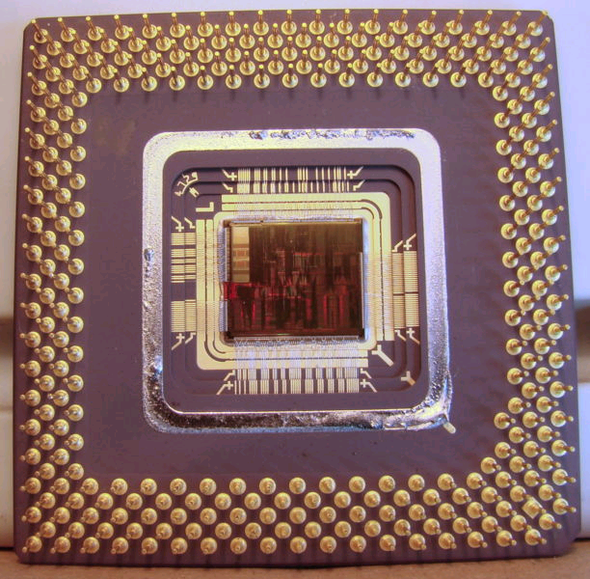
CS2150: Program and Data Representation
University of Virginia Computer Science
Spring 2012 Aaron Bloomfield
Introduction to x86
Part 1

Slide 2
CS2150 Roadmap
Data Representation
Program Representation
Real World Problems
Objects
High-level language
“Hello”
Python code
[‘H’,’i’,\0]
Arrays
Low-level language
0x42381a,
3.14,
‘x’
Addresses,
Numbers,
Characters
C++ code
JVML
Virtual Machine language
x86
Assembly
01001010
Bits
Machine
Real World Physics

Slide 3
Introduction to x86

Slide 4
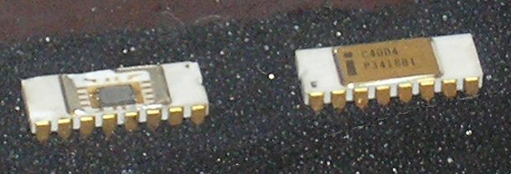
History of x86
1971 – 4004, 4-bit words
1972 – 8008, 8-bit words
1978 – 8086, 16-bit words
1982 – 80286
1985 – 80386, 32-bit words
1989 – 80486
1993 – Pentium
1995 – Pentium Pro
1997 – Pentium II
1998 – Pentium III
2000 - 2004 – Pentium IV
All versions are backwards compatible

Slide 5
IBCM vs. x86
Registers
Fetch-Execute cycle

Slide 6
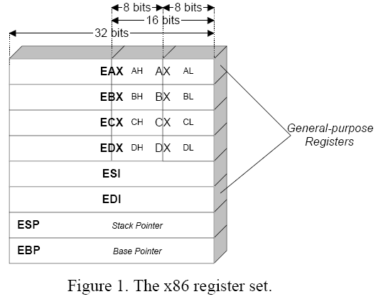
Registers in x86

Slide 7
Fetch Execute Cycle (same)
while(power is on)
{
IR := mem[PC]
PC := PC + 1 (word) // 32-bits in x86
execute instruction in IR
}
PC = program counter
IR = instruction register

Slide 8
Declaring Variables in x86
.DATA
a DB 23
b DW ?
c DD 3000
d DQ -800
x DD 1, 2, 3
y DB 8 DUP(0)
str DB `hello’, 0
z DD 50 DUP(?)
Directives
byte = 1 byte (DB) declare byte
word = 2 bytes (DW)
double = 4 bytes (DD)
quadword = 8 bytes (DQ)
x DUP (y) directive means:
“repeat y, x times”

Slide 9
mov command
mov <dest> <src>
Where <dest> and <src> can be:
A register
A combination of registers and constants
Variable name
Pointer: [ebx]

Slide 10
Addressing Memory
mov eax, ebx
mov eax, [ebx]
mov [var], ebx
mov eax, [esi-4]
mov [esi+eax], cl
mov edx, [esi+ 4*ebx]
Incorrect: (why?)
mov eax, [ebx – ecx]
mov [eax + esi + edi], ebx
mov [4*eax + 2*ebx], ecx
Up to 2 registers and one 32-bit signed constant can be added together to compute a memory address
One register can be pre-multiplied by 2, 4, 8
word-align
double-align
quadword-align

Slide 11
End of lecture on Mon, Mar 19
Also went over the last 6 slides of 08-ibcm

Slide 12
Example
Memory
Address
100
16
8
mov ecx, eax
mov edx, [ebx]
mov esi, [edx+eax+4]
mov [esi], 45
mov [a], 15
lea edi, [a]
104
8
i: 108
3
200
112
200
116
200
45
204
a: 300
15
eax
100
ebx
104
304
ecx
100
edx
8
esi
200
edi
300

Slide 13
mov eax, [4*esi - edx]
Valid
Invalid
Not sure

Slide 14
mov eax, [4*esi + 4]
Valid
Invalid
Not sure

Slide 15
mov eax, [4*esi + edx+ 8]
Valid
Invalid
Not sure

Slide 16
mov eax, [esi + 4*edx]
Valid
Invalid
Not sure

Slide 17
mov eax + 4, [esi]
Valid
Invalid
Not sure

Slide 18
x86 Instruction Set
Data movement instructions
Arithmetic instructions
Logical instructions
Control instructions

Slide 19
Data Movement Instructions
mov
push
push operand onto stack (4 bytes)
First decrements ESP (stack pointer) by 4 (stack grows DOWN)
push eax
push [var]
pop
pop top element of stack to memory or register, increment stack pointer (ESP) by 4
lea (load effective address)
place address specified
lea eax, [var]
lea edi, [ebx+4*esi]

Slide 20
Arithmetic and Logic Instructions
add, sub
add <reg>, <reg>
add <reg>, <mem>
add <mem>, <reg>
add <reg>, <constant>
add<mem>, <constant>
adds, storing result in first operand

Slide 21
Arithmetic and Logic Insts (cont’d)
inc, dec (increment and decrement by one)
inc <reg>
inc <mem>
Examples
dec eax
inc [var]
imul
imul <reg32>, <reg32> (or <mem>)
imul <reg32>, <reg32> (or <mem>), <con>
idiv (divide 64-bit integer in EDX:EAX) by operand
idiv ebx

Slide 22
Logical Insts
and, or, xor
and <reg>, <reg>
and <reg>, <mem>
and <mem>, <reg>
Examples
and eax, 0fH
xor ecx, ecx

Slide 23
End of lecture on Wed, Mar 21
We went over the courses for next semester in the first have of lecture today
We need to go over the previous slide in the next class

Slide 24
Control Instructions
jmp <label>
go to instruction address specified by label
cmp
cmp operand1, operand2
operand1 can be <reg> or <mem>
operand2 can be <reg>, <mem>, or <con>
Sets the machine status word
jCC
Uses the machine status word
Which holds info about the results of the last instruction
je <label>
jump when condition code equal is set
jne, jz, jg, jge, jl, jle

Slide 25
Control Instructions
call <label>
subroutine call
pushes current code address onto stack, then unconditionally jumps to label
ret
subroutine return

Slide 26
Writing Basic x86 Assembly
.DATA
n DD 5
i DD 1
sum DD 0
.CODE
loop: mov ecx, [i]
cmp ecx, [n]
jg endOfLoop
add [sum], ecx
inc [i]
jmp loop
endOfLoop:
END
int n = 5;
int i =1;
int sum = 0;
while(i <= n){
sum += i;
i++;
}

Slide 27
Calling Conventions

Slide 28
Example
int max(int x, int y) {
int theMax = (x > y) ? x : y;
return theMax;
}
int main() {
int a =5, b = 6;
int maxVal = max(a,b);
cout << “Max Value: “ << maxVal << endl;
return 0;
}

Slide 29
Calling Conventions
What is a calling convention?
A set of rules/expectations between functions
How (and where) are parameters passed?
Which registers does the calling function expect to be preserved?
Where should local variables be stored?
How/where should results be returned from functions?
Why?
Separate programmers can
share code more easily
develop libraries

Slide 30
C Calling Convention
Why C’s calling convention?
It’s important
Can be used with C and C++ code
Can enable calling C library functions from assembly code
Or other languages

Slide 31
C Calling Convention
Uses hardware stack (memory)
Stack grows down, towards lower memory addresses
x86 instructions used for calling convention
pop
push
call
ret
Using a stack for calling convention is implemented on most processors. Why?
Recursion

Slide 32
C Calling Convention Overview
Answers to questions
Parameters
passed on the stack
Registers
saved on the stack
Local variables
placed in memory on the stack
Return value
eax register

Slide 33
Calling Convention Overview (2)
The sets of rules
Caller
The function which calls another function
Callee
The function which is called by another function

Slide 34
Caller vs. Callee
void foo() {
// some function code ...
}
int main() {
foo();
return 0;
}
main() is the caller
foo() is the callee

Slide 35
Register usage
One register is used for the return value: eax
Three registers may be modified by the callee: eax, ecx, edx
If the caller wants to keep those values, they need to be saved by pushing them onto the stack
And note eax is where the return value goes
Three registers may not be modified by a subroutine call: ebx, edi, esi
If the subroutine wants to modify them, it needs to back them up first (onto the stack) and restore them before returning
Two registers should almost never be modified directly: ebp, esp
There is an exception: ebp is modified in one case by the callee

Slide 36
Varying number of parameters
Three ways to have a variable number of parameters:
Method overloading
Foo::bar(int) and Foo::bar(int, float)
Default parameters
Foo::bar (int x = 3)
Variable arguments
As seen next

Slide 37
An aside: variable number of arguments in C/C++
(this example from http://www.daniweb.com/forums/thread83437.html)
#include <stdarg.h>
void stringstofile (FILE *filehandle, ...) {
va_list vargs;
va_start (vargs, filehandle);
while (va_arg (vargs, char *))
fputs (va_arg (vargs, char *), filehandle);
va_end (vargs);
}

Slide 38
More on variable number of arguments
The C equivalent of cout is a function called printf
printf (“A %s, a %s, a %s: %s!”, “man”, “plan”, “canal”, “Panama”);
printf (“A percent sign: %%”);
printf (“An int: %d\n”, i);
printf (“A float with 2 decimal digits: %.2f”, float_value);

Slide 39
Calling Convention
Part 1: Caller’s Rules

Slide 40
Caller Rules/Responsibilities
Before calling the function
Save registers that might be needed after the call (eax, ecx, edx)
Push parameters on the stack
Call the function
call instruction places return address in stack
After the called function returns
Remove parameters from stack
Restore saved registers

Slide 41
Callee Rules/Responsibilities
Prologue
BEFORE the function body
Function body
Epilogue
AFTER the function body, before the return

Slide 42
Caller Summary
“Prologue”
Tasks to take care of BEFORE calling a subroutine
“Epilogue”
Tasks to complete AFTER subroutine call returns
Not really called this, but I use this to parallel the equivalent components in the Callee convention

Slide 43
Caller Rules (“Prologue”)
Before calling the subroutine
Caller-saved registers
Registers which the calling function (caller) must save (push onto the stack) ONLY if it wants the values preserved.
eax, ecx, edx
Parameters
Pushed in reverse order (last parameter first) onto stack
Call the subroutine
Use the call instruction
pushes the return address onto the stack and branches to the subroutine

Slide 44
Caller Rules (“Epilogue”)
After subroutine returns (just after call inst)
Remove parameters
Parameters pushed onto stack must be removed. (Restore stack to state before the call)
What is done with the parameters?
Return value
If any, held in eax
Restore caller-saved registers
eax, ecx, edx
pop them off the stack (Caller can assume no other registers were modified)

Slide 45
Caller Rules Example
int MyFunc(int a, int b, int c){
int x
// some code
return result;
}
int main(){
int x = 1, z=3;
int retVal = myFunc(x, 123, z);
//...
return 0;
}

Slide 46
Caller Rules Example
push edx ; caller wants edx to be preserved
; int retVal = myFunc(x, 123, z);
push [z] ; Push last param first
push 123 ; push constant 123
push eax ; push first param last
call _MyFunc ; call the function
add esp, 12 ; clean up stack
pop edx ; restore saved edx value
; return value of myFunc is now available in eax (if any return value)

Slide 47
Stack Visualization for myFunc
Higher addresses
0xFFFFFFFF
value of edx
Memory
var
123
value of eax
esp
Lower addresses
0x00000000

Slide 48
Calling Convention
Part 2: Callee Rules

Slide 49
Callee Rules Summary
Prologue
Tasks to perform BEFORE executing the function body
Epilogue
Tasks to perform AFTER executing function body, but BEFORE leaving function

Slide 50
Callee Rules Example
int MyFunc(int a, int b, int c){
int x
// some code
return result;
}
int main(){
int x = 1, z=3;
int retVal = myFunc(x, 123, z);
//...
return 0;
}

Slide 51
Callee Rules (Prologue)
Before the body of the function
Push ebp and copy esp into ebp
push ebp
mov ebp, esp
ebp – snapshot of esp when subroutine starts
Parameters and local variables are known distances/offsets from this pointer value
Allocate local variables
make space on stack (decrement stack pointer)

Slide 52
Callee Rules (Prologue)
Before the body of the function
Save callee-save registers
ebx, edi, esi (push them onto stack)
only need to do this if callee intends to use them, otherwise, no need to save their contents
THEN, perform body of the function

Slide 53
Callee Rules (Epilogue)
After the body of the function
Return value saved to eax
Restore callee-saved registers
Pop from stack (inverse order from which pushed)
Deallocate local variables
mov esp, ebp
Restore base pointer
pop ebp
Return
ret

Slide 54
Callee Rules Example
int MyFunc(int a, int b, int c){
int result;
result = c;
result += b;
return result;
}
int main(){
int x = 1, z=3;
int retVal = myFunc(x, 123, z);
//...
return 0;
}

Slide 55
Callee Rules Example (1)
.CODE ; start code segment
PUBLIC _myFunc
_myFunc PROC
; prologue
push ebp ; save old base pointer
mov ebp, esp ; set new base pointer
sub esp, 4 ; save room for 1 local var (result)
push ebx ; save callee-save registers
push esi ; both will be used by myFunc

Slide 56
Callee Rules Example (2)
; subroutine body
mov eax, [ebp+8] ; param 1 to eax
mov esi, [ebp+12] ; param 2 to esi
mov ebx, [ebp+16] ; param 3 to ebx
mov [ebp-4], ebx ; put ebx into local var
add [ebp-4], esi ; add esi into local var
mov eax, [ebp-4] ; mov contents of local var to eax
; (return value/final result)

Slide 57
Callee Rules Example (3)
; subroutine epilogue
pop esi ; recover callee save registers
pop ebx ; REVERSE of when pushed
mov esp, ebp ; deallocate local var(s)
pop ebp ; restore caller’s base pointer
ret
_myFunc ENDP
END ; end of CODE segment

Slide 58
Stack Visualization for myFunc just as it is called
Higher addresses
0xFFFFFFFF
ebp
value of edx
copy of z
Caller sets this up
Memory
123
copy of x
(return ADDRESS)
esp
Lower addresses
0x00000000

Slide 59
Stack Visualization for myFunc
Higher addresses
parameter 3
[ebp+16]
parameter 2
[ebp+12]
parameter 1
[ebp+8]
(return address)
(saved value of ebp)
ebp
local variable 1
[ebp-4]
saved value of ebx
esp
Lower addresses
saved value of esi

Slide 60
End of lecture on Fri, Mar 23
We need to go over base pointer / stack pointer setup a bit more…

Slide 61
Activation records

Slide 62
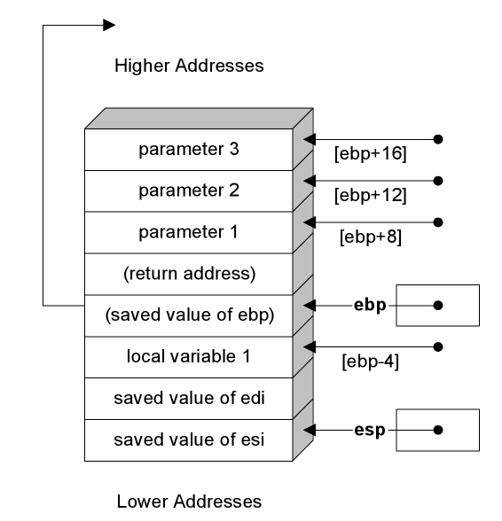
Activation Records
Every time a sub-routine is called, a number of things are pushed onto the stack:
Registers
Parameters
Old base/stack pointers
Local variables
Return address
All of this is called the activation record

Slide 63
Memory management
The binary program takes up a fixed amount of space
The size of the file
There are two types of memory that need to be handled:
Dynamic memory (via new, malloc(), etc.)
This is stored on the heap
Static memory (on the stack)
This is where the activation records are kept

Slide 64
Memory management
The binary program starts at the ‘beginning’ of the 2³² = 4 Gb of memory
The heap starts right after this
The stack starts at the end of this 4 Gb of memory, and grows backward
They could have chosen the heap to grow backwards, but they didn’t
As a program progresses, they both grow towards the middle
And never the twain shall meet

Slide 65
Consider this subroutine…
void security_hole() {
char buffer[10];
scanf ( “%s”, buffer); // and older C input routine
}
The stack looks like (with sizes):
Addresses increase to the right (the stack grows to the left)
What happens if the value stored into buffer is 11 bytes long?
What if it is exactly 18 bytes long?
We overwrite the return address
esi (4)
edi (4)
buffer (10)
ebp (4)
ret addr (4)

Slide 66
Buffer overflow attack
When you read in a string (etc.) that goes beyond the size of the buffer
Hence ‘buffer overflow’
You can then overwrite the return address
And set it to your own code
For example, code that is included later on in the string
We may see an example of this, if there is time in the course…

Slide 67
x86 Examples
Calling Convention Practice
C++ to x86 Assembly Code

Slide 68
A note about x86 compatibility
We are using nasm as our assembler for the x86 labs
The x86 code samples in this slide set are either:
“generic” x86 examples that could work in nasm if put into a proper program
In the same way that I show C++ code snippets
Or the output from “g++ -S” (and probably –masm=intel)
This code will NOT work with nasm, but will work with g++ (which we aren’t really using anyway for our assembly)

Slide 69
x86 Examples
All are in the lectures/09-x86/code directory on Collab
int absolute_value(int x)
int max(int x, int y)
bool compare_string(const char * theStr1, const char * theStr2)
int fib(int n)

Slide 70
int absolute_value(int x)
int absolute_value(int x) {
if(x<0) // if x is negative
x = -x; // negate x
return x; // return x
}

Slide 71
test_abs.cpp
#include <iostream>
using namespace std;
extern “C” int absolute_value(int x);
int absolute_value(int x) {
if(x<0) // if x is negative
x = -x; // negate x
return x; // return x
}
int main(){
int theValue=0;
cout << “Enter a value: “ << endl;
cin >> theValue;
int theResult = absolute_value(theValue);
cout << “The result is: “ << theResult << endl;
return 0;
}

Slide 72
x86 Assembly for absolute_value
; Standard prologue
push ebp
mov ebp, esp
; procedure body
mov eax, [ebp + 8] ; eax ← x
cmp eax, 0 ; x == 0 ?
jge end_of_proc ; if pos goto end
neg eax ; negate x
end_of_proc:
; Standard epilogue
mov esp, ebp
pop ebp
ret

Slide 73
Generating assembly with g++
Using the –S flag, we can generate assembly from C/C++ code
Note that the format is a bit different
Register specification, dest/source order, etc.
So we need to use the –masm=intel flag
The formatting is still different, but the idea is the same

Slide 74
g++’s assembly for absolute_value (note the <src> <dest> order is reversed)
absolute_value:
.LFB1401:
pushl %ebp
.LCFI0:
movl %esp, %ebp
.LCFI1:
cmpl $0, 8(%ebp)
jns .L2
negl 8(%ebp)
.L2:
movl 8(%ebp), %eax
popl %ebp
ret
movl, pushl, compl, negl, popl: the ‘l’ part means ‘long’
i.e. 32 bits, so the assembler doesn’t have to assume
jns means jump if not signed
i.e. if positive
$0 is the constant 0
8(%ebp) is [ebp+8]
i.e. where the parameters are

Slide 75
g++’s assembly for absolute_value using –masm=intel
absolute_value:
.LFB1428:
push %ebp
.LCFI0:
mov %ebp, %esp
.LCFI1:
cmp DWORD PTR [%ebp+8], 0
jns .L2
neg DWORD PTR [%ebp+8]
.L2:
mov %eax, DWORD PTR [%ebp+8]
pop %ebp
ret

Slide 76
End of lecture on Mon, Mar 26
Although we started on slide 59, we went as far back as slide 55 today
And we breezed through the last few slides, so we should start next time at slide 67

Slide 77
g++’s assembly output on Macs
Darwin (i.e., Mac OS X) does not support the –masm=intel flag
So you are stuck using the “other” format
With the <src> and <dest> order reversed
You can compile it on a the Linux VirtualBox image, if you want the ‘correct’ order

Slide 78
test_abs_c.c
#include <stdio.h>
int absolute_value(int x) {
if(x<0) // if x is negative
x = -x; // negate x
return x; // return x
}
int main(){
int theValue=0;
printf (“Enter a value: \n”);
scanf (“%d”, &theValue);
int theResult = absolute_value(theValue);
printf (“The result is: %d\n”, theResult);
return 0;
}

Slide 79
C++ assembly vs. C assembly
Notice how much cleaner C translates into assembly versus C++
Compare files test_abs.s and test_abs_c.s

Slide 80
int max(int x, int y)
int max(int x, int y) {
int theMax;
if(x > y) // if x > y then it is max
theMax = x;
else // else y is the max
theMax = y;
return theMax; // return the max
}

Slide 81
test_max.cpp
#include <iostream>
using namespace std;
extern “C” int max(int x, int y);
// the max function from the previous slide
int main(){
int theValue1=0, theValue2=0;
cout << “Enter value 1: “ << endl;
cin >> theValue1;
cout << “Enter value 2: “ << endl;
cin >> theValue2;
int theResult = max(theValue1, theValue2);
cout << “The result is: “ << theResult << endl;
return 0;
}

Slide 82
x86 code for max() using –masm=intel
max:
.LFB1428:
push %ebp
.LCFI0:
mov %ebp, %esp
.LCFI1:
sub %esp, 16
.LCFI2:
mov %eax, DWORD PTR [%ebp+8]
cmp %eax, DWORD PTR [%ebp+12]
jle .L2
mov %eax, DWORD PTR [%ebp+8]
mov DWORD PTR [%ebp-4], %eax
jmp .L4
.L2:
mov %eax, DWORD PTR [%ebp+12]
mov DWORD PTR [%ebp-4], %eax
.L4:
mov %eax, DWORD PTR [%ebp-4]
leave
ret

Slide 83
x86 code for max() using –O2 using –masm=intel
max:
.LFB1428:
push %ebp
.LCFI0:
mov %ebp, %esp
.LCFI1:
mov %edx, DWORD PTR [%ebp+8]
mov %eax, DWORD PTR [%ebp+12]
cmp %eax, %edx
jge .L2
mov %eax, %edx
.L2:
pop %ebp
ret

Slide 84
x86 code for max() without the ‘extern “C”’ line using –masm=intel
_Z3maxii:
.LFB1428:
push %ebp
.LCFI0:
mov %ebp, %esp
.LCFI1:
sub %esp, 16
.LCFI2:
mov %eax, DWORD PTR [%ebp+8]
cmp %eax, DWORD PTR [%ebp+12]
jle .L2
mov %eax, DWORD PTR [%ebp+8]
mov DWORD PTR [%ebp-4], %eax
jmp .L4
.L2:
mov %eax, DWORD PTR [%ebp+12]
mov DWORD PTR [%ebp-4], %eax
.L4:
mov %eax, DWORD PTR [%ebp-4]
leave
ret

Slide 85
bool compare_string(char * theStr1, char * theStr2)
bool compare_string (const char *theStr1,
const char *theStr2) {
// while *theStr1 is not NULL terminator
// and the current corresponding bytes are equal
while( (*theStr1 != NULL)
&& (*theStr1 == *theStr2) )
{
theStr1++; // increment the pointers to
theStr2++; // the next char / byte
}
return (*theStr1==*theStr2);
}

Slide 86
test_string_compare.cpp
#include <iostream>
#include <string>
using namespace std;
extern “C” bool compare_string(const char* theStr1,
const char* theStr2);
// code for compare_string here
int main(){
string theValue1, theValue2;
cout << “Enter string 1: “ << endl;
cin >> theValue1;
cout << “Enter string 2: “ << endl;
cin >> theValue2;
bool theResult = compare_string(theValue1.c_str(), theValue2.c_str());
cout << “The result is: “ << theResult << endl;
return 0;
}

Slide 87
x86 assembly for compare_string() using –masm=intel
_compare_string:
push ebp
mov ebp, esp
L11:
mov eax, DWORD PTR [ebp+8]
cmp BYTE PTR [eax], 0
je L12
mov eax, DWORD PTR [ebp+8]
mov edx, DWORD PTR [ebp+12]
movzx eax, BYTE PTR [eax]
cmp al, BYTE PTR [edx]
jne L12
inc DWORD PTR [ebp+8]
lea eax, [ebp+12]
inc DWORD PTR [eax]
jmp L11
L12:
mov eax, DWORD PTR [ebp+8]
mov edx, DWORD PTR [ebp+12]
movzx eax, BYTE PTR [eax]
cmp al, BYTE PTR [edx]
sete al
movzx eax, al
pop ebp
ret

Slide 88
int fib(int n)
int fib(int n) {
if((n==0) || (n==1))
return 1;
return fib(n-1) + fib(n-2);
}

Slide 89
test_fib.cpp
#include <iostream>
using namespace std;
extern “C” int fib(int n);
int fib(int n) {
if((n==0) || (n==1))
return 1;
return fib(n-1) + fib(n-2);
}
int main(){
int theValue = 0;
cout << “Enter value for fib(): “ << endl;
cin >> theValue;
int theResult = fib(theValue);
cout << “The result is: “ << theResult << endl;
return 0;
}

Slide 90
x86 assembly for fib() using –masm=intel
fib:
.LFB1428:
push %ebp
.LCFI0:
mov %ebp, %esp
.LCFI1:
push %ebx
.LCFI2:
sub %esp, 8
.LCFI3:
cmp DWORD PTR [%ebp+8], 0
je .L2
cmp DWORD PTR [%ebp+8], 1
jne .L4
.L2:
mov DWORD PTR [%ebp-8], 1
jmp .L5
.L4:
mov %eax, DWORD PTR [%ebp+8]
sub %eax, 1
mov DWORD PTR [%esp], %eax
call fib
mov %ebx, %eax
mov %eax, DWORD PTR [%ebp+8]
sub %eax, 2
mov DWORD PTR [%esp], %eax
call fib
add %ebx, %eax
mov DWORD PTR [%ebp-8], %ebx
.L5:
mov %eax, DWORD PTR [%ebp-8]
add %esp, 8
pop %ebx
pop %ebp
ret

Slide 91
RISC versus CISC
RISC
Reduced instruction set computer
Fewer and simpler instructions (maybe 50 or so)
Less chip complexity means they can run fast
CISC
Complex instruction set computer
More and more complex instruct-ions (300-400 or so)
More chip complexity means harder to make run fast

Slide 92
End of lecture on Wed, Mar 28
Donnie Newell lectured today

