Slide 1

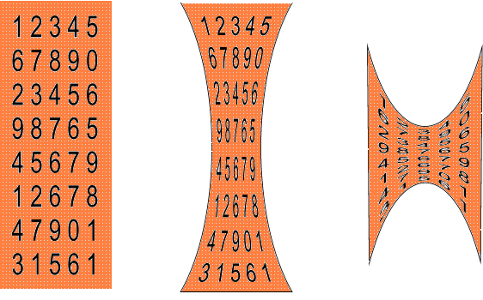
Data Compression: Huffman Coding
CS2150: Program and Data Representation
University of Virginia Computer Science
Spring 2012 Aaron Bloomfield
10.1.2 in Weiss
Notes:
We discussed the memory hierarchy before.
Discussed locality and the cost of accessing data at lower levels of the hierarchy.
A related problem is that of keeping file sizes small.

Slide 2
Why compress files?
Disk space is limited
File transfer
Bigger files take longer to transfer
Smaller file might fit in memory more easily
For long term storage (disc space is limited)
For transferring files over the internet (bigger files take longer)
A smaller file more likely to fit in cache
Notes:
Why?
For long term storage (disc space is limited)
For transferring files over the internet (bigger files take longer)
A smaller file is more likely to be able to fit in higher levels (e.g. cache) of the memory hierarchy

Slide 3
What is a file?
Named collection of information
C++ program
Application executables
Word documents
Email
Web pages
Pictures, audio, video
C++ program
Executable
Word document
Email - text
Pictures (lossy)
JPEG
Video (lossy)
MPEG
Audio (lossy)
MP3
Q: Which of these needs to be exactly the same when we use them?
Q: Which of these do we require to in pristine shape? (loss-less?)
Notes:
QUESTION: What is a file?
C++ program
Executable
Word document
Email - text
Pictures (lossy)
Audio (lossy)
Video (lossy)
All of these we might store, want to fit in cache, or want to move over internet.
QUESTION: Which of these do we require to in pristine shape when we see them? (loss-less?)

Slide 4
Data Compression
original
compressed
decompressed
Lossless compression X = X’
Lossy compression X != X’
information is lost (irreversible)
Compression Ratio |X|/|Y|
Where |X| is the # of bits in X.
X
Y
X’
Encoder
Decoder
Reversible or Entropy Coding
Irreversible Coding
Notes:
Lossless is sometimes called entropy coding, or reversible coding
Losy is called irreversible coding.

Slide 5
Lossy Compression
Some data is lost, but not too much.
Standards:
JPEG (Joint Photographic Experts Group)
Still images
MPEG (Motion Picture Experts Group)
Audio and video
MP3 (MPEG-1, Layer 3), Ogg vorbis
Can get compression ratios of 10:1
I won’t talk about these techniques: (wavelets, block transforms, vector quantization)
Compression ratios of 10:1 are possible
Notes:
What file types could we use this for? (audio, video, still images, photographs.)
Can get compression ratios of 10:1
I won’t talk about these techniques (wavelets, block transforms, vector quantization)

Slide 6
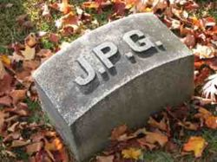




JPEG image quality comparison
Quality = 100
Image size: 83,261 (100%)
Quality = 50
Image size: 15,138 (18%)
Quality = 25
Image size: 9,553 (11%)
Quality = 10
Image size: 4,787 (6%)
Quality = 1
Image size: 1,523 (2%)

Slide 7
Lossless Compression
Must stay true to original: TEXT, EXECUTABLES
Can get compression ratios of 4:1
No data is lost.
Standards:
Gzip, Unix compress, zip, Morse code
PNG image file formats
Run-length encoding (RLE)
We’ll talk about Huffman Coding.
Another technique is run-length encoding (RLE), part of several compression techniques (BMP, PCX, TIFF, PDF)
A run of characters is replaced by: - the number of characters of that type and a single character:
RTAAAAAADEEEE
RT*6AD*4E
Can get compression ratios of 4:1
Notes:
Must keep absolutely TRUE to the original (text files, executables – binaries)
Can get compression ratios of 4:1
Technique we will talk about – Huffman coding (arithmetic coding, golomb coding)
Also run-length encoding. (RLE) – part of several compression techniques (BMP, PCX, TIFF, PDF) [Loss-less]
A run of characters is replaced by the number of characters of that type and a single character:
RTAAAAAADEEEE
RT*6AD*4E

Slide 8
Lossless Compression of Text
Really only need 7 bits for 128 things
ASCII = fixed 8 bits per character
Example: “hello there”
11 characters * 8 bits = 88 bits
Can we encode this message using fewer bits?
We could look JUST at the message,
there are only 6 possible characters + one space. = 7 things
– needs 3 bits.
Encode: aabddcaa = could do as 16 bits (each character = 2 bits each)
Huffman can do as 14 bits
Notes:
(Really only need 7 bits for ASCII)
UNICODE = fixed 16 bits per character (or 8 or 32?)
We could look JUST at the message, there are only 6 possible characters + one space. = 7 things – needs 3 bits.
We could do even better.

Slide 9
Huffman Coding
1951
Uses frequencies of symbols in a string to build a prefix code.
The more frequent a character is, the fewer bits we’ll use to represent it
Prefix Code – no code in our encoding is a prefix of another code.
Note: codes are variable length – (0 to 3 bits per character)
Letter | code
a | 0
b | 100
c | 101
d | 11
Draw a TREE. Show how to use the tree to figure out what the code is.
Notes:
Huffman (1951)
Encode: aabddcaa = could do as 16 bits (each character = 2 bits each)
Huffman can do as 14 bits
Note: codes are variable length – (0 to 3 bits per character)
Draw a TREE. Show how to use the tree to figure out what the code is.

Slide 10
End of lecture on Mon, Apr 9
We also went over the last 6 slides of 11-heaps

Slide 11
Decoding a Prefix Code
Create the Huffman coding tree
Loop
start at root of tree
loop
if bit read = 1 then go right
else, go left
until node is a leaf
Report character found!
Until end of the message

Slide 12
Decode: 1110001010011
d b a c a a d a
-
8 characters:
8*8 bits = 64 bits in ASCII
8*2 bits = 16 bits (if used 2 bits each)
14 bits = Huffman (uses frequency
This is a full binary tree!
Letter | code
a | 0
b | 100
c | 101
d | 11
a
-
-
d
b
c
Why does this work?
No code is the PREFIX of any other code.
1110001010011 = dbacaad
Notes:
dbacaada

Slide 13
Huffman Trees
Cost of a Huffman Tree containing n symbols
C(T) = p₁*r₁+p₂*r₂+p₃*r₃+….+ p_{n}*r_{n}
Where:
p_{i} = the probability that a symbol occurs
r_{i} = the length of the path from the root to the node
For previous example = (.50 * 1) + (.125 * 3) + (.125 * 3) + (.25 * 2)
Notes:
For the lowest cost tree, we want symbols with highest probability (probability sums to 1) to have the shortest length.
We want a tree that minimizes the number of bits to code a message.

Slide 14
Huffman encoding costs
What is the cost of this tree?
= 1.75
This is the example from 2 slides ago
a: 3/7 * 1 = 3/7
b: 1/7 * 3 = 3/7
c: 1/7 * 3 = 3/7
d: 2/7 * 2 = 4/7
Cost is 3/7 + 3/7 + 3/7 + 4/7 = 13/7 = 1.85 bits per character
Ascii is 8 bits per char
Straight encoding is 2 bits per char
Letter | Frequency | code
a | 3/7 | 0
b | 1/7 | 100
c | 1/7 | 101
d | 2/7 | 11
SWITCH TO HANDOUT – how to construct Huffman trees
Notes:
Switch to handout….

Slide 15
Huffman Encoding

Slide 16
Compression Phase
Determine the frequencies of the characters stored in the source file.
Read the source file
Then store the character frequencies in a min-heap
Build a tree of prefix codes (a Huffman code) that determines the unique bit codes for each character.
Write the prefix codes or code tree to the output file.
Re-read the source file and for each character read, write its prefix code into the output file.
You must WRITE the prefix code/tree and the encoded file to the SAME output file

Slide 17
Huffman coding example
From Weiss, page 416
Uses 5 letters (a, e, i, s, t), plus the space and the newline
Total of 58 characters
Normal ASCII encoding is 8 bits per character
58*8 = 464 bits
Which is 58 bytes, obviously
Straight encoding is 3 bits per character
58*3 = 174 bits
Which is 21.75 bytes

Slide 18
Compression step 1 (a)
Determine frequencies of letters
Character | Frequency
a | 10
e | 15
i | 12
s | 3
t | 4
(space) | 13
(newline) | 1
Total | 58

Slide 19
Compression step 1 (b)
Build a min-heap
Sorted by frequency
Character | Frequency
a | 10
e | 15
i | 12
s | 3
t | 4
(space) | 13
(newline) | 1
Total | 58
1: nl
4: t
3: s
15: e
10: a
13: sp
12: i

Slide 20
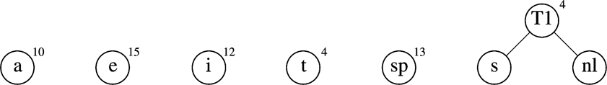
Compression step 2
Build the tree
Start with a “forest” of trees:
Repeat
Take the two trees that have the lowest frequency
The next two removals from the heap
Make them children of a new node
Keep track of the total frequency of that node
And stick that tree back into the heap

Slide 21
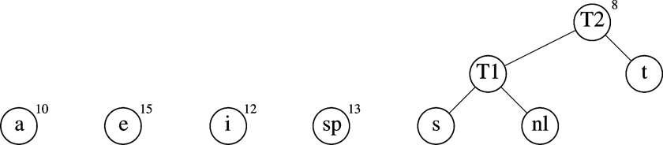
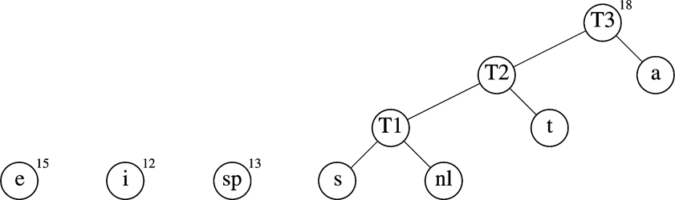

Slide 22
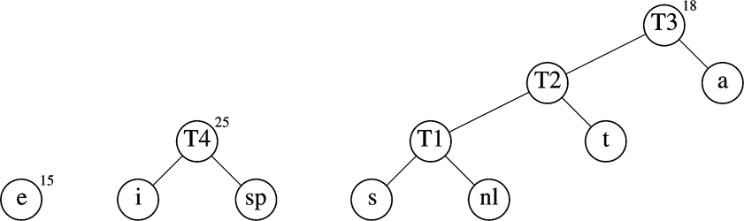
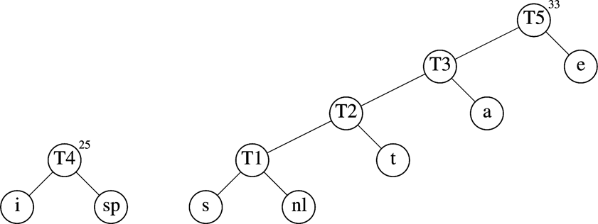

Slide 23
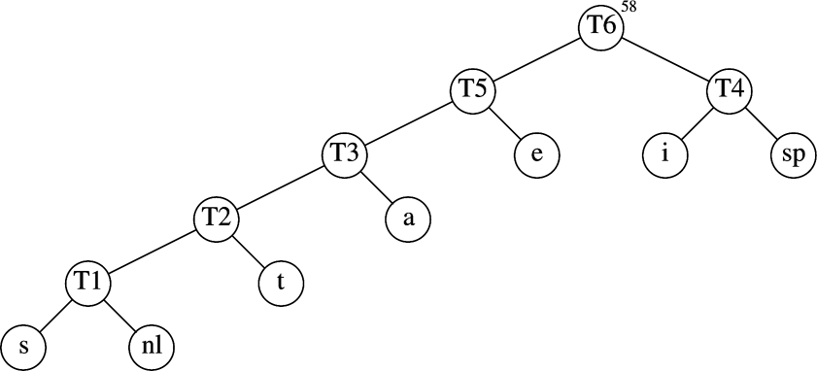
The final Huffman coding tree
Character | Code
a | 001
e | 01
i | 10
s | 00000
t | 0001
(space) | 11
(newline) | 00001

Slide 24
Resulting encoding table
Total encoding is 146 bits
ASCII was 464 bits: compression ratio of 3.2:1
Straight encoding was 174 bits: compression ratio of 1.2:1
Character | Code | Frequency | Total bits
a | 001 | 10 | 30
e | 01 | 15 | 30
i | 10 | 12 | 24
s | 00000 | 3 | 15
t | 0001 | 4 | 16
(space) | 11 | 13 | 26
(newline) | 00001 | 1 | 5
Total |  | 58 | 146

Slide 25
Compression step 3
Write the prefix codes to a file
We’ll use regular ASCII characters
Does this actually do any compression, then?
a 001
e 01
i 10
s 00000
t 0001
(sp) 11
(nl) 00001

Slide 26
Compression step 4
Write the text to the file using the Huffman encoding
sit becomes 00000 10 0001
taste becomes 0001 001 00000 0001 01
etc.
Char | Code
a | 001
e | 01
i | 10
s | 00000
t | 0001
(space) | 11
(newline) | 00001

Slide 27
Decompression Phase
Read in the prefix code structure (tree or array) from the compressed file.
Build a new Huffman tree for performing decompression
Read in one bit at a time from the compressed file and move through the prefix code tree until a leaf node is reached.
Write the character stored at the leaf node into the decompressed file.
While there is still input, repeat.

Slide 28
Huffman Coding Lab
Compression (pre-lab)
Decompression (in-lab)
Report (post-lab)

Slide 29
Huffman Encoding Prelab
Write a program that reads input from a file (see class website for test files)
Build a binary heap (priority queue) that calculates the letter frequencies
Build the huffman tree
Print the letter-encoding mapping to the file
There is a specific format, as specified in the lab
Encode the message, printing this also to the file

Slide 30
Tips/Hints
You may use Weiss code, or create your own heap code.
File input/output reference material
readfile.cpp from hashing lab
Class resources page

Slide 31
ASCII

Slide 32
ASCII Character Codes
American Standard Code for Information Interchange (ASCII)
Character encoding standard
Specifies correspondence between digital bit patterns and English alphabet
7-bit encoding with 1 bit for parity (error correction)
128 characters
95 printable characters
33 non-printable characters
http://en.wikipedia.org/wiki/ASCII

Slide 33
End of lecture on Wed, Apr 11

Slide 34
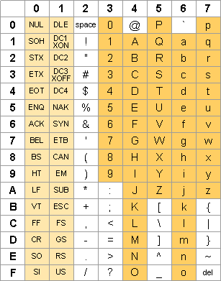
ASCII Character Codes (Hexadecimal)
For the lab, only need
to account for printable
characters (the red box)
Character codes:
32₁₀ (0x20) = space
33₁₀ (0x21) = !
127₁₀(0x7e) = ~

Slide 35
Priority Queues

Slide 36
Priority Queue Operations (Weiss)
insert( x )
deleteMin( )
deleteMin( minItem )
findMin( )
isEmpty( )
makeEmpty( )

Slide 37
Binary Heap Class
template <typename Comparable>
class BinaryHeap {
public:
explicit BinaryHeap( int capacity = 100 );// Constructor
explicit BinaryHeap( const vector<Comparable> & items );
bool isEmpty( ) const;
const Comparable & findMin( ) const;
void insert( const Comparable & x );
void deleteMin( );
void deleteMin( Comparable & minItem )
void makeEmpty( );
private:
int currentSize; // Number of elements in heap
vector<Comparable> list; // The heap array
// Internal methods
void buildHeap( );
void percolateDown( int hole );
};

Slide 38
Heap Data Members
int currentSize
Size of the heap
vector <Comparable> list
The heap implemented as an array

Slide 39
Constructors
// Default constructor
explicit BinaryHeap( int capacity = 100 ) : list( capacity + 1 ), currentSize( 0 ) { }
// Copy constructor
explicit BinaryHeap( const vector<Comparable> & items ) : list( items.size( ) + 10 ), currentSize( items.size( ) ) {
for( int i = 0; i < items.size( ); i++ )
list[ i + 1 ] = items[ i ];
buildHeap( );
}

Slide 40
isEmpty()
bool isEmpty( ) const {
return currentSize == 0;
}

Slide 41
findMin()
const Comparable & findMin( ) const {
if( isEmpty( ) )
throw UnderflowException( );
return list[ 1 ];
}

Slide 42
insert(x)
void insert( const Comparable & x ) {
if( currentSize == list.size( ) - 1 )
list.resize( list.size( ) * 2 );
// Percolate up
int hole = ++currentSize;
for( ; hole>1 && x<list[hole /2]; hole /= 2 )
list[ hole ] = list[ hole / 2 ];
list[ hole ] = x;
}

Slide 43
deleteMin()
void deleteMin( ) {
if( isEmpty( ) )
throw Underflow( );
// put last element in the heap at the top
list[ 1 ] = list[ currentSize-- ];
// percolate down
percolateDown( 1 );
}

Slide 44
makeEmpty()
void makeEmpty( ) {
currentSize = 0;
}

Slide 45
buildHeap()
// Internal method
void buildHeap( ) {
for( int i = currentSize / 2; i > 0; i-- )
percolateDown( i );
}

Slide 46
percolateDown()
void percolateDown( int hole ) {
int child;
Comparable tmp = list[ hole ];
for( ; hole * 2 <= currentSize; hole = child ) {
child = hole * 2;
if(child!=currentSize && list[child+1] < list[child])
child++; // look at the min of 2 children
if( list[ child ] < tmp )
list[ hole ] = list[ child ];
else break;
}
list[ hole ] = tmp;
}

Slide 47
End of lecture on Fri, Apr 13
Also went over the first 9 slides of 13-graphs

