Slide 1
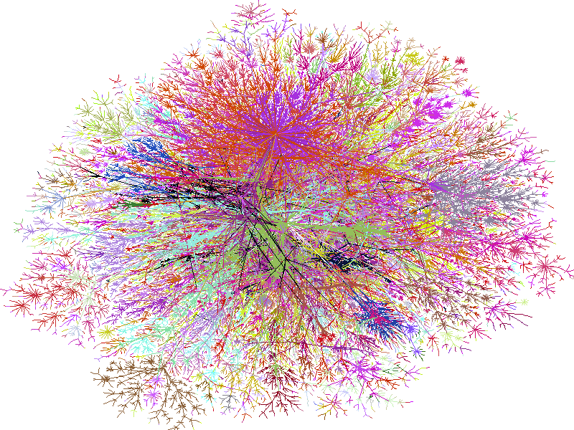
Graphs
CS2150: Program and Data Representation
University of Virginia Computer Science
Spring 2012 Aaron Bloomfield
www.cheswick.com/ches/map/index.html

Slide 2
Topic Coverage
Graph terminology
Lots of it!
Ways of representing graphs and costs & benefits
Adjacency matrix
Adjacency list
Solving problems with graphs
Topological sort
Traveling salesperson

Slide 3
Graph examples
Google Maps, of course
Which actually uses MapQuest data
But we’ll call it Google Maps data
Others?

Slide 4
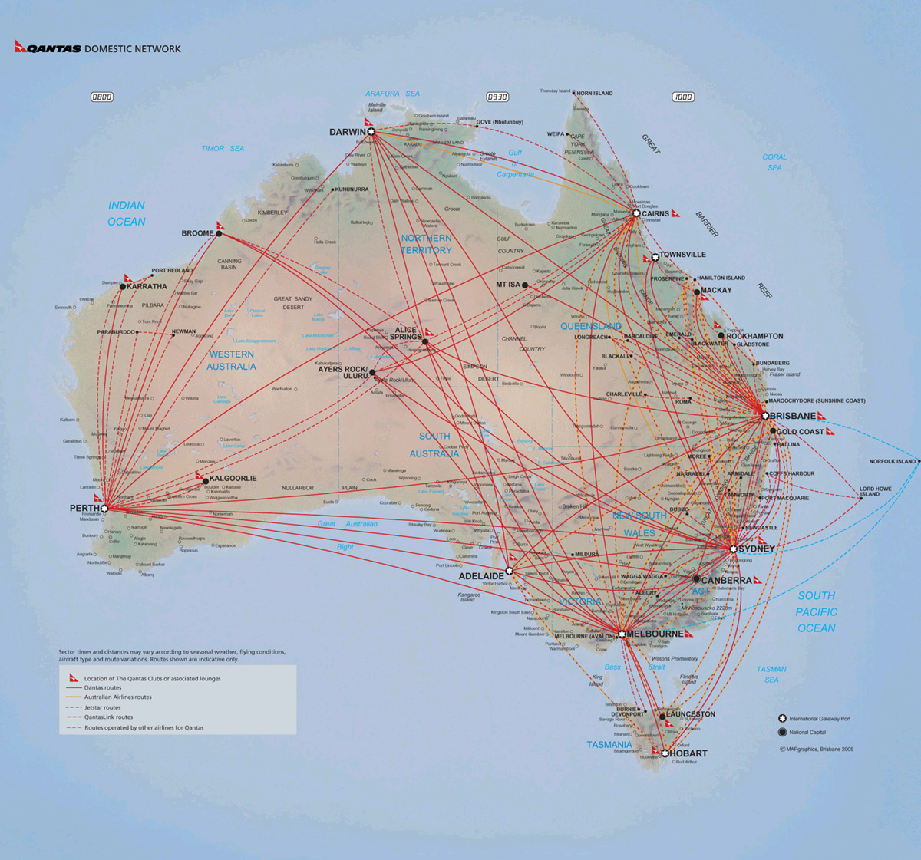
Airline maps
From http://www.travelmood.com /site/seatsale/QF/images/ MR_Domestic-April2005.jpg

Slide 5
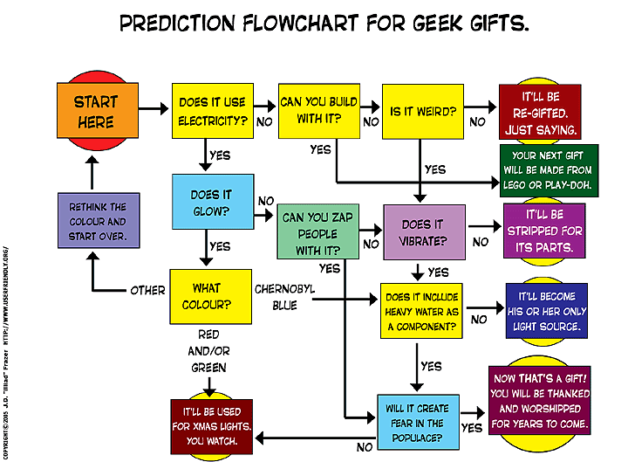
Flowcharts

Slide 6
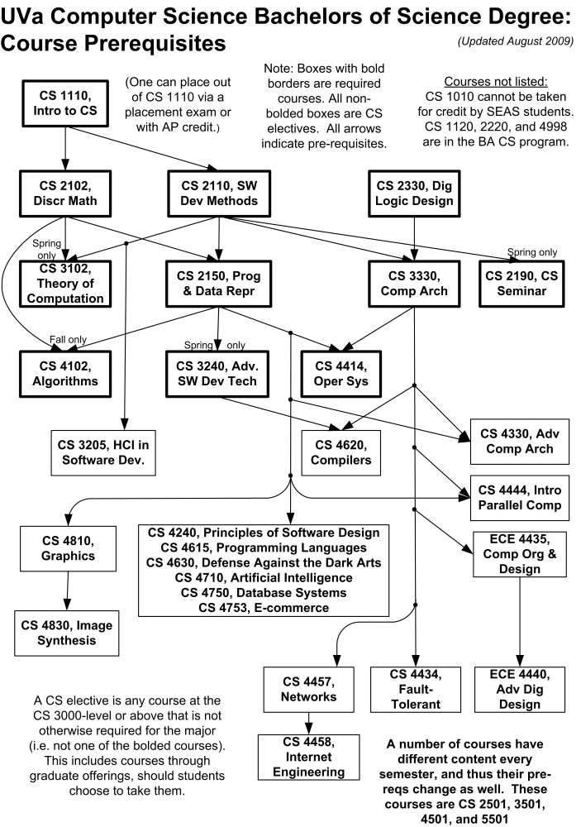
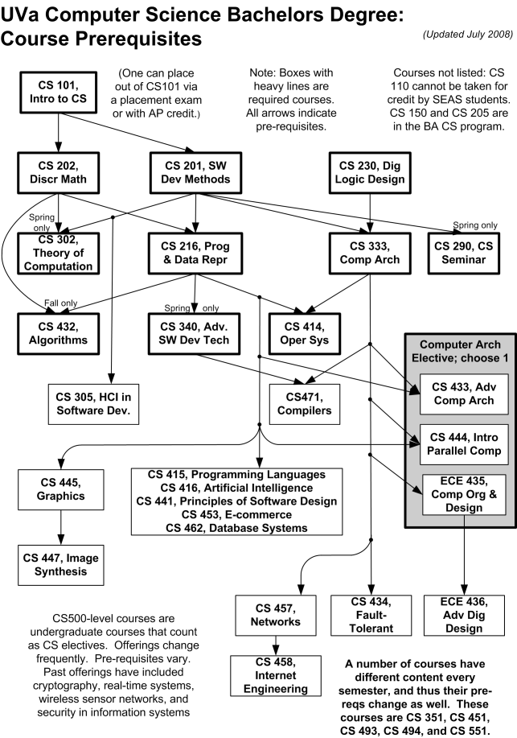
Course pre-req graphs

Slide 7
Graphs
G = (V, E)
V are the vertices; E are the edges.
Edges are of the form (v, w), where v, w ∈V.
ordered pair: directed graph or digraph
unordered pair: undirected graph
v₉
v₁₀
v₈
v₁
v₃
v₆
v₇
v₂
v₄
v₅
Notes:
This is an example of an undirected graph.

Slide 8
How big are these graphs?
These are educated guesses, by the way
Airport codes
There are probably 3,000 world-wide airports
Assume you can fly to 25 airports from each
That’s 3,000*25 = 75,000 edges
Google maps
There are probably 30 million vertices in the US
Assume each one connects to three or four others
That’s 3.5 * 30 million ≈ 100 million edges

Slide 9
End of lecture on Fri, Apr 13
Also went over the last 14 slides of 12-huffman

Slide 10
Terminology
A weight or cost can be associated with each edge.
w is adjacent to v iff (v, w) ∈ E.
path: sequence of vertices w₁, w₂, w₃, … , w_{N} such that (w_{i}, w_{i+1}) ∈ E for 1 ≤ i < N.
length of a path: number of edges in the path.
simple path: all vertices are distinct.

Slide 11
How to weight a graph…
For Google maps?
For airline routes?

Slide 12
More terminology
cycle:
directed graph: path of length ≥ 1 such that w₁ = w_{N}.
undirected graph: same, except all edges are distinct.
connected: there is a path from every vertex to every other vertex.
loop: (v, v) ∈ E.
complete graph: there is an edge between every pair of vertices.

Slide 13
Digraph terminology
directed acyclic graph: no cycles. “DAG”
strongly connected: there is a path from every vertex to every other vertex.
weakly connected: the underlying undirected graph is connected.
D
F
A
C
E
G
B

Slide 14
Representation
adjacency matrix:
1 2 3 4
1
2
1
2
3
4
3
4
Notes:
Set the diagonal = to 1.
Θ (|V|²) space. (Good for dense graphs)

Slide 15
Representation
adjacency list:
1
2
1
2
3
4
2
3
4
3
1
2
3
4
Notes:
Good for (sparse graphs): space = O(|V| + |E|)

Slide 16
Representation in the real world
Two types of representation
Adjacency matrix
Adjacency list
How does Google maps probably store it?
How do airline routes probably store it?

Slide 17
Topological Sort

Slide 18
Topological Sort
Given a directed acyclic graph, construct an ordering of the vertices such that if there is a path from v_{i} to v_{j}, then v_{j} appears after v_{i} in the ordering.
The result is a linear list of vertices
indegree of v: # of edges (u, v).
v₁
v₆
v₂
v₃
v₇
v₈
v₄
v₅
Notes:
A valid topo sort of this graph is:

Slide 19
Topological Sort
A valid topological sort is:
V1, V6, V8, V3, V2, V7, V4, V5
v₁
v₆
v₂
v₃
v₇
v₈
v₄
v₅
Notes:
A valid topo sort of this graph is:

Slide 20
What is the topological sort?
2
1
4
3
Notes:
Valid topo sorts = 1 3 2 4 and 1 2 3 4

Slide 21
What is the topological sort?
2
1
4
3

Slide 22
This is already topo-logically sorted!

Slide 23
Topological sort
void Graph::topsort(){
Vertex v, w;
for (int counter=0; counter < NUM_VERTICES; counter++){
v = findNewVertexOfDegreeZero();
if (v == NOT_A_VERTEX)
throw CycleFound();
v.topologicalNum = counter;
for each w adjacent to v
w.indegree--;
}
}
What’s the big-Oh running time?
Observation: The only new (eligible) vertices with indegree 0 are the ones adjacent to the vertex just processed.
Notes:
We should never find a cycle – this is a DAG
How long does this take?
Observation: The only new (eligible) vertices with indegree 0 are the ones adjacent to the vertex just processed.

Slide 24
Topological sort
void Graph::topsort(){
Queue q(NUM_VERTICES);
int counter = 0;
Vertex v, w;
q.makeEmpty();
for each vertex v
if (v.indegree == 0)
q.enqueue(v);
while (!q.isEmpty()){
v = q.dequeue();
v.topologicalNum = ++counter;
for each w adjacent to v
if (--w.indegree == 0)
q.enqueue(w);
}
if (counter != NUM_VERTICES)
throw CycleFound();
}
intialize the
queue
get a vertex with
indegree 0
insert new
eligible
vertices
Notes:
Idea: Use a set data structure to keep track of eligible vertices (Queue or Stack).

Slide 25
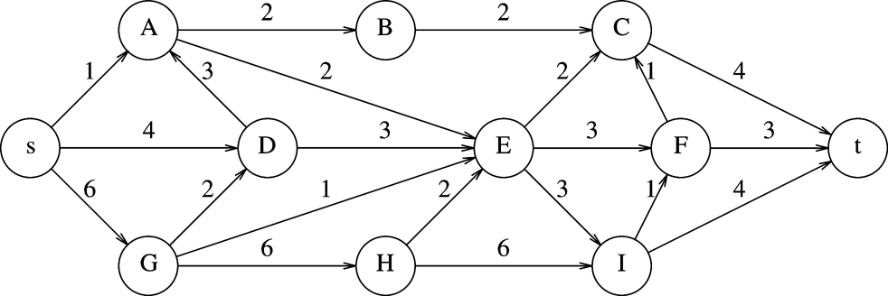
Problem 9.1 from Textbook
Topological sort

Slide 26
End of lecture on Mon, Apr 16

Slide 27
Shortest Path Algorithms
Unweighted and Weighted Graphs

Slide 28
Why do we care about shortest paths?
The obvious answers:
Map routing (car navigation systems, Google Maps, flights)
6 degrees of separation
But what else?
Internet routing
Puzzle answers (Rubik’s cube)

Slide 29
3 types of algorithms
Single pair
Single source
All pairs
And a variant that we’ll see later:
Travelling salesperson

Slide 30
Shortest Path Algorithms
This version is called the “single-source” shortest path
Given a graph G = (V, E) and a single distinguished vertex s, find the shortest weighted path from s to every other vertex in G.
weighted path length of v₁, v₂, … , v_{N}:
, where c_{i,j} is the cost of edge (v_{i}, v_{j})
Notes:
applications:
fastest way to get from one place to another
cheapest way to fly/send data from one city to another.

Slide 31
Unweighted Shortest Path
Special case of the weighted problem: all weights are 1.
Solution: breadth-first search. Similar to level-order traversal for trees.
v₁
v₃
v₆
s
v₀
v₄
v₇
v₂
v₅

Slide 32
void Graph::unweighted (Vertex s){
Queue q(NUM_VERTICES);
Vertex v, w;
q.enqueue(s);
s.dist = 0;
while (!q.isEmpty()){
v = q.dequeue();
for each w adjacent to v
if (w.dist == INFINITY){
w.dist = v.dist + 1;
w.path = v;
q.enqueue(w);
}
}
}
each edge examined
at most once – if adjacency lists are used
each vertex enqueued
at most once
total running time: O( ? )

Slide 33
Weighted Shortest Path
no negative weight edges.
Dijkstra’s algorithm: uses similar ideas as the unweighted case.
Greedy algorithms:
do what seems to be best at every decision point.
v
s
S
“known”
V - S
“unknown”

Slide 34
Dijkstra’s algorithm
Initialize each vertex’s distance as infinity
Start at a given vertex s
Update s’s distance to be 0
Repeat
Pick the next unknown vertex with the shortest distance to be the next v
If no more vertices are unknown, terminate loop
Mark v as known
For each edge from v to adjacent unknown vertices w
If the total distance to w is less than the current distance to w
Update w’s distance and the path to w

Slide 35
v₀
2
v₁
2
1
5
1
1
1
v₂
v₃
v₄
6
5
3
V | Known | Dist | path
v0
v1
v2
v3
v4
v5
v6
2
10
v₅
v₆

Slide 36
void Graph::dijkstra(Vertex s){
Vertex v,w;
s.dist = 0;
while (there exist unknown vertices, find the unknown v with the smallest distance)
v.known = true;
for each w adjacent to v
if (!w.known)
if (v.dist + Cost_VW < w.dist){
w.dist = v.dist + Cost_VW;
w.path = v;
}
}
}

Slide 37
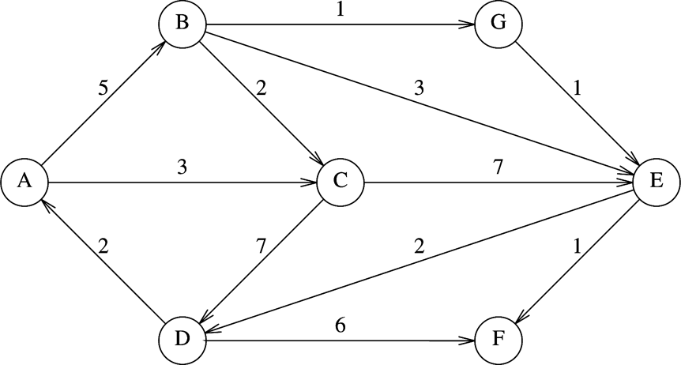
Weighted Single Source Shortest Paths (Weiss 9.5)
V | Known | Dist | Path
A
B
C
D
E
F
G

Slide 38
Analysis
How long does it take to find the smallest unknown distance?
simple scan using an array: O(v)
Total running time:
Using a simple scan: O(v²+e) = O(v²)
Optimizations?
Use adjacency lists and heaps
Assuming that the graph is connected (i.e. e > v-1), then the running time decreases to O(e + v log v)
We can simplify this to O(e log v)
although we won’t see how to do that here

Slide 39
Negative Cost Edges?
Perhaps the graph weights are the amount of fuel expended
Positive means fuel was used
And passing by a fuel station is a refueling, which is a negative cost edge
Dijkstra’s algorithm does not work for negative cost edges
Others do, but are much less efficient
What about negative cost cycles?

Slide 40
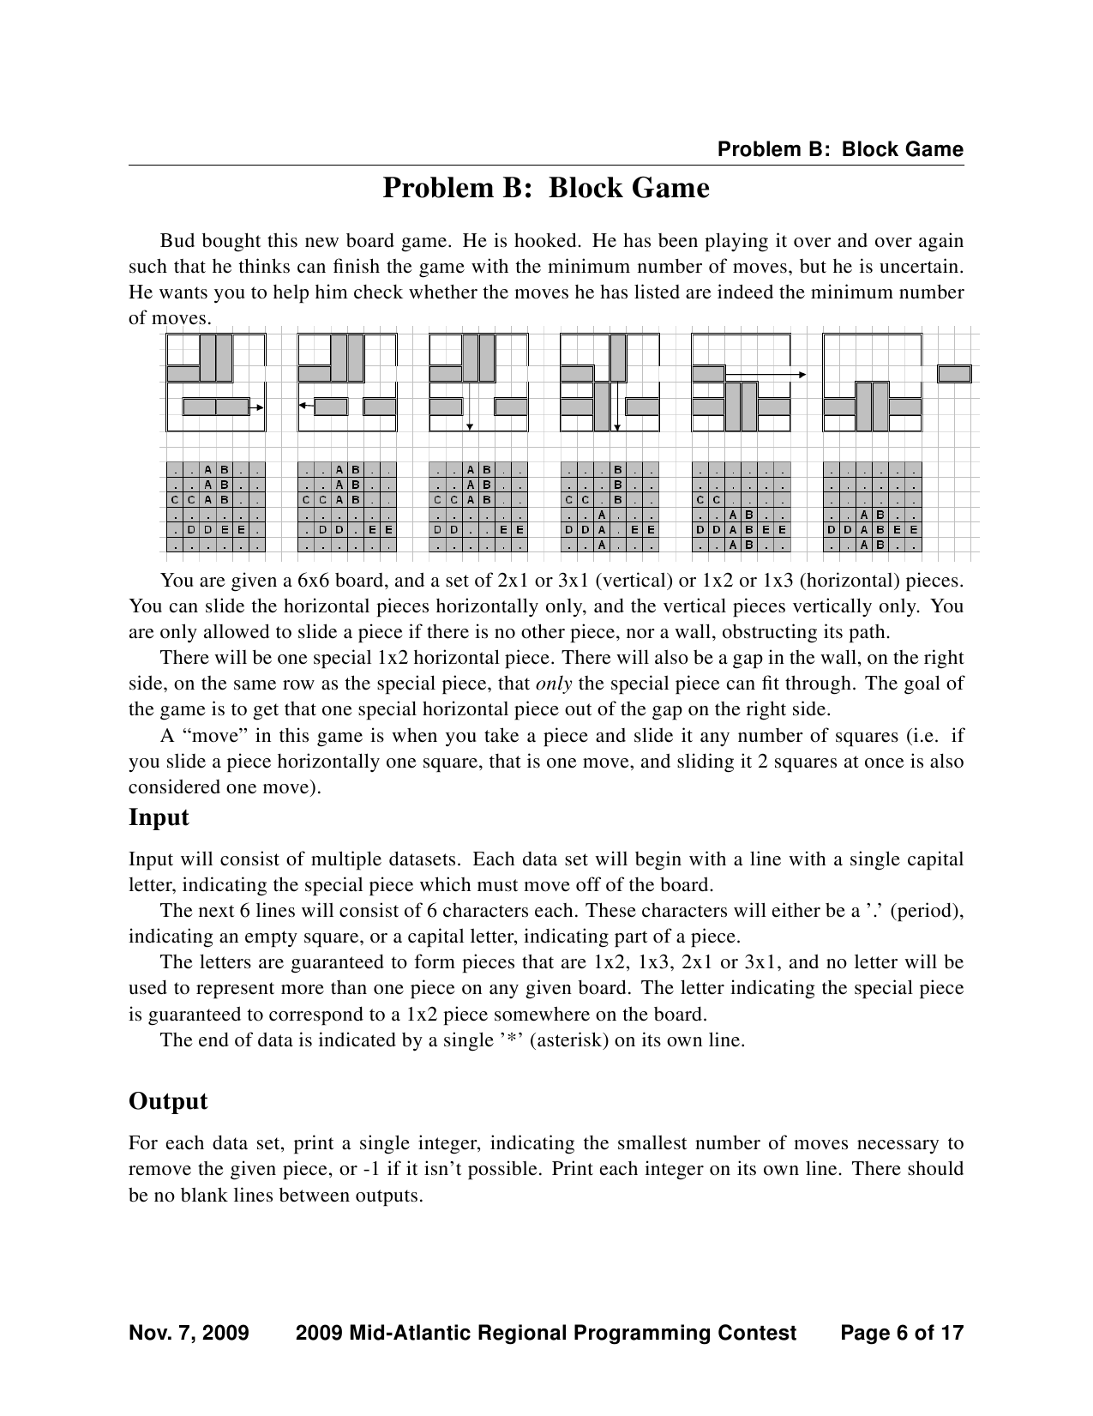
Shortest Path Example Problem (from the ICPC Mid-Atlantic Regionals, 2009)

Slide 41
Google Maps

Slide 42
More on shortest path
We studied finding the shortest path from a single vertex to every vertex
But what about just 1 destination?
Do the same algorithm, but stop when the destination enters the set S
Thus, the running time is the same!

Slide 43
How would you drive to Seattle?
What constitutes a “highway”?

Slide 44
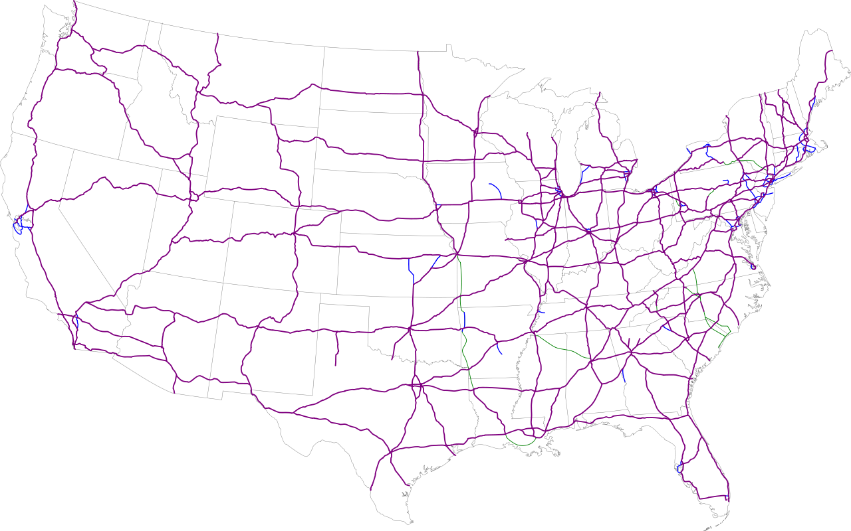
The Eisenhower Interstate System

Slide 45
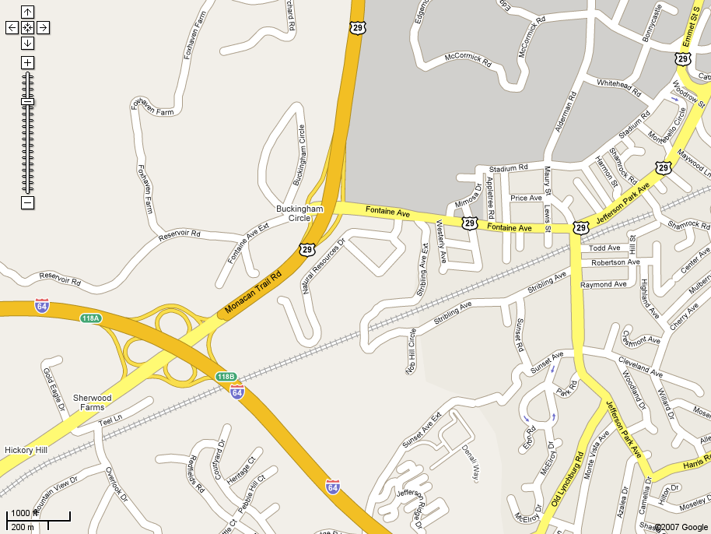

Slide 46
Google Maps’ algorithm
(This is an educated guess, btw)
Assume you are starting on a “side road”
Transition to a “main road”
Transition to a “highway”
Get as close as you can to your destination via the “highway” system
Transition to a “main road”, and get as close as you can to your destination
Transition to a “side road”, and go to your destination

Slide 47
Travelling Salesman Problem

Slide 48
Travelling Salesman Problem (TSP)
Given a number of cities and the costs of traveling from any city to any other city, what is the least-cost round-trip route that visits each city exactly once and then returns to the starting city?
Really important problem for:
UPS, Federal Express, USPS
Any transport delivery system
Cost = distance because more fuel is used

Slide 49
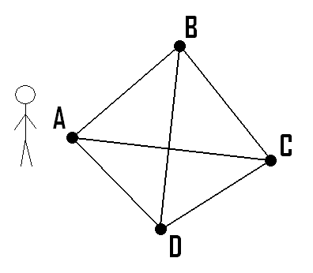
Easy

Slide 50
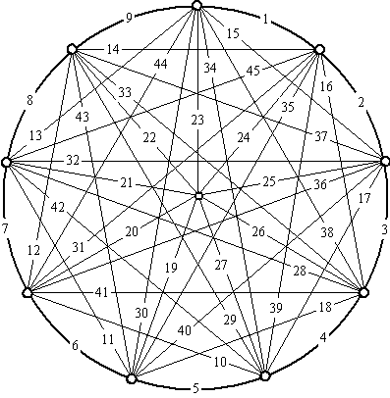
Hard
From http://www.geocities.com/~harveyh/Image_object/graph-10.gif

Slide 51
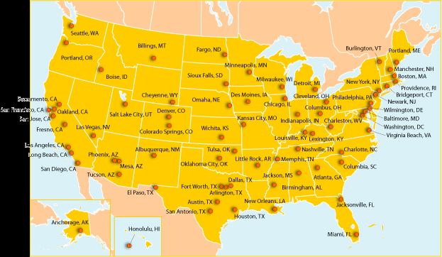
Really Hard
From http://www.earthday.net/UER/report/images/earthday1_MAPONLY_CITY.gif

Slide 52
Analysis
Hamiltonian path: a path in a connected graph that visits each vertex exactly once
Hamiltonian cycle: a Hamiltonian path that ends where it started
The traveling salesman problem is thus to find the least weight Hamiltonian path (cycle) in a connected, weighted graph
The size of the solution space is ½(n-1)!
Which means it’s an O(n!) algorithm
That’s exponential
For 10 cities: 181,440
For 20 cities: 6 * 10¹⁶

Slide 53
More Analysis
This problem is NP-complete
Meaning there is no known efficient solution
Just to try every possible path
But there are ways to get a somewhat efficient solution (Heuristic)
It just might not be the most efficient
What’s the (usually) least expensive way to get between two US cities?
And is that significantly slower than the “best” algorithm?

Slide 54
The Record
http://en.wikipedia.org/wiki/Traveling_salesman
In April 2006, a computer cluster computed a path of 85,900 cities visited in 136 CPU years
About 3-6 months of “wall time”
85,900! = 9.61 * 10^{386,526}
Assume you can compute 1 million paths each second
That would take 3.04 * 10^{386,516} years!
They used acceleration techniques, obviously…

Slide 55
Lab 11

Slide 56
Lab 11
Pre-lab: implement a topological sort
In-lab: implement a brute-force traveling salesman problem
Using locations in Tolkien’s Middle Earth
Post-lab: do a report containing analysis and a study of acceleration techniques

Slide 57
End of lecture on Fri, Apr 20

Slide 58
Minimum Spanning Trees (MST)

Slide 59
Spanning Tree
Suppose you are going to build a transport system:
Set of cities
Roads, rail lines, air corridors connecting cities
Trains, buses or aircraft between cities
Which links do you actually use?
Cannot use a complete graph
Passengers can change at connection points
Want to minimize number of links used
Any solution is a tree

Slide 60
Spanning Tree

Slide 61
Spanning Tree
A spanning tree of a graph G is a subgraph of G that contains every vertex of G and is a tree
Any connected graph has a spanning tree
Any two spanning trees of a graph have the same number of nodes
Construct a spanning tree:
Start with the graph
Remove an edge from each cycle
What remains has the same set of vertices but is a tree

Slide 62
Spanning Tree
Graph
Spanning Trees

Slide 63
Minimal Spanning Tree
Spanning trees are simple
But suppose edges have weights!
“Cost” associated with the edge
Miles for a transport link, for example
Spanning trees each have a different total weight
Minimal-weigh Spanning Tree:
Spanning tree with the minimal total weight

Slide 64
Minimum Spanning Trees
Given an undirected graph G=(V,E), find a graph G’=(V,E’) such that
E’ is a subset of E
|E’| = |V| - 1
G’ is connected
is minimal
G’ is a minimal spanning tree.
Applications: wiring a house, cable TV lines, power grids, Internet connections

Slide 65
Generic Minimum Spanning Tree Algorithm
KnownVertices ← {}
while KnownVertices does not form a spanning tree loop
find edge (u,v) that is “safe” for KnownVertices
KnownVertices ←KnownVertices U {(u,v)}
end loop
OK, So How?

Slide 66
Prim’s algorithm
Idea: Grow a tree by adding an edge from the “known” vertices to the “unknown” vertices. Pick the edge with the smallest weight.
G
v
known
Notes:
Pick one node as the root,
Incrementally add edges that connect a “new” vertex to the tree.
Pick the edge (u,v) where u is in the tree, v is not AND
where the edge weight is the smallest of all edges (where u is in the tree and v is not).

Slide 67
Prim’s Algorithm for MST
Pick one node as the root,
Incrementally add edges that connect a “new” vertex to the tree.
Pick the edge (u,v) where:
u is in the tree, v is not AND
where the edge weight is the smallest of all edges (where u is in the tree and v is not).

Slide 68
MST
v1
{v1, v4}
{v1, v2}
{v4, v3}
{v4, v7}
{v7, v6}
{v7, v5}
2
v₂
v₁
4
1
3
10
v₃
2
v₄
7
v₅
5
8
4
6
v₂
v₁
v₆
1
v₇
v₃
v₄
v₅
v₇
v₆

Slide 69
Analysis
Running time: Same as Dijkstra’s: O(e log v)
Correctness:
Suppose we have a partially built tree that we know is contained in some minimum spanning tree T. Let (u,v)∈E, where u is “known” and v is “unknown” and has minimal cost.
Then there is a MST T’ that contains the partially built tree and (u,v) that has as low a cost as T.

Slide 70
Kruskal’s MST Algorithm
Idea: Grow a forest out of edges that do not create a cycle. Pick an edge with the smallest weight.
G=(V,E)
v

Slide 71
MST
2
v₁
v₂
4
1
3
10
v₃
2
v₄
7
v₅
5
8
4
6
v₆
1
v₇
v₁
v₂
v₃
v₄
v₅
v₇
v₆

Slide 72
Kruskal code
void Graph::kruskal(){
int edgesAccepted = 0;
DisjSet s(NUM_VERTICES);
while (edgesAccepted < NUM_VERTICES – 1){
e = smallest weight edge not deleted yet;
// edge e = (u, v)
uset = s.find(u);
vset = s.find(v);
if (uset != vset){
edgesAccepted++;
s.unionSets(uset, vset);
}
}
}
|E| heap ops
2|E| finds
|V| unions

Slide 73
End of lecture on Mon, Apr 23

