Slide 1

Memory Hierarchy & Locality
CS2150: Program and Data Representation
University of Virginia Computer Science
Spring 2012 Aaron Bloomfield

Slide 2
Outline
Concepts
Memory Allocation
Stack
static
Heap
Dynamic
Memory leak
Memory Allocation in C
malloc()
alloca()
free()
realloc()

Slide 3
Static/Dynamic Allocation
Static: space required is known before program starts (at “compile time”)
Dynamic: space required is not known before the program starts
Can be placed on either the stack or the heap
But most often on the heap

Slide 4
Memory in C
Stack
Managed by compiler automatically
Lifetime is determined by program scope
Cannot outlive procedure return
Address space grows “down” from the top
Heap
Managed by programmer explicitly
Lifetime is controlled by programmer
Lives until freed by program
Address space grows “up” from the bottom

Slide 5
Memory Layout
Memory Leak!
Stack
Heap
f calls g, g calls h, h calls k
P*
Pointers
f()
g()
h()
k()
Function Call & Return
Garbage Collector

Slide 6
Memory Allocators
 |  | Lifetime
 |  | Scoped | Unlimited
 | Known
 | Unknown |  | new & malloc
global, static
variable
declarations
local variable
declarations
Size
alloca
alloca – like malloc, but on the
stack, not heap (rarely used)

Slide 7
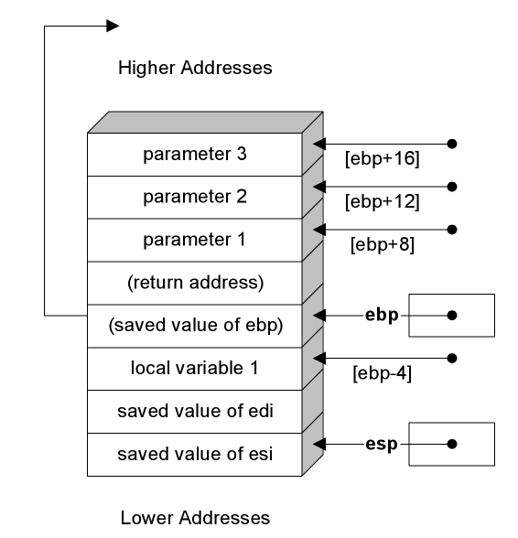
x86 callee epilogue
; subroutine epilogue
pop esi ; recover saved registers
pop edi ; reverse of push order
mov esp, ebp ; deallocate local var(s)
pop ebp ; restore base pointer
ret
_myFunc ENDP
END ; end of CODE segment
How would this change with alloca()?

Slide 8
malloc
void *malloc (size_t size)
Size in bytes
Returns an untyped pointer
(can point to anything)
Returns an address that is the location of at least size bytes of previously unused memory, and reserves that space.
Returns null is there isn’t enough space.

Slide 9
malloc Example
char *s = (char *) malloc (sizeof(*s) * n)
type cast
malloc returns void *
cast tells compiler that program will use it as a char *
sizeof operator
Takes a type or
expression, evaluates to the number of bytes to store it

Slide 10
How is the heap managed?
Compiled into the program’s code is a heap directory management routine
This adds extra time to a new or malloc()
It allocates memory in two ways:
Fixed-size-blocks allocation
A free list of available blocks is kept, and the appropriate number are allocated
Buddy blocks
Blocks are divided into powers of 2, so the memory takes up the next highest power of 2 bytes

Slide 11
What happens when a new or malloc() is called
A subroutine is invoked
The OS is consulted
This requires switching context back to the OS
The heap directory is examined
And new space is determined somehow
The subroutine returns
How expensive would this be?

Slide 12
Why Do We Care About Memory?
Memory hierarchy, locality
Computer architecture
What does this have to do with CS 2150?
Course: Program and data representation
Does the memory hierarchy affect how we think about efficiency?
What about data in memory?

Slide 13
Memory Hierarchy
CPU Registers
Faster
Larger
Caches
RAM
Disk

Slide 14
Definitions
Processor Cycle
(for our purposes) the time it takes to execute a “simple” instruction
E.g., add eax, ebx
Memory Access Time (Latency)
Time it takes to access memory
Memory Cycle Time
Time to write to memory

Slide 15
Some (older) numbers
Typical numbers for 1 GHz processor
Cycle time 1 ns (10-⁹)
L1 cache: accessed in 2-3 ns
L2 cache: 20-50 ns
Main memory: 60-100 ns
Disk: 5-12 ms (5 x 10⁶ ns to 12 x 10⁶ ns)
1 ns = 10⁻⁹ s; 1 ms = 10⁻³ s

Slide 16
More Example Numbers Memory Capacities
L1 cache: 1 Mb
L2 cache: 10 Mb
Main memory: 1 Gb
Disk: 1 Tb

Slide 17
Caches
Content at each level is a subset of the level below
Cache Hit – address requested is in cache
Cache Miss – address requested is NOT in cache
Cache page size (chunk size, line size) – the number of contiguous bytes that are moved into the cache at one time

Slide 18
So What?
Program speed is affected by where the data is
Data in main memory much slower to access than data in cache
Goal
Attempt to reduce the number of access to slower levels
How?

Slide 19
End of lecture on Wed, Apr 25

Slide 20
Locality
Temporal Locality
Locality in time
If an item is referenced, it will tend to be referenced again soon.
Spatial Locality
Locality in space
If an item is referenced, items whose addresses are close by will tend to be referenced soon.

Slide 21
An Example
int sum = 0;
for(int i = 0; i < n; i++)
{
sum += a[i];
}

Slide 22
Example code
int main (void) {
cout << "page size: " << getpagesize() << endl;
int array[1024][1024];
for ( int i = 0; i < 1024; i++ )
for ( int j = 0; j < 1024; j++ )
array[i][j] = 0;
for ( int c = 0; c < 1024; c++ )
for ( int i = 0; i < 1024; i++ )
for ( int j = 0; j < 1024; j++ )
array[i][j]++;
int sum = 0;
for ( int i = 0; i < 1024; i++ )
for ( int j = 0; j < 1024; j++ )
sum += array[i][j];
cout << sum << endl;
}
What if we swap the i and j loops?

Slide 23
Execution of cache.cpp
On my (older) Linux Pentium machine
Page size is 4Kb (4096 bytes)
Execution times:
With i as the outer and j as the inner: 2.7 seconds
With j as the outer and i as the inner: 124.9 seconds
A factor of almost 50!

Slide 24
What Can Be Done?
Goal
Attempt to reduce the number of access to slower levels
How?

Slide 25
Trends (Example)
Between 1980 – 2000
CPU speed: 600x speed
SRAM: 200x capacity
100x latency
DRAM: 8,000x capacity
6x latency
Disk 50,000x capacity
10x latency
See any implications?

Slide 26
Who is Working on This Problem?
Architects
Compiler writers
Programmers
Operating system

Slide 27
Locality and Data Structures
Which has better spatial locality? Arrays or linked lists?
How does this change the big-theta analysis of the data structures?

Slide 28
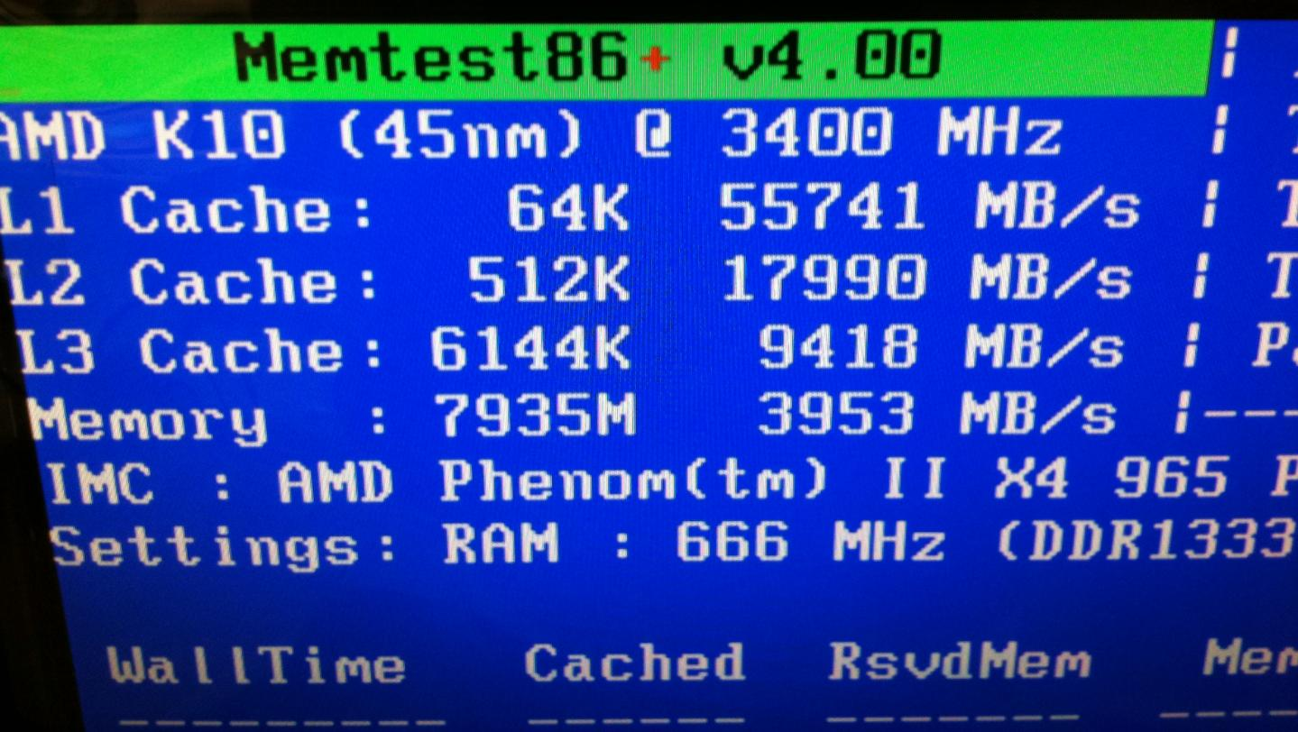
Some actual numbers…

Slide 29
End of lecture on Fri, Apr 27
We are not going over the remaining slides during lecture
We also went over the first 30 slides of 15-aop

Slide 30
Back to string functions

Slide 31
string functions
int strlen(char *s) – returns number of chars in s
char *strcpy(char *s1, const char *s2) – Copies s2 to s1
char *strcat(char *s1, const char * s2) - Appends s2 to s1
Notes:
int strlen(char *s) – returns number of chars in s (not counting null terminator)
char *strcpy(char *s1, const char *s2) – Copies the string pointed to by s2 (including the terminating null byte) into the space pointed to by s1. If copying takes place between objects that overlap, the behavior is undefined.
char *strcat(char *s1, const char * s2) - Appends a copy of the string pointed to by s2 (including the terminating null byte) to the end of the string pointed to by s1. The initial byte of s2 overwrites the null byte at the end of s1. If copying takes place between objects that overlap, the behavior is undefined.

Slide 32
String Concatenation
#include <stdlib.h>
#include <string.h>
#include <stdio.h>
int main (int argc, char **argv) { // argc: number of arguments
// argv[]: the commandline arguments
int i = 0;
// allocate a space in memory for result
char *result = (char *) malloc (sizeof (*result));
*result = '\0';
while (i < argc) { // while there are still arguments
char *s = (char *) malloc (sizeof (*s)
* (strlen (result) + strlen (argv[i]) + 1));
strcpy (s, result);
strcat (s, argv[i]);
result = s;
i++;
}
printf ("Concatenation: %s\n", result);
return 0;
}
Q: Do you see any
memory leak
problems?

Slide 33
Concatenating Strings
//allocate space for result and next argument
char *s = (char *)
malloc (sizeof (*s)
* (strlen (result)
+ strlen (argv[i]) + 1));
// copy result to s
strcpy (s, result);
// concatenate next argument
strcat (s, argv[i]);
Why +1?

Slide 34
Memory Lifetimes
#include <stdlib.h>
#include <string.h>
#include <stdio.h>
int main (int argc, char **argv) {
int i = 0;
char *result = (char *) malloc (sizeof (*result));
*result = '\0';
while (i < argc) {
char *s = (char *) malloc (sizeof (*s)
* (strlen (result) + strlen (argv[i]) + 1));
strcpy (s, result);
strcat (s, argv[i]);
result = s;
i++;
}
printf ("Concatenation: %s\n", result);
return 0;
}
When is space allocated by malloc reclaimed?

Slide 35
Reclaiming Storage
Storage allocated by malloc is reserved forever
Give it back by passing it to free
void free(void *ptr);
Notes:
The free() function shall cause the space pointed to by ptr to be deallocated; that is, made available for further allocation. If ptr is a null pointer, no action shall occur. Otherwise, if the argument does not match a pointer earlier returned by malloc(), … (or a few other allocators) function, or if the space has been deallocated by a call to free(), the behavior is undefined.

Slide 36
Memory Leaks
Program fails to release memory when no longer needed
Consequences/symptoms
Reduces amount of available memory, run out of memory available for allocation
When all memory is in RAM, there will be an immediate failure
Virtual memory. Effect: once RAM has run out, increasing use of hard disk
Usually, the performance of the application and/or system will have become so slow that they will be considered to have failed

Slide 37
Plugging Memory Leaks
#include <stdlib.h>
#include <string.h>
#include <stdio.h>
int main (int argc, char **argv)
{
int i = 0;
char *result = (char *) malloc (sizeof (*result));
*result = '\0';
while (i < argc)
{
char *s = (char *) malloc (sizeof (*s)
* (strlen (result) + strlen (argv[i]) + 1));
strcpy (s, result);
strcat (s, argv[i]);
result = s;
i++;
}
printf ("Concatenation: %s\n", result);
return 0;
}
After last use or
before reassignment
free (result);

Slide 38
Memory Leak
There is no reference to allocated storage
It can never be reached
It can never be reclaimed
Losing references
Variable goes out of scope
Variable reassigned

Slide 39
References
char *result = (char *) malloc (sizeof (*result));
…
while (i < argc) {
char *s = (char *) malloc (…);
strcpy (s, result);
strcat (s, argv[i]);
result = s;
i++;
}
scope of s is closed – should we
free(s) first?
No! result now references same storage

Slide 40
References
char *result = (char *) malloc (sizeof (*result));
…
while (i < argc) {
char *s = (char *) malloc (…);
strcpy (s, result);
strcat (s, argv[i]);
result = s;
i++;
}
after this assignment,
no way to reach storage result previously pointed to

Slide 41
realloc
void *realloc(void *ptr, size_t size);
The realloc() function changes the size of the memory object pointed to by ptr to the size specified by size.
But it’s risky…
It changes the address of the pointer
So other pointers pointing there are now pointing to invalid memory
Notes:
The realloc() function changes the size of the memory object pointed to by ptr to the size specified by size. The contents of the object will remain unchanged up to the lesser of the new and old sizes. If the new size of the memory object would require movement of the object, the space for the previous instantiation of the object is freed. If the new size is larger, the contents of the newly allocated portion of the object are unspecified. If size is 0 and ptr is not a null pointer, the object pointed to is freed. If the space cannot be allocated, the object remains unchanged.

Slide 42
Running time of realloc
Time to reserve new space: O(1)
Time to copy old data into new space:
O(n) where n is the size of the old data

Slide 43
Efficiency and Order Classes
Recall Big-Oh, Big-Theta, ...
When are the differences meaningful?
Inputs get large
Difference in order class
High-level comparison tool
Not as useful when
2 solutions are in the same order class
Fine-tuning of an algorithm is important

Slide 44
Efficiency and Order Classes (2)
Order classes based on counting statements
Is this useful for fine-grained algorithm analysis?
One assumption
All operations take the same amount of time
Is this really true?

Slide 45
Factorial - Recursive
int factorial_recursive(int x)
{
if(x <= 1)
return 1;
else
return x * factorial_recursive(x-1);
}
Note that we have to find the recursive value, and make a modification to it (multiply it by x) before we return it

Slide 46
Factorial - Tail Recursion
int factorial_tail_recursive(int x, int y)
{
if(x <= 1)
return y;
else
return factorial_tail_recursive(x-1, x*y);
}
Note that the answer to a given invocation is exactly the answer to the recursive call
How could we modify the calling convention for this?

Slide 47
Activation Records

Slide 48
Factorial – Loop Implementation
int factorial_loop(int x)
{
int y = 1;
while( x > 1) {
y *= x;
x--;
}
return y;
}

