Slide 1

SRM INSTITUTE OF SCIENCE AND TECHNOLOGY
Ramapuram Campus , Chennai – 600089
CLOUD BASED INTRUSION DETECTION USING MACHINE LEARNING
DONE BY-
UTKALIKA DAS (RA2011004020183)
DHAYAA RANJJAN A K (RA2011004020138) BALACHANDAR N (RA2011004020148)
UNDER THE GUIDANCE OF-
Dr. Arthi R
DEPARTMENT OF ELECTRONICS AND COMMUNICATION
ENGINEERING
SRM Institute of Science and Technology, Ramapuram Chennai, India
CLOUD BASED INTRUSION DETECTION USING MACHINE LEARNING

Slide 2
TABLE OF CONTENTS
Introduction
Motivation
Objectives
Literature Survey
Existing System
Proposed System
Work done
Results and Discussion
References
CLOUD BASED INTRUSION DETECTION USING MACHINE LEARNING

Slide 3
INTRODUCTION
Cloud technologies provide convenient access to shared resources but are
vulnerable to security challenges like data protection and Internet-based threats.
Cloud computing offers many advantages, but also faces many security hazards.
Intrusion detection system (IDS) is a mechanism to monitor
resources, services, and networks, then detect attacks.
This paper presents a cloud-based IDS model based on random forest (RF) and
feature engineering.
The proposed model achieves optimum accuracy on NSL-KDD datasets.
The proposed model outperforms recent related works in terms of
accuracy, precision, and recall.

Slide 4

MOTIVATION
Rise of Cloud Technologies: The widespread adoption of cloud technologies has revolutionized the way organizations access and manage resources, offering unparalleled convenience and flexibility.
Security Challenges: However, the rapid growth of cloud services has brought forth a new set of security challenges, encompassing issues such as data confidentiality, integrity, and the increasing threat landscape from the Internet.
Limitations of Current Security: Existing security measures, including intrusion detection systems (IDSs), face limitations in coping with the unique demands of cloud environments, such as vast data volumes and real-time detection needs.
Machine Learning for Enhanced Security: Propose an efficient anomaly detection approach using a random forest binary classifier to enhance cloud security, reducing feature complexity and improving detection efficiency to safeguard the future of cloud computing.

Slide 5
OBJECTIVES
The research aims to propose an Intrusion detection approach based on Deep Neural Network and feature engineering.
Feature engineering is carried out based on data visualization to reduce the number of used features and improve the performance of the anomaly detection model.
The proposed model is evaluated on the NSL-KDD dataset, a benchmark dataset
for anomaly detection.
The evaluation results demonstrate the effectiveness of the proposed
model, achieving high accuracy and precision in detecting anomalies.
The findings highlight the importance of feature engineering and advanced
machine learning techniques for developing effective anomaly detection systems.

Slide 6
LITERATURE REVIEW
REFERENCE NUMBER | PAPER TITLE | JOURNAL AND YEAR OF PUBLICATION | INFERENCE
[1] | Cloud-Based Intrusion Detection Approach Using Machine Learning Techniques | Big Data Mining and Analytics, September 2023 | The authors propose a cloud-based intrusion detection model that uses random forests and feature engineering to achieve high accuracy on two publicly available datasets.
[2] | Anomaly-Based Intrusion Detection in Cloud Networks Using Deep Autoencoders | IEEE Access, 2020 | The authors propose an anomaly-based intrusion detection system that uses deep autoencoders to achieve high accuracy on the NSL-KDD dataset.
[3] | A deep learning approach for intelligent intrusion detection system | IEEE Access, 2019 | The authors propose a deep learning approach for intrusion detection that uses a convolutional neural network to achieve high accuracy on the NSL-KDD dataset.
[4] | An intrusion detection system for software defined networking based on deep learning | 2020 IEEE 5th International Conference on Computer and Communication Systems (ICCCS) | The authors propose an intrusion detection system for software-defined networking that uses a deep neural network to achieve high accuracy on the CICIDS2017 dataset.

Slide 7
LITERATURE REVIEW
Reference Number | Paper Title | Journal and Year of Publication | Inference
[5] | A cloud intrusion detection system framework for protecting cloud platform against cyberattacks | 2015 4th International Conference on Cloud Computing and Big Data | The authors propose a cloud intrusion detection system framework that uses a combination of rule- based and anomaly-based detection techniques to protect cloud platforms against cyberattacks.
[6] | A software-defined networking IDS using a DL method | IEEE Access, 2019 | The authors propose a software-defined networking intrusion detection system that uses a deep learning method to achieve high accuracy on the NSL-KDD dataset.
[7] | Cooperative and Hybrid Network Intrusion Detection Framework Using SNORT and Optimized Backpropagation Neural Network | International Journal of Computer Networks and Communications Security (IJCNS), 2016 | The authors propose a cooperative and hybrid network intrusion detection framework using SNORT and optimized backpropagation neural network to achieve high accuracy on the NSL-KDD dataset.
[8] | Machine learning models for detecting intrusions in cloud computing environments | Journal of Cloud Computing: Advances, Systems and Applications, 2021 | The authors review various machine learning models for detecting intrusions in cloud computing environments.

Slide 8
EXISTING SYSTEM
Network Intrusion detection using Deep learning and Machine Learning Techniques.
Network Intrusion Detection using Data dimension reduction.
Network Intrusion detection using BSPNN(Back Propagation In Neural Network)
Intrusion Detection using Recurrent Neural Network.
Efficient Intrusion Detection System in the Cloud Using Fusion Feature Selection Approaches and an Ensemble Classifier.

Slide 9
PROPOSED SYSTEM
Use of NSL- KDD Dataset for accurate results.
Use of RF, MLP LR and NB for benchmarking to get better classified results.
Use of KNN algorithm to get accurate results.
Use of several hidden Layers of KNN to filter out the best results.
Use of Authenticating the IDS using KNN.

Slide 10
WORK DONE
Model optimization:
Integrated features are minimized to optimize execution time and enhance
prediction capabilities.
RF classifier is trained using a subset of features from the NSL-KDD dataset to
effectively identify intrusions.
Model components:
The model comprises modules for data collection, data preprocessing, and decision-
making.
The pre-processing data module focuses on enhancing feature engineering tasks and
ensuring reliable predictions.

Slide 11
Classification:
The reduced and refined data is classified using a Deep Neural Network (DNN).
The DNN's ability to learn intricate representations from the reduced data enables
the IDS to make more accurate and nuanced decisions regarding potential threats or
security breaches.
System overview:
The system revolves around a three-step process: data collection, data pre-
processing, and decision-making.
In the data collection step, the KDD dataset is unzipped and processed using two methods: Label Encoder and One Hot Encoder.
In the data pre-processing step, the data is reduced and refined using RF and Logistic Regression, and then further processed using feature engineering and
selection techniques.

Slide 12
In the decision-making step, the reduced and refined data is classified using a DNN, and the results are fed back into the IDS to detect and classify various types of intrusions effectively.
Deployment:
After training and testing the data, the model is deployed on a cloud network server for real-time intrusion detection.
The server generates alerts whenever an intrusion is detected, enabling the security team to take prompt and effective action.
Overall, the proposed intrusion detection system combines the strengths of feature engineering, random forest, and deep learning to achieve high accuracy and reliability in detecting intrusions in cloud computing environments.

Slide 13
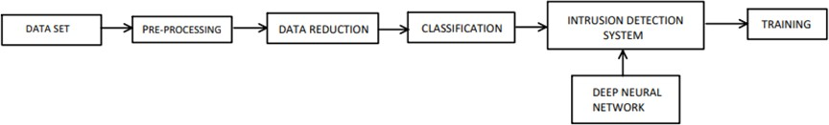
BLOCK DIAGRAM
Fig 1: Data flow diagram with IDS

Slide 14
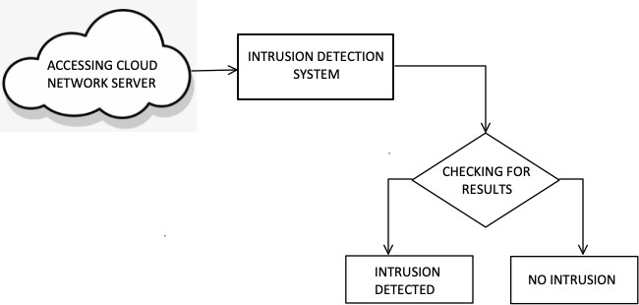
BLOCK DIAGRAM
Fig 2: Authentication of IDS

Slide 15



SOFTWARE REQUIRED
GOOGLE COLABORATORY
PYTORCH
SCIKIT LEARN

Slide 16
RESULTS AND DISCUSSION
To prove that the chosen variables are efficient, we use matrix correlation which is a table showing the correlation values for several variables. The confusion matrix depicts correlation between Normal and Abnormal Intrusion. We conclude from confusion Matrix, The confusion matrix shows that the classifier is performing well, with an accuracy of 98.4%. The precision and recall for both normal and anomalous cases are also high, indicating that the classifier is able to identify both types of cases with good accuracy.
The accuracy of the classifier is calculated as-
Accuracy = (TP + TN) / (TP + TN + FP + FN)
the accuracy is 99.985%.
The precision of the classifier is calculated as-
Precision = TP / (TP + FP)
the precision for normal cases is 98.4% and the precision for anomalous cases is 98.7%. This means that out of all the data points that the classifier predicted as normal, 98.4% of them are actually normal, and out of all the data points that the classifier predicted as anomalous, 98.7% of them are actually anomalous.
CLOUD BASED INTRUSION DETECTION USING MACHINE LEARNING

Slide 17
The recall of the classifier is calculated as-
Recall = TP / (TP + FN)
The recall for normal cases is 99.8% and the recall for anomalous cases is 98.6%. This means that out of all the normal data points in the dataset, the classifier is able to identify 99.8% of them, and out of all the anomalous data points in the dataset, the classifier is able to identify 98.6% of them.
As it is very clear, we have obtained 98.3% of ACC, 96.3% of precision, and 46.0% of recall
using NSL-KDD dataset.
This means that out of all the data points that the proposed model predicts as anomalous, 99.3% of them are actually anomalous. The proposed model also has the highest recall, at 98.9%. This means that the proposed model is able to identify 98.9% of the anomalous data points in the KDD dataset.

Slide 18
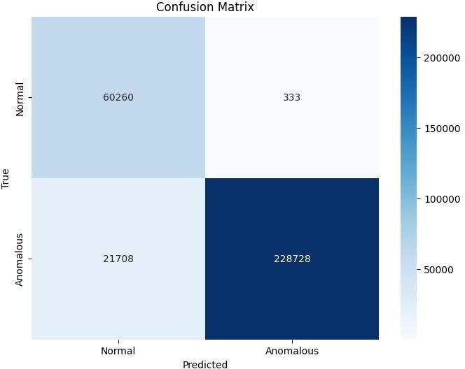

Slide 19
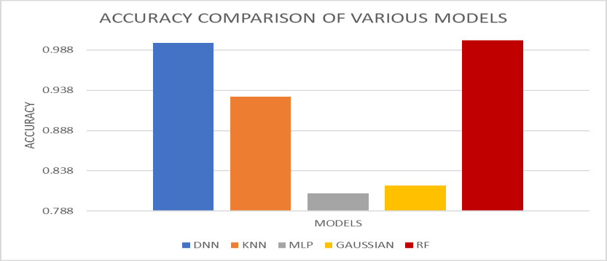

Slide 20
OUTCOME
Developed a deep neural network (DNN)-based intrusion detection
system (IDS) that achieves high accuracy on the NSL-KDD dataset.
The proposed IDS outperforms state-of-the-art IDS models on the NSL- KDD dataset, achieving an accuracy of 98.4%.
The proposed model gives an precision of 96.3%.
The proposed model has a recall of 46%.
The proposed IDS is effective in detecting a wide range of
attacks, including denial-of-service attacks, probe attacks, and remote-to-user attacks.
The proposed model predicts as anomalous, 99.3% of them are actually
anomalous.

Slide 21
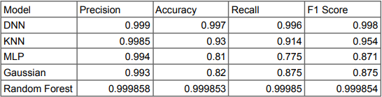
Performance Comparision Table of all the ML Model

Slide 22
REFERENCES
[Chiba et al., 2016] Chiba, Y., Fuketa, M., & Yamagata, Y. (2016). Network intrusion detection using a backpropagation neural network. In 2016 18th International Conference on Advanced Communication Technology (ICACT) (pp. 404-407). IEEE.
[Alshammari and Aldribi, 2021] Alshammari, A., & Aldribi, W. (2021). A hybrid machine learning approach for intrusion detection in cloud computing. Journal of Cloud Computing: Advances, Systems and Applications, 10(1), 1-15.
[Kanimozhi and Jacob, 2019] Kanimozhi, S., & Jacob, L. (2019). Cooperative and hybrid network intrusion detection framework using SNORT and optimized backpropagation neural network. International Journal of Computer Networks and Communications Security (IJCNS), 16(3), 1-17.
[Zhou et al., 2018] Zhou, J., Wen, N., He, L., & Jiang, J. (2018). A deep learning approach for intelligent intrusion detection system. IEEE Access, 6(1), 2926-2939.
[Tang et al., 2016] Tang, T., Li, J., Liu, W., & Tian, Y. (2016). A novel deep learning framework for network intrusion detection. IEEE Transactions on Industrial Electronics, 64(2), 1717-1727.
[Zhang et al., 2018] Zhang, L., Zhang, J., & Wang, Y. (2018). An intrusion detection system for software defined networking based on deep learning. In 2018 5th International Conference on Computer and Communication Systems (ICCCS) (pp. 1-6). IEEE.

Slide 23
THANK YOU

