Slide 1
AWS CLOUD PROJECT
Restaurant Management System
An AWS Cloud-Based Restaurant Management Solution designed to streamline operations, manage orders, and simplify billing for modern restaurants.
Presented By:
KADALI BALA NAGENDRA
REDDY RUPESH
RAPAKA PRAVEEN SURYA KRISHNA
LAKSHMI RAVI KRISHNA
Mentors:
Mrs Bethala Sumana
Mr Juttuka Lovababu

Slide 2
OVERVIEW
Agenda
01
02
Problem Statement
Solution Overview
Challenges in traditional restaurant operations
Cloud-based management system approach
03
04
Key Features
AWS Services Used
Core functionalities of the system
Cloud infrastructure and components
05
06
Architecture
Future Work & Conclusion
System design and data flow
Enhancements and project summary

Slide 3

CHAPTER 1
Problem Statement
Traditional restaurant operations face several challenges that impact efficiency and customer experience.
Slow Manual Order Management
Handwritten orders lead to delays and miscommunication between staff.
Time-Consuming Billing
Manual bill calculation results in long customer wait times and errors.
Difficult Menu Updates
Changing prices or items requires reprinting physical menus every time.
Unorganized Customer Records
No central system to track customer data, orders, or preferences.

Slide 4
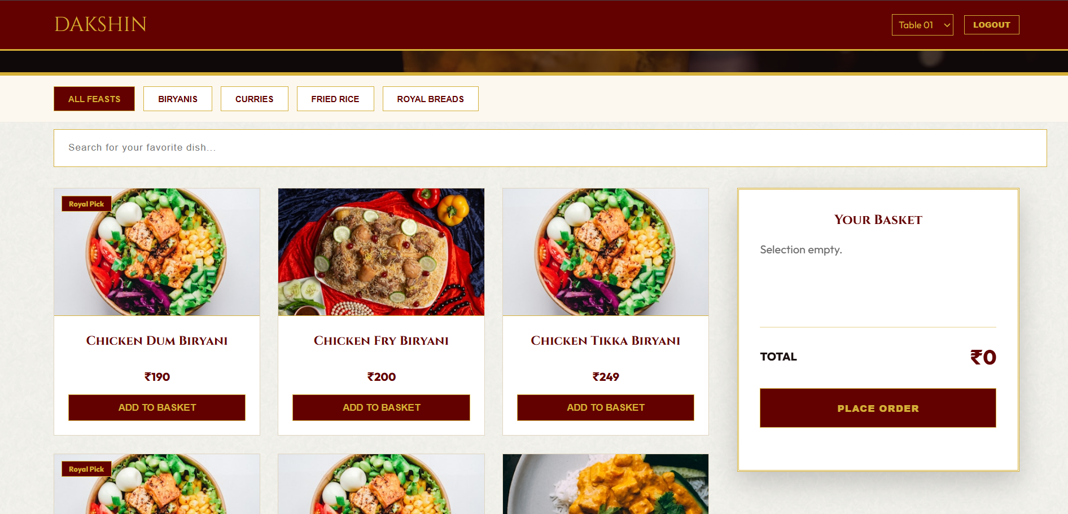
CHAPTER 2
Solution Overview
A cloud-based Restaurant Management System hosted on AWS EC2, designed to replace manual processes with a fast, secure, and centralized web application.
Centralized Management
Fast & Secure
Easy Access
Manage menu, orders, customers, and billing from one platform.
Built on AWS infrastructure for reliability and security.
Accessible from any device with a web browser, anytime.

Slide 5
CHAPTER 3
Key Features
Customer Management
Food Menu Management
Store and track customer details, order history, and preferences in one place.
Easily add, edit, or remove menu items and update prices in real time.
Order Management
Billing System
Streamline order taking and routing directly to the kitchen staff.
Generate accurate bills instantly with automatic tax calculations.
Dashboard
Responsive Website
Get an overview of daily operations, orders, and performance metrics.
Works seamlessly across desktops, tablets, and mobile devices.

Slide 6
CHAPTER 4
AWS Services Used
AWS Service
Purpose
Amazon EC2
Hosts the Restaurant Management website application
Amazon VPC
Provides an isolated private network environment
Internet Gateway
Enables internet access for the VPC
Route Table
Manages network routing within the VPC
Security Group
Controls secure access to the EC2 instance
Apache Server
Runs and serves the website on the EC2 instance

Slide 7
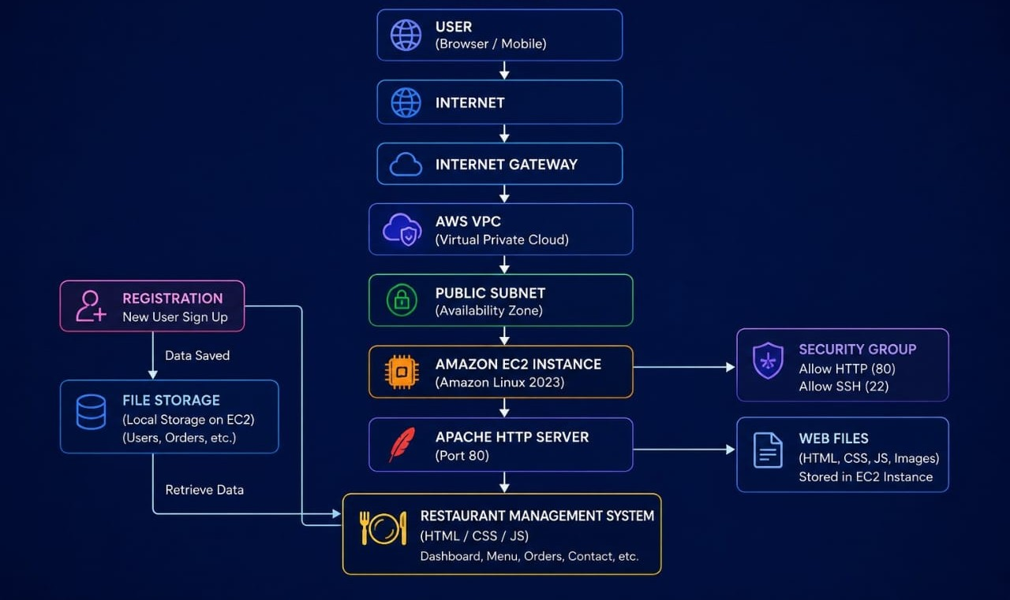
CHAPTER 5
Architecture
The system follows a streamlined flow from the user's browser through AWS infrastructure to the hosted web application.
Each request flows through the Internet Gateway into the VPC, reaching the EC2 instance where Apache serves the Restaurant Management website securely.

Slide 8
CHAPTER 6
Future Work
Planned enhancements to expand the system's capabilities and deliver even more value to restaurant operators.
Online Payment
Database Integration
Admin Dashboard
Integrate digital payment gateways for seamless checkout.
Connect with Amazon RDS for persistent data storage.
Advanced analytics and reporting for restaurant owners.
Mobile Application
Inventory Management
Native mobile app for staff and customer convenience.
Track stock levels and ingredient usage automatically.

Slide 9

SUMMARY
Conclusion
The Restaurant Management System has been successfully deployed on AWS, delivering a solution that is fast, secure, and scalable. It simplifies daily restaurant operations and is easy to maintain and use.
Successfully Deployed
Restaurant Management System live on AWS cloud.
By leveraging AWS cloud infrastructure, the system ensures high availability and reliability for restaurant operations of any scale.
Fast & Scalable
Secure solution built for growth and performance.
Simplified Operations
Streamlines order, menu, and billing management.
Easy to Maintain
User-friendly interface for staff and administrators.

Slide 10
THANK YOU
For your time and attention
Restaurant Management System — AWS Cloud Based Solution
Questions & Discussion

