Slide 1


AI-Powered & FAQ Chatbot
Student Name: BALAMURUGAN MS & Roll No: 20234108
Student Name: SIVAKUMAR K & Roll No: 20234143
Student Name: DHASARATHASAKKA & Roll No: 20234110
RA VARTHI P
Student Name: SUNDARESWARAN P & Roll No: 20233350
Student Name: MANOJKUMAR A & Roll No: 20232131
Student Name:MUTHAMIZHEZHIYAN M & Roll No: 20241263
Team Name : Prime Vision
Name: M.S.BALAMURUGAN

Slide 2
  Students repeatedly ask the same academic and campus-related questions.
  Manual communication from staff causes delays.
  Students have difficulty finding correct and updated information quickly.
  No centralized automated answering system for common student questions.
  Increased workload for office staff and faculty due to repetitive queries.
Challenge

Slide 3
  The chatbot provides instant responses 24×7, helping students save time.
  Reduces manual dependency on staff, improving efficiency.
  Supports smoother communication during exams, events & announcements.
  Beneficial for colleges with large student counts.
  Helps digital transformation of educational institutions.
Significance

Slide 4
Use case
  A student logs into the website and asks questions like:
  “What is the fees due date?”
  “Where is the exam timetable?”
  “When is the symposium?”
  Chatbot answers instantly based on college data from database.
  Admin can log in and add new FAQs like timetables, circulars, results etc.
Target User
  College students (UG / PG)
  College administration staff
  Department coordinators
  First-year students who need frequent guidance

Slide 5
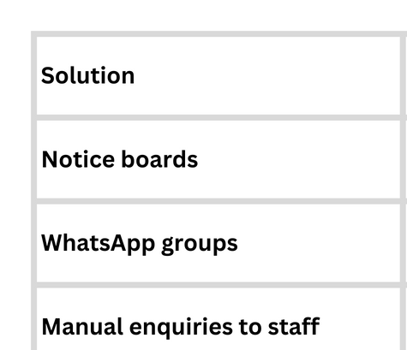
Existing Solutions

Slide 6
Solution Concept
  A web-based chatbot system starting as a GK Chatbot using API.
  A button switches to College Chatbot Mode.
  User Login → Use College FAQ chatbot.
  Admin Login → Add / Edit / Delete college information.
  Simple text-only interface (No voice, No multi-language).

Slide 7
Thank You

