Slide 1
CGB1201 – JAVA PROGRAMMING PROJECT FINAL REVIEW
Department of CSE(Artificial Intelligence and Machine Learning)
Academic Year: 2024 – 2025 (Odd Semester)
Register Number : 8115U23AM045
Name : SATHYABALAN S
Year : 2nd
Semester : 3rd
Department :CSE(AIML)
Date :05.12.2024

Slide 2
Title of the Project
Exam Management System A practical and efficient solution for automating and streamlining the examination process using Java.

Slide 3
Abstract
The Exam Management System is an advanced tool to automate and streamline all aspects of exam planning, execution, and evaluation. It covers processes such as exam scheduling, seating arrangement, question paper management, and result processing. The system ensures efficiency, reduces errors, and provides real-time updates for administrators and students. Designed with Java and database integration, it is scalable, secure, and user-friendly.

Slide 4
Abstract with CO/PO Mapping
Abstract | CO | POs | PSO
Apply object-oriented programming concepts to solve real-world problems Use modern tools to enhance professional practice in engineering. | CO3 | PO5

Slide 5
Introduction
The Exam Management System simplifies the traditional examination process. It replaces manual methods prone to errors with a fully automated system. The key features include scheduling, invigilation management, hall allocation, and result processing. By providing real-time communication and robust security, the system ensures transparency and accuracy in academic institutions.

Slide 6
Java Programming - Concepts Used
Object-Oriented Programming (OOP): To create modular, reusable classes for users, exams, and schedules.
Exception Handling: Ensures secure and uninterrupted operations during runtime.
JDBC (Java Database Connectivity): For seamless interaction with the database.
Multi-threading: To handle simultaneous requests, such as result queries and exam scheduling.
File Handling: For exporting reports like attendance sheets and results.

Slide 7
Proposed Architecture
Architecture Type: Layered, modular system.
Components:
Frontend: User interfaces for Admin, Students, and Examiners.
Backend: Java-based logic to process exam data and user requests.
Database: Stores user data, exam schedules, and results.

Slide 8
Proposed Architecture - Description
Frontend Layer:
User-friendly interfaces developed using HTML, CSS, and JavaScript.
Role-based access for administrators, students, and examiners.
Backend Layer:
Business logic implemented using Java.
Handles scheduling, seat allocation, and notifications.
Database Layer:
MySQL database for storing and retrieving exam-related data.

Slide 9
List of Modules
User Management: Manage roles like admin, examiner, and student.
Exam Scheduling: Create and update timetables.
Hall Allocation: Automate seating arrangements based on student count.
Result Processing: Evaluate and publish results.
Notification System: Real-time alerts for updates and changes.

Slide 10
Module Description
User Management: Handles authentication and role-based access control.
Exam Scheduling: Facilitates automated creation of exam timetables with conflict checks.
Hall Allocation: Allocates students to rooms while optimizing available space.
Result Processing: Automates evaluation logic and generates reports.
Notification System: Delivers updates via email/SMS to all stakeholders.

Slide 11
Results and Discussion
Outcomes:
Streamlined scheduling and resource allocation reduced manual workload.
Automated result processing minimized errors and expedited declarations.
Real-time updates improved communication between students and faculty

Slide 12
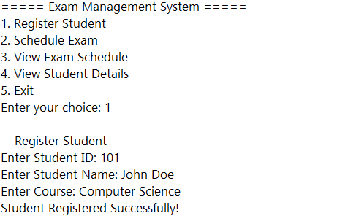
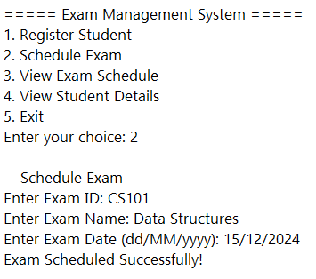
Results and Discussion (Cont..)

Slide 13
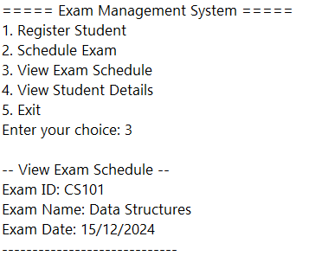
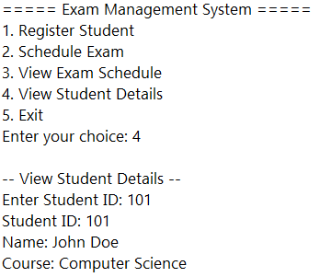
Results and Discussion (Cont..)

Slide 14
Conclusion
The Exam Management System revolutionizes how institutions manage exams. By automating core processes like scheduling and result declaration, it enhances efficiency, accuracy, and user satisfaction. With a scalable architecture, the system can cater to institutions of varying sizes, ensuring future adaptability and growth.

Slide 15
Thank You
Any queries???

