Slide 1
Walmart Superstore Sales
Analysed by Balachander.S

Slide 2
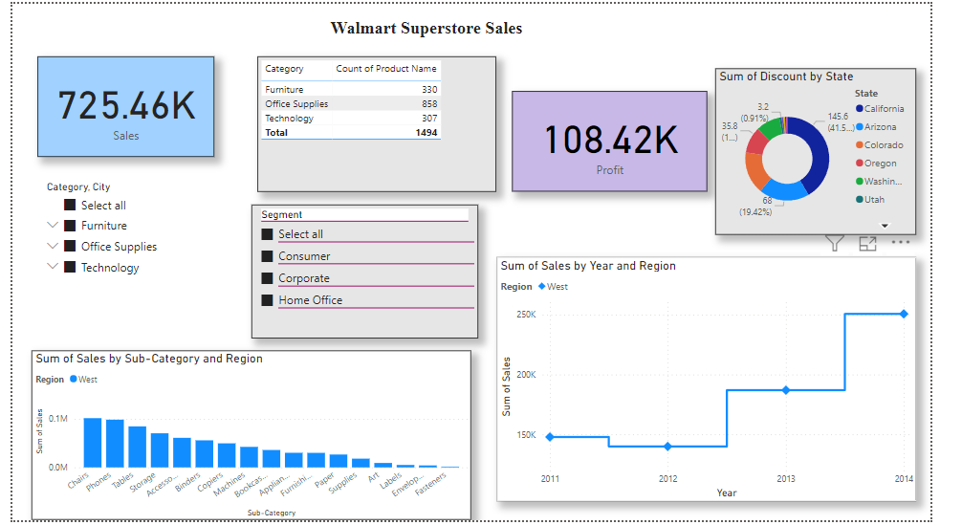

Slide 3
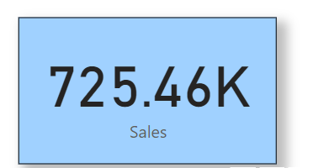
Sum of Sales:
The card represents sum of sales from the Walmart data

Slide 4
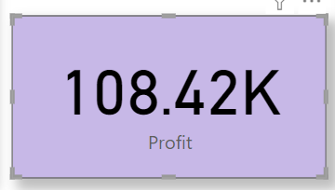
Sum of profit:
The card represents the sum of profit from the Walmart data

Slide 5
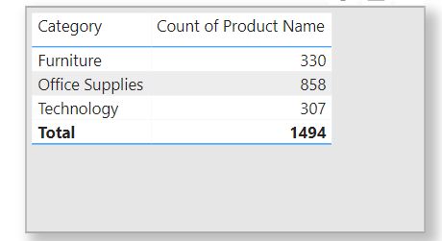
Matrix Table:
The table represents the data for category and count(distinct) of product name
The major categories are furniture, office supplies, technology.

Slide 6
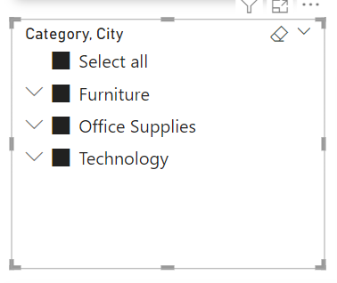
Slicer:
Slicer is used to for category and city.
Dropdown is selected for the view.

Slide 7
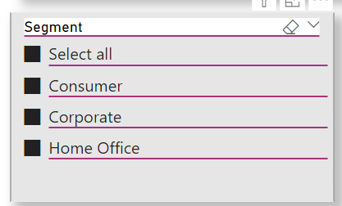
Slicer:
Slicer is used for Segment from the Walmart data.

Slide 8
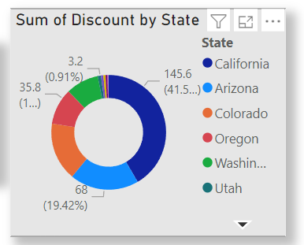
Donut Chart:
Donut chart is used for the sum of discount by state.
Region refers to States.

Slide 9
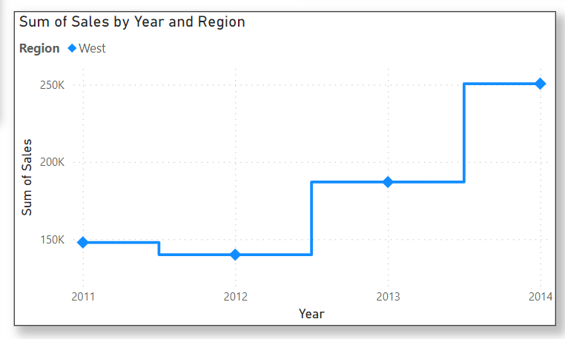
Line chart:
The line chart represents the sum of sales by year and region.
It shows the profit with respect to time and overall analysis of the trend.

Slide 10
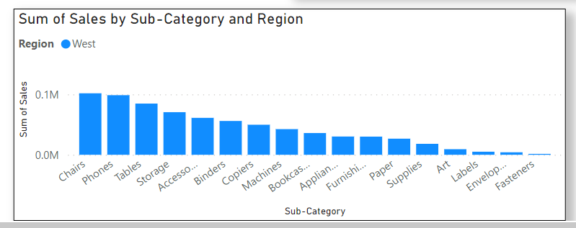
Bar chart:
Bar chart shows the sum of sales of the sub-category of the products.
The chart shows the products purchased by the customers.

