Slide 1
Serverless Web Application using AWS
A Full-Stack, Scalable, and Secure Web App without Server Management
Presented by: Pravin Balaji K N

Slide 2
Introduction
This project demonstrates the design and deployment of a fully serverless web application using AWS services. By leveraging S3, Lambda, API Gateway, and DynamoDB, we built a scalable and cost-effective solution that processes and stores student data through a responsive frontend interface.
The solution ensures secure and fast access through CloudFront and eliminates the need for any server provisioning or maintenance.

Slide 3
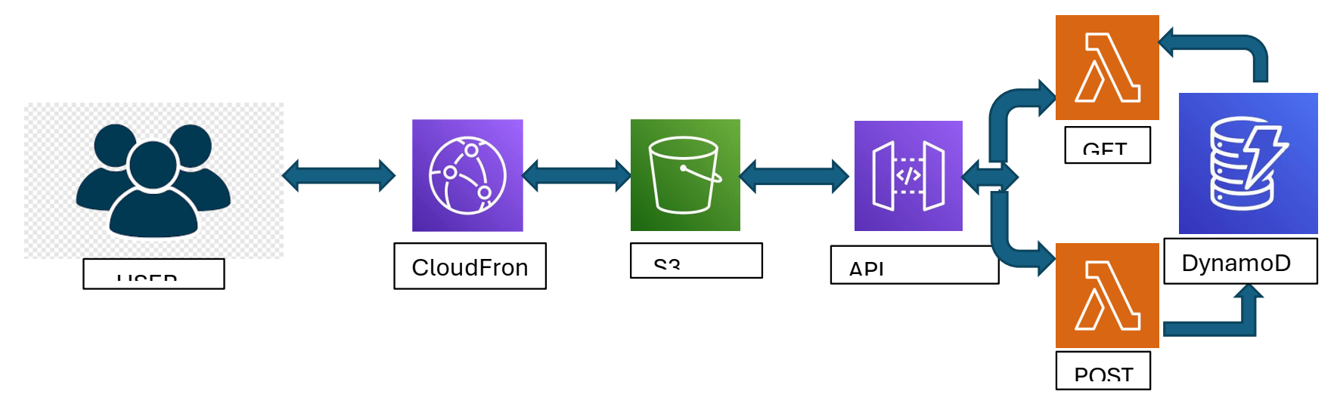
Architecture Overview

Slide 4
Services Involved:
Amazon S3: Hosts the frontend HTML/JavaScript.
Amazon CloudFront: Distributes content securely over HTTPS.
API Gateway: Interfaces between frontend and backend.
AWS Lambda: Runs GET and POST logic.
Amazon DynamoDB: NoSQL data store for student records.
Flow Summary:
User interacts with a static frontend hosted on S3.
JavaScript sends requests to API Gateway.
API Gateway routes to Lambda (GET/POST)
Lambda processes data and interacts with DynamoDB
CloudFront serves the frontend over HTTPS

Slide 5
Work Partition
This serverless web application project highlights the efficiency of using AWS cloud-native services to build responsive, scalable, and secure systems. It proves that high-performance applications can be built without managing a single server, allowing developers to focus on features and experience.
Partition 1: Backend Configuration
Partition 2: API Gateway & Static Website
Partition 3: CloudFront Distribution

Slide 6
Problem-Solution Summary
The Problem:
Traditional web hosting involves provisioning, scaling, and securing backend servers.
Increased complexity and cost for lightweight apps.
Our Solution:
A 100% serverless architecture with no servers to manage.
Uses AWS managed services to automate scaling, security, and availability.
Rapid deployment of full-stack apps with minimal code.

Slide 7
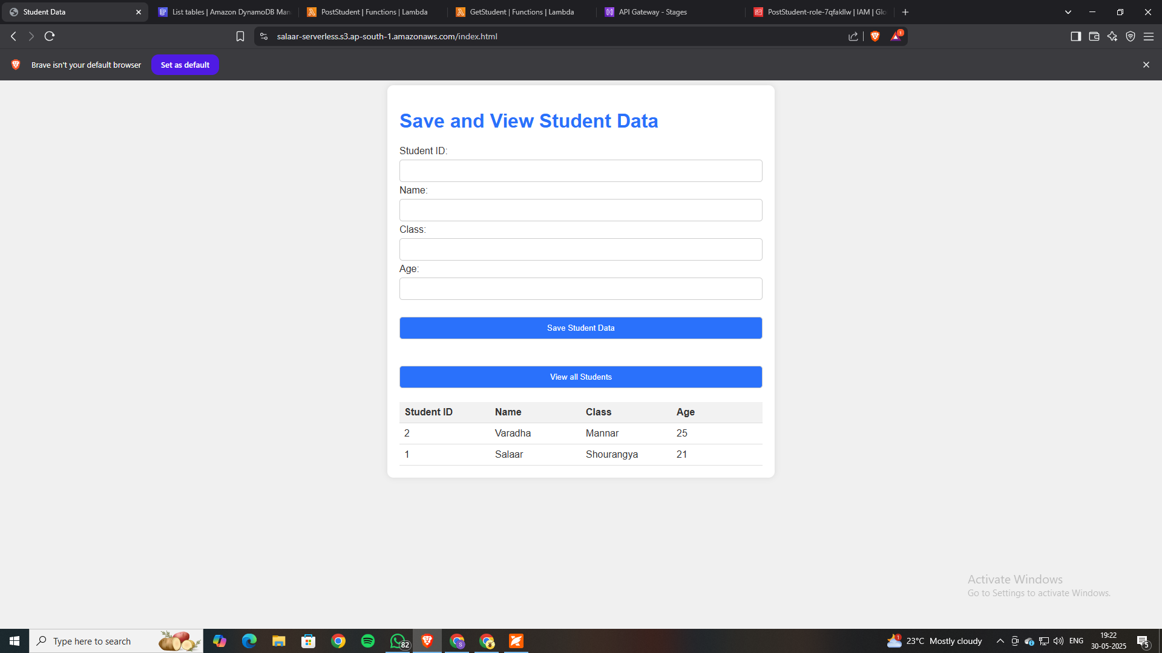
Primary Use Cases
To-Do-List Static website can be hosted.
Online registration and student forms.
Contact submission systems.
Lightweight SaaS product dashboards.
Event signup or feedback applications.

Slide 8
Benefits & Value Proposition
Serverless Design: No infrastructure to manage.
High Scalability: Seamless scaling with user traffic.
Real-Time Processing: Instant data storage and retrieval via Lambda & DynamoDB.
Low Cost: Pay only for what you use.
Secure Access: HTTPS and role-based security.
Conclusion
This serverless web application project highlights the efficiency of using AWS cloud-native services to build responsive, scalable, and secure systems. It proves that high-performance applications can be built without managing a single server, allowing developers to focus on features and experience.

Slide 9


