Slide 1




CAMPUSHIRE
Course: CB23F35 – Low-Code Application Development using Zoho Creator
Campus Placement Management System
Faculty: Dr. Jinu Sophia
Simplifying and Automating the Campus Placement Process
Department of Computer Science and Engineering
Rajalakshmi Engineering College
Presented by: Balaambiga C A
Roll No: 240701068

Slide 2
CAMPUSHIRE
Understanding the Problem
Traditional campus placement management is fragmented, manual and difficult to monitor end to end.
Scattered Information
Manual Tracking
Repeated Data Entry
Student details, company information and placement records are maintained in different spreadsheets and files.
Applications, interview schedules and selection status are updated manually.
The same student and company information may be entered multiple times.
Manual Notifications
Lack of Centralised Monitoring
Registration confirmations and placement updates require manual communication.
No single consolidated view of students, companies, drives and interviews.

Slide 3
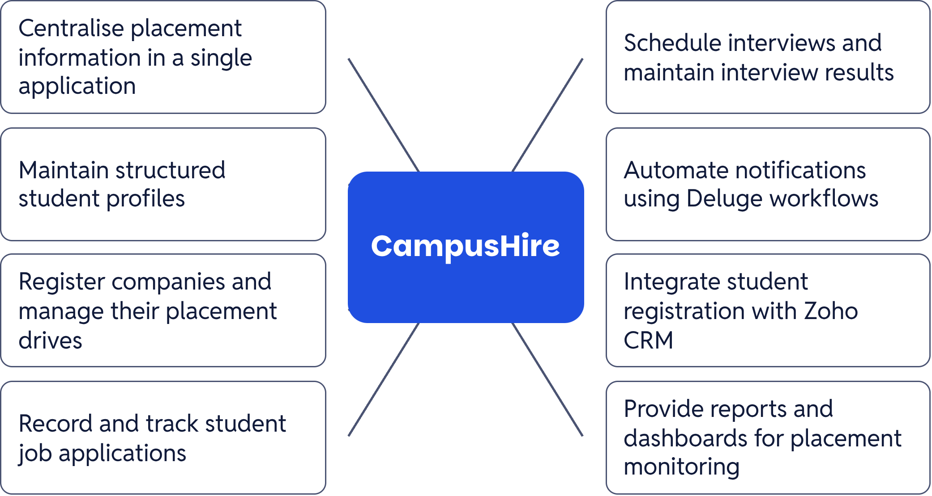
CAMPUSHIRE
What We Aim to Achieve
CampusHire brings the placement lifecycle into one structured application.

Slide 4
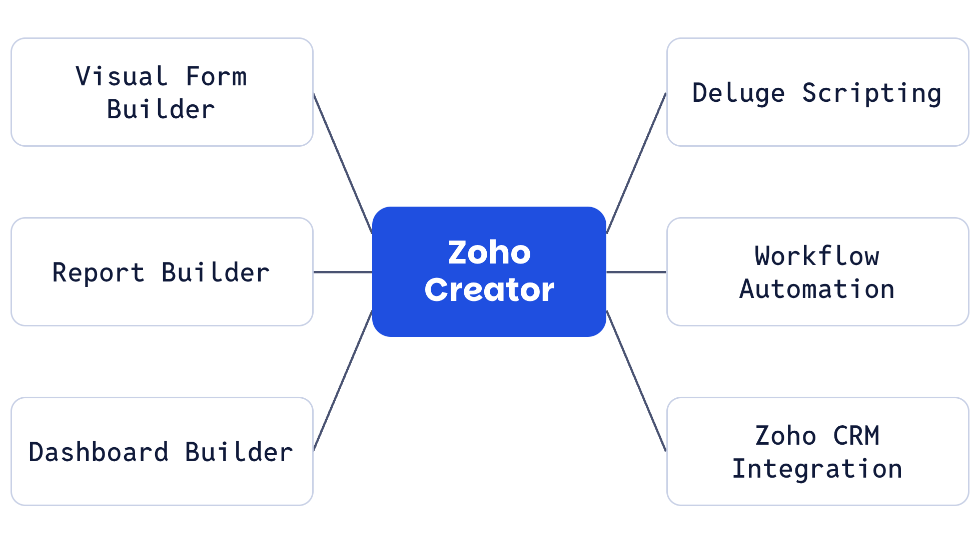
PLATFORM
Why Zoho Creator?
A low-code platform supports fast form creation, structured reporting and workflow automation with limited custom code.
Technology: Platform: Zoho Creator · Scripting Language: Deluge · Integration: Zoho CRM

Slide 5
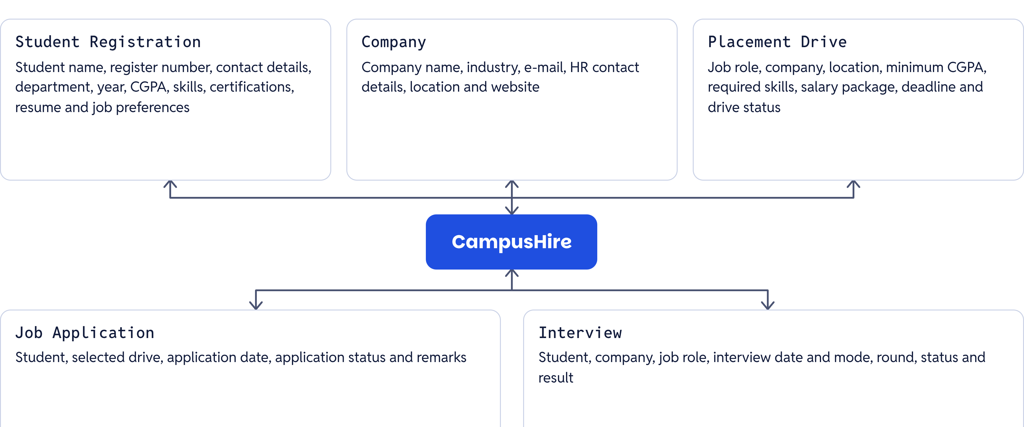
SYSTEM ARCHITECTURE
Five Core Modules of CampusHire

Slide 6
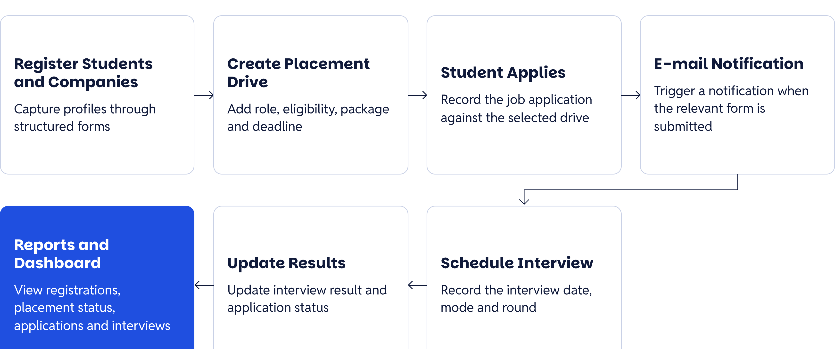
PLACEMENT LIFECYCLE
How Does CampusHire Work?

Slide 7
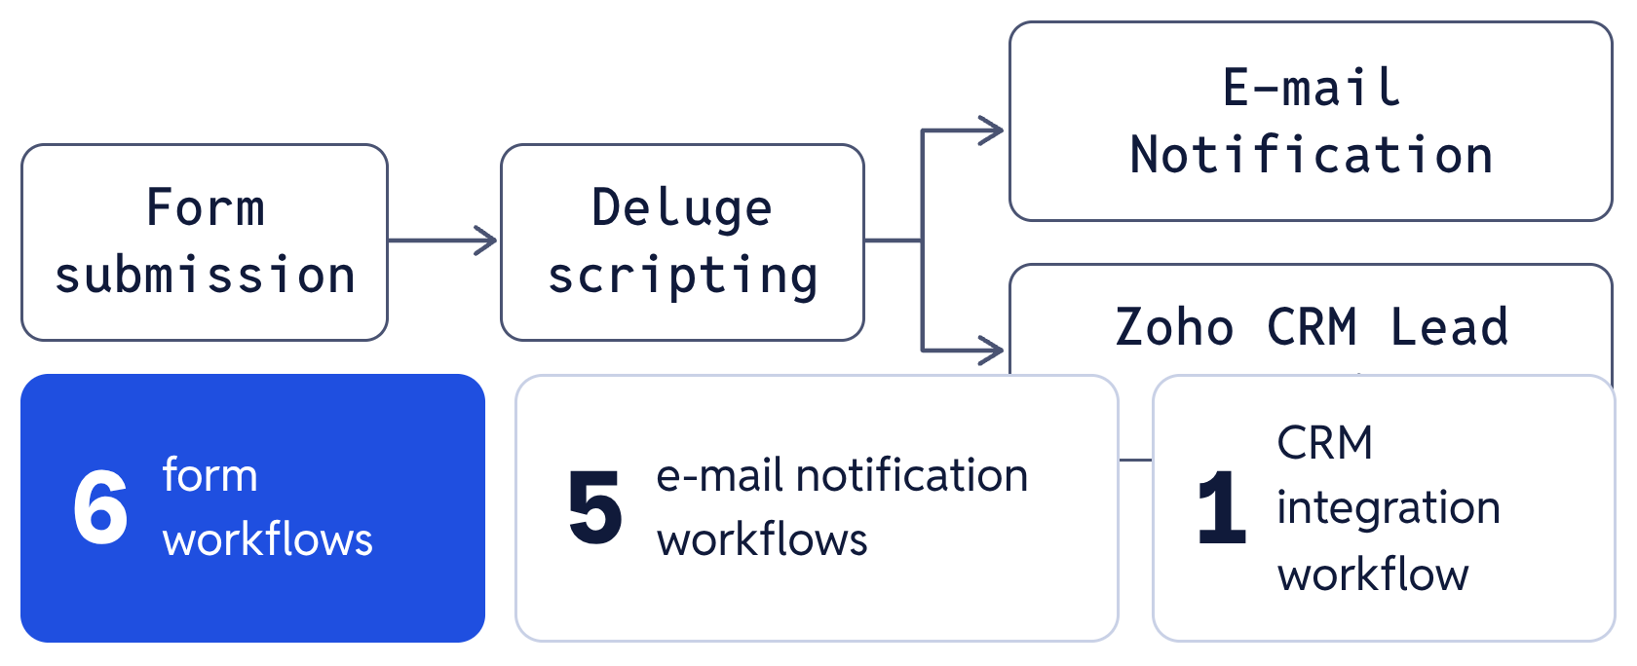
AUTOMATION
Making Placement Management Smarter
Deluge scripting and Zoho Creator workflows connect form submissions to timely actions.
E-mail automation:
Student Registration confirmation; Company Registration confirmation; Placement Drive notification; Job Application confirmation; Interview scheduling notification.
Zoho CRM integration:
Student registration data creates a lead in Zoho CRM; student name, e-mail and phone details are mapped to the CRM lead; the CRM workflow runs when a student record is added or edited.
Technology:
Deluge scripting + Zoho Creator Workflows + Zoho CRM.
Workflow structure:
6 form workflows — 5 e-mail notification workflows and 1 CRM integration workflow.

Slide 8
VISIBILITY
Monitoring Placement Activities
Reports and dashboards provide a consolidated view of placement records and progress.
9 reports
Dashboard count cards
All Student Registrations; All Companies; Placement Drive Report; All Job Applications; All Interviews; Student Details Report; Company Details Report; Job Application Tracking Report; Interview Tracking Report.
Total Registered Students; Total Registered Companies; Active Placement Drives; Interviews Scheduled.
Charts
Placement Status — Donut Chart; Application Status — Column Chart.
Benefit: The placement team can review important records, track activities and monitor placement progress through a consolidated dashboard.
INSERT YOUR CAMPUSHIRE DASHBOARD SCREENSHOT HERE
Actual Dashboard – Zoho Creator

Slide 9
ROADMAP
What’s Next for CampusHire?
Advanced Lookup Relationships
Automatic Eligibility Verification
Student Portal
Let students access profiles, explore drives and track applications.
Connect student, company and placement drive records through lookup fields for better data consistency.
Check student CGPA, backlogs and skills against placement drive requirements.
Company Portal
Deadline Reminders
Enhanced Analytics
Let companies manage recruitment information and placement drives.
Send automatic reminders for upcoming application deadlines and interviews.
Introduce department-wise placement reports, placement percentages and package-wise charts.

Slide 10
CAMPUSHIRE
Bringing Campus Placements Together
Centralised placement information.
Five structured application modules.
Automated e-mail notifications.
Zoho CRM integration.
Nine reports and an interactive dashboard.
A scalable foundation for future improvements.
CampusHire demonstrates how low-code development can simplify complex administrative processes through structured data management and workflow automation.
THANK YOU!
Questions & Answers
Presented by: Balaambiga C A

