Slide 1

MICROPROJECT - DATA STRUCTURE
BINARY SEARCH VISUALIZATION
Presented By :
Akshaya.J -23ISR003
Asish Khan.A -23ISR004
Balamurugan.M -23ISR006

Slide 2
INTRODUCTION
1
BINARY SEARCH
Binary search is an efficient algorithm for finding an element in a sorted array .
It works by repeatedly dividing the search interval in two half .
This process repeats until the target is found or the search interval is empty.

Slide 3
TECHNICAL ASPECTS
2
CSS
HTML
TO STRUCTURE THE WEBPAGE, INCLUDING INPUT FORMS FOR USERS TO ENTER NUMBERS AND DISPLAY THE VISUALIZATION.
APPLIED FOR DESIGNING THE WEBPAGE, SETTING COLORS, FONTS, AND LAYOUT TO ENSURE A CLEAN AND PROFESSIONAL LOOK.
JAVASCRIPT
HANDLES THE BINARY SEARCHING LOGIC, UPDATES THE ARRAY, AND CREATES THE DYNAMIC VISUALIZATION PROCESS STEP BY STEP.
.

Slide 4
PROPERTIES
3
Sorted Array: Binary search requires a sorted array to work correctly.
Divide and Conquer: Binary search uses a divide-and-conquer approach to find the element.
Time Complexity: O(log n), making it much faster than linear search (O(n)) for large datasets.
Space Complexity: O(1), requiring only a small amount of extra memory.

Slide 5
4
STEP BY STEP PROCESS
1
Start with entire array as search interval
2
Calculate midpoint index
3
Compare target element with midpoint element
4
Update search interval based on comparison
5
Repeat until element found or search interval empty

Slide 6
ALGORITHM
5
BINARY_SEARCH(A, lower_bound, upper_bound, VAL)
Step 1: [INITIALIZE] SET BEG = lower_bound ,END = upper_bound, POS=-1
Step 2: Repeat Steps 3 and 4 while BEG <= END
Step 3: SET MID = (BEG + END)/2
Step 4: IF A[MID] = VAL SET POS = MID PRINT POS Go to Step 6 ELSE IF A[MID] > VAL
SET END = MID-1 ELSE SET BEG = MID+1 [END OF IF] [END OF LOOP]
Step 5: IF POS=-1 PRINT “VALUE IS NOT PRESENT IN THE ARRAY” [END OF IF]
Step 6: EXIT

Slide 7

SEARCHING PROCESS
6
Search the number 7 in the array
Low
High
Mid (7>5 , consider right half)
STEP : 1
1
2
3
4
5
6
7
8
9
10
Low
High
Mid (7<8 , consider left half)
STEP : 2
1
2
3
4
5
6
7
8
9
10

Slide 8
7
Mid (7>6 , consider right half)
Low
High
STEP : 3
1
2
3
4
5
6
7
8
9
10
Low = Mid =High
STEP : 4
6
1
2
3
4
5
7
8
9
10
Finally (7 is present at the index 6)

Slide 9
CODING
<!DOCTYPE html>
<html lang="en">
<head>
<meta charset="UTF-8">
<meta name="viewport" content="width=device-width, initial-scale=1.0">
<title>Binary Search Visualization</title>
<style>
body {
font-family: Arial, sans-serif;
text-align: center;
background-color: #f9f9f9;
margin: 0;
padding: 0;
display: flex;
align-items: center;
justify-content: center;
height: 100vh; /* Full viewport height */
}
8

Slide 10
#visualization {
margin: 0;
max-width: 800px;
width: 100%;
display: flex;
flex-direction: column;
align-items: center;
}
#array-container {
display: flex;
justify-content: center;
flex-wrap: wrap;
margin: 20px 0;
gap: 10px;
}
;
9

Slide 11
.array-element {
width: 60px;
height: 60px;
display: flex;
align-items: center;
justify-content: center;
border: 2px solid #007bff;
border-radius: 5px;
background-color: #ffffff;
color: #007bff;
font-size: 18px;
font-weight: bold;
transition: background-color 0.3s, transform 0.3s;
}
.highlight {
background-color: #ffeb3b;
transform: scale(1.1);
}
10

Slide 12
.index-label {
margin-top: 5px;
font-size: 14px;
color: #333;
}
#controls {
margin-top: 20px;
}
input[type="number"] {
width: 80px;
padding: 5px;
font-size: 16px;
border: 2px solid #007bff;
border-radius: 5px;
outline: none;
}
11

Slide 13
button:hover {
background-color: #0056b3;
transform: scale(1.05);
}
button:disabled {
background-color: #cccccc;
cursor: not-allowed;
}
.status-message {
margin: 20px;
font-size: 18px;
color: #333;
}
12
</style>
</head>
<body>
<div id="visualization">

Slide 14
13
<h1>Binary Search Visualization</h1>
<div id="array-container"></div>
<div id="controls">
<button onclick="startBinarySearch()">Start Binary Search</button>
<input type="number" id="target" placeholder="Enter target value">
</div>
<div id="status" class="status-message"></div>
</div>
<script>
const arrayContainer = document.getElementById('array-container');
const targetInput = document.getElementById('target');
const statusMessage = document.getElementById('status');
const buttons = document.querySelectorAll('button');
let array = [1, 4, 7, 10, 15, 20, 25, 30, 35, 40];

Slide 15
const element = document.createElement('div');
element.className = 'array-element';
if (highlightIndices.includes(index)) {
element.classList.add('highlight');
}
element.textContent = value;
const indexLabel = document.createElement('div');
indexLabel.className = 'index-label';
indexLabel.textContent = index;
const container = document.createElement('div');
container.className = 'element-container';
container.appendChild(element);
container.appendChild(indexLabel);
arrayContainer.appendChild(container);
});
}
14

Slide 16
function startBinarySearch() {
const target = parseInt(targetInput.value);
if (isNaN(target)) return;
statusMessage.textContent = 'Starting Binary Search...';
buttons.forEach(btn => btn.disabled = true);
binarySearch(array, target);
}
function binarySearch(array, target) {
let low = 0;
let high = array.length - 1;
const intervalId = setInterval(() => {
if (low > high) {
clearInterval(intervalId);
statusMessage.textContent = 'Target not found!';
buttons.forEach(btn => btn.disabled = false);
return;
}
15

Slide 17
1
16
const mid = Math.floor((low + high) / 2);
displayArray(array, [low, mid, high]);
if (array[mid] === target) {
displayArray(array, [mid]);
statusMessage.textContent = `Target element found at the index ${mid} `;
clearInterval(intervalId);
buttons.forEach(btn => btn.disabled = false);
} else if (array[mid] < target) {
low = mid + 1;
} else {
high = mid - 1;
}
}, 1000);
}

Slide 18
17
window.onload = function() {
displayArray(array);
};
</script>
</body>
</html>

Slide 19
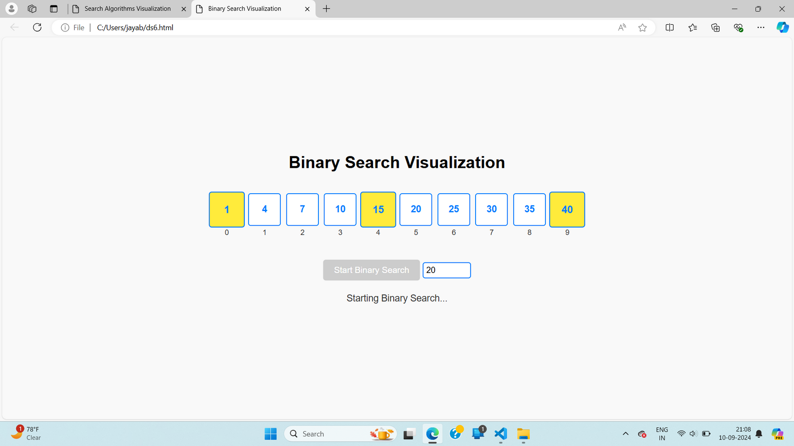
SAMPLE OUTPUT
18

Slide 20
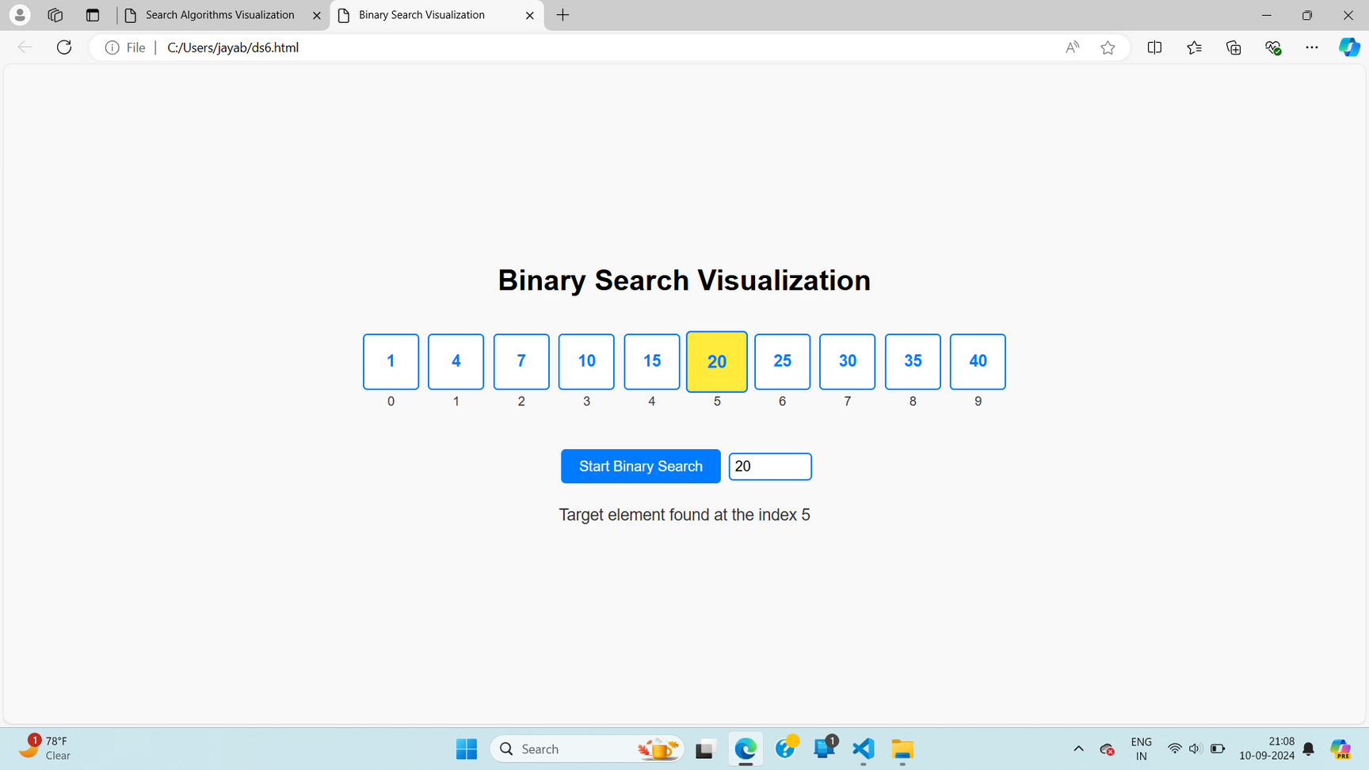
SAMPLE OUTPUT
19

Slide 21
THANK YOU

