Slide 1
Structured Query Language (SQL)

Slide 2
Outline
The SQL Language
How SQL Works
Relational Databases
Contents of a Table
Types of SQL Statements
  DDL
    Create table
    Alter table
    Drop table
    Rename table
    Truncate table
    Comment
  DML
    Insert

Slide 3
The SQL Language
SQL - a computer language that is used to interact with a database
SQL - tool for organizing, managing, and retrieving data stored by a computer database
Original name - given by IBM – “Structured English Query Language “ - SEQUEL
SEQUEL - was a trademark owned by the Hawker Siddeley Aircraft Company of the United Kingdom, Hence, IBM shortened the acronym to SQL
SQL - pronounced as either a word (“sequel”) or as a string of letters (“S-Q-L”) - both are considered correct
SQL works with one specific type of database - Relational Database
SQL is case-insensitive

Slide 4
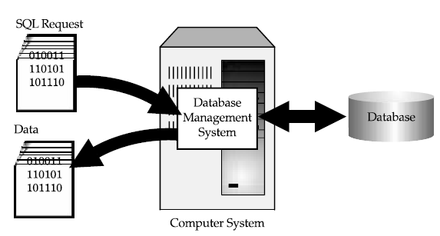
How SQL Works?
Database management system (DBMS) - Computer program that controls the database
Figure : Using SQL for database access

Slide 5
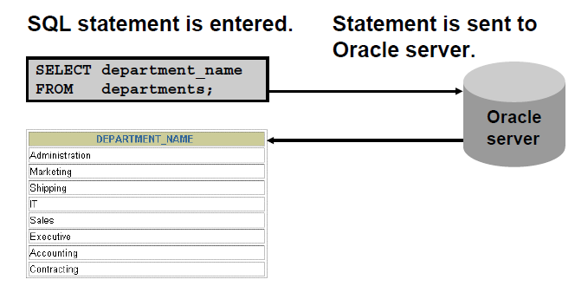
How SQL Works?

Slide 6
How SQL Works?
SQL request – to retrieve data from a database
DBMS processes the SQL request, retrieves the requested data, and returns it
Database Query - process of requesting data from a database and receiving the results
SQL - used to control all of the functions that a DBMS provides for its users, including
  Data definition - SQL lets a user define the structure and organization of the stored data and relationships among the stored data items
  Data retrieval - SQL allows a user or an application program to retrieve stored data from the database and use it
  Data manipulation - SQL allows a user or an application program to update the database by adding new data, removing old data, and modifying previously stored data

Slide 7
How SQL Works?
  Access control - SQL can be used to restrict a user’s ability to retrieve, add, and modify data, protecting stored data against unauthorized access.
  Data sharing - SQL is used to coordinate data sharing by concurrent users, ensuring that changes made by one user do not inadvertently wipe out changes made at nearly the same time by another user
  Data integrity - SQL defines integrity constraints in the database, protecting it from corruption due to inconsistent updates or system failures
SQL - a comprehensive language for controlling and interacting with a database management system
SQL is not really a complete computer language like COBOL, C, C++, or Java
  Instead, SQL is a database language, consisting of about 40 statements specialized for database management tasks

Slide 8
How SQL Works?
SQL statements can be embedded into another language such as COBOL or C to extend that language for use in database access
SQL - differs from other computer languages because it describes what the user wants the computer to do rather than how the computer should do it
  In more technical terms, SQL is a declarative or descriptive language rather than a procedural one
SQL - contains no IF statement for testing conditions, and no GOTO, DO, or FOR statements for program flow control.
SQL statements describe how a collection of data is to be organized, or what data is to be retrieved or added to the database
SQL - emerged as the standard language for using relational databases. It is both a powerful language and one that is relatively easy to learn

Slide 9
Relational Databases
DBMS - Organizes and structures data so that it can be saved and retrieved by users and application programs
Data Model - data structures and access techniques provided by a particular DBMS
  Hierarchical Model
  Network Model
  Relational Model
SQL - a database language for databases that use the relational data model
Relational model proposed by Codd (1970’s) - to simplify database structure
  A relational database is a database where all data visible to the user is organized strictly as tables of data values, and where all database operations work on these tables

Slide 10
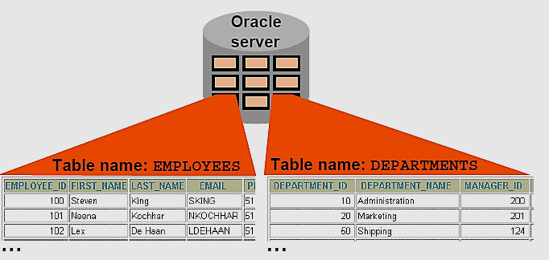
Relational Databases
The organizing principle in a relational database is the table, a rectangular row/column arrangement of data values
Each table in a database has a unique table name that identifies its contents

Slide 11
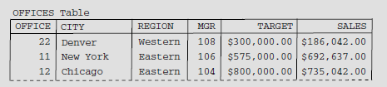
Contents of a Table
Each horizontal row
  represents a single physical entity
  ie., a single sales office
Each column
  Represents one item of data that is stored in the database for each office
  For example,
  CITY column holds the location of each office
  MGR column shows the employee number of the person who manages the office
Each row of a table contains exactly one data value in each column
  In the row representing the New York office, for example, the CITY column contains the value “New York”

Slide 12
Contents of a Table
For each column of a table, all of the data values in that column hold the same type of data
For example,
  all of the CITY column values are text,
  all of the SALES values are money amounts, and
  all of the MGR values are integers
The set of data values that a column can contain is called the domain of the column
  domain of the CITY column is the set of all names of cities
  domain of the SALES column is any money amount
Each column in a table has a column name, which is usually written as a heading at the top of the column
  The columns of a table must all have different names
  Two columns in two different tables can have identical names

Slide 13
Contents of a Table
The columns of a table have a left-to-right order, which is defined when the table is first created
A table always has at least one column
Maximum number of columns in a table
  The ANSI/ISO SQL standard does not specify a maximum number of columns in a table
  Almost all commercial SQL products do impose a limit, which is seldom less than 255 columns
Unlike the columns, the rows in a table do not have any particular order
A table can have any number of rows
A table of zero rows is perfectly legal and is called an empty table
  The ANSI/ISO standard does not limit the number of rows in a table, and many SQL products will allow a table to grow until it exhausts the available storage

Slide 14
MySQL Login
Putty IP : 54.243.216.217
  User name : 19pw01
  Password : 19pw
Command Prompt of Putty
  mysql –p19pw;
Show databases;
use 19pw01;
Show tables; -> shows the tables created
desc tablename; -> to view the definition of the table
To logout from MySQL
  quit

Slide 15
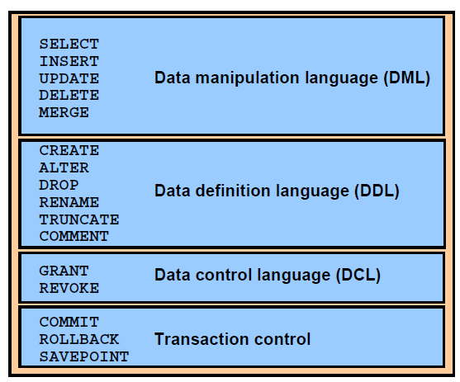
Types of SQL Statements

Slide 16
Data Definition Language (DDL)
Using DDL statements, we can
  Define and create a new table
  Remove a table that’s no longer needed
  Change the definition of an existing table
  Define a virtual table (or view) of data
  Build an index to make table access faster
  Control the physical storage of data by the DBMS

Slide 17
CREATE Table
CREATE TABLE statement - allows to create and define a table
  Syntax – Simplest form
CREATE TABLE table_name
( column1 datatype [ NULL | NOT NULL ],
column2 datatype [ NULL | NOT NULL ],
...
);
table_name - The name of the table that you wish to create
column1, column2 - The columns that you wish to create in the table
datatype -The data type for the column. Refer the link to learn various data types supported in MySQL.
https://dev.mysql.com/doc/refman/8.0/en/data-types.html
NULL or NOT NULL - Each column should be defined as NULL or NOT NULL. If this parameter is omitted, the database assumes NULL as the default.

Slide 18
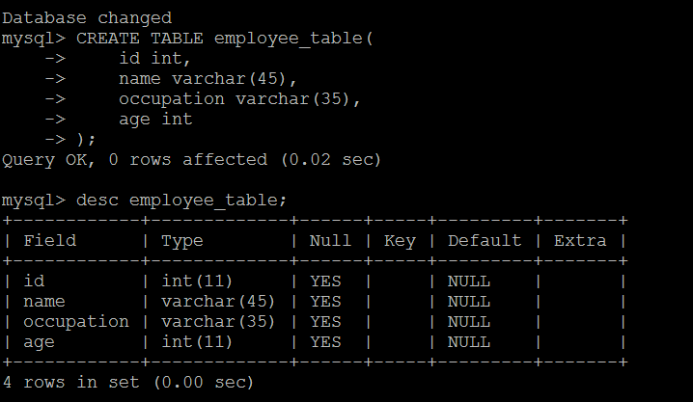
CREATE TABLE
Example
CREATE TABLE employee_table(
  id int,
  name varchar(45),
  occupation varchar(35),
  age int
  );
DESC employee_table;
(or)
DESCRIBE employee_table;
To create duplicate structure of a table
CREATE TABLE IF NOT EXISTS dup_employee_table LIKE employee_table;

Slide 19
CREATE TABLE AS
Used to create a table from an existing table by copying the existing table's columns
Syntax
  CREATE TABLE [ IF NOT EXISTS ] new_table [ AS ]
  SELECT expressions FROM existing_tables
  [WHERE conditions];
IF NOT EXISTS - Optional. If specified, the CREATE TABLE AS statement will not raise an error if the table already exists.
new_table - The name of the table that you wish to create.
AS - Optional. Whether you specify the AS keyword or not has no impact on the creation of the table.
Expressions - The columns from the existing_tables that you would like created in the new_table. The column definitions from those columns listed will be transferred to the new_table that you create.
existing_tables - The existing tables from which to copy the column definitions and the associated records (as per the WHERE clause).
WHERE conditions - Optional. The conditions that must be met for the records to be copied to the new_table.

Slide 20
CREATE TABLE AS
Example
  CREATE TABLE local_companies AS
  SELECT * FROM companies WHERE state = 'Florida';
To create a table by copying selected columns
  CREATE TABLE local_companies AS
  SELECT cid, cname FROM companies WHERE state = 'Florida';
It is possible to create a table by copying selected columns from multiple tables
  CREATE TABLE suppliers AS
  SELECT companies.company_id, companies.address, companies.state,
  categories.category_type
  FROM companies, categories
  WHERE companies.company_id = categories.category_id
  AND companies.state = 'Florida';

Slide 21
ALTER TABLE
ALTER table
  rename a column / a table
  add a column
  modify a column
  Drop/delete a column
Changing the name of the Table (Rename a table)
  Syntax
    ALTER TABLE table_name RENAME TO new_table_name;
    table_name - The new_table_nameable to rename
    - The new table name to use
  ALTER TABLE employee_table RENAME to employee;

Slide 22
ALTER TABLE
Rename a column
  Syntax
    ALTER TABLE table_name
    CHANGE COLUMN old_name new_name column_definition
    [ FIRST | AFTER column_name ]
table_name - The name of the table to modify
old_name - The column to rename.
new_name - The new name for the column.
column_definition - The datatype and definition of the column (NULL or NOT NULL, etc). You must specify the column definition when renaming the column, even if it does not change.
FIRST | AFTER column_name - Optional.
  It tells MySQL where in the table to position the column, if you wish to change its position

Slide 23
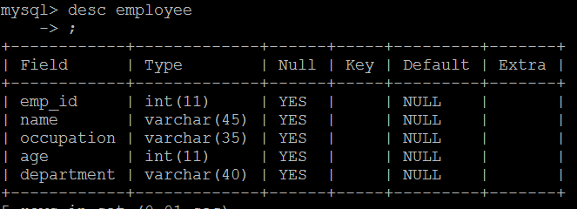
ALTER TABLE
Example
  ALTER TABLE employee CHANGE id emp_id int;

Slide 24
ALTER TABLE
Adding a new column
  Syntax
  ALTER TABLE table_name
  ADD new_column_name column_definition
  [ FIRST | AFTER column_name ];
table_name - The name of the table to modify
new_column_name - The name of the new column to add to the table
column_definition - The datatype and definition of the column (NULL or NOT NULL, etc)
FIRST | AFTER column_name - Optional
  It tells MySQL where in the table to create the column. If this parameter is not specified, the new column will be added to the end of the table

Slide 25
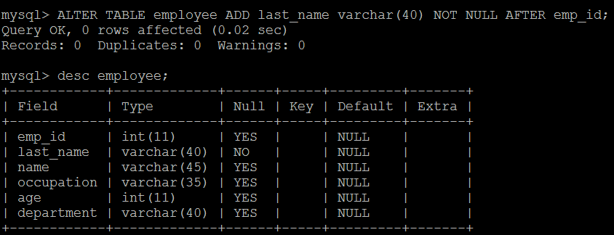
ALTER TABLE
  Example
    ALTER TABLE employee ADD last_name varchar(40) NOT NULL AFTER emp_id;
  To add last_name as the first field
    ALTER TABLE employee ADD last_name varchar(40) NOT NULL FIRST;

Slide 26
ALTER TABLE
Add multiple columns in table
  Syntax
    ALTER TABLE table_name
    ADD new_column_name column_definition
    [ FIRST | AFTER column_name ],
    ADD new_column_name column_definition
    [ FIRST | AFTER column_name ],
    ...
    ;
FIRST | AFTER column_name - Optional
  It tells MySQL where in the table to create the column. If this parameter is not specified, the new column will be added to the end of the table

Slide 27
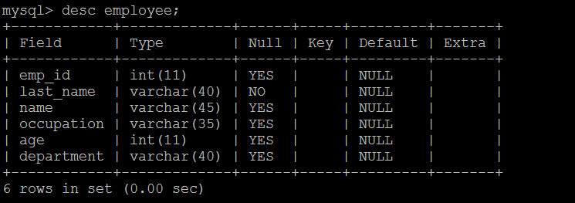
ALTER TABLE
Add multiple columns in table
  Example
ALTER TABLE employee ADD first_name varchar(20) FIRST, ADD address varchar(20) AFTER name;

Slide 28
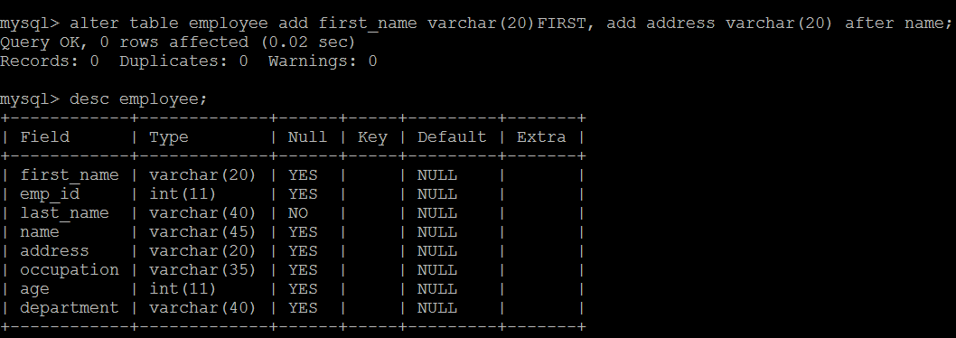
ALTER TABLE

Slide 29
ALTER TABLE
Modify column in table
  Syntax
    ALTER TABLE table_name
    MODIFY column_name column_definition
    [ FIRST | AFTER column_name ];
table_name - The name of the table to modify.
column_name - The name of the column to modify in the table.
column_definition - The modified datatype and definition of the column (NULL or NOT NULL, etc)
FIRST | AFTER column_name - Optional
  It tells MySQL where in the table to position the column, if you wish to change its position

Slide 30
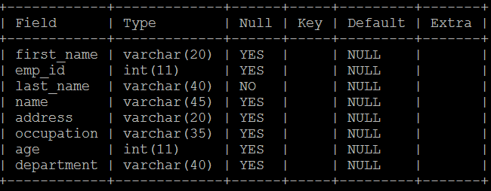
ALTER TABLE
Example
  ALTER TABLE employee MODIFY first_name varchar(50) not null;

Slide 31
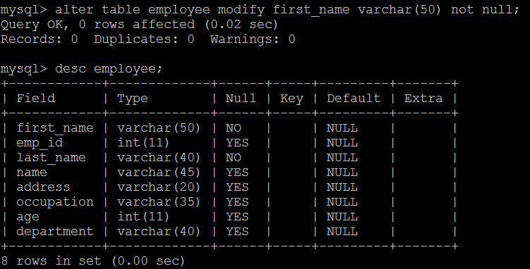
ALTER TABLE

Slide 32
ALTER TABLE
Modify Multiple columns in table
  Syntax
    ALTER TABLE table_name
MODIFY column_name column_definition
[ FIRST | AFTER column_name ],
MODIFY column_name column_definition
[ FIRST | AFTER column_name ],
...
;
table_name - The name of the table to modify.
column_name - The name of the column to modify in the table.
column_definition - The modified datatype and definition of the column (NULL or NOT NULL, etc).
FIRST | AFTER column_name - Optional
  It tells MySQL where in the table to position the column, if you wish to change its position

Slide 33
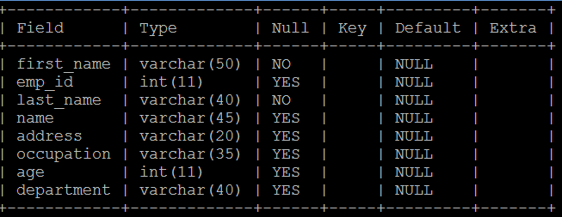
ALTER TABLE
Example
ALTER TABLE employee MODIFY first_name varchar(20) null AFTER emp_id, MODIFY last_name varchar(20);

Slide 34
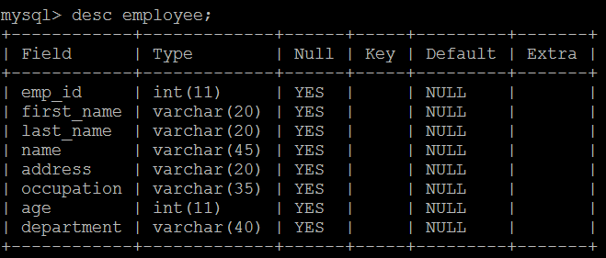
ALTER TABLE

Slide 35
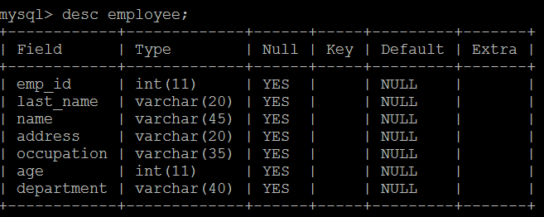
ALTER TABLE
Drop column
  Syntax
    ALTER TABLE table_name DROP COLUMN column_name;
table_name - The name of the table to modify
column_name - The name of the column to delete from the table
Example
  ALTER TABLE employee
  DROP first_name;

Slide 36
DROP TABLE
Allows you to remove or delete a table from the MySQL database
This statement deletes the entire structure as well as the content of the table
  Syntax : Simplest form
  DROP TABLE table_name;
  table_name - The name of the table to remove from the database.
Another syntax
  DROP [TEMPORARY]TABLE [ IF EXISTS ]
  table_name1, table_name2, ...;
[TEMPORARY] - allows you to remove temporary tables only
IF EXISTS - Optional. If specified, the DROP TABLE statement will not raise an error if one of the tables does not exist.
table_name1, table_name2 - The tables to remove from the database, if removing more than one table in the DROP TABLE statement.

Slide 37
DROP TABLE
Examples
  Drop One Table
  DROP TABLE table1;
  MySQL generates an error if you try to drop a table that does not exist
To avoid this
  DROP TABLE IF EXISTS table1;
  Drop Multiple Tables
DROP TABLE IF EXISTS customers, suppliers;
This DROP TABLE statement example would delete two tables - customers and suppliers.

Slide 38
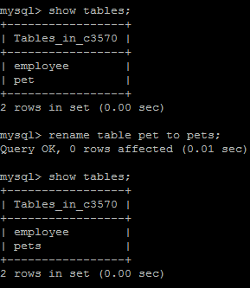
RENAME TABLE Statement
RENAME TABLE Statement - Renames one or more tables
  You must have ALTER and DROP privileges for the original table, and CREATE and INSERT privileges for the new table
  Syntax
  RENAME TABLE tbl_name TO new_tbl_name
  [, tbl_name2 TO new_tbl_name2] ...
  Example
  To rename a table named old_table to new_table
    RENAME TABLE old_table TO new_table;

Slide 39
RENAME TABLE
That statement is equivalent to the following ALTER TABLE statement
  ALTER TABLE old_table RENAME new_table;
  (or)
  ALTER TABLE old_table RENAME to new_table;
Unlike ALTER TABLE, Rename table can rename multiple tables within a single statement
  Syntax
    RENAME TABLE old_table1 TO new_table1,
    old_table2 TO new_table2,
    old_table3 TO new_table3;
Renaming operations are performed left to right. Thus, to swap two table names, do this (assuming that a table with the intermediary name tmp_table does not already exist)

Slide 40
RENAME TABLE
RENAME TABLE old_table TO tmp_table,
new_table TO old_table,
tmp_table TO new_table;
RENAME TABLE - can also be used to move a table from one database to another
RENAME TABLE current_db.tbl_name TO other_db.tbl_name;

Slide 41
TRUNCATE TABLE Statement
The TRUNCATE TABLE statement is used to remove all records from a table in MySQL
It performs the same function as a DELETE statement (DML statement) without a WHERE clause
Note
  If you truncate a table, the TRUNCATE TABLE statement can not be rolled back
  DELETE operations can be rolled back (undone)
  DROP and TRUNCATE operations cannot be rolled back
Syntax
  TRUNCATE TABLE [database_name.]table_name;
  database_name - Optional. If specified, it is the name of the database
  table_name - The table that you wish to truncate

Slide 42
TRUNCATE TABLE Statement
Example
  TRUNCATE TABLE pet;
This example would truncate the table called pet and remove all records from that table
This is equivalent to the following DELETE statement in MySQL:
DELETE FROM customers;
Another example - where we prefix the table name with the database name.
Example
TRUNCATE TABLE Sales.products;
This example would truncate the table called products in the database
called sales

Slide 43
Comment
Comments can be used to document the purpose of an SQL statement or the logic of a code block in a stored procedure
When parsing SQL code, MySQL ignores the comments part
MySQL supports three comment styles
  '-- ‘ to the end of the line. The double dash-comment style requires at least whitespace or control character (space, tab ) after the second dash. This method of commenting can only span a single line
    Example : SELECT * FROM users; -- This is a comment
  '#‘ - must be at the end of a line in your SQL statement with a line break after it. This method of commenting can only span a single line
  Example
  SELECT firstName FROM employees WHERE reportsTo = 1002; # get subordinates of Diane
  C-style comment /* comment goes here */ can span multiple lines. You use this comment style to document a block of SQL code

Slide 44
Comment
Examples
SELECT contact_id, last_name, first_name
/* Author: PSG Tech */ FROM contacts;
SELECT /* Author: PSG Tech */ contact_id, last_name, first_name
FROM contacts;
SELECT contact_id, last_name, first_name /* Author: PSG Tech */
FROM contacts;
SELECT contact_id, last_name, first_name -- Author: PSG Tech
FROM contacts;
SELECT contact_id, last_name, first_name # Author: PSG Tech
FROM contacts;
/* Get sales rep employees
that reports to Anthony */
SELECT lastName, firstName
FROM employees WHERE reportsTo = 1143 AND jobTitle = 'Sales Rep';
Note : MySQL does not support nested comments

Slide 45
Comment
SELECT contact_id, last_name, first_name
/*
* Author: PSG TECCH
* Purpose: To show a comment that spans multiple lines in your SQL
* statement in MySQL.
*/
FROM contacts;
SELECT contact_id, last_name, first_name /* Author: TechOnTheNet.com Purpose: To show a comment that spans multiple lines in your SQL statement. */
FROM contacts;
-- Select all:
SELECT * FROM Customers;

Slide 46
Data Manipulation Language (DML) - INSERT
Insert Statement - used to insert a single record or multiple records into a table in MySQL
Syntax (simplest form)
  INSERT INTO table (column1, column2, ... )
  VALUES (expression1, expression2, ... ),
  (expression1, expression2, ... ), ...;
The simplest way to create a MySQL INSERT query to list the values using the VALUES keyword
  INSERT INTO suppliers (supplier_id, supplier_name)
VALUES (1000, 'Dell');
  INSERT INTO suppliers(supplier_id, supplier_name)
VALUES(1000, ‘Dell’), (2000, ‘Lenovo’), (3000, ‘Sony’);

Slide 47
INSERT STATEMENT
  INSERT INTO suppliers (supplier_id, supplier_name)
VALUES ROW(1000, ‘Dell’), ROW(2000, ‘Lenovo’), ROW(3000, ‘Sony’);
The syntax for the INSERT statement when inserting multiple records using a subselect in MySQL is
  INSERT INTO table (column1, column2, ... )
  SELECT expression1, expression2, ...
  FROM source_table [WHERE conditions];
Example
  INSERT INTO suppliers (supplier_id, supplier_name)
  SELECT account_no, name
  FROM customers
  WHERE customer_id < 5000;

Slide 48
INSERT STATEMENT
CREATE TABLE projects(
project_id INT AUTO_INCREMENT,
name VARCHAR(100) NOT NULL,
start_date DATE,
end_date DATE,
PRIMARY KEY(project_id) );
INSERT INTO projects(name, start_date, end_date)
VALUES ('AI for Marketing', '2019-08-01', '2019-12-31'),
('ML for Sales', '2019-05-15', '2019-11-20');

Slide 49
INSERT STATEMENT
INSERT ON DUPLICATE KEY UPDATE statement
  When you insert a new row into a table if the row causes a duplicate in UNIQUE index or PRIMARY KEY , MySQL will issue an error
  However, if you specify the ON DUPLICATE KEY UPDATE option in the INSERT statement, MySQL will update the existing row with the new values instead
  Syntax
    INSERT INTO table (column_list)
    VALUES (value_list)
    ON DUPLICATE KEY UPDATE c1 = v1, c2 = v2, ...;
  The statement first tries to insert a new row into the table. If a duplicate error occurs, it will update the existing row with the value specified in the ON DUPLICATE KEY UPDATE clause

Slide 50

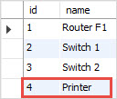
INSERT STATEMENT
CREATE TABLE devices (
id INT AUTO_INCREMENT PRIMARY KEY,
name VARCHAR(100) );
INSERT INTO devices(name)
VALUES('Router F1'),('Switch 1'),('Switch 2');
INSERT INTO devices(name)
VALUES ('Printer')
ON DUPLICATE KEY UPDATE name = 'Printer';

Slide 51

INSERT STATEMENT
Insert a row with a duplicate value in the id column
INSERT INTO devices(id, name)
VALUES (4,'Printer')
ON DUPLICATE KEY UPDATE name = 'Central Printer';

