Slide 1
REST Services
Spring MVC, Swagger
Balakumar Sethuraman

Slide 2
The REST stands for Representational State Transfer.
Representational
- Representational means formats (such as xml, json, yaml, html, etc)
– Clients possess the information necessary to identify, modify, and/or delete a web resource.
State
- State means data
– All resource state information is stored on the client.
Transfer
- Transfer means carry data between consumer and provider using HTTP protocol
– Client state is passed from the client to the service through HTTP.
The author of the REST (It is also called as RESTful Web Services) is Roy Fielding.

Slide 3
Agenda
Objective
Introduction and defining REST endpoints
REST APIs
Demo REST API
Spring MVC with Swagger Annotations
Demo Spring MVC with Swagger
Resources
Q&A

Slide 4
Objective
Review the basics of REST
Showcase a REST API implementation
Compare different REST APIs
Develop a RESTful Service using Swagger
Notes:
Summarize Slide – very brief bullets and expand

Slide 5
What is REST
REpresentational State Transfer
An architecture style for designing distributed systems
Not a standard, rather a set of patterns:
  Client/Server, Stateless, Uniform interface, etc.
Not tied to HTTP, but associated most commonly with it.

Slide 6
HTTP’s Uniform Interface
URI’s identify resources
HTTP verbs describe a limited set of operations that can be used to manipulate a resource
  GET
  DELETE
  PUT
  POST
Headers help describe the messages

Slide 7
Defining a REST Endpoint
What does this endpoint mean to a developer, tester or any consumer:
/account
What does the endpoint tell us?

Slide 8
Defining a REST Endpoint (2)
/account
Operations:
GET
POST
PUT
DELETE
Endpoint Description:
Operation Descriptions
Error Codes:
Validation
Input:
Parameter Values
Form Values
JSON Format
Header information
Return formats

Slide 9
Salesforce REST APIs
https://github.com/jesperfj/force-rest-api
Developer: Jesper Joergensen (Product Management @ Heroku)
Lightweight library for building Force.com apps with OAuth authentication and data access through the Force.com REST API.
https://github.com/ryanbrainard/force-rest-api
Developer: Ryan Brainard
Forked version of Jasper Joergensen project
Caching enhancements
Available in Maven Central
Notes:
Jess Jorgensen
Ryan Brainard

Slide 10
Force.com REST API Maven dependency
<repositories>
<repository>
<id>force-rest-api</id>
<name>force-rest-api repository on GitHub</name>
<url>http://jesperfj.github.com/force-rest-api/repository/</url>
</repository>
</repositories>
<dependency>
<groupId>com.force.api</groupId>
<artifactId>force-rest-api</artifactId>
<version>0.0.19</version>
</dependency>

Slide 11
Authenticating to Salesforce
Using Username and Password
  For backend application where only server authentication is needed:
ForceApi api = new ForceApi(new ApiConfig()
.setUsername("user@domain.com")
.setPassword("password+token"));
Using OAuth Username and Password
  Front end application where user authentication is needed:
ForceApi api = new ForceApi(new ApiConfig()
.setUsername("user@domain.com")
.setPassword("password")
.setClientId("longclientidalphanumstring")
.setClientSecret("notsolongnumeric"));
Notes:
Why use one rather than the other – oauth (user) + username password = server/instance

Slide 12
OAuth Web Server Flow
String url = Auth.startOAuthWebServerFlow(new AuthorizationRequest()
.apiConfig(new ApiConfig()
.setClientId("longclientidalphanumstring")
.setRedirectURI("https://myapp.mydomain.com/oauth"))
.state("mystate"));
ApiSession s = Auth.completeOAuthWebServerFlow(new AuthorizationResponse()
.apiConfig(new ApiConfig()
.setClientId("longclientidalphanumstring")
.setClientSecret("notsolongnumeric")
.setRedirectURI("https://myapp.mydomain.com/oauth"))
.code("alphanumericstringpassedbackinbrowserrequest"));
ForceApi api = new ForceApi(s.getApiConfig(),s);

Slide 13
Defining your Salesforce POJO Object (Model)
import org.codehaus.jackson.annotate.JsonIgnoreProperties;
import org.codehaus.jackson.annotate.JsonProperty;
@JsonIgnoreProperties(ignoreUnknown=true)
public class Account {
@JsonProperty(value="Id")
String id;
@JsonProperty(value="Name")
String name;
}

Slide 14
REST API Operations
GET: Query a List of SObjects
  QueryResult<Account> res = api.query("SELECT id FROM Account WHERE name LIKE 'Test account%'", Account.class);
GET: Get an SObject
  Account res = api.getSObject("Account", "001D000000INjVe").as(Account.class);
POST: Create a new SObject
  Account a = new Account();
  a.setName("Test account");
  String id = api.createSObject("account", a);

Slide 15
REST API Operations
PUT: Update an SObject when already exist
  Account exAccount = api.getSObject("Account", "001D000000INjVe").as(Account.class);
  api.createOrUpdateSObject("account", exAccount);
DELETE: Delete an existing SObject
  api.deleteSObject("account”, “001D000000INjVe”);

Slide 16
Putting it all together
import com.force.api.ApiConfig;
import com.force.api.ForceApi;
import com.thysmichels.swagger4forcedotcom.models.Account;
public class Main {
private static final String USERNAME = ”username@email.com";
private static final String PASSWORDTOKEN = ”password+token”;
public static void main(String[] args) {
ForceApi api = new ForceApi(new ApiConfig().setUsername(USERNAME).setPassword(PASSWORDTOKEN));
Account a = new Account();
a.setName("Test account");
String id = api.createSObject("account", a);
a.setName("Updated Test Account");
api.updateSObject("account", id, a);
Account res = api.getSObject("Account",id).as(Account.class);
api.deleteSObject("account", res.getId());
}
}

Slide 17
Demo Salesforce REST API
Demo

Slide 18
Spring MVC vs Visualforce
The Spring Web model-view-controller (MVC) framework is designed around a DispatcherServlet that dispatches requests to:
  Model (POJO)
  View (JSP)
  Controller (@Controller and @RequestMapping annotation classes)
Visualforce MVC
  Model (SObject, Apex Classes)
  View resolution (Visualforce Pages/Components)
  Controller (Standard or Custom Apex classes)

Slide 19
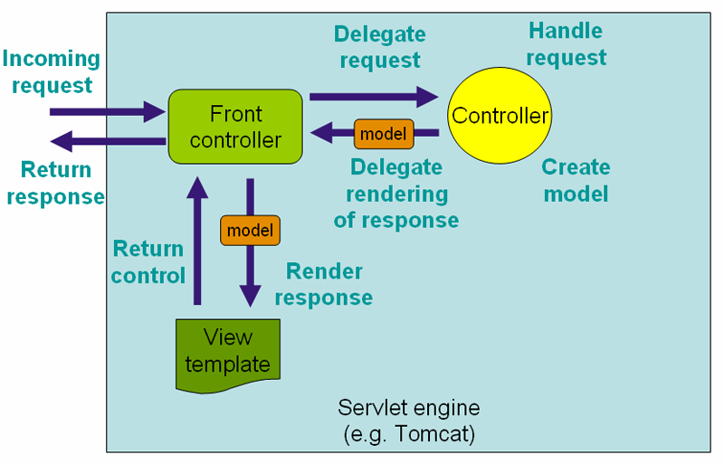
Spring MVC Architecture

Slide 20
Spring MVC OAuth Login Service
XML AnnotationConfiguration for setting up Salesforce OAuth:
<fss:oauth>
<fss:oauthInfo endpoint="http://login.salesforce.com"
oauth-key="#{systemEnvironment['OAUTH_CLIENT_KEY']}"
oauth-secret="#{systemEnvironment['OAUTH_CLIENT_SECRET']}"/>
</fss:oauth>
Windows:
  Set OAUTH_CLIENT_KEY=3MVM3_GuVCQ3gmEE5al72RmBfiAWhBX5O2wYc9zTZ8
  Set OAUTH_CLIENT_SECRET=1319558946720906100
Unix/Linux
  Export OAUTH_CLIENT_KEY=3MVM3_GuVCQ3gmEE5al72RmBfiAWhBX5O2wYc9zTZ8
  Export OAUTH_CLIENT_SECRET=1319558946720906100

Slide 21
Salesforce API Spring MVC Controller
@Controller
@RequestMapping(value = "/api/v1/account")
public class AccountController {
//Login to salesforce
@Autowired
LoginService loginService;
@RequestMapping(value = "/", method = RequestMethod.GET, produces = "application/json")
public @ResponseBody List<Account> showAllAccounts() {
QueryResult<Account> res = loginService.getForceApi().query("SELECT Name FROM Account", Account.class);
return res.getRecords();
}
}
Notes:
No username and password

Slide 22
Some Spring MVC Annotations
@Controller - The @Controller annotation indicates that a particular class serves the role of a controller.
@RequestMapping – The @RequestMapping annotation is used to map URLs such as http://yourwebsiteurl.com/api/v1/account onto an entire class or a particular handler method.
@PathVariable – Provides access to URI template variables.
@RequestParam – Provides access to specific Servlet request parameters.

Slide 23
Intro to Swagger
Swagger is a specification and complete framework implementation for describing, producing, consuming, and visualizing RESTful web services.
Company: http://helloreverb.com/
Link: https://developers.helloreverb.com/swagger/
We will use Swagger to describe, produce, consume and visualize our Force.com REST services.

Slide 24
Swagger Maven Dependency
http://mvnrepository.com/artifact/com.knappsack/swagger4spring-web/0.2.0
Include Maven dependency to you project:
<dependency>
<groupId>com.knappsack</groupId>
<artifactId>swagger4spring-web</artifactId>
<version>0.2.0</version>
</dependency>

Slide 25
Swagger Base Controller
@Controller
@RequestMapping(value = "/api")
public class ApiController extends ApiDocumentationController {
public ApiController() {
setBasePath("https://force-com-rest-swagger.herokuapp.com");
setBaseControllerPackage("com.thysmichels.swagger4forcedotcom.controllers.api");
setBaseModelPackage("com.thysmichels.swagger4forcedotcom.model");
setApiVersion("v1");
}
@RequestMapping(value = "/", method = RequestMethod.GET)
public String documentation() {
return "api";
}
}

Slide 26
Swagger Base Controller Annotations
basePath - optional - the base URL of your web application, for example https://force-com-rest-swagger.herokuapp.com
baseControllerPackage - optional - this is the package you want swagger4spring-web to scan to look for classes annotated with @Controller.
baseModelPackage - optional - this is the package you want to scan if all your model objects are in a specific directory.
apiVersion - required - this is the version of your API

Slide 27
Swagger Annotations
@Api – describe a RESTful Endpoint on a high level
@Api(value = "Account operations", listingClass = "AccountController", basePath = "/api/v1/account", description = "All operations for accounts")

Slide 28
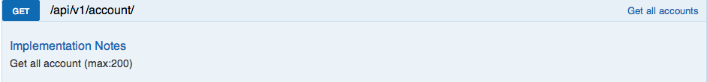
Swagger Annotations
@ApiOperation – define a RESTful operation
@ApiOperation(value = ”Get all accounts", notes = ”Get all account (max: 200) ", httpMethod = "GET", responseClass = "Account", multiValueResponse = true)

Slide 29
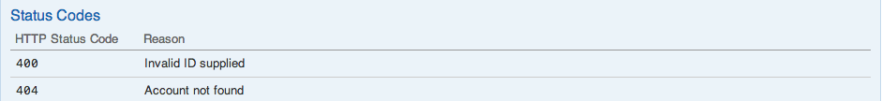
Swagger Annotations
@ApiError – define one error code
@ApiError(code = 500, reason = "Process error")
@ApiErrors – define multiple error codes
@ApiErrors(value = { @ApiError(code = 400, reason = "Invalid Id supplied"), @ApiError(code = 404, reason = "Account not found") })

Slide 30
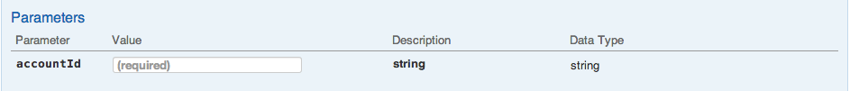
Swagger Annotations
@ApiParam– define path variables
public @ResponseBody Account findAccountById
(@ApiParam(internalDescription = "java.lang.string",
name = "accountId", required = true, value = "string”)) {}

Slide 31
Putting it all together
@Controller
@RequestMapping(value = "/api/v1/account")
@Api(value = "Account operations", listingClass = "AccountController", basePath = "/api/v1/account", description = "All operations for accounts")
public class AccountController {
@Autowired
AccountService accountService;
@ApiOperation(value = "Find all accounts", notes = "Get all account currently available", httpMethod = "GET", responseClass = "Account", multiValueResponse = true)
@ApiError(code = 500, reason = "Process error")
@RequestMapping(value = "/", method = RequestMethod.GET, produces = "application/json")
public @ResponseBody List<Account> showAllAccounts() {
return accountService.listAccounts();
}
}

Slide 32
Swagger JavaScript
function displaySwaggerDocuments() {
var url = '<c:url value="/api/resourceList"/>';
window.swaggerUi = new SwaggerUi({
discoveryUrl: url,
dom_id: "swagger-ui-container",
supportHeaderParams: false,
supportedSubmitMethods: ['get', 'post', 'put', 'delete'],
apiKey: "",
…
}

Slide 33
Invoking REST Endpoint
Using curl
  curl -H "Accept: application/json" -H "Content-type: application/json" -X POST -d '{"name": "New Account Name"}' http://localhost:8080/api/v1/account
Using Java
HttpClient client = new DefaultHttpClient();
HttpPost post = new HttpPost("http://localhost:8080/api/v1/account");
post.setEntity(new StringEntity("{\"name\": \"New Account\"}"));
post.setHeader("Accept", "application/json");
post.setHeader("Content-Type", "application/json");
HttpResponse response = client.execute(post);

Slide 34
Force.com REST Services with Swagger
Demo
Notes:
Find something that people

Slide 35
Resources
Heroku: Force.com Services using Swagger
  https://force-com-rest-swagger.herokuapp.com/
GitHub: Repository
  https://github.com/thysmichels/force.com-swagger-rest-spring-mvc
Swagger Sample Projects
  https://github.com/wordnik/swagger-core/tree/master/samples

Slide 36

Thys Michels
Software Engineer,
@thysmichels

