Slide 1

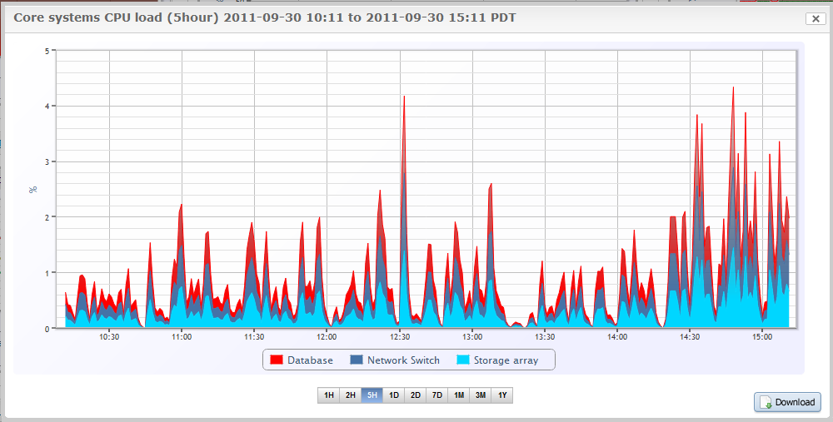
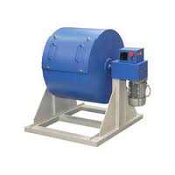
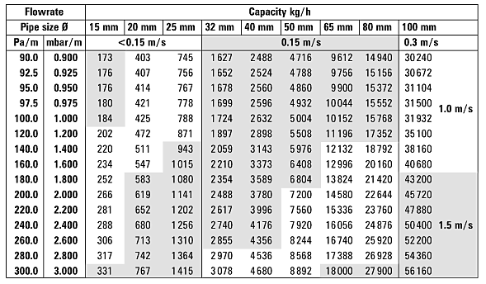
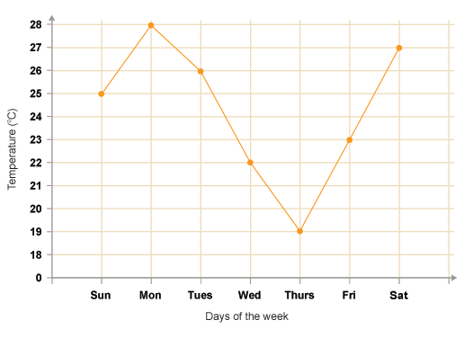

Project Title goes here, Containing Strictly fit into one line [48 font size]
Your name | Teacher’s name | School
Introduction
Results
The page size of this poster template is A1 (59.4x84cm), portrait (vertical) format. Do not change this page size, when printing. If you need a different shape start with either a portrait (vertical) or a square poster template.
Discuss the literature [previous work] , gap identified.
Importing / inserting files…
Images such as photographs, graphs, diagrams, logos, etc., can be added to the poster.
To insert scanned images into your poster, go through the menus as follows: Insert / Picture / From File… then find the file on your computer, select it, and press OK.
The best type of image files to insert are JPEG or TIFF, JPEG is the preferred format.
Be aware of the image size you are importing. The average colour photo (13 x 18cm at 180dpi) would be about 3Mb (1Mb for B/W greyscale).
Do not use images from the web ass they will print very poorly.
Notes about graphs…
For simple graphs use MS Excel, or do the graph directly in PowerPoint.
Graphs done in a scientific graphing programs (e.g.. Sigma Plot, Prism, SPSS, Statistica, Matlab) should be saved as JPEG or TIFF and them imported.
Captions to be set in Calibri, italic, 18 to 24 points, to the length of the column in case a figure takes more than 2/3 of column width.
Captions to be set in Calibri, italic, 18 to 24 points, should be set above the table and centre aligned
Motivation
Do not make your poster bigger than it is necessary just to fill that given size! The maximum size of the poster is given by the red outline. Do not exceed this. Otherwise you will have to push pins through the material of your poster.
SCOPE of the Project
Simply highlight this text and replace it by typing in your own text, or copy and paste your text from a MS Word document or a PowerPoint slide presentation.
The body text / font size should be between 24 and 32 points. Calibri font. This is too small!
Keep body text left-aligned, and do not justify text! The colour of the text, title and poster background can be chosen from the four colours blue red green black
Methodology
Tips for making a successful poster…
Re-write your paper into poster format i.e.. Simplify everything, avoid data overkill.
Headings of more than 6 words should be in upper and lower case, not all capitals.
NEVER DO WHOLE SENTENCES IN CAPITAL or underline to stress your point, use bold characters instead.
When laying out your poster leave space around you text. Don’t overcrowd your poster.
Spell check and get someone else to proof-read.
Ensure that the graphs are labelled. The labels should be the same as 18 points size in the poster. Graphs are best posted as high quality images to prevent them from being altered.
Equations should be written using the Microsoft Equation Editor. An example is given below.
$$\frac{σ_{max}}{MOR}=1−β\left(1−R_{max}\int_{0}^{2π}{\sin{x}dx}\right)$$
Equations should used the same font size as the text. It should be centre aligned and the variables used should be obvious to the reader.
Captions to be set in Calibri, italic, between Try using photographs or coloured graphs. Avoid long numerical tables.
Spell check and get someone else to proof-read and 24 points. Left aligned if it refers to a figure on its left. Caption starts right at the top edge of the picture (graph or photo).
Captions to be set in Calibri, italic, between 18 and 24 points. Right aligned if it refers to a figure on its Right. Caption starts right at the top edge of the picture (graph or photo).
Conclusion
Brief summary of what you discovered based on results
Indicate and explain whether or not the data supports your hypothesis
Give directions for future work in this area.
Each of the areas can be expanded as per requirement. Please use only a two columns to make it visually appealing.
References
The body text / font size should be between 24 and 32 points. Calibri font

