Slide 1
Lending Club Case Study
Group Members:
Gorrepati Bala Chandra Reddy
Jitesh Rathod

Slide 2
Objective
Lending club is a bank which lends loans for various purposes. Dataset contains loans data
The objective is to find out patterns that indicate if a person is likely to default

Slide 3
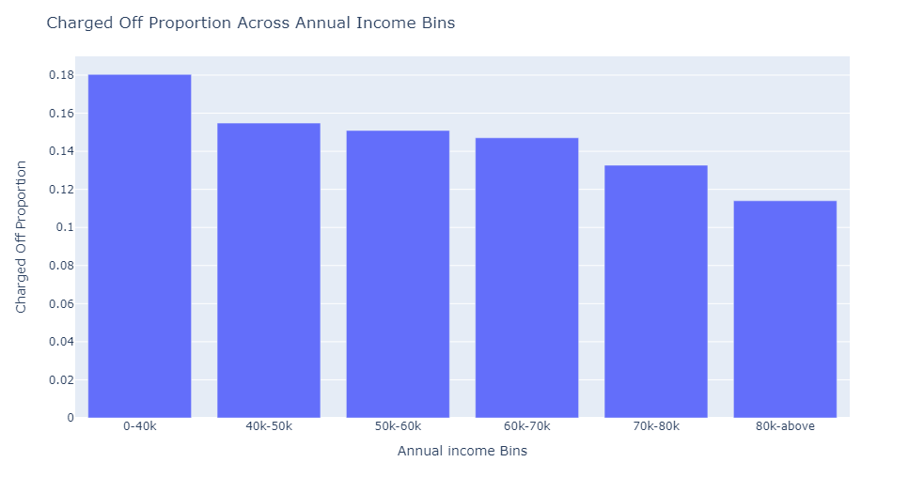
Analysis
Applicants with an income range of $80,000 or more have lower chances of charged-off loans.
Those with an income range of $0-$40,000 have higher chances of charged-off loans.
Overall, the charged-off proportion decreases with an increase in annual income.

Slide 4
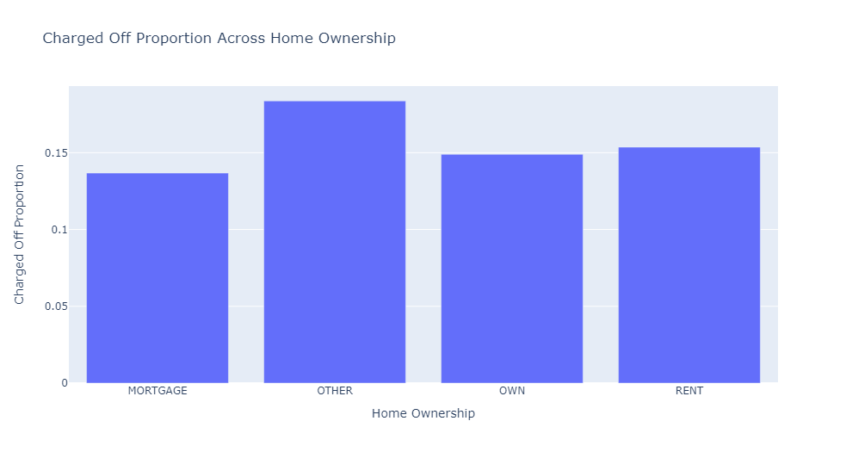
Analysis
Applicants without homes are more likely to default on loans.

Slide 5
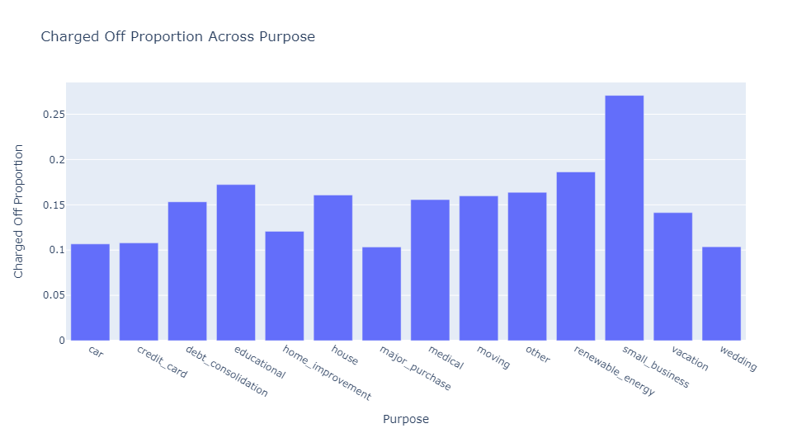
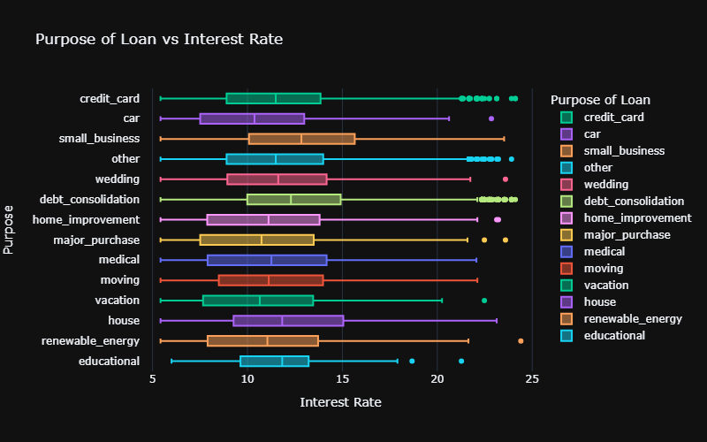
Analysis
Loans for small businesses have higher chances of defaults.
Small business loans have the highest average interest rates, indicating greater risk.

Slide 6
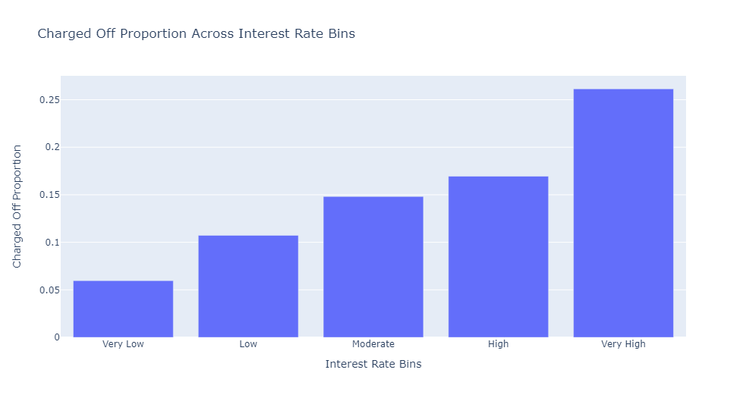
Analysis
Interest rates below 10% have significantly lower chances of charged-off loans.
Interest rates above 16% have a higher likelihood of charged-off loans compared to other categories.

Slide 7
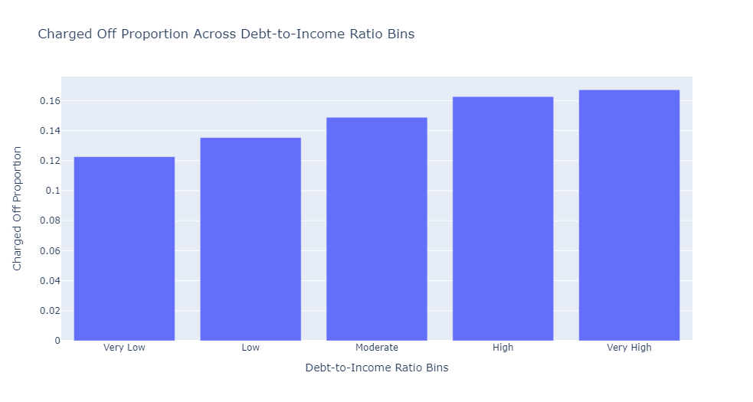
Analysis
Higher DTI values are associated with a higher risk of loan defaults.
Lower DTI values indicate lower chances of loan defaults .

Slide 8
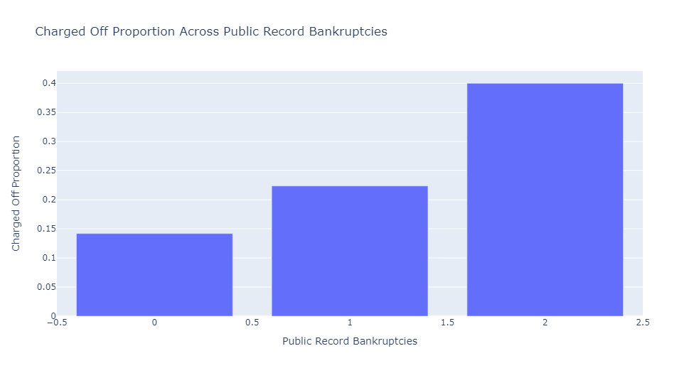
Analysis
Bankruptcies with a record of 2 have a high impact on loan defaults.
Bankruptcies with a record of 0 have a low impact on loan defaults.

Slide 9
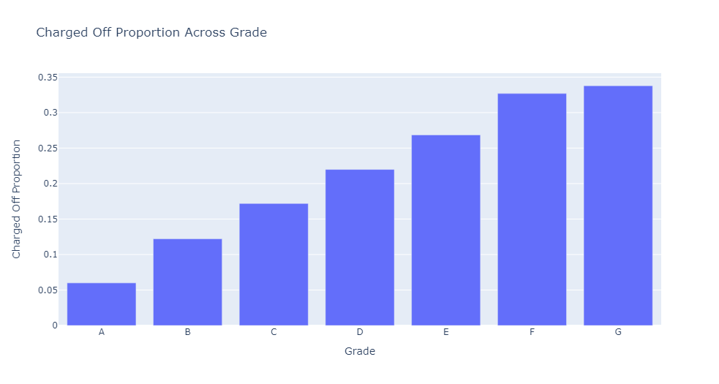
Analysis
Applicants with loan Grade G have the highest loan defaults.
Those with loan Grade A have the lowest loan defaults.

Slide 10
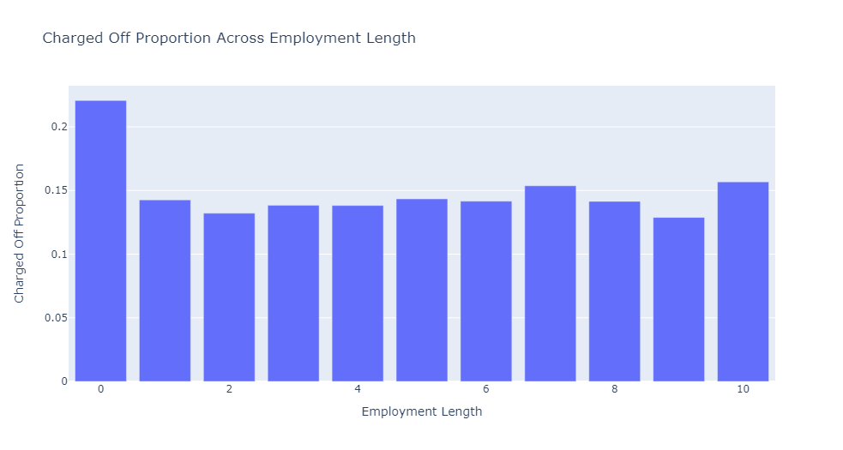
Analysis
Applicants with less or no experience may lack a stable income source, leading to higher loan defaults.
Other applicants show relatively similar chances of getting charged off.

Slide 11
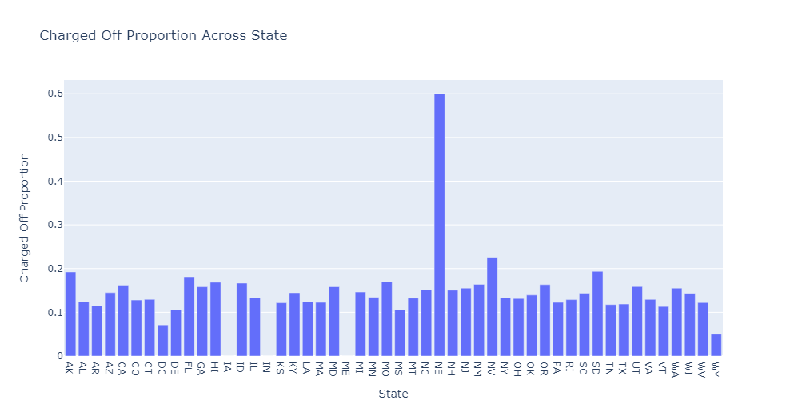
Analysis
Northeast (NE) state have the highest number of loan defaults.

Slide 12
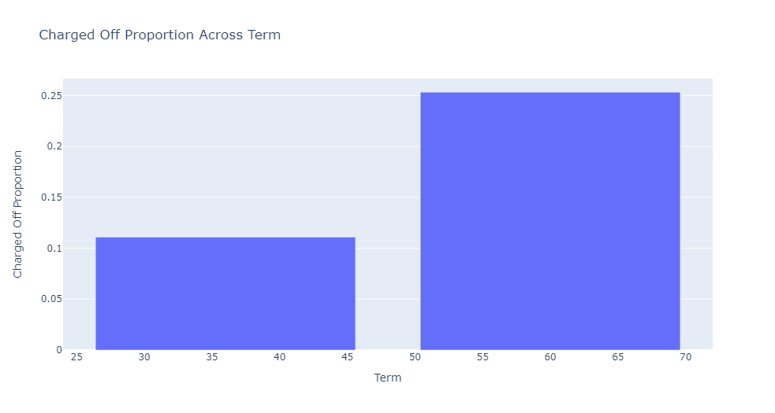
Analysis
Higher term have higher chance of defaulter

Slide 13
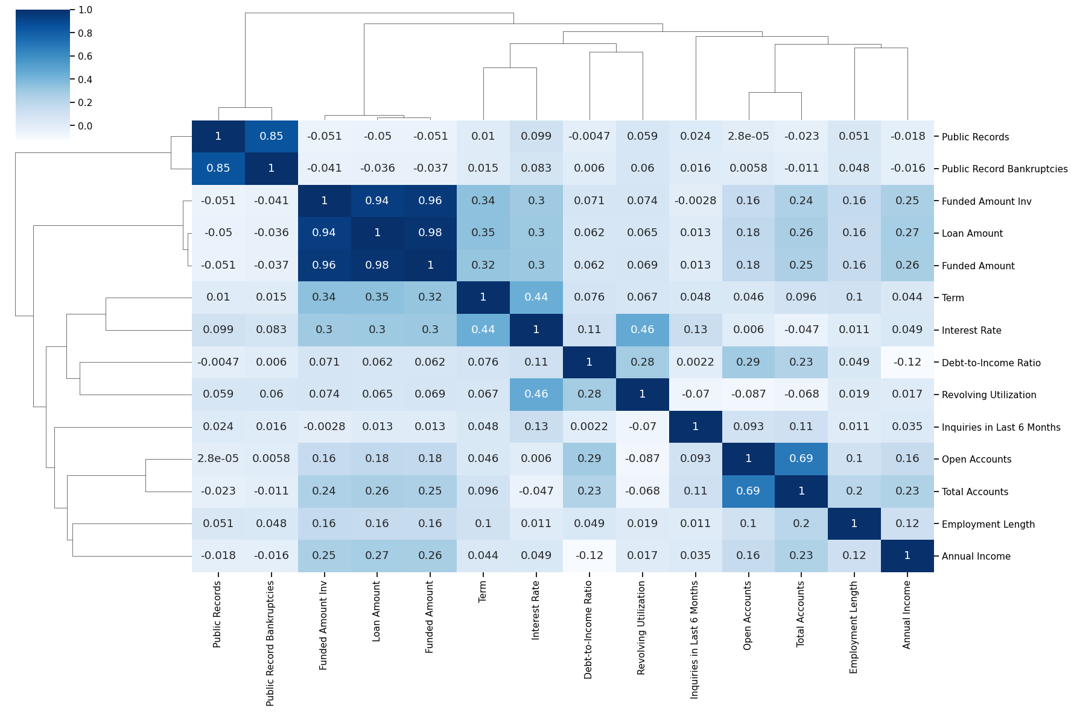
Analysis
Positive Correlation between Term and Interest Rate

Slide 14
Analysis
Interest rates below 10% have significantly lower chances of charged-off loans.
Interest rates above 16% have a higher likelihood of charged-off loans compared to other categories.

Slide 15
Conclusions
Lending club should reduce loans to below 40K income borrowers as they are more likely to default
Lending club should reduce giving loans to borrowers without owning house.
Small business loans are defaulted more. Lending club should stop or reduce issuing the loans to them.
Borrows with high DTI should be avoided
People with more number of public derogatory records are having more chance of filing a bankruptcy. Lending club should make sure there are no public derogatory records for borrower.
Lending club should examine borrowers before issuing loans to Low grade (G to A).
Employers who have less than 1 year of experience more likely to default
Lending Club should reduce number of loan issues to borrowers who are from NE
Higher the term more risk of defaulting
High interest rate have more defaulters. Providing loans to above categories with high interest rate will increase the risk

