Slide 1
Spring3 Framework
Fresher Learning Program
September, 2013
Notes:
© 2006 Capgemini - All rights reserved

Slide 2
Objectives
Purpose:
  To understand the spring IOC, MVC, JDBC , Database Transactions and AOP.
Product:
  Spring3 IOC containers and Dependency Injection
  Spring3 MVC
  Spring3 JDBC and transactions
  Spring3 AOP
Process:
  Theory Sessions along with hands on assignments
  A review at the end of the session and a Quiz.
© 2007 Capgemini - All rights reserved

Slide 3
Table of Contents
Understanding Of IOC and How Spring provides IOC
  Spring IOC Containers and Bean Definition
  Spring Bean Scopes and LifeCycle
  Spring Bean Post Processors and Inheritance
  Dependency Injection
Spring MVC
  Features of Spring web MVC
  The Dispatcher Servlet and Resolving the Request
  Required Configuration and Defining the controller
  Creating JSP views and Handling Exception
Spring JDBC Framework
  JDBC Template Class and Configuring DataSource
  DataAccessObject (DAO)
  Executing SQL Statements.
  SQL Stored Procedures in Spring
Spring Transaction Management
  Programmatic Transaction Management
  Declarative Transaction Management
Aspect oriented programming
  AOP Terminologies and Types of Advice
  XML Schema Based and @AspectJ Based AOP with Spring
© 2007 Capgemini - All rights reserved
Notes:
© 2006 Capgemini - All rights reserved

Slide 4
Spring IOC containers
The Spring container will create the objects, wire them together, configure them, and manage their complete lifecycle from creation till destruction.
The Spring container uses dependency injection (DI) to manage the components that make up an application.
The container gets its instructions on what objects to instantiate, configure, and assemble by reading configuration metadata provided.
The configuration metadata can be represented either by XML, Java annotations, or Java code.
The Spring IoC container makes use of Java POJO classes and configuration metadata to produce a fully configured and executable system or application.
© 2011 Capgemini - All rights reserved
Notes:
Spring container is at the core of the Spring Framework. The following diagram shows that how the spring container works.
© 2006 Capgemini - All rights reserved

Slide 5
Spring IOC containers
Java POJO classes
Metadata
The Spring container
Final Result
Ready to use
application
© 2011 Capgemini - All rights reserved

Slide 6
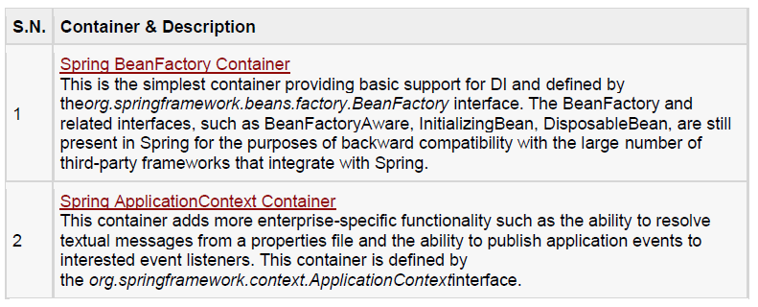
Spring IOC containers
Spring provides following two distinct types of containers.
© 2011 Capgemini - All rights reserved

Slide 7
Spring IOC containers
Spring BeanFactory Container
This is the simplest container providing basic support for DI and defined by the org.springframework.beans.factory.BeanFactory interface.
The BeanFactory and related interfaces, such as BeanFactoryAware, InitializingBean, DisposableBean, are still present in Spring for the purposes of backward compatibility with the large number of third-party frameworks that integrate with Spring.
© 2011 Capgemini - All rights reserved
Notes:
There are a number of implementations of the BeanFactory interface that come supplied straight out-of-the-box with Spring. The most commonly used BeanFactory implementation is the XmlBeanFactoryclass. This container reads the configuration metadata from an XML file and uses it to create a fully configured system or application.
The BeanFactory is usually preferred where the resources are limited like mobile devices or applet based applications. So use an ApplicationContext unless you have a good reason for not doing so.
© 2006 Capgemini - All rights reserved

Slide 8
Spring IOC containers
XmlBeanFactory
XmlBeanFactory factory = new XmlBeanFactory
(new ClassPathResource("Beans.xml"));
Spring ApplicationContext Container
The Application Context is spring's more advanced container. Similar to BeanFactory it can load bean definitions, wire beans together and dispense beans upon request.
Additionally it adds more enterprise-specific functionality such as the ability to resolve textual messages from a properties file and the ability to publish application events to interested event listeners.
This container is defined by the org.springframework.context.ApplicationContext interface.
© 2011 Capgemini - All rights reserved
Notes:
The ApplicationContext includes all functionality of the BeanFactory, it is generally recommended over the BeanFactory. BeanFactory can still be used for light weight applications like mobile devices or applet based applications.
Refer Lab1.1 for spring IOC containers.
© 2006 Capgemini - All rights reserved

Slide 9
Spring IOC containers
The most commonly used ApplicationContext implementations are:
FileSystemXmlApplicationContext
ClassPathXmlApplicationContext
WebXmlApplicationContext
© 2011 Capgemini - All rights reserved
Notes:
FileSystemXmlApplicationContext: This container loads the definitions of the beans from an XML file. Here you need to provide the full path of the XML bean configuration file to the constructor.
ClassPathXmlApplicationContext: This container loads the definitions of the beans from an XML file. Here you do not need to provide the full path of the XML file but you need to set CLASSPATH properly because this container will look bean configuration XML file in CLASSPATH.
WebXmlApplicationContext: This container loads the XML file with definitions of all beans from within a web application.
© 2006 Capgemini - All rights reserved

Slide 10
Spring Bean Definition
The bean definition contains the information called configuration metadata which is needed for the container to know the followings:
  How to create a bean
  Bean's lifecycle details
  Bean's dependencies
© 2011 Capgemini - All rights reserved
Notes:
The objects that form the backbone of your application and that are managed by the Spring IoC container are called beans. A bean is an object that is instantiated, assembled, and otherwise managed by a Spring IoC container. These beans are created with the configuration metadata that you supply to the container, for example, in the form of XML <bean/> definitions which you have already seen in previous chapters.
© 2006 Capgemini - All rights reserved

Slide 11
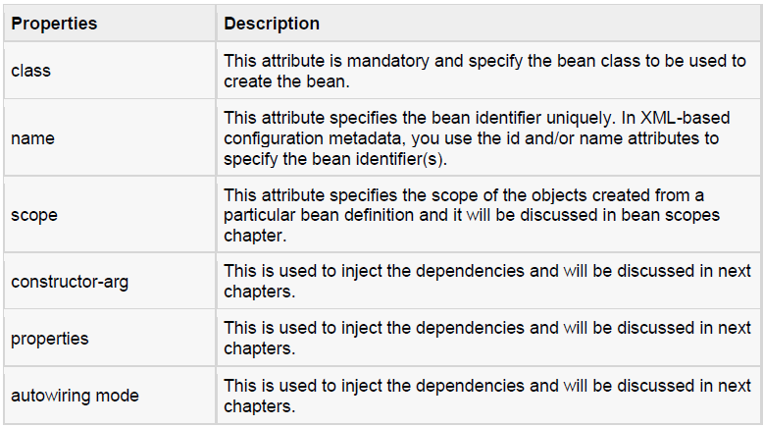
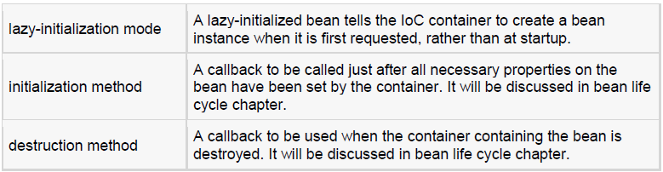
All the above configuration metadata translates into a set of the following properties that make up each bean definition.
© 2011 Capgemini - All rights reserved

Slide 12
Spring Bean Definition
Spring Configuration Metadata
Spring IoC container is totally decoupled from the format in which this configuration metadata is actually written. There are following three important methods to provide configuration metadata to the Spring Container:
1. XML based configuration file.
2. Annotation-based configuration
3. Java-based configuration
© 2011 Capgemini - All rights reserved

Slide 13
Spring Bean Definition
Beans.xml
<?xml version="1.0" encoding="UTF-8"?>
<beans xmlns="http://www.springframework.org/schema/beans"
xmlns:xsi="http://www.w3.org/2001/XMLSchema-instance"
xsi:schemaLocation="http://www.springframework.org/schema/beans
http://www.springframework.org/schema/beans/spring-beans-3.0.xsd">
    <!-- A simple bean definition -->
    <bean id="..." class="...">
    <!-- collaborators and configuration for this bean go here -->
    </bean>
<!-- A bean definition with lazy init set on -->
<bean id="..." class="..." lazy-init="true">
<!-- collaborators and configuration for this bean go here -->
</bean>
    <!-- A bean definition with initialization method -->
    <bean id="..." class="..." init-method="...">
    <!-- collaborators and configuration for this bean go here -->
    </bean>
<!-- A bean definition with destruction method -->
<bean id="..." class="..." destroy-method="...">
<!-- collaborators and configuration for this bean go here -->
</bean>
    <!-- more bean definitions go here -->
</beans>
© 2011 Capgemini - All rights reserved

Slide 14
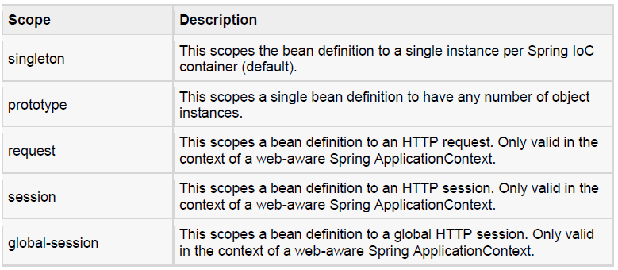
Spring Bean Scopes
The Spring Framework supports following five scopes, three of which are available only if you use a web-aware ApplicationContext.
© 2011 Capgemini - All rights reserved

Slide 15
Spring Bean Scopes
The singleton scope
If scope is set to singleton, the Spring IoC container creates exactly one instance of the object defined by that bean definition. This single instance is stored in a cache of such singleton beans, and all subsequent requests and references for that named bean return the cached object.
Syntax:
<!-- A bean definition with singleton scope -->
<bean id="..." class="..." scope="singleton">
<!-- collaborators and configuration for this bean go here -->
</bean>
© 2011 Capgemini - All rights reserved
Notes:
© 2006 Capgemini - All rights reserved

Slide 16
Spring Bean Scopes
The prototype scope
If scope is set to prototype, the Spring IoC container creates new bean instance of the object every time a request for that specific bean is made. As a rule, use the prototype scope for all state-full beans and the singleton scope for stateless beans.
To define a prototype scope, you can set the scope property to prototype in the bean configuration file, as shown below:
Syntax:
    <!-- A bean definition with singleton scope -->
    <bean id="..." class="..." scope="prototype">
    <!-- collaborators and configuration for this bean go here -->
    </bean>
© 2011 Capgemini - All rights reserved
Notes:
While explaining about the bean types refer Lab1.2
© 2006 Capgemini - All rights reserved

Slide 17
Spring Bean Life Cycle
To define setup and teardown for a bean, we simply declare the <bean> with init-method and/ordestroy-method parameters.
The init-method attribute specifies a method that is to be called on the bean immediately upon instantiation.
Similarly, destroy-method specifies a method that is called just before a bean is removed from the container.
© 2011 Capgemini - All rights reserved
Notes:
The life cycle of a Spring bean is easy to understand. When a bean is instantiated, it may be required to perform some initialization to get it into a usable state. Similarly, when the bean is no longer required and is removed from the container, some cleanup may be required.
Though, there is lists of the activities that take place behind the scenes between the time of bean Instantiation and its destruction, but this chapter will discuss only two important bean lifecycle callback methods which are required at the time of bean initialization and its destruction.
© 2006 Capgemini - All rights reserved

Slide 18
Spring Bean Life Cycle
Initialization callbacks
The org.springframework.beans.factory.InitializingBean interface specifies a single method:
void afterPropertiesSet() throws Exception;
So you can simply implement above interface and initialization work can be done inside afterPropertiesSet() method as follows:
In the case of XML-based configuration metadata, you can use the init-method attribute to specify the name of the method that has a void no-argument signature. For example:
Following is the class definition:
    public class ExampleBean implements InitializingBean {
    public void afterPropertiesSet() {
    // do some initialization work
    } }
<bean id="exampleBean“ class="examples.ExampleBean" init-method="init"/>
      public class ExampleBean {
      public void init() {
      // do some initialization work
      }}
© 2011 Capgemini - All rights reserved

Slide 19
Spring Bean Life Cycle
Destruction callbacks
The org.springframework.beans.factory.DisposableBean interface specifies a single method:
void destroy() throws Exception;
So you can simply implement above interface and finalization work can be done inside destroy() method as follows:
In the case of XML-based configuration metadata, you can use the destroy-method attribute to specify the name of the method that has a void no-argument signature. For example:
Following is the class definition:
      public class ExampleBean implements DisposableBean {
      public void destroy() {
      // do some destruction work
      } }
<bean id="exampleBean" class="examples.ExampleBean" destroy-method="destroy"/>
      public class ExampleBean {
      public void destroy() {
      // do some destruction work
      } }
© 2011 Capgemini - All rights reserved
Notes:
If you are using Spring's IoC container in a non-web application environment; for example, in a rich client desktop environment; you register a shutdown hook with the JVM. Doing so ensures a graceful shutdown and calls the relevant destroy methods on your singleton beans so that all resources are released.
It is recommended that you do not use the InitializingBean or DisposableBean callbacks, because XML configuration gives much flexibility in terms of naming your method.
© 2006 Capgemini - All rights reserved

Slide 20
Spring Bean Life Cycle
Default initialization and destroy methods
    <beans xmlns="http://www.springframework.org/schema/beans"
    xmlns:xsi="http://www.w3.org/2001/XMLSchema-instance"
    xsi:schemaLocation="http://www.springframework.org/schema/beans
    http://www.springframework.org/schema/beans/spring-beans-3.0.xsd"
    default-init-method="init"
    default-destroy-method="destroy">
    <bean id="..." class="...">
    <!-- collaborators and configuration for this bean go here -->
    </bean>
    </beans>
© 2011 Capgemini - All rights reserved
Notes:
Refer lab 1.3 for bean life cycle management
If you have too many beans having initialization and or destroy methods with the same name, you don't need to declare init-method and destroy-method on each individual bean. Instead framework provides the flexibility to configure such situation using default-init-method and default-destroy-method attributes on the <beans> element as follows:
© 2006 Capgemini - All rights reserved

Slide 21
Spring Bean Post Processors
The BeanPostProcessor interface defines callback methods that you can implement to provide your own instantiation logic, dependency-resolution logic etc.
You can also implement some custom logic after the Spring container finishes instantiating, configuring, and initializing a bean by plugging in one or more BeanPostProcessor implementations.
© 2011 Capgemini - All rights reserved
Notes:
Refer Lab1.3.1
You can configure multiple BeanPostProcessor interfaces and you can control the order in which these BeanPostProcessor interfaces execute by setting the order property provided the BeanPostProcessor implements the Ordered interface.
The BeanPostProcessors operate on bean (or object) instances which means that the Spring IoC container instantiates a bean instance and then BeanPostProcessor interfaces do their work.
An ApplicationContext automatically detects any beans that are defined with implementation of theBeanPostProcessor interface and registers these beans as post-processors, to be then called appropriately by the container upon bean creation.
© 2006 Capgemini - All rights reserved

Slide 22
Spring Bean Definition Inheritance
A bean definition can contain a lot of configuration information, including constructor arguments, property values, and container-specific information such as initialization method, static factory method name, and so on.
A child bean definition inherits configuration data from a parent definition. The child definition can override some values, or add others, as needed.
When you use XML-based configuration metadata, you indicate a child bean definition by using the parent attribute, specifying the parent bean as the value of this attribute.
© 2011 Capgemini - All rights reserved
Notes:
Spring Bean definition inheritance has nothing to do with Java class inheritance but inheritance concept is same. You can define a parent bean definition as a template and other child beans can inherit required configuration from the parent bean.
© 2006 Capgemini - All rights reserved

Slide 23
Spring Bean Definition Inheritance
Beans.xml
<?xml version="1.0" encoding="UTF-8"?>
<beans xmlns="http://www.springframework.org/schema/beans"
xmlns:xsi="http://www.w3.org/2001/XMLSchema-instance"
xsi:schemaLocation="http://www.springframework.org/schema/beans
http://www.springframework.org/schema/beans/spring-beans-3.0.xsd">
<bean id="helloWorld" class=“org.capgemini.HelloWorld">
<property name="message1" value="Hello World!"/>
<property name="message2" value="Hello Second World!"/>
</bean>
<bean id="helloIndia" class="org.capgemini.HelloIndia"
parent="helloWorld">
<property name="message1" value="Hello India!"/>
<property name="message3" value="Namaste India!"/>
</bean>
</beans>
© 2011 Capgemini - All rights reserved

Slide 24
Spring Bean Definition Inheritance
Bean Definition Template
You can create a Bean definition template which can be used by other child bean definitions without putting much effort. While defining a Bean Definition Template, you should not specify class attribute and should specify abstract attribute with a value of true as shown below:
The parent bean cannot be instantiated on its own because it is incomplete, and it is also explicitly marked as abstract.
When a definition is abstract like this, it is usable only as a pure template bean definition that serves as a parent definition for child definitions.
© 2011 Capgemini - All rights reserved
Notes:
© 2006 Capgemini - All rights reserved

Slide 25
Spring Bean Definition Inheritance
<?xml version="1.0" encoding="UTF-8"?>
<beans xmlns="http://www.springframework.org/schema/beans"
xmlns:xsi="http://www.w3.org/2001/XMLSchema-instance"
xsi:schemaLocation="http://www.springframework.org/schema/beans
http://www.springframework.org/schema/beans/spring-beans-3.0.xsd">
<bean id="beanTemplate" abstract="true">
<property name="message1" value="Hello World!"/>
<property name="message2" value="Hello Second World!"/>
<property name="message3" value="Namaste India!"/>
</bean>
<bean id="helloIndia" class="org.capgemini.HelloIndia"
parent="beanTemplate">
<property name="message1" value="Hello India!"/>
<property name="message3" value="Namaste India!"/> </bean>
</beans>
© 2011 Capgemini - All rights reserved

Slide 26
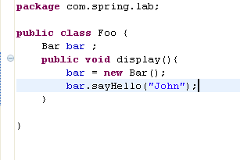
Dependency Injection
Situation
Assume any user creates an object of class Foo and calls the display method on it. Foo class creates an object of Bar class and calls the sayHello method.
Problem
Issue with this approach is Foo class not only have to perform its job of executing display method it also needs to maintain the lifecycle of Bar class object which is surely a break in OOP principle!!
Solution
This is the place where different IOC containers like Spring,PicoContainer or Guice comes into picture and handles the responsibilty of managing the lifecycle of objects and also takes care of object graph.
© 2011 Capgemini - All rights reserved

Slide 27
Dependency Injection
How to achieve Dependency Injection
Constructor-based dependency injection
Constructor-based DI is accomplished when the container invokes a class constructor with a number of arguments, each representing a dependency on other class.
Setter-based dependency injection.
Setter-based DI is accomplished by the container calling setter methods on your beans after invoking a no-argument constructor or no-argument static factory method to instantiate your bean.
© 2011 Capgemini - All rights reserved

Slide 28
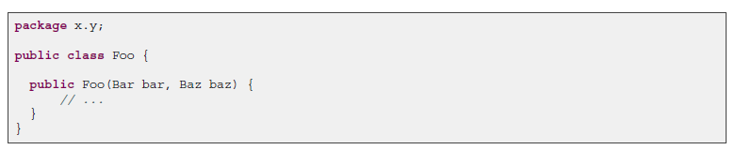
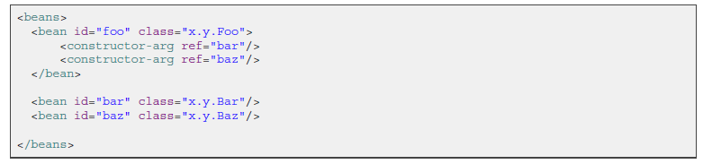
Constructor based Injection
Constructor-based DI
It is accomplished by the container invoking a constructor with a number of arguments, each representing a dependency. Calling a static factory method with specific arguments to construct the bean is nearly equivalent, and this discussion treats arguments to a constructor and to astatic factory method similarly. The following example shows a class that can only be dependency-injected with constructor injection. Notice that there is nothing special about this class, it is a POJO that has no dependencies on container specific interfaces, base classes or annotations.
© 2012 Capgemini - All rights reserved
Notes:
Ver 1.0 © 2006 Capgemini - All rights reserved

Slide 29

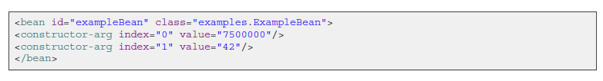
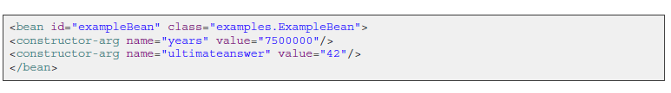
Other variations of constructor based DI
Constructor argument type matching
Constructor argument index
Constructor argument name
© 2012 Capgemini - All rights reserved

Slide 30
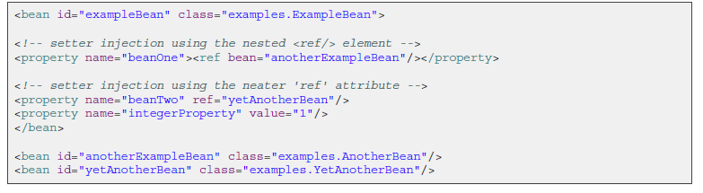
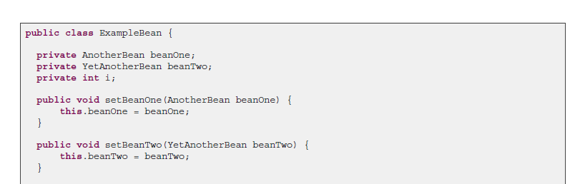
Setter based Injection
© 2012 Capgemini - All rights reserved
Notes:
Ver 1.0 © 2006 Capgemini - All rights reserved

Slide 31
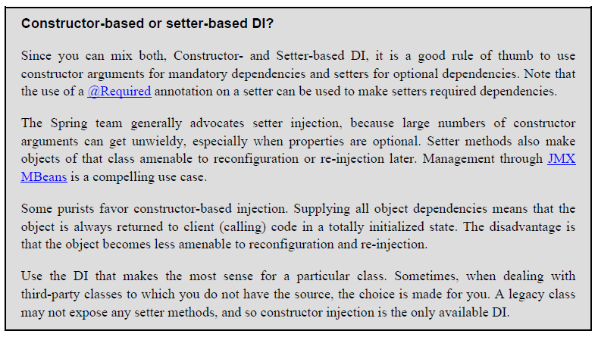
Setter/Constructor based Injection
© 2012 Capgemini - All rights reserved
Notes:
Ver 1.0 © 2006 Capgemini - All rights reserved

Slide 32
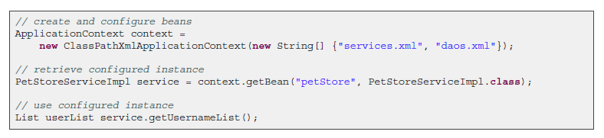
Instantiating a container
Instantiating a Spring IoC container is straightforward. The location path or paths supplied to an ApplicationContext constructor are actually resource strings that allow the container to load configuration metadata from a variety of external resources such as the local file system, from the Java CLASSPATH, and so on.
© 2012 Capgemini - All rights reserved
Notes:
Ver 1.0 © 2006 Capgemini - All rights reserved

Slide 33
Dependency resolution process
The container performs bean dependency resolution as follows:
1. The ApplicationContext is created and initialized with configuration metadata that describes all
the beans. Configuration metadata can be specified via XML, Java code or annotations.
2. For each bean, its dependencies are expressed in the form of properties, constructor arguments, or
arguments to the static-factory method if you are using that instead of a normal constructor. These
dependencies are provided to the bean, when the bean is actually created.
3. Each property or constructor argument is an actual definition of the value to set, or a reference to
another bean in the container.
4. Each property or constructor argument which is a value is converted from its specified format to the
actual type of that property or constructor argument. By default Spring can convert a value supplied in
string format to all built-in types, such as int, long, String, boolean, etc.
The Spring container validates the configuration of each bean as the container is created, including the
validation of whether bean reference properties refer to valid beans. However, the bean properties
themselves are not set until the bean is actually created. Beans that are singleton-scoped and set to be
pre-instantiated (the default) are created when the container is created. Scopes are defined in “Bean scopes” Otherwise, the bean is created only when it is requested. Creation of a bean potentially
causes a graph of beans to be created, as the bean's dependencies and its dependencies' dependencies (and so on) are created and assigned.
© 2012 Capgemini - All rights reserved

Slide 34
Quiz
Questions
Define BeanFactory and ApplicationContext
Difference between Singleton and prototype bean
Explain Bean Life Cycle
Explain DI and how will you achieve the DI in Spring?
Discuss which DI is better constructor or setter.
© 2011 Capgemini - All rights reserved

Slide 35
Spring3 Web MVC Framework
The Model encapsulates the application data and in general they will consist of POJO.
The View is responsible for rendering the model data and in general it generates HTML output that the client's browser can interpret.
The Controller is responsible for processing user requests and building appropriate model and passes it to the view for rendering.
© 2007 Capgemini - All rights reserved
Notes:
The Spring web MVC framework provides model-view-controller architecture and ready components that can be used to develop flexible and loosely coupled web applications. The MVC pattern results in separating the different aspects of the application (input logic, business logic, and UI logic), while providing a loose coupling between these elements.
© 2006 Capgemini - All rights reserved

Slide 36
Features of Spring web MVC
Clear separation of roles.
Powerful and straightforward configuration of both framework and application classes as JavaBeans.
Adaptability, non-intrusiveness, and flexibility.
Reusable business code, no need for duplication.
Customizable binding and validation.
Customizable handler mapping and view resolution.
Flexible model transfer.
Customizable locale and theme resolution, support for JSPs with or without Spring tag library, support for JSTL, support for Velocity without the need for extra bridges, and so on.
A simple yet powerful JSP tag library known as the Spring tag library that provides support for features such as data binding and themes.
A JSP form tag library, introduced in Spring 2.0, that makes writing forms in JSP pages much easier.
Beans whose lifecycle is scoped to the current HTTP request or HTTP Session.
© 2011 Capgemini - All rights reserved

Slide 37
The Dispatcher Servlet
Dispatcher Servlet
(awaiting incoming HttpservletRequests)
WebApplicationContext
(containing controllers, view resolvers,
locale resolvers and
other web-related beans)
WebApplication
Context (s)
(contain middle – tier
Services, datasources,
Etcetera)
HandlerMapping
WebApplication
Context (s)
(contain middle – tier
Services, datasources,
Etcetera)
Controllers
WebApplication
Context (s)
(containing middle – tier
Services, datasources,
etcetera)
ViewResolver
Context hierarchy in Spring Web MVC
© 2011 Capgemini - All rights reserved
Notes:
ApplicationContext instances in Spring can be scoped. In the Web MVC framework, each DispatcherServlet has its own WebApplicationContext, which inherits all the beans already defined in the root WebApplicationContext. These inherited beans can be overridden in the servlet-specific scope, and you can define new scope-specific beans local to a given servlet instance.
© 2006 Capgemini - All rights reserved

Slide 38
The Dispatcher Servlet (Continue…)
Delegate
request
Handle
request
Incoming
request
Controller
Front
Controller
model
Create
model
Return
response
Delegate
rendering
of response
model
Return
control
Render
response
View
template
Servlet engine
(ex: Tomcat)
The requesting processing workflow in Spring Web MVC (high level)
© 2011 Capgemini - All rights reserved
Notes:
Spring's web MVC framework is, like many other web MVC frameworks, request-driven, designed around a central servlet that dispatches requests to controllers and offers other functionality that facilitates the development of web applications. Spring's DispatcherServlet however, does more than just
that. It is completely integrated with the Spring IoC container and as such allows you to use every other feature that Spring has. The request processing workflow of the Spring Web MVC DispatcherServlet is illustrated in the following diagram. The pattern-savvy reader will recognize that the DispatcherServlet is an expression of the “Front Controller” design pattern (this is a pattern that Spring Web MVC shares with many other leading web frameworks).
© 2006 Capgemini - All rights reserved

Slide 39
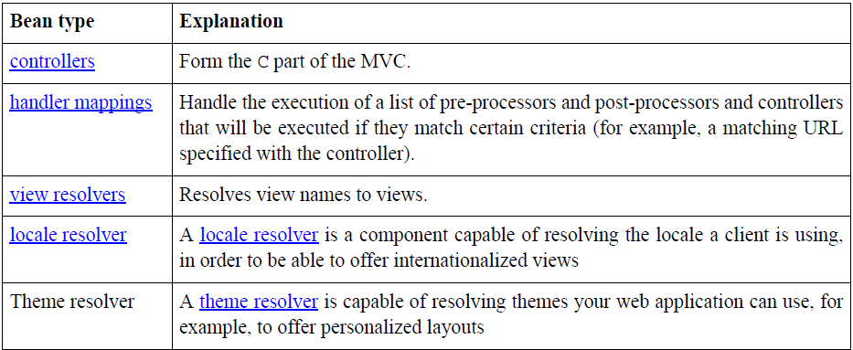
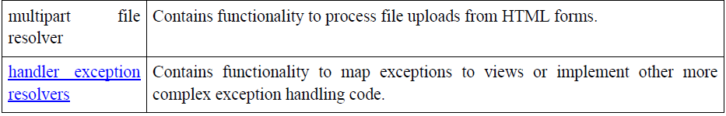
The Dispatcher Servlet (Continue…)
Special beans in the WebApplicationContext
© 2011 Capgemini - All rights reserved
Notes:
The Spring DispatcherServlet uses special beans to process requests and render the appropriate views. These beans are part of Spring Framework. You can configure them in the WebApplicationContext, just as you configure any other bean. However, for most beans, sensible defaults are provided so you initially do not need to configure them. These beans are described in the following table.
© 2006 Capgemini - All rights reserved

Slide 40
The Dispatcher Servlet (Continue…)
Following is the sequence of events corresponding to an incoming HTTP request to DispatcherServlet:
After recieving an HTTP request, DispatcherServlet consults the HandlerMapping to call the appropriate Controller.
The Controller takes the request and calls the appropriate service methods based on used GET or POST method. The service method will set model data based on defined business logic and returns view name to the DispatcherServlet.
The DispatcherServlet will take help from ViewResolver to pickup the defined view for the request.
Once view is finalized, The DispatcherServlet passes the model data to the view which is finally rendered on the browser.
© 2011 Capgemini - All rights reserved
Notes:
All the above mentioned components ie. HandlerMapping, Controller and ViewResolver are parts ofWebApplicationContext which is an extension of the plain ApplicationContext with some extra features necessary for web applications.
© 2006 Capgemini - All rights reserved

Slide 41
Required Configuration
<?xml version="1.0" encoding="UTF-8"?>
<web-app xmlns:xsi="http://www.w3.org/2001/XMLSchema-instance" xmlns="http://java.sun.com/xml/ns/javaee" xmlns:web="http://java.sun.com/xml/ns/javaee/web-app_2_5.xsd" xsi:schemaLocation="http://java.sun.com/xml/ns/javaee http://java.sun.com/xml/ns/javaee/web-app_2_5.xsd" id="WebApp_ID" version="2.5">
<display-name>HelloWeb</display-name>
<welcome-file-list>
<welcome-file>index.jsp</welcome-file>
</welcome-file-list>
<servlet>
<servlet-name>springmvc</servlet-name>
<servlet-class>
org.springframework.web.servlet.DispatcherServlet
</servlet-class>
<load-on-startup>1</load-on-startup>
</servlet>
<servlet-mapping>
<servlet-name>springmvc</servlet-name>
<url-pattern>*.html</url-pattern>
</servlet-mapping>
</web-app>
© 2011 Capgemini - All rights reserved
Notes:
You need to map requests that you want the DispatcherServlet to handle, by using a URL mapping in the web.xml file. The following is an example to show declaration and mapping for springmvc DispatcherServlet example:
© 2006 Capgemini - All rights reserved

Slide 42
Resolving the Request
After you set up a DispatcherServlet, and a request comes in for that specific DispatcherServlet, the DispatcherServlet starts processing the request as follows:
The WebApplicationContext is searched for and bound in the request as an attribute that the controller and other elements in the process can use. It is bound by default under the key DispatcherServlet.WEB_APPLICATION_CONTEXT_ATTRIBUTE.
The locale resolver is bound to the request to enable elements in the process to resolve the locale to use when processing the request (rendering the view, preparing data, and so on). If you do not need locale resolving, you do not need it.
The theme resolver is bound to the request to let elements such as views determine which theme to use. If you do not use themes, you can ignore it.
If you specify a multipart file resolver, the request is inspected for multiparts; if multiparts are found, the request is wrapped in a MultipartHttpServletRequest for further processing by other elements in the process. (See the section called “Using the MultipartResolver” for further information about multipart handling).
An appropriate handler is searched for. If a handler is found, the execution chain associated with the handler (preprocessors, postprocessors, and controllers) is executed in order to prepare a model or rendering.
If a model is returned, the view is rendered. If no model is returned, (may be due to a preprocessor or postprocessor intercepting the request, perhaps for security reasons), no view is rendered, because the request could already have been fulfilled.
© 2011 Capgemini - All rights reserved

Slide 43
Required Configuration (Continue…)
<?xml version="1.0" encoding="UTF-8"?>
<beans xmlns="http://www.springframework.org/schema/beans"
xmlns:xsi="http://www.w3.org/2001/XMLSchema-instance"
xmlns:context="http://www.springframework.org/schema/context"
xsi:schemaLocation="http://www.springframework.org/schema/beans http://www.springframework.org/schema/beans/spring-beans-3.0.xsd
http://www.springframework.org/schema/context http://www.springframework.org/schema/context/spring-context-3.0.xsd">
<!-- It will load all the components from the package org.capgemini -->
<context:component-scan base-package="org.capgemini"/>
<bean id="viewResolver" class="org.springframework.web.servlet.view.UrlBasedViewResolver">
<property name="viewClass" value="org.springframework.web.servlet.view.JstlView"/>
<property name="prefix" value="/WEB-INF/jsp/"/>
<property name="suffix" value=".jsp"/>
</bean>
</beans>
© 2011 Capgemini - All rights reserved
Notes:
© 2006 Capgemini - All rights reserved

Slide 44
Defining the controller
@Controller
public class HelloWorldController {
@RequestMapping("/hello")
public ModelAndView sayHello()
{
String msg="Spring3 MVC, Hello World!!!!!";
return new ModelAndView("hello", "message", msg);
} }
(or)
@Controller
public class HelloWorldController {
@RequestMapping("/hello")
public ModelAndView sayHello()
{
ModelAndView mv=new ModelAndView();
mv.setViewName(“hello”);
mv.addObject("message", "Spring3 MVC, Hello World!!!!!“);
return mv;
} }
© 2011 Capgemini - All rights reserved
Notes:
Controllers provide access to the application behavior that you typically define through a service
interface. Controllers interpret user input and transform it into a model that is represented to the user by
the view. Spring implements a controller in a very abstract way, which enables you to create a wide
variety of controllers.
© 2006 Capgemini - All rights reserved

Slide 45
Defining the controller (continue…)
The @Controller annotation indicates that a particular class serves the role of a controller.
Spring does not require you to extend any controller base class or reference the Servlet API.
The dispatcher scans such annotated classes for mapped methods and detects @RequestMapping annotations
© 2011 Capgemini - All rights reserved
Notes:
You can define annotated controller beans explicitly, using a standard Spring bean definition in the dispatcher's context. However, the @Controller stereotype also allows for autodetection, aligned with Spring general support for detecting component classes in the classpath and auto-registering bean definitions for them.
© 2006 Capgemini - All rights reserved

Slide 46
@RequestMapping
@Controller
@RequestMapping("/appointments")
public class AppointmentsController {
private final AppointmentBook appointmentBook;
@Autowired
public AppointmentsController(AppointmentBook appointmentBook) {
this.appointmentBook = appointmentBook;
}
@RequestMapping(method = RequestMethod.GET)
public Map<String, Appointment> get() {
return appointmentBook.getAppointmentsForToday();
}
@RequestMapping(value="/{day}", method = RequestMethod.GET)
public Map<String, Appointment> getForDay(@PathVariable @DateTimeFormat(iso=ISO.DATE) Date day, Model model) return appointmentBook.getAppointmentsForDay(day);
} (continue…)
© 2011 Capgemini - All rights reserved
Notes:
You use the @RequestMapping annotation to map URLs such as /appointments onto an entire
class or a particular handler method. Typically the class-level annotation maps a specific request path (or
path pattern) onto a form controller, with additional method-level annotations narrowing the primary
mapping for a specific HTTP method request method ("GET"/"POST") or specific HTTP request
parameters.
© 2006 Capgemini - All rights reserved

Slide 47
@RequestMapping (continue…)
@RequestMapping(value="/new", method = RequestMethod.GET)
public AppointmentForm getNewForm() {
return new AppointmentForm();
}
@RequestMapping(method = RequestMethod.POST)
public String add(@Valid AppointmentForm appointment, BindingResult result) {
if (result.hasErrors()) {
return "appointments/new";
}
appointmentBook.addAppointment(appointment);
return "redirect:/appointments";
}
}
© 2011 Capgemini - All rights reserved

Slide 48
@RequestMapping (continue…)
The first usage of @RequestMapping is on the type (class) level, which indicates that all handling methods on this controller are relative to the /appointments path.
The get() method has a further @RequestMapping refinement: it only accepts GET requests, meaning that an HTTP GET for /appointments invokes this method.
The post() has a similar refinement, and the getNewForm() combines the definition of HTTP method and path into one, so that GET requests for appointments/new are handled by that method.
The getForDay() method shows another usage of @RequestMapping: URI templates.
Use the @PathVariable method parameter annotation to indicate that a method parameter should be
bound to the value of a URI template variable.
© 2011 Capgemini - All rights reserved

Slide 49
Creating JSP views
<html>
<head>
<title>Hello Spring MVC</title>
</head>
<body>
<h2>${message}</h2>
</body>
</html>
Here ${message} is the attribute which we have setup inside the Controller. You can have multiple attributes to be displayed inside your view.
© 2011 Capgemini - All rights reserved
Notes:
Spring MVC supports many types of views for different presentation technologies. These include - JSPs, HTML, PDF, Excel worksheets, XML, Velocity templates, XSLT, JSON, Atom and RSS feeds, JasperReports etc. But most commonly we use JSP templates written with JSTL. So let us write a simple hello view in /WEB-INF/hello/hello.jsp:
© 2006 Capgemini - All rights reserved

Slide 50
Resolving views
The two interfaces that are important to the way Spring
handles views are ViewResolver and View.
The ViewResolver provides a mapping between view names and actual views.
The View interface addresses the preparation of the request and hands the request over to one of the view technologies.
© 2011 Capgemini - All rights reserved
Notes:
All MVC frameworks for web applications provide a way to address views. Spring provides view
resolvers, which enable you to render models in a browser without tying you to a specific view
technology. Out of the box, Spring enables you to use JSPs, Velocity templates and XSLT views, for
example.
© 2006 Capgemini - All rights reserved

Slide 51
Resolving views (continue…)
ViewResolver | Description
AbstractCachingViewResolver | Abstract view resolver that caches views. Often views need preparation before they can be used; extending this view resolver provides caching.
XmlViewResolver | Implementation of ViewResolver that accepts a configuration file written in XML with the same DTD as Spring's XML bean factories. The default configuration file is /WEB-INF/views.xml.
ResourceBundleViewResolver | Implementation of ViewResolver that uses bean definitions in a ResourceBundle, specified by the bundle base name. Typically you define the bundle in a properties file, located in the classpath. The default file name is views.properties.
ContentNegotiatingViewResolver | Implementation of the ViewResolver interface that resolves a view based on the request file name or Accept header.
© 2011 Capgemini - All rights reserved

Slide 52
Resolving views (continue…)
ViewResolver | Description
UrlBasedViewResolver | Simple implementation of the ViewResolver interface that effects the direct resolution of logical view names to URLs, without an explicit mapping definition. This is appropriate if your logical names match the names of your view resources in a straightforward manner, without the need for arbitrary mappings.
InternalResourceViewResolver | Convenient subclass of UrlBasedViewResolver that supports InternalResourceView (in effect, Servlets and JSPs) and subclasses such as JstlView and TilesView. You can specify the view class for all views generated by this resolver by using setViewClass(..).
VelocityViewResolver / FreeMarkerViewResolver | Convenient subclass of UrlBasedViewResolver that supports VelocityView (in effect, Velocity templates) or FreeMarkerView ,respectively, and custom subclasses of them.
© 2011 Capgemini - All rights reserved

Slide 53
Resolving views (continue…)
Changing ViewResolvers
<bean id="jspViewResolver" class="org.springframework.web.servlet.view.InternalResourceViewResolver">
<property name="viewClass" value="org.springframework.web.servlet.view.JstlView"/>
<property name="prefix" value="/WEB-INF/jsp/"/>
<property name="suffix" value=".jsp"/>
</bean>
<bean id="excelViewResolver" class="org.springframework.web.servlet.view.XmlViewResolver">
<property name="order" value="1"/>
<property name="location" value="/WEB-INF/views.xml"/>
</bean>
<!-- in views.xml -->
<beans>
<bean name="report" class="org.springframework.example.ReportExcelView"/>
</beans>
© 2011 Capgemini - All rights reserved
Notes:
Spring supports multiple view resolvers. Thus you can chain resolvers and, for example, override specific
views in certain circumstances. You chain view resolvers by adding more than one resolver to your
application context and, if necessary, by setting the order property to specify ordering. Remember, the
higher the order property, the later the view resolver is positioned in the chain.
© 2006 Capgemini - All rights reserved

Slide 54
Resolving views (continue…)
Redirecting to views
The RedirectView issues an HttpServletResponse.sendRedirect() call that returns to the client browser as an HTTP redirect. All model attributes are exposed as HTTP query parameters. This means that the model must contain only objects (generally Strings or objects converted to a String representation), which can be readily converted to a textual HTTP query parameter.
    The redirect: prefix
    The forward: prefix
© 2011 Capgemini - All rights reserved
Notes:
As mentioned previously, a controller typically returns a logical view name, which a view resolver resolves to a particular view technology. For view technologies such as JSPs that are processed through the Servlet or JSP engine, this resolution is usually handled through the combination of
InternalResourceViewResolver and InternalResourceView, which issues an internal forward or include via the Servlet API's RequestDispatcher.forward(..) method or RequestDispatcher.include() method. For other view technologies, such as Velocity, XSLT, and so on, the view itself writes the content directly to the response stream.
© 2006 Capgemini - All rights reserved

Slide 55
Resolving views (continue…)
The redirect: prefix
The special redirect: prefix allows you to accomplish this. If a view name is returned that has the prefix redirect:, the UrlBasedViewResolver (and all subclasses) will recognize this as a special indication that a redirect is needed. The rest of the view name will be treated as the redirect URL.
The forward: prefix
It is also possible to use a special forward: prefix for view names that are ultimately resolved by UrlBasedViewResolver and subclasses. This creates an InternalResourceView (which ultimately does a RequestDispatcher.forward()) around the rest of the view name, which is considered a URL.
© 2011 Capgemini - All rights reserved

Slide 56
Handling Exception
Exception | HTTP Status Code
ConversionNotSupportedException | 500 (Internal Server Error)
HttpMediaTypeNotAcceptableException | 406 (Not Acceptable)
HttpMediaTypeNotSupportedException | 415 (Unsupported Media Type)
HttpMessageNotReadableException | 400 (Bad Request)
HttpMessageNotWritableException | 500 (Internal Server Error)
HttpRequestMethodNotSupportedException | 405(Method Not Allowed)
MissingServletRequestParameterException | 400(Bad Request)
NoSuchRequestHandlingMethodException | 404 (Not Found)
TypeMismatchException | 400 (Bad Request)
© 2011 Capgemini - All rights reserved

Slide 57
Handling Exception (continue…)
@ExceptionHandler
@Controller
public class SimpleController {
// other controller method omitted
@ExceptionHandler(IOException.class)
public String handleIOException(IOException ex, HttpServletRequest request) {
return ClassUtils.getShortName(ex.getClass());
}
}
© 2011 Capgemini - All rights reserved
Notes:
An alternative to the HandlerExceptionResolver interface is the @ExceptionHandler
annotation. You use the @ExceptionHandler method annotation within a controller to specify which
method is invoked when an exception of a specific type is thrown during the execution of controller
methods. For example:
© 2006 Capgemini - All rights reserved

Slide 58
Questions
Compare DispatcherServlet and FrontController.
Define the different way of handling @RequestMapping
How do you enable context component scan?
What is the purpose of ModelView class?
Discuss the ViewResolver in spring.
How will you handle the exception in Spring MVC. Give one example also.
Try to write a code to deal with the form input data. Accept the form details from one page and display that into the next page.
  Note:
  Design a simple form to accept the Employee details(empno,empname,salary,date of joining)
© 2011 Capgemini - All rights reserved

Slide 59
Spring JDBC Framework
While working with database using plain old JDBC, it becomes cumbersome to write unnecessary code to handle exceptions, opening and closing database connections etc.
Spring JDBC Framework takes care of all the low-level details starting from opening the connection, prepare and execute the SQL statement, process exceptions, handle transactions and finally close the connection.
We can just define connection parameters and specify the SQL statement to be executed and do the required work for each iteration while fetching data from the database.
Spring JDBC provides several approaches and correspondingly different classes to interface with the database.
One of the most popular approach which makes use of JdbcTemplateclass of the framework.
This is the central framework class that manages all the database communication and exception handling.
© 2011 Capgemini - All rights reserved

Slide 60
Spring JDBC Framework
JdbcTemplate Class
The JdbcTemplate class executes SQL queries, update statements and stored procedure calls, performs iteration over ResultSets and extraction of returned parameter values.
It also catches JDBC exceptions and translates them to the generic, more informative, exception hierarchy defined in the org.springframework.dao package.
Instances of the JdbcTemplate class are threadsafe once configured. So you can configure a single instance of a JdbcTemplate and then safely inject this shared reference into multiple DAOs.
A common practice when using the JdbcTemplate class is to configure a DataSource in your Spring configuration file, and then dependency-inject that shared DataSource bean into your DAO classes, and the JdbcTemplate is created in the setter for the DataSource.
© 2011 Capgemini - All rights reserved

Slide 61
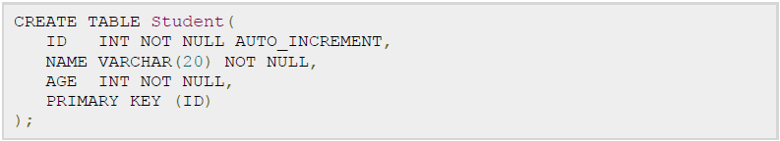
Spring JDBC Framework
Configuring Data Source
Let us create a database table Student in our database CAP.
© 2011 Capgemini - All rights reserved

Slide 62
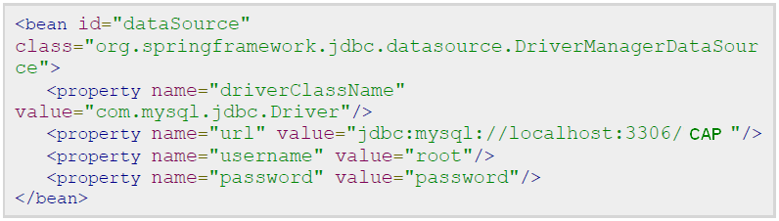
Spring JDBC Framework
we need to supply a DataSource to the JdbcTemplate so it can configure itself to get database access. You can configure the DataSource in the XML file with a piece of code as shown below:
© 2011 Capgemini - All rights reserved
Notes:
Refer Lab assignment 1.9 that shows a complete example of CRUD operations with JDBC.
© 2006 Capgemini - All rights reserved

Slide 63
Spring JDBC Framework
Data Access Object (DAO)
DAO stands for data access object which is commonly used for database interaction.
DAOs exist to provide a means to read and write data to the database and they should expose this functionality through an interface by which the rest of the application will access them.
The Data Access Object (DAO) support in Spring makes it easy to work with data access technologies like JDBC, Hibernate, JPA or JDO in a consistent way.
© 2011 Capgemini - All rights reserved

Slide 64
Spring JDBC Framework
Executing SQL statements
Let us see how we can perform CRUD (Create, Read, Update and Delete) operation on database tables using SQL and jdbcTemplate object.
Querying for an integer:
String SQL = "select count(*) from Student";
int rowCount = jdbcTemplateObject.queryForInt( SQL );
© 2011 Capgemini - All rights reserved

Slide 65
Spring JDBC Framework
Querying for a long:
String SQL = "select count(*) from Student";
long rowCount = jdbcTemplateObject.queryForLong( SQL );
A simple query using a bind variable:
String SQL = "select age from Student where id = ?";
int age = jdbcTemplateObject.queryForInt(SQL, new Object[]{10});
Querying for a String:
String SQL = "select name from Student where id = ?";
String name = jdbcTemplateObject.queryForObject(SQL, new Object[]{10}, String.class);
© 2011 Capgemini - All rights reserved

Slide 66
Spring JDBC Framework
Querying and returning an object:
String SQL = "select * from Student where id = ?";
Student student = jdbcTemplateObject.queryForObject(SQL,
new Object[]{10}, new StudentMapper());
public class StudentMapper implements RowMapper<Student> {
public Student mapRow(ResultSet rs, int rowNum) throws SQLException {
Student student = new Student();
student.setID(rs.getInt("id"));
student.setName(rs.getString("name"));
student.setAge(rs.getInt("age"));
return student;
}
}
© 2011 Capgemini - All rights reserved

Slide 67
Spring JDBC Framework
Querying and returning multiple objects:
String SQL = "select * from Student";
List<Student> students = jdbcTemplateObject.query(SQL,
new StudentMapper());
public class StudentMapper implements RowMapper<Student> {
public Student mapRow(ResultSet rs, int rowNum) throws SQLException {
Student student = new Student();
student.setID(rs.getInt("id"));
student.setName(rs.getString("name"));
student.setAge(rs.getInt("age"));
return student;
}
}
© 2011 Capgemini - All rights reserved

Slide 68
Spring JDBC Framework
Inserting a row into the table:
String SQL = "insert into Student (name, age) values (?, ?)";
jdbcTemplateObject.update( SQL, new Object[]{"Zara", 11} );
Updating a row into the table:
String SQL = "update Student set name = ? where id = ?";
jdbcTemplateObject.update( SQL, new Object[]{"Zara", 10} );
Deleting a row from the table:
String SQL = "delete Student where id = ?";
jdbcTemplateObject.update( SQL, new Object[]{20} );
© 2011 Capgemini - All rights reserved

Slide 69
Spring JDBC Framework
Executing DDL Statements
You can use the execute(..) method from jdbcTemplate to execute any SQL statements or DDL statements. Following is an example to use CREATE statement to create a table:
    String SQL = "CREATE TABLE Student( " +
    "ID INT NOT NULL AUTO_INCREMENT, " +
    "NAME VARCHAR(20) NOT NULL, " +
    "AGE INT NOT NULL, " +
    "PRIMARY KEY (ID)); "
    jdbcTemplateObject.execute( SQL );
© 2011 Capgemini - All rights reserved

Slide 70
Spring JDBC Framework
SQL Stored Procedure in Spring
The SimpleJdbcCall class can be used to call a stored procedure with IN and OUT parameters. You can use this approach while working with either of the RDBMS like Apache Derby, DB2, MySQL, Microsoft SQL Server, Oracle, and Sybase.
To understand the approach let us take our Student table which can be created in MySQL TEST database with the following DDL:
      CREATE TABLE Student(
      ID INT NOT NULL AUTO_INCREMENT,
      NAME VARCHAR(20) NOT NULL,
      AGE INT NOT NULL,
      PRIMARY KEY (ID)
      );
© 2011 Capgemini - All rights reserved
Notes:
Refer Lab Assignment 1.10 that guides you how to call the stored procedures.
© 2006 Capgemini - All rights reserved

Slide 71
Spring JDBC Framework
      Consider the following code block. It contains both IN and OUT parameters.
      DELIMITER $$
      DROP PROCEDURE IF EXISTS `CAP`.`getRecord` $$
      CREATE PROCEDURE `CAP`.`getRecord` (
      IN in_id INTEGER,
      OUT out_name VARCHAR(20),
      OUT out_age INTEGER)
      BEGIN
      SELECT name, age
      INTO out_name, out_age
      FROM Student where id = in_id;
      END $$
      DELIMITER ;
© 2011 Capgemini - All rights reserved

Slide 72
Spring JDBC Framework
Following is the implementation class file StudentJDBCTemplate.java for the defined DAO interface StudentDAO:
public class StudentJDBCTemplate implements StudentDAO {
private DataSource dataSource;
private SimpleJdbcCall jdbcCall;
public void setDataSource(DataSource dataSource) {
this.dataSource = dataSource;
this.jdbcCall = new SimpleJdbcCall(dataSource).
withProcedureName("getRecord");
}
© 2011 Capgemini - All rights reserved

Slide 73
Spring JDBC Framework
…..
//Specify the stored procedure parameters here.
public Student getStudent(Integer id) {
SqlParameterSource in = new MapSqlParameterSource().
addValue("in_id", id);
Map<String, Object> out = jdbcCall.execute(in);
Student student = new Student();
student.setId(id);
student.setName((String) out.get("out_name"));
student.setAge((Integer) out.get("out_age"));
return student;
}
….
…..
….
© 2011 Capgemini - All rights reserved
Notes:
Refer lab assignment 1.2 in lab amnual
© 2006 Capgemini - All rights reserved

Slide 74
Questions
What JDBC Framewrok?
How to configure the DataSource in xml file?
What is JDBC Template?
Give the code block to query the record from the database?
Explain about SimpleJDBCCall
© 2011 Capgemini - All rights reserved

Slide 75
Spring Transaction Management
A database transaction is a sequence of actions that are treated as a single unit of work. These actions should either complete entirely or take no effect at all. Transaction management is an important part of and RDBMS oriented enterprise applications to ensure data integrity and consistency.
© 2011 Capgemini - All rights reserved
Notes:
The concept of transactions can be described with following four key properties described as ACID:
© 2006 Capgemini - All rights reserved

Slide 76
Spring Transaction Management
Example for Transaction
Everything goes well
  Verify Seats
  Reserve Seats
  Receive payment
  Issue ticket
Purchase ticket
Something goes wrong
© 2011 Capgemini - All rights reserved
Notes:
© 2006 Capgemini - All rights reserved

Slide 77
Spring Transaction Management
ACID properties:
Atomicity: A transaction should be treated as a single unit of operation which means either the entire sequence of operations is successful or unsuccessful.
Consistency: This represents the consistency of the referential integrity of the database, unique primary keys in tables etc.
Isolation: There may be many transactions processing with the same data set at the same time, each transaction should be isolated from others to prevent data corruption.
Durability: Once a transaction has completed, the results of this transaction have to be made permanent and cannot be erased from the database due to system failure.
© 2011 Capgemini - All rights reserved

Slide 78
Spring Transaction Management
A real RDBMS database system will guarantee all the four properties for each transaction. The simplistic view of a transaction issued to the database using SQL is as follows:
  Begin the transaction using begin transaction command.
  Perform various deleted, update or insert operations using SQL queries.
  If all the operation are successful then perform commit otherwise rollback all the operations.
© 2011 Capgemini - All rights reserved

Slide 79
Spring Transaction Management
Spring framework provides an abstract layer on top of different underlying transaction management APIs. The Spring's transaction support aims to provide an alternative to EJB transactions by adding transaction capabilities to POJOs. Spring supports both programmatic and declarative transaction management. EJBs requires an application server, but Spring transaction management can be implemented without a need of application server.
© 2011 Capgemini - All rights reserved

Slide 80
Spring Transaction Management
Local vs. Global Transactions
Local transactions are specific to a single transactional resource like a JDBC connection, whereas global transactions can span multiple transactional resources like transaction in a distributed system.
Local transaction management can be useful in a centralized computing environment where application components and resources are located at a single site, and transaction management only involves a local data manager running on a single machine. Local transactions are easier to be implemented.
© 2011 Capgemini - All rights reserved
Notes:
Global transaction management is required in a distributed computing environment where all the resources are distributed across multiple systems. In such a case transaction management needs to be done both at local and global levels. A distributed or a global transaction is executed across multiple systems, and its execution requires coordination between the global transaction management system and all the local data managers of all the involved systems.
© 2006 Capgemini - All rights reserved

Slide 81
Spring Transaction Management
Programmatic vs. Declarative
Spring supports two types of transaction management:
Programmatic transaction management: This means that you have manage the transaction with the help of programming. That gives you extreme flexibility, but it is difficult to maintain.
Declarative transaction management: This means you separate transaction management from the business code. You only use annotations or XML based configuration to manage the transactions.
© 2011 Capgemini - All rights reserved
Notes:
Declarative transaction management is preferable over programmatic transaction management though it is less flexible than programmatic transaction management, which allows you to control transactions through your code. But as a kind of crosscutting concern, declarative transaction management can be modularized with the AOP approach. Spring supports declarative transaction management through the Spring AOP framework.
© 2006 Capgemini - All rights reserved

Slide 82
Spring Transaction Management
Spring Transaction Abstractions
The key to the Spring transaction abstraction is defined by theorg.springframework.transaction.PlatformTransactionManager interface, which is as follows:
  public interface PlatformTransactionManager {
  TransactionStatus getTransaction(TransactionDefinition definition);
  throws TransactionException;
  void commit(TransactionStatus status) throws TransactionException;
  void rollback(TransactionStatus status) throws TransactionException;
  }
© 2011 Capgemini - All rights reserved

Slide 83
Spring Transaction Management
Description about the methods
Method | Description
TransactionStatus getTransaction(TransactionDefinition definition) | This method returns a currently active transaction or create a new one, according to the specified propagation behavior.
void commit(TransactionStatus status) | This method commits the given transaction, with regard to its status.
void rollback(TransactionStatus status) | This method performs a rollback of the given transaction.
© 2011 Capgemini - All rights reserved

Slide 84
Spring Transaction Management
The TransactionDefinition is the core interface of the transaction support in Spring and it is defined as below:
    public interface TransactionDefinition {
    int getPropagationBehavior();
    int getIsolationLevel();
    String getName();
    int getTimeout();
    boolean isReadOnly();
    }
© 2011 Capgemini - All rights reserved

Slide 85
Spring Transaction Management
Method | Description
int getPropagationBehavior() | This method returns the propagation behavior. Spring offers all of the transaction propagation options familiar from EJB CMT.
int getIsolationLevel() | This method returns the degree to which this transaction is isolated from the work of other transactions.
String getName() | This method returns the name of this transaction.
int getTimeout() | This method returns the time in seconds in which the transaction must complete.
boolean isReadOnly() | This method returns whether the transaction is read-only.
© 2011 Capgemini - All rights reserved

Slide 86
Spring Transaction Management
Following are the possible values for isolation level:
TransactionDefinition.ISOLATION_DEFAULT This is the default isolation level.
TransactionDefinition.ISOLATION_READ_COMMITTED Indicates that dirty reads are prevented; non-repeatable reads and phantom reads can occur.
TransactionDefinition.ISOLATION_READ_UNCOMMITTED Indicates that dirty reads, non-repeatable reads and phantom reads can occur.
TransactionDefinition.ISOLATION_REPEATABLE_READ Indicates that dirty reads and non-repeatable reads are prevented; phantom reads can occur.
TransactionDefinition.ISOLATION_SERIALIZABLE Indicates that dirty reads, non-repeatable reads and phantom reads are prevented.
© 2011 Capgemini - All rights reserved

Slide 87
Spring Transaction Management
Following are the possible values for propagation types:
TransactionDefinition.PROPAGATION_MANDATORY Support a current transaction; throw an exception if no current transaction exists.
TransactionDefinition.PROPAGATION_NESTED Execute within a nested transaction if a current transaction exists.
TransactionDefinition.PROPAGATION_NEVER Do not support a current transaction; throw an exception if a current transaction exists.
TransactionDefinition.PROPAGATION_NOT_SUPPORTED Do not support a current transaction; rather always execute non-transactionally.
TransactionDefinition.PROPAGATION_REQUIRED Support a current transaction; create a new one if none exists.
TransactionDefinition.PROPAGATION_REQUIRES_NEW Create a new transaction, suspending the current transaction if one exists.
TransactionDefinition.PROPAGATION_SUPPORTS Support a current transaction; execute non-transactionally if none exists.
TransactionDefinition.TIMEOUT_DEFAULT Use the default timeout of the underlying transaction system, or none if timeouts are not supported.
© 2011 Capgemini - All rights reserved

Slide 88
Spring Transaction Management
The TransactionStatus interface provides a simple way for transactional code to control transaction execution and query transaction status.
    public interface TransactionStatus extends SavepointManager {
    boolean isNewTransaction();
    boolean hasSavepoint();
    void setRollbackOnly();
    boolean isRollbackOnly();
    boolean isCompleted();
    }
© 2011 Capgemini - All rights reserved

Slide 89
Spring Transaction Management
Method | Description
boolean hasSavepoint() | This method returns whether this transaction internally carries a savepoint, that is, has been created as nested transaction based on a savepoint.
boolean isCompleted() | This method returns whether this transaction is completed, that is, whether it has already been committed or rolled back.
boolean isNewTransaction() | This method returns true in case the present transaction is new.
boolean isRollbackOnly() | This method returns whether the transaction has been marked as rollback-only.
void setRollbackOnly() | This method sets the transaction rollback-only
© 2011 Capgemini - All rights reserved

Slide 90
Spring Transaction Management
Programmatic Transaction Management
Programmatic transaction management approach allows you to manage the transaction with the help of programming in your source code. That gives you extreme flexibility, but it is difficult to maintain.
Before we begin, it is important to have at least two database tables on which we can perform various CRUD operations with the help of transactions. Let us take Student table, which can be created in MySQL CAP database with the following DDL:
© 2011 Capgemini - All rights reserved

Slide 91
Spring Transaction Management
    CREATE TABLE Student(
    ID INT NOT NULL AUTO_INCREMENT,
    NAME VARCHAR(20) NOT NULL,
    AGE INT NOT NULL,
    PRIMARY KEY (ID) );
Second table is Marks in which we will maintain marks for students based on years. Here SID is the foreign key for Student table.
    CREATE TABLE Marks(
    SID INT NOT NULL,
    MARKS INT NOT NULL,
    YEAR INT NOT NULL);
© 2011 Capgemini - All rights reserved

Slide 92
Spring Transaction Management
PlatformTransactionManager directly to implement programmatic approach to implement transactions.
To start a new transaction we need to have a instance of TransactionDefinition with the appropriate transaction attributes. For this example we will simply create an instance of DefaultTransactionDefinition to use the default transaction attributes.
Once the TransactionDefinition is created, we can start our transaction by calling getTransaction()method, which returns an instance of TransactionStatus.
The TransactionStatus objects helps in tracking the current status of the transaction and finally, if everything goes fine, you can use commit() method of PlatformTransactionManager to commit the transaction, otherwise you can use rollback() to rollback the complete operation.
© 2011 Capgemini - All rights reserved
Notes:
Now let us write our Spring JDBC application which will implement simple operations on Student and Marks tables. Let us have working Eclipse IDE in place and follow the following steps to create a Spring application:
© 2006 Capgemini - All rights reserved

Slide 93
Spring Transaction Management
Declarative Transaction Management
We use <tx:advice /> tag, which creates a transaction-handling advice and same time we define a pointcut that matches all methods we wish to make transactional and reference the transactional advice.
If a method name has been included in the transactional configuration then created advice will begin the transaction before calling the method.
Target method will be executed in a try / catch block.
If the method finishes normally, the AOP advice commits the transaction successfully otherwise it performs a rollback.
© 2011 Capgemini - All rights reserved
Notes:
Declarative transaction management approach allows you to manage the transaction with the help of configuration instead of hard coding in your source code. This means that you can separate transaction management from the business code. You only use annotations or XML based configuration to manage the transactions. The bean configuration will specify the methods to be transactional. Here are the steps associated with declarative transaction:
© 2006 Capgemini - All rights reserved

Slide 94
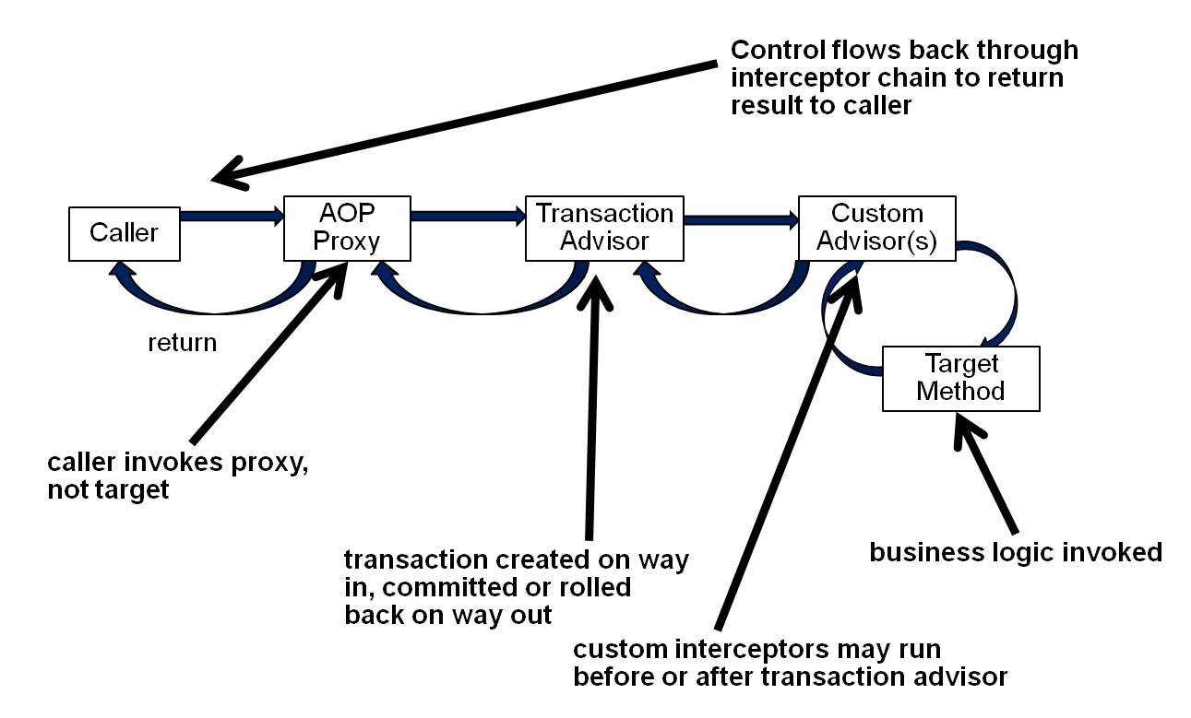
Spring Transaction Management
© 2011 Capgemini - All rights reserved

Slide 95
Spring Transaction Management
Let us see how above mentioned steps work but before we begin, it is important to have at least two database tables on which we can perform various CRUD operations with the help of transactions. Let us take Student table, which can be created in MySQL TEST database with the following DDL:
      CREATE TABLE Student(
      ID INT NOT NULL AUTO_INCREMENT,
      NAME VARCHAR(20) NOT NULL,
      AGE INT NOT NULL,
      PRIMARY KEY (ID) );
Second table is Marks in which we will maintain marks for students based on years. Here SID is the foreign key for Student table.
      CREATE TABLE Marks(
      SID INT NOT NULL,
      MARKS INT NOT NULL,
      YEAR INT NOT NULL);
© 2011 Capgemini - All rights reserved

Slide 96
Spring Transaction Management
Following is the configuration file Beans.xml:
<?xml version="1.0" encoding="UTF-8"?>
<beans xmlns="http://www.springframework.org/schema/beans"
xmlns:xsi="http://www.w3.org/2001/XMLSchema-instance"
xmlns:tx="http://www.springframework.org/schema/tx"
xmlns:aop="http://www.springframework.org/schema/aop"
xsi:schemaLocation="http://www.springframework.org/schema/beans
http://www.springframework.org/schema/beans/spring-beans-3.0.xsd
http://www.springframework.org/schema/tx
http://www.springframework.org/schema/tx/spring-tx-3.0.xsd
http://www.springframework.org/schema/aop
http://www.springframework.org/schema/aop/spring-aop-3.0.xsd">
<!-- Initialization for data source -->
© 2011 Capgemini - All rights reserved

Slide 97
Spring Transaction Management
<bean id="dataSource"
class="org.springframework.jdbc.datasource.DriverManagerDataSource">
<property name="driverClassName" value="com.mysql.jdbc.Driver"/>
<property name="url" value="jdbc:mysql://localhost:3306/CAP"/>
<property name="username" value="root"/>
<property name="password" value="cohondob"/>
</bean>
<tx:advice id="txAdvice" transaction-manager="transactionManager">
<tx:attributes>
<tx:method name="create"/>
</tx:attributes>
</tx:advice>
© 2011 Capgemini - All rights reserved

Slide 98
Spring Transaction Management
<aop:config>
<aop:pointcut id="createOperation"
expression="execution(* com.tutorialspoint.StudentJDBCTemplate.create(..))"/>
<aop:advisor advice-ref="txAdvice" pointcut-ref="createOperation"/>
</aop:config>
<!-- Initialization for TransactionManager -->
<bean id="transactionManager"
class="org.springframework.jdbc.datasource.DataSourceTransactionManager">
<property name="dataSource" ref="dataSource" />
</bean>
<!-- Definition for studentJDBCTemplate bean -->
<bean id="studentJDBCTemplate"
class="com.capgemini.StudentJDBCTemplate">
<property name="dataSource" ref="dataSource" />
</bean>
</beans>
© 2011 Capgemini - All rights reserved

Slide 99
Questions
Difference between programmatic and Declarative transaction.
Difference between Local Vs Global
Describe ACID properties
Discuss Transaction management used in EJB and Spring framework.
© 2011 Capgemini - All rights reserved

Slide 100
AOP in SpringFramework
Breaking down program logic into distinct parts called so-called concerns.
Cross-cutting concerns and these cross-cutting concerns are conceptually separate from the application's business logic.
Examples of aspects like logging, auditing, declarative transactions, security, and caching etc.
© 2011 Capgemini - All rights reserved
Notes:
The key unit of modularity in OOP is the class, whereas in AOP the unit of modularity is the aspect. Dependency Injection helps you decouple your application objects from each other and AOP helps you decouple cross-cutting concerns from the objects that they affect. AOP is like triggers in programming languages such as Perl, .NET, Java and others.
Spring AOP module provides interceptors to intercept an application, for example, when a method is executed, you can add extra functionality before or after the method execution.
© 2006 Capgemini - All rights reserved

Slide 101
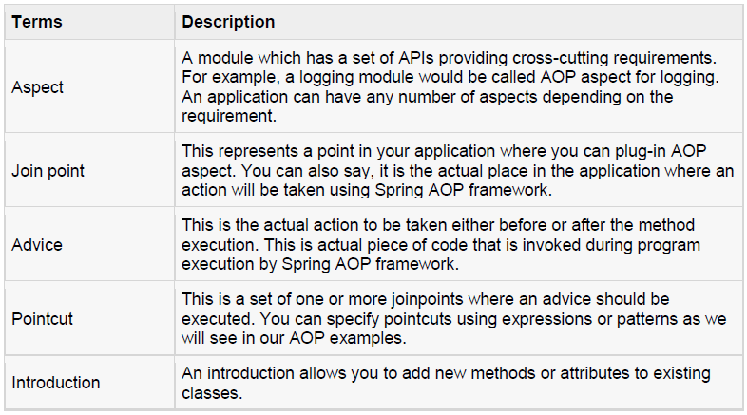
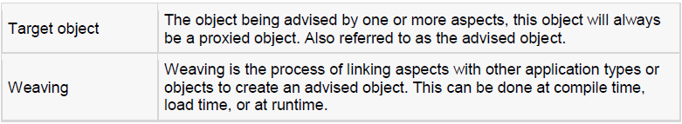
AOP Terminologies
© 2011 Capgemini - All rights reserved

Slide 102
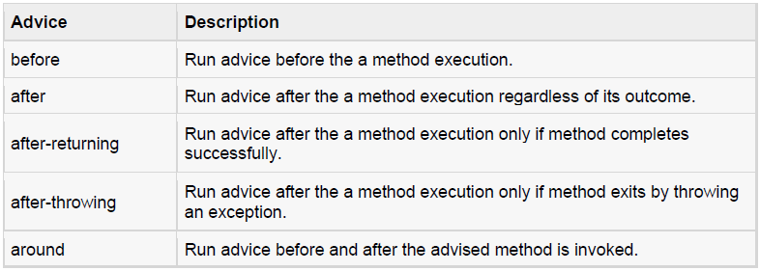
Types of Advice
Spring aspects can work with five kinds of advice mentioned below:
© 2011 Capgemini - All rights reserved
Notes:
Refer Lab 1.12 to implement different types of AOP.
© 2006 Capgemini - All rights reserved

Slide 103
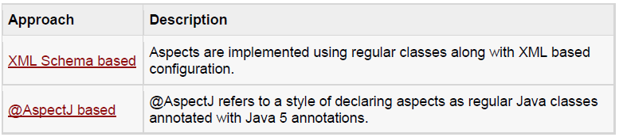
Custom Aspects Implementation
© 2011 Capgemini - All rights reserved
Notes:
Spring supports the @AspectJ annotation style approach and the schema-based approach to implement custom aspects. These two approaches have been explained in detail in the following two sub chapters
© 2006 Capgemini - All rights reserved

Slide 104
XML Schema Based AOP with Spring
We need to import the spring-aop schema as described below:
<?xml version="1.0" encoding="UTF-8"?>
<beans xmlns="http://www.springframework.org/schema/beans"
xmlns:xsi="http://www.w3.org/2001/XMLSchema-instance"
xmlns:aop="http://www.springframework.org/schema/aop"
xsi:schemaLocation="http://www.springframework.org/schema/beans
http://www.springframework.org/schema/beans/spring-beans-3.0.xsd
http://www.springframework.org/schema/aop
http://www.springframework.org/schema/aop/spring-aop-3.0.xsd ">
<!-- bean definition & AOP specific configuration -->
</beans>
© 2011 Capgemini - All rights reserved
Notes:
You will also need following AspectJ libraries on the CLASSPATH of your application. These libraries are available in the 'lib' directory of an AspectJ installation, otherwise you can download them from the internet.
• aspectjrt.jar
• aspectjweaver.jar
• aspectj.jar
© 2006 Capgemini - All rights reserved

Slide 105
Declaring an aspect
    An aspect is declared using the <aop:aspect> element, and the backing bean is referenced using the ref attribute as follows:
    <aop:config>
    <aop:aspect id="myAspect" ref="aBean">
    ...
    </aop:aspect>
    </aop:config>
    <bean id="aBean" class="...">
    ...
    </bean>
© 2011 Capgemini - All rights reserved
Notes:
Here "aBean" will be configured and dependency injected just like any other Spring bean as you have seen in previous chapters.
© 2006 Capgemini - All rights reserved

Slide 106
Declaring a pointcut
A pointcut helps in determining the join points (ie methods) of interest to be executed with different advices. While working with XML Schema based configuration, pointcut will be defined as follows:
      <aop:config>
      <aop:aspect id="myAspect" ref="aBean">
      <aop:pointcut id="businessService"
      expression="execution(* com.xyz.myapp.service.*.*(..))"/>
      ...
      </aop:aspect>
      </aop:config>
      <bean id="aBean" class="...">
      ...
      </bean>
© 2011 Capgemini - All rights reserved

Slide 107
Declaring a pointcut (continue…)
The example defines the pointcutnamed 'businessService' that will match the execution of getName() method available in Student class under the package org.capgemini.
    <aop:config>
    <aop:aspect id="myAspect" ref="aBean">
    <aop:pointcut id="businessService"
    expression="execution(* org.capgemini.Student.getName(..))"/>
    ...
    </aop:aspect>
    </aop:config>
    <bean id="aBean" class="...">
    …
    </bean>
© 2011 Capgemini - All rights reserved

Slide 108
@AspectJ Based AOP with Spring
@AspectJ refers to a style of declaring aspects as regular Java classes annotated with Java 5 annotations.
The @AspectJ support is enabled by including the following element inside your XML Schema-based configuration file.
<aop:aspectj-autoproxy/>
© 2011 Capgemini - All rights reserved
Notes:
You will also need following AspectJ libraries on the classpath of your application. These libraries are available in the 'lib' directory of an AspectJ installation, otherwise you can download them from the internet.
• aspectjrt.jar
• aspectjweaver.jar
• aspectj.jar
© 2006 Capgemini - All rights reserved

Slide 109
Declaring an aspect
Aspects classes are like any other normal bean and may have methods and fields just like any other class, except that they will be annotated with @Aspect as follows:
    package org.capgemini;
    import org.aspectj.lang.annotation.Aspect;
    @Aspect
    public class AspectModule {
    }
They will be configured in XML like any other bean as follows:
    <bean id="myAspect" class="org.capgemini.AspectModule">
    <!-- configure properties of aspect here as normal -->
    </bean>
© 2011 Capgemini - All rights reserved

Slide 110
Declaring a pointcut
A pointcut helps in determining the join points (ie methods) of interest to be executed with different advices. While working with @AspectJ based configuration, pointcut declaration has two parts:
  A pointcut expression that determines exactly which method executions we are interested in.
  A pointcut signature comprising a name and any number of parameters. The actual body of the method is irrelevant and in fact should be empty.
© 2011 Capgemini - All rights reserved

Slide 111
Declaring a pointcut (continue…)
Example
The following example defines a pointcut named 'businessService' that will match the execution of every method available in the classes under the package org.capgemini.myapp.service:
The following example defines a pointcut named 'getname' that will match the execution of getName() method available in Student class under the package org.capgemini:
    import org.aspectj.lang.annotation.Pointcut;
    @Pointcut("execution(* org.capgemini.myapp.service.*.*(..))") // expression
    private void businessService() {} // signature
    import org.aspectj.lang.annotation.Pointcut;
    @Pointcut("execution(* org.capgemini.Student.getName(..))")
    private void getname() {}
© 2011 Capgemini - All rights reserved
Notes:
© 2006 Capgemini - All rights reserved

Slide 112
Declaring advices
@Before("businessService()")
public void doBeforeTask(){
...
}
@After("businessService()")
public void doAfterTask(){
...
}
@AfterReturning(pointcut = "businessService()", returning="retVal")
public void doAfterReturnningTask(Object retVal){
// you can intercept retVal here.
...
}
@AfterThrowing(pointcut = "businessService()", throwing="ex")
public void doAfterThrowingTask(Exception ex){
// you can intercept thrown exception here.
...
}
@Around("businessService()")
public void doAroundTask(){ ... }
© 2011 Capgemini - All rights reserved
Notes:
You can define you pointcut inline for any of the advices. Below is an example to define inline pointcut for before advice:
@Before("execution(* org.capgemini.myapp.service.*.*(..))")
public doBeforeTask(){
...
}
© 2006 Capgemini - All rights reserved

Slide 113
Questions
Define AOP?
Discuss different types of Advices
Difference between XML schema based AOP and @AspectJ based AOP.
© 2011 Capgemini - All rights reserved

Slide 114
Recap
DI IOC
AOP Merits
Framework
Architecture
MVC
JDBC Transactions
© 2007 Capgemini - All rights reserved
Notes:
Recap – tips : To make it further lighter, many facilitator ask participant that they were allow to leave only if they will answer say 12 correct answers out of 15 questions. And then produce all recaps as questions.
© 2006 Capgemini - All rights reserved

Slide 115
Thank You For Your Time
Notes:
© 2006 Capgemini - All rights reserved

