Slide 1
Customer Segmentation Using Unsupervised Machine Learning
BALAGURUSAMY R Batch - Data Science Batch 303 Registration No: 3896
14June2025

Slide 2
Outline
Project Objective
Tools & Libraries Used
Dataset Overview
Data Preprocessing
Exploratory Data Analysis
Feature Engineering (Date split, encoding)
Standardization
TSNE Visualization
Elbow Method & Cluster Count
KMeans Segmentation Result
Business Insights & Conclusion

Slide 3
Project Objective
Goal: Segment customers into distinct groups using machine learning.
Use Case: Helps in targeted marketing and customer-specific strategy.
Approach: K-Means Clustering on demographic and behavioral data.

Slide 4
Tools & Libraries Used
Programming Language: Python
Libraries: pandas, numpy, matplotlib, seaborn
Machine Learning: scikit-learn (KMeans, LabelEncoder, TSNE, StandardScaler )

Slide 5
Dataset Overview
Source: CustomerSegmentation.csv
Initial Shape: Rows = X, Columns = Y (replace X, Y)
Sample Columns: Income, Marital_Status, MntWines, MntMeatProducts, Dt_Customer

Slide 6
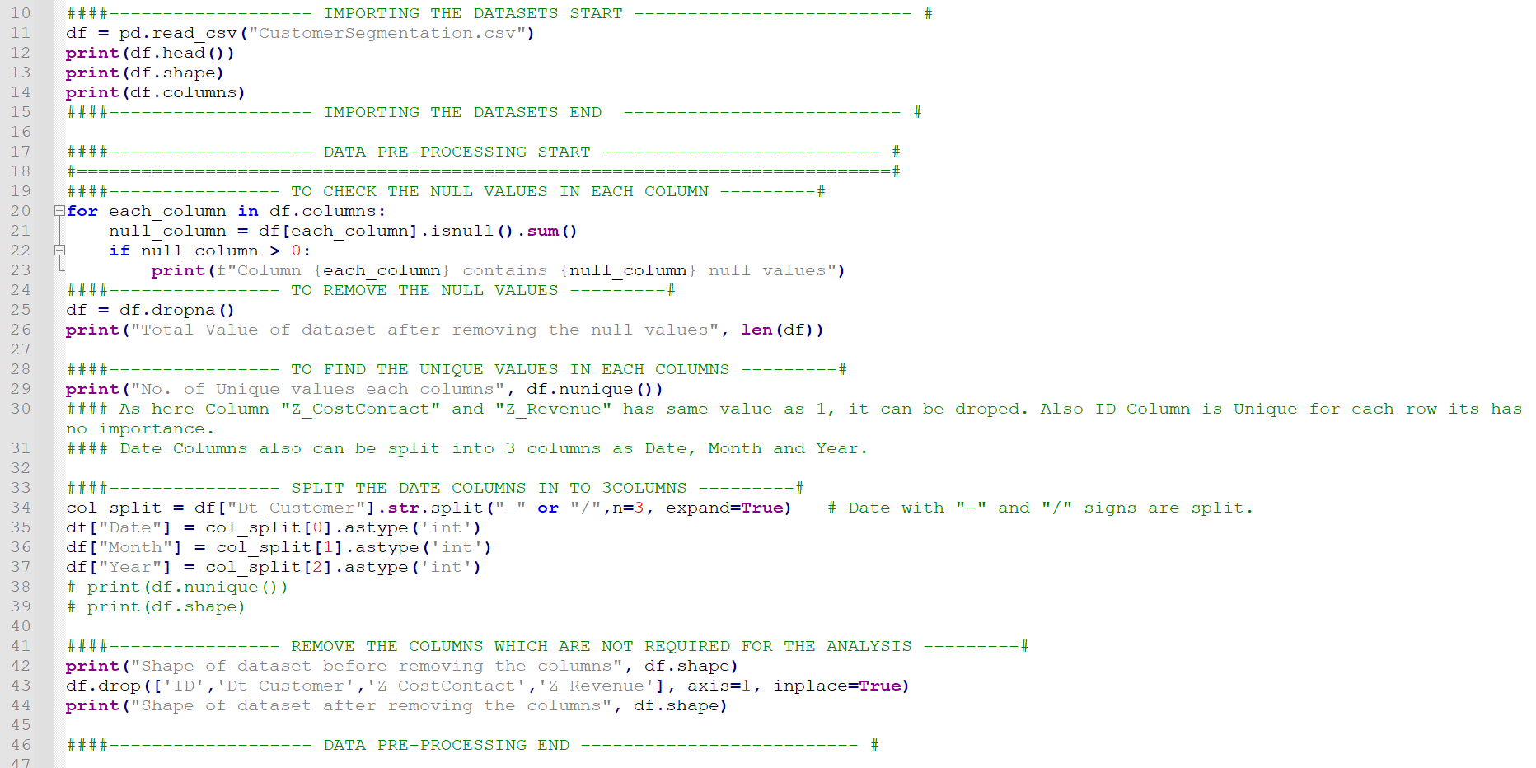
Dataset Preprocessing
Removed null values
Dropped columns: ID, Z_CostContact, Z_Revenue, Dt_Customer
Split Dt_Customer into Date, Month, Year
Encoded categorical columns using LabelEncoder

Slide 7
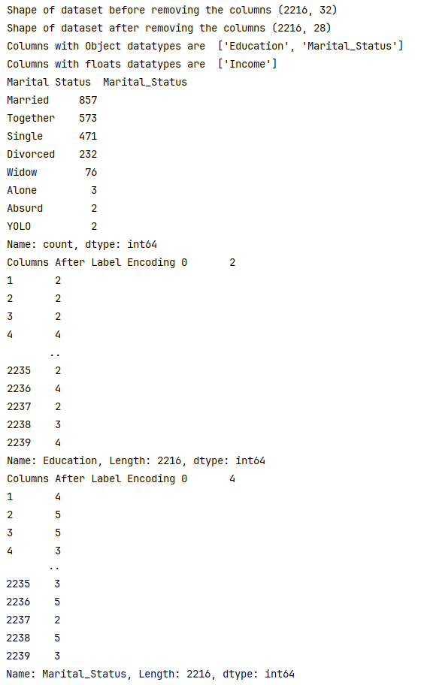
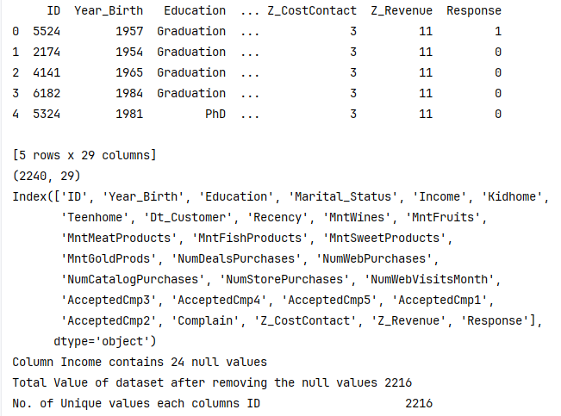
Dataset Preprocessing Outputs
Removed null values
Dropped columns: ID, Z_CostContact, Z_Revenue, Dt_Customer
Split Dt_Customer into Date, Month, Year
Encoded categorical columns using LabelEncoder

Slide 8
Dataset Preprocessing Outputs
Removed null values
Dropped columns: ID, Z_CostContact, Z_Revenue, Dt_Customer
Split Dt_Customer into Date, Month, Year
Encoded categorical columns using LabelEncoder

Slide 9
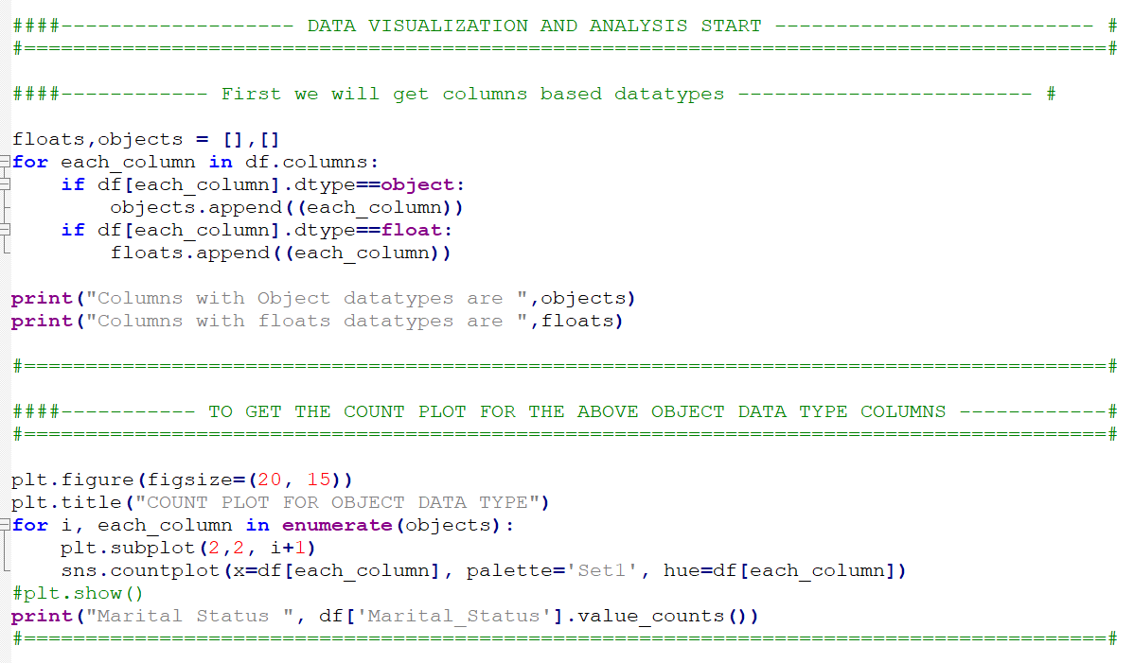
Exploratory Data Analysis
Visualized distributions using count plots
Example Insight: Marital Status and Education distribution

Slide 10
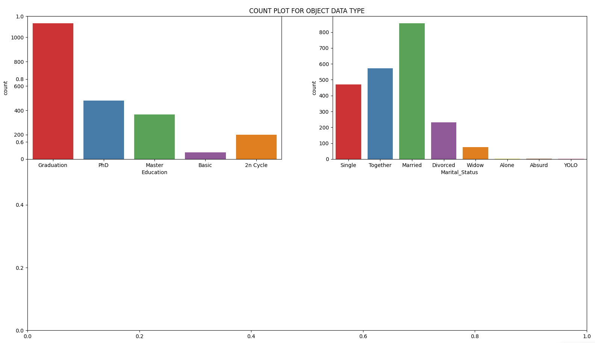
Exploratory Data Analysis - Output
Visualized distributions using count plots
Example Insight: Marital Status and Education distribution

Slide 11
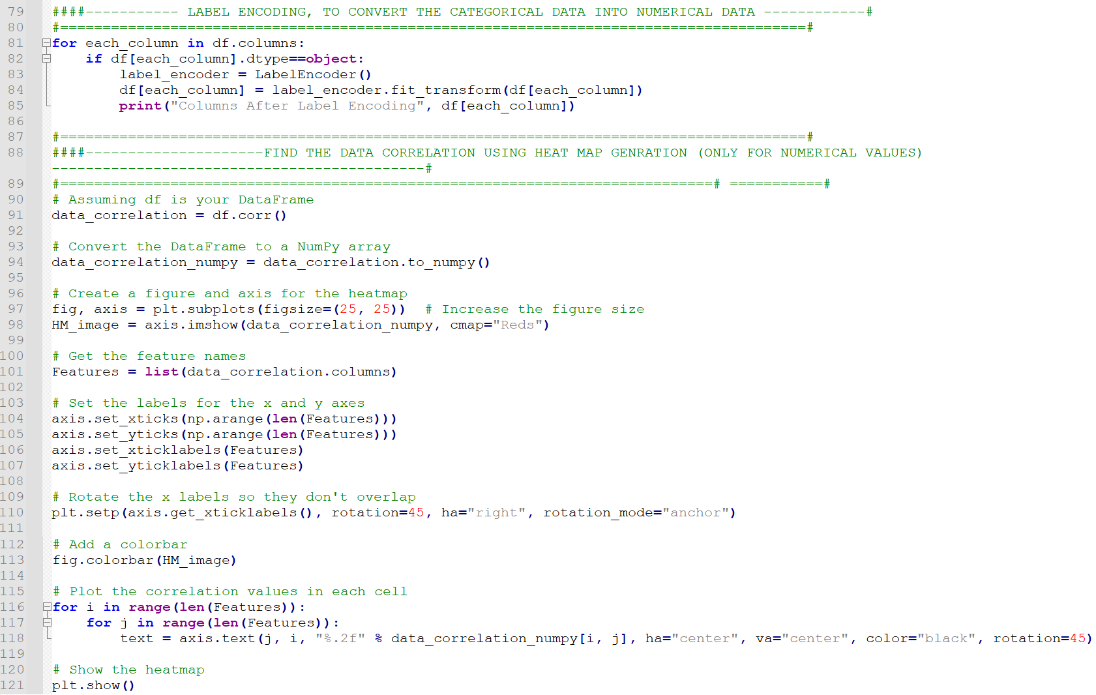
Exploratory Data Analysis
Label Encoding and Computed data correlations using heatmap

Slide 12
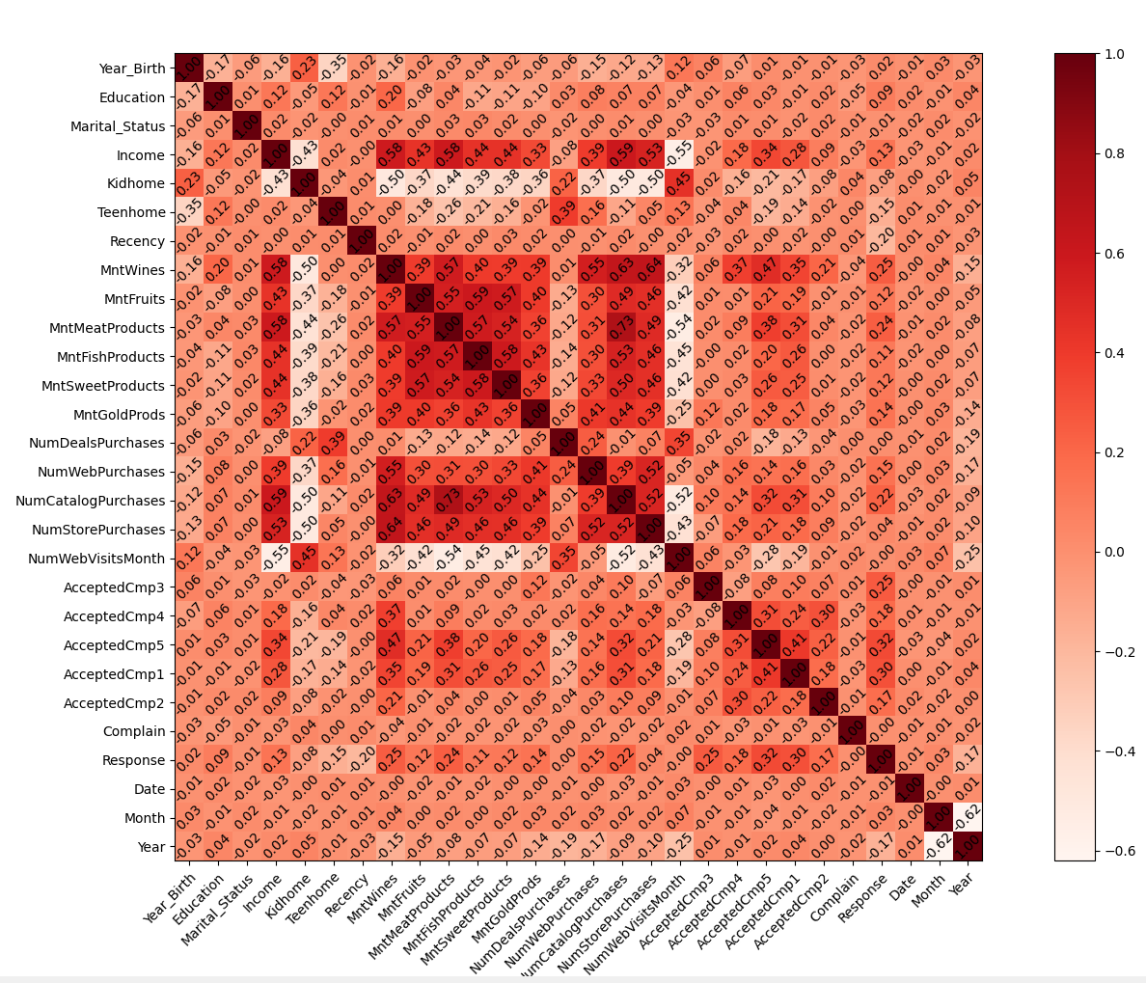
Exploratory Data Analysis - Output
Label Encoding and Computed data correlations using heatmap

Slide 13
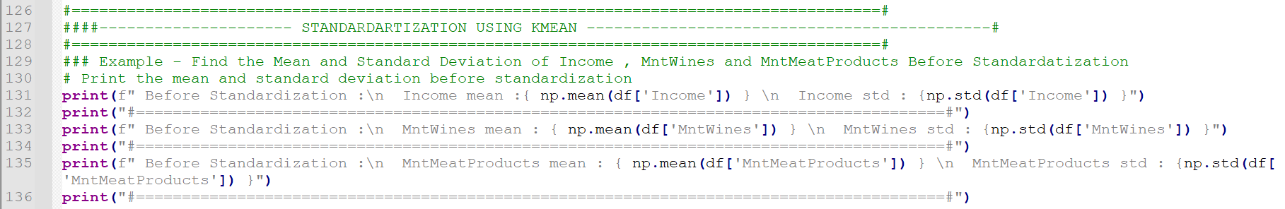
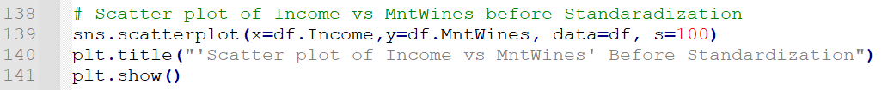
Standardization
Checked the values of mean and std deviation values of Income, MntWines, MntMeatProducts before standardization
Visualized scatter plots before standardization

Slide 14
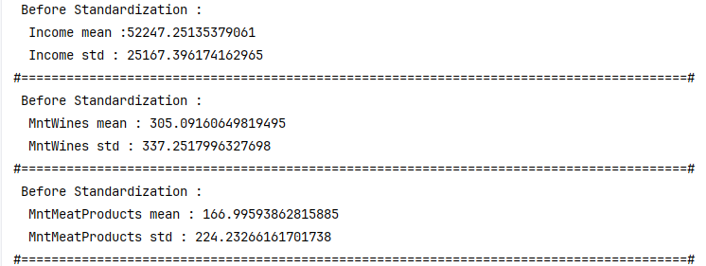
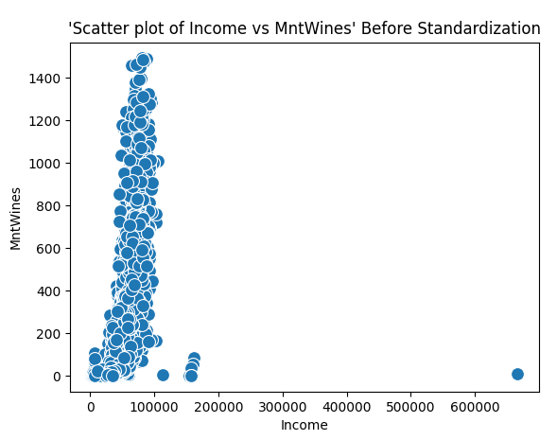
Standardization - Output
Output of Income, MntWines, MntMeatProducts values before standardization

Slide 15
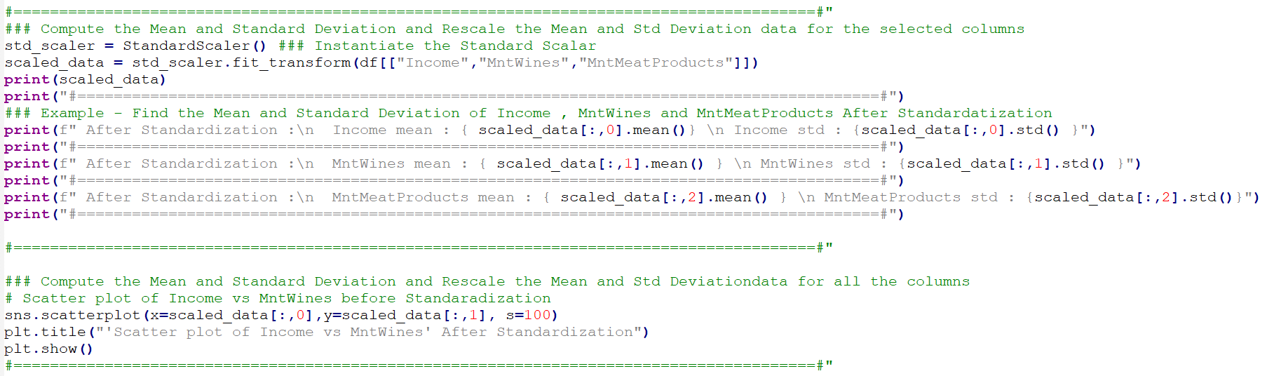
Standardization
Output of Income, MntWines, MntMeatProducts after standardization
Ensured features have 0 mean and unit variance
Visualized scatter plots after standardization

Slide 16
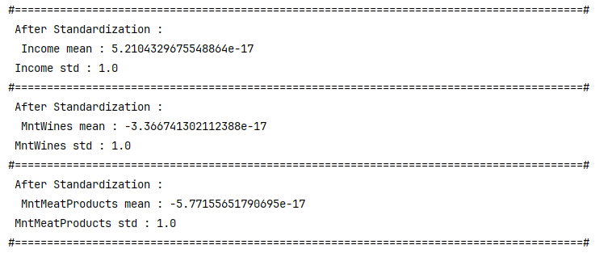
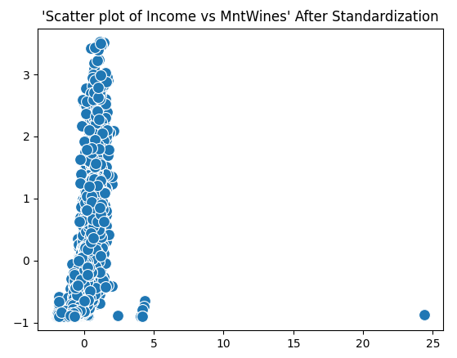
Standardization - Output
Output of Income, MntWines, MntMeatProducts after standardization
Ensured features have 0 mean and unit variance
Visualized scatter plots after standardization

Slide 17
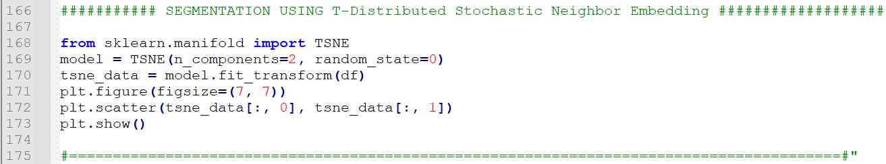
Dimensionality Reduction (TSNE)
Used T-SNE to reduce features to 2D
Helped visualize data clusters pre-segmentation

Slide 18
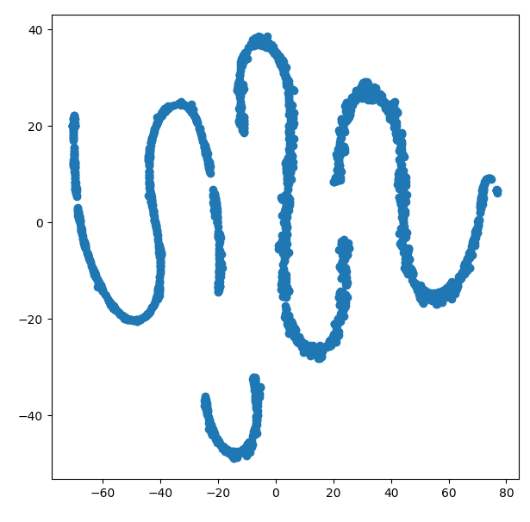
Dimensionality Reduction (TSNE) - Output
Used T-SNE to reduce features to 2D
Helped visualize data clusters pre-segmentation

Slide 19
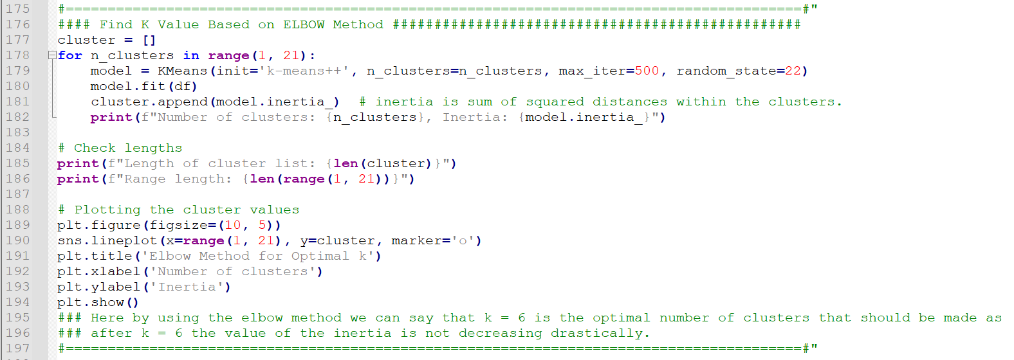
Optimal Number of Clusters (Elbow Method)
Used KMeans with inertia values from k=1 to 20
Elbow point observed at k = 6
Visualized inertia plot to identify optimal clusters

Slide 20
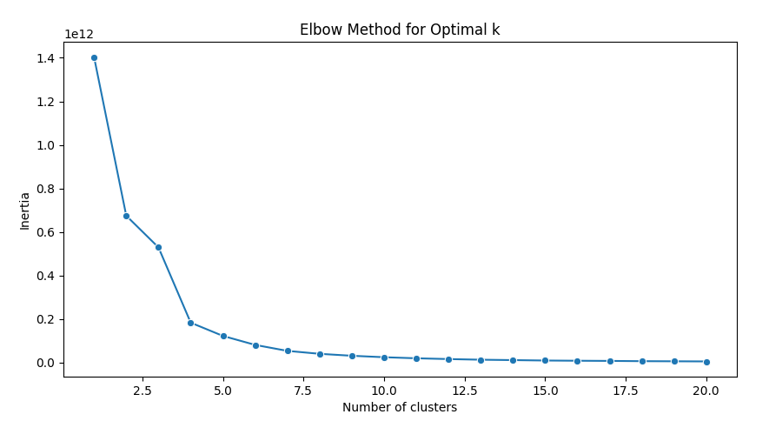
Optimal Number of Clusters (Elbow Method)
Used KMeans with inertia values from k=1 to 20
Elbow point observed at k = 6
Visualized inertia plot to identify optimal clusters

Slide 21
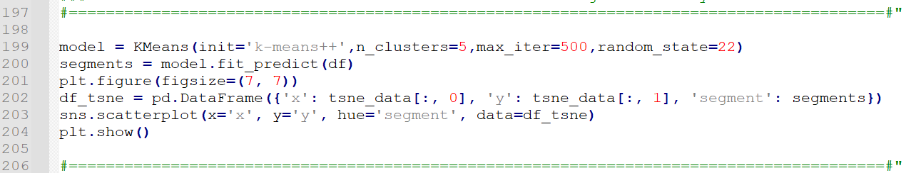
Customer Segmentation with KMeans
Final model: KMeans with 5 clusters
Visualized clustered customers using TSNE scatter plot
Plotted x, y values colored by segment

Slide 22
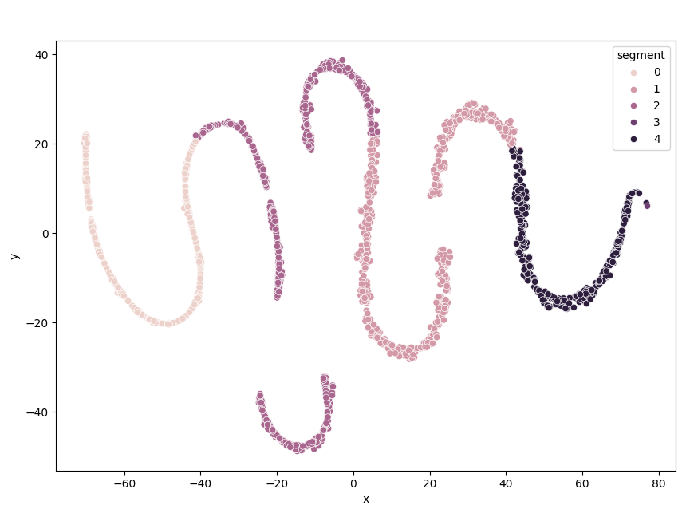
Customer Segmentation with Kmeans -Output
Final model: KMeans with 5 clusters
Visualized clustered customers using TSNE scatter plot
Plotted x, y values colored by segment

Slide 23
Business Insights and Conclusion
Each cluster represents a unique customer type
Use Cases: Personalized offers, Customer retention, Inventory planning
Clear customer segmentation achieved using unsupervised learning
Here we can see that we have divide customers into 5 clusters and based on these clusters we can target customers with same purchasing behaviour much better. We can give personalized ads and can make informed decision about business for better growth.

Slide 24
Thank you
BALAGURUSAMY R Batch - Data Science Batch 303 Registration No: 3896
balaguru4u@gmail.com
https://www.linkedin.com/in/balagurusamy-ramadass-686a464a/

