Slide 1
Login Page Project
HTML, CSS & JavaScript Combined
Presented by Vijayalakshmi

Slide 2
Project Introduction
• Simple Login Page Application
• Developed using HTML, CSS, and JavaScript
• Validates username and password
• Displays landing page after successful login

Slide 3
HTML Structure
• Created login form with username and password fields
• Sign In button to trigger login function
• Landing page section for successful login
• All content combined in a single HTML file

Slide 4
CSS Design
• Gradient background design
• Centered login container
• Styled input fields and buttons
• Hover effects for better user experience

Slide 5
JavaScript Functionality
• login() function checks username and password
• Valid credentials: admin / 1234
• Shows landing page on success
• logout() function returns to login page

Slide 6
How It Works
1. User enters username and password
2. Clicks Sign In
3. If correct → Welcome page shown
4. If incorrect → Error alert message

Slide 7
Conclusion
• Demonstrates basic front-end login system
• Combines HTML, CSS & JavaScript
• Beginner-friendly web development project
• Can be enhanced using database integration

Slide 8
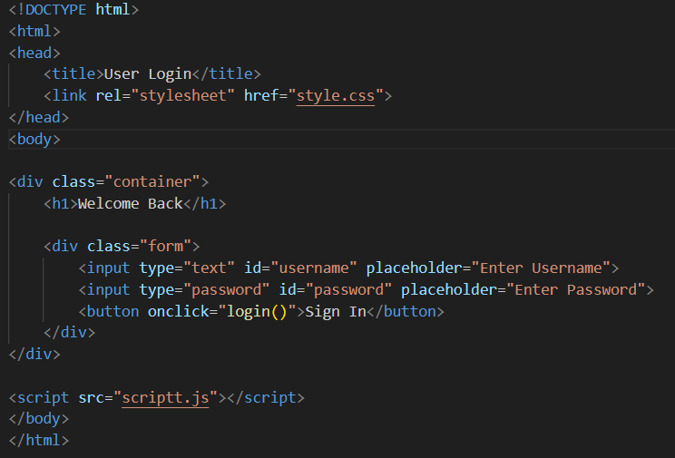
CODE :1

Slide 9
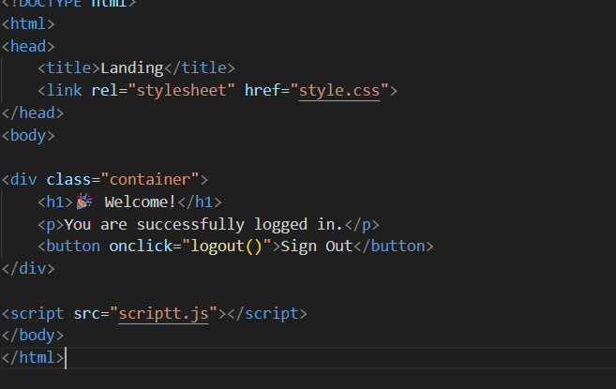
CODE :2

Slide 10
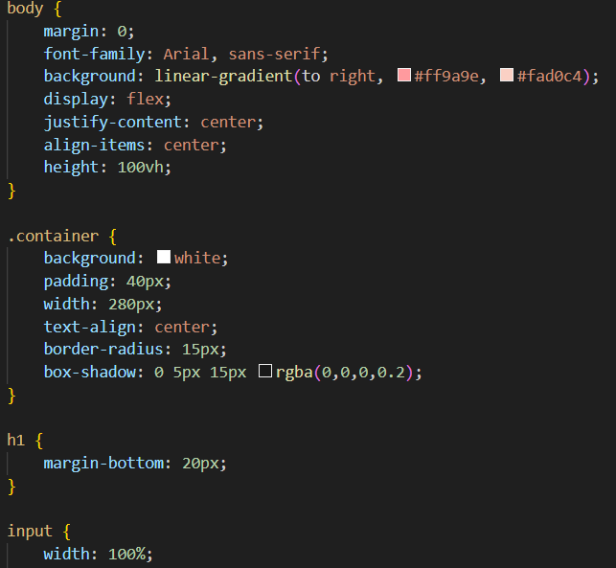
CODE :3

Slide 11
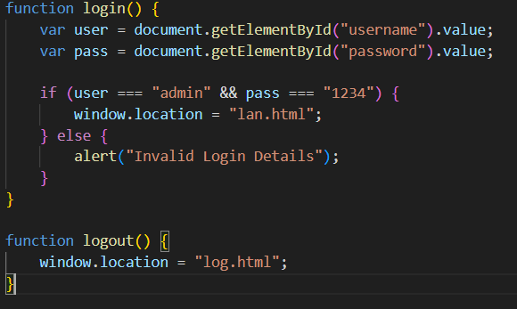
CODE :4

Slide 12
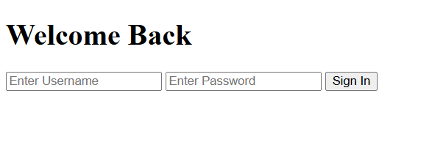
OUTPUT

