Slide 1



Insider Threat Intel System
AI-POWERED USER & ENTITY BEHAVIOR ANALYTICS (UEBA) PLATFORM

Slide 2



Technology Stack: Architecture Explained
Redis
PostgreSQL: Relational Audit & Logs Storage
React + Vite: Dynamic Threat Dashboard
FastAPI: High-Performance Async Backend
Redis: In-Memory Streaming & Cache
PostgreSQL stores user activity logs, entity baseline profiles, threat alert triggers, and historical risk scoring with full relational integrity.
React and Vite power modern, responsive threat monitoring user interfaces with interactive analytical charts and live risk indicators.
FastAPI delivers asynchronous request handling, Pydantic validation, and automatic OpenAPI documentation for low-latency security telemetry.
Redis enables high-speed session management, rapid risk score lookups, and real-time buffering of incoming user action events.

Slide 3

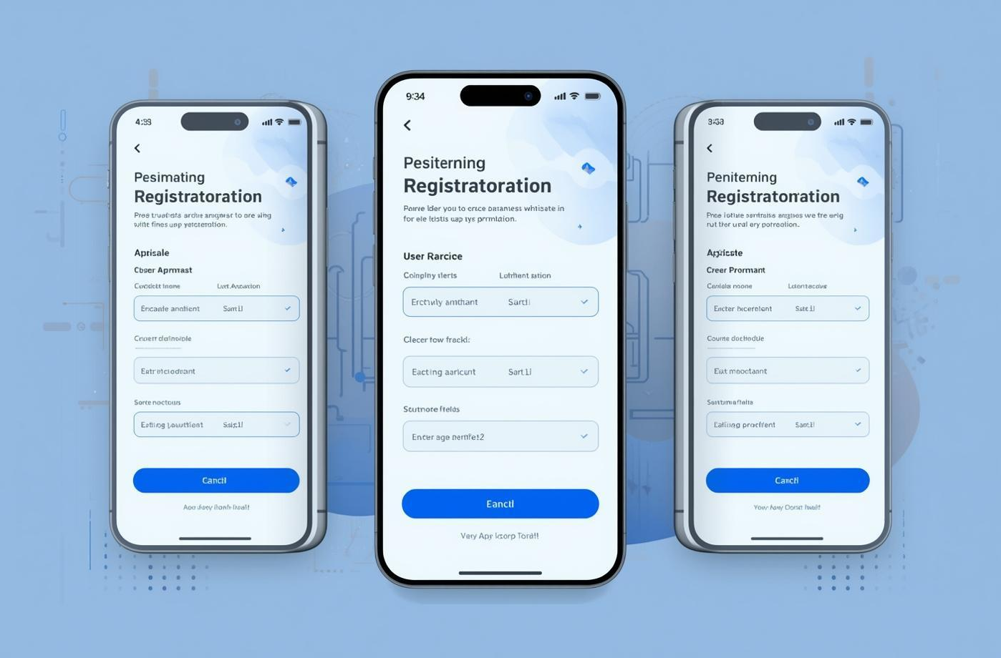

Core Features of Insider Threat Intel Platform
Real-Time Anomaly Detection
Dynamic User Risk Scoring
Automated Response Playbooks
Machine learning models (Isolation Forest, Z-score) detect off-hours access, volume spikes, and unusual location activities.
Continuous calculation of user risk scores (0–100), categorizing threats into Critical, High, Medium, and Low severity tiers.
Instant response playbooks trigger account lockouts, step-up MFA, IP blocking, and real-time alert notifications for SOC analysts.

Slide 4
Challenges Facing Enterprise Cybersecurity
1
2
High False Positive Rates
Silent Insider Threats
Security operation centers are overwhelmed by thousands of static rule alerts lacking context, causing analyst fatigue and missed incidents.
Traditional SIEM tools miss low-and-slow anomalous behavior from authenticated internal users, leaving critical blind spots in enterprise defenses.
3
4
Lack of Behavioral Baselines
Automated UEBA Protection
Without automated baseline profiling for individual users and department peer groups, detecting subtle behavioral deviations is nearly impossible.
Deploying an intelligent UEBA system enables continuous baseline tracking, contextual risk scoring, and automated threat mitigation.

Slide 5
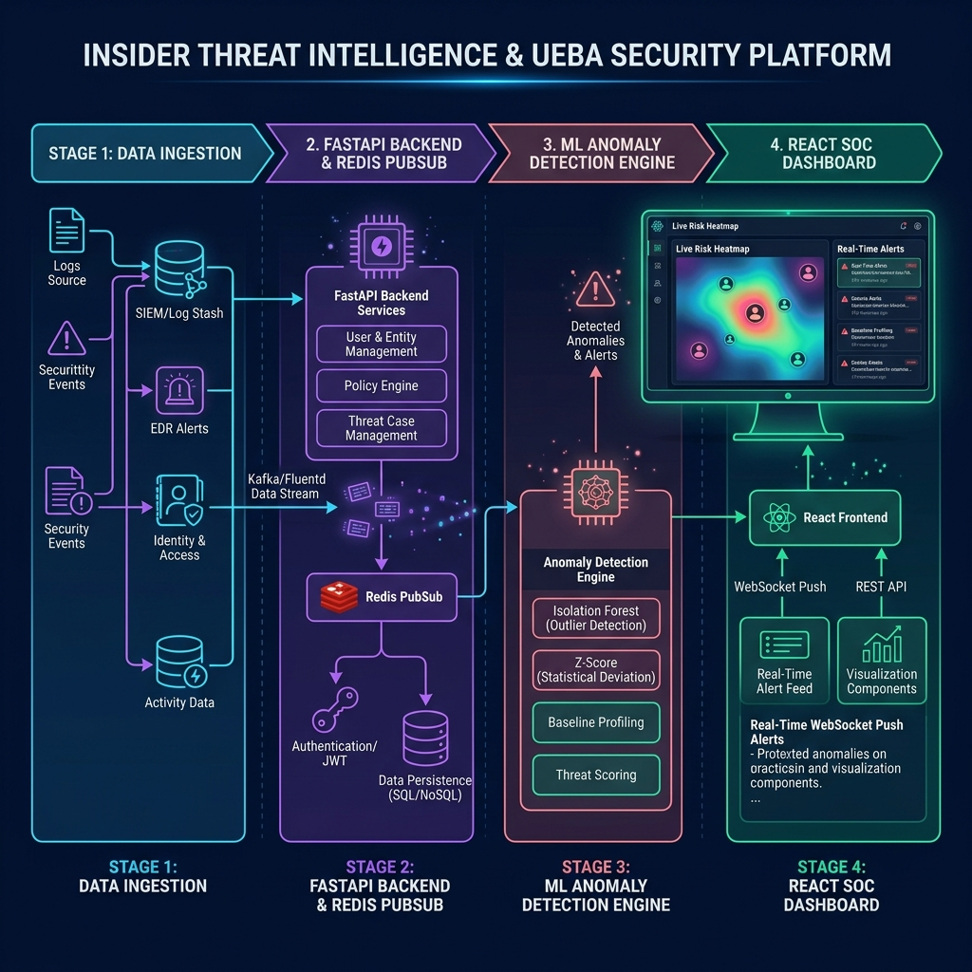
System Architecture Overview

Slide 6
Key Challenges & Engineering Solutions
1
2
Security & Compliance
Scalability & High Throughput
Implementing strict RBAC policies (Admin, Analyst, Auditor) and audit trails ensures regulatory compliance and zero unauthorized access.
Asynchronous log ingestion and Redis caching allow the platform to process 4,500+ security events continuously without system lag.
3
4
False Positive Minimization
Real-Time Incident Triage
Adaptive machine learning models evaluate user actions against 30-day historical behavior and peer group benchmarks to reduce false alarms.
Instant WebSocket push notifications and background execution loops ensure SOC teams receive high-severity threat alerts immediately.

Slide 7
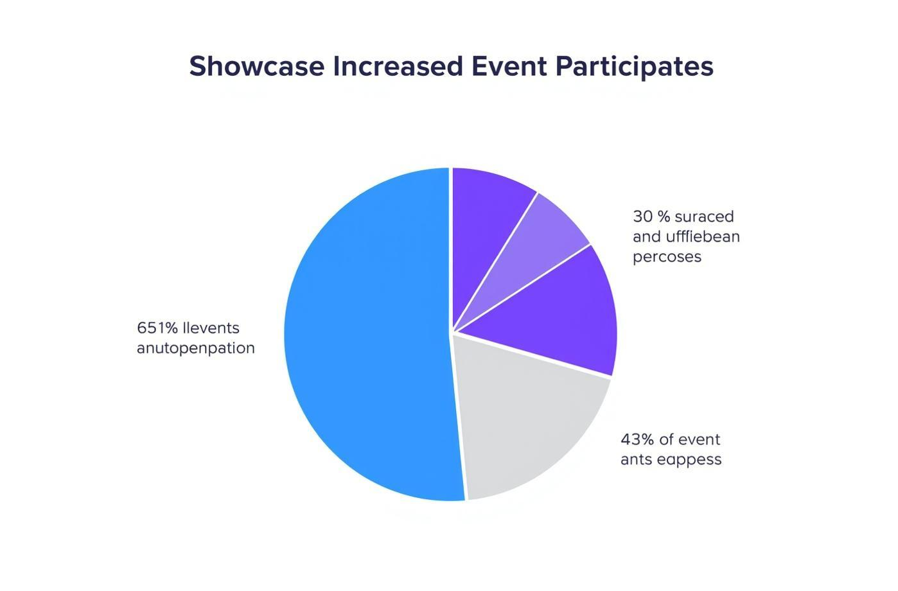
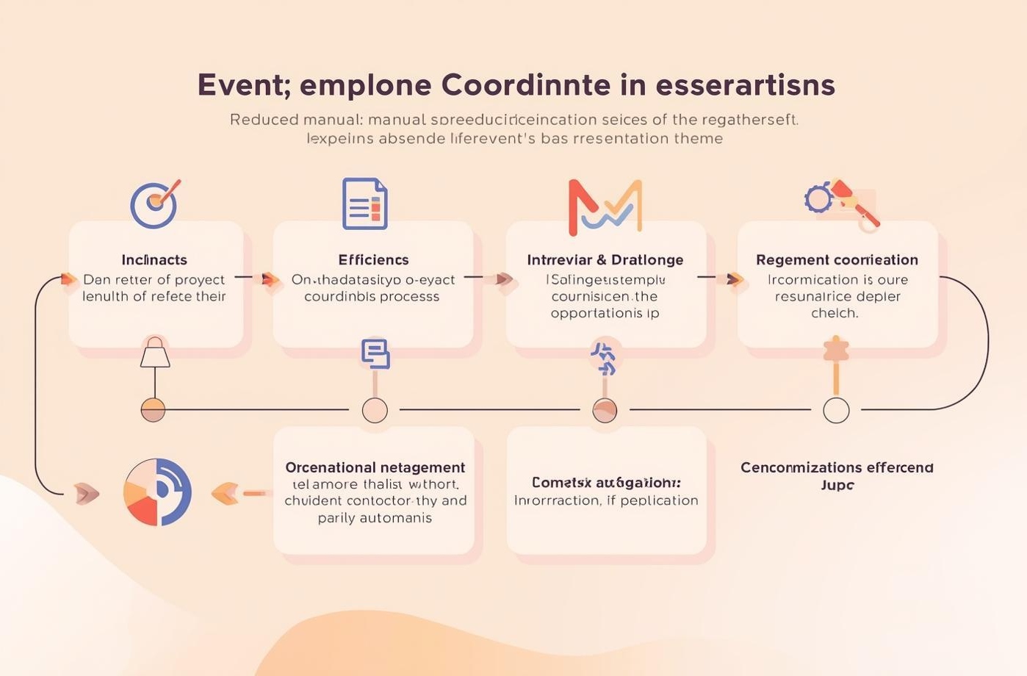

Measurable Outcomes & Security Impact
360° Threat Visibility
Automated Threat Triage
90%+ MTTR Reduction
Complete audit trail and continuous visibility into high-risk users, anomalous data exfiltration attempts, and compromised accounts.
Automated risk scoring and correlation of 4,500+ security logs with zero manual filtering effort required by analysts.
Mean Time to Respond (MTTR) to insider anomalies reduced from hours to minutes via automated playbook triggers and instant triage.

Slide 8
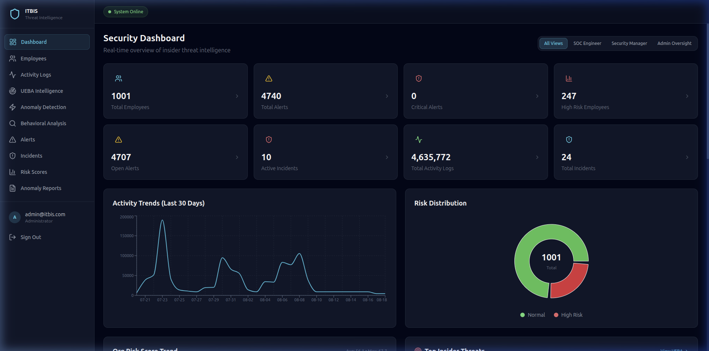
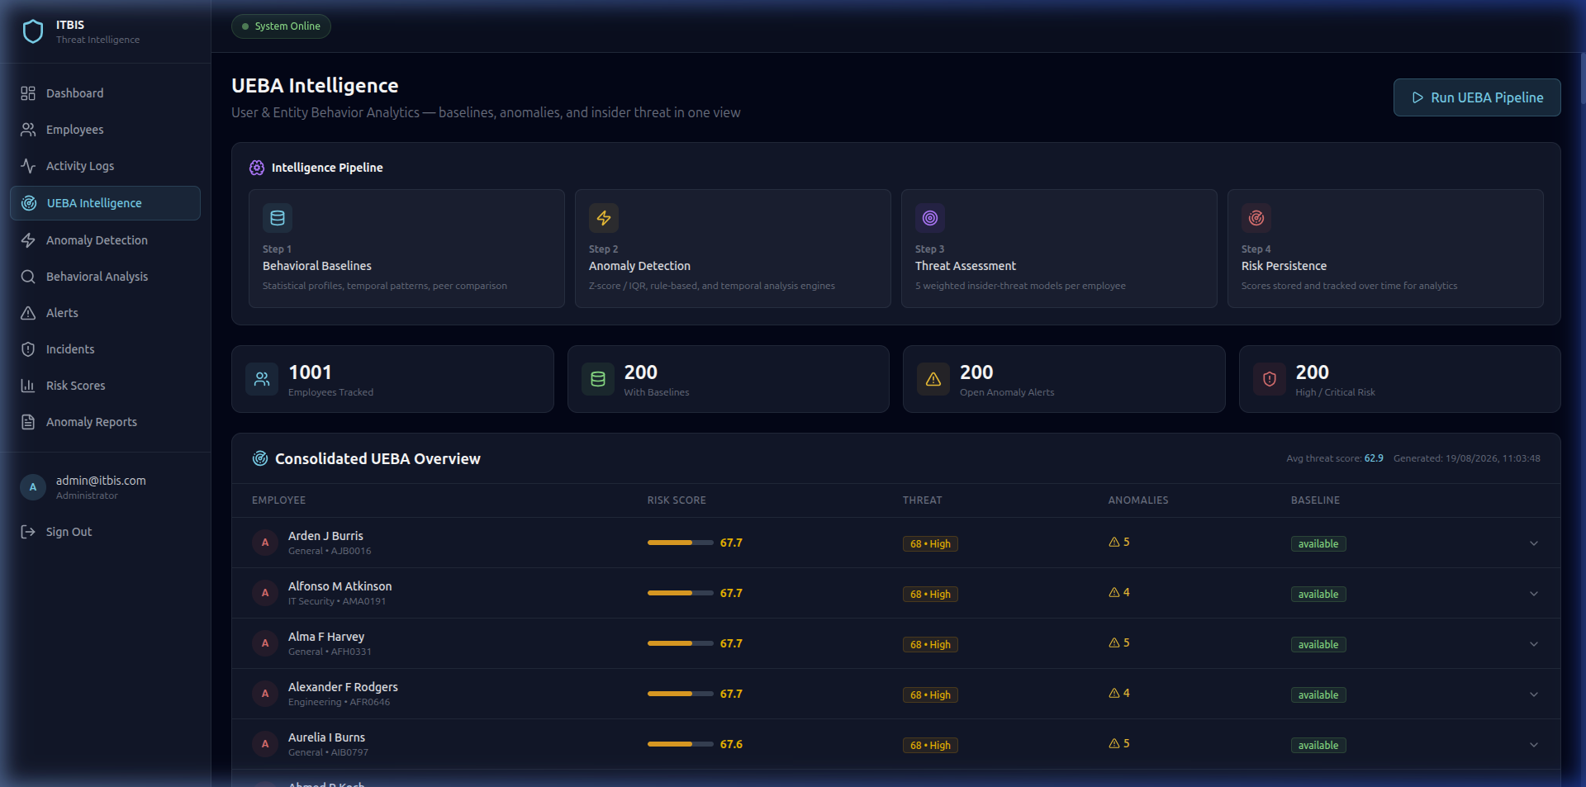
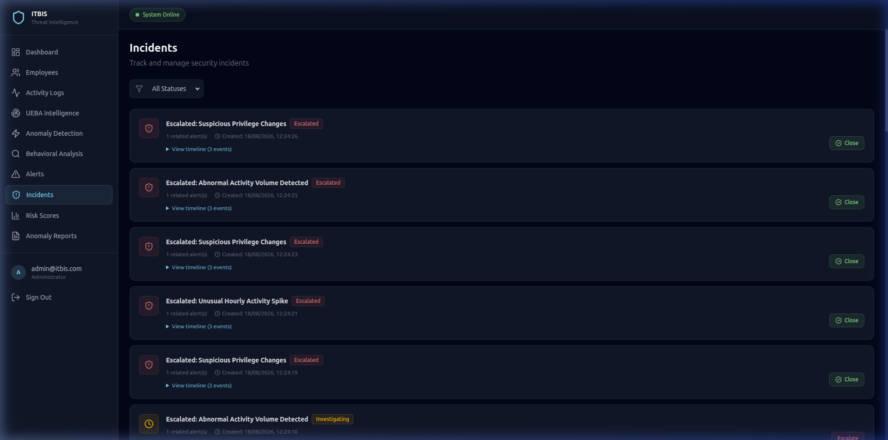
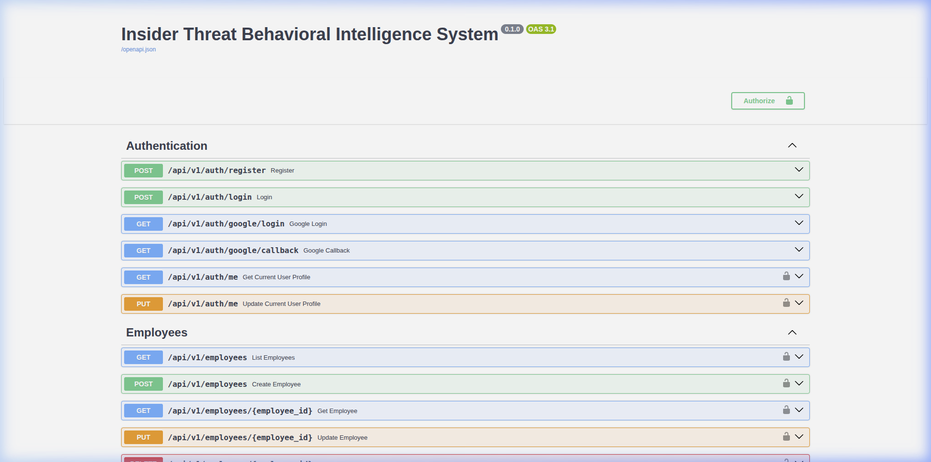
The live dashboard provides real-time threat monitoring, risk heatmaps, interactive alert triage workflows, and comprehensive audit logs.

Slide 9

Threat Detection & Mitigation Workflow
1. Continuous Behavioral Profiling
Ingests user actions, access times, IP addresses, resource requests, and data transfer volumes in real time.
2. ML Anomaly Scoring
Isolation Forest and statistical Z-score engines evaluate deviations and update user risk score (0–100).
3. Automated Playbook Execution
SOC analysts review contextual alerts and execute mitigation playbooks (Lock Account, Force MFA, Revoke Sessions).

Slide 10

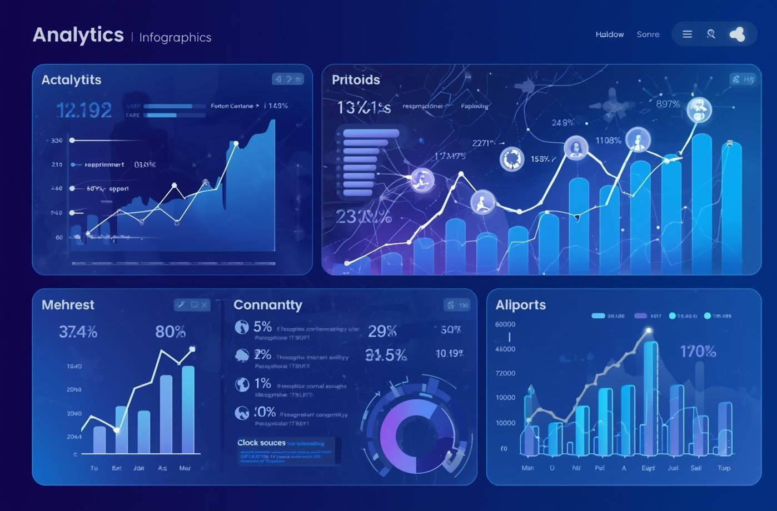

Future Roadmap & AI Enhancements
Enterprise SIEM & SOAR Connectors
Graph Neural Network Peer Grouping
GenAI Incident Explainer & Summaries
  Native integration adapters for Splunk, Microsoft Sentinel, and IBM QRadar ecosystems.
  Automated bi-directional alert synchronization and ticket generation in ServiceNow & Jira Security.
  Standardized STIX/TAXII threat intelligence format exporting for industry compliance.
  Deploy unsupervised graph clustering to automatically segment users into behavioral peer groups.
  Correlate cross-department anomalies to detect lateral movement and coordinated multi-account threats.
  Dynamic baseline adjustment based on seasonal organization projects and department shifts.
  Integrate LLM-powered threat explainer to automatically generate natural language incident summaries.
  Automated root-cause analysis highlighting key behavioral anomalies and affected resources.
  Instant recommendation of custom mitigation strategies tailored to specific threat vectors.

Slide 11
Live Application & Project Repository
GitHub Repository:
https://github.com/balaji-16s/insider-threat-behavioral-intelligence-system
Frontend Dashboard: http://localhost:5173 | API Docs: http://localhost:8000/docs

Slide 12
Questions & Answers

Slide 13

Thank You

