Slide 1

CODENEST
by
G. BALAJI
Roll No. 224G1A0510
D. YASWANTH
Roll No. 234G5A0516
P. SANIYA KOWSAR
Roll No. 224G1A0594
Under the guidance of
Dr. T. Venkata Naga Jayudu, M.Tech., ph.D.
Professor
Department of Computer Science and Engineering
Srinivasa Ramanujan Institute of Technology
Autonomous
Rotarypuram Village, B K Samudram Mandal, Ananthapuramu – 515701.
2025-2026
A20
DEPT. OF COMPUTER SCIENCE AND ENGINEERING
02
SRINIVASA RAMANUJAN INSTITUTE OF TECHNOLOGY

Slide 2
CODENEST
Contents
Title Justification
Abstract
Problem statement
Objectives of Project
Literature survey
Proposed Work
References
GitHub Link
Queries
A20
DEPT. OF COMPUTER SCIENCE AND ENGINEERING
02
SRINIVASA RAMANUJAN INSTITUTE OF TECHNOLOGY

Slide 3
CODENEST
Title Justification
The title “CodeNest” is chosen because the platform acts as a “digital nest” where all essential coding components—practice, analytics, guidance, and tracking—come together in one place.
It provides a unified, well-organized environment for students to learn, practice, and improve coding skills while enabling educators to monitor progress efficiently.
Thus, the name clearly reflects the purpose and integrated nature of the system.
A20
DEPT. OF COMPUTER SCIENCE AND ENGINEERING
03
SRINIVASA RAMANUJAN INSTITUTE OF TECHNOLOGY

Slide 4
CODENEST
Abstract
CodeNest is a web-based integrated platform designed to simplify and enhance the coding learning process. It consolidates coding analytics, a built-in coding environment, real-time error explanations, and an AI chatbot for learning support.
The system tracks performance across multiple coding platforms such as LeetCode and HackerRank, provides topic-wise insights, and assists students with debugging and concept clarification. Role-based dashboards allow faculty to review student progress and offer targeted guidance.
Overall, CodeNest delivers a seamless, intelligent, and data-driven coding education experience.
A20
DEPT. OF COMPUTER SCIENCE AND ENGINEERING
04
SRINIVASA RAMANUJAN INSTITUTE OF TECHNOLOGY

Slide 5
CODENEST
Problem Statement
Currently, students often rely on fragmented tools and platforms for coding practice, lacking a centralized system that effectively tracks progress, provides immediate error assistance, and supports pedagogical oversight.
Existing educational platforms seldom integrate real-time coding with intelligent tutoring and detailed performance analytics, limiting students' ability to self-assess and educators' capacity to provide targeted guidance. This gap undermines efficient learning and slows skill acquisition in coding disciplines.
A20
DEPT. OF COMPUTER SCIENCE AND ENGINEERING
05
SRINIVASA RAMANUJAN INSTITUTE OF TECHNOLOGY

Slide 6
CODENEST
Objectives of Project
To develop a unified platform that consolidates coding practice, analytics, and performance tracking.
To allow real-time code execution with instant error explanations and chatbot-based learning assistance.
To provide detailed topic-wise analytics for students and faculty.
To implement role-based login for personalized student dashboards and educator monitoring.
To support continuous learning, goal tracking, and data-driven mentoring.
A20
DEPT. OF COMPUTER SCIENCE AND ENGINEERING
06
SRINIVASA RAMANUJAN INSTITUTE OF TECHNOLOGY

Slide 7
CODENEST
Literature Survey
No | Title | Author | Journal Name & Year | Methodology Adapted | Key Findings | Gaps
1 | Web-Based Coding Practice & Learning Platforms | S. Combéfis & G. Wautelet | EDUCON (IEEE), 2021 | Developed a web-based tool for coding practice with automated feedback | Helped improve learning efficiency through browser-based coding and evaluation | No performance analytics dashboard, no chatbot assistance
2 | Automated Feedback in Programming Education | D. Keuning & J. Jeuring | ACM TOCE, 2021 | Reviewed programming tools offering auto-feedback using web interfaces | Automated feedback supports faster debugging and reinforces concepts | No unified platform, no multi-platform coding integration
3 | Learning Analytics in Web-Based Programming Courses | E. Chaparro et al. | CEUR Workshop Proc., 2021 | Applied learning analytics to student coding behavior | Analytics improved understanding of strengths, weaknesses, and progress | Does not include IDE or real-time execution features
4 | Lightweight Chatbots for Educational Web Systems | M. Bendjaballah | Journal of Web Engineering, 2023 | Integrated rule-based chatbot in web platforms for user guidance | Chatbots improved user engagement and offered simple explanations | No code-related error support or execution-based assistance
5 | Visual Dashboards for Student Performance Monitoring | G. Al-Shargabi & M. Sabri | iJET, 2022 | Designed dashboards for monitoring student progress in e-learning systems | Dashboards helped track performance trends and support educators | No coding-specific insights, no integration with coding platforms
A20
DEPT. OF COMPUTER SCIENCE AND ENGINEERING
07
SRINIVASA RAMANUJAN INSTITUTE OF TECHNOLOGY

Slide 8
CODENEST
Proposed System
CodeNest introduces an integrated system featuring:
Centralized Dashboard: Aggregates data from coding platforms like LeetCode, HackerRank etc.
Built-in IDE: Supports real-time code writing, execution, and test cases.
AI Chatbot Assistant: Provides error explanations, coding hints, and concept clarifications.
Analytics Engine: Shows progress graphs, topic-wise skill levels, and trends.
Role-based Access: Personalized student dashboards and faculty monitoring tools.
Secure Architecture: Supports scalable deployment and multi-user access.
A20
DEPT. OF COMPUTER SCIENCE AND ENGINEERING
08
SRINIVASA RAMANUJAN INSTITUTE OF TECHNOLOGY

Slide 9
CODENEST
References
Combéfis S & Wautelet G. (2021). Programming education through web-based tools and automated feedback. IEEE EDUCON.
Keuning D , Jeuring J & Heeren B (2021). A systematic literature review of automated feedback in programming education. ACM Transactions on Computing Education.
Chaparro E (2021). Learning analytics for computing education. CEUR Workshop Proceedings.
Bendjaballah M (2023). Lightweight chatbots in web applications supporting education. Journal of Web Engineering.
Al-Shargabi G & Sabri M (2022). Using visual dashboards in e-learning systems to enhance student monitoring. International Journal of Emerging Technologies in Learning (iJET).
A20
DEPT. OF COMPUTER SCIENCE AND ENGINEERING
09
SRINIVASA RAMANUJAN INSTITUTE OF TECHNOLOGY

Slide 10
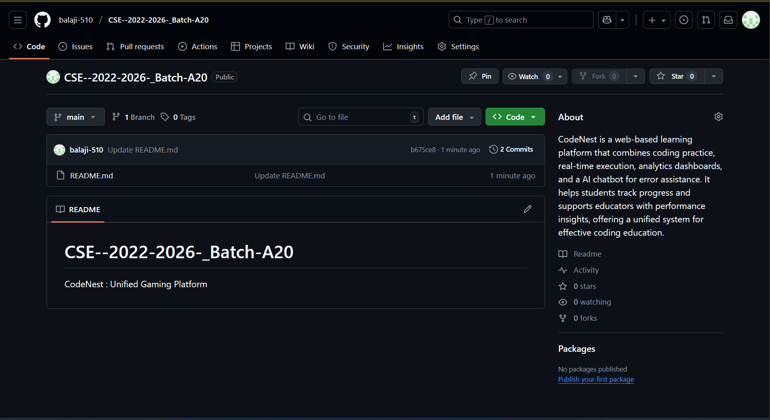
CODENEST
GitHub Dashboard
GitHub Link : https://github.com/balaji-510/CSE_2022-2026_Batch-A20
DEPT. OF COMPUTER SCIENCE AND ENGINEERING
10
A20
SRINIVASA RAMANUJAN INSTITUTE OF TECHNOLOGY

Slide 11
CODENEST
Any Queries?
A20
DEPT. OF COMPUTER SCIENCE AND ENGINEERING
11
SRINIVASA RAMANUJAN INSTITUTE OF TECHNOLOGY

