Slide 1
Image Based Classification Of Waste Material
Submitted to the
ELECTRONICS AND COMMUNICATION ENGINEERING DEPARTMENT
of
NATIONAL INSTITUTE OF TECHNOLOGY PATNA
April, 2020
Under the able guidance
of
Dr JAYANTHA GHOSH

Slide 2
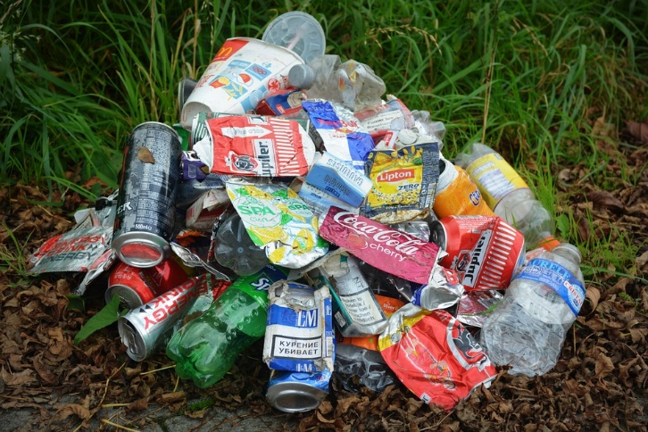
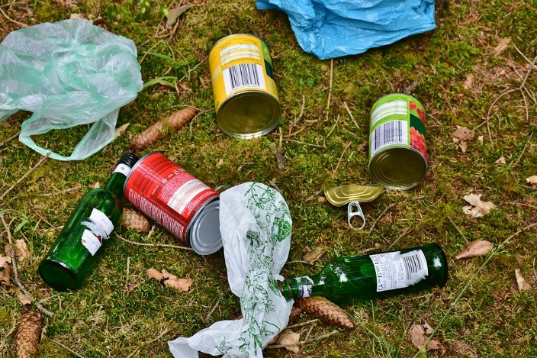
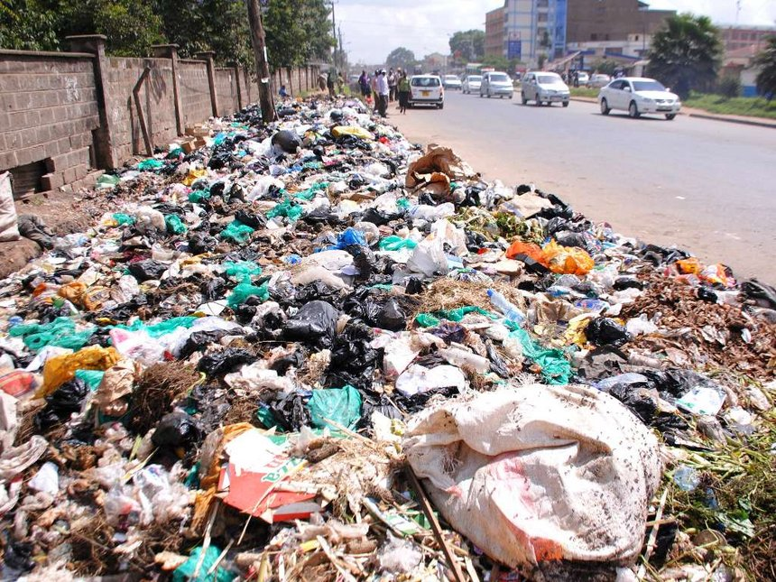
Problem at Hand
The problem that we tried to tackle is that of image based classification of waste material.

Slide 3
Current Scenario
Current waste disposal system is far from being adequate.
Governments cannot cope up with the overwhelming amount of waste generated by ever-increasing population.
The root problem of inefficient waste disposal is the traditional way of segregating different kinds of weight manually.
This way is time consuming, difficult, requiting large workforce, and plainly inefficient.
Different types of waste material need different kind of treatment

Slide 4
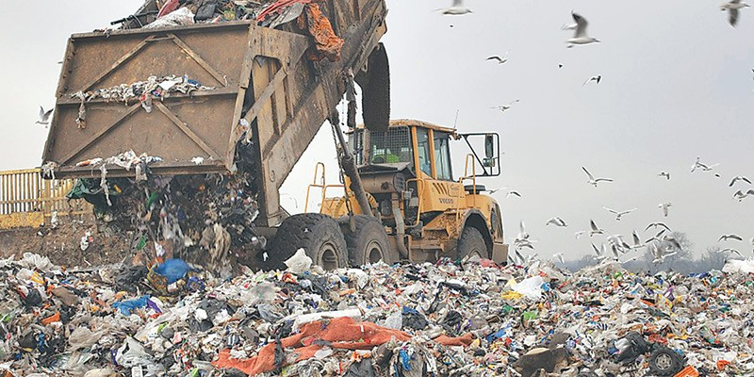

Slide 5
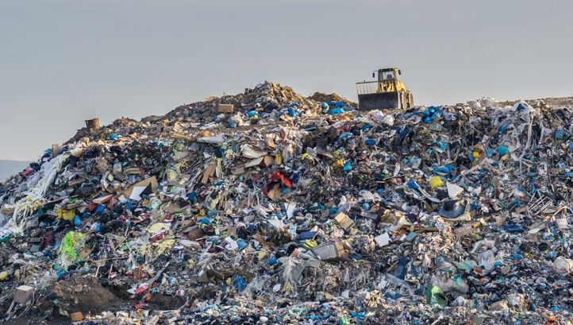

Slide 6
Why is Waste Management Important?
Waste, when collected, creates unhygienic environment.
Improper waste disposal causes environmental pollution.
Waste has hidden potential for reusage and recycling.

Slide 7

Role of Waste Classification in Waste Management
Waste classification helps in recycling garbage.
Different kinds of waste material undergo different treatment.
Waste classification is the bottleneck step in the whole process.

Slide 8
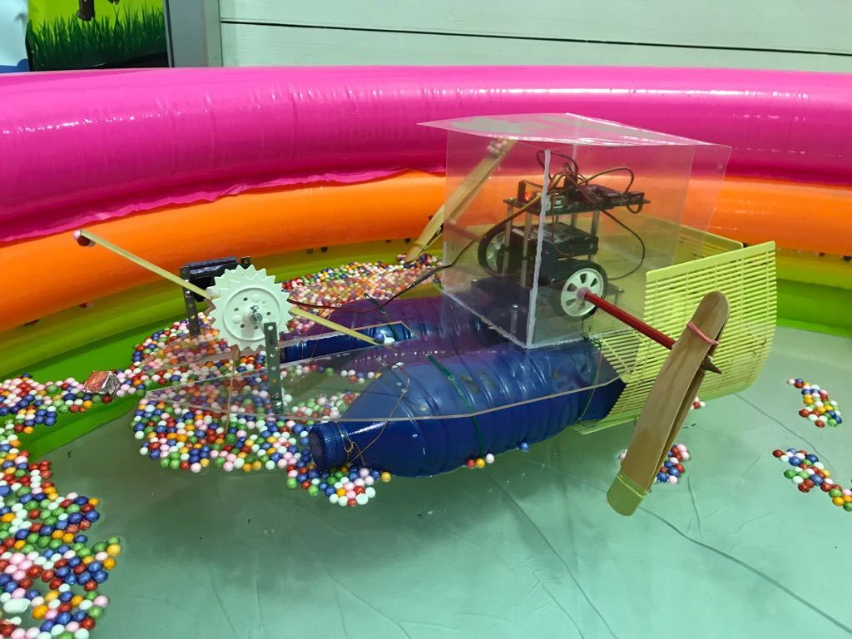
Need of Automation
Current waste classification techniques are inefficient.
They involve manual classification.
It is time consuming and hard.
It requires large investments and labor costs.
Misclassification rate is high due to difference of opinion.

Slide 9
Our Project
In this project, we attempt image based garbage classiﬁcation. Classiﬁcation is based on transfer learning of given input of images to learn and based on that predicting the category of the waste using the Inception model. The approach used in this paper is transfer learning on convolutional neural networks which is accomplished as follows.
1. Recognising small patterns in image matrix.
2. Assigning values to feature maps based on weighted values of previous neurons.
3. Detecting bigger patterns based on combination of small patterns.
4. Calculating the score of each category based on ﬁnal layer of feature map values

Slide 10
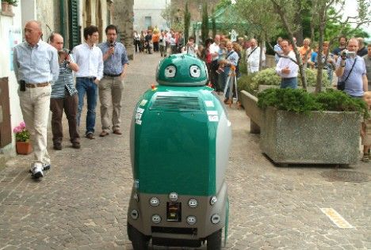
Previous Attempts
There have been some attempts at automating garbage classification. But none of them have given the required efficiency that is required. The projects that stand out from all of these are:
AlexNet : This project was made in 2012 and was capable of classifying different kinds of items with a dwindling accuracy of 50-70%. The model’s architecture was not very deep and fairly straightforward. Although it won the 2012 ImageNet LargeScale Visual Recognition Challenge (ILSVRC), it is not very efficient for solving the problem at hand.
AutoTrash: This project included software and hardware. It was a small bot that classified garbage and put it in different bins. But the model could not use a deep architecture because that took too much time, and without it, misclassifications were frequent.

Slide 11
Our Dataset
Our dataset is divided as following:
1) Training Data: 1052 cardboard images, 501 glass images, 410 metal images, 594 paper images and 482 plastic images.
2) Test Data: 115cardboard images, 105 glass images, 95 metal images, 181 paper images and 105 plastic images.
The model uses training data for training, cross validation and testing purposes. The test data is for our independent testing purposes.

Slide 12

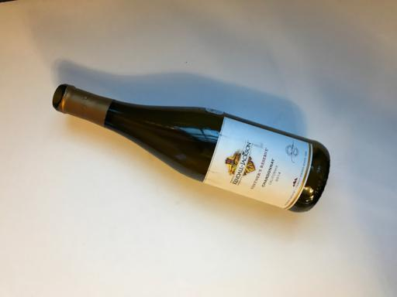
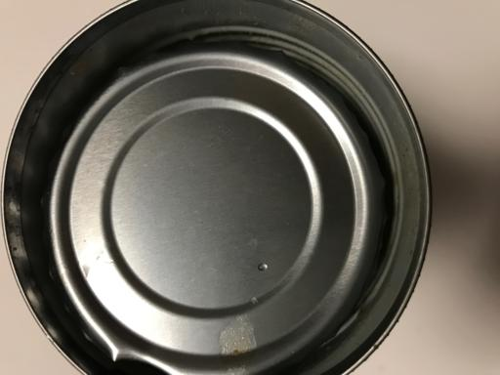
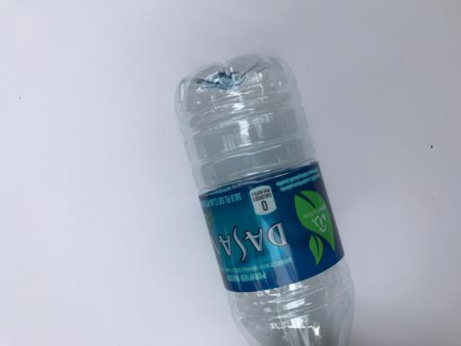
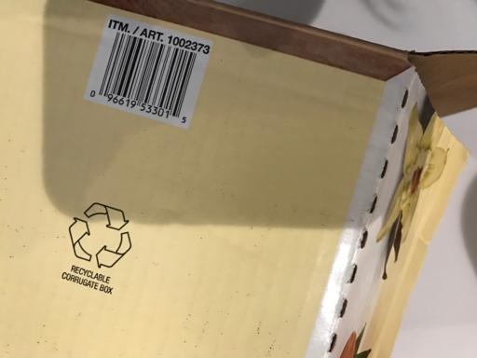
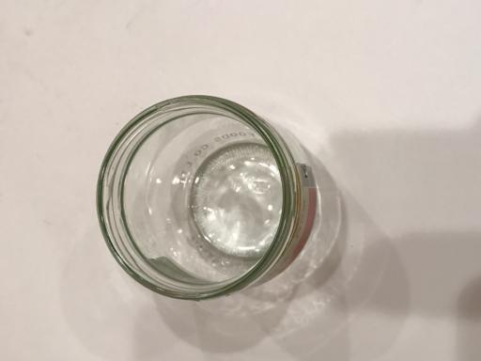
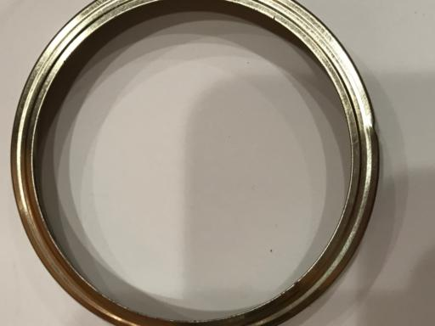
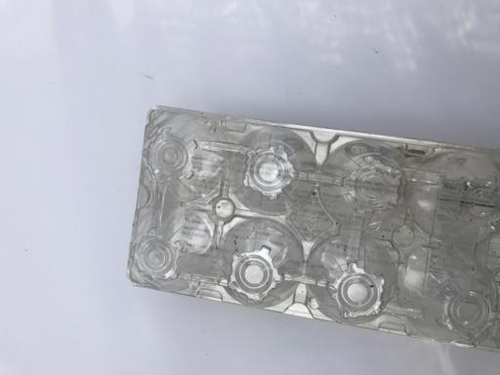

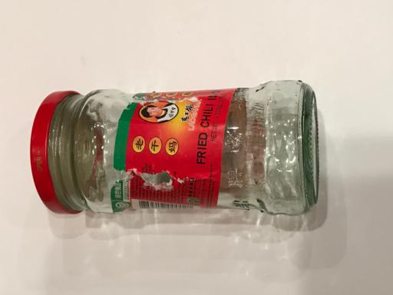
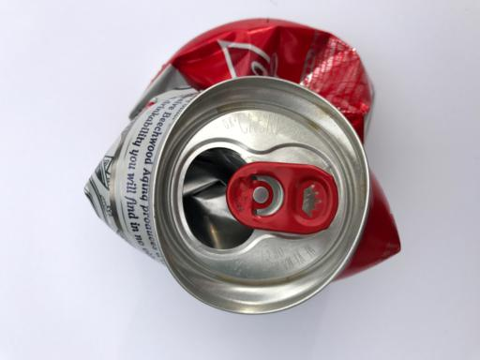
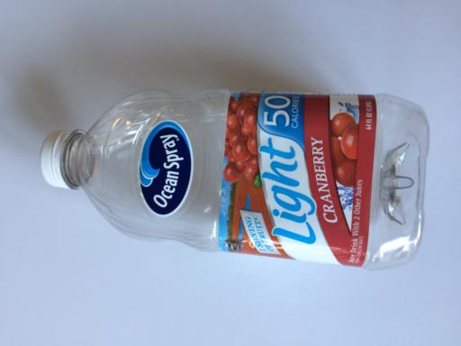
Our Dataset

Slide 13
Our Approach
The current approach is far superior to the previous model. The following points are worth noting:
Inception Model
Transfer Learning
Data pre-processing methods

Slide 14
Inception Model
Google’s Inception-v3 is trained for the ImageNet Large Visual Recognition Challenge using the data from 2012
Inception modules
Architecture
Dimensionality Reduction

Slide 15
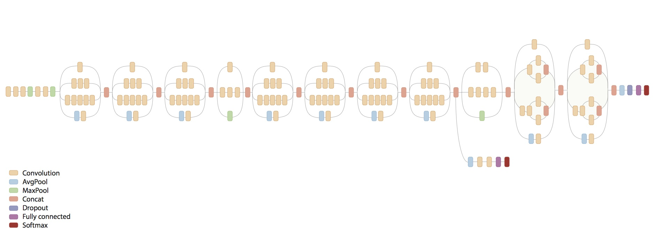
Inception Model - Modules

Slide 16
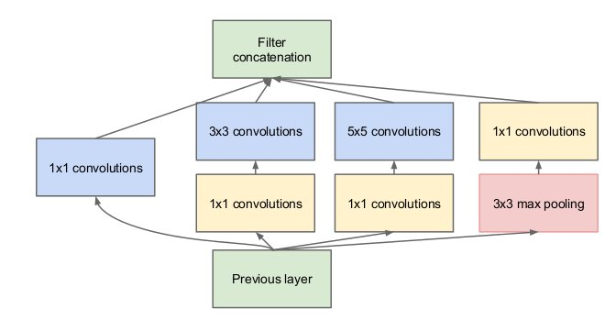
Inception Model - Architecture

Slide 17
Inception Model- Dimensionality Reduction
The model suggests that you can use 1x1 convolutions.
Keeps computations reasonable.
Reduces the number of computations by a factor of 10!

Slide 18
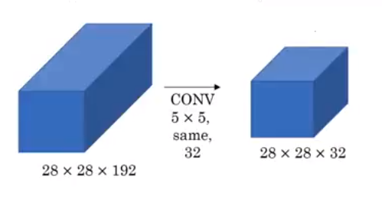
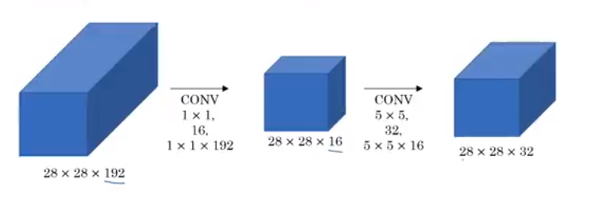
Inception Model- Dimensionality Reduction (Example)
28*28*32*5*5*192 = 120422400
28*28*16*1*1*192 +
28*28*32*5*5*16 = 12443648

Slide 19
Transfer Learning
It is a popular approach in deep learning where pre-trained models are used as the starting point on computer vision and natural language processing tasks given the vast computation and time resources required to develop neural network models on these problems and from the huge jumps in skill that they provide on related problems.
Transfer learning is an optimization that allows rapid progress or improved performance when modeling the second task.

Slide 20
Transfer Learning- How to use?
You can use transfer learning on your own predictive modeling problems. Two common approaches are as follows:
1. Develop Model Approach
2. Pre-trained Model Approach

Slide 21
Transfer Learning – Developer Model Approach
Select Source Task.
Develop Source Model.
Reuse Model.
Tune Model

Slide 22
Transfer Learning – Pre-Trained Model Approach
Select Source Model.
Reuse Model.
Tune Model.

Slide 23
Data Pre-processing
This includes many operations that are done on data before training that help the model to train more efficiently – with respect to time or accuracy or both
Zooming
Flipping
Scaling
Cropping
Background Subtraction
Max Pooling
Flattening
Bottlenecking
Brightening

Slide 24
Hardware and Software Support
Hardware
• Multicore processor
• Atleast 8GB of RAM
• Atleast 1GB disk space
• Preferably a decent graphics card, like GtX Nvidia graphics card
Software
• Python, with version greater than 2.6
• An operating system that supports python, like Windows, Mac, or Ubuntu
• Some python libraries like tensorﬂow, numpy, scipy etc.

Slide 25
Steps Involved
ImageNet Data Download
Image Loading
Image Morphing
Dataset Splitting
Bottlenecking
Initialization
Training
Saving model for future use
Predicting

Slide 26
Steps Involved - ImageNet Data Download
The ﬁrst step is to train the Inception model on the ImageNet dataset.
For that, the dataset is needed.
In case the ImageNet dataset is not present in the speciﬁed path, it is downloaded from the link http://download.tensorﬂow.org/models/image/imagenet/inception2015-12-05.tgz.
Internet connectivity is required for this step.

Slide 27
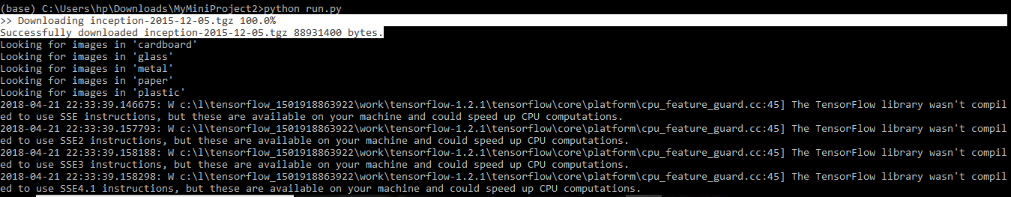
Steps Involved - ImageNet Data Download

Slide 28
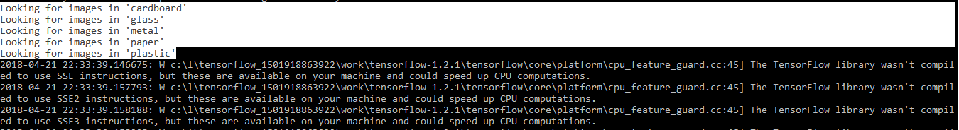
Steps Involved – Image Loading
The images on which the model needs to train, in this case, the images of garbage, are loaded in this step.

Slide 29
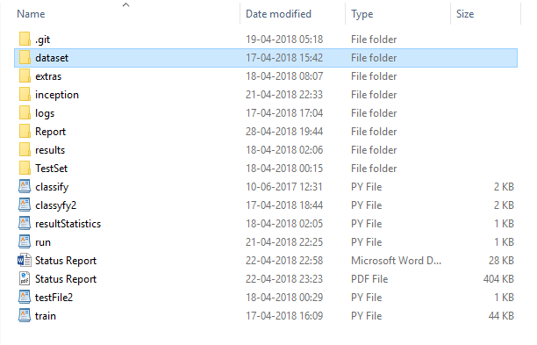
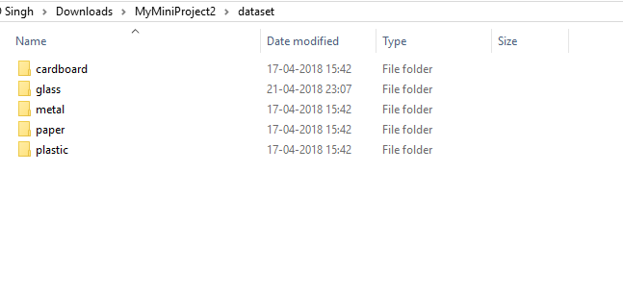
Steps Involved – Image Loading

Slide 30
Steps Involved - Image Morphing
If specified, the dataset undergoes the following transformations:
Flip left / Right
Random Crop
Random Scale
Random Brighten
The biggest impact this step has on training is that caching becomes useless if this step is used

Slide 31
Steps Involved – Dataset Splitting
By default, 10% of the dataset is selected as cross-validation set.
Another 10% is selected as test set.
The model trains on the remaining 80% of the provided dataset.
These values can be modiﬁed.

Slide 32
Steps Involved - Bottlenecking
The bottleneck values of images are stored ( if training for the ﬁrst time ).
Because every image is reused multiple times during training and calculating each bottleneck takes a signiﬁcant amount of time, it speeds things up to cache these bottleneck values on disk so they don’t have to be repeatedly recalculated.
By default, they’re stored in the /tmp/bottleneck directory, and if we rerun the script they’ll be reused so we don’t have to wait for this part again.

Slide 33
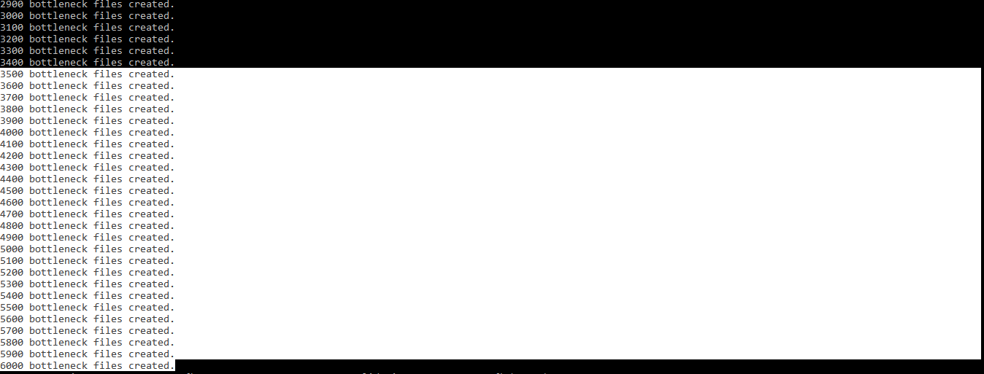
Steps Involved - Bottlenecking

Slide 34
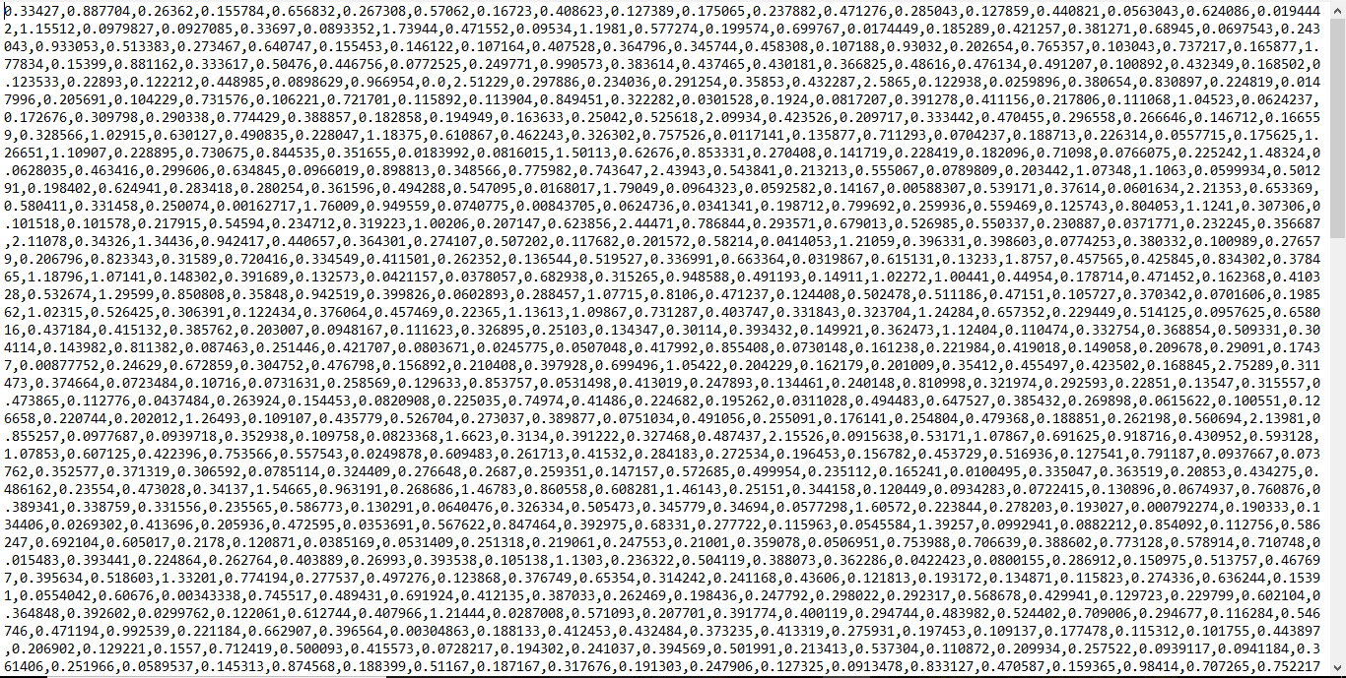
Steps Involved - Bottlenecking

Slide 35
Steps Involved – Initialization
Now, the graph object for modelling is initialized with the command line values like train-validate-test split percentage, morphing, destination paths, number of epochs, evaluation metric etc. on tensorﬂow.

Slide 36
Steps Involved - Training
At this point, the model is ready to be trained ﬁrstly on ImageNet ( if it is being trained for the ﬁrst time ) and then on the images provided.
With each passing epoch, the accuracy increases as the model learns from previous mistakes and learns to judge better.
In the end, a decent accuracy is obtained.

Slide 37
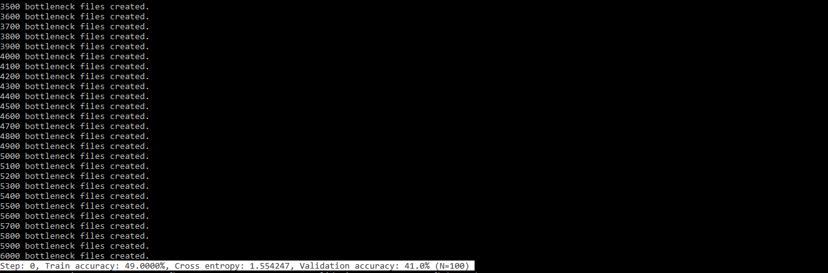
Steps Involved - Training

Slide 38
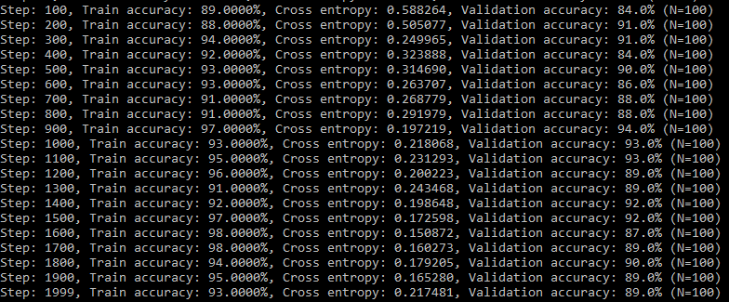
Steps Involved - Training

Slide 39
Steps Involved – Saving Model For Future Use
After training, the model is saved for future use as trained graph.pb. This enables us to use our model for predictions without having to retrain it each time.

Slide 40
Steps Involved - Predicting
The model can classify multiple images at a time.
If path to an image is given, that image is classified and results are shown.
If the path to a directory is given, all images inside that directory and the subdirectories are classiﬁed one by one.
The prediction can be a single label or all labels with the likeness of the image belonging to that label

Slide 41
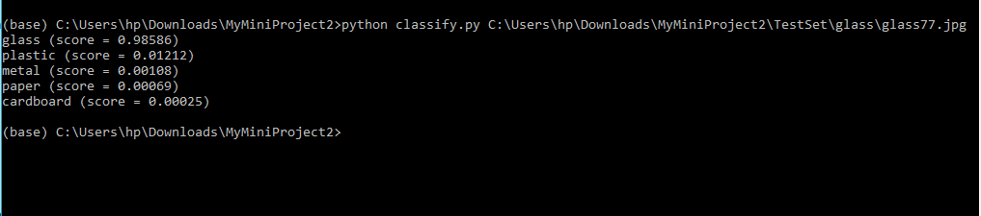
Steps Involved - Predicting

Slide 42

Steps Involved - Predicting

Slide 43
Results
Data Type | Correctly Classified | Total Images | Accuracy
Dataset | 2885 | 3039 | 94.93%
Independent Test Set | 559 | 601 | 93.01%

Slide 44
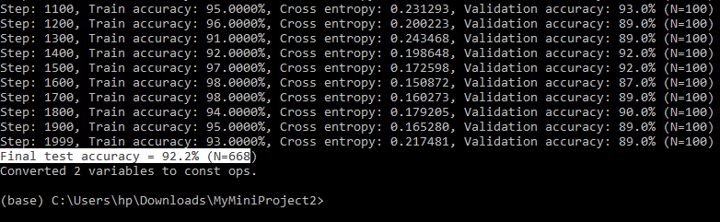
Results

Slide 45
Result Analysis
The accuracy appears to be high in training set.
The problem of overﬁtting is also avoided since test accuracy is high too.
This means that the model is doing well and is able to distinguish between diﬀerent images with appreciable accuracy.
However, there are some mis-classiﬁcations.
For example, the cardboard image shown in next slide was incorrectly classiﬁed as paper.

Slide 46
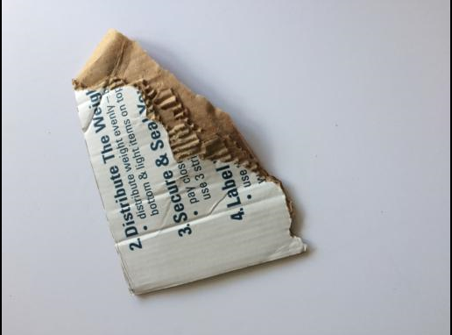
Result Analysis

Slide 47
Result Analysis
This seems like a forgivable mistake, but it also means that there is scope for improvement.
There are some features which although work for majority of cases, fail in some tricky ones.
The following could be done to increase the accuracy of the model even further:
1) Collect more data
2) Use deeper model with more layers
3) Change the underlying model for something better

