Slide 1
C# - Latest

Slide 2
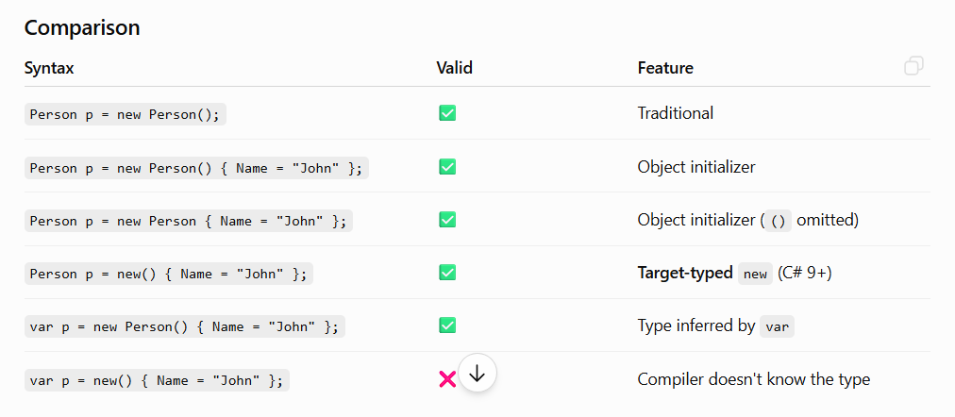
Object Initializer

Slide 3
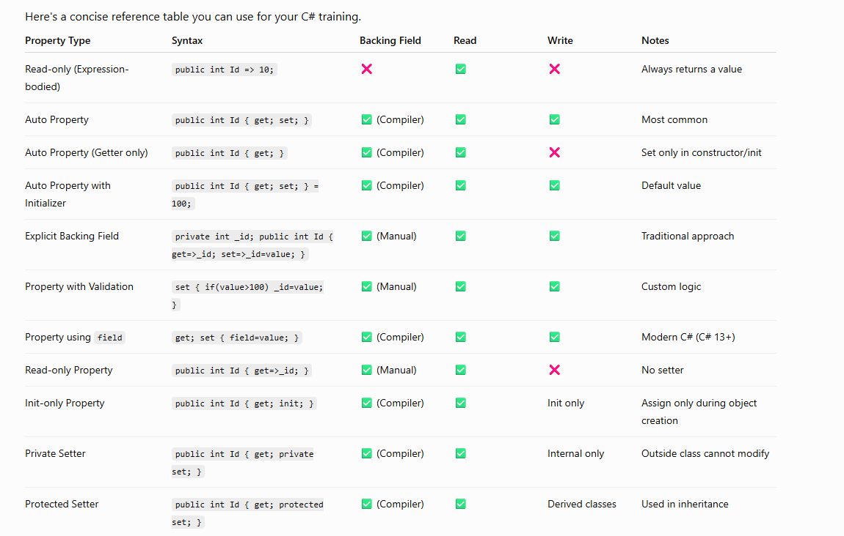
Properties Declaration

Slide 4
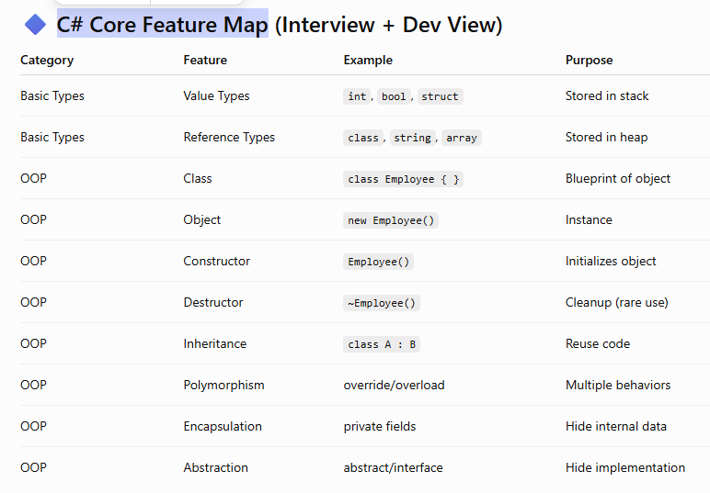

Slide 5
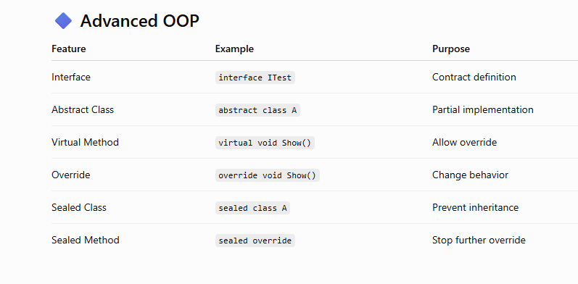

Slide 6
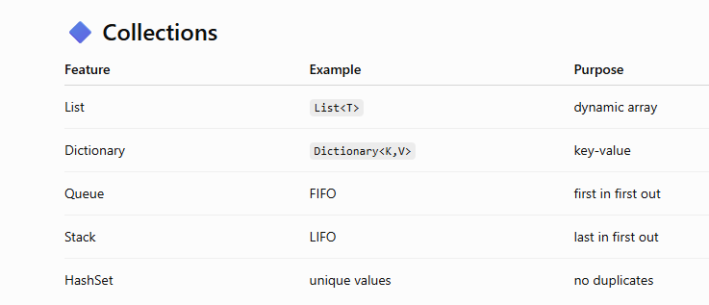

Slide 7
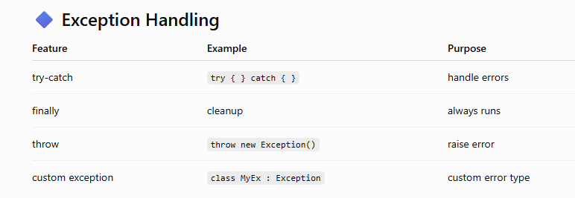

Slide 8
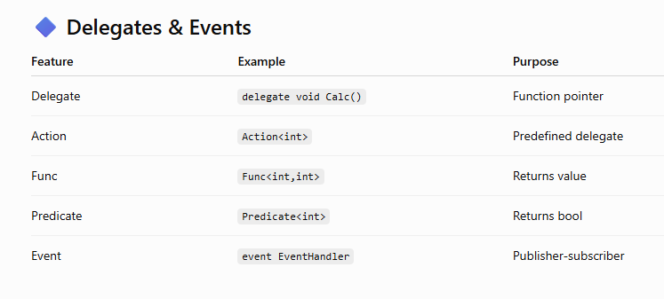

Slide 9
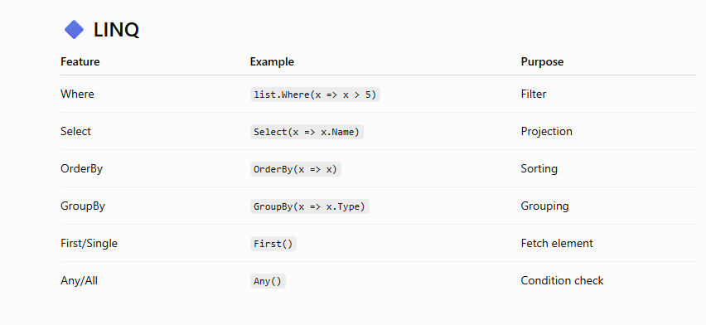

Slide 10
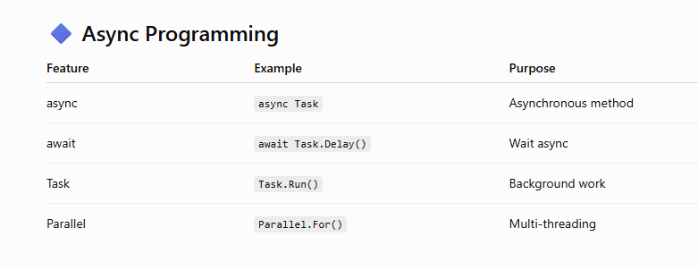

Slide 11
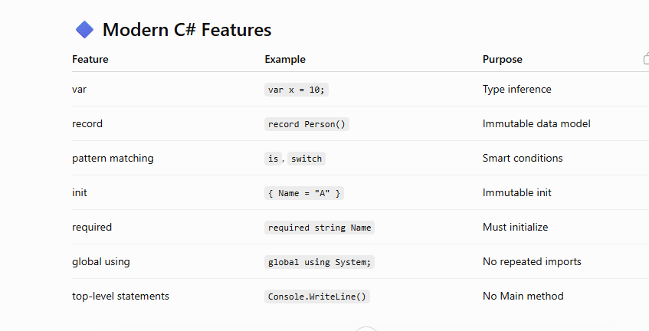

Slide 12
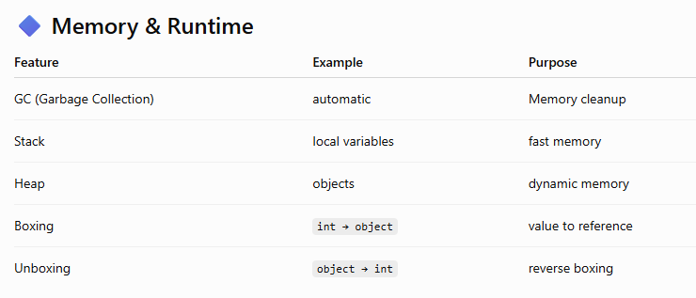

Slide 13
Record
These automatically become:
Properties (init by default)
Constructor parameters
Used for value equality
Used in ToString()
public record GameDtos(
int Id,
string Name
)
{
// Additional members go here
}

Slide 14
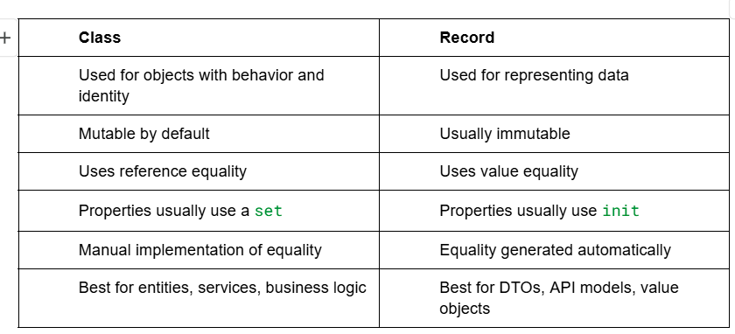
Class vs Record

Slide 15
var builder = WebApplication.CreateBuilder(args);
Creates a WebApplicationBuilder object.
It prepares everything needed to build your web application.
It automatically configures:
Dependency Injection (DI)
Configuration (appsettings.json, environment variables, etc.)
Logging
Kestrel web server
Hosting environment

Slide 16
var app = builder.Build();
Builds the application from the builder.
Creates the actual WebApplication object that will receive HTTP requests.
After this point, most services are already configured.

Slide 17
app.UseHttpsRedirection();
Adds middleware that automatically redirects HTTP requests to HTTPS.
Example: http://localhost:5176 ↓ https://localhost:7036

Slide 18
app.MapGet("/", () => "Hello World!");
Creates a GET endpoint.
When someone sends a GET request to /, it returns "Hello World!".

Slide 19
app.Run(); Middleware (Terminal)
Starts the Kestrel web server.
Begins listening for incoming HTTP requests.
This is a blocking call—the application keeps running until it is stopped.

Slide 20
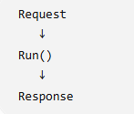
Run() Middleware (Terminal)
Handles the request.
Does not call the next middleware.
Ends the pipeline.
app.Run(async context =>
{
await context.Response.WriteAsync("Hello");
});
Use when you want to produce the final response.

Slide 21
MapGet(), MapPost(), MapPut(), MapPatch(), MapDelete()
These map HTTP methods directly to endpoints.
app.MapGet("/games", () => games);
app.MapGet("/games/{id}", (int id) => games.FirstOrDefault(x => x.Id == id)).WithName(GetGameEndPointName);
app.MapPost("/games", (CreateGameDtos createGame)=>
{
return "User Created";
});

Slide 22
Middleware
Each middleware component can:
Process an incoming HTTP request.
Decide whether to pass the request to the next middleware.
Process the outgoing HTTP response.
Think of middleware as a chain of handlers through which every request passes.

Slide 23
app.Use() Middleware
Executes code before and after the next middleware.
Calls next() to continue the pipeline.
Use cases
Logging
Authentication
Exception handling
Custom headers

Slide 24
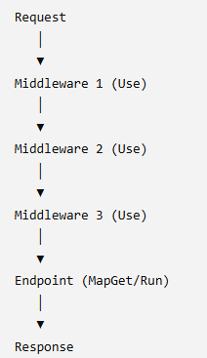
app.Use() (Normal Middleware Pipeline)

Slide 25
app.Use() - Implemented for api key
Sample code:
app.Use(async (context, next) =>
{
if (context.Request.Path.StartsWithSegments("/games"))
{
if (!context.Request.Headers.TryGetValue("X-API-Key", out var key) ||
key != ApiKey)
{
context.Response.StatusCode = StatusCodes.Status401Unauthorized;
await context.Response.WriteAsync("Invalid API Key");
return;
}
}
await next();
});

Slide 26
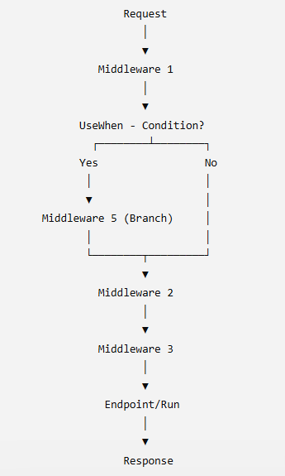
app.UseWhen() (Conditional Middleware, Returns to Main Pipeline)
Runs middleware only when a condition is true, then returns to the main pipeline.

Slide 27
UseWhen() Middleware
app.UseWhen(
context => context.Request.Path.StartsWithSegments("/api"),
appBuilder =>
{
appBuilder.Use(async (context, next) =>
{
Console.WriteLine("API Request");
await next();
});
});

Slide 28
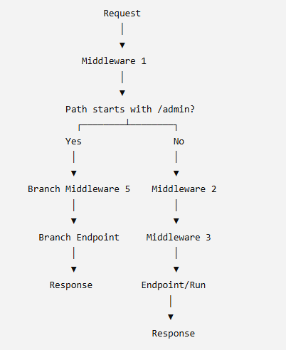
app.Map() (Path-Based Branch)
Branches the pipeline based on the URL path.
Use when different URL paths need different middleware.

Slide 29
app.Map() Middleware
app.Map("/admin", adminApp =>
{
adminApp.Run(async context =>
{
await context.Response.WriteAsync("Admin Page");
});
});
Requests:
/admin → Admin Page
/anything → Continues in main pipeline

Slide 30
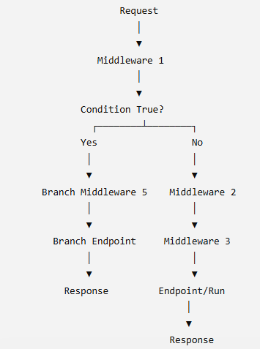
app.MapWhen() (Condition-Based Branch)
Branches the pipeline based on a condition.

Slide 31
app.MapWhen() Middleware
app.MapWhen(
context => context.Request.Query.ContainsKey("admin"),
adminApp =>
{
adminApp.Run(async context =>
{
await context.Response.WriteAsync("Admin");
});
});

Slide 32
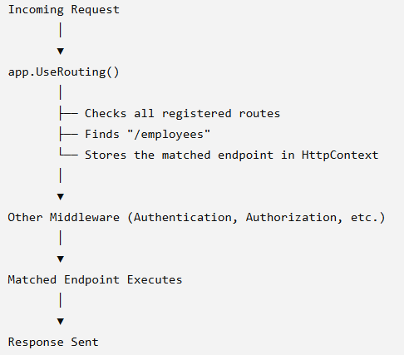
app.UseRouting();
Adds the routing middleware to match incoming URLs to endpoints.

Slide 33
app.UseStaticFiles();
Tells ASP.NET Core to serve files from the wwwroot folder.

Slide 34
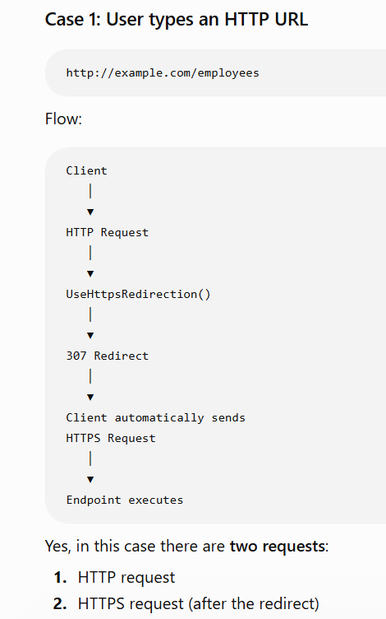
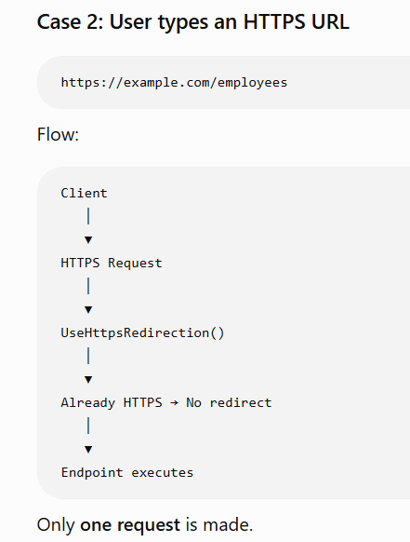
app.UseHttpsRedirection();

Slide 35
app.UseHttpsRedirection();
dotnet dev-certs https --check
dotnet dev-certs https --clean
dotnet dev-certs https --trust
Command line execution:
dotnet run --launch-profile https
VS Code:
Command palette -> .Net Select Launch Configuration → http or https

Slide 36
Check
app.UseHttpsRedirection();
dotnet dev-certs https --check
dotnet dev-certs https --clean
dotnet dev-certs https --trust
dotnet run --launch-profile https
app.UseAuthorization();
app.MapStaticAssets();
app.MapControllerRoute(
name: "default", pattern: "{controller=Home}/{action=index}/{id?}");

Slide 37
Breakdown of MVC
//configure logging, DI, kestrel web server, hosting environment
var builder = WebApplication.CreateBuilder(args);
// Add services to the container.
//build mvc services in DI container (model, view, controller, validation )
builder.Services.AddControllersWithViews();
//for validating [Required] [Range]
builder.Services.AddValidation();
//build the configured application, built the middleware pipeline.
var app = builder.Build();
//Adds the routing middleware to match incoming URLs to endpoints.
app.UseRouting();
//tells ASP.NET Core to serve files from the wwwroot folder.
app.UseStaticFiles();
app.UseHttpsRedirection();
//map default routing for base url
app.MapControllerRoute(
name: "default", pattern: "{controller=Home}/{action=index}/{id?}");
app.Run();

Slide 38
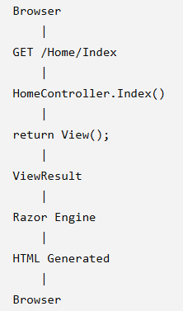
Controller
IActionResult - IActionResult is an interface in ASP.NET Core MVC that represents the result of an action method. It gives you the flexibility to return different types of responses from the same action.

Slide 39
Understanding MVC
MVC → only with controller
MVC → controller-view (Home controller - View\home\index.cshtml)
MVC→ Controller-model-view

Slide 40
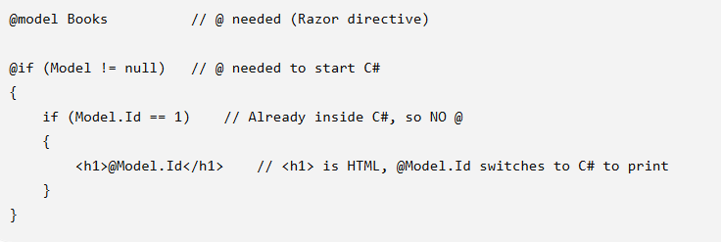
Understanding Razor view

Slide 41
_Layout and _Viewstart
Views\Shared\_Layout.cshtml (@RenderBody)
Views\_viewstart.cshtml (avoid import of _Layout in all .cshtml)
_Layout.cshtml
<div class="pd-3">
@RenderSection("title",false)
</div>
<div class="container">
@RenderBody()
</div>
_ViewStart.cshtml
@{
Layout = "_Layout";
}

Slide 42
Section
Step 1: _Layout.cshtml
<div class="pd-3">
@RenderSection("title",false)
</div>
<div class="container">
@RenderBody()
</div>
Step 2: Index.cshtml
@section title {
@if (Model != null)
{
<h3>Book Section</h3>
}
}

Slide 43
_ViewImports
Helps to avoid import in all views

Slide 44
Entity Framework
Without migration
Database already exists.
Table already exists.
EF Core is simply mapping the model.
No migrations
GET, POST, PUT, DELETE
With migration
Change db name in connection string
Command
dotnet tool install --global dotnet-ef
dotnet ef migrations add InitialCreate
dotnet ef database update
To remove migration
dotnet ef migrations remove
To drop db
dotnet ef database drop

Slide 45
Without migration
Database already exists.
Table already exists.
EF Core is simply mapping the model.

Slide 46
Without migration
using _9MinimalAPIEntityProject.Data;
using Microsoft.EntityFrameworkCore;
using WebApplication2.Model;
var builder = WebApplication.CreateBuilder(args);
builder.Services.AddDbContext<AppDbContext>(options =>
{
options.UseSqlServer(builder.Configuration.GetConnectionString("DefaultConnection"));
});
var app = builder.Build();
app.MapGet("/books", async (AppDbContext dbContext) =>
{
var books = await dbContext.Books.ToListAsync();
return books;
});
app.MapGet("/books/{id}", async (AppDbContext dbContext, int id) =>
{
var book = await dbContext.Books.FirstOrDefaultAsync(x => x.Id == id);
if (book == null)
return Results.NotFound();
return Results.Ok(book);
}).WithName("GetBookById");
app.MapPost("/books", async (AppDbContext dbContext, Book book) =>
{
if (book == null)
return Results.BadRequest();
dbContext.Books.Add(book);
// book.Id == 0 - before save
await dbContext.SaveChangesAsync();
// book.Id == 0 after SaveChanges.
return Results.CreatedAtRoute("GetBookById", new { id = book.Id }, book);
});

Slide 47
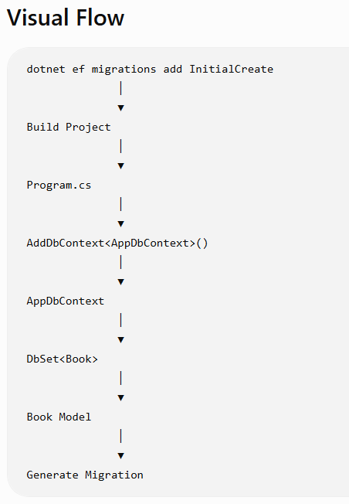
With migration
EF Core will:
install dotnet tool install --global dotnet-ef
create model, Appdbcontext, program.cs, connectionstring
dotnet ef migrations add InitialCreate
dotnet ef database update
check sql
add new property to model again
dotnet ef migrations add updatecolumnmigration
dotnet ef database update

Slide 48
IQueryable vs IEnumerable
IEnumerable → db.Books.Where(x => x.Price > 500);
IQueryable
db.Books.Where(x => x.Price > 500) .ToQueryString())
await db.Books .Where(x => x.Price > 500) .FirstOrDefaultAsync()

Slide 49
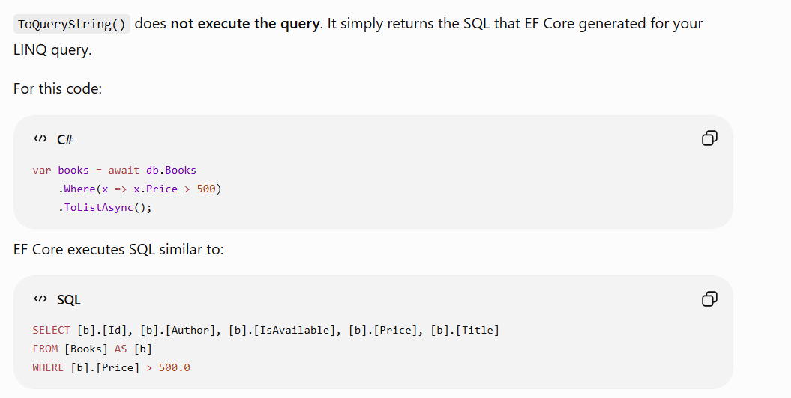
ToQueryString()

Slide 50
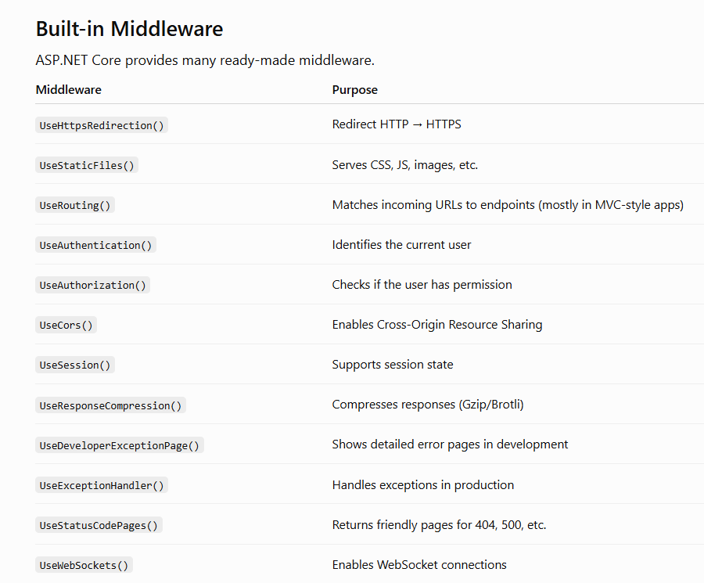

Slide 51
Routing Details
Http method
Required route parameter (Route Constraints)
group.MapGet("/{id:int}", (int id) =>
Route parameter with default values
group.MapGet("/{id:int=2}", (int id) =>
Optional route parameter
group.MapGet("/{id:int?}", (int? id) =>
{
if (id is null)
return Results.Ok("All games");
return Results.Ok($"Game Id: {id}");
});
Use [AsParameters]

Slide 52
app.MapOpenApi(); - OpenAPI JSON is the contract of an API.
Creates OpenAPI document
https://localhost:5001/openapi/v1.json
The OpenAPI JSON describes:
Available endpoints
HTTP methods (GET, POST, PUT, DELETE)
Route parameters
Query parameters
Request body schema
Response schema
Status codes (200, 404, etc.)
API title and version
ASP.NET Core:
Looks at all your Minimal API endpoints.
Collects their metadata (routes, HTTP methods, parameters, request/response types).
Generates an OpenAPI JSON document.
Returns that JSON to the client.

Slide 53
app.MapOpenApi();
builder.Services.AddOpenApi();
var app = builder.Build();
if (app.Environment.IsDevelopment())
{
app.MapOpenApi();
}
builder.Services.AddOpenApi(); - Registers the services required to generate an OpenAPI document.
app.MapOpenApi(); - Creates an endpoint that serves the generated OpenAPI document.

Slide 54
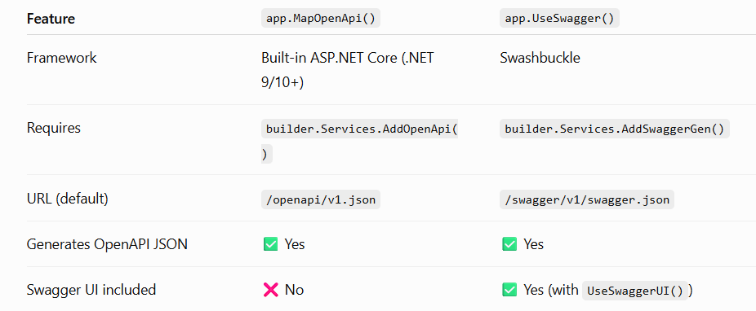
MapOpenAPI (Direct support ) vs Swagger (external)

Slide 55
Swagger
Nuget package - Swashbuckle.AspNetCore
// Swagger
builder.Services.AddEndpointsApiExplorer();
builder.Services.AddSwaggerGen(options =>
{
options.SwaggerDoc("v1", new OpenApiInfo
{
Title = "Weather API",
Version = "v1",
Description = "Sample Minimal API"
});
});
if (app.Environment.IsDevelopment())
{
// Swagger JSON
app.UseSwagger();
// Swagger UI
app.UseSwaggerUI(options =>
{
options.SwaggerEndpoint("/swagger/v1/swagger.json", "Weather API v1");
});
}

Slide 56
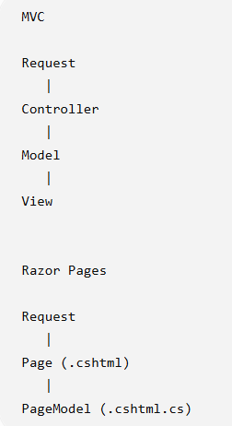
MVC vs Razor

Slide 57
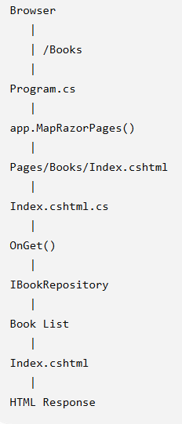
RazorPage Request Flow
In Razor Pages, every .cshtml normally has a corresponding .cshtml.cs PageModel. Unlike MVC where multiple views can use the same controller, Razor Pages follows a page-focused model.
@page is the most important directive in Razor Pages.
It tells ASP.NET Core:
"This .cshtml file is a Razor Page and can handle HTTP requests directly."
Without @page, the file is treated as a normal Razor view and cannot be accessed directly by a URL.

Slide 58
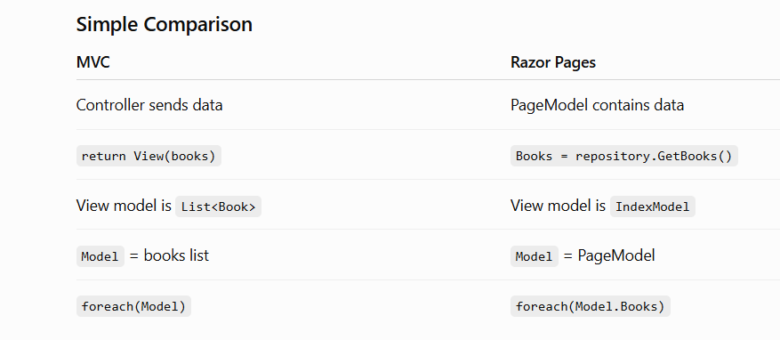
Simple Comparison MVC vs RazorPage

Slide 59
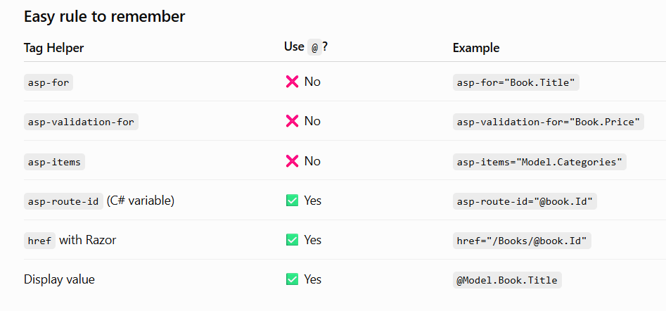
.cshtml

Slide 60
ViewData
ViewData is available only during the current HTTP request.
It is shared between the Controller/PageModel and the View/Razor Page for that request.
It does not survive a redirect, refresh, or a new request.
If data needs to persist across requests, use TempData, Session, or another persistence mechanism instead.

Slide 61
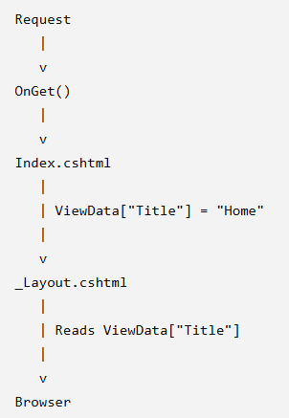
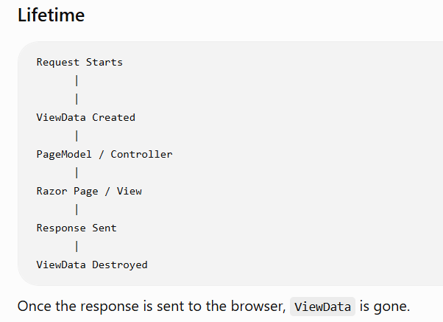
ViewData - only during the current HTTP request

Slide 62
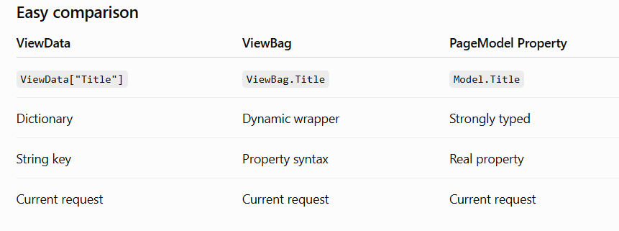
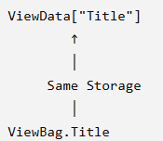
ViewBag
ViewBag doesn't provide any new capability. It is simply a more convenient syntax (ViewBag.Title) for accessing the same data stored in ViewData["Title"]

Slide 63
ViewData and ViewBag
MVC: ViewBag and ViewData share the same underlying data, so you can set one and read from the other.
Razor Pages: ViewData is available, but ViewBag is not exposed by PageModel, so use ViewData or strongly typed PageModel properties instead.

Slide 64
TempData
TempData is used to pass data from one request to the next request.
It is most commonly used after a Redirect.

Slide 65
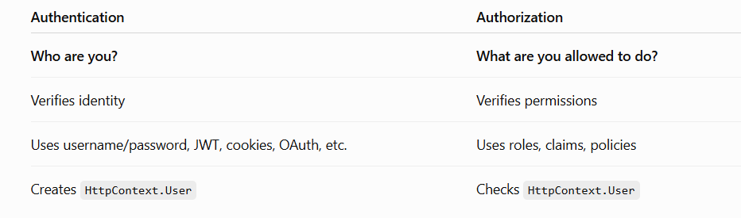
Authentication and Authorization

Slide 66
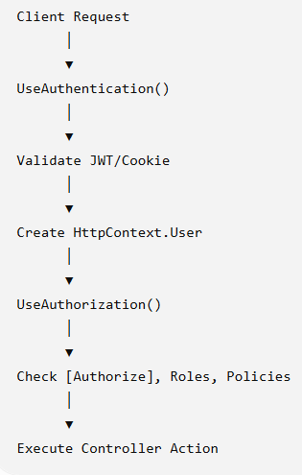
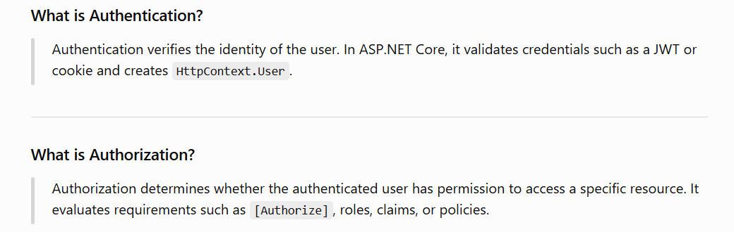
ASP.NET Core Flow

Slide 67
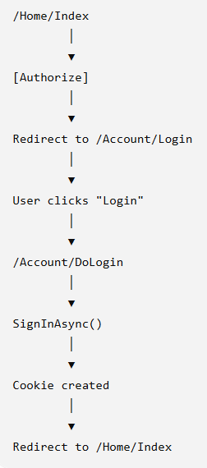
Cookies Auth
You request /Home/Index.
[Authorize] sees you're not authenticated.
It redirects to /Account/Login.
Your Login() action immediately signs you in.
A cookie is created.
From then on, every request is authenticated.

Slide 68
Cookies - Understanding - Claim Identity, Claim Principal, SignIn Option
Step 1: Login
Step 2: Create Claims - A claim is information about the logged-in user.
Later, you can access User.Identity?.Name
Step 3: Create Identity- A user's identity containing claims and the authentication type.
Step 4: Create Principal - Represents the authenticated user and contains one or more identities.
Step 5: Sign In → Creates the authentication cookie and sends it to the browser
ASP.NET Core:
Creates an authentication cookie
Stores the encrypted claims inside it
Sends it to the browser
Step 6: Redirect on success. Check .AspNetCore.Cookies in Application tab

Slide 69
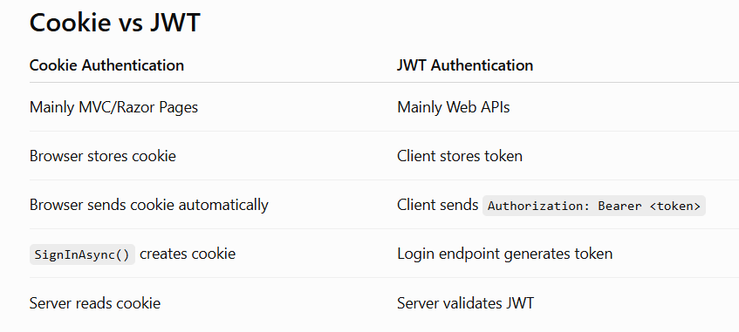
Cookies vs JWT

Slide 70
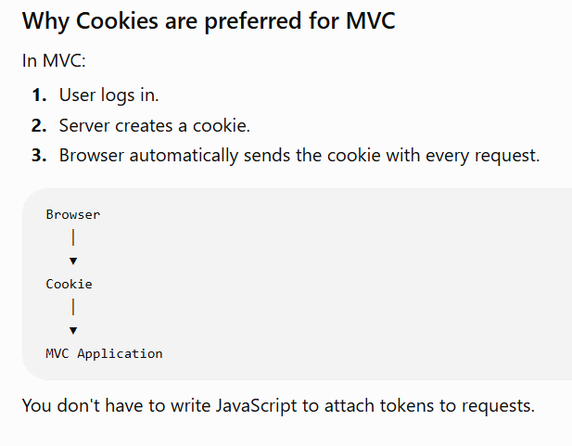
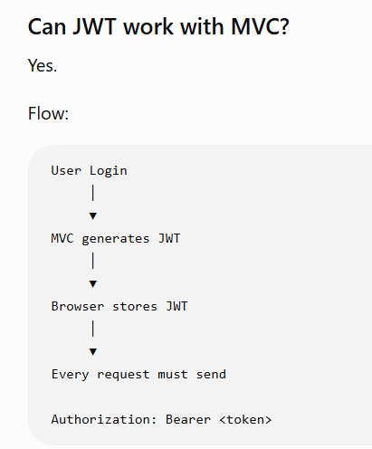

Slide 71
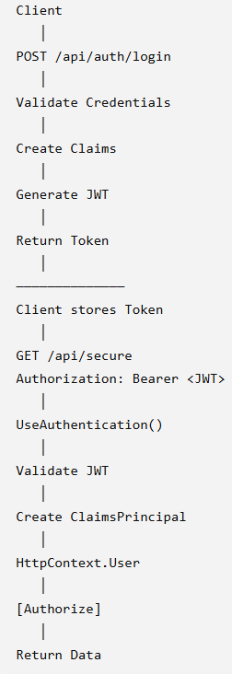
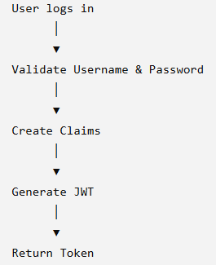
JWT Flow

Slide 72
Logger in asp.net core
Build service
builder.Logging.ClearProviders();
builder.Logging.AddConsole();
builder.Logging.AddDebug();
builder.Logging.AddEventLog();
Update appsettings.json
{ "Logging": { "LogLevel": { "Default": "Information", "Microsoft": "Warning", "Microsoft.AspNetCore": "Warning" } } }
Configure ILogger to controller, razor page, service

Slide 73
ASP.NET Core - Serilog
Install NuGet Packages
Serilog.AspNetCore
Serilog.Sinks.File
Add Service
builder.Host.UseSerilog();
Remove
builder.Logging.ClearProviders();
builder.Logging.AddConsole();
builder.Logging.AddDebug();
Keep below for windows event
builder.Logging.AddEventLog();
Add logger
var logConfig = new LoggerConfiguration()
.WriteTo.Console()
.WriteTo.File("Logs/log-.txt", rollingInterval: RollingInterval.Day);
if (OperatingSystem.IsWindows())
{
logConfig.WriteTo.EventLog(
source: "BookManagement",
manageEventSource: true);
}
Log.Logger = logConfig.CreateLogger();

Slide 74
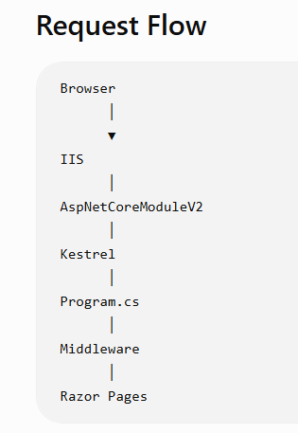
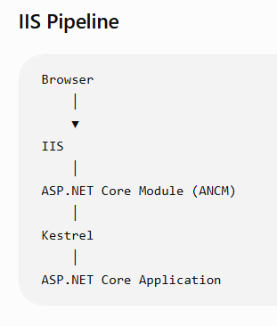
IIS

Slide 75
Enable IIS and Verify it
Open
Control Panel → Programs → Turn Windows features on or off
Enable:
Internet Information Services (IIS)
World Wide Web Services
Click OK and wait for installation.
Verify IIS Installation
http://localhost
You should see the IIS Welcome Page.

Slide 76
For asp.net core 10 apps
Install .NET SDK 10
Verify -> dotnet --list-sdks
Install ASP.NET Core Hosting Bundle
Verify → Control Panel → Programs and Features → Look for Microsoft .NET Windows Server Hosting 10

Slide 77
Publish Application and Configure Folder Permission
Goto .csproj folder
dotnet publish -c Release
Creates → bin/Release/net10.0/publish
Configure publish Folder Permissions
Properties → Security → Edit → Add
Add IIS_IUSRS
Create an Application Pool
IIS Manager –> Application Pools –> Create Application Pools → WebRazorProject
Settings:
.NET CLR Version → No Managed Code
Managed Pipeline → Integrated
Important
ASP.NET Core applications run on Kestrel.
IIS acts only as a Reverse Proxy, so always select No Managed Code.

Slide 78
Configure Site in IIS for created App Pool
Sites → Add Website
Manage Website → Start
http://localhost:8080 (Check if any other port )

Slide 79
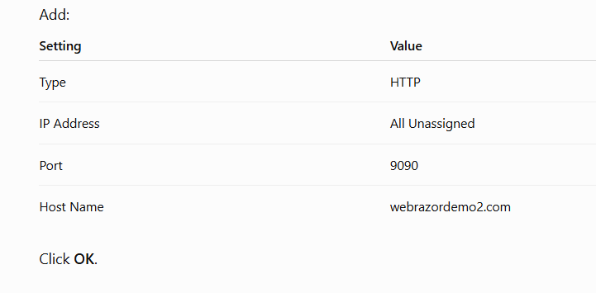
Hosting using Custom Domain
Open Notepad as Administrator. C:\Windows\System32\drivers\etc\hosts
Add
127.0.0.1 webrazordemo2.com
Flush DNS Cache → ipconfig /flushdns
ping webrazordemo2.com and verify the response
Open IIS → Site → Bindings... → Configure below details → browser & check http://webrazordemo2.com:9090

Slide 80
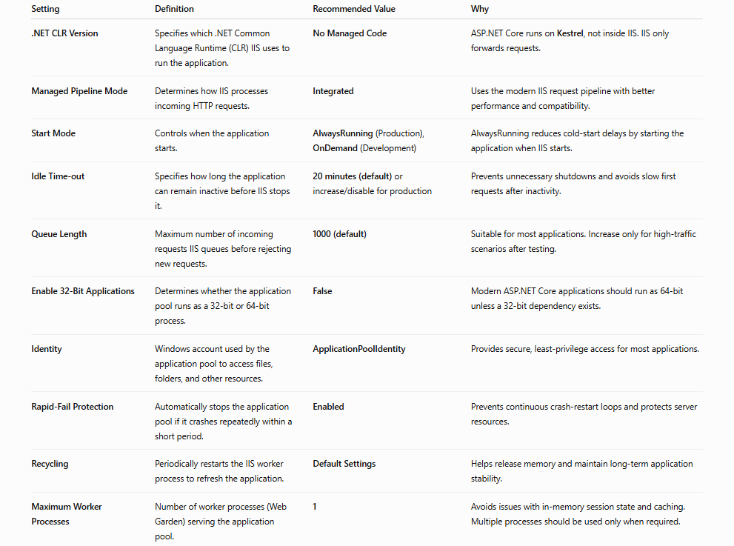
IIS Advance settings

Slide 81
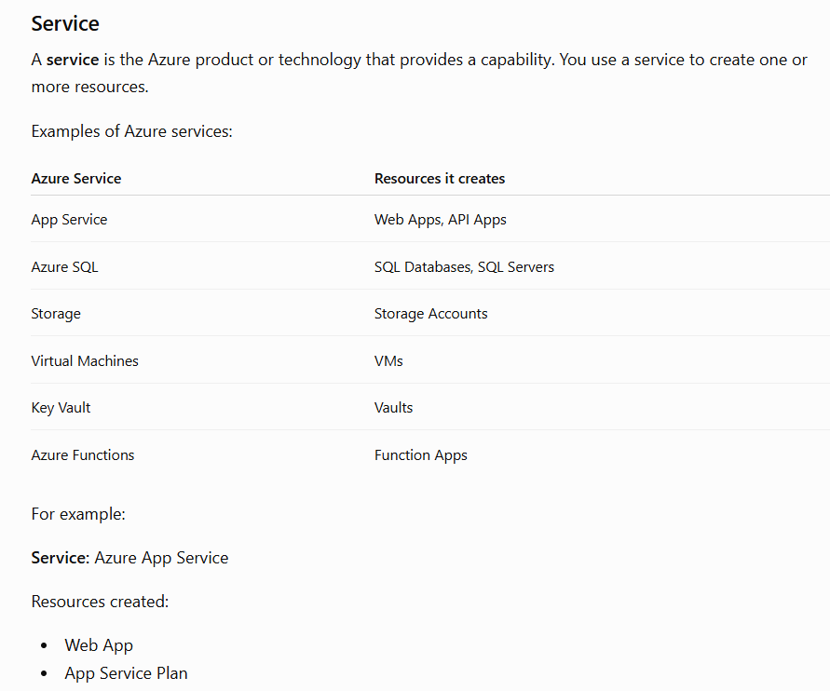
Azure - Understanding its Service

Slide 82
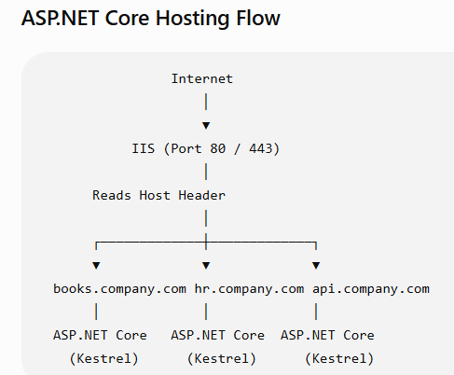
How IIS host multiple application in default port
This is the same principle used by IIS, Apache, and Nginx to host many applications on a single server using ports 80 and 443.

Slide 83
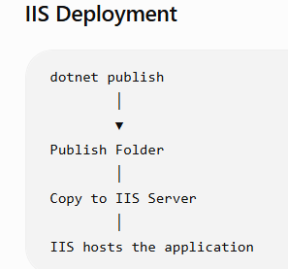

IIS vs Azure hosting

Slide 84

Azure - Understanding its Resource

Slide 85
Hosting Web App in Azure - Setting up App service
Create an App Service
Subscription : Azure Subscription 1
Resource Group : ResourceDemo1
Name : WebRazorApp
Runtime : .NET 10
OS : Windows
Region : Central US
Free tier as of now
Select next till final page
Review & Create
Wait for Deployment Complete

Slide 86

Verify the default app hosting
Open the Hosted Application
Go to Resource → Select your app → check hosted link → The default Azure welcome page or your application appears.
Azure Resources Created

Slide 87
Using vscode to publish to azure
Goto .csproj folder and run dotnet publish -c Release
Publish folder that need to be deployed in azure will be created.
Azure Extension
Sign in to Azure from VS Code
Azure icon → subscription → app service → (You should see your Web App.)
Right-click the Web App → Deploy to Web App... → select the published folder
VS Code creates a configuration file.
.vscode/settings.json - change if needed to change deployment later

Slide 88

Quick Demo on good to know features
Transient, Scoped, Singleton
Session State Management (vs singleton - only to understand it clearly)

Slide 89
Caching - In-Memory Cache
Caching stores frequently used data temporarily so the application doesn't have to fetch it repeatedly from the database or an API.
In memory cache
Stores data in the application's RAM.
Very fast
Lost when the application restarts
Best for a single server
Without cache → every request need to access DB or API
With cache →
First Refresh Database → Cache
Next 100 Refreshes Cache → User

Slide 90

In memory cache usage
builder.Services.AddMemoryCache();

Slide 91
Distributed Cache
Stores cache in a separate server (usually Redis).
Used when multiple application servers are running.
Every application shares the same cache.
To work on it
dotnet add package Microsoft.Extensions.Caching.StackExchangeRedis
builder.Services.AddStackExchangeRedisCache(options =>
{ options.Configuration = "localhost:6379";
options.InstanceName = "BookApp:"; });

Slide 92

Distributed Cache
InstanceName = "BookApp:" →
A prefix (namespace) automatically added to every key.
"Books" → The actual cache key you use in your code.
Internally Redis stores it as:
BookApp:Books

Slide 93

Cache vs Session

Slide 94

HttpClient
HttpClient is used to communicate with external Web APIs or web services
HttpClient allows one application to call another application over HTTP (GET, POST, PUT, DELETE).
Example:
// GET await _httpClient.GetAsync(url);
// POST await _httpClient.PostAsJsonAsync(url, book);
// PUT await _httpClient.PutAsJsonAsync(url, book);
// DELETE await _httpClient.DeleteAsync(url);

Slide 95


Project Structure

Slide 96

Unit Testing

Slide 97
Learning never stops. Keep exploring, keep building, and keep developing!
Balaji Dinakaran
Linkedin

