Slide 1
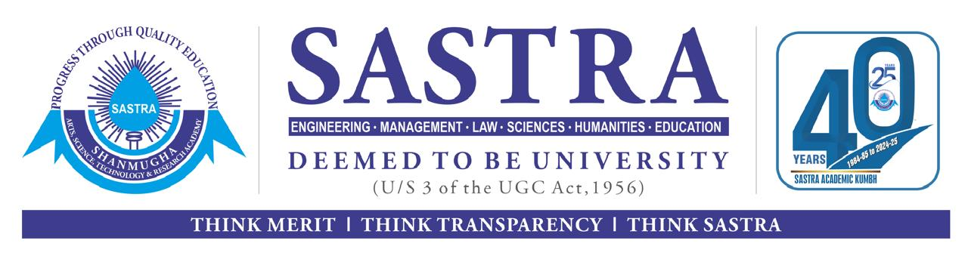
Vision-Based Hand Exercise Recognition and Feedback System for Rehabilitation
Presented by
Balaji M(126006058)
Project Guide
Dr.Nirmala Jegadeesan, SEEE
SASTRA Deemed to be University

Slide 2
Contents
Problem Statements
Objective
Literature Survey
Methodology
Exercise Selection
Data Acquisition
Feature Normalization
Model Training
Performance Evaluation
Future Work

Slide 3
Problem Statements
Stroke patients with hand paralysis often lack continuous supervision during rehabilitation, making it difficult to ensure correct exercise performance.
Existing rehabilitation systems commonly rely on wearable sensors, which may be uncomfortable, expensive, or unsuitable for long-term home use.
There is a need for a low-cost, non-invasive system that can automatically recognize hand rehabilitation exercises and provide real-time feedback.

Slide 4
Objective
Literature review – Study existing hand rehab and gesture systems
Exercise selection – Choose predefined hand exercises
Image capture – Collect hand exercise images using a camera
Recognition – Detect exercises in real time using live video
Feedback – Provide real-time hardware feedback

Slide 5
Literature Survey
Title | Limitations | Improvements
A Device for Local or Remote Monitoring of Hand Rehabilitation Sessions for Rheumatic Patients D. Pani, G. Barabino, A. Dessì, IEEE Journal of Biomedical and Health Informatics, Nov. 2015. | Focused on static gestures, limited classes, no rehabilitation feedback, and constrained real-time adaptability. | Extended to dynamic hand exercises with real-time recognition and hardware-based feedback for rehabilitation support.
Wearable Hand Rehabilitation System With Soft Gloves X. Chen, L. Gong, L. Wei, S.-C. Yeh, IEEE Transactions on Industrial Informatics, Feb. 2021. | The glove doesn’t support many rehab tasks, and we don’t know if it works well long-term. Adding more therapy features and better real-time changes can help more patients. | Adding more exercises to help with different hand movements and recovery. Testing the glove for a longer time to see how well it works.
Sign language detection P. Kadiyala, International Research Journal of Engineering and Technology (IRJET),Jul. 2021. | Limited to static sign recognition for communication, lacks real-time monitoring, rehabilitation focus, exercise evaluation, and hardware-based feedback. | Supports real-time hand rehabilitation exercise recognition, continuous monitoring, and integrates hardware-based visual or auditory feedback for effective therapy.

Slide 6
Methodology
1
Literature Review
4
3
2
Data Organization
Data Acquisition
Exercise Selection
5
6
7
Feature Normalization
Model Training
Performance Evaluation
9
9
8
Final Prototype
Real-Time Inference

Slide 7
Methodology
Review hand rehabilitation literature
Select predefined hand exercises
Capture and organize exercise data
Extract and preprocess hand landmarks
Train and evaluate ML model
Implement real-time recognition with feedback

Slide 8
Exercise Selected
Grip power
Finger flexion
Flexion
Bending of knuckle
Abduction and adduction
Opposition
Thumb movement

Slide 9
Data Acquisition
Data Acquisition & Dataset Preparation
Real-Time Capture: Used OpenCV with Python to capture webcam images.
Structured Classes: Defined 14 gesture classes for clear classification.
Balanced Dataset: Collected 100 images per class (1400 total) to avoid bias.
Quality Control: Used manual key capture to ensure clear and correct gestures.
Auto Organization: Script automatically saved images into class folders.
Training Ready: Created a labeled dataset ready for feature extraction and model training.

Slide 10
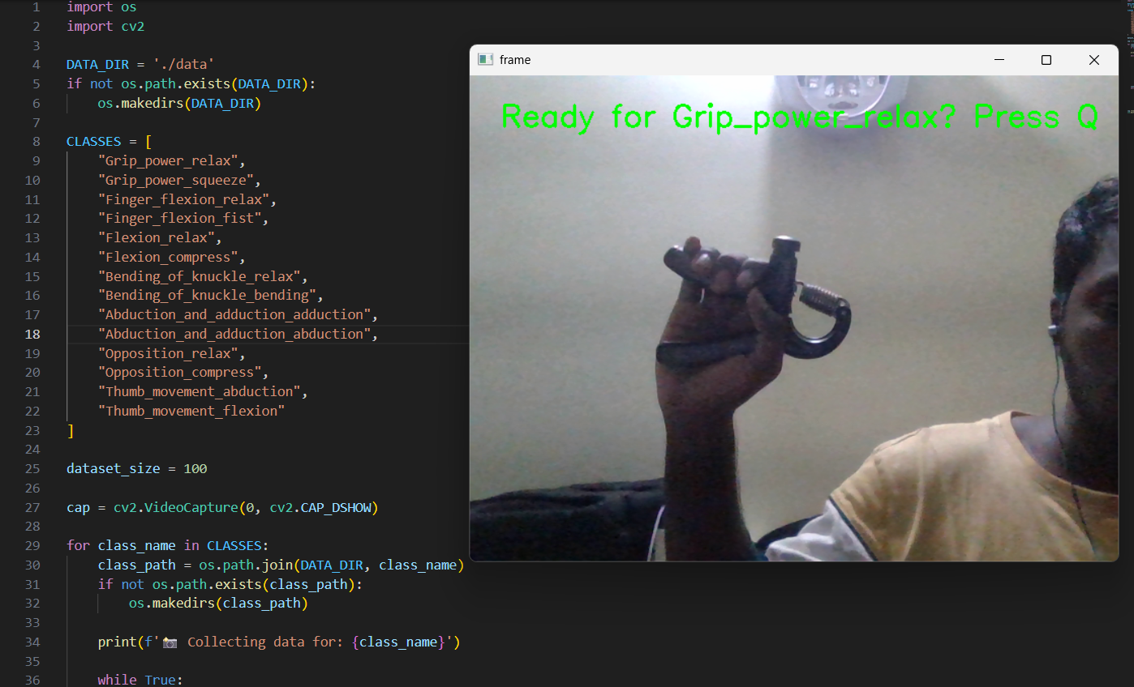
Data Acquisition
Capturing hand gesture images using a webcam for dataset creation.

Slide 11
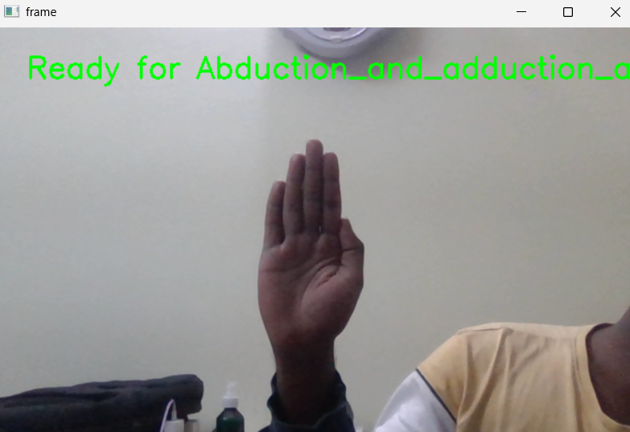
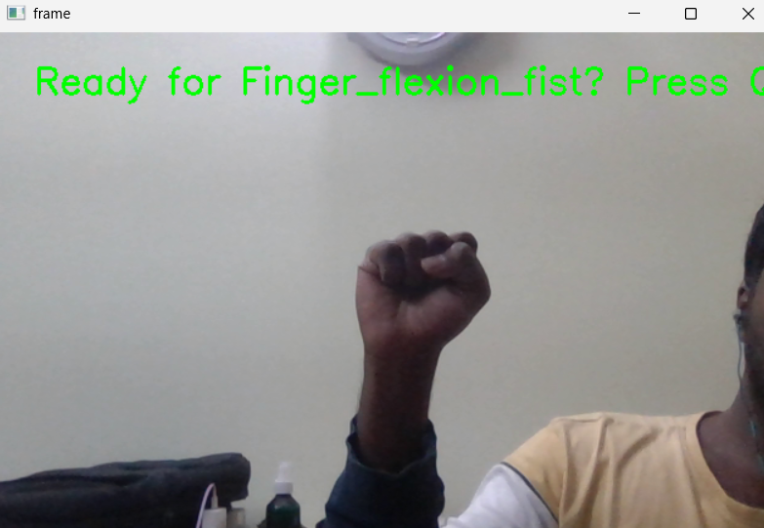
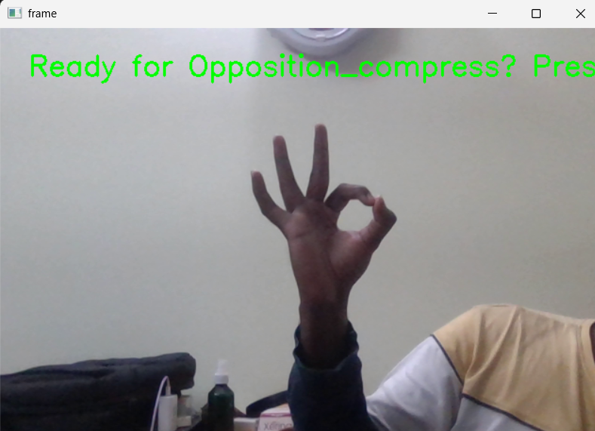
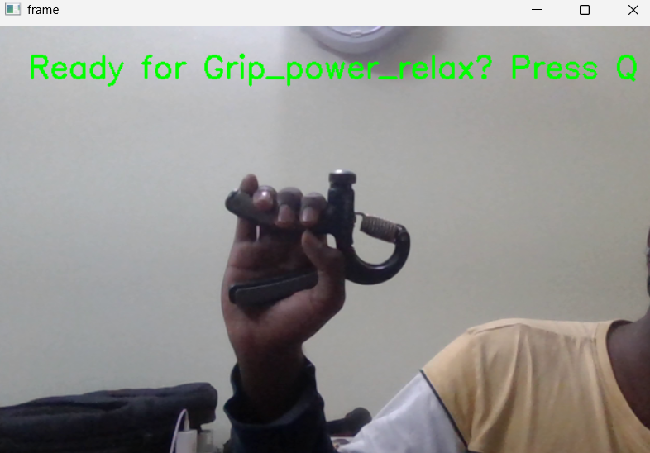
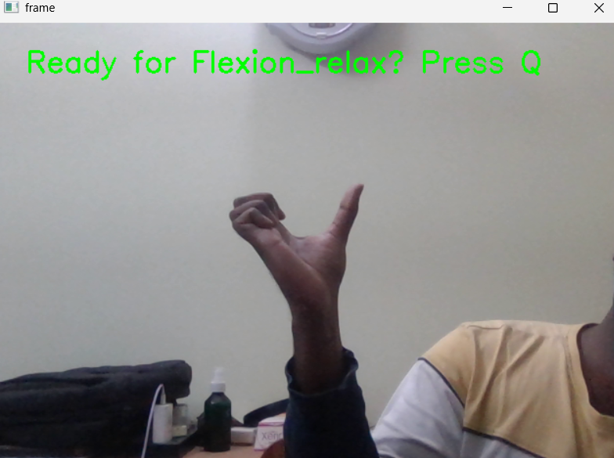
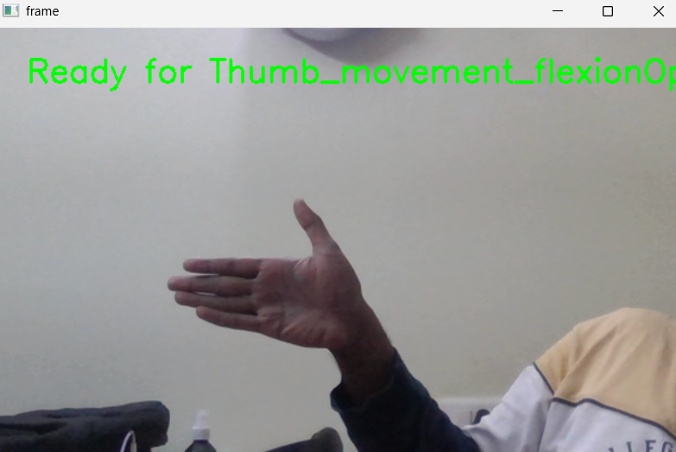
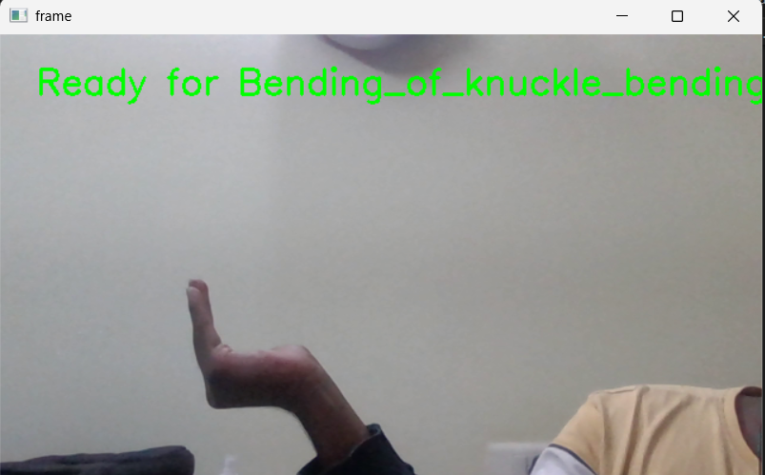
Data Acquisition
Real time Data Acquisition:
Abduction & adduction
Finger Flexion
Opposition
Grip Power
Bending of Knuckle
Flexion
Thumb Movement

Slide 12
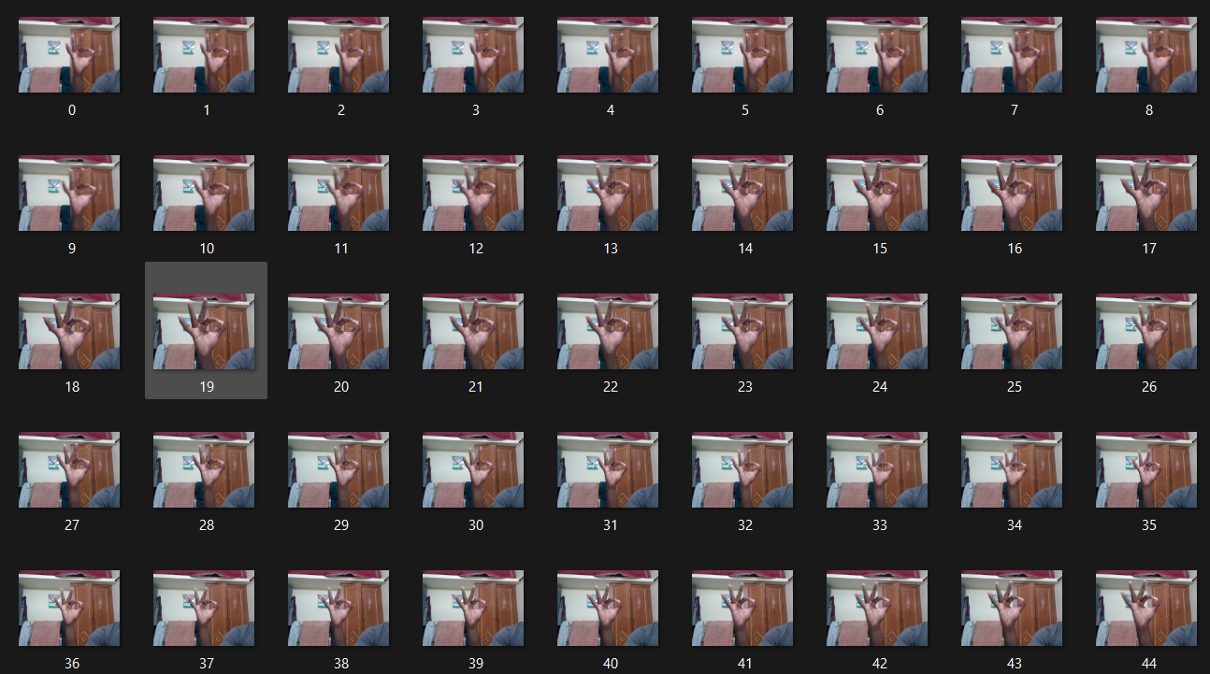
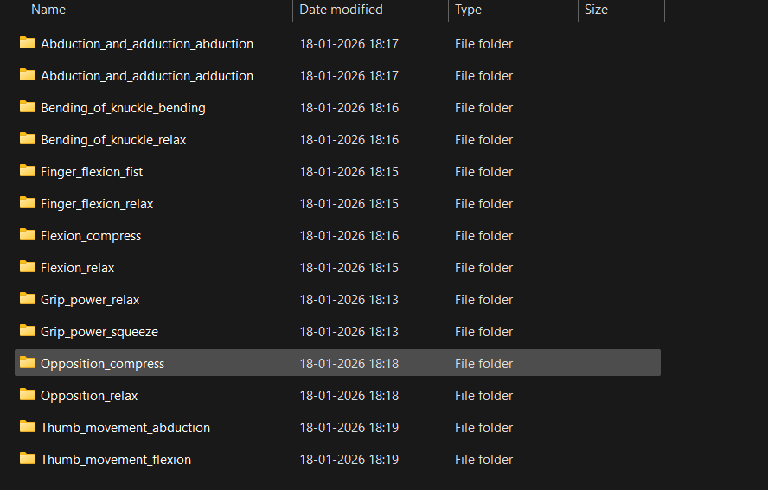
Data Acquisition
Capturing 100 hand gesture images per exercise in separate folders

Slide 13
Feature Normalization
Feature Extraction & Data Processing
Structured Dataset: Images stored in labeled folders for supervised learning.
Hand Landmark Detection: Used MediaPipe Hands to detect 21 hand landmarks.
Feature Creation: Extracted 42 features (x, y coordinates) to represent hand shape.
Data Cleaning: Removed images where no hand landmarks were detected.
Efficient Storage: Saved processed data in a Pickle file for faster training.

Slide 14
Model Training
Classifier Evaluation
 | Final Accuracy (%) | Training Time (s) | Testing time (s) | F1- Score
Random Forest | 99.831 | 0.51 | 0.008 | 0.9988
KNN | 99.031 | 2.54 | 1.599 | 0.9698
XGBoost | 99.001 | 1.25 | 0.532 | 0.9898
Comparison table between three ML models

Slide 15
Model Training
Model Selection
High Accuracy: Random Forest achieved the best accuracy and F1 score.
Gesture Detection: Learns patterns between hand landmarks (42 features) and gestures.
Ensemble Method: Uses many decision trees and combines their results.
Robust Model: Handles noise better than K-Nearest Neighbors and XGBoost.
Good Speed: Balanced training and prediction speed for real-time use.

Slide 16
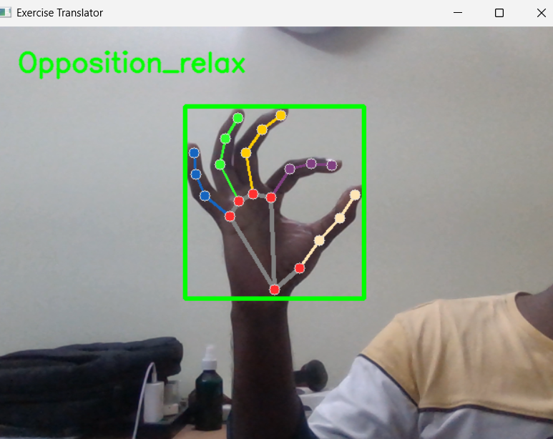
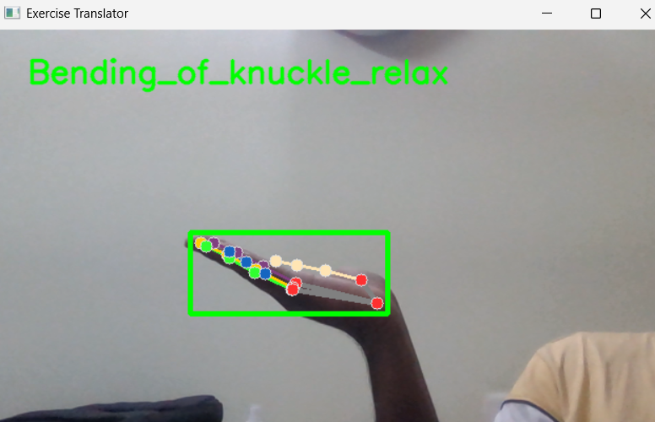
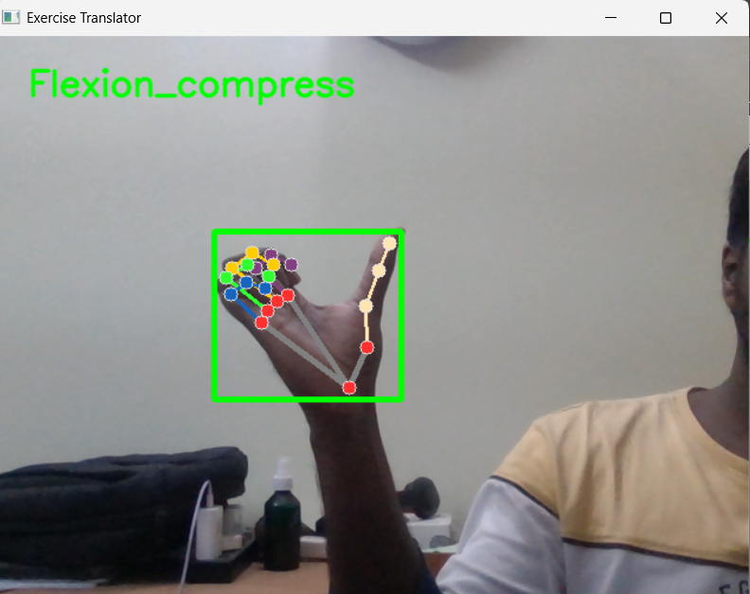
Performance Evaluation
The system identifies different hand movements and displays the corresponding exercise name.

Slide 17
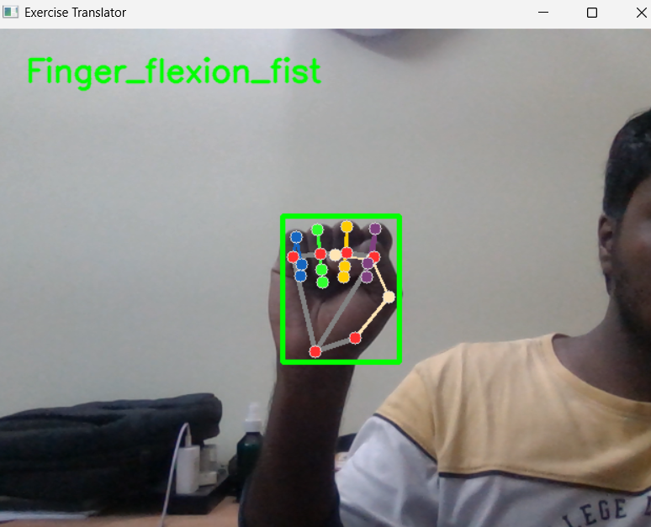
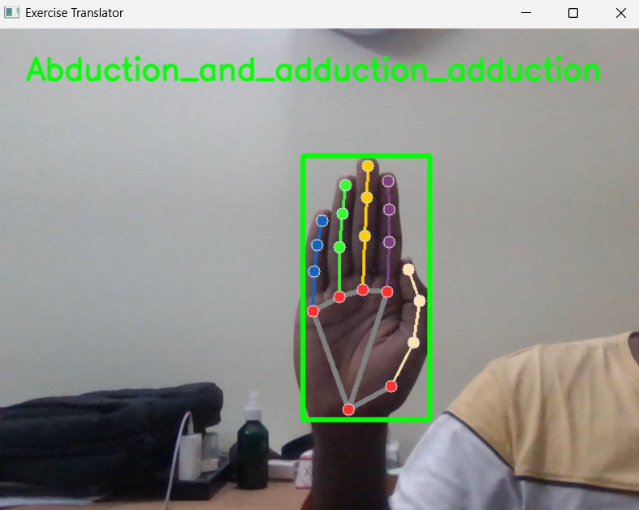
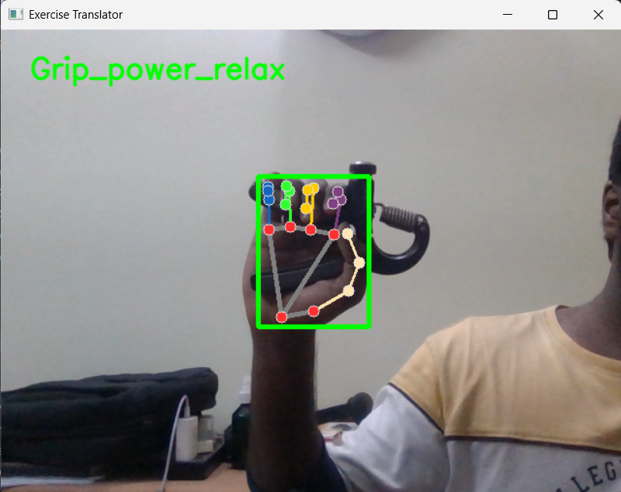
Performance Evaluation
Real-time exercise recognition using the trained ML model and hand landmark detection.

Slide 18
Performance Evaluation
System Performance Analysis
Accurate Detection: The system correctly detects hand landmarks in real time.
Exercise Classification: Different hand exercises are recognized by the trained ML model.
Real-Time Processing: The system processes video frames instantly without delay.
Reliable Performance: The system works consistently for different hand movements.

Slide 19
Future Work
Phase 1
Literature Review
Exercise Selection
✅
Phase 2
Data Acquisition
Feature Normalization
Model Training &
Performance Evaluation
✅
Hardware Implementation
Real-Time Inference
& Feedback
Phase 3
Custom UI Creation
❌
9
Phase 4
Final Prototype
❌

Slide 20
Thank You

