Slide 1

Vision-Based Hand Exercise Recognition and Feedback System for Rehabilitation
Presented by
Balaji M(126006058)
Project Guide
Dr.Nirmala Jegadeesan, SEEE
SASTRA Deemed to be University

Slide 2
Contents
Problem Statements
Objective
Literature Survey
Methodology
Exercise Selection
Data Acquisition
Feature Normalization
Model Training
Performance Evaluation
Future Work

Slide 3
Problem Statements
Stroke patients with hand paralysis often lack continuous supervision during rehabilitation, making it difficult to ensure correct exercise performance.
Existing rehabilitation systems commonly rely on wearable sensors, which may be uncomfortable, expensive, or unsuitable for long-term home use.
There is a need for a low-cost, non-invasive system that can automatically recognize hand rehabilitation exercises and provide real-time feedback.

Slide 4
Objective
Literature review – Study existing hand rehab and gesture systems
Exercise selection – Choose predefined hand exercises
Image capture – Collect hand exercise images using a camera
Recognition – Detect exercises in real time using live video
Feedback – Provide real-time hardware feedback

Slide 5
Discussion
1. Compared to wearable glove systems, the proposed system is:
Low-cost
Comfortable
Easy to use at home
2. Eliminates need for hardware sensors → reduces maintenance
3. Provides real-time feedback, improving exercise correctness
4. Limitation:
Sensitive to camera quality and lighting
Requires proper hand positioning

Slide 6
Literature Survey
Title | Limitations | Improvements
A Device for Local or Remote Monitoring of Hand Rehabilitation Sessions for Rheumatic Patients D. Pani, G. Barabino, A. Dessì, IEEE Journal of Biomedical and Health Informatics, Nov. 2015. | Focused on static gestures, limited classes, no rehabilitation feedback, and constrained real-time adaptability. | Extended to dynamic hand exercises with real-time recognition and hardware-based feedback for rehabilitation support.
Wearable Hand Rehabilitation System With Soft Gloves X. Chen, L. Gong, L. Wei, S.-C. Yeh, IEEE Transactions on Industrial Informatics, Feb. 2021. | The glove doesn’t support many rehab tasks, and we don’t know if it works well long-term. Adding more therapy features and better real-time changes can help more patients. | Adding more exercises to help with different hand movements and recovery. Testing the glove for a longer time to see how well it works.
Sign language detection P. Kadiyala, International Research Journal of Engineering and Technology (IRJET),Jul. 2021. | Limited to static sign recognition for communication, lacks real-time monitoring, rehabilitation focus, exercise evaluation, and hardware-based feedback. | Supports real-time hand rehabilitation exercise recognition, continuous monitoring, and integrates hardware-based visual or auditory feedback for effective therapy.

Slide 7
Methodology
1
Literature Review
4
3
2
Data Organization
Data Acquisition
Exercise Selection
5
6
7
Feature Normalization
Model Training
Performance Evaluation
9
9
8
Final Prototype
Real-Time Inference

Slide 8
Methodology
Review hand rehabilitation literature
Select predefined hand exercises
Capture and organize exercise data
Extract and preprocess hand landmarks
Train and evaluate ML model
Implement real-time recognition with feedback

Slide 9
Exercise Selected
Grip power
Finger flexion
Flexion
Bending of knuckle
Abduction and adduction
Opposition
Thumb movement

Slide 10
Data Acquisition
Data Acquisition & Dataset Preparation
Real-Time Capture: Used OpenCV with Python to capture webcam images.
Structured Classes: Defined 14 gesture classes for clear classification.
Balanced Dataset: Collected 100 images per class (1400 total) to avoid bias.
Quality Control: Used manual key capture to ensure clear and correct gestures.
Auto Organization: Script automatically saved images into class folders.
Training Ready: Created a labeled dataset ready for feature extraction and model training.

Slide 11
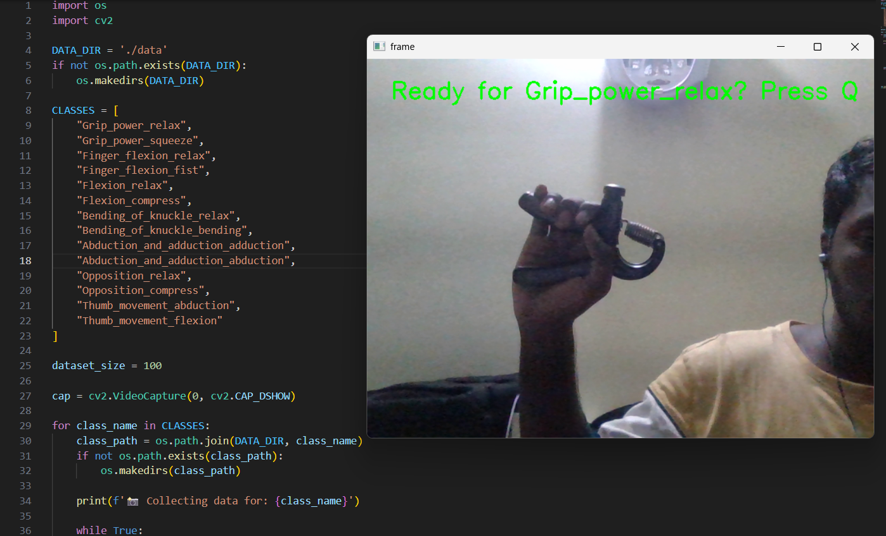
Data Acquisition
Capturing hand gesture images using a webcam for dataset creation.

Slide 12
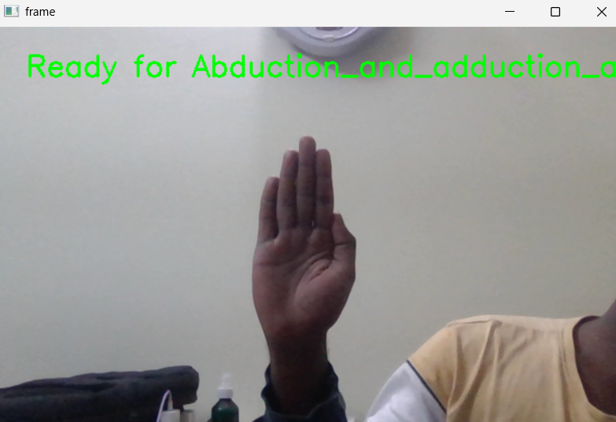
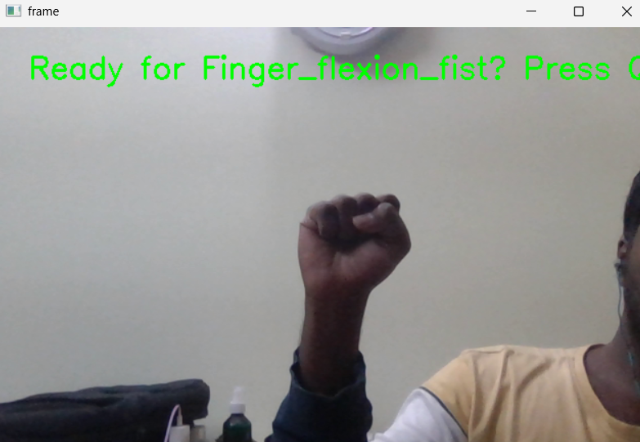
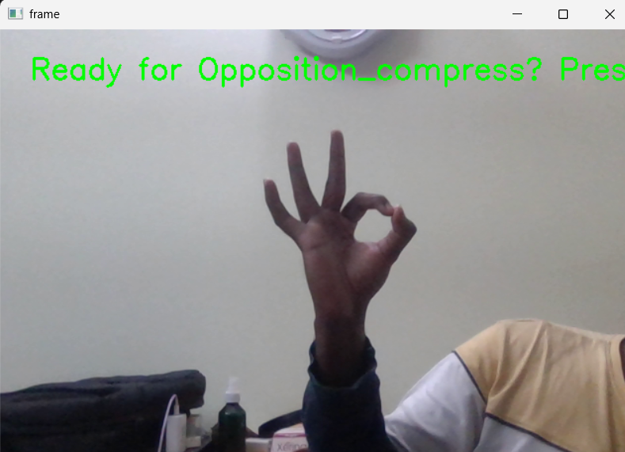
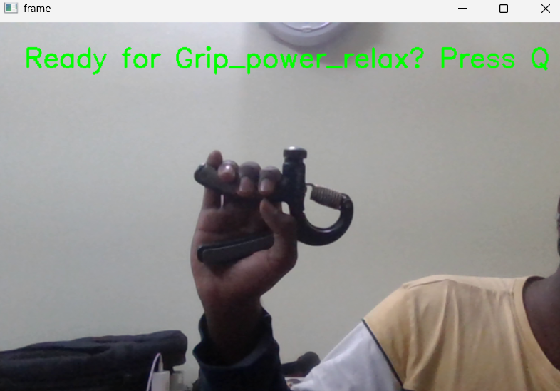
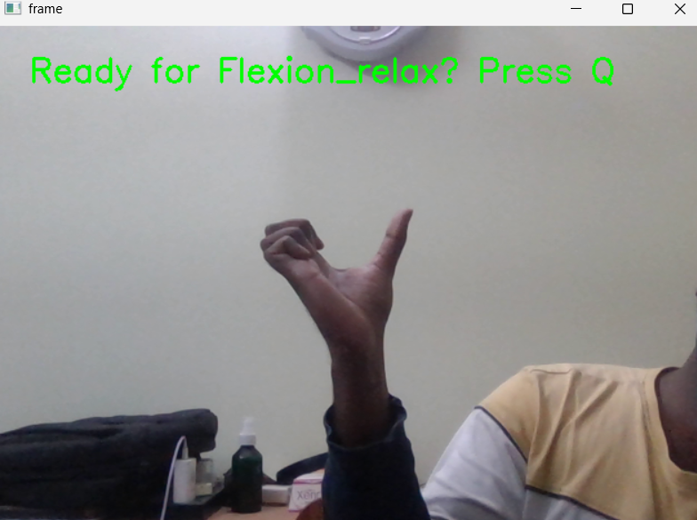
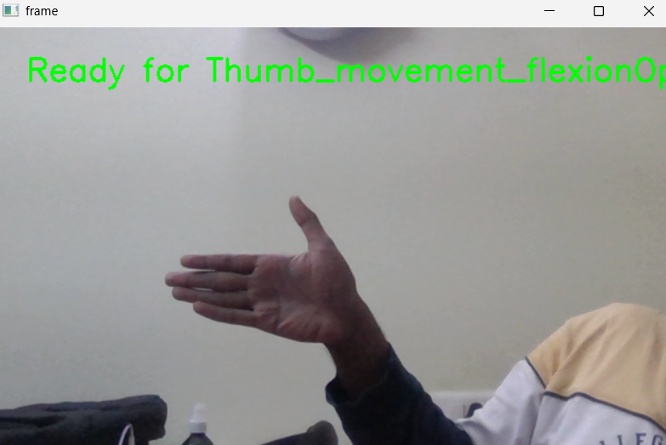
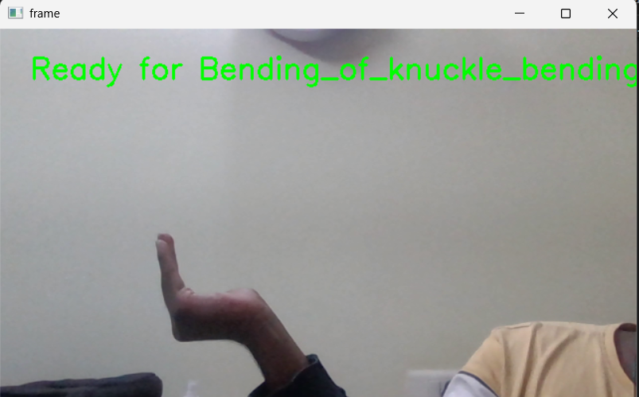
Data Acquisition
Real time Data Acquisition:
Abduction & adduction
Finger Flexion
Opposition
Grip Power
Bending of Knuckle
Flexion
Thumb Movement

Slide 13
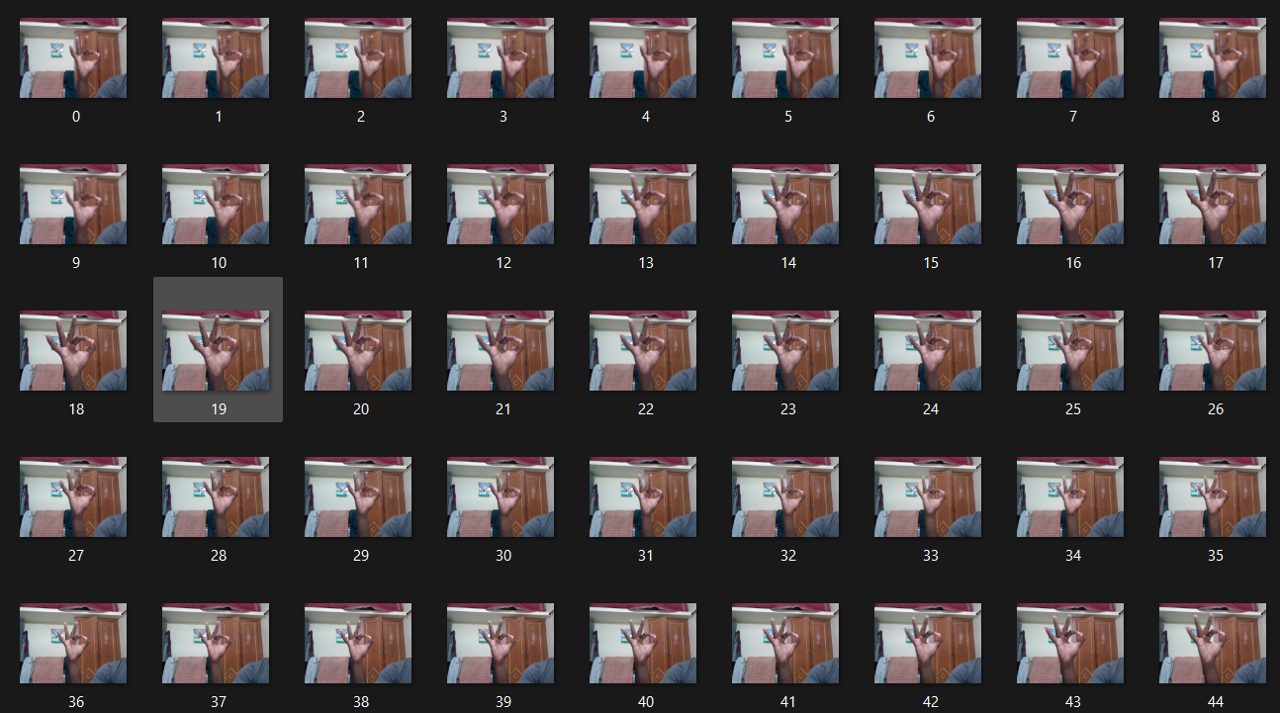
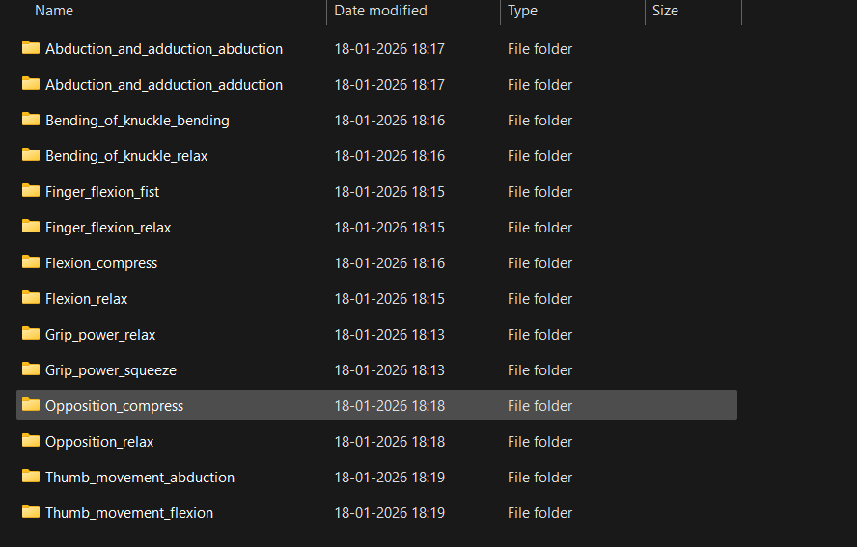
Data Acquisition
Capturing 100 hand gesture images per exercise in separate folders

Slide 14
Data Acquisition
Ethical Considerations & Standards:
The system is non-invasive and does not require wearable sensors, ensuring user comfort
No personal or sensitive user data is stored or shared, it is used to train the model, once it is done, the data is erased
All processing is done locally or securely, ensuring data privacy
Designed for assistive rehabilitation only, not as a replacement for medical professionals
Ensures safe usage without causing strain or incorrect exercise enforcement

Slide 15
Feature Normalization
Feature Extraction & Data Processing
Structured Dataset: Images stored in labeled folders for supervised learning.
Hand Landmark Detection: Used MediaPipe Hands to detect 21 hand landmarks.
Feature Creation: Extracted 42 features (x, y coordinates) to represent hand shape.
Data Cleaning: Removed images where no hand landmarks were detected.
Efficient Storage: Saved processed data in a Pickle file for faster training.

Slide 16
Evaluation Metrics
We evaluate and select the most suitable machine learning model based on the following performance metrics.
Performance metrics and formulas:
Accuracy = (TP + TN) / (TP + TN + FP + FN)
Precision = TP / (TP + FP)
Recall = TP / (TP + FN)
F1 Score = 2 × (Precision × Recall) / (Precision + Recall)
Abbreviation:
TP → Correct prediction
FP → Wrong positive
FN → Missed detection

Slide 17
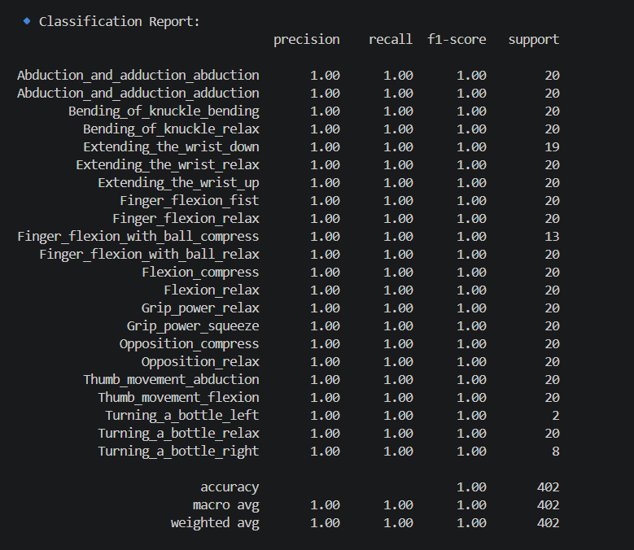
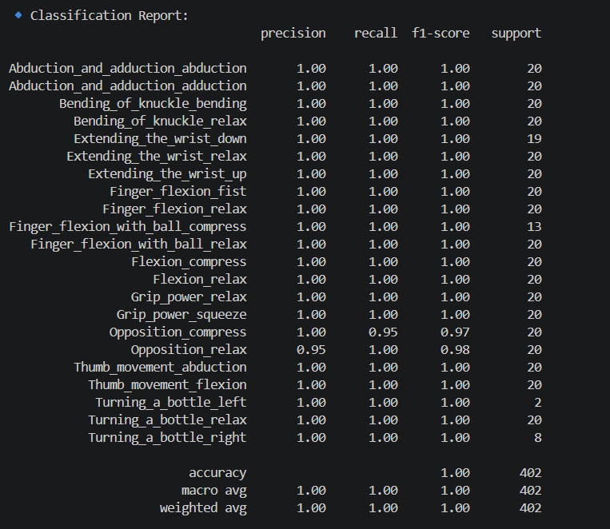
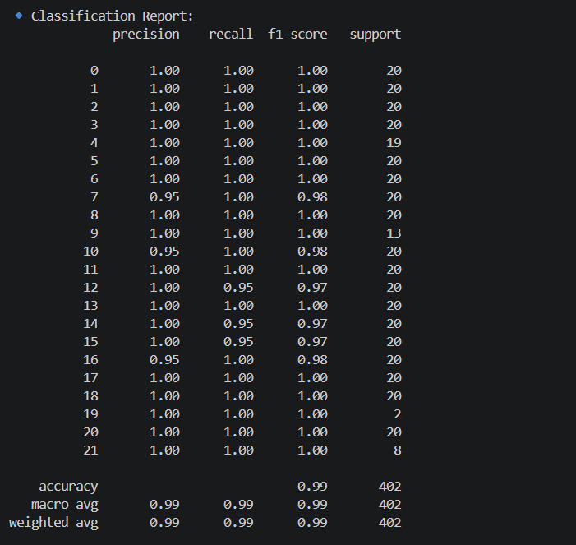
Evaluation Metrics
Classification report of Random Forest
Classification report of KNN
Classification report of XGBoost

Slide 18
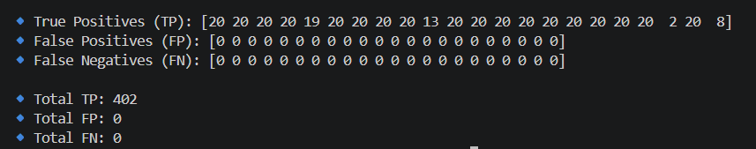
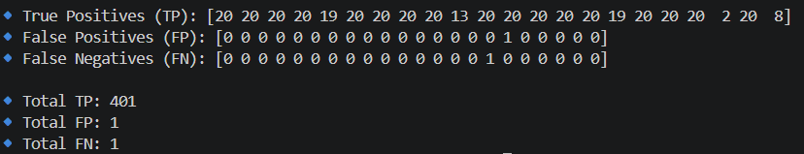
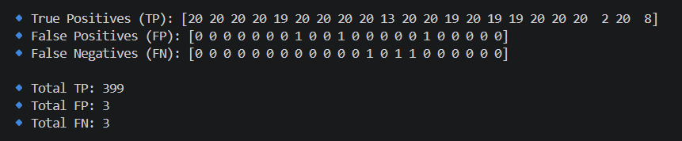
Evaluation Metrics
Random forest
Based on the TP(Correct positive), FP(Wrong positive) and FN(Missed Detection), the evaluation metrics has been calculated and the Machine Learning model is decided
KNN
XGBoost

Slide 19
Model Training
Final comparison table:
 | Final Accuracy (%) | Training Time (s) | Testing time (s) | F1- Score
Random Forest | 99.831 | 0.51 | 0.008 | 0.9988
KNN | 99.031 | 2.54 | 1.599 | 0.9698
XGBoost | 99.001 | 1.25 | 0.532 | 0.9898
Comparison table between three ML models

Slide 20
Results
Result - Model Selection:
High Accuracy: Random Forest achieved the highest accuracy of 99.831 and highest F1 score of 0.9988.
Gesture Detection: Learns patterns between hand landmarks (42 features) and detects 14 exercises phase
Ensemble Method: Uses many decision trees and combines their results.
Robust Model: Handles noise better than K-Nearest Neighbors and XGBoost.
Good Speed: Real-Time latency is less than 1 second

Slide 21
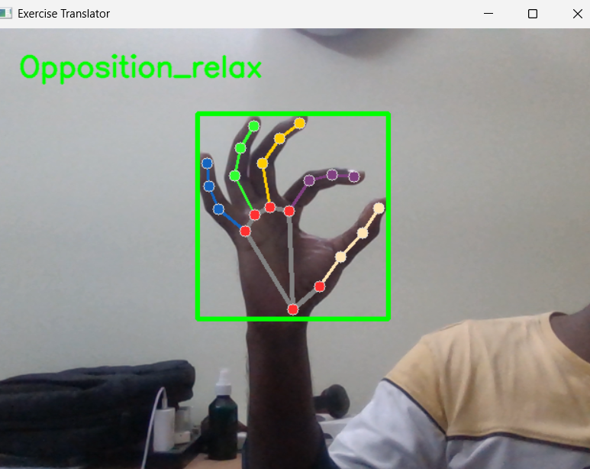
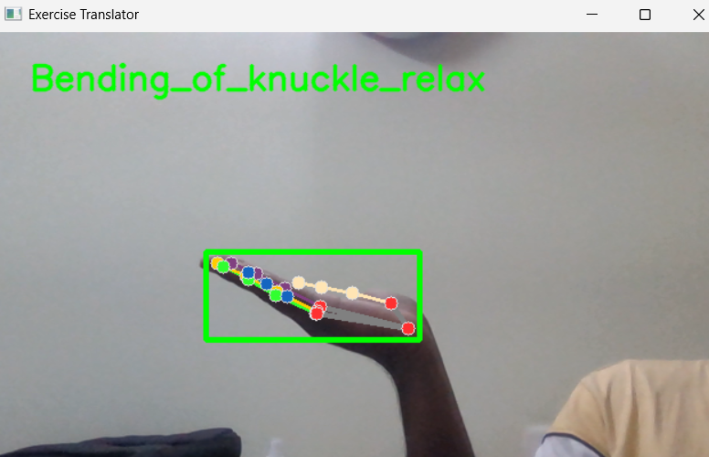
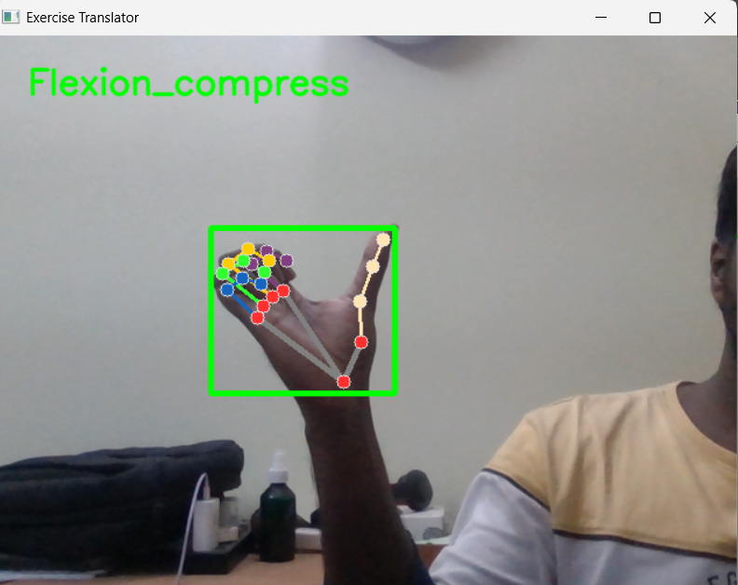
Performance Evaluation
The system identifies different hand movements and displays the corresponding exercise name.

Slide 22
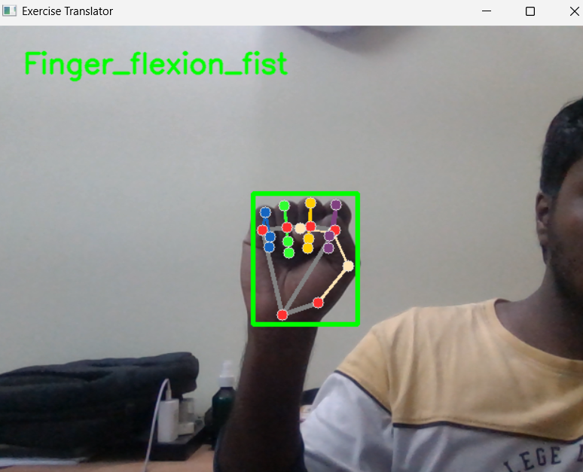
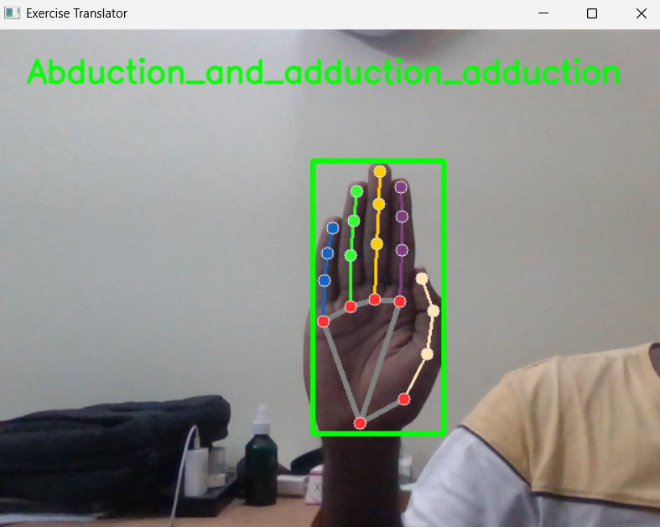
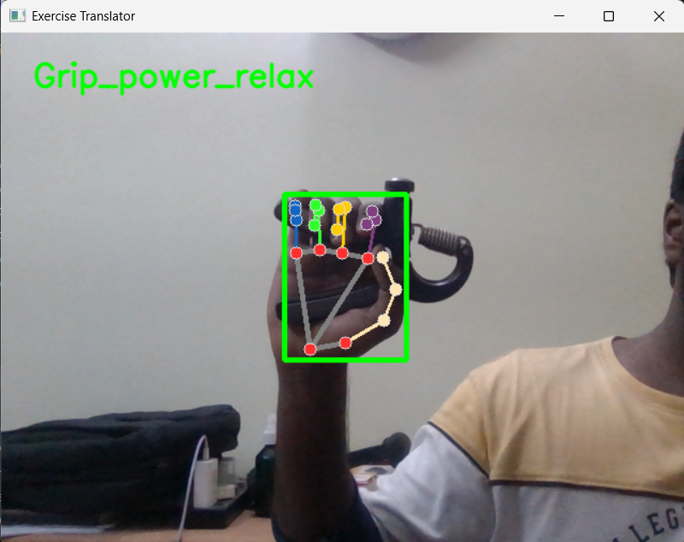
Performance Evaluation
Real-time exercise recognition using the trained ML model and hand landmark detection.

Slide 23
Performance Evaluation
System Performance Analysis
Accurate Detection: The system correctly detects hand landmarks in real time.
Exercise Classification: Different hand exercises are recognized by the trained ML model.
Real-Time Processing: The system processes video frames instantly without delay.
Reliable Performance: The system works consistently for different hand movements.

Slide 24
Interpretation
Performance Interpretation:
Random Forest achieved the best performance due to its ability to handle high-dimensional landmark data (42 features)
Ensemble learning improves robustness and reduces overfitting
The model effectively captures spatial relationships of hand landmarks
Real-time prediction is possible due to efficient feature representation
Insights & Observations:
System performs consistently across predefined gestures with minimal delay
Accuracy depends on lighting conditions and hand visibility
Misclassification may occur for similar gestures (e.g., flexion vs finger flexion)
Model generalizes well due to balanced dataset (100 images per class)

Slide 25
Hardware Implementation
Components & Uses:
1. Arduino Uno:
Acts as the main microcontroller
Controls data flow and connected devices
Interfaces with display and communication modules
2. ESP8266 Wi-Fi Module:
Enables wireless communication
Sends data to Blynk / external applications
Supports real-time feedback
3. OLED Display (I2C):
Displays detected hand exercises
Provides instant visual feedback to the user
Compact and low power
4. SD Card Module:
Used for storing system data and final reports
Enables offline data logging for later analysis
Provides reliable and portable storage solution

Slide 26
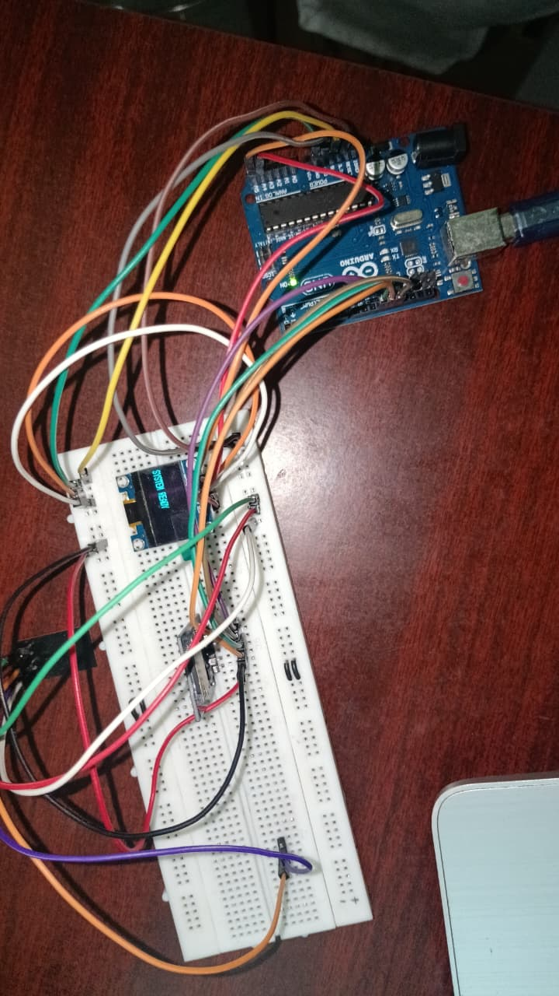
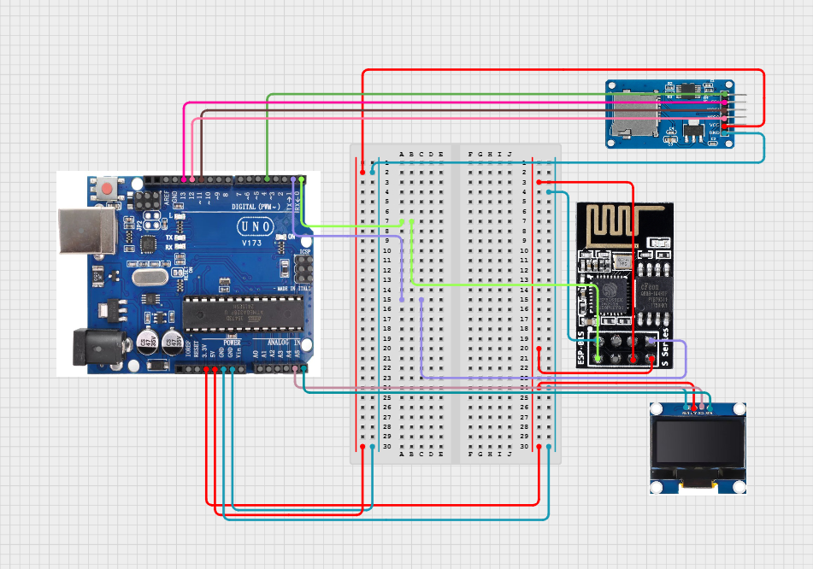
Hardware Implementation
From circuit design simulation to real-time hardware implementation of the rehabilitation feedback system

Slide 27
Custom UI Creation
Custom UI Design:
Displays live camera feed with hand tracking and current exercise/phase information
Includes timer and progress bar for tracking phase duration and workout completion
Shows system status (Idle / Running / Paused / Stopped) clearly
Provides live score and feedback message display for user performance
Offers interactive control buttons: Start, Pause, Resume, and Finish

Slide 28
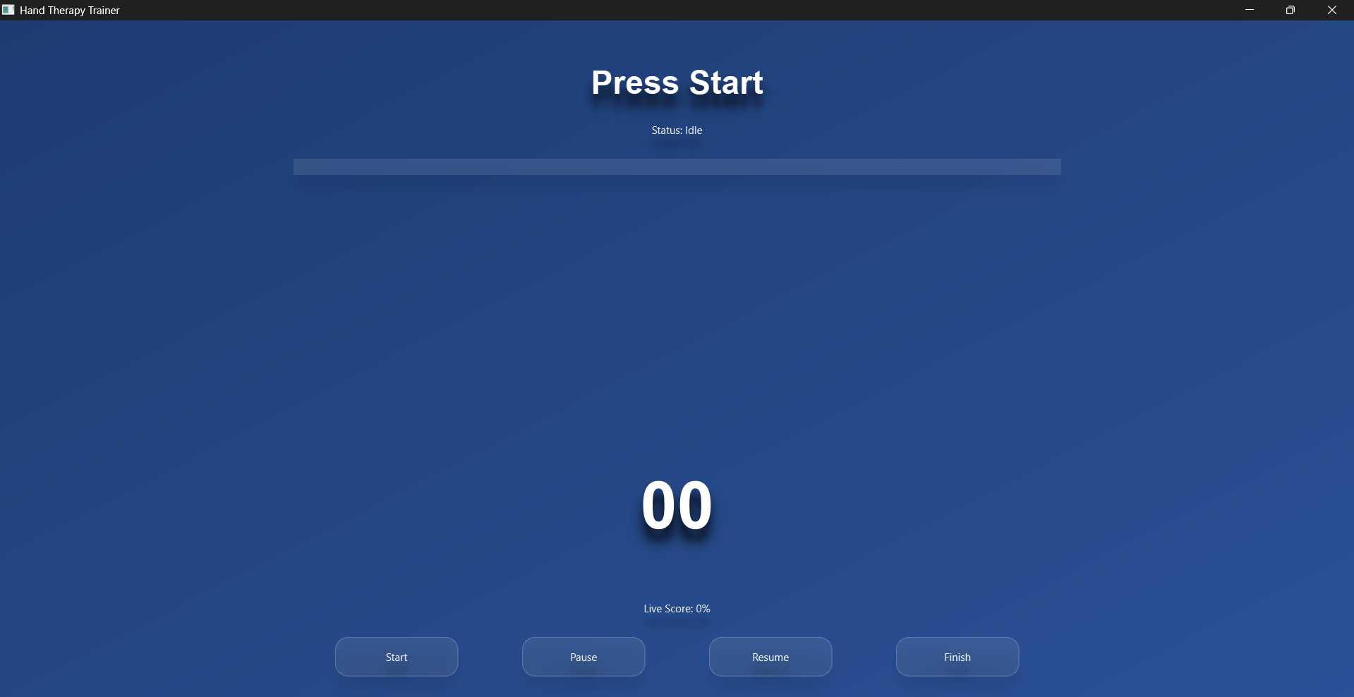
Custom UI Creation
A unified interface that simplifies exercise guidance, monitoring, and user interaction.

Slide 29
Real-Time Inference & Feedback
Real-Time Control, Feedback, and Performance Monitoring:
The custom UI integrates workout control logic and gives real-time feedback, displaying live video feed with hand landmark detection
Processes model predictions, evaluates user performance instantly, and provides real-time feedback messages (Perfect Form, Wrong Phase, etc.)
Calculates and displays live accuracy score dynamically while managing workout flow including exercise phases and rest periods
Includes interactive controls (Start, Pause, Resume, Finish) and automatically stops or pauses when no hand is detected
Generates final report with exercise-wise and overall accuracy and sends feedback to hardware (Arduino & SD card module) and IoT platform (Blynk)

Slide 30
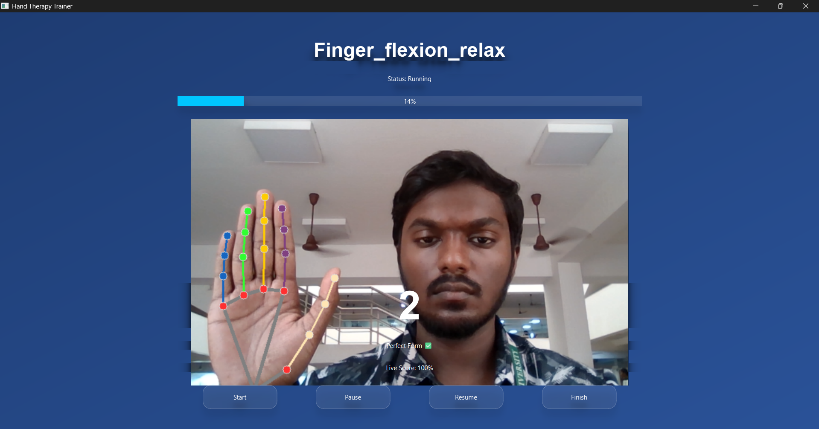
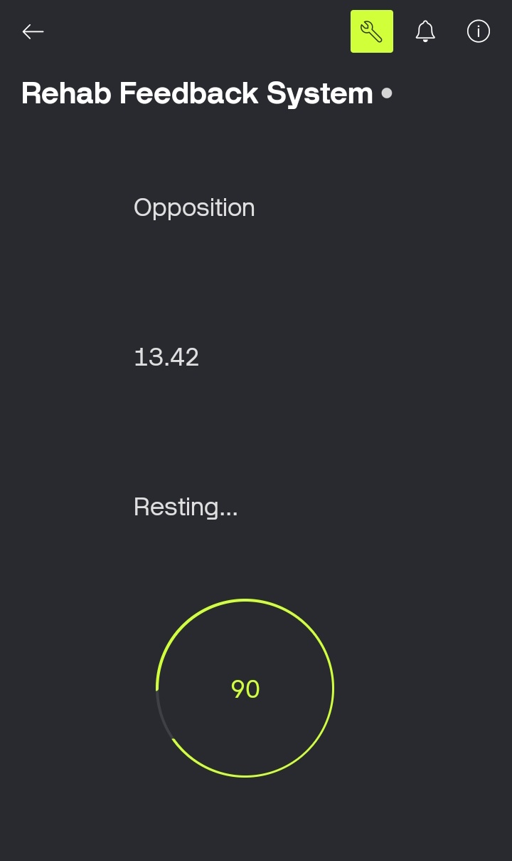
Real-Time Inference & Feedback
Real-time feedback through the UI helps users correct and optimize their movements instantly
Real-time rehabilitation performance, monitored and accessible on Blynk.

Slide 31
Conclusion
Successfully developed a vision-based hand rehabilitation system
Achieved accurate recognition of 14 hand exercises phases
Provides real-time instruction and feedback using ML and computer vision
The System stores final report in SD card as offline logging
Eliminates need for wearable devices
System is suitable for low-cost home-based rehabilitation

Slide 32
References
D. Pani, G. Barabino, A. Dessì, IEEE Journal of Biomedical and Health Informatics, Nov. 2015. “A Device for Local or Remote Monitoring of Hand Rehabilitation Sessions for Rheumatic Patients”. DOI: 10.1109/JTEHM.2014.2299274
Xiaoshi Chen, Li Gong, Liang Wei, Shih-Ching Yeh, Li Da Xu, Lirong Zheng. “A Wearable Hand Rehabilitation System With Soft Gloves”. DOI:10.1109/TII.2020.3010369
P. Kadiyala, International Research Journal of Engineering and Technology (IRJET),Jul. 2021 “Sign language detection”.

Slide 33
Thank You

