Slide 1
TABLEAU
MAKES HUMAN-DATA INTERACTION EASY

Slide 2
Agenda
Introduction
Tableau a success Story
Why Tableau
Use of Tableau
Tableau Terminology
Important to Understand
Tableau Interface
Hands on

Slide 3
Working with Tableau
Connect to Data
Hierarchy, Sorting, Grouping, Filtering
Basic Chart
Advanced Charting
Mapping
Dashboard
Forecasting
Clustering

Slide 4
Why Tableau
Tableau a great tool for Visualization, BI and data analytics
Ideal for complex visualization
Interactive Presentation
Importing Data from other sources is easy
Fast Analytics
Interactive and Smart Dashboards
Share results within seconds
Great support from Tableau Teaching

Slide 5
PRODUCTS OF TABLEAU
TABLEAU DESKTOP
TABLEAU SERVER
TABLEAU READER
TABLEAU ONLINE
TABLEAU PUBLIC

Slide 6
Nitty and gritty
FEATURES OF TABLEAU
Various positions for Tableau
Rapidly analyse data
Browse and Explore
User-friendly Dashboards
Observe and Calculate
Share and Interact
Business Analyst
Data Scientist
Tableau Expert
Tableau Developer
BI Developer
Lead Reporting

Slide 7
TABLEAU CONCEPT
Dimensions
Measures
Dimensions contains qualitative values (such as names, dates or geographical data) that you can not aggregate
Measures contains quantitative values that you can measure, aggregate and use for mathematical operations.

Slide 8
TABLEAU CONCEPT
BLUE FIELDS
GREEN FIELDS
Tableau represents blue fields as ‘Discrete’ means “individually separate and distinct.”
Blue measures such as SUM(Profit) and dimensions Product Name are discrete. These values are treated as finite and add headers to the view.
Tableau represents green fields as ‘Continuous’ means “forming an unbroken whole, without interruption.”
Green measures SUM(Profit) and dimensions Year(Order Date) are continuous. These fields are treated as an infinite range and add axes to the view.

Slide 9
Downloading and Installing Tableau
Go to https://www.tableau.com/academic/students and download tableau after filling the form/registration.
Install the Program.
Run the exe file
After installation you get free trial for 14 days

Slide 10

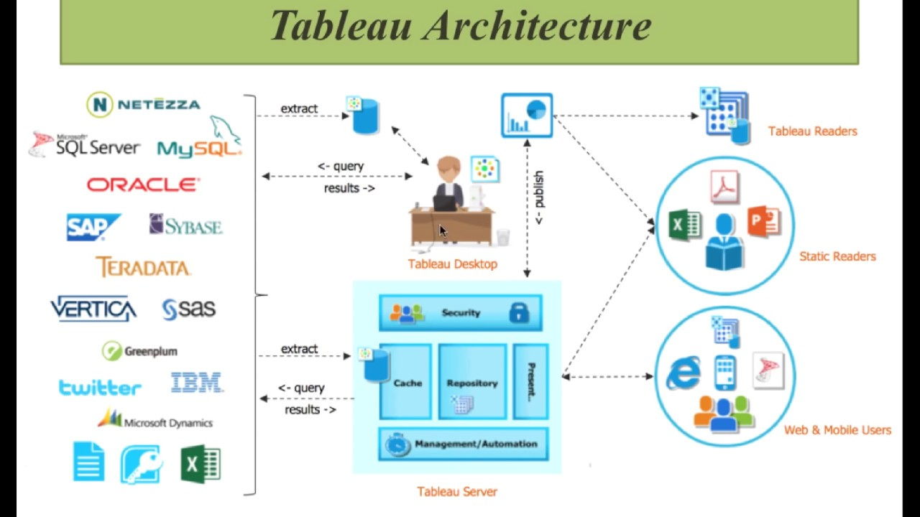
ARCHITECTURE

Slide 11
Analyze data Calculations in tableau
Basic Calculations – transform values at the data source level of detail (a row – level calculation) or at the visualization level of detail (an aggregate calculation)
Table Calculations- transform values at the visualization level only.
Level of Detail (LOD) expressions-
FIXED
INCLUDE
EXCLUDE
(Advanced Level Concept)

Slide 12
Functions
Logical Functions | Syntax | Description
AND | IF <expr1> AND <expr2> THEN <then END | Performs a logical conjunction on two expressions.
CASE | CASE <expression> WHEN <value1> THEN <return1> WHEN <value2> THEN <return2> ... ELSE <default return> END | Performs logical tests and returns appropriate values.

Slide 13
Functions
Logical Function | Syntax | Description
IF | IF <expr> THEN <then> [ELSEIF <expr2> THEN <then2>...] [ELSE <else>] END | Tests a series of expressions returning the <then> value for the first true <expr>.
IFNULL | IFNULL(expr1, expr2) | Returns <expr1> if it is not null, otherwise returns <expr2>.

Slide 14
Functions
Logical Function | Syntax | Description
ISNULL | ISNULL(expression) | Returns true if the expression does not contain valid data (Null).
ZN | ZN(expression) | Returns <expression> if it is not null, otherwise returns zero.

Slide 15
Functions
Aggregate Function | Syntax | Description
ATTR | ATTR(expression) | Returns the value of the expression if it has a single value for all rows. Otherwise returns an asterisk. Null values are ignored.
AVG | AVG(expression) | Returns the average of all the values in the expression. AVG can be used with numeric fields only. Null values are ignored.

Slide 16
Functions
Aggregate Function | Syntax | Description
COUNT | COUNT(expression) | Returns the number of items in a group. Null values are not counted.
COUNTD | COUNTD(expression) | Returns the number of distinct items in a group. Null values are not counted.

Slide 17
Functions
Aggregate Function | Syntax | Description
SUM | SUM(expression) | Returns the sum of all values in the expression. SUM can be used with numeric fields only. Null values are ignored.
CORR | CORR(expression 1, expression2) | Returns the Pearson correlation coefficient of two expressions.

Slide 18
Functions
Aggregate Function | Syntax | Description
COVAR | COVAR(expression 1, expression2) | Returns the sample covariance of two expressions.
COVARP | COVARP(expression 1, expression2)) | Returns the population covariance of two expressions.

Slide 19
Functions
Aggregate Function | Syntax | Description
PERCENTILE | PERCENTILE(expression, number) | Returns the percentile value from the given expression corresponding to the specified number.
STDEVP | STDEVP(expression) | Returns the statistical standard deviation of all values in the given expression based on a biased population.

Slide 20
Functions
Date Function | Syntax | Description
DATEADD | DATEADD(date_part, interval, date) | Returns the specified date with the specified number interval added to the specified date_part of that date.
DATEDIFF | DATEDIFF(date_part, date1, date2, [start_of_week]) | Returns the difference between date1 and date2 expressed in units of date_part.

Slide 21
Functions
Date Function | Syntax | Description
DATENAME | DATENAME(datepart, date, [start_of_week]) | Returns date_part of date as a string. The start_of_weekparameter, which you can use to specify which day is to be considered the first day or the week, is optional.
DATEPART | DATEPART(date_part, date, [start_of_week]) | Returns date_part of date as an integer. The start_of_weekparameter, which you can use to specify which day is to be considered the first day or the week, is optional.

Slide 22
Functions
Date Function | Syntax | Description
DATETRUNC | DATETRUNC(date_part, date, [start_of_week]) | Returns true if a given string is a valid date.
ISDATE | ISDATE(string) | Returns true if a given string is a valid date.

Slide 23
Functions
Date Function | Syntax | Description
MAKEDATE | MAKEDATE(year, month, day) | Returns a date value constructed from the specified year, month, and date.
MAKEDATETIME | MAKEDATETIME(date, time) | Returns a datetime that combines a date and a time. The date can be a date, datetime, or a string type. The time must be a datetime.

Slide 24
Connect to your data
Tableau supports connecting to a wide variety of data, stored in a variety of places.

Slide 25
Know where your data is coming From
Data comes from a single table
Data comes from multiple tables from the same database
Data comes from multiple tables from different databases

Slide 26
Ways to combine your data
Joining
DATA blending
Joining is a method for combining tables related by common fields (that is, common columns).
Tableau supports joins between tables in the same database and between tables in different databases, which is also known as a cross-database join.
Data blending is also another method that lets you combine data.
When you use data blending to combine your data, you combine data in what is called a primary data source with common fields from one or more secondary data sources.

Slide 27
CREATING A DASHBOARD
Balaji and I will now create a Dashboards each to give you a better insight.

Slide 28
BEST PRACTICES FOR BUILDING EFFECTIVE DASHBOARD
Know your Audience – consider display size
Fast Load Times - filtering is a common culprit for slow load times.
Leverage the sweet spot - once you know your dashboard’s main purpose, leverage this known sweet spot by placing your most important view in the upper-left corner of your dashboard.
Limit the number of views & colors - stick to two or three views, too many views creates visual overload for your audience
Format from largest to smallest
Leverage tooltips

Slide 29
Optimizing dashboard performance
Minimize the number of fields.
Reduce the number of filters in use.
Use an include filter.
Use a continuous date filter.
Use parameters and action filters.
Perform calculations in the database.
Reduce the number of nested calculations
Where possible, use MIN or MAX instead of AVG.
Use Booleans or numeric calculations instead of string calculations.
Minimize joined tables.
Blend on low-granularity dimensions

Slide 30
references
https://onlinehelp.tableau.com/current/pro/desktop/en-us/perf_data.htm
https://www.tableau.com/about/blog/2016/1/5-tips-make-your-dashboards-more-performant-48574
https://www.tableau.com/learn/whitepapers/10-best-practices-building-effective-dashboards?ref=wc&signin=8928c8545e3606426aedafd0a991077a

Slide 31
Thanks for spending your Saturday evening with us.

