Slide 1

Accelerating Belief Propagation with Task-Based Hardware Parallelism
Balaji Venkatesh, Leo Han, Mark C. Jeffrey
May 27th, 2025
Notes:
Hello everyone
My name is Balaji, and today I will be speaking about using task-based hardware parallelism to accelerate belief propagation

Slide 2
Innovations in relaxed-priority
belief propagation
Hardware support
for priority-ordered irregular algorithms
Introduction ● Design ● Results ● Conclusion
Notes:
This project is the convergence of two distinct directions…
these being innovations in relaxed-priority belief propagation (BP), and hardware support for priority-ordered irregular algorithms,
I will cover these first and second respectively

Slide 3
Belief Propagation
Stouffville
Vaughan
Markham
Pickering
Mississauga
Toronto
Oakville
Introduction ● Design ● Results ● Conclusion
Notes:
Belief propagation is a graph algorithm, operating on a set of nodes and connecting edges like those are shown above

Slide 4
Belief Propagation
Stouffville
5
3
Vaughan
2
Markham
Pickering
1
5
2
4
10
Mississauga
Toronto
5
Oakville
Introduction ● Design ● Results ● Conclusion
Notes:
A graph algorithm you may be familiar with is single source shortest path, which considers the edges to represent distances or traversal difficulty of the paths between the nodes

Slide 5
Belief Propagation
Stouffville
0.5
0.3
Vaughan
0.2
Markham
Pickering
0.1
0.9
0.2
0.1
0.4
Mississauga
Toronto
0.5
Oakville
Introduction ● Design ● Results ● Conclusion
Notes:
In contrast, we consider the edges to represent relationships between the probability distributions of random variables at each of the nodes
This type of graph is called a Markov random field, and it represents a joint conditional probability distribution
In this example here, our random variable is the chance of it raining tomorrow
And from this graph we can understand that the chance of rain in Mississauga is slightly dependent on it raining in Toronto,
but it is both greatly affected by and greatly affects the chance of rain in Vaughan

Slide 6
Belief Propagation
90%
Stouffville
0.5
0.3
Vaughan
0.2
Markham
Pickering
0.1
0.9
0.2
0.1
70%
0.4
Mississauga
Toronto
0.5
0%
Oakville
Introduction ● Design ● Results ● Conclusion
Notes:
To begin, rather than provide a starting node, we provide some starting probabilities

Slide 7
Belief Propagation
90%
Stouffville
0.5
0.3
Vaughan
0.2
Markham
Pickering
0.1
0.9
0.2
0.1
70%
0.4
Mississauga
Toronto
0.5
0%
Oakville
Introduction ● Design ● Results ● Conclusion
Notes:
and we propagate these probabilities to adjacent nodes by passing messages about our beliefs throughout the graph, updating each node when messages arrive from neighbours.
For instance we’ll see that Mississauga here establishes a probability between Oakville and Toronto, but much closer to Oakville in the next cycle

Slide 8
Belief Propagation
80%
Stouffville
0.5
0.3
85%
70%
Vaughan
0.2
Markham
Pickering
0.1
0.9
0.2
10%
0.1
70%
0.4
Mississauga
Toronto
0.5
0%
Oakville
Introduction ● Design ● Results ● Conclusion
Notes:
This process is the algorithm’s namesake belief propagation

Slide 9
Belief Propagation
75%
Stouffville
0.5
30%
0.3
80%
80%
Vaughan
0.2
Markham
Pickering
0.1
0.9
0.2
20%
0.1
70%
0.4
Mississauga
Toronto
0.5
0%
Oakville
Introduction ● Design ● Results ● Conclusion
Notes:
After some iterations, we hope that our values propagate throughout the graph and converge on the correct answer
In this example, our result is the probabilities of rain in all of these cities

Slide 10
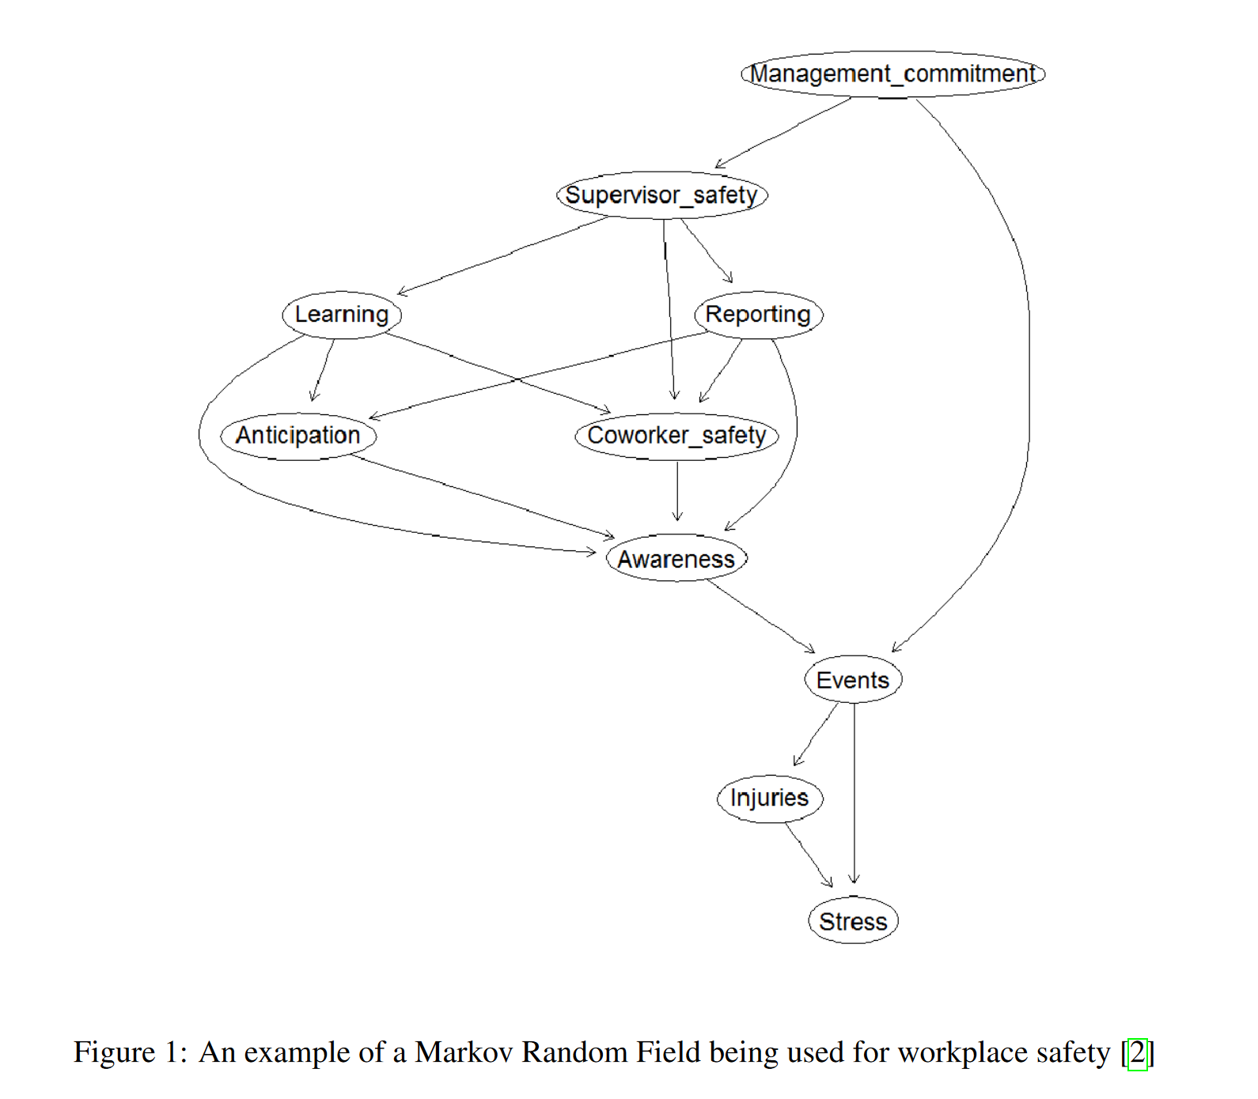
Applications and Significance
Stereo image processing [1]
Workplace safety predictions [2]
Hospital patient experience [3]
Insurance risk analysis [4]
Error correcting codes [5]
These applications can benefit from being able to make faster predictions on larger graphs.
Introduction ● Design ● Results ● Conclusion
Notes:
While the weather example is made up, in the real world, there are various applications where experts build markov random fields and make predictions using BP
Some examples are listed here, and most can benefit from being able to make faster predictions on larger graphs
On the right we have an example graph from a study on workplace safety, where they were able to relate elements like supervisor safety and training to hazardous events and injuries, and we can imagine that with a better algorithm, they would increase the number of included factors and make others more detailed

Slide 11
Metrics
Convergence coverage
How big are the graphs that converge?
Convergence rate
How fast can we converge?
Scalability
How well does rate improve with more resources?
Efficiency
How well do we deal with priority queue overhead?
Introduction ● Design ● Results ● Conclusion
Notes:
On closer inspection, you may notice that this graphs contains no loops
This is an important distinction as the original BP algorithm could not operate on graphs with loops, so an improved algorithm, called loopy BP was created
Unfortunately, loops mean that there is no analytical solution, so loopy BP and its successors are approximate algorithms
A significant struggle with in is the convergence, with even medium-sized graphs being unable to converge to an answer at all, and an abysmal rate of convergence overall
As such, the metrics for this project are:
convergence coverage, which measures the total solvable problems, or how big of a graph we can converge on
convergence rate, which just measures the speed
scalability, which measures how much we can improve the algorithm with more cores, or a larger accelerator
Efficiency, which measures how we deal with priority queue overhead, which is what we will explore next

Slide 12
Program Flow
while (updates > convergence_criteria) {
pick_updates();
compute_beliefs();
send_updates();
}
Introduction ● Design ● Results ● Conclusion
Notes:
Regardless of our implementation, we can boil down our program flow to main 3 steps:
While our updates are larger than a certain convergence criteria, we pick important updates, compute beliefs using those updates, and then send new ones
Picking the updates is what makes variants of BP distinct, and we’ll return to our weather example to explore this

Slide 13
Synchronous Update Order
Stouffville
Vaughan
Markham
Pickering
Mississauga
Toronto
Oakville
Introduction ● Design ● Results ● Conclusion
Notes:
Here we see synchronous ordering, which means that all nodes send, receive, and compute (nextslide) their messages before repeating the process (nextslide)

Slide 14
Synchronous Update Order
Computing…
Stouffville
Computing…
Computing…
Computing…
Vaughan
Markham
Pickering
Computing…
Computing…
Mississauga
Toronto
Computing…
Oakville
Introduction ● Design ● Results ● Conclusion
Notes:
Synchronous ordering means that all nodes send, receive, and compute (nextslide) their messages before repeating the process (nextslide)

Slide 15
Synchronous Update Order
Stouffville
Vaughan
Markham
Pickering
Mississauga
Toronto
Oakville
Introduction ● Design ● Results ● Conclusion
Notes:
Synchronous ordering means that all nodes send, receive, and compute (nextslide) their messages before repeating the process (nextslide) with new updates
This results in a lot of work during every cycle, often making small updates that don’t have much of an effect

Slide 16
Residual Update Order
Stouffville
Vaughan
Markham
Pickering
Mississauga
Toronto
Oakville
Introduction ● Design ● Results ● Conclusion
Notes:
Asynchronous ordering looks at the residuals as a measure of how “large” or important each message is, and picks the biggest one (nextslide) similarly computing and (nextslide) continuing the process

Slide 17
Residual Update Order
Stouffville
Vaughan
Markham
Pickering
Computing…
Mississauga
Toronto
Oakville
Introduction ● Design ● Results ● Conclusion
Notes:
Asynchronous ordering looks at the residuals as a measure of how “large” or important each message is, and picks the biggest one (nextslide) similarly computing and (nextslide) continuing the process

Slide 18
Residual Update Order
Stouffville
Vaughan
Markham
Pickering
Mississauga
Toronto
Oakville
Introduction ● Design ● Results ● Conclusion
Notes:
Asynchronous ordering looks at the residuals as a measure of how “large” or important each message is, and picks the biggest one (nextslide) similarly computing and (nextslide) continuing the process
Asynchronous ordering greatly improves performance with respect to coverage and rate, but the priority queue used in residual BP greatly limits the parallelism, as maintaining the priority queue is a lot of work in a multicore processor

Slide 19
Residual Splash Update Order
Stouffville
Vaughan
Markham
Pickering
Mississauga
Toronto
Oakville
Introduction ● Design ● Results ● Conclusion
Notes:
Various algorithmic innovations have been made to improve this
For instance, residual splash partitions the graph each cycle to allow multiple localized updates to happen at the same time, with smaller priority queues

Slide 20
Relaxed-Priority Update Order
Stouffville
Vaughan
Markham
Pickering
Mississauga
Toronto
Oakville
Introduction ● Design ● Results ● Conclusion
Notes:
And relaxed-priority uses a relaxed priority queue to update the largest few messages every cycle

Slide 21
Algorithmic Innovations
Algorithm | How do updates happen? | Coverage | Rate | Scalability | Efficiency
Bulk Synchronous [6] | Synchronous, single-threaded | Poor | Poor | None | N/A
Parallel [7] | Synchronous, multi-threaded | Poor | Poor | Linear | N/A
Residual [8] | Asynchronous, strictly-ordered | Good | Good | None | Poor
Residual Splash [9] | Asynchronous, strictly-ordered and partitioned | Good | Good | Sub-linear | Poor
Relaxed-priority [10] | Loosely-ordered asynchronous | Okay | Okay | Sub-linear | Okay
Speculative Parallel Residual [11] | Asynchronous, strict-order avoided using speculation | Good | Good | Linear | Good
Introduction ● Design ● Results ● Conclusion
Notes:
This is a summary of the improvements that have been made
We are focusing here on the last algorithm, which uses hardware-level speculative parallelism
This is because due to the dynamic ordering of relaxed priority BP, it is difficult to scale using traditional parallelization techniques such as work division across multicores, or general accelerators like vector and graphics processors

Slide 22
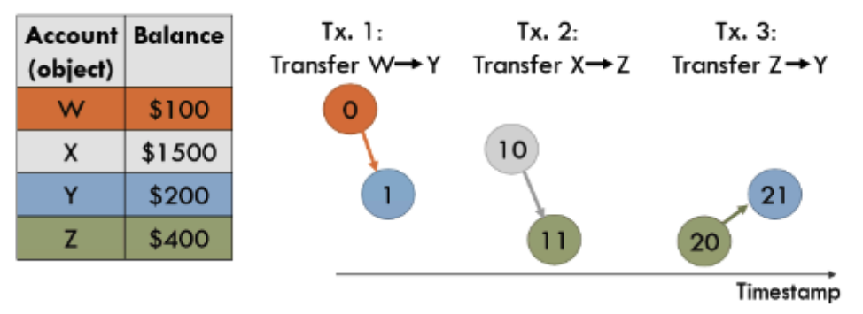
Task-Based Hardware Parallelism
Spatially-Located Ordered Tasks Chronos [12]
Introduction ● Design ● Results ● Conclusion
Notes:
As such, we turn to task-based parallelism, which breaks down computations much further than threads into many smaller independent tasks
Rather than defining synchronization, through structures like locks, we allow tasks to create children, so that the scheduler can order and distribute tasks accordingly on the fly, which is very suitable for an irregular algorithm like BP
Chronos is an FPGA implementation of a task-based parallel computer,
It limits each task to accessing a single object in order to eliminate the need for cache consistency, which is often a parallelism blocker
For example, we can see that each of these bank transfers is split into two tasks to pass updates from one account to the other

Slide 23
Task-Based Hardware Parallelism
while (updates > convergence_criteria) {
pick_updates();
compute_beliefs();
send_updates();
}
Pick updates @node 2
Compute beliefs
@node 2
Pick updates @node 1
Compute beliefs
@node 1
Send updates ->node 2
Introduction ● Design ● Results ● Conclusion
Notes:
As such, Chronos is able to split our program flow into multiple tasks that are located at certain nodes, and can parallelize these tasks

Slide 24
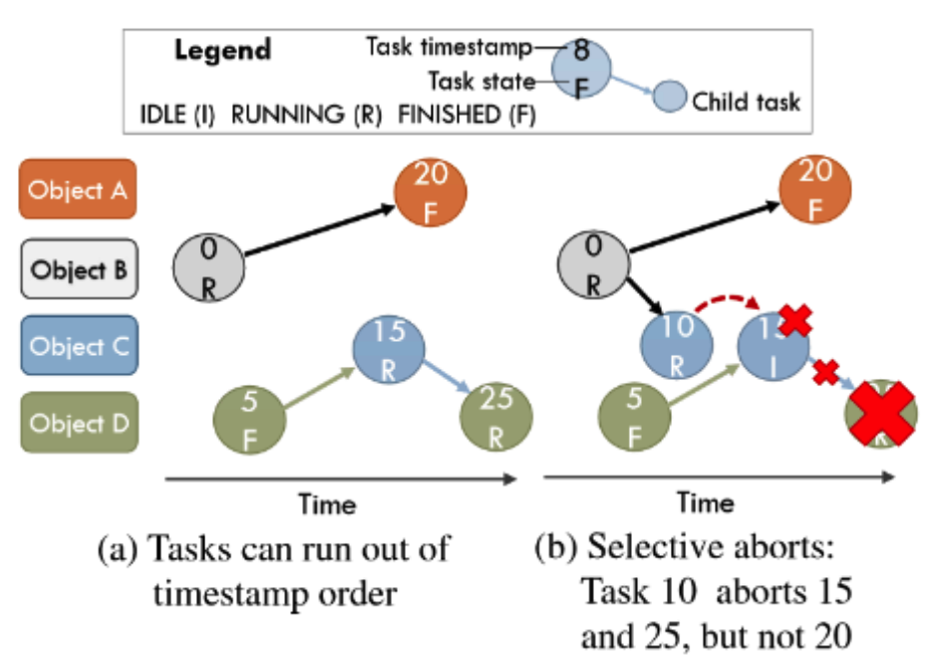
Speculation Extracts Parallelism by Relaxing Order
Chronos [12]
Introduction ● Design ● Results ● Conclusion
Notes:
Chronos further extracts parallelism by speculating as to when tasks will be independent and preemptively scheduling children to be processed, aborting and retrying if data dependencies arise
We can see in the diagram here, that chronos allows tasks to abort child tasks that turn out to be incorrectly computed due to a data dependency that was not forseen
This means that in BP, we could be computing the beliefs based on an update that hasn’t been computed and sent yet, with the assumption that the update will not affect our current belief computation, which is often the case

Slide 25
Research Gap
Existing accelerators are
overly specific [5]
too costly to implement [11]
General Belief Propagation Accelerator on Chronos
Introduction ● Design ● Results ● Conclusion
Notes:
These hardware and software innovations form the basis of our accelerator
We can therefore identify our research gap as other existing accelerators are overly specific, being effective for only certain graphs, or are too costly to implement due to the use of custom chip design
The existence of residual BP and the Chronos accelerator presents the possibility of a general FPGA-based BP accelerator which could improve the aforementioned applications due to relatively lower cost and higher possible convergence coverage, convergence rate, and scalability through better efficiency.

Slide 26
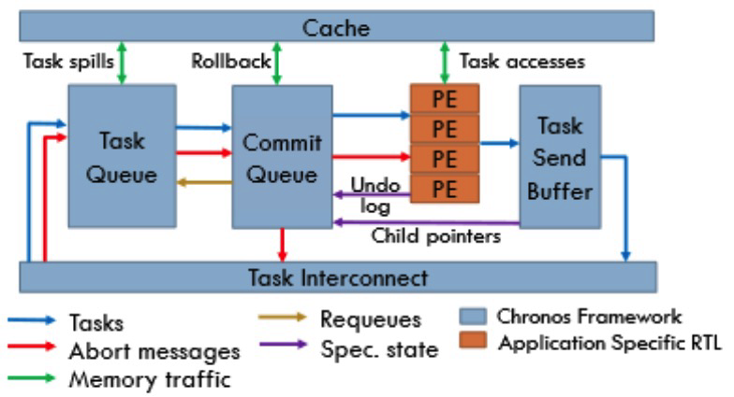
Design Goal
Eliminate deadlocks while retaining functional correctness
Scaling and optimizing to improve:
Convergence coverage
Convergence rate
Scalability
Efficiency
Introduction ● Design ● Results ● Conclusion
Notes:
Those metrics form our highest level objective for this project
On the right we have the architecture of a chronos tile, where blue shows the chronos framework itself, and the orange shows the application specific processing elements
We designed processing elements for our residual belief propagation application, but due to the differences between BP and other apps designed for Chronos, there are a number of deadlocks that arise
In this high level overview, we can see that there are multiple queues and buffers, and the overflow of these buffers is the main source of deadlocks
The design goal was to eliminate deadlocks while retaining functional correctness, followed by scaling and optimizing the accelerator to improve on our metrics

Slide 27
System Diagram
Tile
Tile
Tile
Tile
PE
PE
PE
PE
PE
PE
PE
PE
PE
PE
PE
PE
PE
PE
PE
PE
Tile Infrastructure
Tile Infrastructure
Tile Infrastructure
Tile Infrastructure
Introduction ● Design ● Results ● Conclusion
Notes:
This is a system diagram of the chronos accelerator, showing the distinct tiles with their individual tile infrastructure supporting onboard processing elements
Scaling and optimization includes controlling parameters such as the number of tiles and cores per tile, as well as the sizes of onboard queues and busses
One objective is to make the best use of the FPGA area and another is maintaining tight timing constraints to keep a high cycle frequency
The high level architecture greatly impacts timing since communication between tiles is much slower than within tiles
In addition, this large system with many queues and points of contention presents many deadlock possibilities, each of which becomes finding a needle in a haystack

Slide 28
Deadlock Avoidance Prioritizes the GVT
Core
Core
Core
Core
Local virtual time
Arbiter
Task Send Buffer
Global virtual
time (GVT)
Introduction ● Design ● Results ● Conclusion
Notes:
Let’s zoom into our tile infrastructure to see that there is contention between the PEs trying to send their child tasks, where Chronos’ first deadlock avoidance method comes into play, called the global virtual time
These dots represent the tasks being processed by each core, and each task has an assigned timestamp to maintain order
Each core’s lowest timestamp task, or oldest task, identifies its local virtual time
This time is sent from each core to an arbiter, who compares the timestamps and declares a global virtual time, corresponding to the oldest task across the entire system, in this case, the orange one
Since this task is the oldest, it has no dependencies, only dependents, and as such, we want to ensure that it completes as soon as possible and is never blocked, so that the accelerator always makes progress
We can liken the task corresponding to the GVT to a VIP who should be served first, and as such, they should skip all the queues and we can never kick them out if there isn’t enough space

Slide 29
Prioritizing the GVT with Reservations
Reservation for GVT
Task Send Buffer
Introduction ● Design ● Results ● Conclusion
Notes:
Within buffers and queues, we implemented various additional methods to serve the GVT first
One method was was reserving the first slot in a queue for the GVT at all times
Since there is only 1 GVT in the system at any time, there can never be contention for the GVT slot

Slide 30

Prioritizing the GVT with Resource Aborts
Resource Aborts
Introduction ● Design ● Results ● Conclusion
Notes:
Another method was aborting tasks or requests at random to make space for the GVT holding task
This requires verification that aborting the task or request doesn’t affect the functional correctness of the accelerator

Slide 31
Deadlock Avoidance
Tile
Task Held Back
Introduction ● Design ● Results ● Conclusion
Notes:
A challenge here was applying the correct backpressure signals to ensure that tasks were held during GVT skips, rather than simply dropped

Slide 32
Deadlock Avoidance
Tile
Spill
level
Task Spilling
Task Unit
Memory
Introduction ● Design ● Results ● Conclusion
Notes:
The second deadlock avoidance method is task spilling, which is spilling tasks out from the tile into the DDR memory on the FPGA
This occurs when the task queue in the task unit exceeds a certain capacity
We changed how this capacity was calculated to avoid having the children of the GVT holding task be prevented from being queued, which was preventing the GVT task from completing.

Slide 33
Results
Coverage improved by removing deadlocks that occur with large graphs
Rate improved by optimizing size and configuration of accelerator
Scalability demonstrated with more PEs computing larger graphs
Efficiency used to extract parallelism by lowering priority queue overhead
Introduction ● Design ● Results ● Conclusion
Notes:
We simulated these changes to find a few results
Coverage is improved by removing deadlocks that occur with large graphs
Rate is improved by optimizing size and configuration of accelerator
Scalability is demonstrated with multi-PE configurations computing larger graphs
Efficiency extracts parallelism by lowering priority queue overhead

Slide 34
Next Steps
Implement and test solution in hardware
Extend to larger graphs to test limits and compare to prior work
Introduction ● Design ● Results ● Conclusion

Slide 35
Conclusions
Relaxed-priority BP and task-based parallelism can be combined to improve convergence coverage, convergence rate, and scalability of belief propagation through increased efficiency.
Implementing the accelerator on an FPGA makes it accessible for use in broader applications.
Introduction ● Design ● Results ● Conclusion
Notes:
Relaxed-priority BP and task-based parallelism can be combined to improve convergence coverage, convergence rate, and scalability of belief propagation
Implementing the accelerator on an FPGA makes it accessible for use in broader applications

Slide 36
References
[0] L. Han, “Accelerating Belief Propagation with Hardware Speculative Parallelism,” Undergrad Thesis, University of Toronto, Toronto, Canada, 2023.
[1] T. Yan, X. Yang, G. Yang, and Q. Zhao, “Hierarchical Belief Propagation on Image Segmentation Pyramid,” IEEE Transactions on Image Processing, 2023, doi: 10.1109/TIP.2023.3299192.
[2] M. C. E. Simsekler and A. Qazi, “Adoption of a Data‐Driven Bayesian Belief Network Investigating Organizational Factors that Influence Patient Safety,” Risk Analysis, vol. 42, no. 6, pp. 1277–1293, Jun. 2022, doi: 10.1111/risa.13610.
[3] A. Al Nuairi, M. C. E. Simsekler, A. Qazi, and A. Sleptchenko, “A data-driven Bayesian belief network model for exploring patient experience drivers in healthcare sector,” Ann Oper Res, Jun. 2023, doi: 10.1007/s10479-023-05437-9.
[4] L. Mkrtchyan, U. Straub, M. Giachino, T. Kocher, and G. Sansavini, “Insurability risk assessment of oil refineries using Bayesian Belief Networks,” Journal of Loss Prevention in the Process Industries, vol. 74, p. 104673, Jan. 2022, doi: 10.1016/j.jlp.2021.104673.
[5] Y. Sun, Y. Shen, W. Song, Z. Gong, X. You, and C. Zhang, “LSTM Network-Assisted Belief Propagation Flip Polar Decoder,” in 2020 54th Asilomar Conference on Signals, Systems, and Computers, Pacific Grove, CA, USA: IEEE, Nov. 2020, pp. 979–983. doi: 10.1109/IEEECONF51394.2020.9443504.
[6] J. Pearl, Probabilistic reasoning in intelligent systems: networks of plausible inference, Rev. 2. ed., Transferred to digital printing. in The Morgan Kaufmann series in representation and reasoning. San Francisco, Calif: Morgan Kaufmann, 2009.
[7] J.-F. Yan, J. Zeng, Y. Gao, and Z.-Q. Liu, “Communication-efficient algorithms for parallel latent Dirichlet allocation,” Soft Comput, vol. 19, no. 1, pp. 3–11, Jan. 2015, doi: 10.1007/s00500-014-1376-8.
[8] G. Elidan, I. McGraw, and D. Koller, “Residual Belief Propagation: Informed Scheduling for Asynchronous Message Passing,” 2006. [Online]. Available: http://www.robotics.stanford.edu/~galel/papers/ElidanRBP.pdf
[9] J. Gonzalez, Y. Low, and C. Guestrin, “Residual Splash for Optimally Parallelizing Belief Propagation,” in Proceedings of the Twelth International Conference on Artificial Intelligence and Statistics, PMLR, Apr. 2009, pp. 177–184. [Online]. Available: https://proceedings.mlr.press/v5/gonzalez09a.html
[10] V. Aksenov, D. Alistarh, and J. H. Korhonen, “Relaxed Scheduling for Scalable Belief Propagation,” Dec. 2020. [Online]. Available: https://proceedings.neurips.cc/paper/2020/file/fdb2c3bab9d0701c4a050a4d8d782c7f-Paper.pdf
[11] G. Posluns, Y. Zhu, G. Zhang, and M. C. Jeffrey, “A scalable architecture for reprioritizing ordered parallelism,” in Proceedings of the 49th Annual International Symposium on Computer Architecture, New York New York: ACM, Jun. 2022, pp. 437–453. doi: 10.1145/3470496.3527387.
[12] M. Abeydeera and D. Sanchez, “Chronos: Efficient Speculative Parallelism for Accelerators,” Mar. 2020. doi: 10.1145/3373376.3378454.

