Slide 1
DemandForge
Turning Industrial Waste Heat into Profit
Team CityCoders | Hybrid Hack 2026 — Final Round: Business Model Pitch
AI-Driven Hybrid Renewable Energy • Energy-as-a-Service • Zero Upfront Cost

Slide 2
The Rs.4 Lakh Crore Problem
Rs.4 Lakh Crore
35% Wasted at Peak
400°C Dumped
India's annual industrial electricity spend (~500 BU × Rs.8/kWh avg)
Evening surcharges + demand charges punish manufacturers every single day
Furnace exhaust heat vented to atmosphere — free energy thrown away
An TN metal-processing cluster pays Rs.2.13 lakh/DAY in electricity — Rs.78 lakh/month
Source: India industrial electricity ~500 BU/year (CEA 2024-25) × avg. Rs.8/kWh

Slide 3
DemandForge: The Solution
"The furnaces causing the peak demand also produce the waste heat that powers the solution."
☀ Solar PV — 1.0 MWp
Daytime base load coverage
🔥 ORC Waste Heat — 500 kW
Converts 400°C exhaust → electricity
🔋 LFP Battery — 3.5 MWh
Bridges solar-to-ORC evening gap
🧠 AI Controller — XGBoost + MPC
Optimal dispatch every 15 min
Higher demand = more waste heat = more ORC power → natural hedge

Slide 4
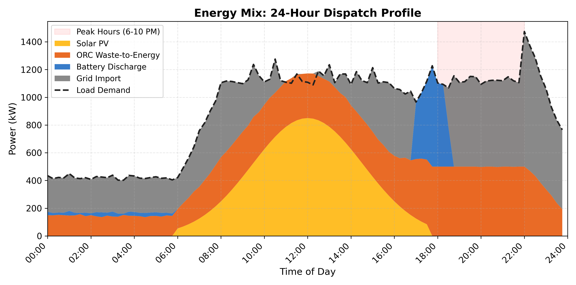
How It Works: 24-Hour Energy Dispatch
6 AM – 5 PM
Solar + ORC serve load Battery charges from surplus
5 – 6 PM
Solar dies, ORC ramps Battery begins discharge
6 – 10 PM
ORC + Battery cover peak Grid capped at 60%
10 PM – 6 AM
Night shift: ORC residual + minimal grid

Slide 5
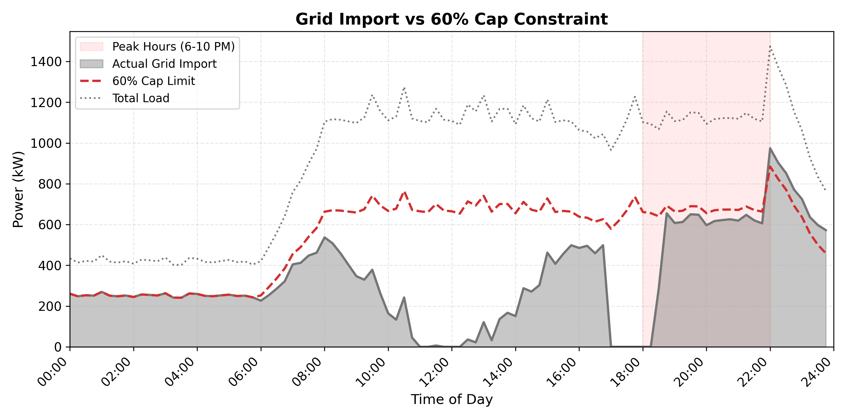
Simulation Results: Proven Performance
65.9%
61.2%
Rs.6.01
27.9%
Peak Grid Reduction
Daily Cost Saving
LCOS (Grid: Rs.7.65)
IRR (4-yr payback)
↑ Grid import before vs after DemandForge — 60% cap satisfied at every timestep

Slide 6
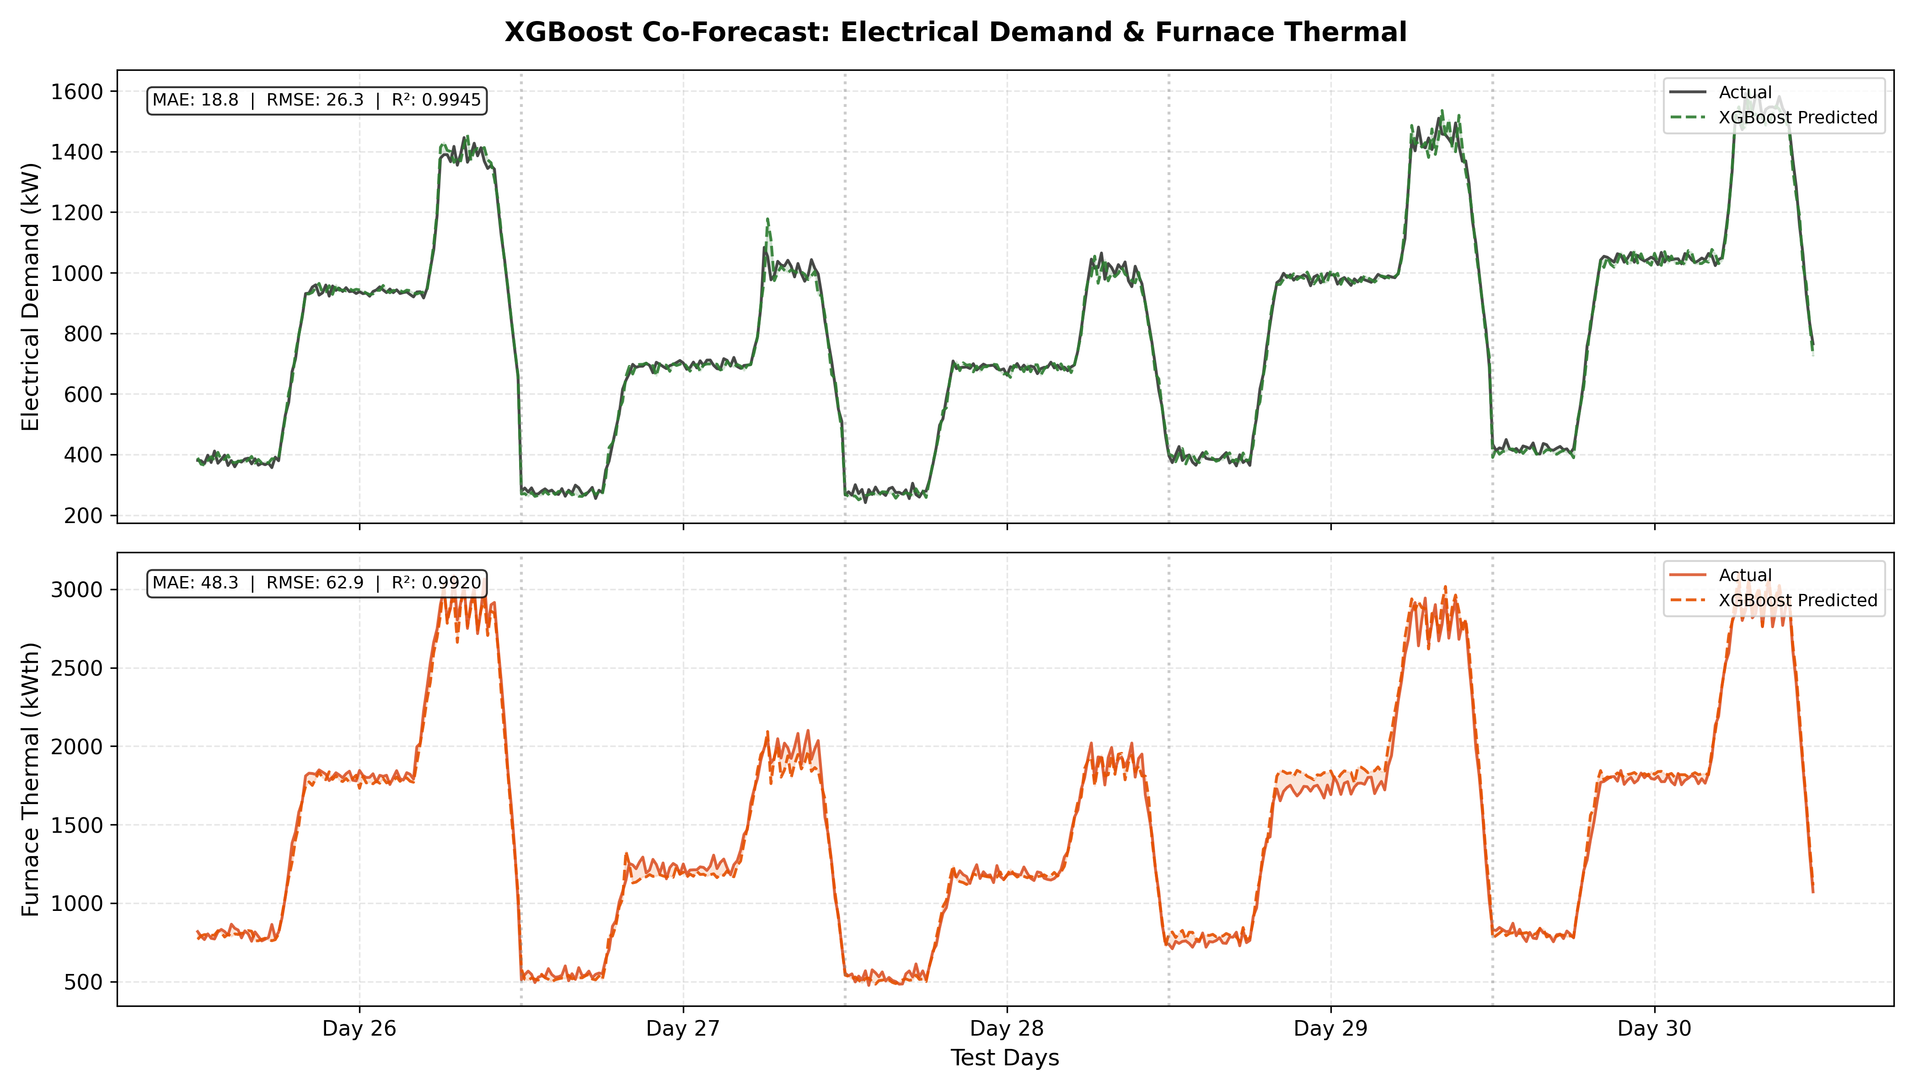
AI Engine: XGBoost + MPC Optimization
• 2-output XGBoost: jointly predicts electrical
demand AND furnace thermal output
• Thermal forecast → optimizer knows ORC power
coming during the evening peak
• Tested on 5 held-out days (temporal split)
• MPC: MILP optimizer solves provably optimal
dispatch every 15 minutes (not rule-of-thumb)
MAPE 2.7% (demand) | 3.6% (thermal) — R² = 0.9945

Slide 7
Business Model: Energy-as-a-Service (EaaS)
1. We Install
2. They Save
3. We Earn
We fund, own & install the DemandForge system at the factory. Zero cost to the customer.
Factory pays Rs.6.75/kWh — 12% cheaper than grid (Rs.7.65). Savings from Day 1.
10-year PPA contract. We earn Rs.0.74/kWh spread. Predictable recurring revenue.
Key selling line: "Your electricity bill drops from Day 1. You pay nothing upfront."
Factory: Rs.7.65/kWh (grid) → Rs.6.75/kWh (DemandForge) = 12% savings | DemandForge: Rs.0.74/kWh margin × 22,000 kWh/day × 300 days = Rs.48.8 L/year net per factory

Slide 8
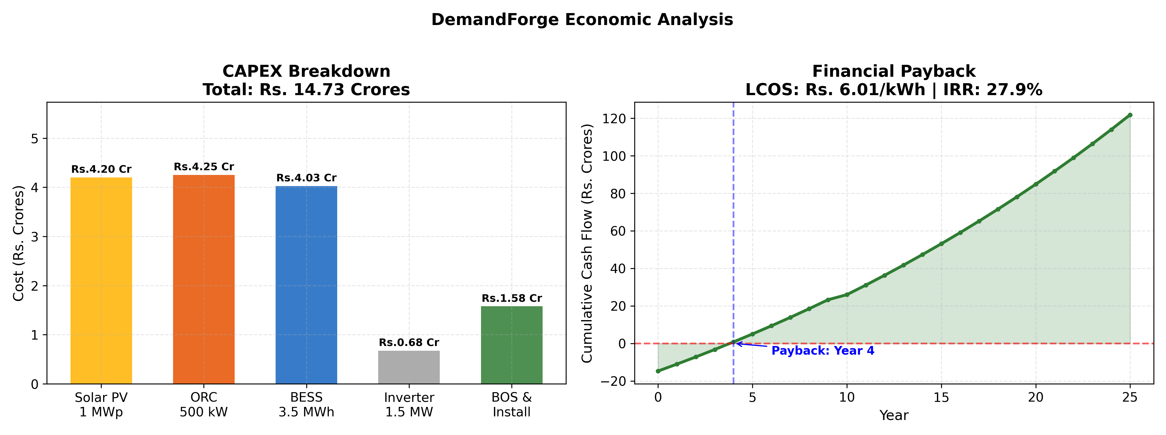
Unit Economics: Per Factory
Component | Cost (Rs.) | % of Total
Solar PV (1 MWp) | 4.20 Cr | 28%
ORC System (500 kW) | 4.25 Cr | 29%
LFP Battery (3.5 MWh) | 4.03 Cr | 27%
GFM Inverter (1.5 MW) | 0.68 Cr | 5%
Balance of System | 1.58 Cr | 11%
TOTAL CAPEX | 14.73 Cr | 100%
LCOS
Rs.6.01/kWh
Grid Tariff
Rs.7.65/kWh
PPA Rate
Rs.6.75/kWh
Margin
Rs.0.74/kWh (12.3%)
Annual Revenue
Rs.1.2 Cr/factory
Annual OPEX
Rs.33.5 Lakhs
IRR
27.9%
LCOS Rs.6.01 < Grid Rs.7.65 → Economically viable WITHOUT any subsidy
Payback
4 years

Slide 9
Market Opportunity
TAM
All Indian factories with waste heat >300°C
Target Industries
~50,000 units • Rs.40,000+ Cr addressable
• Metal processing (reheating furnaces)
• Steel mills (blast furnace waste heat)
• Cement plants (kiln exhaust >400°C)
• Glass manufacturing
• Textile dyeing (steam waste heat)
• Oil refineries (process heat)
Common trait: All have waste heat
>300°C AND pay peak tariff surcharges
SAM
AP + Telangana + TN clusters
~8,000 units • Rs.6,400 Cr
SOM
Year 1-3: 1 pilot → 20 factories
Rs.24 Cr annual revenue by Year 3
Sources: MNRE Industrial Energy Audit database, BEE PAT scheme designated consumers list, CEA 2024-25

Slide 10
Go-to-Market Strategy
1. Government Subsidies
2. State Industrial Bodies
MNRE KUSUM scheme, BEE PAT (Perform-Achieve-Trade), PLI for advanced energy storage. De-risks our CAPEX.
APIIC (AP), TSIIC (Telangana), TIDCO (Tamil Nadu) partnerships for credibility and deal flow access.
3. Industry Associations
4. Pilot Case Study
CII, FICCI events for lead generation. Direct outreach to factory owners.
"Factory X saved Rs.39L/month" → proof-based selling tool. Most powerful channel.
Behind-the-meter installation → No grid export approvals needed

Slide 11
Implementation Roadmap
Phase 1: Pilot
Phase 2: Scale
Phase 3: Expand
Year 1
Year 2-3
Year 3-5
1 installation at TN metal cluster Prove unit economics in real life Build the case study
10-20 factories in Tamil Nadu/ Telangana/ Andhra Pradesh Standardize ORC + BESS kit Partner with local EPCs
Multi-state: Gujarat, Maharashtra, Karnataka Add more waste heat sources 50 factories by Year 5
Per-Site Deployment: 4 Months Total
Phase | Site Survey | System Design | Installation | Commissioning
Duration | 2 weeks | 4 weeks | 8 weeks | 2 weeks
Details | Load audit, thermal measurement | Custom sizing, PPA contract | Solar, ORC, BESS installation | Testing, grid integration

Slide 12
Why DemandForge Wins
Our Advantage | Why It Matters | Competition Gap
ORC waste heat coupling | Problem powers the solution | Nobody else combines ORC + solar + battery + AI
AI dispatch (XGBoost + MPC) | Provably optimal, adapts to each factory's patterns | Competitors use timers or rule-of-thumb
LCOS < Grid tariff | Viable WITHOUT subsidies | Most BESS projects need subsidies to break even
4-year payback, 28% IRR | Fast returns for investors | Typical infra: 8-10 year payback
Behind-the-meter | No grid export approvals needed | Grid-tied projects face regulatory delays
We're a system integrator, not a component vendor. Solar EPC is commodity, ORC is partnered, battery is off-the-shelf. We're the AI brain.

Slide 13
Revenue Projections & Impact
Year | Factories | Annual Revenue | Cumulative | Status
Year 1 | 1 (pilot) | Rs.1.2 Cr | Rs.1.2 Cr | Prove concept
Year 2 | 5 | Rs.6 Cr | Rs.7.2 Cr | TN cluster expansion
Year 3 | 15 | Rs.18 Cr | Rs.25.2 Cr | Multi-state entry
Year 5 | 50 | Rs.60 Cr | Rs.103 Cr | Scaled operations
Impact per Factory
CO₂ Avoided
3,550 tonnes/yr
Waste Heat Saved
7,425 kWh/day
Renewable Share
61.1%
Grid Dependence
↓ 65.9%
Revenue = Rs.1.2 Cr/factory/year (EaaS PPA at Rs.6.75/kWh × 22,000 kWh/day × 300 days)
Key Risks & Mitigations
Risk | Mitigation
Factory shutdown | PPA has minimum offtake clause + standby charges
Battery degradation | LFP at 20-50% SOC → 10,000+ cycles. Replace Year 10 at 55% cost
Grid tariff decrease | APERC tariffs rose 3-5%/yr for 10 years. LCOS has 21% headroom
Regulatory changes | Behind-the-meter = no export approvals. MNRE supports industrial RE

Slide 14
The Ask
Rs.20 Crores Seed Funding
To deploy 3 pilot systems and prove unit economics at scale
3 Pilot Installations
AI Platform Dev
Team & Operations
~Rs.5 Cr each after MNRE/BEE subsidies (3 sites = Rs.15 Cr)
Rs.2 Cr — productize the XGBoost + MPC engine into deployable product
Rs.1.5 Cr — engineers, business development, working capital
With proven pilots → Rs.60 Cr annual revenue by Year 5 50 factories • 27.9% IRR • 1,77,500 tonnes CO₂ avoided

Slide 15
Thank You
Team CityCoders
"Every factory with waste heat is a power plant in disguise. DemandForge wakes it up."
Full simulation: python main.py → 25 seconds → reproducible results 65.9% grid reduction • Rs.6.01 LCOS • 28% IRR • 4-year payback
Questions?

