Slide 1


Machine Learning Project on Customer Churn Analysis
Velagana Balaji
12219897 – k22up - 28

Slide 2
Introduction
Customer churn is a critical issue in the telecom industry, where retaining existing customers is more cost-effective than acquiring new ones. Predicting which customers are likely to leave helps companies take timely action to improve satisfaction and reduce turnover. This project uses machine learning to analyze customer data and predict churn based on factors like contract type, tenure, and service usage.
The dataset includes demographic and service-related features, and the workflow involves data cleaning, exploratory analysis, feature encoding, and model training. Two models—Decision Tree and Random Forest—are used to classify customers as likely to churn or not, with an emphasis on recall to catch as many potential churners as possible. The final model offers both predictive power and business insight for proactive customer retention.

Slide 3
Problem Statement
Telecom companies face significant revenue loss due to customer churn.
Acquiring new customers is more expensive than retaining existing ones.
Churn is influenced by various factors like:
Contract type (e.g., month-to-month contracts).
Payment method (e.g., electronic check users churn more).
Service engagement (e.g., not using tech support or streaming services).
Traditional analysis methods are insufficient for early churn detection.
There is a need for automated, data-driven solutions to reduce churn and improve retention

Slide 4
Significance & Objectives
Significance
Revenue Protection: Helps prevent financial losses by identifying customers at risk of leaving.
Customer Retention: Enables proactive engagement with high-risk customers through targeted offers and support.
Business Strategy: Supports data-driven decision-making for marketing, customer service, and product teams.
Objectives
Build a machine learning model to predict customer churn accurately.
Identify the most influential features contributing to churn (e.g., contract type, charges).
Handle data preprocessing, including missing values, categorical encoding, and class imbalance.
Compare the performance of multiple classifiers (Decision Tree, Random Forest).

Slide 5
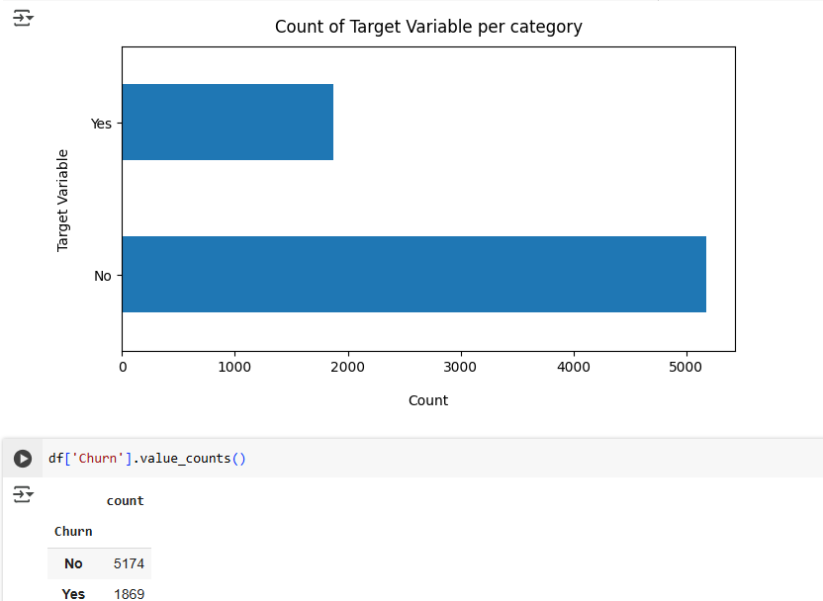
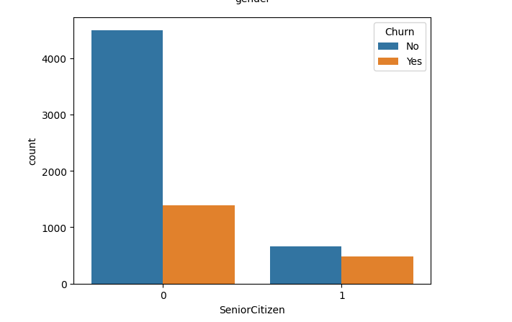
Data Preprocessing
- Dropped customerID column
- Replaced blanks in TotalCharges with 0.0
- Label encoded categorical features Target column encoded (Yes=1, No=0)
Fig1:shows the churners and non-churners
Fig2:Churners in senior citizens and non senior citizens

Slide 6
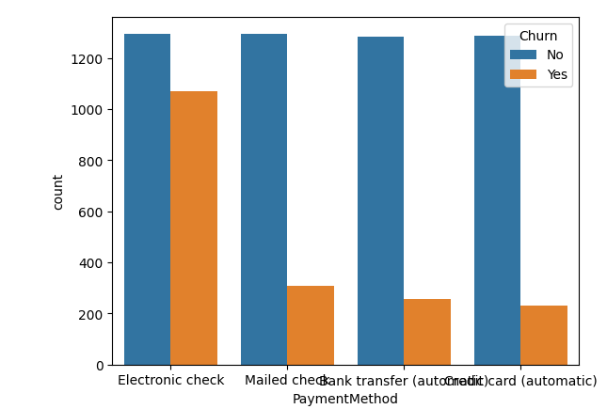
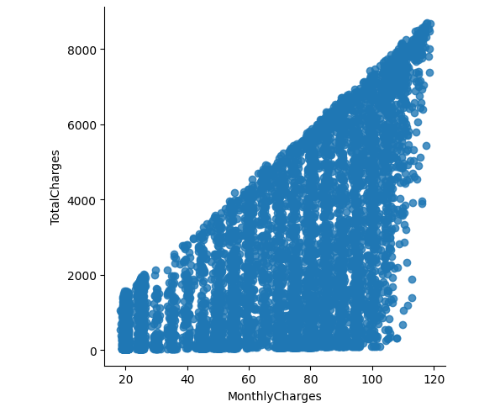
Exploratory Data Analysis (EDA)
- Histograms and boxplots for numerical data
- Countplots for categorical data
- Correlation heatmap: tenure and TotalCharges positively correlated.
Fig3:Churners based on payment method
Fig4:Realtion between Monthly charges and Total charges.

Slide 7
Class Imbalance Handling
- Original churn ratio: 26.5% churned, 73.5% retained
- SMOTEEN used to balance training data

Slide 8
Model Training & Evaluation
- Models: Decision Tree, Random Forest
- Before SMOTENN (Accuracy): Decision Tree Classifier (~79%)
- After SMOTENN(Accuracy): Decision Tree Classifier(~93%)
- Before SMOTENN (Accuracy): Random Forest Classifier(~81%)
- After SMOTENN(Accuracy): Decision Tree Classifier(~93%) - Confusion Matrix shows moderate recall for churn class

Slide 9
Results and Conclusion
- Random Forest provided best results
- Effective for identifying customers at risk of churn
- Future scope: hyperparameter tuning, real-time prediction system

Slide 10


